Slide 1

Monday 27th April
We will begin our day with Morning Maths - just like in school!
You can do these independently then share them with an adult.
Remember question 10 may have more than one answer.
Don’t worry about always finding the answer it is how you try to work out and reason that is important.

Slide 2
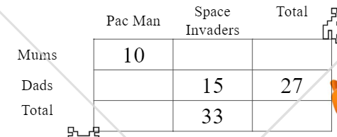
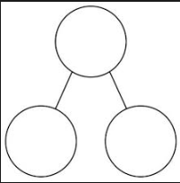

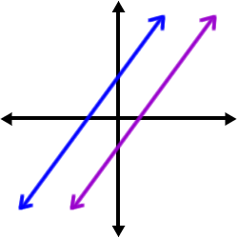
Morning Maths 27.04.20
8. Copy and complete
9. A First Class Stamp costs 70p. How many could I buy with a £5 note?
10. If I know 9 x 7 = 63, what else do I know (can you write 6 or more
related facts without having to
calculate any)?
5 more than 18
2. 250 10 (how many 10’s in 250)
3. Complete this
part-whole model.
4. Add 30 to 834
5. What fraction is shaded?
6. ⅗ + ⅕
7. Which pairs of lines are parallel?
(blue and purple or the black
lines?)
99
151

Slide 3
23
25
52
864
2/10 or 1/5
4/5
Purple and blue
.
7
Multiple answers including: 90 x 7 = 630, 9 x 70 = 630,
63 ÷ 7 = 9, 63 ÷ 9 = 7
18
28
12
22

Slide 4

St Catherine’s Classroom Beliefs
Mistakes are valuable.
Everyone can learn maths to the highest level.
Questions are really important.
Depth is more important than speed.
Maths is about making connections.
We may not be learning together in the classroom, but it is important to still remember our classroom beliefs.

Slide 5
WALT: add and subtract fractions.

Slide 6

When adding fractions, you only add the numerators (top numbers) together. The denominator (bottom number) will stay the same.
For example.
As you can see the numerators have been added together. 1 + 4 = 5
Remember, the denominator doesn’t change. Because both fractions have 7 as the denominator, the answer has the denominator as 7.

Slide 7

Subtracting fractions works in exactly the same way. You subtract the numerators (top number) and the denominator (bottom number) stays the same.
As you can see the numerators have been subtracted. 4 - 1 = 3
Remember, the denominator doesn’t change. Because both fractions have 5 as the denominator, the answer has the denominator as 5.

Slide 8
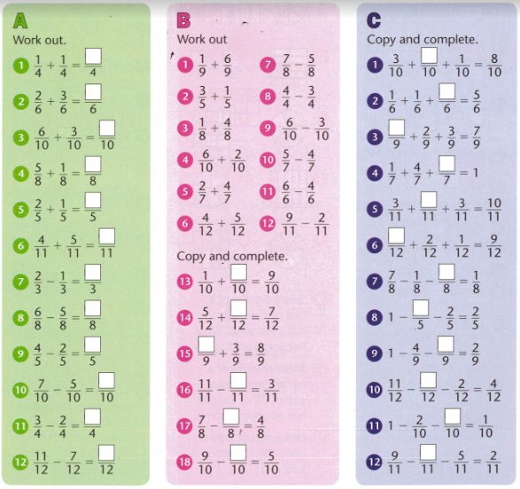

Slide 9
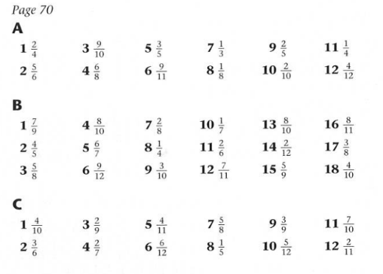
Answers.

Slide 10

Time for a break.
Have a drink and a snack.

Slide 11
Our English tasks for today begin with a Close Reading Task
WALT: retrieve and infer information from a text.
Ask an adult to read the Fact Box about pirates (on the next page) to you.
2. Here are some meanings of words that might help you -
sloop - type of pirate boat
mast - an upright pole
average - common or popular size
spoil - go off or decay
infested - lots of beetles living in them
limb - arms or legs
3. Now read it with your adult twice, they can help you with expression.
4. Now read it twice by yourself.
5. Read the questions and look for evidence in the text to help you answer them.
6. Write your answers in full sentences.

Slide 12
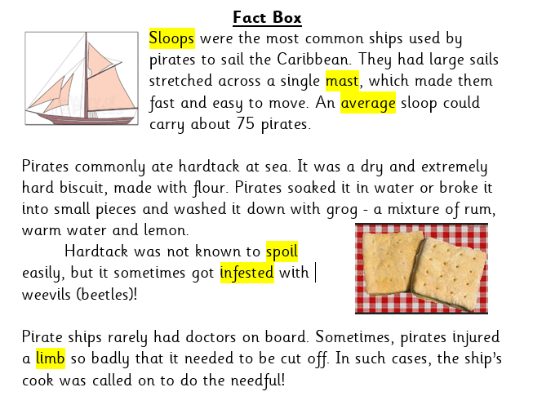

Slide 13
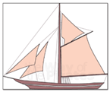
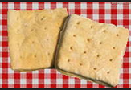
1. How could you identify a sloop?
2. Why did the pirates drink grog with their hardtack?
3. Do you think you would have enjoyed the diet on board a pirate vessel? Explain your answer referring to the text.

Slide 14
1. How could you identify a sloop?
You could identify a sloop by its single mast with a large sail stretched across it and it would move easily and quickly through the water.
2. Why did the pirates drink grog with their hardtack?
They drank grog to soften or moisten the hardtack because it was very dry and would have been difficult to swallow without the liquid.
3. Do you think you would have enjoyed the diet on board a pirate vessel? Explain your answer referring to the text.
The pirates diet would have been very dry and uninteresting. The thought of seeing a beetle in your food would put you off eating it.

Slide 15
Now here is a short exercise to practise the work you began last week.
WALT: use inverted commas accurately in dialogue.

Slide 16
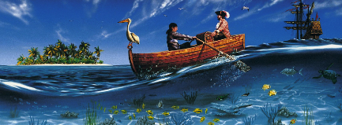
captain purple-beard said Heave, you scurvy sea dogs There be treasure ahead
heave you scurvy sea dogs! there be treasure ahead said captain purple-beard.
heave, you scurvy sea dogs said captain purple-beard. There be treasure ahead
Punctuate these accurately.
Look back at the pages from yesterday if you need a reminder.
Can you include a better synonym for said?

Slide 17
Captain Purple-beard bellowed, “Heave, you scurvy sea dogs! There be treasure ahead.”
“Heave, you scurvy sea dogs! There be treasure ahead,” thundered Captain Purple-beard.
“Heave, you scurvy sea dogs!” ordered Captain Purple-beard. “There be treasure ahead.”
Here are the answers.
Did you include a better synonym for said?

Slide 18

Spelling long vowel sound A with ei and eigh.
15 minute Spelling Activity

Slide 19
How many different words can you make?
You may choose one from each column or choose just from the first two.Or your own combinations.
(e.g) r + eign + n =reign
Challenge! Can you make more than Mrs Shipley and Mr Mottershead?
r | ei | n
v | eign | l
s | eigh | s
n | eight
w
sl
fr

Slide 20
Here are our 14 answers.
reins vein veins veil neigh neighs
weigh weighs
sleigh sleighs eight freight weight weights
Did you find them all? Did you find one we missed?
Look up these words in a dictionary if you do not know what they mean.

Slide 21


Your morning lessons are completed.
Time for lunch.
Then come back this afternoon for your curriculum activity.

Slide 22
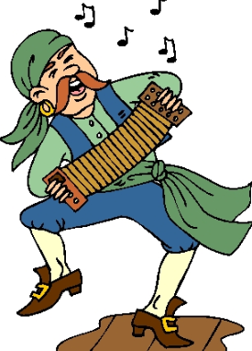
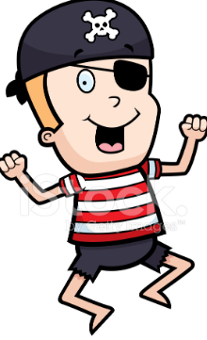
Let’s Go Noodle
Remember what you did last week….
Well here is another version to join in with
https://family.gonoodle.com/activities/the-pirate-life
Now try this!
https://family.gonoodle.com/activities/pirate-prep

Slide 23

Spanish this afternoon.
Task 3
Complete the activities below. (See next slide too)
1) Match the pictures to the correct word
2) Use the numbers by each fruit to fill in the crossword
3) Complete the word search
4) Complete by adding un, una (or x for neither una or un)

Slide 24
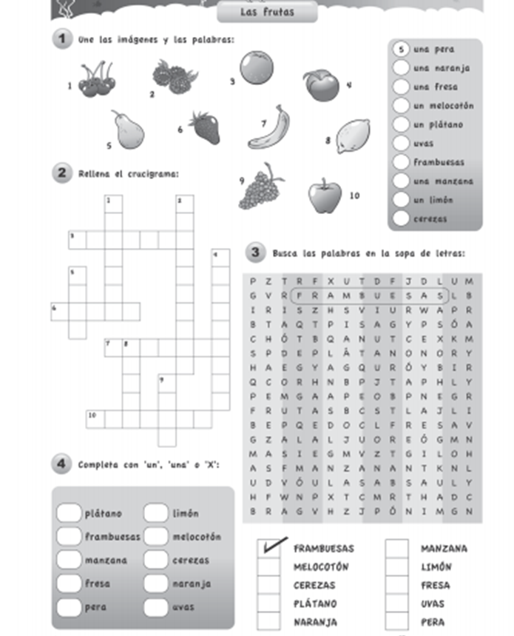

Slide 25

We hope your day went well.
See you tomorrow.

Slide 26

Tuesday 28th April
Ready to wake up your maths brains?
Remember you can do these independently then share them with an adult.
Question 10 may have more than one answer.
Don’t worry about always finding the answer it is how you try to work out and reason that is important.

Slide 27

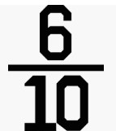


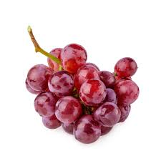
Morning Maths 28.04.20
7. Which pairs of lines are perpendicular?
(blue and purple or the black lines?)
8. How many sides
on a heptagon?
9. How much liquid is there?
10. Over 4 days I ate 62 grapes.
Each day, I ate one more
than the previous day. How
many grapes did I eat on
the first day?
Which of these sums equal 100?
  65 + 45
  12 + 88
  23 + 77
2. 399 - 60
3. 673 + 264
4. Use a number line to add 67 to 125
5. = 0.__
6. Complete the statement (using <,>,=)

Slide 28
B & C
339
937
192
0.6
>
Black
7
95ml
17

Slide 29
St Catherine’s Classroom Beliefs
Mistakes are valuable.
Everyone can learn maths to the highest level.
Questions are really important.
Depth is more important than speed.
Maths is about making connections.
We may not be learning together in the classroom, but it is important to still remember our classroom beliefs.

Slide 30
WALT: identify two fractions that make a whole.

Slide 31



A fraction is part of a whole amount. For example 3/5.
We started with ⅗ and to make it up to the whole we added ⅖. We added ⅖ because 3 + 2 = 5 (the numerators) which is how many parts the whole was made of to be complete.
=
⅗ ⅖ 5/5 (1 whole)

Slide 32
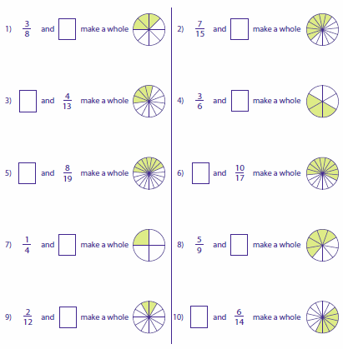

Slide 33
Answers
⅝
8/15
9/13
3/6
11/19
7/17
¾
4/9
10/12
8/14

Slide 34
Time for a break.
Have a drink and a snack.

Slide 35
Today we would like you to put your skills into practice.
WALT: use inverted commas accurately in dialogue.

Slide 36
Look at the picture on the next page.
Choose four of the pirates and write some speech bubbles for them.
Turn the speech bubbles into direct speech.
Use this checklist to help you.
Turn the speech bubbles into direct speech.
Remembered to open and close the words being spoken with inverted commas. “ “
Remembered the capital letter to begin the speech and the end piece of punctuation before the inverted commas are closed.
Remember to include a reporting clause to tell us who said it.
Remember to use a synonym for said.

Slide 37
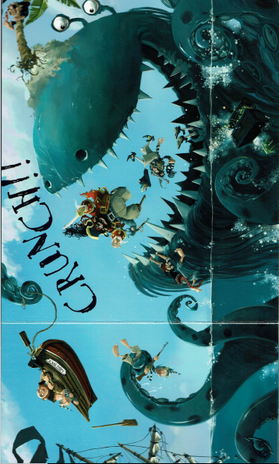

Slide 38
Reread your work to check it, edit your direct speech using the checklist below.
You will be able to use this writing you have done today to include into your work tomorrow.
Turn the speech bubbles into direct speech.
Remembered to open and close the words being spoken with inverted commas. “ “
Remembered the capital letter to begin the speech and the end piece of punctuation before the inverted commas are closed.
Remember to include a reporting clause to tell us who said it.
Remember to use a synonym for said.

Slide 39
More practise...
Spelling long vowel sound A with ei and eigh.
15 minute Spelling Activity

Slide 40
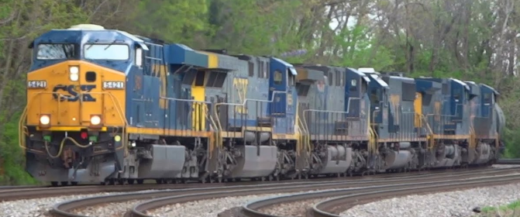
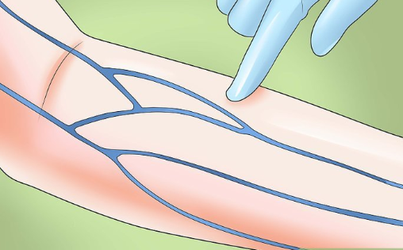
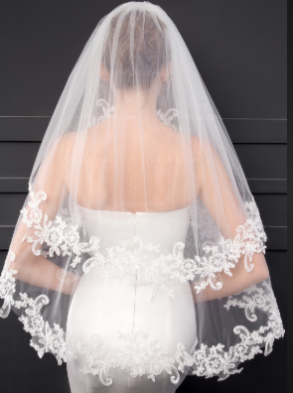
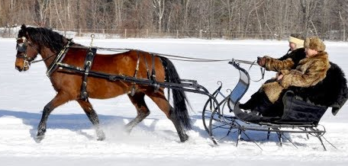

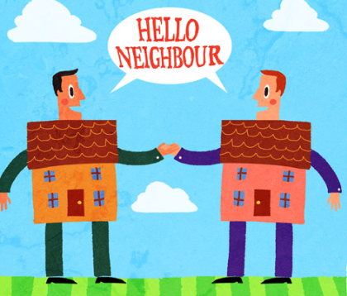
Match the long vowel A word to the picture.
sleigh
vein
freight train
neighbour
weight
veil

Slide 41
Match the long vowel A word to the picture.
sleigh
vein
freight train
neighbour
weight
veil

Slide 42

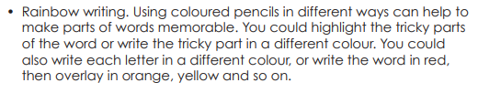
Rainbow write each
word 3 times.
sleigh
vein
freight train
neighbour
weight
veil

Slide 43
Use some of the words to complete the sentences correctly.
Make sure you are accurate with the spellings.
The _____ pulled into the station.
She wore a ____ to her wedding.
Across the snow, they sped in their ____.
The friendly ______ spoke over the fence.
The body builder enjoyed lifting the ______.
______ allow the blood to travel around our bodies.

Slide 44
Check your answers. Were your spellings correct.?
The freight train pulled into the station.
She wore a veil to her wedding.
Across the snow, they sped in their sleigh.
The friendly neighbours spoke over the fence.
The body builder enjoyed lifting the weights.
Veins allow the blood to travel around our bodies.

Slide 45
Your morning lessons are completed.
Time for lunch.
Then come back this afternoon for your curriculum activity.

Slide 46
WALT: find out about the history of pirate boats.
The following slides are from Twinkl. You can find out about which boats were used during the Golden Age of Piracy and discover more about how they worked.
You will need to identify and label a boat in your lesson tomorrow afternoon.

Slide 47
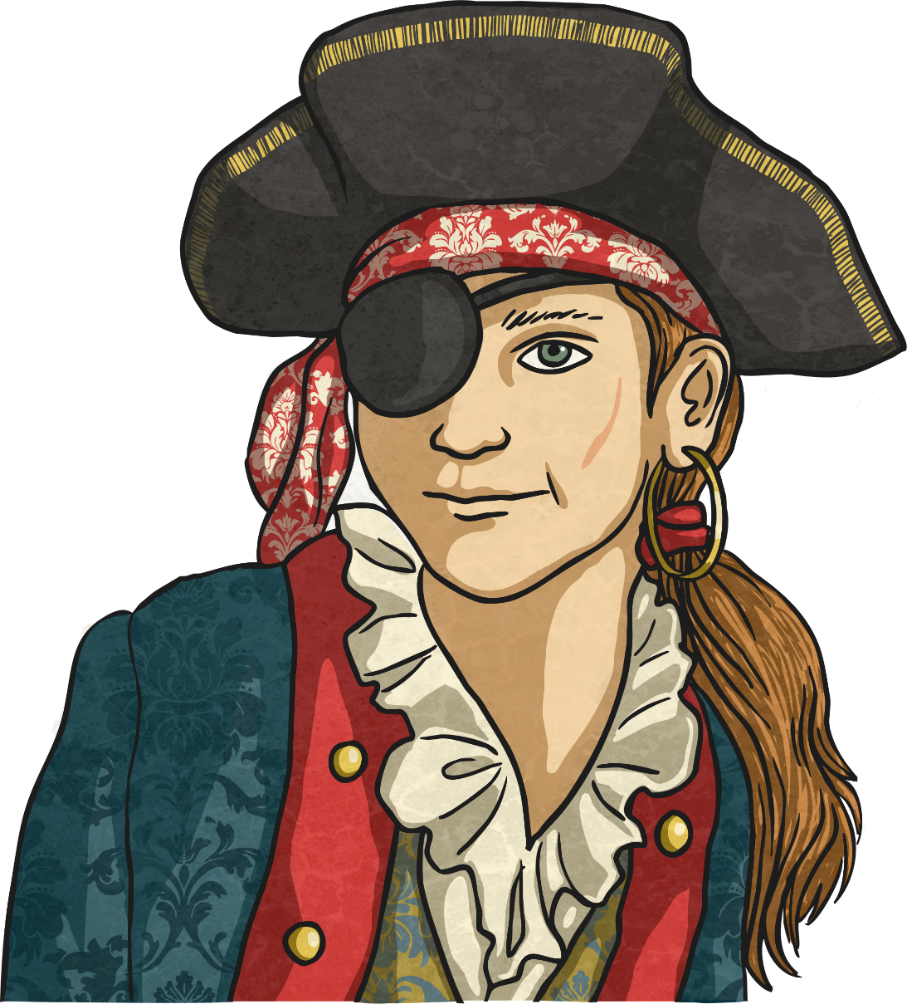
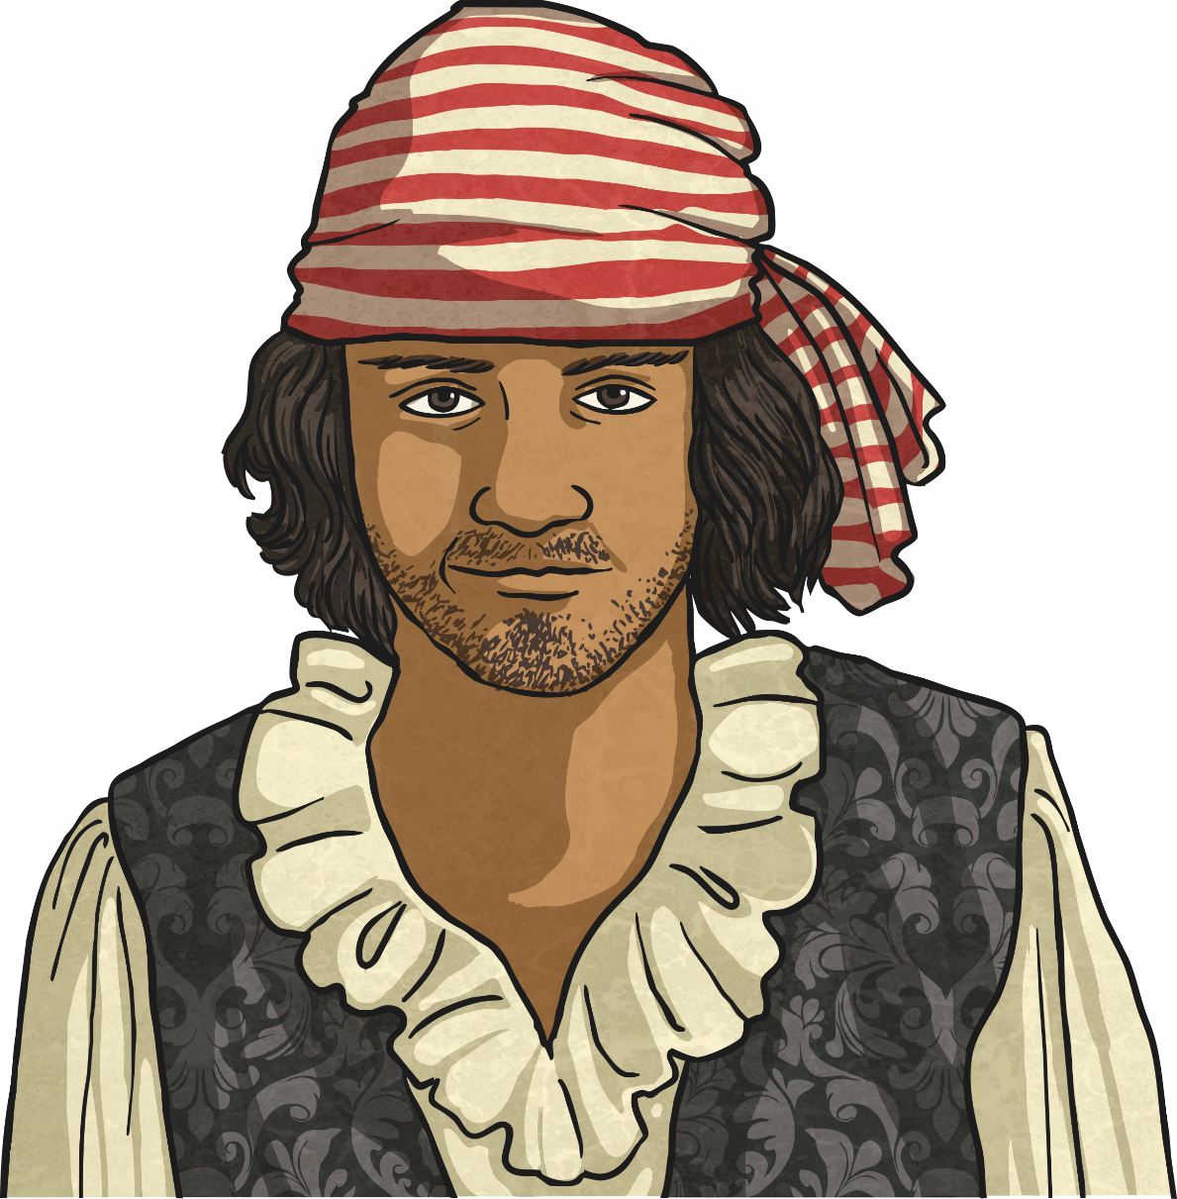

What Is a Pirate?
Pirates are people from any country who steal from ships at sea. (Yes, this still happens now but not quite as often!)
Pirates needed ships of their own (which they stole too) as they worked at sea, stealing loot from other ships.

Slide 48
The Golden Age of Piracy
The period between 1650 and 1730 is commonly known as the Golden Age of Piracy as this was a time when piracy was common. The age can be divided into three main sections:
1690
The Pirate Round
1716-1726
The Post-Spanish Succession
1650-1680
The Buccaneers
Buccaneers were pirates that worked specifically in the Caribbean (where a lot was happening) plundering Spanish ships.
Pirates worked on the specific trade route that covered the Indian Ocean and Red Sea.
After the war of the Spanish Succession, there were many English and American unemployed sailors who turned to piracy and privateering.

Slide 49
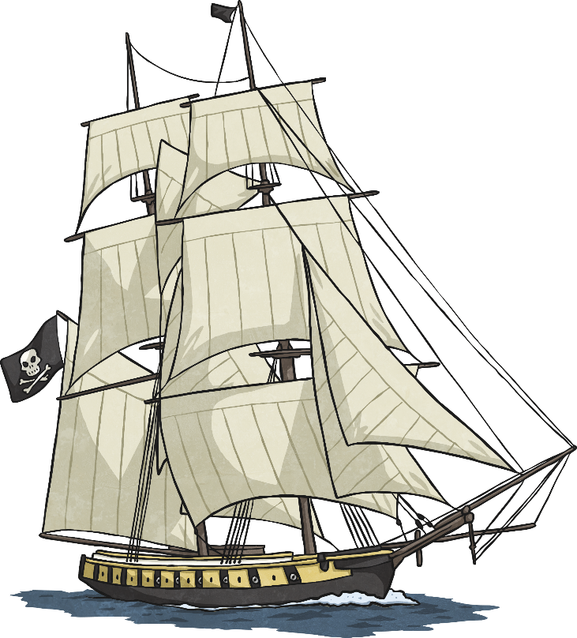
Part of a Pirate Ship
mainmast
yardarm
mizzenmast
rigging
foremast
quarterdeck
deck
jib
ratlines
Spanker boom
bowsprit
stern
helm
bow

Slide 50
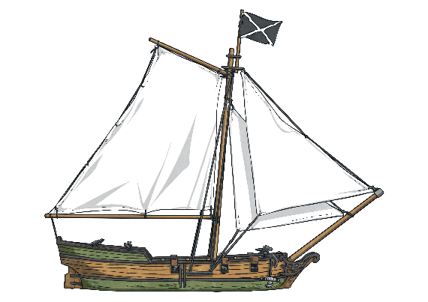
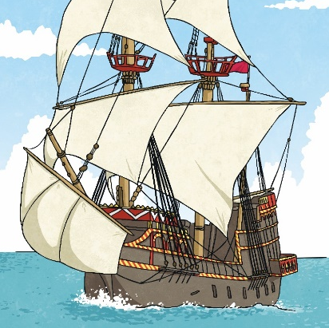

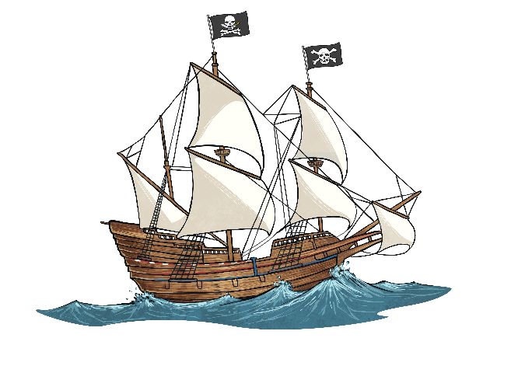
Types of Pirate Ships
Pirates not only stole loot and treasure from other ships, they also stole the ships as well! So pirates used any ships they could get their hands on. However, they did tend to favour the following vessels…
sloop
brigantine
schooner
square-rigger
Let’s Look…
Let’s look at these ships in more detail…

Slide 51


A Sloop
The sloop was one of the quickest ships available and that’s why pirates liked them. Quick enough to out sail the enemy and good in shallow waters.
One Mast
A small boat, which meant it was easier to hide.
It could hold around 75 pirates and 10 cannons.
super-long bowsprit for speed
It was shallow so it could sail in shallow waters.
It had a top speed of 11 knots.

Slide 52
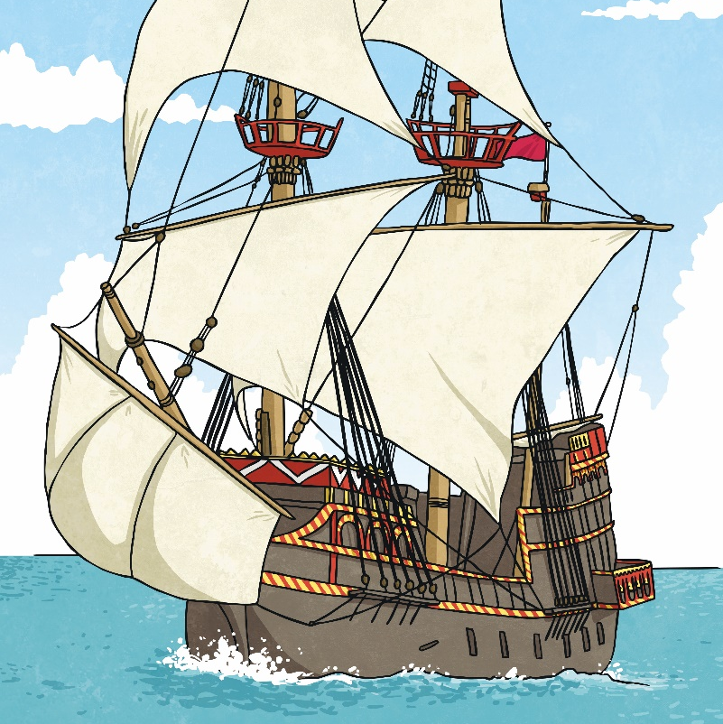
A Brigantine
Larger than the sloop and the schooner, a brigantine had more room and was more powerful.
two masts
excellent steering and handling
It could hold around 125 pirates and 120 cannons.
square-rigged foremast
It had a top speed of over 11 knots.

Slide 53

A Schooner
Very similar to the sloop. It was known for its speed and its small size which made it good for hiding.
two masts
Larger than a sloop but it was still small enough to hide.
It could hold around 75 pirates and 10 cannons.
long bowsprit for speed
It was shallow so it could sail in shallow waters.
It had a top speed of 11 knots.

Slide 54

A Square-Rigger
A pirate ship made for showing off! A square-rigger is so named because of its masts and sails. It includes the ship types of barques, brigs and full-rigged ships.
three masts
A huge ship that would deter enemies.
It could hold around 125 pirates and 120 cannons.
square sails hanging from the yardarms
Extra room for cargo (and loot!)

Slide 55
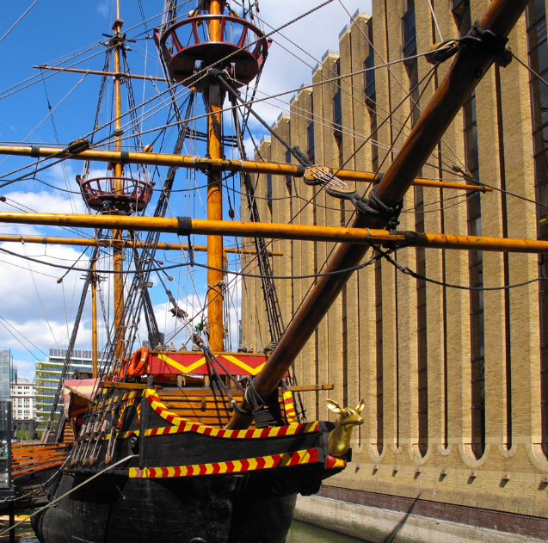
Famous Pirate Ships The Golden Hind
Belonged to: Sir Francis Drake
(Privateer for Queen Elizabeth I)
Type: Galleon
Used to be: ‘The Pelican’
Cannons: 18–22
Crew: 80 men
The End: It stayed on display in London until the mid 1600s when it eventually rotted away.

Slide 56
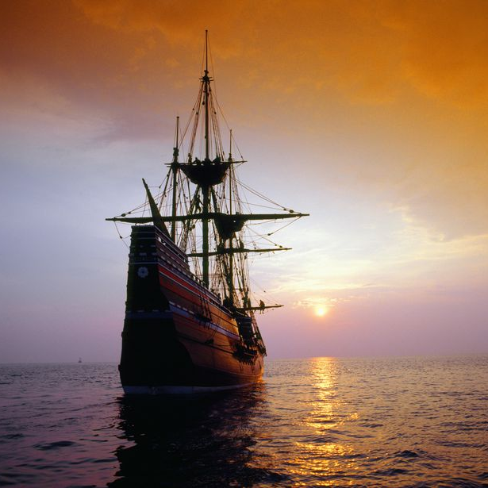
Famous Pirate Ships Queen Anne’s Revenge
Belonged to: Blackbeard (Edward Teach)
Type: Guineaman (a large cargo ship)
Used to be: ‘La Concorde’ – a French ship
Cannons: It had 14 originally but
blackbeard added 26 more!
Crew: 280 men
Flag: His flag showed a skeleton piercing a heart with an arrow.
The End: In May 1718, after looting five ships, it was finally run aground.

Slide 57
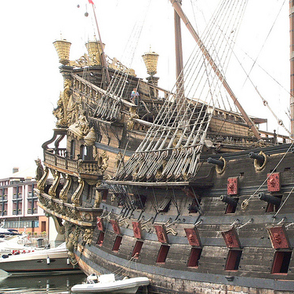
Famous Pirate Ships Royal Fortune
Belonged to: Captain Bartholomew Roberts
(also known as Black Bart)
Type: Frigate
Used to be: ‘Onslow’
Cannons: 42
Crew: 157 men
Flag: His first flag depicted him holding an hourglass with death. His second showed him standing on two skulls.
The End:Captain Roberts died in battle on the Royal Fortune in 1722.

Slide 58
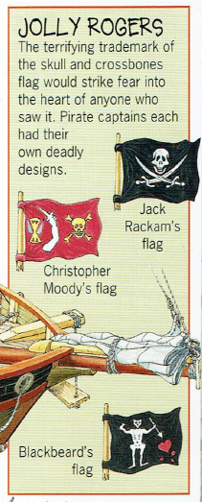
Do you remember reading about the Jolly Roger pirate flags.
Design one of your own that you can hoist to the top of the mast on your boat.
You can use this tomorrow.

Slide 59

We hope you had fun today.
See you tomorrow.

