Slide 1
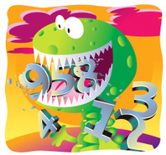
Wednesday 29th April
Ready to crunch some numbers?
Remember you can do these independently then share them with an adult.
Question 10 may have more than one answer.
Don’t worry about always finding the answer it is how you try to work out and reason that is important.

Slide 2
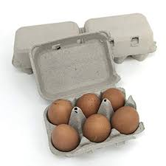
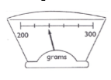
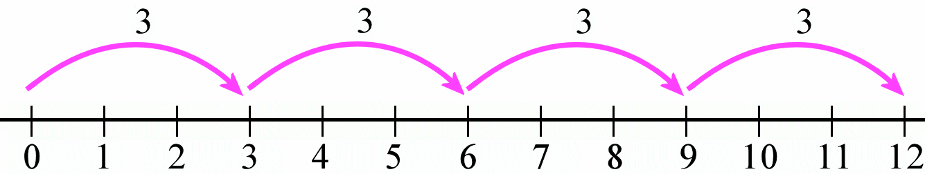
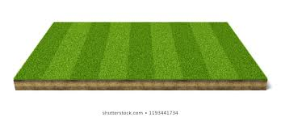
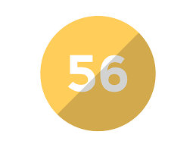
Morning Maths 29.04.20
7. I have 25 eggs. How many egg-boxes can I fill?
(extra challenge: what if I had 250 eggs?)
8. What is the weight shown here?
9. A sports field is 30m long and 20m wide. How many times do I need to run round it to have ran 1km?
10. The answer is 56.
What’s the question?
438 + 500
2. Complete the pattern
4 x 10 = 40
4 x 100 = 400
4 x 1000 =
3. Half of 90
4. What is the multiplication calculation here?
5. 435 + 42
6. 72 ➗ 4 =

Slide 3
938
4000
45
4 x 3 = 12
477
18
4 (challenge: 40)
240g
10
Multiple answers e.g. 40 + 16 = 56, 70 - 14 = 56, 7 x 8 = 56,
112 ÷ 2 = 56

Slide 4

St Catherine’s Classroom Beliefs
Mistakes are valuable.
Everyone can learn maths to the highest level.
Questions are really important.
Depth is more important than speed.
Maths is about making connections.
We may not be learning together in the classroom, but it is important to still remember our classroom beliefs.

Slide 5
WALT: recognise equivalent fractions.

Slide 6
Equivalent means equal in value.
Equivalent fractions are fractions that have the same value. For example.
2/3
4/6
Can you see that although the fractions are different, they are equal in value. They both cover the same amount of their whole.

Slide 7
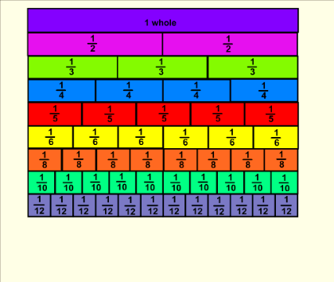
This is called a fraction wall. All of the fractions are split equally along each row. The fraction wall helps you identify equivalent fractions. If we look at our example from earlier, we can see how 2/3 and 4/6 are equivalent.
2/3
4/6

Slide 8
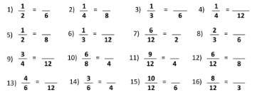
Use the fraction wall to help you find the equivalent fractions to solve the following questions.

Slide 9
3/6
2/8
2/6
3/12
4/8
4/12
1/2
4/6
9/12
3/4
3/4
4/8
8/12
2/4
5/6
2/3
Answers!!

Slide 10

Time for a break.
Have a drink and a snack.

Slide 11
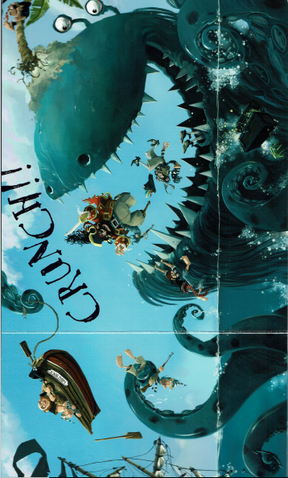
Today, we are going to write two paragraphs to tell the reader what is happening in this picture.
Pirates thrown into the air
Pirates eaten alive
You need to use
exciting sentence openers
appropriate vocab
onomatopoeia words (WHOOSH! SPLASH! CREAK!)
punctuated speech (inverted commas)
HINT - you can use the direct speech from yesterday.
There are some ideas on the next two pages to help you with writing your two paragraphs.

Slide 12
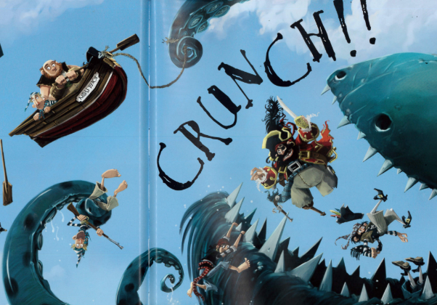
Pirates thrown into the air
Sentence Openers:
Without warning,
Falling through the air,
Screaming in terror,
All at once,
All of sudden,
Unable to believe their own eyes,
Like rag dolls,
Onomatopoeia
WOAH!
AGHHH!
Powerful Verbs
tumbled threw
somersaulted soared
flew dropped hurled

Slide 13
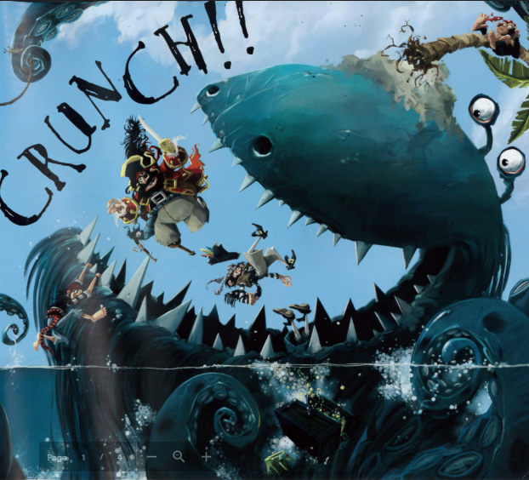
Pirates eaten alive
Sentence Openers
With its razor-sharp teeth,
With an almighty roar,
In one huge…
Before they had time to even …
In one vast gulp,
Opening its mouth wide,
With a huge grin on its face,
Screaming in terror,
Greedily,
Onomatopoeia
CRUNCH!
GULP! AGHHH!
CHOMP!
Powerful Verbs
cried yelled scrambled devoured swallowed

Slide 14
How did you do?
Reread your paragraphs and edit them against your checklist.
Did you need to use
exciting sentence openers
appropriate vocab
onomatopoeia words (WHOOSH! SPLASH! CREAK!)
punctuated speech (inverted commas)
Did you use the direct speech from yesterday?
Share your story writing with an adult.

Slide 15

What is a homophone?
A homophone is a word that sounds the same but is spelt differently and means something different. ‘Homo’ means ‘same’ and ‘phone’ means ‘sound’.
Example:
ate and eight
I ate my apple. I have eight friends.
Watch the on line clip.
https://uk.video.search.yahoo.com/yhs/search;_ylt=AwrIAX8Y_YVecR4AnAN3Bwx.;_ylu=X3oDMTB0ZTgxN3Q0BGNvbG8DaXIyBHBvcwMxBHZ0aWQDBHNlYwNwaXZz?p=homophones&type=pds_sjiqmxum1acegikmuebkmoqsuwl96p7j8qmodg_19_21_ssg00&hspart=itm&hsimp=yhs-001&param1=1&param2=f%3D4%26b%3Dchrome%26ip%3D86.143.79.246%26pa%3Dpdfconverterds%26type%3Dpds_sjiqmxum1acegikmuebkmoqsuwl96p7j8qmodg_19_21_ssg00%26cat%3Dweb%26a%3Dpds_sjiqmxum1acegikmuebkmoqsuwl96p7j8qmodg_19_21_ssg00%26xlp_pers_guid%3Daf929fc4210e4abac6f2a4042b064d6d%26xlp_sess_guid%3Daf929fc4210e4abac6f2a4042b064d6d-ad1e-09fb78766ee3%26uref%3D%26abid%3D%26xt_abg%3D%26xt_ver%3D10.1.4.64%26ls_ts%3D1558379397&ei=UTF-8&fr=yhs-itm-001#id=3&vid=c6df02f66d749fda64d4e5038abf7f01&action=view
15 minute Spelling Activity

Slide 16
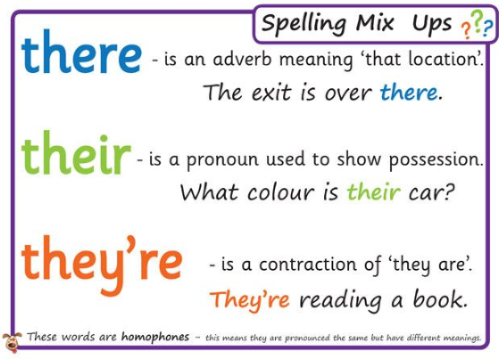
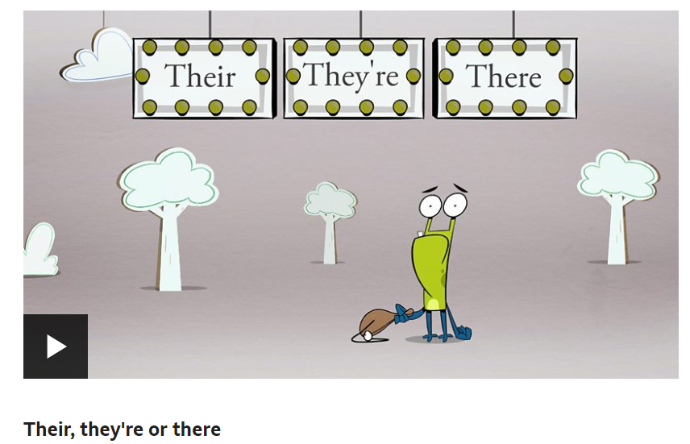
https://www.bbc.co.uk/bitesize/topics/zqhpk2p/articles/z3cxrwx
Remember this poster from our classroom? We often mix up there, their and there. So… let’s practise this today.
Use the link to watch the bbc bite size clip, try the fill the gaps exercise and the quiz.

Slide 17
Now write out these sentences adding in the correct spelling of the correct their, there or they’re.
They put _______ barrels upon the deck.
The pirates went to get out ________ oars.
“Carry that treasure over _______!” ordered the captain.
__________ off to hoist the Jolly Roger.
What have they done with ______ treasure?
__________ going to take _________ parrot over _______.

Slide 18
Now write out these sentences adding in the correct spelling of the correct their, there or they’re.
They put their barrels upon the deck.
The pirates went to get out their oars.
“Carry that treasure over there!” ordered the captain.
They’re off to hoist the Jolly Roger.
What have they done with their treasure?
They’re going to take their parrot over there.

Slide 19


Your morning lessons are completed.
Time for lunch.
Then come back this afternoon for your curriculum activity.

Slide 20

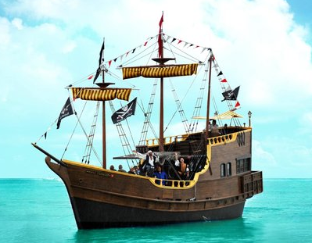
https://uk.video.search.yahoo.com/yhs/search;_ylt=AwrIQZLVJ4deBmEAQhB3Bwx.;_ylu=X3oDMTB0ZTgxN3Q0BGNvbG8DaXIyBHBvcwMxBHZ0aWQDBHNlYwNwaXZz?p=howtodrawapirate+boat+step+by+step&type=pds_sjiqmxum1acegikmuebkmoqsuwl96p7j8qmodg_19_21_ssg00&hspart=itm&hsimp=yhs-001&param1=1&param2=f%3D4%26b%3Dchrome%26ip%3D86.143.79.246%26pa%3Dpdfconverterds%26type%3Dpds_sjiqmxum1acegikmuebkmoqsuwl96p7j8qmodg_19_21_ssg00%26cat%3Dweb%26a%3Dpds_sjiqmxum1acegikmuebkmoqsuwl96p7j8qmodg_19_21_ssg00%26xlp_pers_guid%3Daf929fc4210e4abac6f2a4042b064d6d%26xlp_sess_guid%3Daf929fc4210e4abac6f2a4042b064d6d-ad1e-09fb78766ee3%26uref%3D%26abid%3D%26xt_abg%3D%26xt_ver%3D10.1.4.64%26ls_ts%3D1558379397&ei=UTF-8&fr=yhs-itm-001#id=3&vid=350fddaf1fa0a548fa14a98713c7ce27&action=view
Use the link to draw a simple pirate boat step by step. You will need a piece of paper, a pencil and an eraser.
Remember try again increasing the size of your drawing.
Draw it by yourself a third time and you could add some of your own details (like your own Jolly Roger from yesterday)before colouring.
Add labels to your ship using what you found out yesterday in the history session.

Slide 21
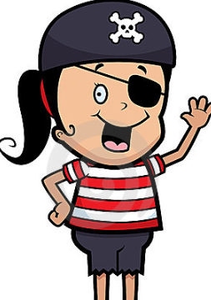
Did you have a good day learning today?
See you in the morning.

Slide 22
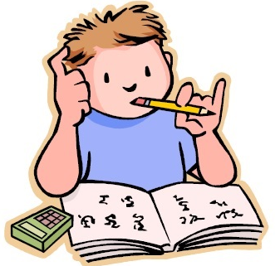
Thursday 30th April
Is your head ready to calculate?
Remember you can do these independently then share them with an adult.
Question 10 may have more than one answer.
Don’t worry about always finding the answer it is how you try to work out and reason that is important.

Slide 23
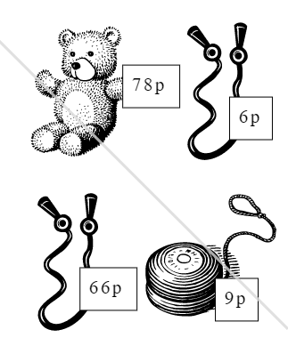

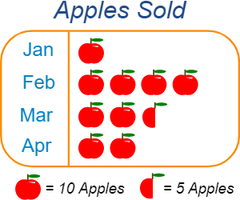
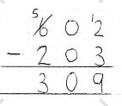
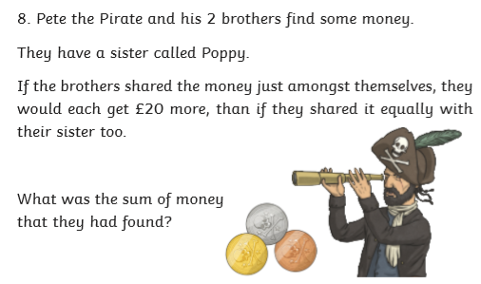




Morning Maths 30.04.20
8. How much change
from £5?
9. How many more
Apples are sold in
Feb than Mar?
10.
682 + 10
2. 37 + __ = 100
3.
4. Spot the mistake:
5. 4 x 72
6. = ?
7. 0.__ =

Slide 24
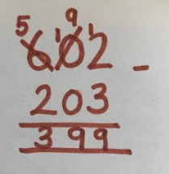
692
63
60
They forgot to repartition the number to 500, 100 and 2 when they moved a 100 to the tens column, they moved the hundred straight to the ones column.
4 x 2 = 8, 4 x 70 =280, 280 + 8 = 288
2/6
0.3 = white or 0.7 = peach
78 + 66 + 9 + 6 = 159, 500 - 159 = 341
February = 40, March = 25, 40 - 25 = 15
Pete + 2 brothers = 3 3 x 20 = 60 so Poppy had £60
Pete + 2 brothers + Poppy = 4 so 4 x 60 = £240. In total

Slide 25
St Catherine’s Classroom Beliefs
Mistakes are valuable.
Everyone can learn maths to the highest level.
Questions are really important.
Depth is more important than speed.
Maths is about making connections.
We may not be learning together in the classroom, but it is important to still remember our classroom beliefs.

Slide 26
WALT: compare fractions

Slide 27
We are going to use the fraction wall to compare fractions. I want to know which fraction is bigger 4/5 or 6/8.
As you can see I have put boxes round 4/5 and 6/8. I can see that 4/5 covers more of the bar and is therefore larger.

Slide 28
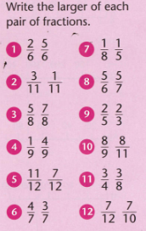

Slide 29
Answers
5/6
3/11
7/8
4/9
11/12
4/7
1/5
5/6
2/3
8/9
3/4
7/10

Slide 30
Time for a break.
Have a drink and a snack.

Slide 31
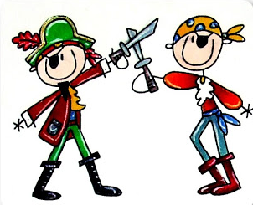
Fight like a Pirate!
Today’s English is a comprehension activity.
The extract from Pirates a Collins Children’s Book.
You will learn how a pirate tries to win a battle.
WALT: retrieve information from non-fiction texts and make inferences

Slide 32
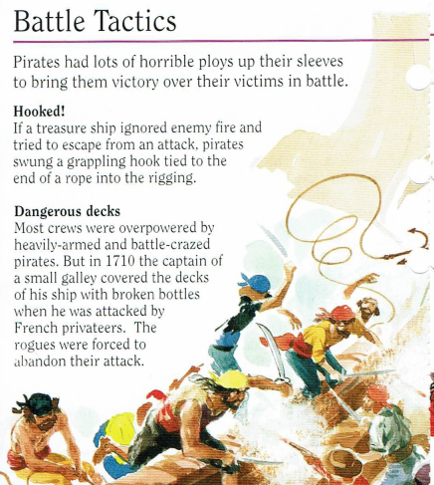
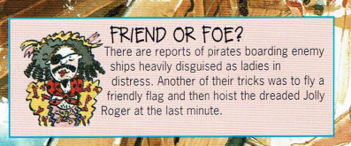

Slide 33
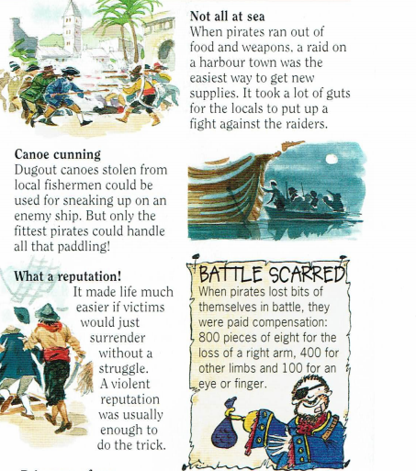
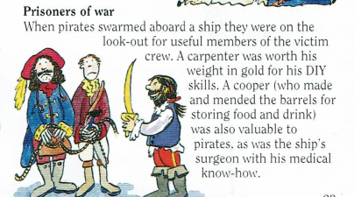

Slide 34
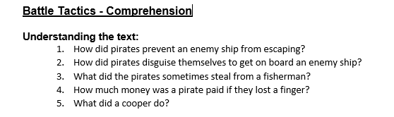
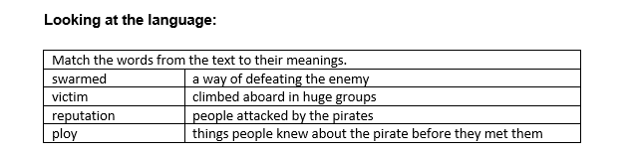

Slide 35
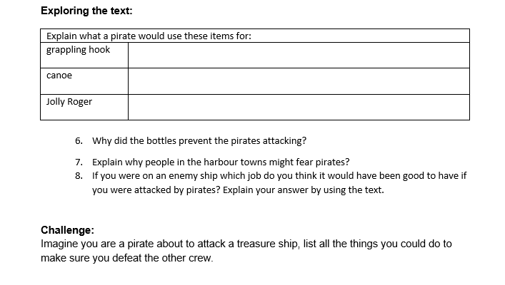

Slide 36
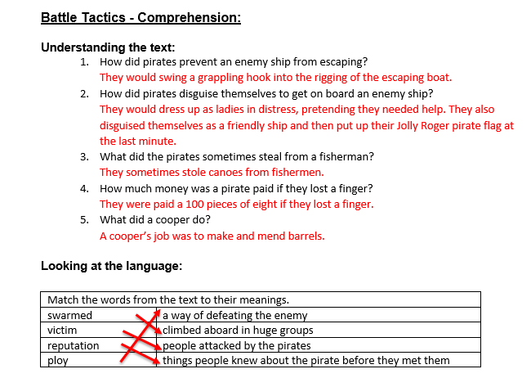

Slide 37
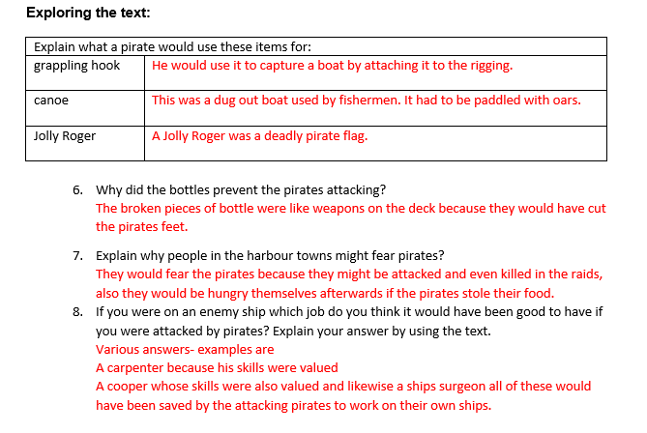

Slide 38
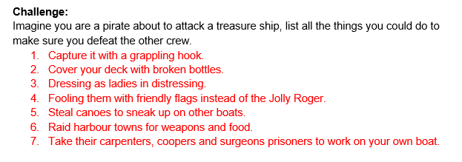

Slide 39
More practise.
What is a homophone?
A homophone is a word that sounds the same but is spelt differently and means something different.
15 minute Spelling Activity

Slide 40
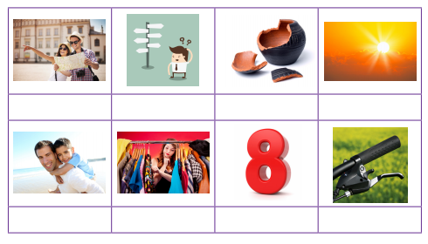
their or there, where or wear, break or brake, sun or son, eight or ate ?
Can you write the correct spellings for the pictures?

Slide 41
Check your answers.
there where break sun
son wear eight brake

Slide 42
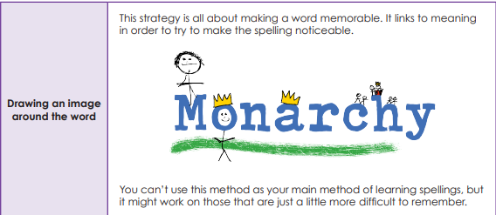
Try drawing some images to remember some of the homophones you have used today.
wear | where
break | brake

Slide 43
Your morning lessons are completed.
Time for lunch.
Then come back this afternoon for your curriculum activity.

Slide 44
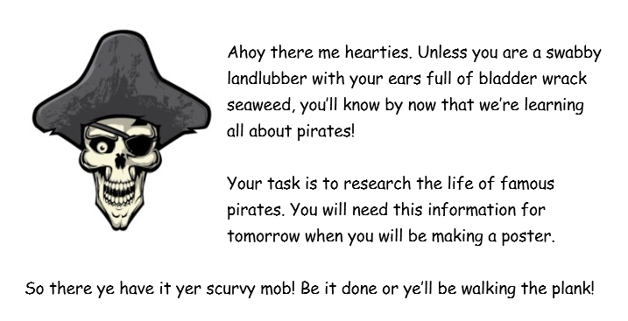
A history research project.
See the next slide!

Slide 45
Here are some useful links where you can do your research.
You can find out about some of these famous pirates
Anne Bonny
Mary Read
Blackbeard
Black Bart
Calico Jack
Benjamin Hornigold
Henry Morgan
https://www.dkfindout.com/uk/history/pirates/
https://www.exploration-and-piracy.org/pirates
https://mocomi.com/history-of-pirates/
http://www.bahamas4kids.com/famous_pirates.html
Remember to write notes ready for tomorrow.

Slide 46
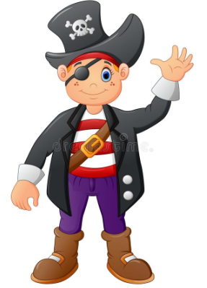
Did you work hard with your learning today?
See you in the morning.

Slide 47
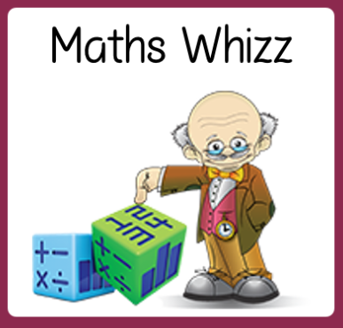
Friday 1st /may
Are you a maths whizz today?
Remember you can do these independently then share them with an adult.
Question 10 may have more than one answer.
Don’t worry about always finding the answer it is how you try to work out and reason that is important.

Slide 48
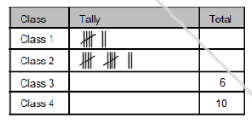
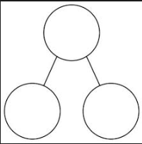
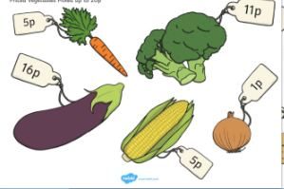
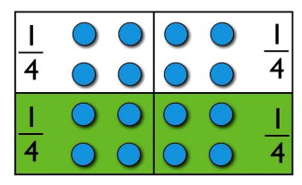
Morning Maths 01.05.20
8. Copy and complete:
9. I bought three items and had 79p change from £1. What did I buy?
10. If I know 9x6 = 54, what else do I know?
5 fewer than 23
2. 370 10 (how many 10’s in 370)
3. Complete this
part-whole model.
4. subtract 30 from 824
5. 300 + 40 + 5
6. What is 2 of 16?
4
7. What is the 6th
month of the year?
45
99

Slide 49


18
37
54
794
345
8
June
Class 1 = 7, Class 2 = 12, Class 3 , Class 4
Multiple answers (e.g) 16 + 11+ 5 =32p 100 - 32 = 68p
1 + 5 + 11 = 17p 100 - 17 = 83p
Multiple answers - (e.g) 6 x 9 = 54, 9 x 60 = 540, 54 ➗ 6 =9

Slide 50
St Catherine’s Classroom Beliefs
Mistakes are valuable.
Everyone can learn maths to the highest level.
Questions are really important.
Depth is more important than speed.
Maths is about making connections.
We may not be learning together in the classroom, but it is important to still remember our classroom beliefs.

Slide 51
WALT: recall timestable facts up to 12 x 12

Slide 52
To end the week, we’re sending you a link to a times tables game.
https://www.topmarks.co.uk/maths-games/hit-the-button
If you are unable to use the link follow the next slides to get onto the game.

Slide 53
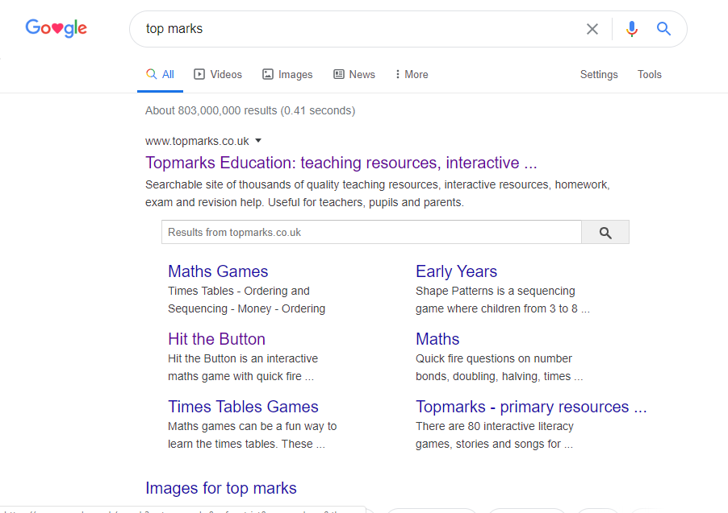
Type in ‘top marks’ in your search engine.
Click on the following link.

Slide 54
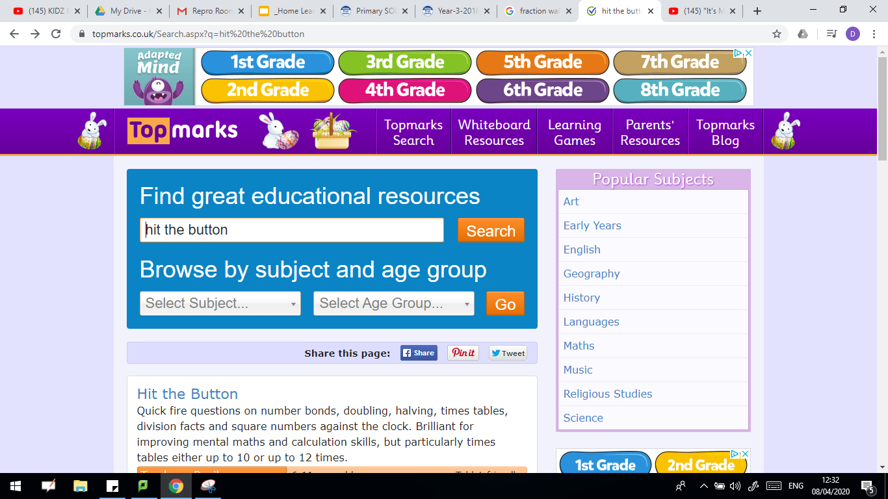
Type in “hit the button” and press search.
Click on hit the button

Slide 55
Time for a break.
Have a drink and a snack.

Slide 56
Our English tasks for today begin with a Close Reading Task
WALT: to use evidence from a text to justify an answer and infer about a character’s feelings through their speech and actions.
Ask an adult to read the extract about pirates (on the next page) to you.
Here are some meanings of words that might help you -
simple - plain and not special
fancy - posh, rich looking clothes
swash-buckling - going on a daring adventurous journey to steal off others
voyages - a journey on the sea
fabrics - different types of material
merchant - a trading ship, that sells things
3. Now read it with your adult twice, they can help you with expression.
4. Now read it twice by yourself.
5. Read the questions and look for evidence in the text to help you answer them.
6. Write your answers in full sentences.

Slide 57
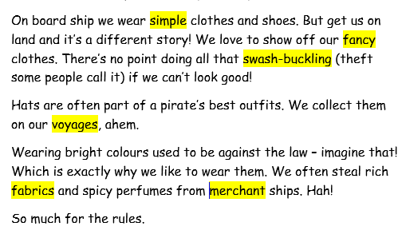
This an extract from ‘How Pirates Really Work’ by Alan Snow

Slide 58
Task:
1. What are the main reason pirates like to show off their ‘fancy’ clothes?
2. What does the narrator mean by - We ‘collect’ them on our voyages?
3. What does ‘so much for the rules’ tell us about the pirates attitude?

Slide 59
Task:
1. What are the main reason pirates like to show off their ‘fancy’ clothes?
The main reasons are because they usually wear plain, simple clothes and they want to show off the special things they have plundered as it shows what excellent pirates they are. They also like to wear coloured clothes because it means they are breaking the law and they take pride in that.
2. What does the narrator mean by - We ‘collect’ them on our voyages?
The narrator means they steal them from other people in towns or on other ships.
3. What does ‘so much for the rules’ tell us about the pirates attitude?
It tells us they have no respect for rules and do not follow them.

Slide 60
WALT: write a clear description
We had been working on this at school, here are a few reminders.
We can use an adjective to describe a noun - the scarlet red jacket
A descriptive verb - The sword was glinting in the sun.
A simile to compare - He was as fierce as a lion.

Slide 61
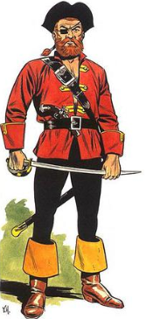
Standing tall and proud, Captain Jack with his gilt-handled silver sword that glinted in the sun, surveyed the land. One eye hidden behind the patch, which made him look even more fearsome. Tucked into his black leather belt, was a blunderbuss sporting a wooden handle. His scarlet red jacket gave him an air of importance. As he smirked, his ginger moustache twitched and he strode surefooted towards the enemy. He appeared as brave as a lion.
Read the description of the pirate.

Slide 62
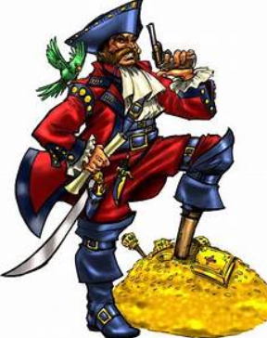
Write a description of this pirate wearing his fancy clothes.
Remember you can magpie words from the text you read and here are some words to help you:
emerald green macaw
midnight black, three cornered hat
sturdy, wooden leg
pistol poised ready
decorated with shining gold buckles
crisp white frills like the sails of a boat
thick furrowed eyebrows
a stare fixed like steel
dangling at his side

Slide 63
Time to test you out on the homophones you’ve been looking at!
Write out the sentences on the next page putting in the accurate spelling of the correct homophone.
15 minute Spelling Activity

Slide 64
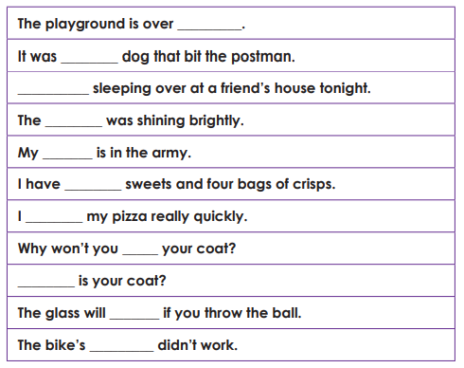
sun
wear
their
ate
they’re
break
there
brake
son
where
eight

Slide 65
there
their
They’re
sun
son
eight
ate
wear
Where
break
brake

Slide 66
Your morning lessons are completed.
Time for lunch.
Then come back this afternoon for your curriculum activity.

Slide 67
Time to continue your history research project.
See the next slide!

Slide 68

Use the notes you made yesterday to create an information poster about famous pirates.
Remember, just like when we did our non-chronological report writing about Mount Everest ...
You should include:
headings
sub-headings
diagrams or pictures with labels or captions
an introductory paragraph
factual paragraphs about the pirates.

Slide 69
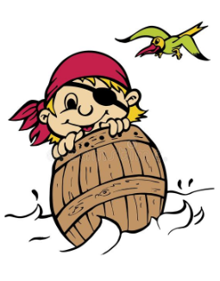
Mr Mottershead and Mrs Shipley really hope you enjoyed the pirate theme over the past two weeks.
Enjoy your weekend and we will have a new theme for you on Monday.

