Slide 1
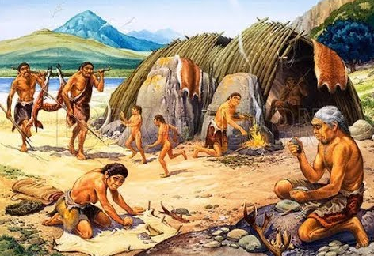
Welcome back to our second Stone Age themed week
We hope you had a good weekend break.
Are you raring to go?

Slide 2

Monday 11th May
We will begin our day with Morning Maths - just like in school!
You can do these independently then share them with an adult.
Remember question 10 may have more than one answer.
Don’t worry about always finding the answer it is how you try to work out and reason that is important.

Slide 3
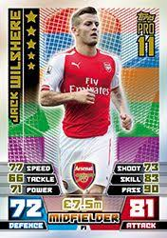
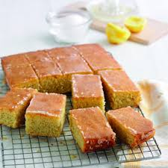




Morning Maths 11.05.20
8. Football card packs cost £1.15. How much for 4 packs?
9.Nan bakes a cake
and cuts it into 14
slices. She gives 1/7 to her friends.
She then gives a quarter of what is left to her granddaughter. How much did her granddaughter have?
10. How many 4 digit numbers can you make from the digits 4,6,2,7 (using each digit once)?
45 + 7
2. 100 = 35 +
3. 435 - 138
4. One tenth of 30
5. What number is a multiple of both 5 and 3
45, 42, 40
6. Order these fractions from largest to smallest:
1 1 1 1
3 2 8 12
7. Write the two division statements related to this:
8 x 11 = 88

Slide 4
52
65
297
3
45
1/2 , 1/3 , 1/8 , 1/12
88 ÷ 11 = 8 and 88 ÷ 8 = 11
£4.60 or 460p
3
16 different options.
2467 , 2476 , 2674 , 2647 , 2764 , 2746
4267 , 4276 , 4672 , 4627 , 4726 , 4762
6247 , 6274 , 6472 , 6427 , 6742 , 6724
7624 , 7642 , 7246 , 7264 , 7462 , 7426

Slide 5

St Catherine’s Classroom Beliefs
Mistakes are valuable.
Everyone can learn maths to the highest level.
Questions are really important.
Depth is more important than speed.
Maths is about making connections.
We may not be learning together in the classroom, but it is important to still remember our classroom beliefs.

Slide 6
WALT: read the time to the nearest 5 minutes

Slide 7
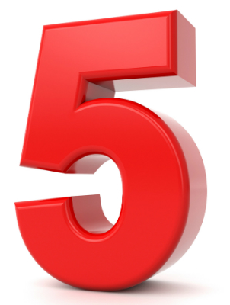
Have a go at practicing your 5x tables. Remember we go up up 12 x 5.
1 x 5 =
2 x 5 =
3 x 5 =
4 x 5 =
5 x 5 =
6 x 5 =
7 x 5 =
8 x 5 =
9 x 5 =
10 x 5 =
11 x 5 =
12 x 5 =

Slide 8
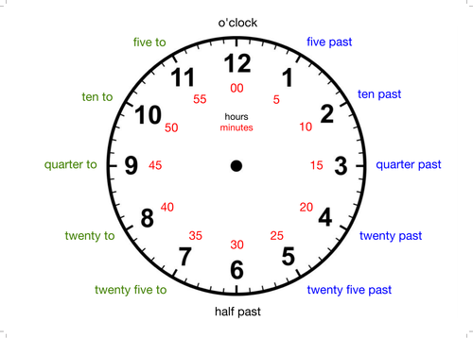
Practice counting in 5’s going around the clock. Use the red numbers on the inside of the clock to help you.
To challenge yourself, try not using the red numbers.

Slide 9
Now count round the clock like you did on the previous slide but now say the words that are around the edge for each number.
Start at O’clock then five past then ten past …
You should notice the first 6 times all end in “past” and the last five end in “to”.
Spend plenty of time on this stage. This is a key part of telling the time!

Slide 10
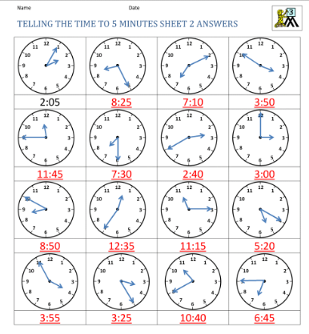
Have a go at including the minutes in the following time. Luckily, we have given you the hours already so all you have to do is work out the minutes part of the time. Look at the first one as an example.
For a challenge
For each one, try saying the time outloud in the proper mathematical way.
For example the time on the first clock would be said “Five past”.

Slide 12

Time for a break.
Have a drink and a snack.

Slide 13
Our English task for today is a Close Reading Task
WALT: retrieve and infer information from a text.
Ask an adult to read the information (on the next page) to you.
Here are some meanings of words that might help you – shoals - a group of fish
primitive - basic and simple
effective - good for the job
shaft - a long thin pole
sundried - hung up in the sun to dry out
preserved -able to be kept for a long time
trance - as if they are hypnotised and sleeplike
Now read it with your adult twice, they can help you with expression.
Now read it twice by yourself.
Read the questions and look for evidence in the text to help you answer them.
Write your answers in full sentences.

Slide 14
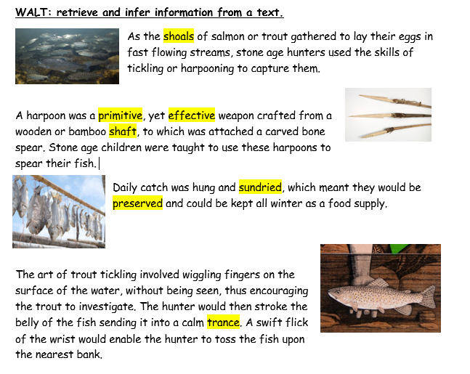

Slide 15
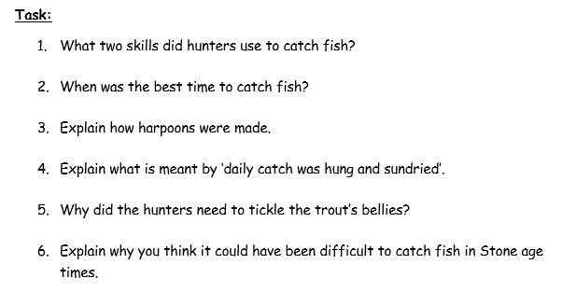

Slide 16
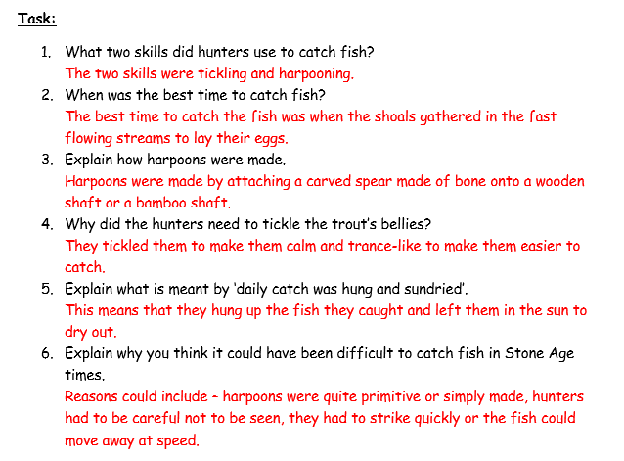

Slide 17

What is a prefix? (mis)
Do you remember that a prefix is a group of letters which we add to the beginning of a word to make a new word with a different meaning?
For example:
un + happy = unhappy
dis + like = dislike
Today we will look at the prefix mis which usually means wrongly
For example:
I understood the book - means that you accurately made sense of it
I misunderstood the books means that you did not understand it
Or
I made a mistake means that you got something wrong
15 minute Spelling Activity

Slide 18
Put the prefix mis in front of these words and write down your new words.
Read the new words aloud.
Practise writing each word 3 times.
Which words would you use in the sentences on the next slide?
calculate | place | hear | take
spell | use | behave | read

Slide 19
Write these sentences out filling in the missing spellings accurately.
Do not _______ in class! You will move down the zone board.
I can’t find my bag. Where did I _____ it?
This is the wrong there. Why do I always _____ it?
The cake is too dry. I must have _____ the recipe.
I’m sorry I don’t have enough money. I must have _______.
Now check your answers on the next page.

Slide 20
Write these sentences out filling in the missing spellings accurately.
Do not misbehave in class! You will move down the zone board.
I can’t find my bag. Where did I misplace it?
This is the wrong there. Why do I always misspell it?
The cake is too dry. I must have misread the recipe.
I’m sorry I don’t have enough money. I must have miscalculated.
Now check your answers on the next page.

Slide 21

The days of the week
Task 3 from Miss Wheeler
Remind yourself how to express your opinion in Spanish.
Me gusta (n) = I like
No me gusta (n)= I don’t like
Me encanta (n) = I love
Odio = I hate
Write sentences or tell your family how you feel about certain days of the week.
Eg/ Me gustan los lunes pero no me gustan los martes.
Odio los martes y los domingos
*pero = but y = and

Slide 22
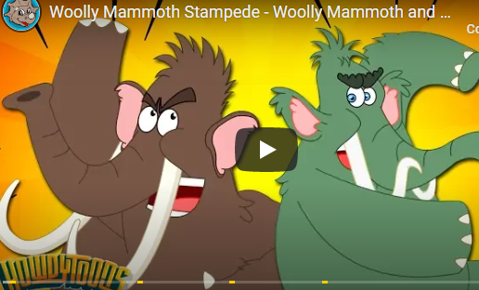
Finish your day with a fun clip about a Woolly Mammoths.
It will give you a taster for our learning tomorrow in English.
Knowing about a mammoth ambush will also be helpful tomorrow afternoon.
https://uk.video.search.yahoo.com/yhs/search;_ylt=AwrJ6tXpLI5eEQYAszie3olQ?p=wooly+mammoth+stampede+for+kids&hsimp=yhs-001&hspart=itm&type=pds_sjiqmxum1acegikmuebkmoqsuwl96p7j8qmodg_19_21_ssg00&param1=1&param2=f%3D4%26b%3Dchrome%26ip%3D62.252.176.123%26pa%3Dpdfconverterds%26type%3Dpds_sjiqmxum1acegikmuebkmoqsuwl96p7j8qmodg_19_21_ssg00%26cat%3Dweb%26a%3Dpds_sjiqmxum1acegikmuebkmoqsuwl96p7j8qmodg_19_21_ssg00%26xlp_pers_guid%3Daf929fc4210e4abac6f2a4042b064d6d%26xlp_sess_guid%3Daf929fc4210e4abac6f2a4042b064d6d-ad1e-09fb78766ee3%26uref%3D%26abid%3D%26xt_abg%3D%26xt_ver%3D10.1.4.64%26ls_ts%3D1558379397&fr=yhs-itm-001&fr2=p%3As%2Cv%3Ai%2Cm%3Apivot#id=1&vid=98310529583f781317f7208de96a89cc&action=view

Slide 23

We hope your day went well.
See you tomorrow.

Slide 24
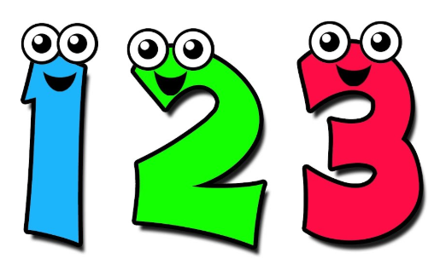
Tuesday 12th May
Ready to wake up your maths brains?
Remember you can do these independently then share them with an adult.
Question 10 may have more than one answer.
Don’t worry about always finding the answer it is how you try to work out and reason that is important.

Slide 25
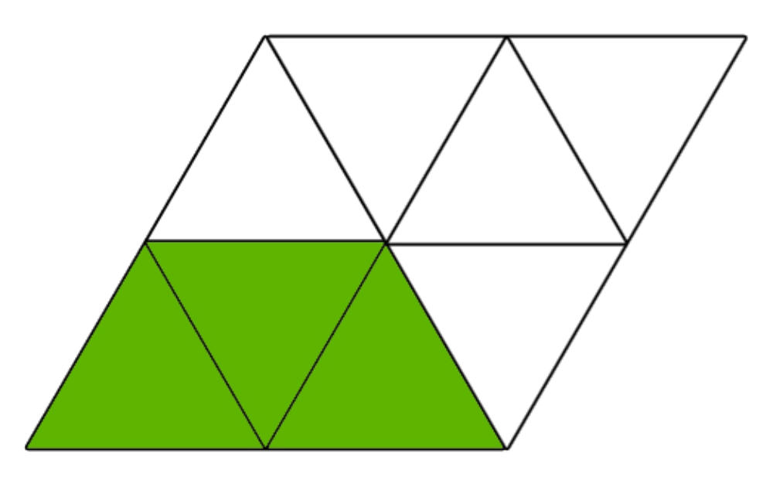





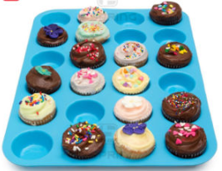
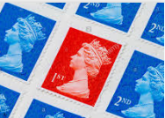
Morning Maths 12.05.20
8. Which pairs of lines are parallel?
9. How many sides on 4 pentagons, 3 hexagons and 2 triangles?
What fraction is shaded?
Which of these calculations total 100?
3. 564 + 156
4. 250 ➗10
5. First Class stamps cost 70p. Second Class stamps cost 61p. How much for two First Class and one Second Class stamp?
6. 35 x 8 7. 350 x 8
a
b
34 + 76
55 + 45
17 + 83
c
d
10. Bill makes 24 cakes.What different amounts of friends can he share the cake between equally and have no cakes left over?(Bill does not give any cakes to himself)

Slide 26
⅜
55 + 45 and 87 + 13
720
25
£2.01 or 201p
280
2800
B
44
He could share his cakes with: 1 friend, 2 friends, 3 friends, 4 friends, 6 friends, 8 friends, 12 friends or 24 friends.

Slide 27
St Catherine’s Classroom Beliefs
Mistakes are valuable.
Everyone can learn maths to the highest level.
Questions are really important.
Depth is more important than speed.
Maths is about making connections.
We may not be learning together in the classroom, but it is important to still remember our classroom beliefs.

Slide 28
WALT: identify hours on an analogue clock.

Slide 29
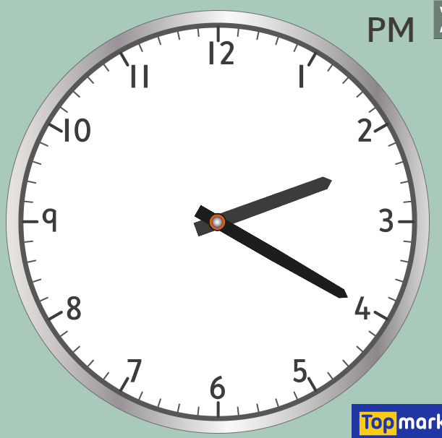
So far with telling the time, we have focused on the minutes. This is shown with the large hand on the clock.
We are now going to look at how to read the hours on an analogue clock. We need to look at the shorter hand on the clock now.
As you can see the hour hand is pointing in between the 2 and 3. This means we have gone past 2 o’clock but haven’t got to 3 o’clock.

Slide 30
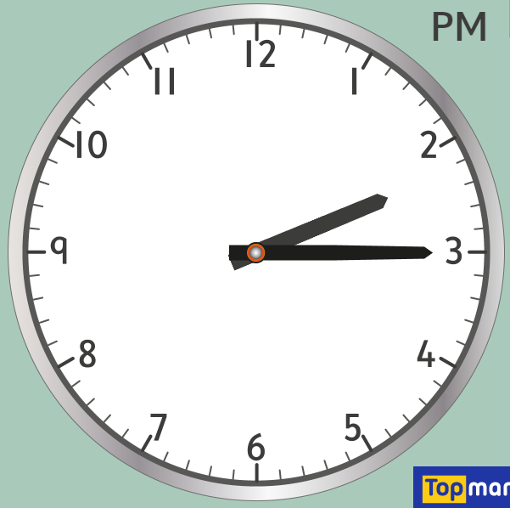
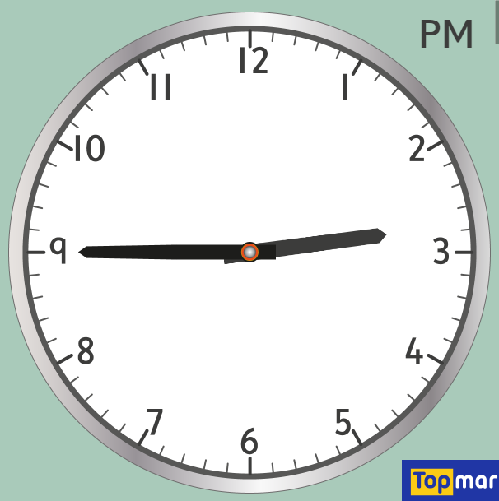
First we have to look at our minute hand. It’s pointing at the quarter past position.
Then we look at the the hour hand. We can see it has gone past the two.
The time is therefore quarter past two.
Let’s have a look at how we read the time.
First we have to look at our minute hand. It’s pointing at the quarter to position.
Then we look at the the hour hand. We can see it is going to the three.
The time is therefore quarter to three.

Slide 31
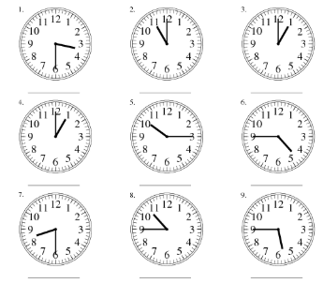
Let’s see what we can do with our hours. For the next few questions we are focusing on the hour part. The answers will all be either o’clock, quarter past, half past or quarter to. We are mainly focusing on the hours remember. Write your answer in words.

Slide 32
Half past three
Eleven o’clock
One o’clock
One o’clock
Quarter past 10
Quarter to 5
Half past eight
Quarter to eleven

Slide 33
For a bit of fun. Have a go at this time telling game. See how many you can get right.
http://www.ictgames.com/mobilePage/hickoryDickory/index.html
If you can’t click on the link. Go onto “Top Marks” and search for “Hickory Dickory Clock” and select level 1.

Slide 34
Time for a break.
Have a drink and a snack.

Slide 35
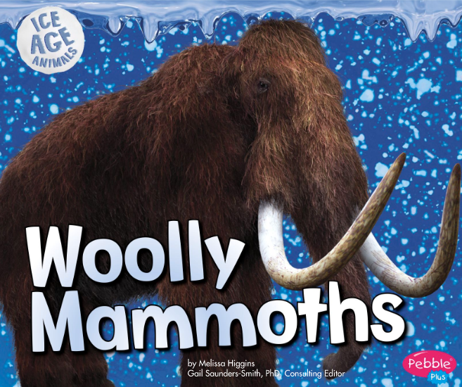
WALT: make notes from a text.
https://readon.myon.co.uk/reader/index.html?a=iaa_wmamm_s15
Use the link to read the e-book Woolly Mammoths.
You can listen to it first, then read along with it.
Read it again thinking about how the mammoths body is good for helping it to live and survive.

Slide 36
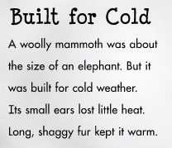
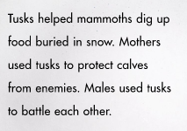
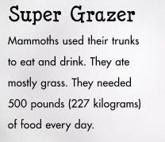
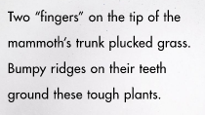
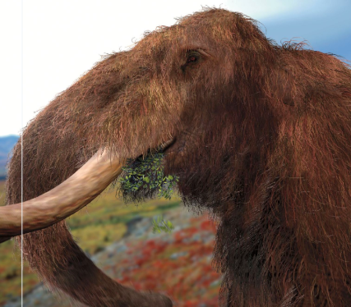
Read this information taken from the text again - you will be asked to make notes about this on the next slide.

Slide 37
Use the text to find out how the mammoth uses each part of its body. Copy the table and fill in the answers. You only need to write notes NOT sentences.
 | ears | fur | tusks | trunks | teeth
Purpose of the feature of the body

Slide 38
Answers | ears | fur | tusks | trunks | teeth
Purpose of the feature of the body | keep heat in | keep warm | dig for food, protect calves, fighting | eat/pluck grass, drink | grind tough plants

Slide 39
What is a prefix? (re)
Do you remember that a prefix is a group of letters which we add to the beginning of a word to make a new word with a different meaning?
Today we will look at the prefix re which usually means again or back
For example:
I read my book once - I reread my book again
I returned to the camp site - means I went back again to the same site.
15 minute Spelling Activity

Slide 40
Put the prefix re in front of these words and write down your new words.
Read the new words aloud.
Practise writing each word 3 times.
Which words would you use in the sentences on the next slide?
calculate | place | reappear | take
build | play | apply | write

Slide 41
Write these sentences out filling in the missing spellings accurately.
I had to ______ the vase when I broke it.
I had to ______ the jenga tower when my friend knocked it over.
The magician made the rabbit ________ in the hat.
I had to ______ my book quiz when it stopped working the first time.
The referee looked at the _______ to see if the ball was in.
Now check your answers on the next page.

Slide 42
Write these sentences out filling in the missing spellings accurately.
I had to replace the vase when I broke it.
I had to rebuild the jenga tower when my friend knocked it over.
The magician made the rabbit reappear in the hat.
I had to retake my book quiz when it stopped working the first time.
The referee looked at the replay to see if the ball was in.
Now check your answers on the next page.

Slide 43

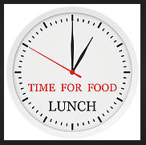
Your morning lessons are completed.
Time for lunch.
Then come back this afternoon for your curriculum activity.

Slide 44
An afternoon of History, Art and Design!
On the following two slides you can see some illustrations of four different types of hunting methods used by Stone Age hunters to catch, trap and kill their food.

Slide 45
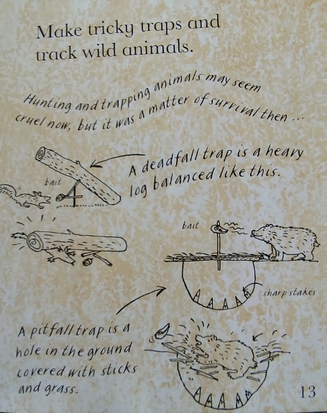
This is an extract from Stone Age, Bone Age! By Mick Manning and Brian Granstrom.
What stops the bear seeing the hole?
What is the bait for?
Why did the hunters put stakes into the pit?
What happens when the animal eats the bait?

Slide 46
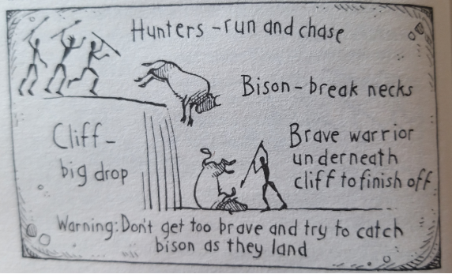
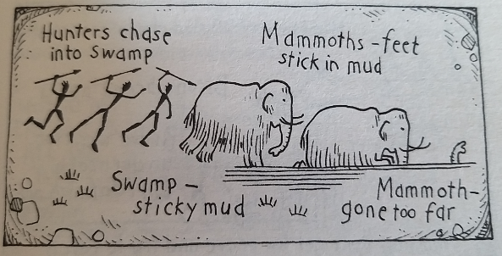
This is an extract from Horrible Histories - Savage Stone Age by Terry Deary.
How did the hunters use the land where they lived to help them capture their food?
Why was this a good method to hunt larger animals?

Slide 47
Here are some activities for you to choose from. You can do one of them or all of them.
Write a short explanation of how each trap worked, saying why you think it was good for its purpose. In other words why it worked well.
Research more hunting methods from the Stone Age and draw your own illustrations with labels.
Design a trap of your own for a Stone Age hunter. Draw it, label it and explain how it works.

Slide 48

We hope you had fun today.
See you tomorrow.

Slide 49
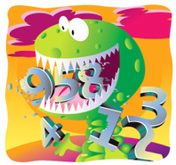
Wednesday 13th May
Ready to crunch some numbers?
Remember you can do these independently then share them with an adult.
Question 10 may have more than one answer.
Don’t worry about always finding the answer it is how you try to work out and reason that is important.

Slide 50
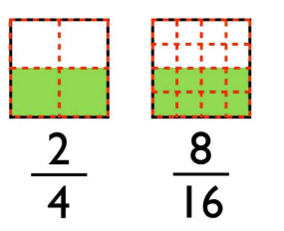
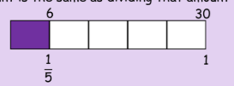

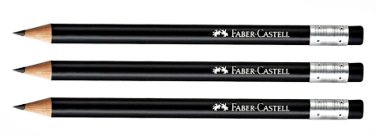
Morning Maths 13.05.20
8.
9. How many cm in 140mm?
10. Captain Sam Seaweed is thinking of two 1-digit numbers. Their product is 41 more than their sum. What are the numbers he is
thinking of?
57 + = 100
2. 59 + 60
3. 40 x 8
4. 345 + 122
5. 45 x 7
6. What is 3 of 30?
5
7. Pencils cost 80p. I buy three. How much change from £5 ?
=

Slide 51
43
119
320
467
315
18
£2.60 or 260p
8/16
14
7 and 8

Slide 52
St Catherine’s Classroom Beliefs
Mistakes are valuable.
Everyone can learn maths to the highest level.
Questions are really important.
Depth is more important than speed.
Maths is about making connections.
We may not be learning together in the classroom, but it is important to still remember our classroom beliefs.

Slide 53
WALT: read the time in minutes and hours.

Slide 54
As you can see the hour hand is pointing between the 2 and 3. This means we have gone past 2 o’clock but haven’t got to 3 o’clock.
If you look at your minute hand it’s on the number 4. Can you remember how many minutes past that is? (It’s not 4 minutes past)

Slide 55
If you look at your minute hand it’s gone 20 minutes past o’clock. The time is therefore twenty minutes past 2 or 2:20.

Slide 56
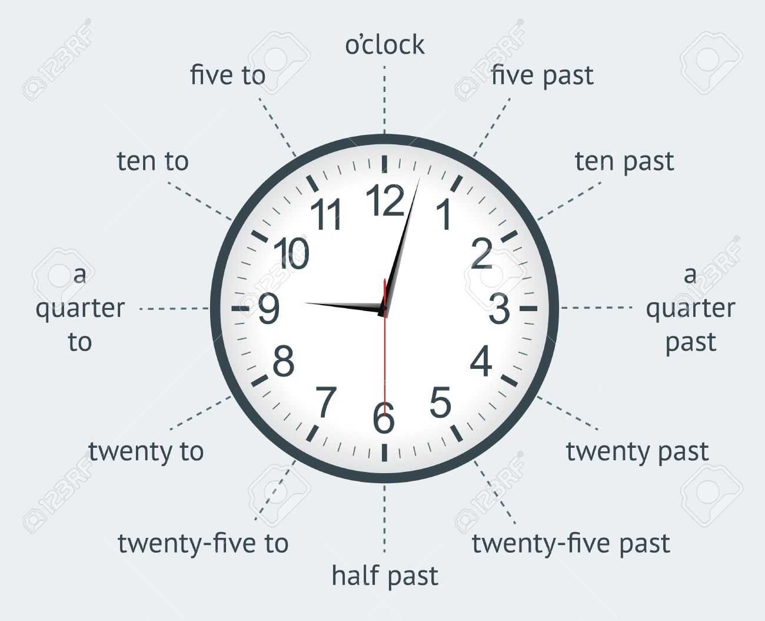



Use the diagram on the left to help you tell the time on the following three clocks.
Remember this only shows you the minutes part of telling the time. It does not tell you the hour.

Slide 57
Use the diagram on the left to help you tell the time on the following three clocks.
Twenty past ten
Twenty to twelve
Remember this only shows you the minutes part of telling the time. It does not tell you the hour.
Twenty five to 5

Slide 58
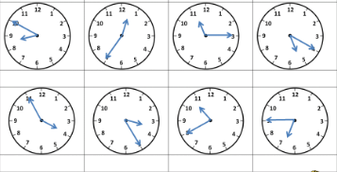
Have a go at the following times. Only use the diagram if you have to. Remember you say the minutes first, then the hour.

Slide 59
Have a go at the following times. Only use the diagram if you have to. Remember you say the minutes first, then the hour.
Ten to nine
Twenty to one
Quarter past eleven
Twenty past 5
Ten to nine
Five to four
Twenty five past three
Twenty to eleven
Quarter to seven

Slide 60
Time for a break.
Have a drink and a snack.

Slide 61

WALT: turn notes into a paragraph
https://www.bbc.co.uk/teach/class-clips-video/story-of-britain-middle-stone-age-animation/zvkg92p
Mr Mottershead watched a short story about life in the middle Stone Age.
If you click on the link above. You can watch it too.

Slide 62

Middle Stone Age
Ice Age - ice melted - seawater rose - Britain island
Deep forest - boar, deer, wild cattle, wolves (dangerous)
Humans - nomadic - walked and moved (long distances) - find food
Hunter gatherers.
Gathered - leaves, nuts (ate roasted), berries - learned which poisonous
Hunted - fish, boar, deer - spear
Stone age - flint stone - shapes easy - tools / weapons
Flint/bone/antlers- spear head - fix to wood shaft
Cave paintings evidence! Headdress - animal antlers/skulls
While he watched the film, he made some notes. Read the notes.
Remember these are not sentences just key words to help you remember what you found out about.
He gave the notes to Mrs Shipley so that she could write about the Middle Stone Age. Look on the next slide.

Slide 63
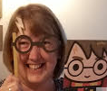
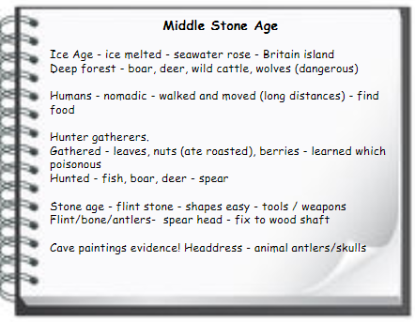
Mrs Shipley used the notes to write this text. Read the text with an adult and then by yourself.
Remember when you write up notes you have to use full sentences.
Middle Stone Age
At the end of the Ice age, when the ice melted, Britain became an island because the sea level rose. Deep forests covered the land, and wild animals such as boar, deer, wild cattle and dangerous wolves inhabited them.
At this time, humans were nomadic, as they had to travel to search for food. Sometimes their journey took them long distances, before they found food.
These people are known as hunter-gatherers because they foraged for leaves, nuts and berries, as well as hunting for fish and forest animals.
Spears and tools were made with flint stone, which was easily shaped into arrowheads and tied onto a wooden shaft, although antlers and bones were also used.
You do not have to use all of the notes if you decide they are not the main focus of your writing.
For example: Mrs Shipley did not include the information about roasting nuts to eat them as her piece of writing was not about how they cooked food.

Slide 64
Middle Stone Age
At the end of the Ice age, ____ the ice melted, Britain became an island _______ the sea level rose. Deep forests covered the land, ___ wild animals such as boar, deer, wild cattle ___ dangerous wolves inhabited them.
At this time, humans were nomadic, __ they had to travel to search for food. Sometimes their journey took them long distances ______ they found food.
These people are known as hunter-gatherers _______ they foraged for leaves, nuts, berries, as well as hunting for fish ___ forest animals.
Spears and tools were made with flint stone, which was easily shaped into arrowheads ___tied onto a wooden shaft, ________ antlers and bones were also used.
Without looking back can you add the conjunctions in this text?
Write them down in the order you think they go.
and, although, as, because, before, when

Slide 65
Middle Stone Age
At the end of the Ice age, when the ice melted, Britain became an island because the sea level rose. Deep forests covered the land, and wild animals such as boar, deer, wild cattle and dangerous wolves inhabited them.
At this time, humans were nomadic, as they had to travel to search for food. Sometimes their journey took them long distances before they found food.
These people are known as hunter-gatherers because they foraged for leaves, nuts, berries, as well as hunting for fish and forest animals.
Spears and tools were made with flint stone, which was easily shaped into arrowheads and tied onto a wooden shaft, although antlers and bones were also used.
and, although, as, because, before, when

Slide 66
What is a prefix?
A prefix is a group of letters which we add to the beginning of a word to make a new word with a different meaning.
You have been working on spellings and meanings of words with mis and re as a prefix.
Remember mis means wrongly
and re means back or again
Today we will test you out to see how you are doing.
15 minute Spelling Activity

Slide 67
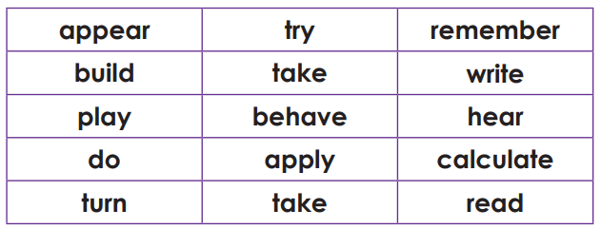
Add the correct prefix mis or re to these root words.
Now check your answers.

Slide 68
Add the correct prefix mis or re to these root words.
reappear | retry | remember
rebuild | retake | rewrite
replay | misbehave | mishear
redo | reapply | miscalculate or recalculate
return | mistake | reread or misread
Now check your answers.

Slide 69
The boy behaved as he played his video.
He heard what his teacher had said.
Check your answers on the next slide.
Rewrite these sentences adding prefix re or mis to make the sentences have the opposite meaning.

Slide 70
The boy misbehaved as he replayed his video.
He misheard what his teacher had said.
How did you get on?

Slide 71
Your morning lessons are completed.
Time for lunch.
Then come back this afternoon for your curriculum activity.

Slide 72
This afternoon you are going to find out about Stone Age homes.
History - What was it like living in the Stone Age?
Science - Which materials did they use for different purposes?
Geography - Where did they build their homes?
The following 6 slides are adapted from the Twinkl website.
History, Science and Geography.

Slide 73
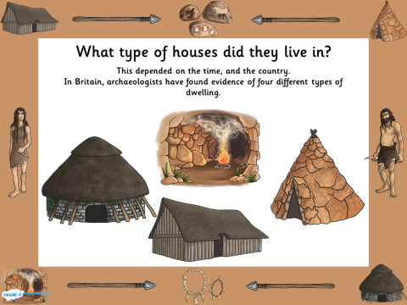

Slide 74
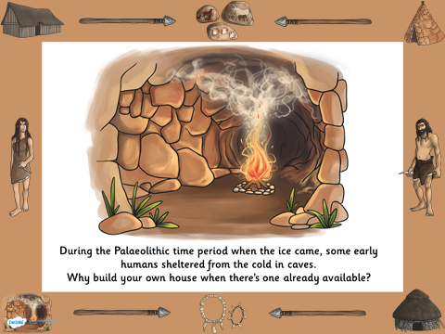

Slide 75
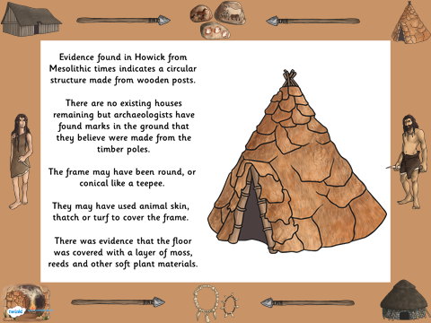

Slide 76
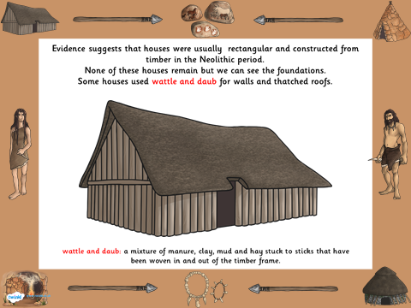

Slide 77
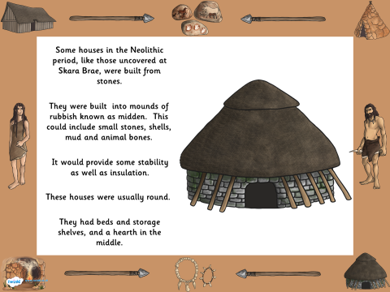

Slide 78


Slide 79
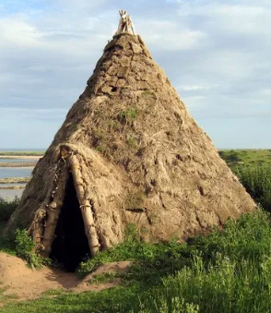
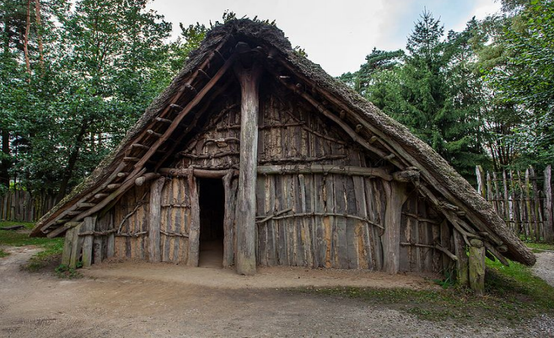
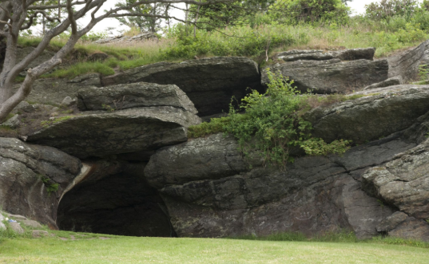
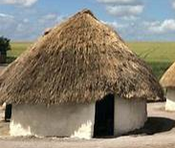
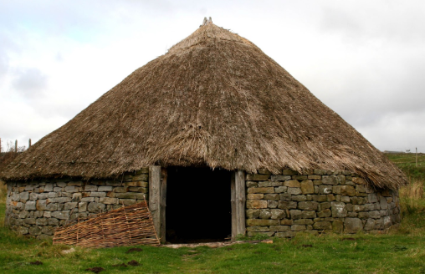
Here are some stone age houses. Can you put them in order from the earliest (first homes) to the latest?

Slide 80
Early Stone Age
Palaeolithic
Middle Stone Age
Mesolithic
Late Stone Age
Neolithic

Slide 81
Make a poster about Stone Age Homes.
Middle Stone Age
Mesoolithic
Late Stone Age
Neolithic
Early Stone Age
Palaeolithic
Draw and label pictures of them or print the last slide out to cut up and stick the pictures on.
Include a timeline to show when they were built.
Label them to show which materials were used.
Include explanations of how they made the homes.
Explain why the neolithic houses looked different and were made of different materials.

Slide 82
Did you have a good day learning today?
See you in the morning.

