Slide 1
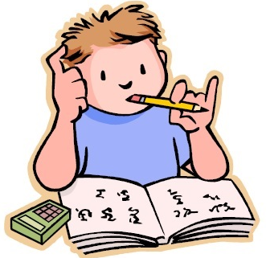
Thursday 14th May
Is your head ready to calculate?
Remember you can do these independently then share them with an adult.
Question 10 may have more than one answer.
Don’t worry about always finding the answer it is how you try to work out and reason that is important.

Slide 2
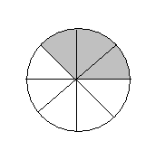
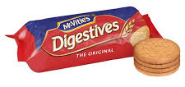
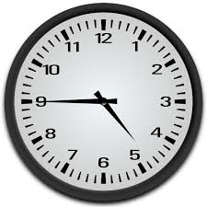
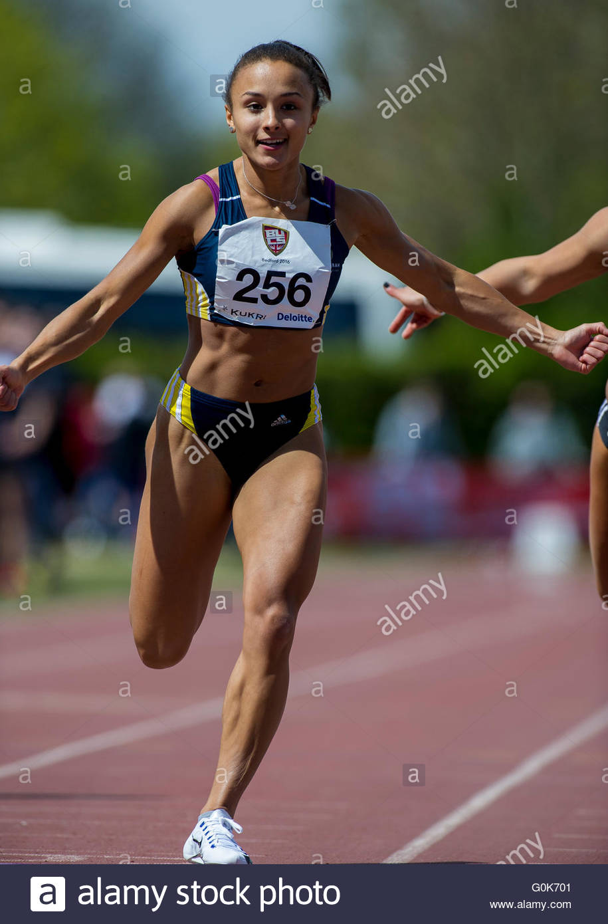
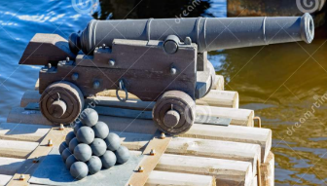
Morning Maths 14.05.20
8. There are 20 biscuits in a pack.
Dave eats ¼ and gives three to Helen. Faye, Simon and Sally share the remaining biscuits equally. Who has eaten the most?
9. Write 3 ½ m as cm.
10. There are more than 40 cannon balls on the Black Hole. When the crew group them in 8s, they have 7 left over.
When they group
them in 5s they
have 1 left over.
How many balls are
there on board?
What fraction is shaded?
2. 45 + 8
3. What is half of 70
4. 60 ➗ 4
5. 453 + 448
6. What is the time shown?
7. The race track is 150m long.
Yasmin runs up and down it
twice. How far did she run?

Slide 3
3/8
53
35
15
901
4:45 / 16:45 / quarter to 5
600m
Dave (he eats 5) all the others eat 3 biscuits each.
350cm
71 cannon balls

Slide 4

St Catherine’s Classroom Beliefs
Mistakes are valuable.
Everyone can learn maths to the highest level.
Questions are really important.
Depth is more important than speed.
Maths is about making connections.
We may not be learning together in the classroom, but it is important to still remember our classroom beliefs.

Slide 5
WALT: convert analogue to digit time.

Slide 6
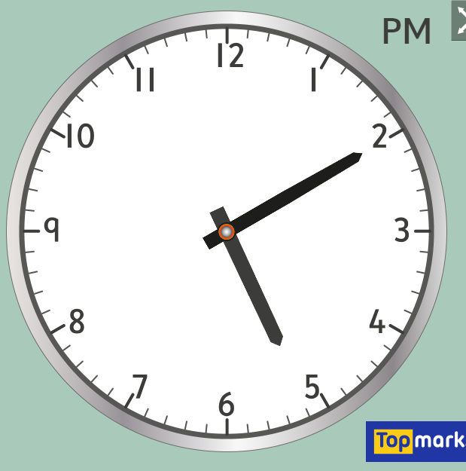
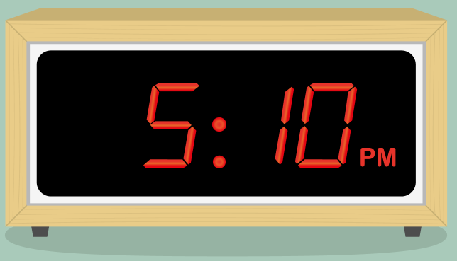
There are two parts to reading the time. Hours and minutes. On an analogue clock, the minutes are shown with the long hand and the hours are shown with the short hand.
Part one for converting to digital time is the hours. Look at the hour hand and see which number it has just gone past. On our clock it has gone past the 5.
Past two is you is you have to see how many minutes we’ve been past the o’clock (number 12). The blue arrow shows how far it has past. If we count the minutes we can see the we have gone 10 minutes past.

Slide 7
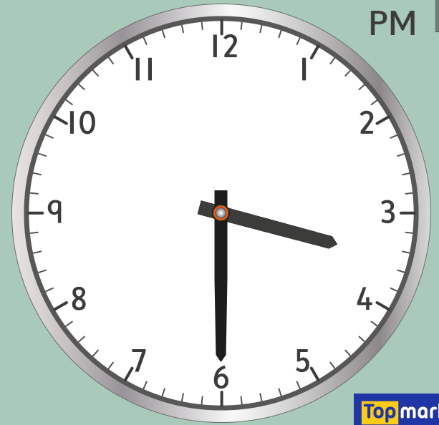
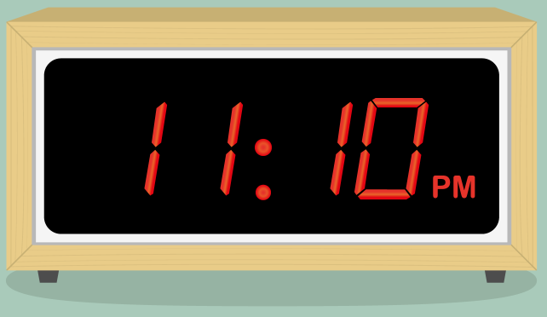
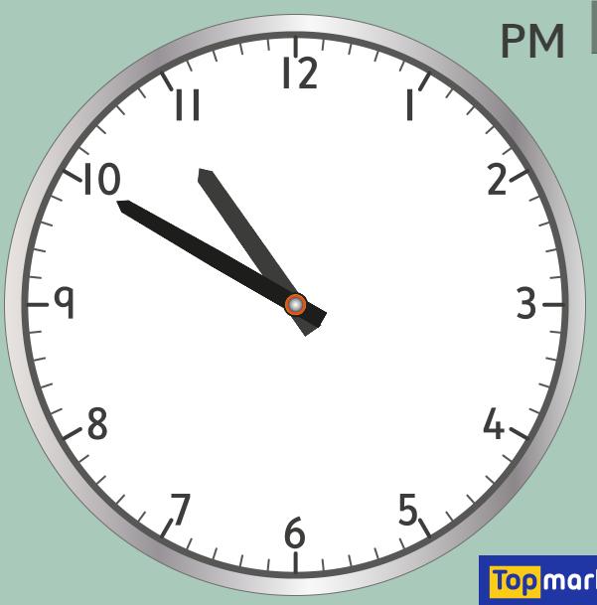
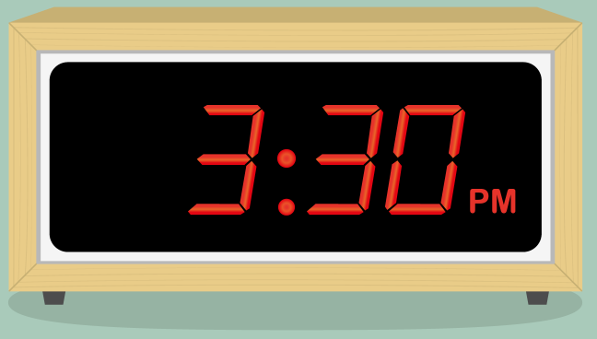
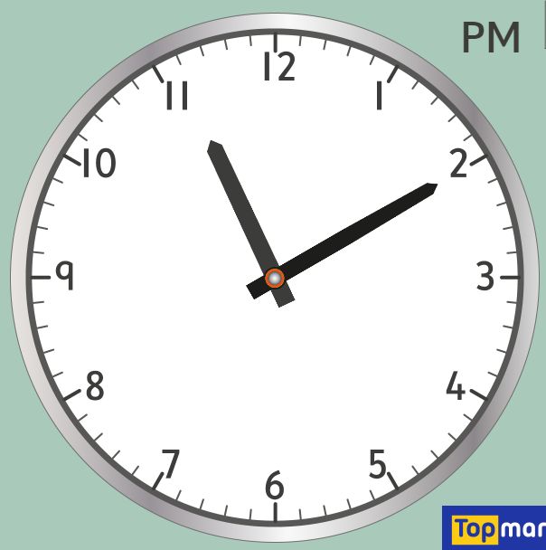
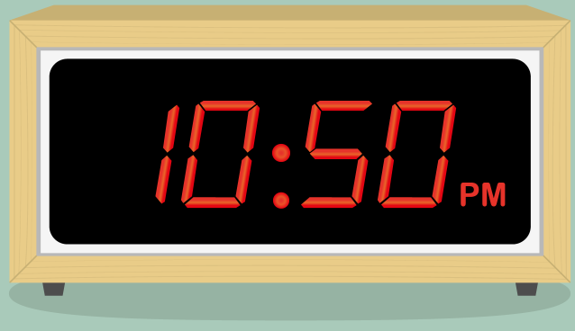

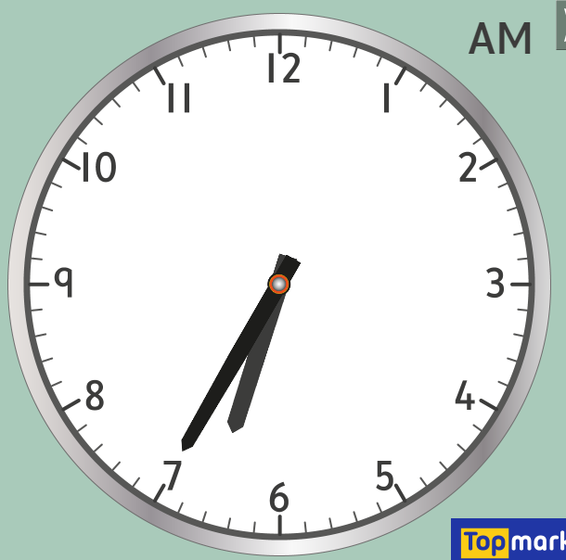
Have a go at matching the analogue times to the digital times.

Slide 9
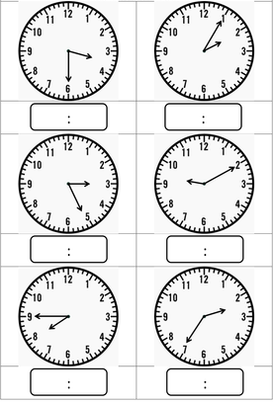
Have a go at converting the following analogue times to digital times.

Slide 10
3:30
2:10
3:25
9:10
7:45
2:35

Slide 11

Time for a break.
Have a drink and a snack.

Slide 12

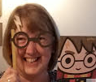
WALT: turn notes into a paragraph
And include conjunctions to extend sentences.
Do you remember how Mrs Shipley turned Mr Mottershead’s notes into a piece of writing yesterday?
Well today it is your turn!
Read Mrs Shipley’s notes on the next slide.
Then you can use them to write 3 paragraphs about ambushing a woolly mammoth.
Think about conjunctions!

Slide 13
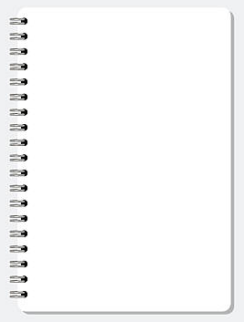
These are the main coordinating conjunctions:
for, and, nor, but, or, yet, so
woolly mammoth - feeds family - 4 weeks.
no waste - eat meat and fat,
skin - clothes and blankets, tusks/bones - tools & carving,
teeth - necklaces or
fuel for fire.
hunters ambush - woolly mammoth herd
track animals - prints.
watch - silence - hidden, until close.
jump sudden - surprise attack - chase. - spears
weapons - spears - throw like javelin - power & distance
spear head -sharpened - flint stone
These are the main subordinating conjunctions for Y3: when, if, because, although, before, while, as, until
Read your writing to an adult when you have finished it.
Have you got a title?
Do you have 3 clear paragraphs?
Have you spelled the words you have been given correctly?
Did you use some of the conjunctions?

Slide 14

Spell the short vowel sound ‘i’ with a Y.
Watch the link below
https://uk.video.search.yahoo.com/yhs/search;_ylt=AwrEzeG88oleREEAhD.c3olQ;_ylu=X3oDMTBncGdyMzQ0BHNlYwNzZWFyY2gEdnRpZAM-;_ylc=X1MDMTM1MTIxMjcwMA
Match the correct spelling words to the pictures on the next page.
Write the words down.
15 minute Spelling Activity

Slide 15
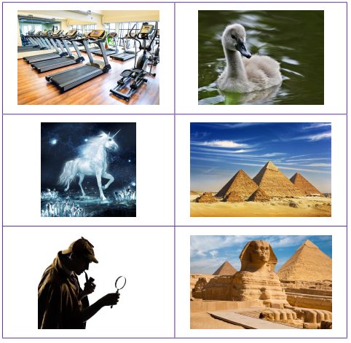
Can you match the word to the picture?
What sound does the Y make in each word?
cygnet
pyramid
Egypt
gym
myth
mystery

Slide 16
Can you match the word to the picture?
Say the words aloud.
What sound does the Y make in each word?
cygnet
pyramid
Egypt
gym
myth
mystery

Slide 17
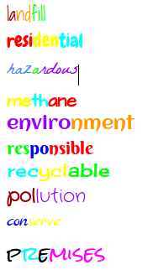
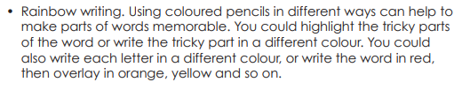
Rainbow write each
word 3 times.
cygnet
pyramid
Egypt
gym
myth
mystery

Slide 18

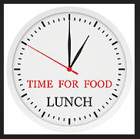
Your morning lessons are completed.
Time for lunch.
Then come back this afternoon for your curriculum activity.

Slide 19
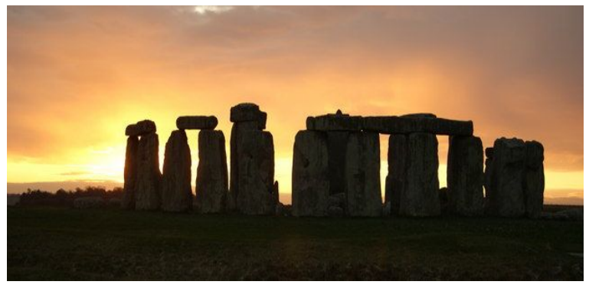
History, Geography and Beliefs.
Time for a MYSTERY that began in the Stone Age and is still here today!

Slide 20
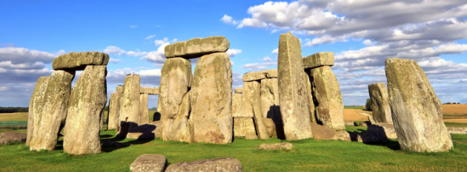
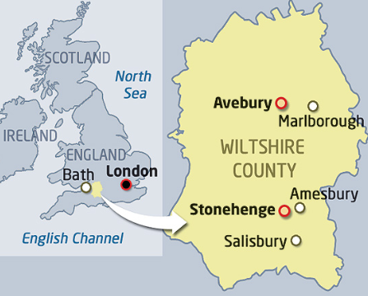
Welcome to Stonehenge.
Stonehenge is a famous landmark in Britain. It is in Wiltshire on Salisbury plain.
It is made of huge stones that can be seen from a long way away.
It took hundreds of years to build, but it began to be built in the Neolithic times 3000 BC or Late Stone age. It was changed over the years but the last changes were made around 1500 BC (Bronze Age)
Historians do not exactly know why it was built but it is thought that people gathered there for religious ceremonies.

Slide 21
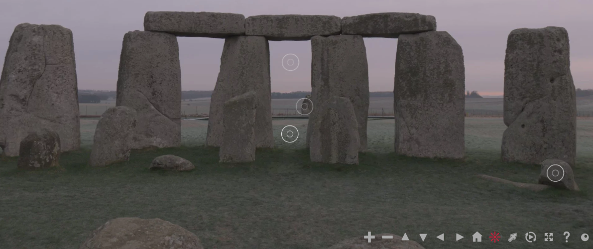
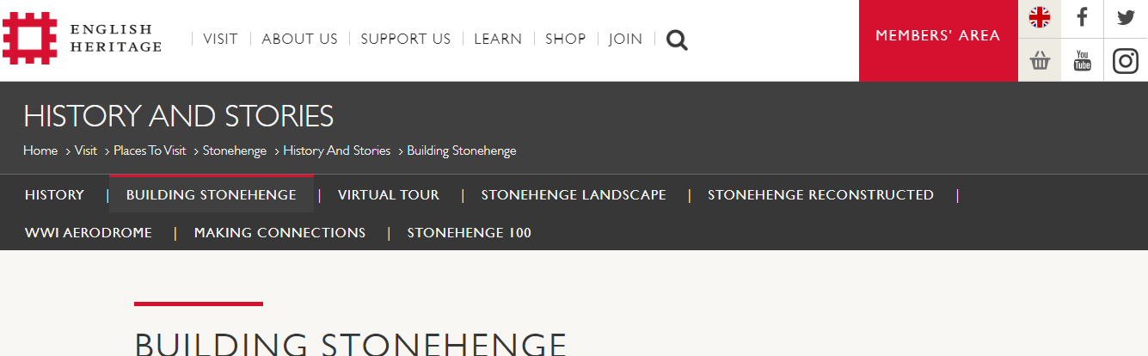
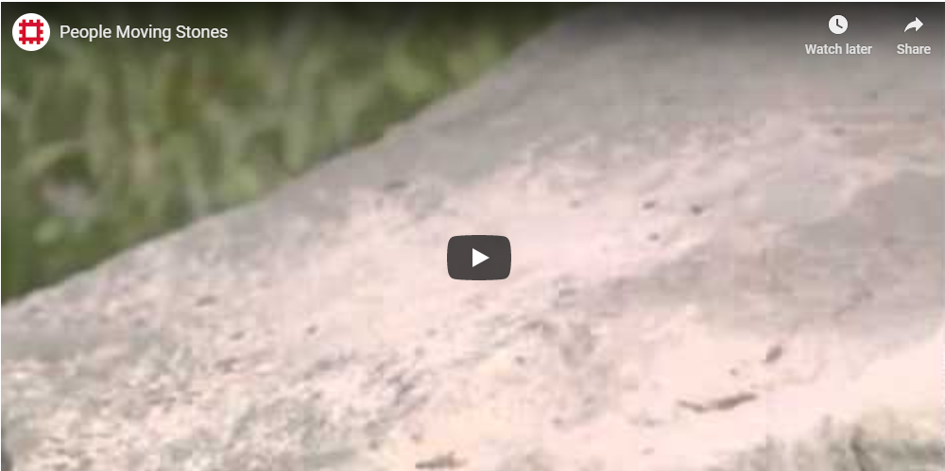
Welcome to Stonehenge.
Use the link below to take a virtual tour of the real Stonehenge as it is today.
Scroll down and look for the picture you can see here and use the controls to tour Stonehenge
https://www.english-heritage.org.uk/visit/places/stonehenge/history-and-stories/stonehenge360/
Return to the home screen and click on Building Stonehenge Watch the video to see how it was built.

Slide 22
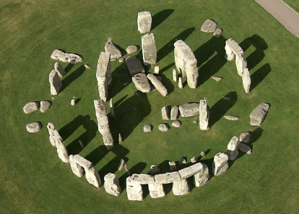
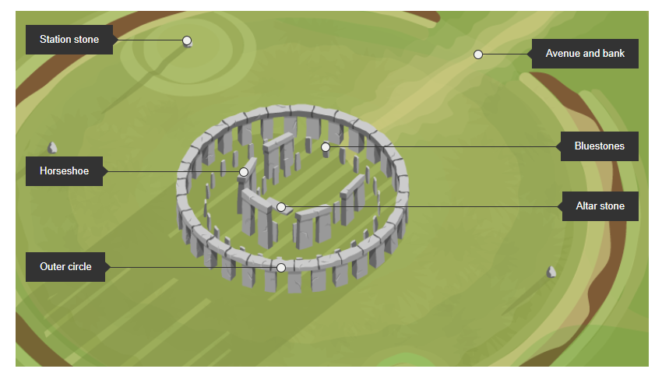
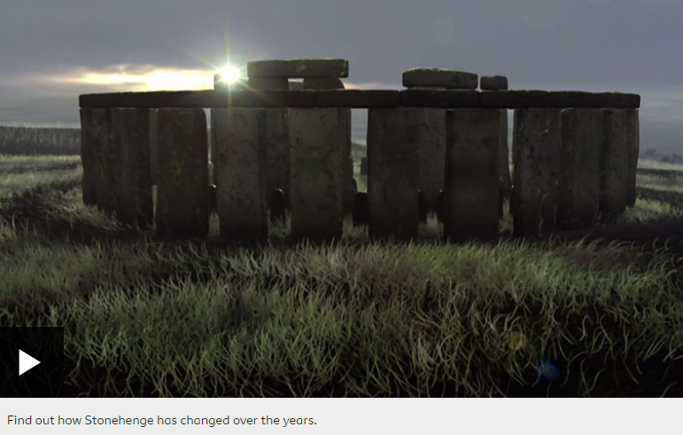
https://www.bbc.co.uk/bitesize/topics/z82hsbk/articles/zg8q2hv
Use the BBC link below to investigate Stonehenge.
Click on the labels to find out more about each of the stones.
Watch the clip to see how Stonehenge has changed over the years.
Find out -
How was it built?
What was it for?

Slide 23
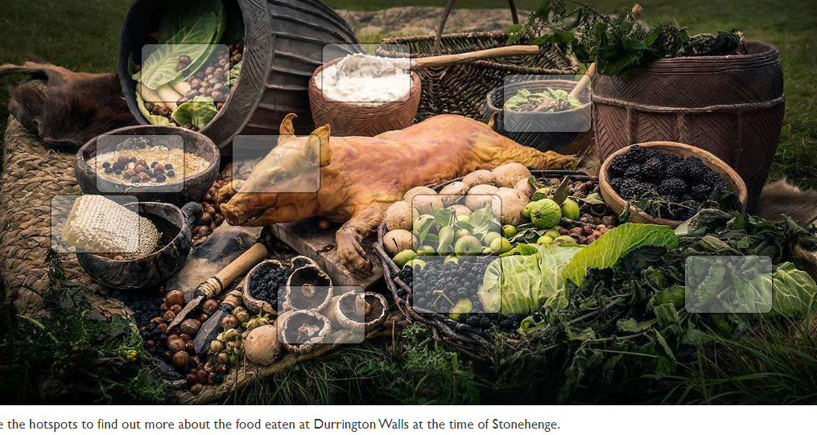
Make an information poster about Stonehenge.
Use the information from the websites to help you.
Find out about Food and Feasting at Stonehenge
https://www.english-heritage.org.uk/visit/places/stonehenge/history-and-stories/history/food-and-feasting-at-stonehenge/
Click on the link, scroll down until you see this picture. Click on the boxes to find out more about food that could have been eaten at Stonehenge gatherings.

Slide 24
Did you work hard with your learning today?
See you in the morning.

Slide 25
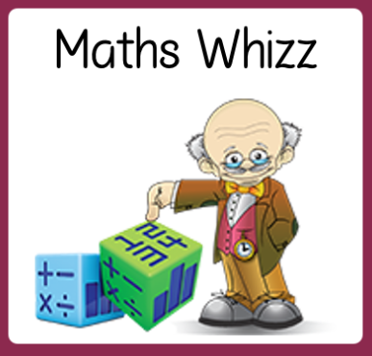
Friday 15th May
Are you a maths whizz today?
Remember you can do these independently then share them with an adult.
Question 10 may have more than one answer.
Don’t worry about always finding the answer it is how you try to work out and reason that is important.

Slide 26
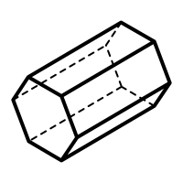
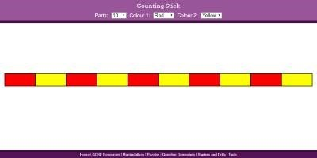
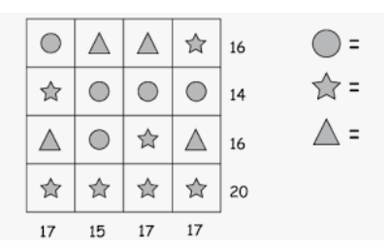

Morning Maths 15.05.20
What shape is this?
a triangular
prism
a square cylinder
a hexagonal prism
8. My friend lives 247m away. How far is it to her house and back again?
9. How many 20p’s in £4?
10.
What is 7 x 8?
2. Half of 76
3. 13 x 10
4. Continue the sequence:
45, 49, __, 57, __, __
5. I can see 28 wheels. How many cars is that?
6. What is the perimeter of this
octagon (each side is 6 cm)?

Slide 27

56
38
130
53, 57, 61, 65
7
48cm
A hexagonal prism
494m
20
3
5
6

Slide 28
St Catherine’s Classroom Beliefs
Mistakes are valuable.
Everyone can learn maths to the highest level.
Questions are really important.
Depth is more important than speed.
Maths is about making connections.
We may not be learning together in the classroom, but it is important to still remember our classroom beliefs.

Slide 29
WALT: locate clocks and time keeping devices.

Slide 30
We’re going to send you on a bit of a scavenger hunt. We want you to go around your house and see where you can see a clock. We want to know if it is a digital or analogue clock and why you think there is a clock there. For example. You will find a digital clock on your phone. I think you have a clock on the phone because it stops you being late for things.

Slide 31
You don’t have to use this but if you’re wondering how to write these down, you could copy this grid onto a bit of paper.
Where is the clock? | What type of clock? Digital or analogue. | Why is there a clock there?
Mobile Phone | Digital | To make sure you aren’t late for anything.

Slide 32
Time for a break.
Have a drink and a snack.

Slide 33
WALT: make notes from a text.
Use a table like this to help you make notes.
Remember when Mr Mottershead watched a short story about life in the Middle Stone Age and made notes.
Today you are going to watch a film about the New Stone Age then watch it again and make your own notes as you watch. https://www.bbc.co.uk/teach/class-clips-video/story-of-britain-new-stone-age-animation/zjh2t39
Homes | Farming
Making Homes | Growing Crops
Homes for the Dead | Farm Animals

Slide 34
Did your notes look something like this?
Homes | Farming
Making Homes Walls- branches cover with mud & animal dung mix - sticks Permanent place - live - no travelling - settlers not nomadic | Growing Crops Sew seeds - protect from birds - children New crops - from other countries - barley, wheat
Homes for the Dead Longbarrow - dead ancestors - meeting place - worship (ask - good harvest) Earth mounds/stone houses - hills thousand hours - build Buried skulls and long bones | Farm Animals Protect animals from eagles - arrows New animals - overseas - sheep, goats, cattle Still hunt - boar forest, fish -harpoon

Slide 35
WALT: turn notes into a paragraph
and include conjunctions to extend sentences.
Remember how you used Mrs Shipley’s notes to write about the woolly mammoth yesterday.
Now you need to use the notes you made about the New Stage Age Clip to write a piece of text with paragraphs.
Remember to use the conjunctions we have been working on.
Use the next slide to help you.

Slide 36
Use this slide for hints and reminders when working and also to check and edit your work.
These are the main coordinating conjunctions:
for, and, nor, but, or, yet, so
These are the main subordinating conjunctions for Y3: when, if, because, although, before, while, as, until
They join two clauses which each make sense on their own and are of equal importance.We call these a main clause.
They join two clauses where one clause adds more information to the main clause, this could be about where, when or why something is happening.We call these a subordinating clause.
Read your writing to an adult when you have finished it.
Have you got a title?
Do you have 3 clear paragraphs?
Did you use some of the conjunctions?

Slide 37
Spell the short vowel sound ‘i’ with a Y.
15 minute Spelling Activity

Slide 38
Remember these words from yesterday.
Read them aloud. Try closing your eyes and spelling them.
Use the words in the sentences on the next page.
cygnet
pyramid
Egypt
gym
myth
mystery

Slide 39
Remember to spell the words accurately.
The mother swan taught the _________ to swim.
The detective tried to solve the _______.
Last summer I travelled to _______ for my holidays.
The ancient pharaohs were buried in _______.
My brother works out at the ____ every day.
Unicorns and dragons are both a ____ but we still like to believe in them.

Slide 40
Remember to spell the words accurately.
The mother swan taught the cygnet to swim.
The detective tried to solve the mystery.
Last summer I travelled to Egypt for my holidays.
The ancient pharaohs were buried in pyramids.
My brother works out at the gym every day.
Unicorns and dragons are both a myth but we still like to believe in them.

Slide 41
Your morning lessons are completed.
Time for lunch.
Then come back this afternoon for your curriculum activity.

Slide 42
P.E.

Slide 43

This afternoon we are going to be doing some PE. You’ll need to log onto Real PE and following the activities. Here’s how you get on.
Type in the website address and then use the login details below to log on.

Slide 44
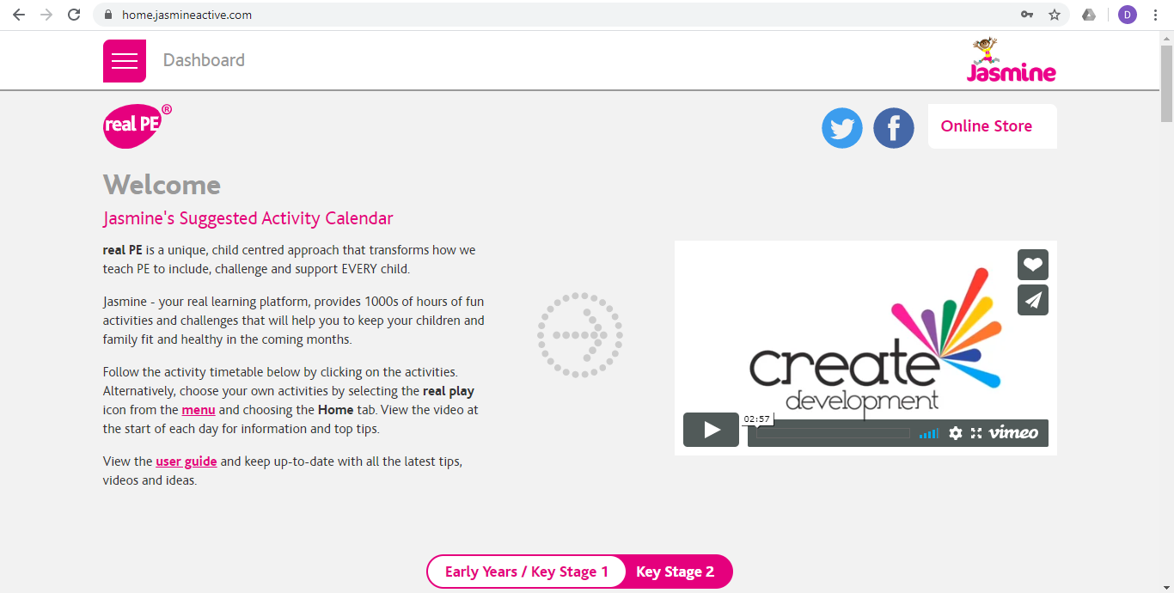
You’ll be directed to this page. You need to click on the section at the bottom of the page that says key stage 2 and then scroll down.

Slide 45
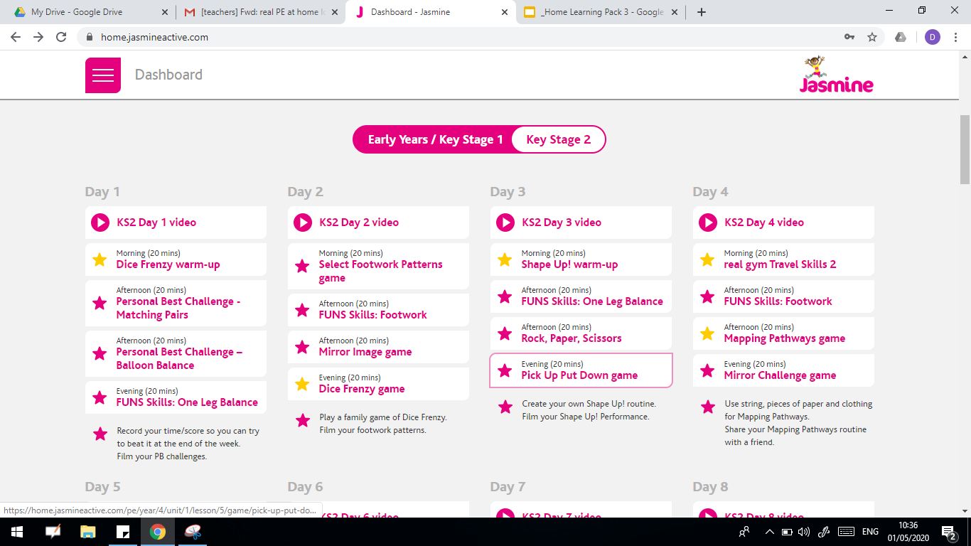
We are then going to be looking at “Day 1”. You can feel free to watch the video or you can just go straight into the first activity.

Slide 46
Mr Mottershead and Mrs Shipley really hope you enjoyed the Stone Age theme over the past two weeks.
Enjoy your weekend and we will have a new theme for you on Monday.

