Slide 1

Thursday 21st May
Is your head ready to calculate?
Remember you can do these independently then share them with an adult.
Question 10 may have more than one answer.
Don’t worry about always finding the answer it is how you try to work out and reason that is important.

Slide 2
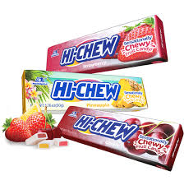
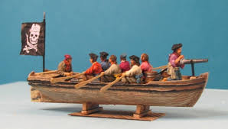

MORNING MATHS – 21.05.20
Which of these letters have perpendicular lines?
E, U, F, T, A and L
8. Chews are 17p. If I have 70p, how many could I afford?
A rowing boat can carry
8 pirates. How many boats
would I need for 53 pirates?
Make each of these
the odd one out:
What is the fifth multiple of 3?
27 + _ = 80
3. Fill in the missing numbers:
¼ , _, _, 1 whole
4. 537 + 99
5. Insert the correct symbol (<,>,=)
16 tens ▢8 x 20
6. 60x 4 =

Slide 3
Morning Maths Answers
15
53
½ or 2/4, and ¾
636
=
240
E, F, T, L
4 chews 4 x 17= 68 so you would have 2p left over
9. 7 boats 7 x 8=56 there would be 3 spare seats in one boat.
10. Various answers (e.g)
96 - only number with 9 tens
77 - only odd number
77 - only multiple of 7
172 - only 3 digit number

Slide 4

St Catherine’s Classroom Beliefs
Mistakes are valuable.
Everyone can learn maths to the highest level.
Questions are really important.
Depth is more important than speed.
Maths is about making connections.
We may not be learning together in the classroom, but it is important to still remember our classroom beliefs.

Slide 5
WALT: identify right angles.

Slide 6
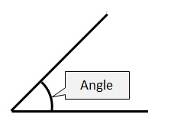
An angle is the amount of space between two lines that are connected. This is shown usually with a curved line that is drawn between two lines that are joined.

Slide 7
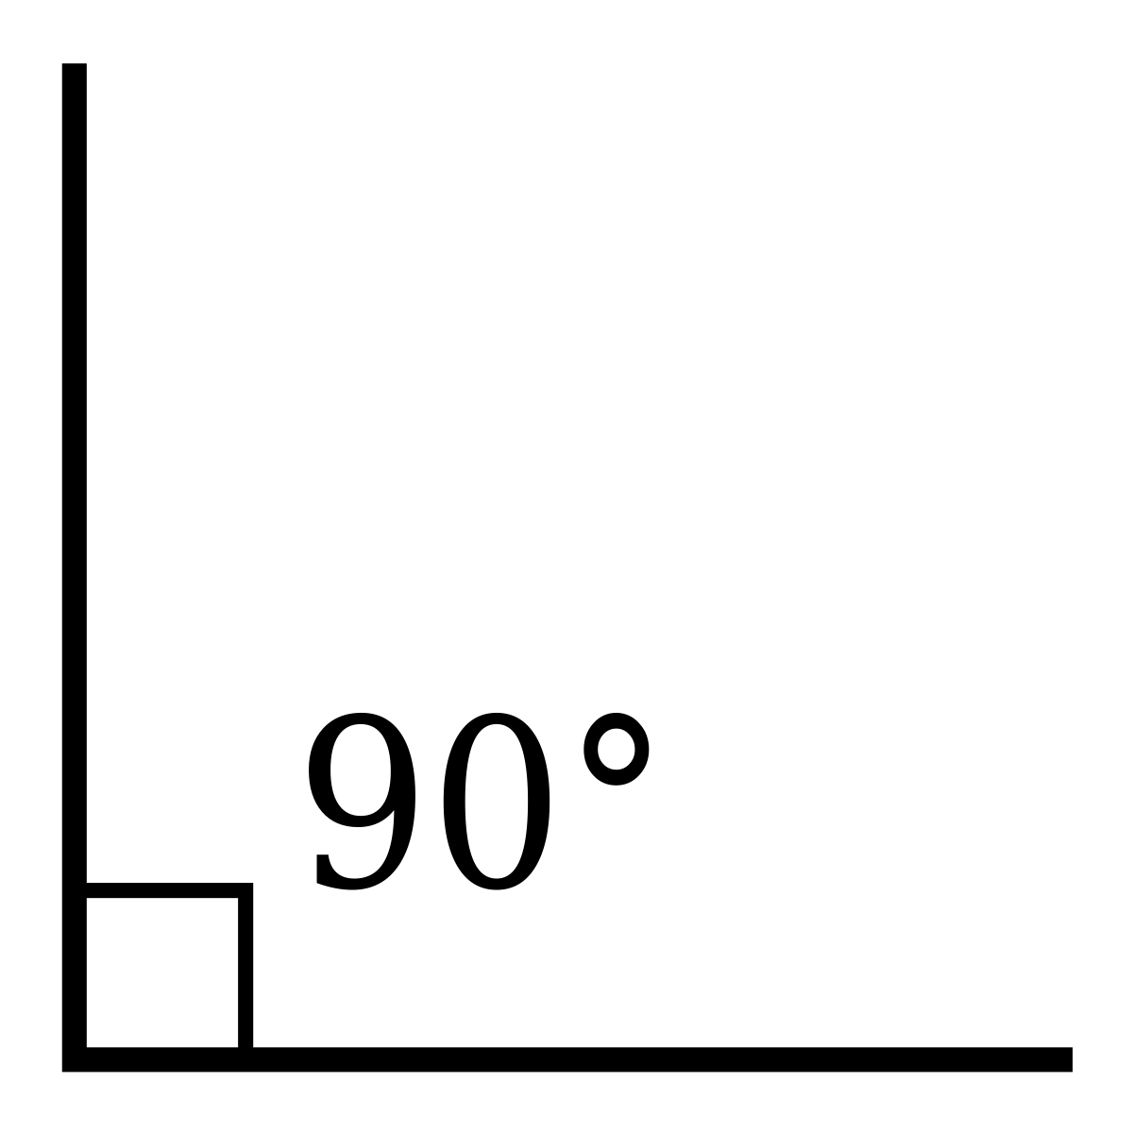

Today we are looking at right angles. These angles are exactly 90 degrees and they look like this.
They look like a capital ‘L’. They can be turned in any direction, as long as they are exactly 90 degrees. Here are some more examples of right angles.

Slide 8
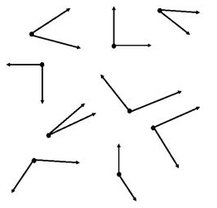
Which of the following are right angles?

Slide 9

Which of the following are right angles?

Slide 10

In the following shape how many right angles can you find?
Hint
You might want to use the corner of a piece of paper or something you know is a right angle to check.

Slide 11
There are 46 right angles in total. We have put red dots at each right angle. How many did you get?

Slide 12

Time for a break.
Have a drink and a snack.

Slide 13
Our English task for today is a Close Reading Task
WALT: retrieve and infer information from a text.
Ask an adult to read the information (on the next page) to you.
Here are some meanings of words that might help you – remnants - remains left behind
locked - buried within
freed - dug up out of the ground
display - something put out for people to look at
3. Now read it with your adult twice, they can help you with expression.
4. Now read it twice by yourself.
5. Read the questions and look for evidence in the text to help you answer them.
6. Write your answers in full sentences.

Slide 14
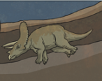
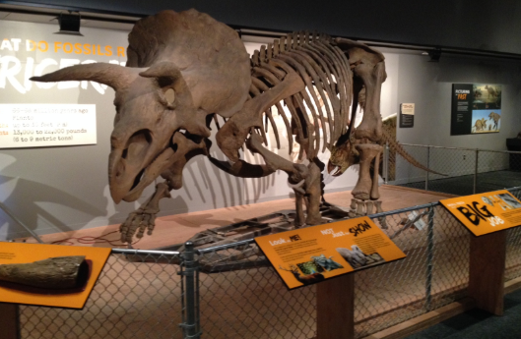
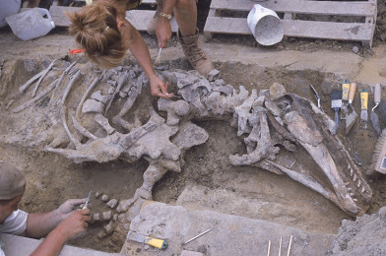
At the Museum
An extract from a poem by Tony Bradman
taken from Dinosaur Poems by John foster.
A fossil remnant I became,
Some bones locked in the land,
And there I stayed til I was freed
And cleaned by human hands.
My bones were put together
To make a fine display,
And you can come to look at me
Almost every day.
I was an ancient dinosaur,
But now you find me here;
A message that’s been waiting
For a hundred million years.

Slide 15
Task: Use the text and what you have learned about fossils so far this week to answer the questions below.
Who is the narrator in the poem?
How did the narrator become a remnant?
Who are the humans that freed the fossil?
Why did the bones have to be put back together?
Explain how you could look at the fossil every day.
Why is the dinosaur referred to as a message that’s been waiting for a hundred million years?

Slide 16
Answers: if you include some of the ideas in blue they are really super answers! (Well done!)
Who is the narrator in the poem?
The narrator is the ancient dinosaur (fossil).
How did the narrator become a remnant?
It died and became a fossil. (You may have described the fossilisation process from Monday 18th May’s science lesson.)
Who are the humans that freed the fossil?
The fossil hunters or people who dug up the bones - paleontologists.
Why did the bones have to be put back together?
The bones were all individual when they were dug up - soft tissues had decayed.
Explain how you could look at the fossil every day.
You could visit the museum to see it on display. ‘You’ could mean people so not just one person - unlikely we would visit everyday but many people visit everyday.
Why is the dinosaur referred to as a message that’s been waiting for a hundred million years?
Because it has been there a long time before it was found and we learn about something that has died and is extinct. It tells us about what life was like in the past.

Slide 17

What is a suffix?
A suffix is a group of letters which we add to the end of a word to make a new word.
You have been working on spellings and meanings of words with ful and ness as a suffix.
Remember ful means full of and adding the suffix ness makes a noun like
kindness - the girl showed kindness to the sick dog
When the root word has a consonant y at the end you drop the y replace it with an i then add the suffix.
(e.g) happy becomes happiness
pity becomes pitiful
Today we will test you out to see how you are doing.
15 minute Spelling Activity

Slide 18
How many words can you make by adding either ful, ness or maybe even both?
Root word | Suffix ful | Suffix ness | ful + ness
hate | hateful | X | hatefulness
hope
pain
foolish
pity
lovely
wish
beauty

Slide 19
How many words can you make by adding either ful, ness or maybe even both?
Root word | Suffix ful | Suffix ness | ful + ness
hate | hateful | X | hatefulness
hope | hopeful | X | hopefulness
pain | painful | X | painfulness
foolish | X | foolishness | X
pity | pitiful | XX | pitifulness
lovely | X | loveliness | X
wish | wishful | X | wishfulness
beauty | beautiful | X | beautifulness
DO YOU NOTICE ANYTHING ABOUT YOUR RESULTS?

Slide 20


Your morning lessons are completed.
Time for lunch.
Then come back this afternoon for your curriculum activity.

Slide 21
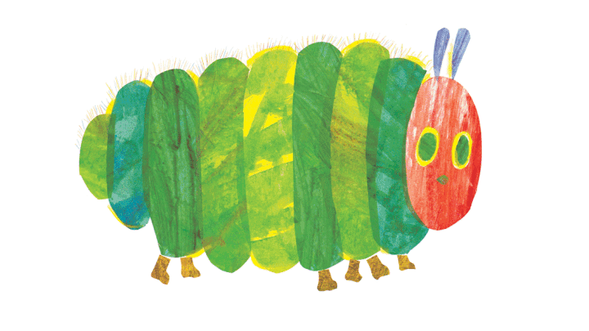
Hola 3M and 3S.
I hope that you have been enjoying your Spanish tasks.
This week I would like you to use the fruit and days of the week vocabulary you have been studying to translate a Spanish version of the story ‘The Hungry Caterpillar’

Slide 22
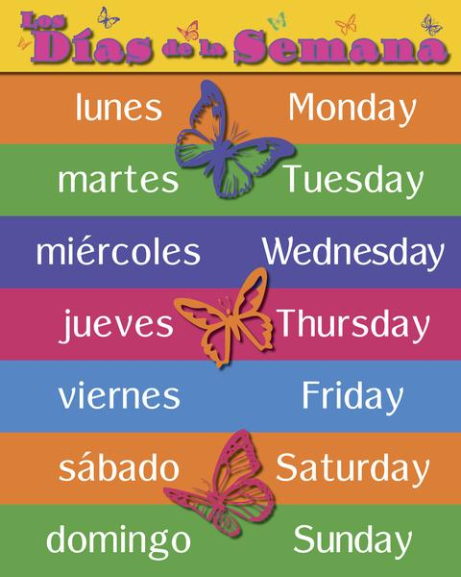
Days of the week

Slide 23

La oruga muy hambrienta
*Click on the sound buttons to hear the story in Spanish.
The Very Hungry Caterpillar
Notes:
The Very Hungry Caterpillar. This is the picture version of the story.
Click on the yellow button to hear the audio of the written text.
The idea is that the pupils will work towards retelling the story, with or without prompts, by the end of this unit.

Slide 24
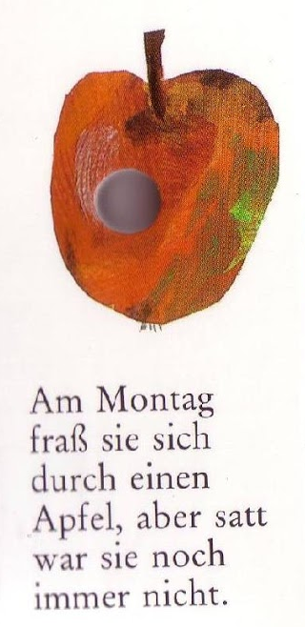
El lunes come una manzana
pero aún tiene hambre.
On _______________ he eats
an ______________ but he’s still hungry.
Notes:
On Monday it eats an apple but it is still hungry.

Slide 25
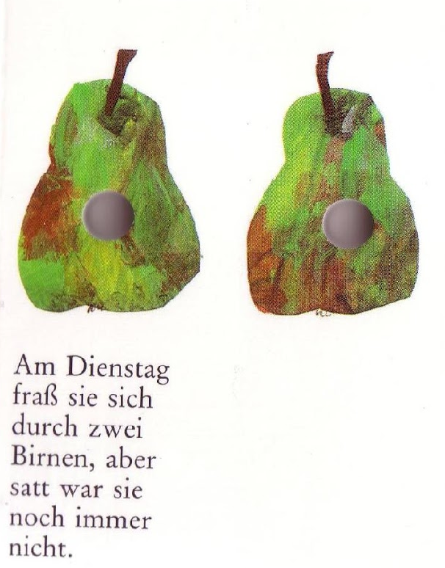
El martes come dos peras
pero aún tiene hambre.
On _____________ he eats ________ _________,
But he’s still hungry.
Notes:
On Tuesday it eats two pears but it is still hungry.

Slide 26
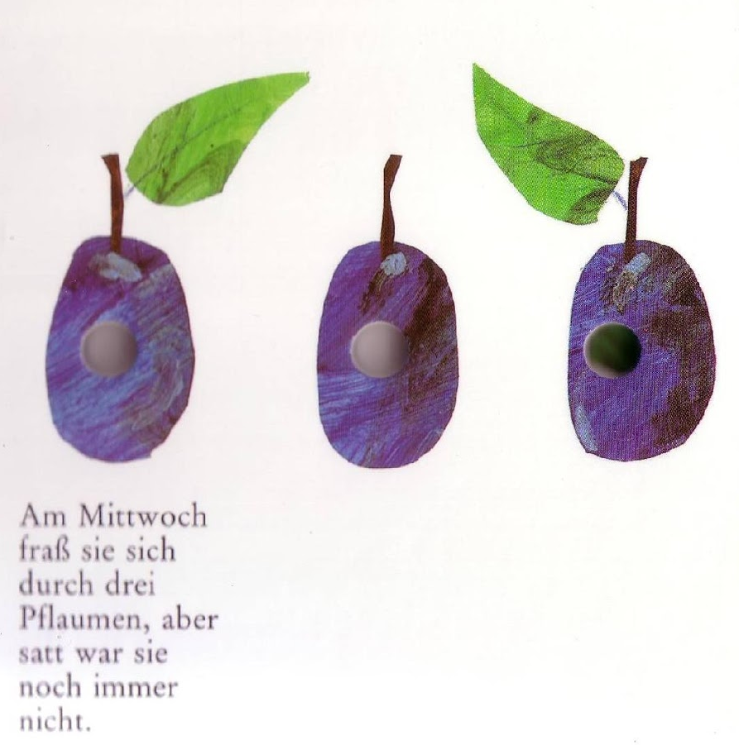
El miércoles come tres ciruelas
pero aún tiene hambre.
On ____________ he eats __________ _______________, but he’s still hungry.
Notes:
On Wednesday it eats 3 plums but it is still hungry.

Slide 27
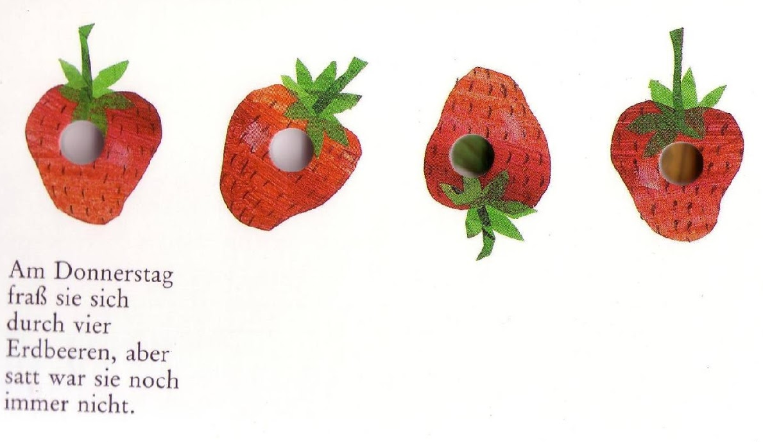
El jueves come cuatro fresas
pero aún tiene hambre.
On ______________ he eats ____________ _______________, but he’s still hungry.
Notes:
On Thursday it eats 4 strawberries but it is still hungry.

Slide 28
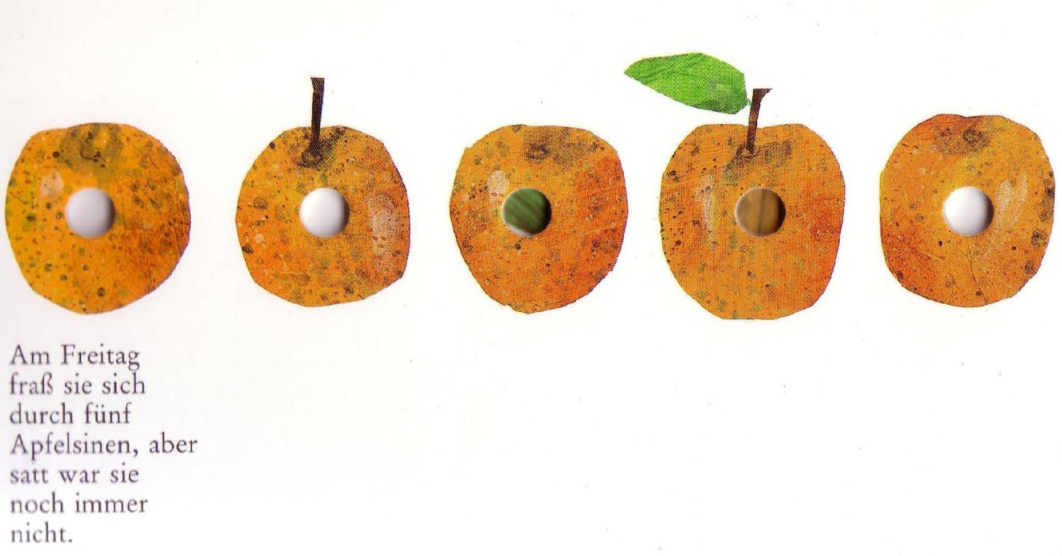
El viernes come cinco naranjas
pero aún tiene hambre.
On _______________ he eats ____________ __________________, but he’s still hungry.
Notes:
On Friday it eats 5 oranges but it is still hungry.

Slide 29
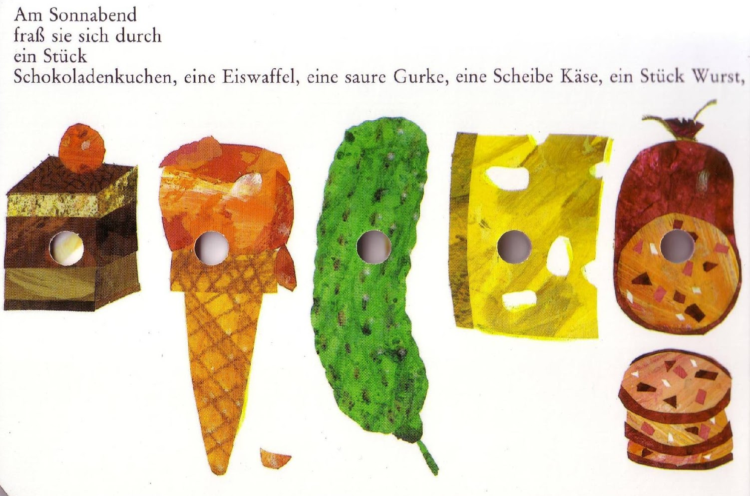
El sábado come un pastel, un helado, un pepinillo, una loncha de queso, una rodaja de salchichón… (use the pictures and google translate to help you with some of these!)
On _________ he eats _________, _______, __________, ____________, ____________.
…
Notes:
On Saturday it eats a cake, an ice-cream, a gurkin, a slide of cheese, a slice of salami...

Slide 30
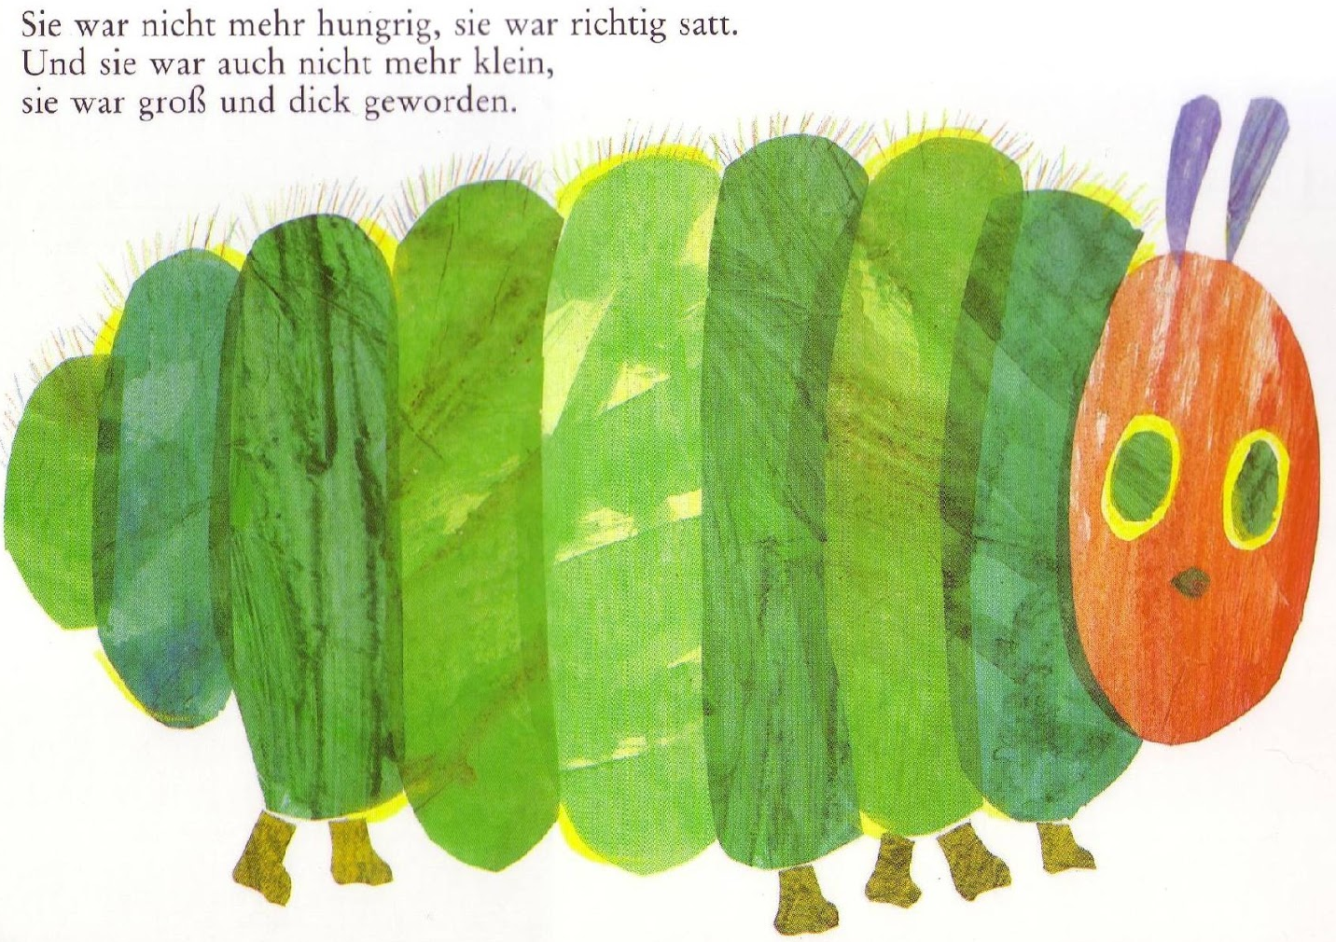
Ya no tiene más hambre y es una oruga grande y gorda.
He wasn’t hungry anymore and is a big, fat caterpillar.
Notes:
It isn’t hungry any more and it is a big fat caterpillar.

Slide 31
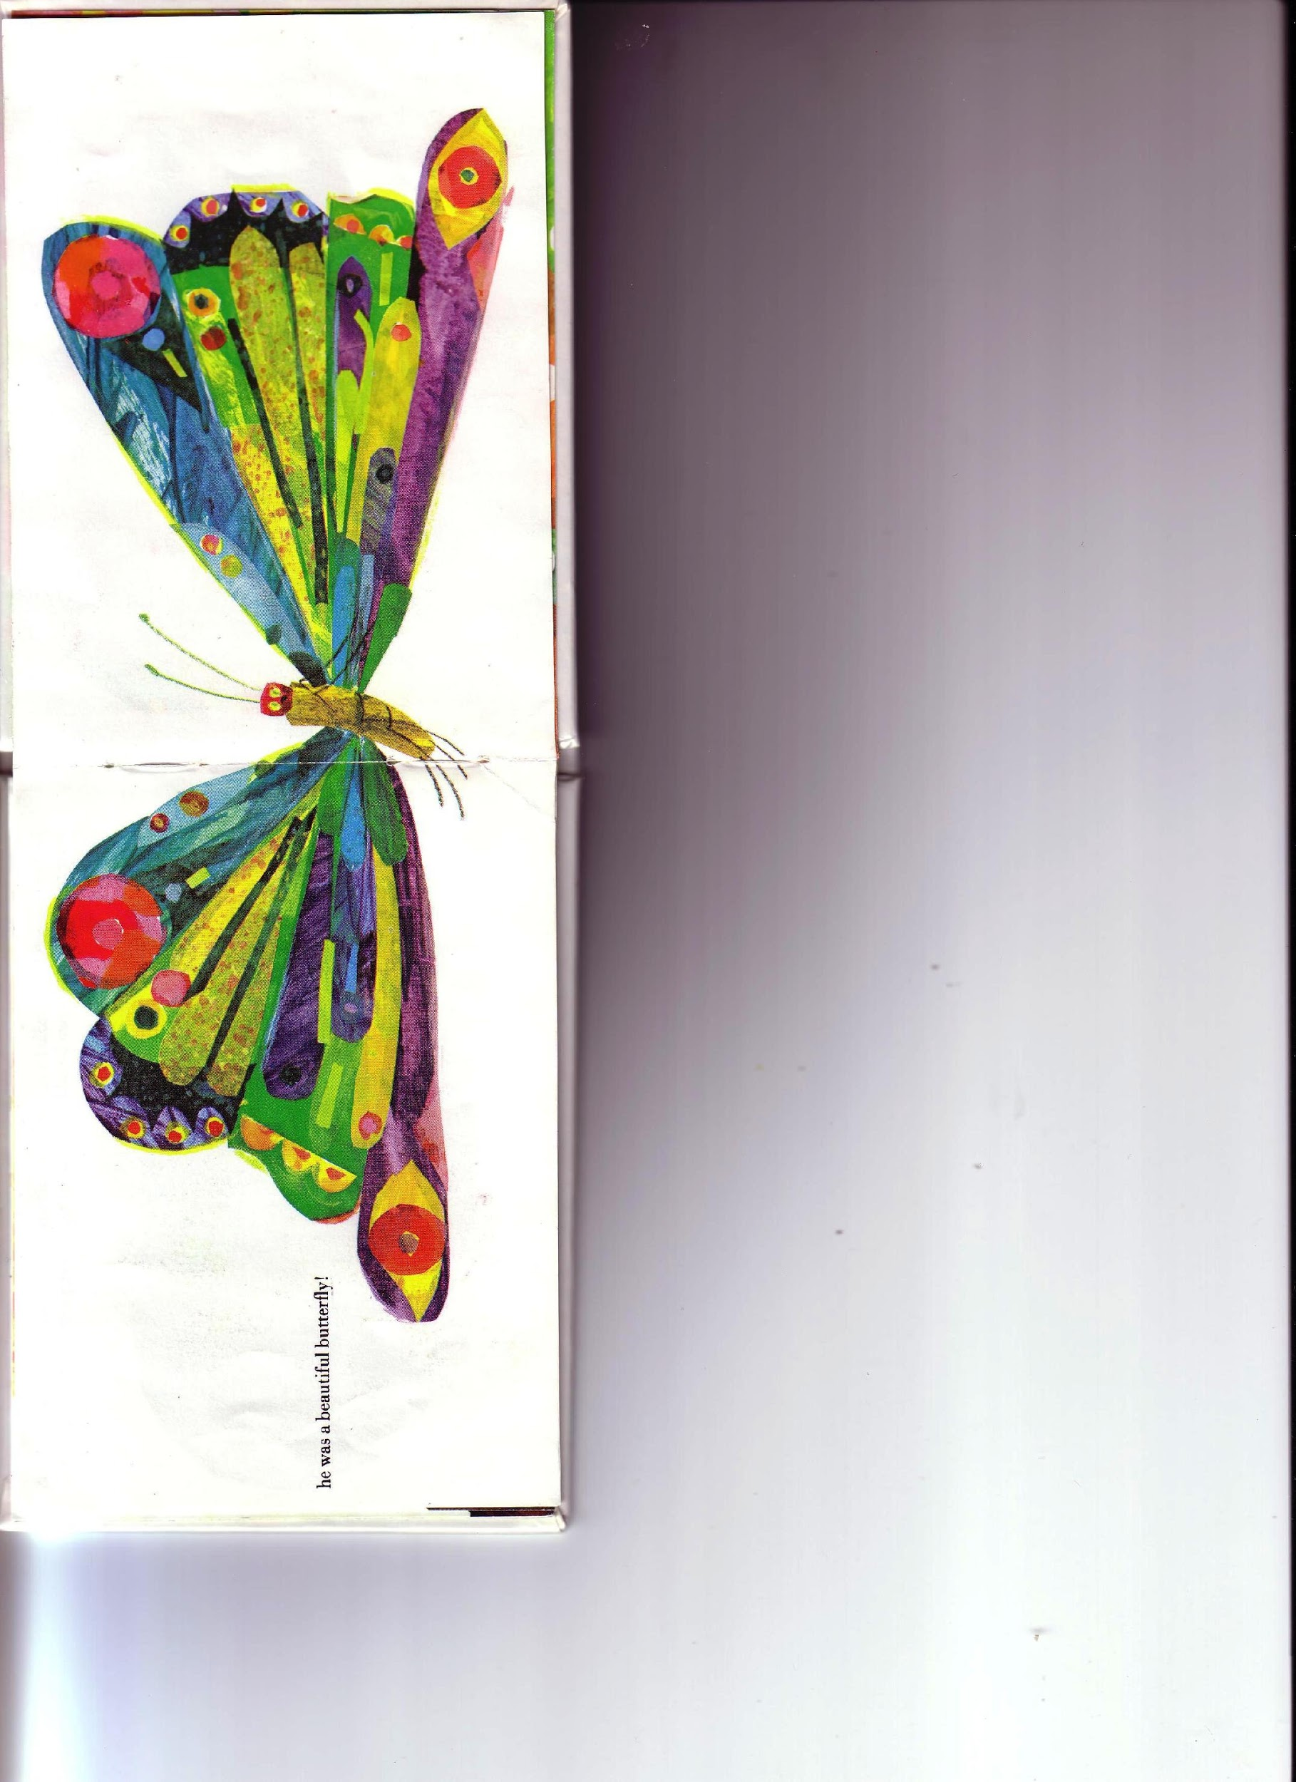
Se ha convertido en
una hermosa mariposa.
He became a beautiful butterfly.
Notes:
It has transformed into a beautiful butterfly!

Slide 32
Answers
On Monday he ate an apple
On Tuesday he ate two pears
On Wednesday he ate three plums
On Thursday he ate four strawberries
On Friday he ate five oranges
On Saturday he ate a cake, an ice cream, a pickle, a slice of cheese, a slice of salami ...
I hope that you enjoyed the story!

Slide 33

Friday 22nd May
Are you a maths whizz today?
Remember you can do these independently then share them with an adult.
Question 10 may have more than one answer.
Don’t worry about always finding the answer it is how you try to work out and reason that is important.

Slide 34
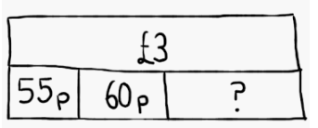
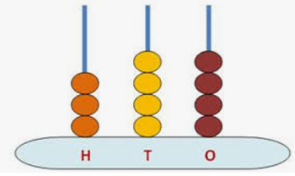
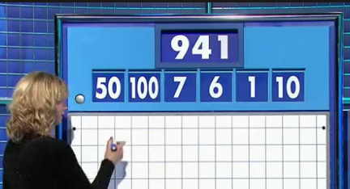
MORNING MATHS – 22.05.20
7. Complete the bar model:
8. 26x 8
9. Kim gets 30p pocket money every week.
How long will it take her to save £2.10?
10. Can you make the big number using some or all of the smaller ones (once only)?
Subtract 90 from
the
number
shown here
2. 134 + _ = 200
3. ⅝ + ⅜ =
4. 535 - 199
5. 25 divided by 3
6. Which shape has 2 sets of parallel sides and four right angles?

Slide 35
Morning Maths Answers
254
66
8/8 or 1 whole
336
8 r 1
Rectangle or square
55 + 60 =115
300 - 115 = 185
8. 6 x 8 = 48, 20 x 8 = 160, 160 + 48 = 208
9. 7 weeks
10. 6 x 100 = 600
7 x 50 = 350
600 + 350 = 950
950 - 10 = 940
940 + 1 = 941

Slide 36
St Catherine’s Classroom Beliefs
Mistakes are valuable.
Everyone can learn maths to the highest level.
Questions are really important.
Depth is more important than speed.
Maths is about making connections.
We may not be learning together in the classroom, but it is important to still remember our classroom beliefs.

Slide 37
WALT: use angles and turns to give directions.
For this lesson, if you have a tablet, laptop or computer, you can follow the link and do this lesson interactively by clicking on the link below. Only go up to slide number 4 with the maze game.
https://app.mymaths.co.uk/1755-lesson/angles-1

Slide 38
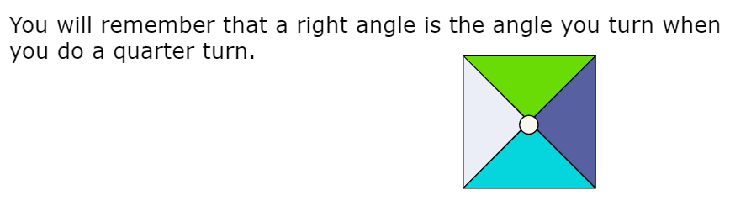
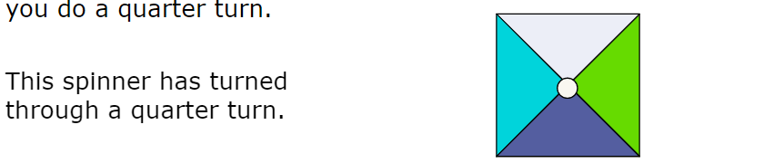
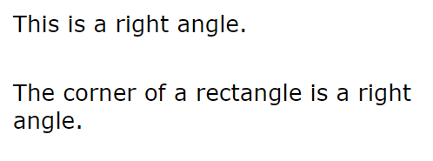


Slide 39





Slide 40
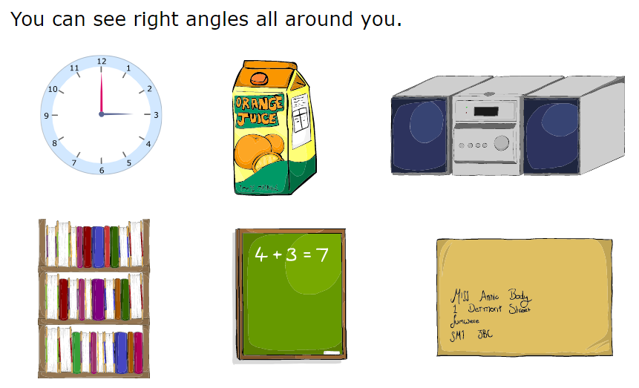

Slide 41


Slide 42
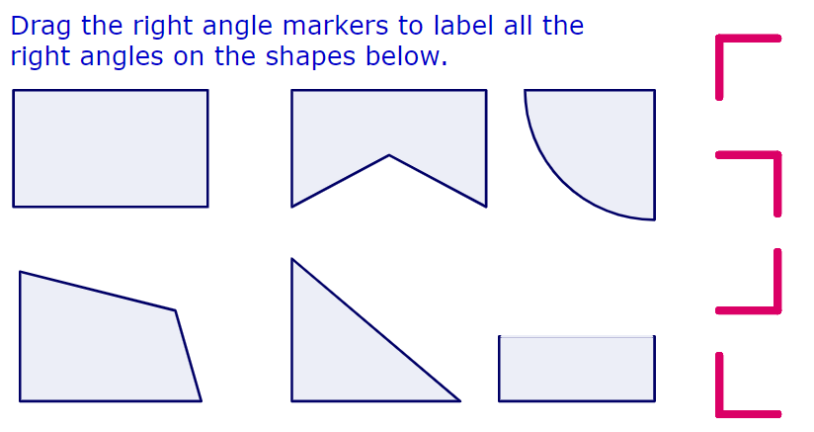

Slide 43
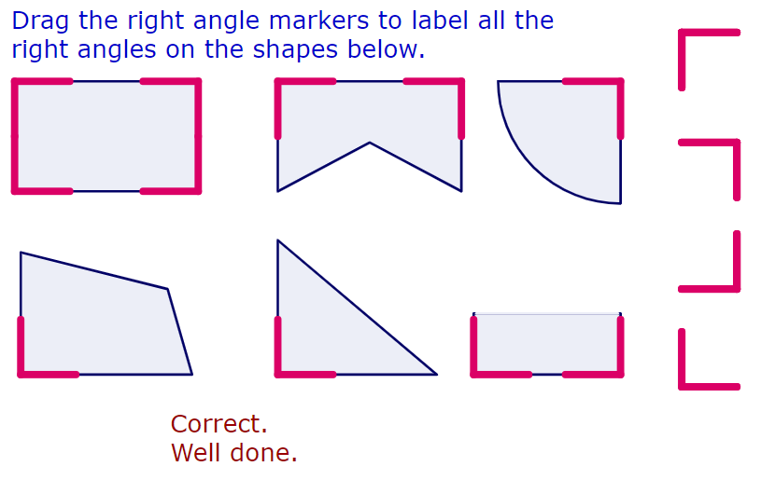

Slide 44
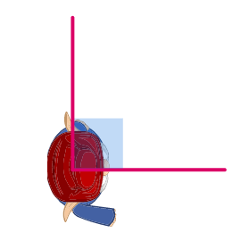

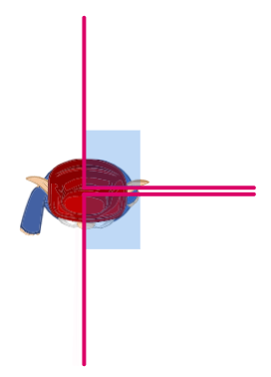


Slide 45
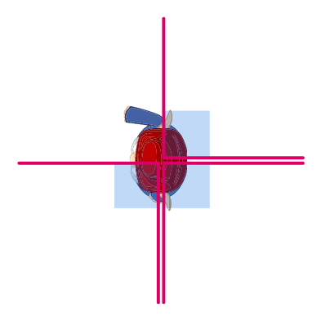
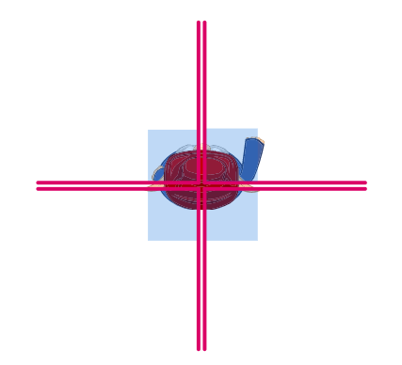


Slide 46
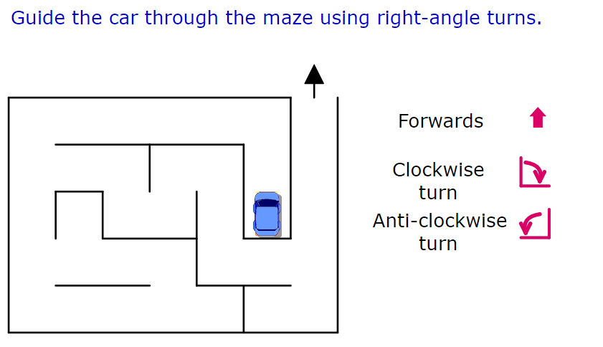
Write a set of instructions to get the car out of the maze.

Slide 47
Time for a break.
Have a drink and a snack.

Slide 48
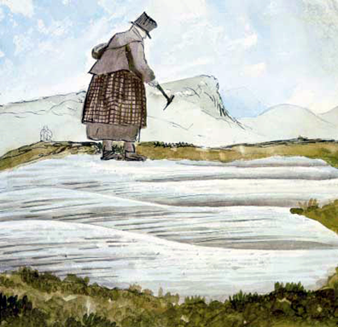
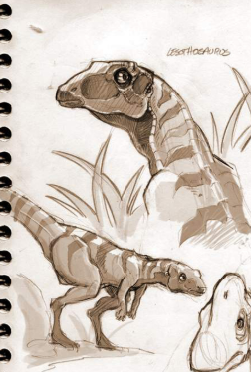
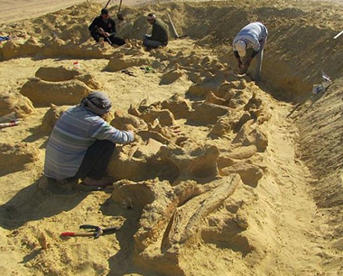
Time for some creative writing!
Imagine that you are a paleontologist like Mary Anning.
You dig up the bones of the ancient dinosaur that we read about in the poem yesterday.
No one has ever discovered this dinosaur before.
What is the dinosaur you discovered?
How did you feel when you found it?
Where did you discover it? (Your work from Wednesday 20th afternoon lesson could give you some ideas.)
What did the dinosaur look like?
Did you have your photograph taken alongside the remains?
Has it been put on display?
What did you learn about the past from finding your fossil?
What would your dinosaur have looked like when it was alive?
What did it eat?
How did it move?
Talk to an adult about some of your ideas.Then choose a writing activity from the next slide.

Slide 49
Creative Writing - What will you choose?
You might choose one or more of these ideas or decide to combine some of them together. AND YES you can include some pictures too.
Write a story about the day you found your dinosaur fossil.
Write a diary account for the end of the day when you found your fossil.
Make an information poster about your dinosaur, include some sketches and labels too.
Write an information card to go on display next to your dinosaur fossil at the museum.
Make and write a postcard to send home to your Mum / Dad to tell them about your discovery
Write a poem about your dinosaur discovery.
You might even write a letter to your teacher to tell them all about your extraordinary find.

Slide 50
What is a prefix? (sub and tele)
Do you remember that a prefix is a group of letters which we add to the beginning of a word to make a new word with a different meaning.
Today we will look at the prefix sub and tele
‘Sub-’ means ‘underneath’.
sub + marine = submarine, sub= under, marine = found in the sea and a submarine is found under the sea.
‘Tele-’ means ‘at a distance’ or ‘long distance’.
tele + phone = telephone, tele = long distance, phone = call someone
Telephone -allows you to call someone who is a distance away from you.
15 minute Spelling Activity

Slide 51
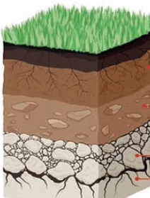
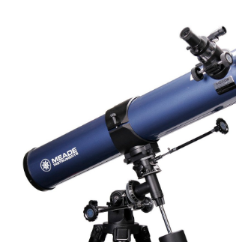
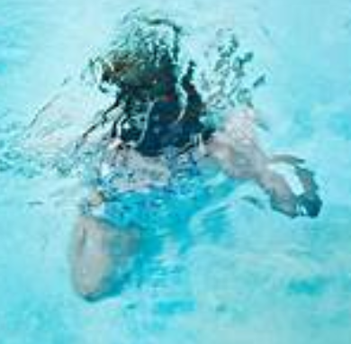
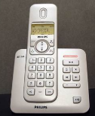
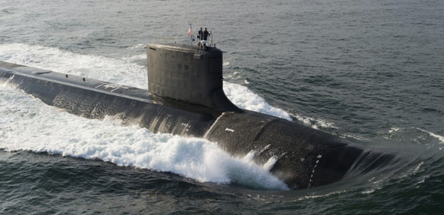
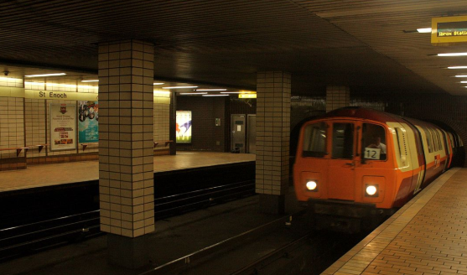
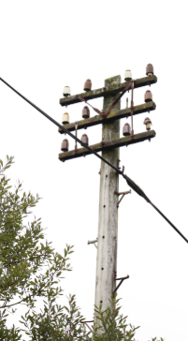
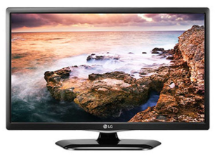
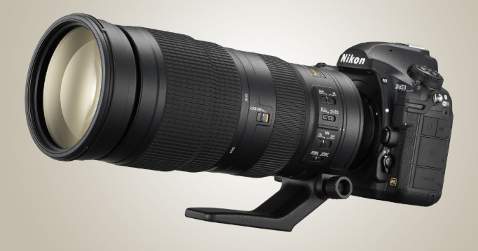
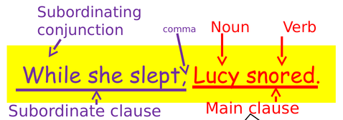
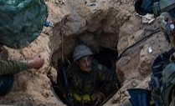
Can you decide which prefix goes before each root word?
Write the new words that you make.
sub or tele
 | phone | soil | marine | scope | merge
photo | way | graph | ordinate | terranean | vision

Slide 52
Check your answers. Did you spell them correctly?
sub or tele
 | telephone | subsoil | submarine | telescope | submerge
telephoto | subway | telegraph | subordinate | subterranean | television

Slide 53
Your morning lessons are completed.
Time for lunch.
Then come back this afternoon for your curriculum activity.

Slide 54
P.E

Slide 55

Type in the website address show at the in the box above into your search engine.
Fill in the log in details and log in.

Slide 56
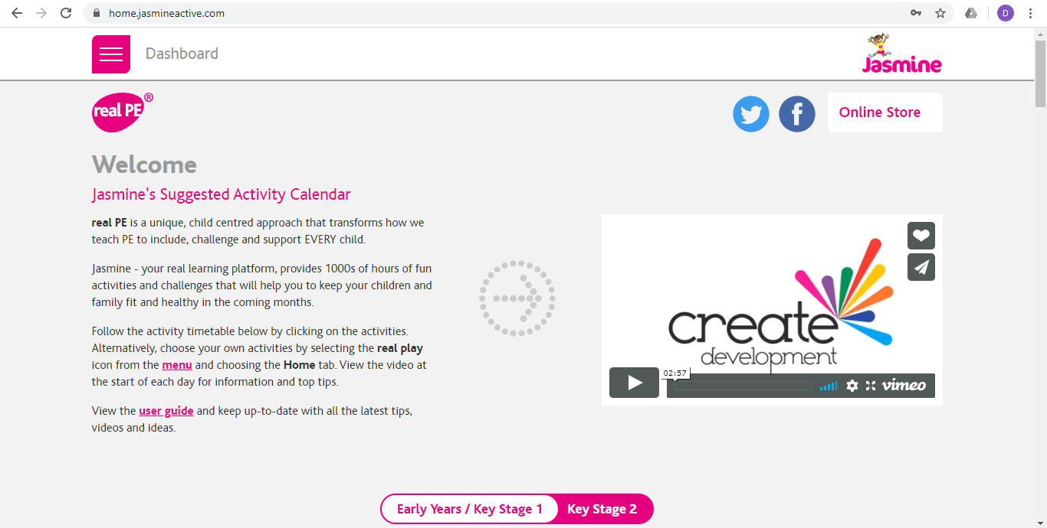
Once you have logged onto real PE click on ‘Key Stage 2’ and scroll down the page.

Slide 57
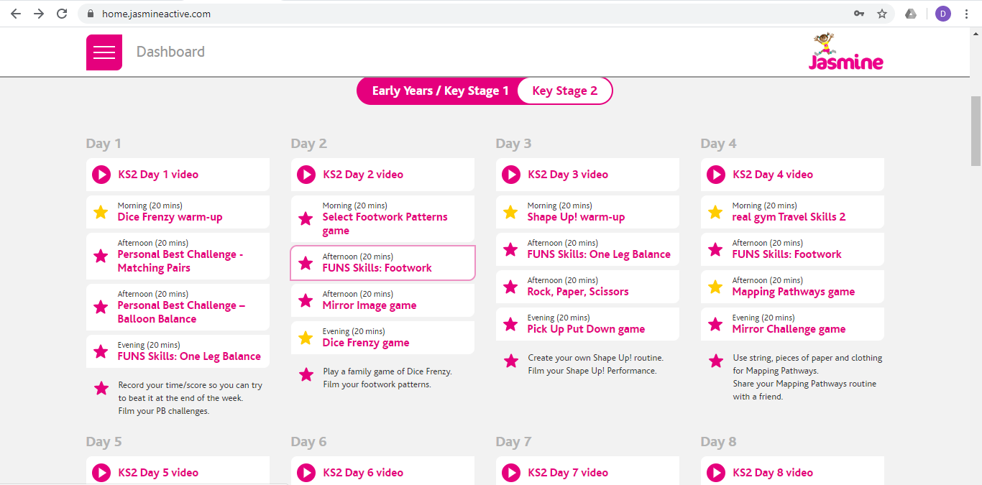
Then follow the sections for Day 2, starting with ‘KS2 Day 2 Video’.

Slide 58
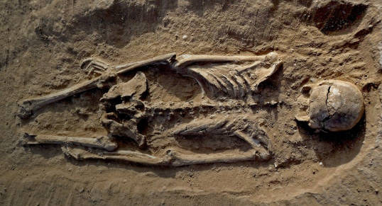
We hope you have found the week’s work interesting and haven’t dried up and turned into old fossils!
Don’t forget to say Thank You to your mums, dads and carers for giving you a helping hand with your learning.
We really hope the sun shines for you during half term next week, and we will be here with more learning on 1st June.
Bye for now from Mrs Shipley and Mr Mottershead.

