Slide 1

Good Morning Year 3
We hope you all enjoyed your half term break and that everyone is safe and well.
This week we have a science theme of Forces and Magnets for you.
You might like to ask your mums and dads if they have a magnet you can use for your lesson on Wednesday afternoon. There might be one on your fridge.
Your afternoon lesson on Monday links with your English on Tuesday and Wednesday this week so remember to take a look.
Have fun from Mrs Shipley and Mr Mottershead.

Slide 2

Monday 1st June
We will begin our day with Morning Maths - just like in school! This should be 10 -15 minutes.
You can do these independently then share them with an adult.
Remember question 10 may have more than one answer.
Don’t worry about always finding the answer it is how you try to work out and reason that is important.

Slide 3

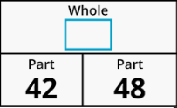

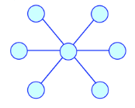
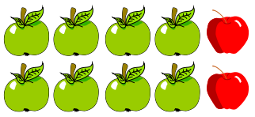
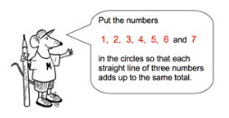
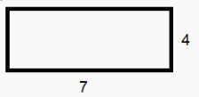
Morning Maths 01.06.20
8. How long is lesson 1?
9. How much longer
until 5 to ten?
10.
30 more than 85
2. 35 x 10
3. Complete this
part-whole model.
4. 48 8
5. What fraction of these apples are red?
6. 4m23cm = ___cm
7. What is the perimeter of
this oblong?

Slide 4
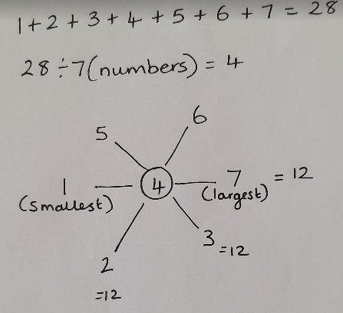
Answers.
8. 1 and ½ hours or 90 mins
9. 10 mins
10.
115
350
90
6
2/10 or ⅕
423 c
7+7 =14
4 + 4 =8
14 + 8 = 22

Slide 5

St Catherine’s Classroom Beliefs
Mistakes are valuable.
Everyone can learn maths to the highest level.
Questions are really important.
Depth is more important than speed.
Maths is about making connections.
We may not be learning together in the classroom, but it is important to still remember our classroom beliefs.

Slide 6
WALT: compare and identify angles.
If you have a tablet, laptop or computer, you can follow the link below and do the following lesson interactively. We will be doing slides 5 and 6, but feel free to start from the first slide for a little recap about angles.
https://app.mymaths.co.uk/1755-lesson/angles-1

Slide 7

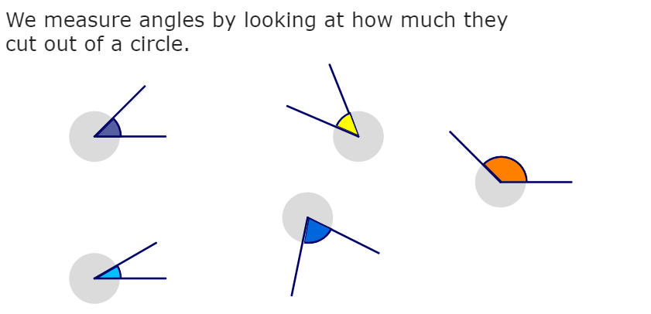

Slide 8
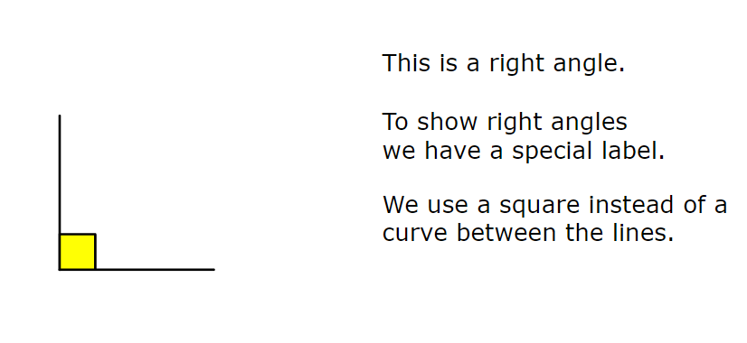

Slide 9
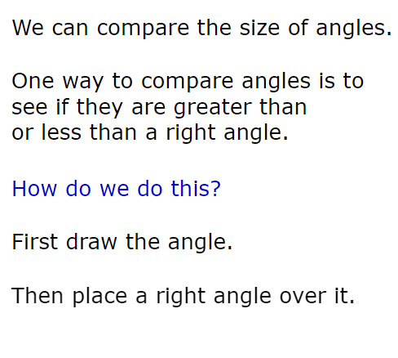
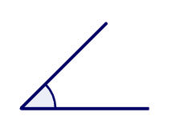
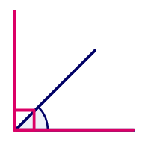

Slide 10
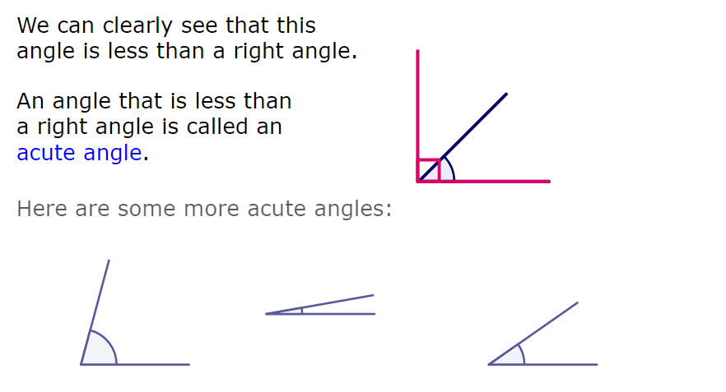

Slide 11
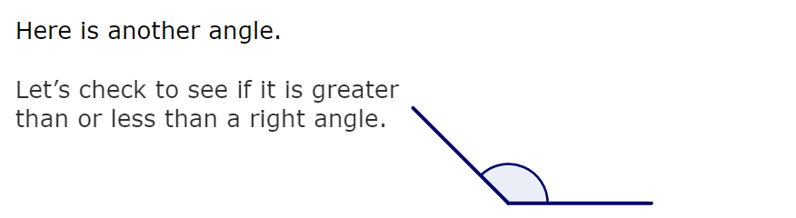
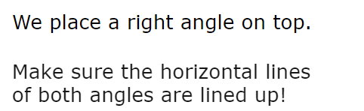
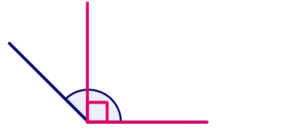

Slide 12
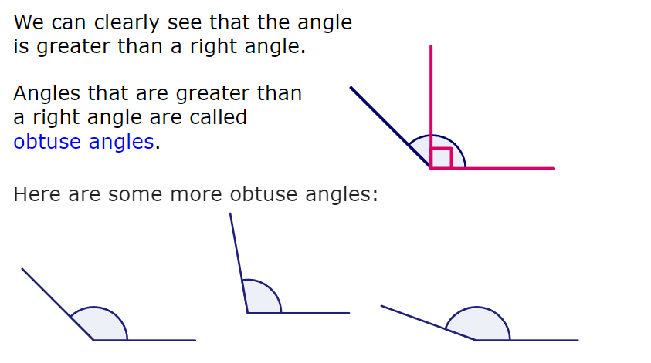

Slide 13
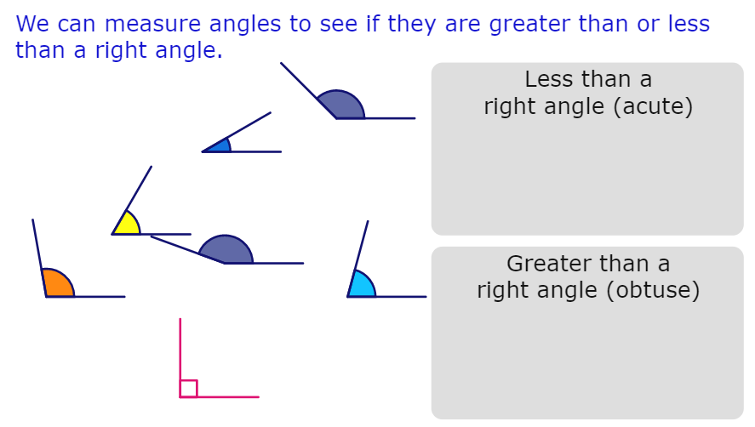

Slide 14
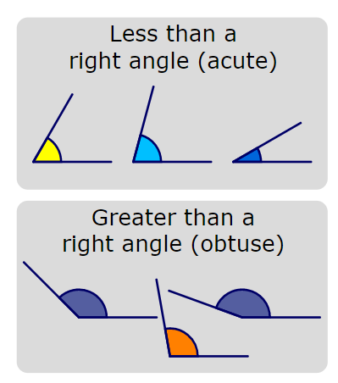

Slide 15
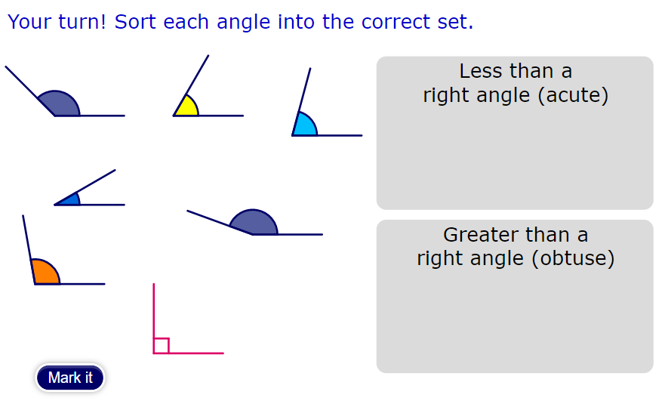

Slide 16
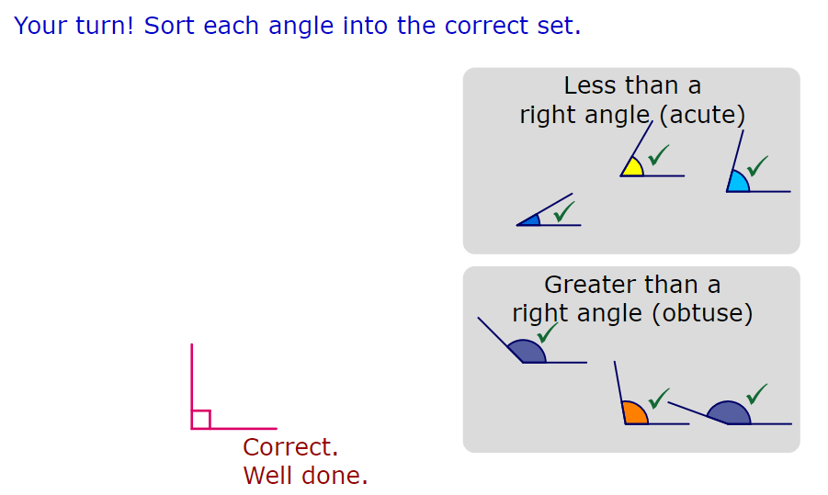

Slide 17

Time for a break.
Have a drink and a snack.

Slide 18

WALT retrieve and infer information from a text.
Use the link below to read the e- book -
A Look at Magnets by Barbara Alpert
https://readon.myon.co.uk/reader/index.html?a=sb_magn_f11

Slide 19
WALT retrieve and infer information from a text.
Answer the following comprehension questions about the book. Use sentences.
What are magnets made of?
What do magnets do?
What is the energy around a magnet called?
What is the strongest part of a magnet?
What happens if you try to put two same poles together?
When do two magnets attract?
Explain how a compass works.
Give four ways from the text of a how a magnet can be useful in daily life.

Slide 20
Answers.
What are magnets made of?
They are made of iron, nickel and steel.
What do magnets do?
They make metal objects move.
What is the energy around a magnet called?
The energy surrounding a magnet is called a magnetic field.
What is the strongest part of a magnet?
The strongest parts are the poles.(North and South poles)
What happens if you try to put two same poles together?
Two same poles repel each other, which means they push away.
When do two magnets attract?
They are attract if the poles are opposite. (One N and one S.)
Explain how a compass works.
A compass helps you to see which direction to travel in because it always shows you North. The needle points North because the earth is like a magnet and the magnetic energy from the North Pole pulls the needle that way.
Give four ways from the text of a how a magnet can be useful in daily life.
To hold things onto a fridge. To find a direction. To make a credit card work. To help a Dr find out what is wrong with someone.

Slide 21

What is a prefix? (sub and tele)
Do you remember that a prefix is a group of letters which we add to the beginning of a word to make a new word with a different meaning.
Today we will continue to look at the prefix sub and tele
‘Sub-’ means ‘underneath’.
sub + marine = submarine, sub= under, marine = found in the sea and a submarine is found under the sea.
‘Tele-’ means ‘at a distance’ or ‘long distance’.
tele + phone = telephone, tele = long distance, phone = call someone
Telephone -allows you to call someone who is a distance away from you.
15 minute Spelling Activity

Slide 22
Can you match the words to the correct meanings.
Use this to speak to people far away. | The thing you watch your favourite programmes on. | An underwater ship. | Look through this to see things from far away.
telescope | telephone | subordinate | subway
submarine | television | submerge | telegraph
A clause that does not make sense on it’s own. | To fill or cover completely, usually with water. | An invention that sent messages quickly over long distances. | An underground tunnel or passage enabling pedestrians to cross a road or railway.

Slide 23
Can you match the words to the correct meanings.
Use this to speak to people far away. | The thing you watch your favourite programmes on. | An underwater ship. | Look through this to see things from far away.
telescope | telephone | subordinate | subway
submarine | television | submerge | telegraph
A clause that does not make sense on it’s own. | To fill or cover completely, usually with water. | An invention that sent messages quickly over long distances. | An underground tunnel or passage enabling pedestrians to cross a road or railway.

Slide 24
Complete the sentences below with an accurate spelling from the words you have been practising.
I turned on the _____________ to watch my favourite show.
The __________ travelled beneath the waves.
All the passengers waited in the _________, when the train was late.
Mrs Shipley and Mr Mottershead made __________ calls to all the families of the children in their classes.
The astronomer looked at the stars through his _________.
We ________ a sponge in water to be able to use it to wash the car.

Slide 25
Complete the sentences below with an accurate spelling from the words you have been practising.
I turned on the television to watch my favourite show.
The submarine travelled beneath the waves.
All the passengers waited in the subway, when the train was late.
Mrs Shipley and Mr Mottershead made telephone calls to all the families of the children in their classes.
The astronomer looked at the stars through his telescope.
We submerge a sponge in water to be able to use it to wash the car.

Slide 26


Your morning lessons are completed.
Time for lunch.
Then come back this afternoon for your curriculum activity.

Slide 27
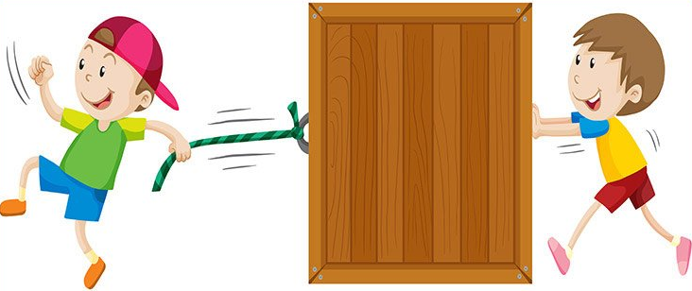
WALT identify forces as pushes or pulls.
What is a force?
A force is a push or a pull.
What can forces do?
Forces can make things move, change their speed, or change their shape.
When does a force happen?
Some forces happen when two things touch, like a boy kicking a football.
Other forces happen, like the earth’s pull of gravity, or like a magnet pulling a piece of metal.

Slide 28
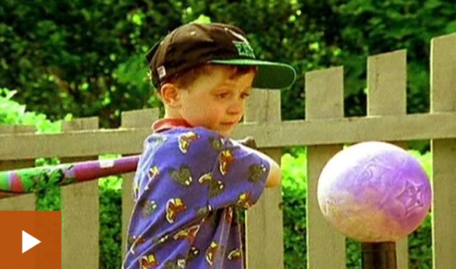
Watch the BBc bitesize clip below and while you watch it say when you can see a push or a pull.
https://www.bbc.co.uk/bitesize/clips/zkw8q6f

Slide 29
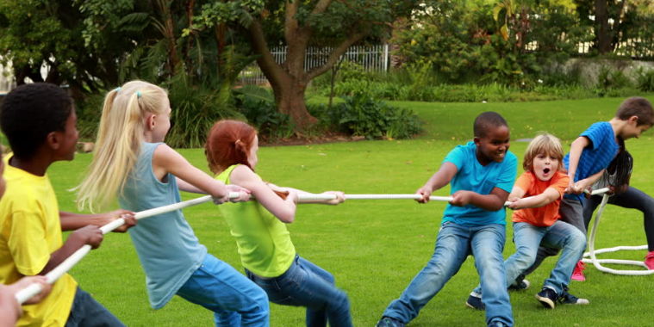
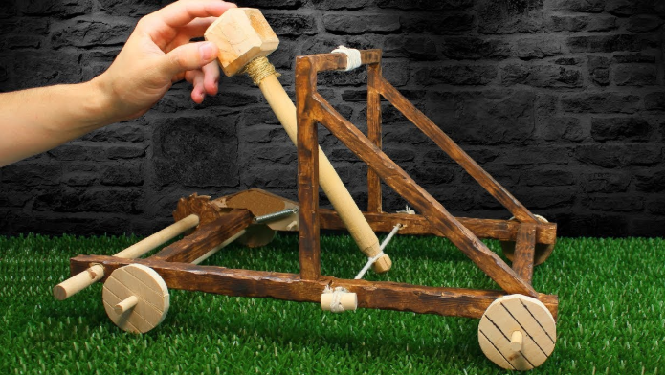
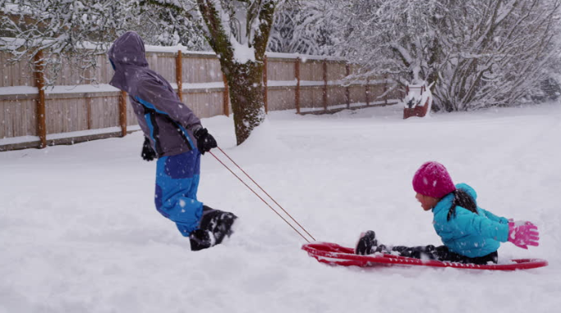
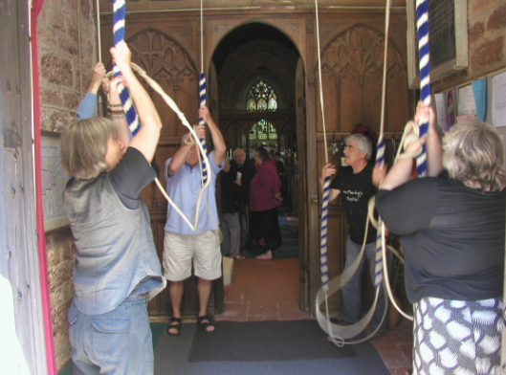
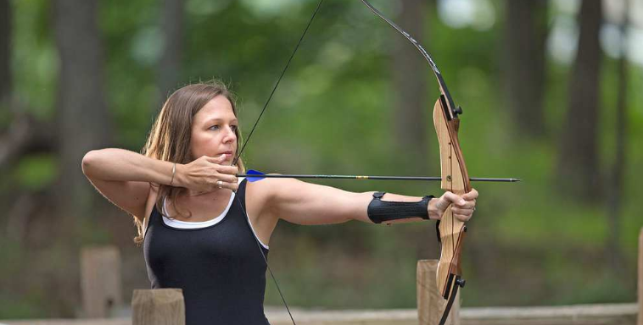
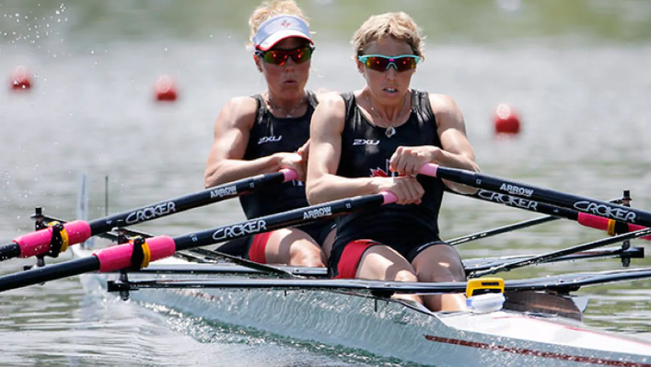
Did you see any of these pulling forces?

Slide 30
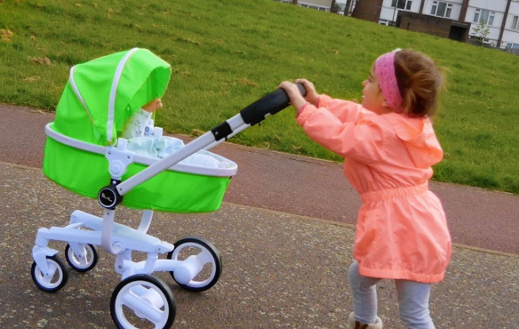
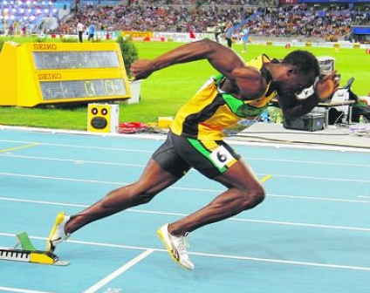
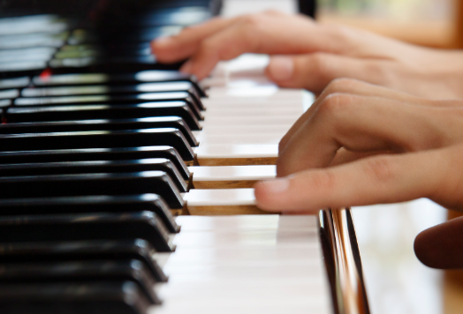
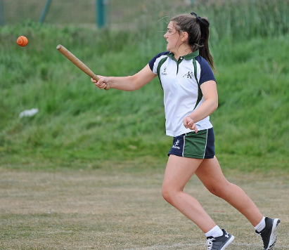
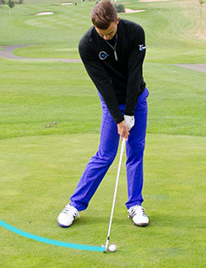
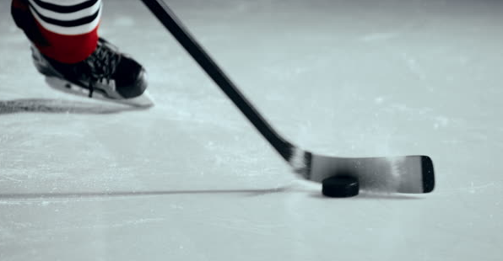
Did you see any of these pushing forces?

Slide 31
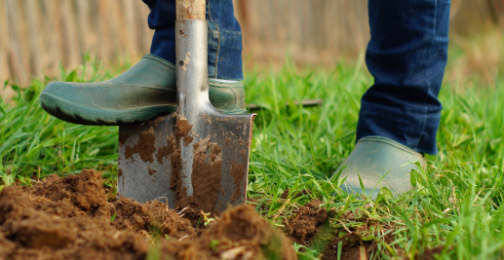
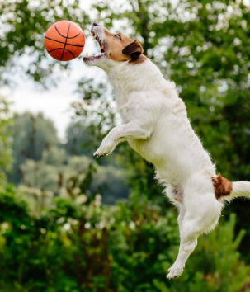
The science activity on the next slide is taken from the twinkl website.
Look at the pictures on the next slide and decide whether the force being used or exerted is a push or a pull.
Then decide if the force makes the object start to move or does it make the object stop?
The dog pushes off the ground to stop the ball moving. When he pushes his mouth together the ball will stop.
The gardener pushes the spade to make it start moving into the ground.

Slide 32
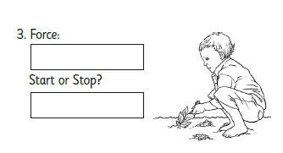
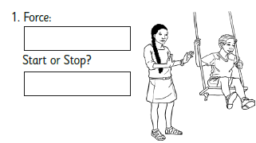
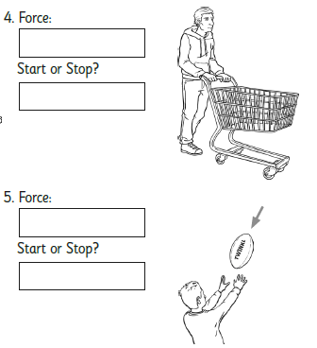
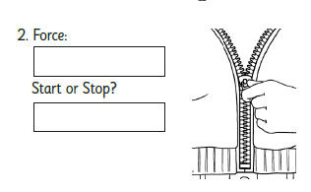

Slide 33
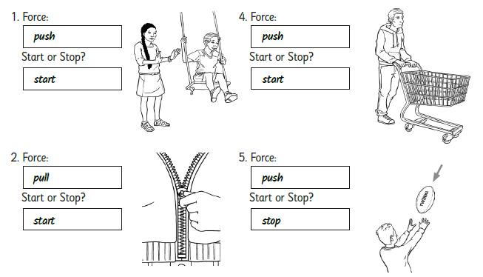
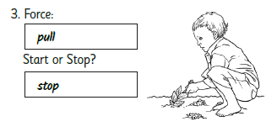
Answers.
How did you do?

Slide 34
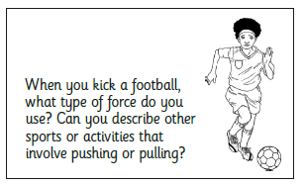
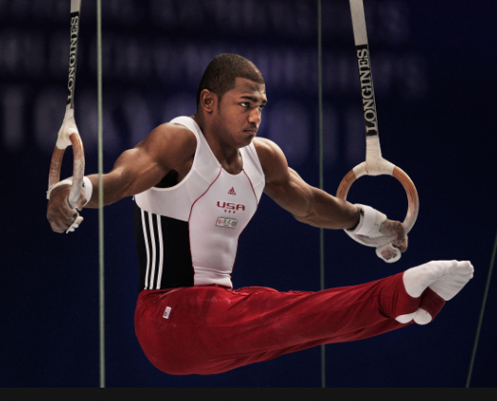
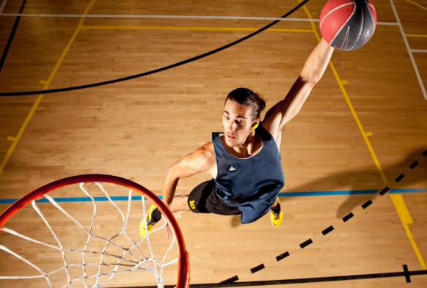
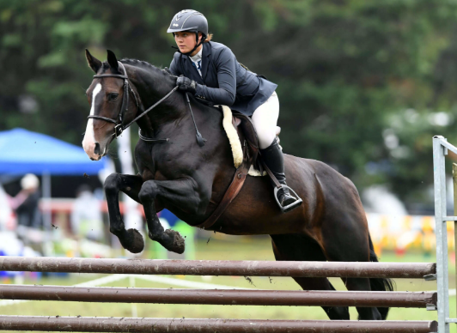
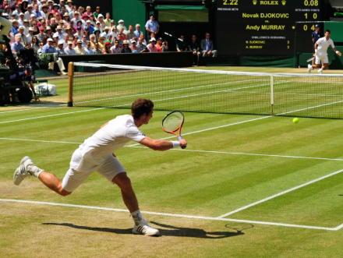
Here are some ideas if you don’t have one of your own.
Share your ideas with an adult.

Slide 35

Tuesday 2nd June
Ready to wake up your maths brains?
Remember you can do these independently then share them with an adult.
Question 10 may have more than one answer.
Don’t worry about always finding the answer it is how you try to work out and reason that is important.

Slide 36
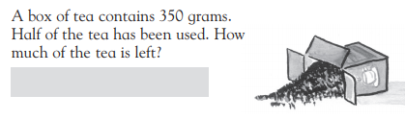

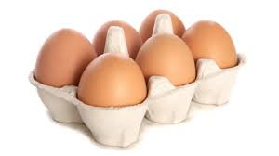
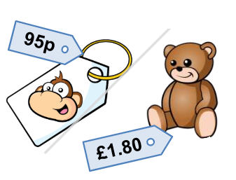


Morning Maths 02.06.20
7.
8. How much change from a £5 note if I bought both of
these?
9.
10. If I know 7 x 9 = 63,
what else do I know?
How many tens in 344 ?
2. Write a calculation statement for this bar model:
3. 345 - 272
4. £6.06 = ___p
5. If there are 6 eggs in a box, how many eggs in 4 boxes?
6. Which of these
pairs of lines are
perpendicular?

Slide 37

Answers.
7. 175g
8. 95 + 180 = 275
500 - 275 = 225p or £2.25
9. ⅚
10. Various answers
9 x 7 = 63, 9 x 70 = 630, 70 x 90 = 6300
630 ÷ 70 = 9, 6300 ÷ 70 = 90
34
26 + 46 = 72
46 +26 = 72
72 - 46 = 26
76 - 26 = 46
73
606p
6 x 4 =24 eggs

Slide 38
St Catherine’s Classroom Beliefs
Mistakes are valuable.
Everyone can learn maths to the highest level.
Questions are really important.
Depth is more important than speed.
Maths is about making connections.
We may not be learning together in the classroom, but it is important to still remember our classroom beliefs.

Slide 39
WALT: identify different types of angles and lines
If you have a tablet, laptop or computer, you can follow the link below and do the following lesson interactively. We will be doing slides 7 to 9 but feel free to start from the first slide for a recap about angles.
https://app.mymaths.co.uk/1755-lesson/angles-1

Slide 40




Slide 41


Slide 42




Slide 43


Slide 44


Slide 45


Slide 46


Slide 47


Slide 48
18

Slide 49
Time for a break.
Have a drink and a snack.

Slide 50
WALT: use synonyms to extend our vocabulary when writing.
Some words are used too often. We overuse them and so need to find some different words to use. Our new words or synonyms will have a more powerful meaning in the sentence we are using them in. BUT we have to choose appropriate words.
For the next two days we will think about the words push and pull and synonyms we can use for them.
Today we will just focus on synonyms for push.

Slide 51
Do you remember these pushing forces from your science lesson yesterday?

Slide 52
press
bulldoze
propel
thrust
prod
Synonyms for PUSH
sweep
drive
plunge
nudge

Slide 53

Which of these words suggest a small push and which words suggest a push with a larger amount of force?
If you are not sure what the words mean you can look them up in a dictionary or use your search engine.
Try acting the words out.
Look back at the pictures showing pulls - which of these words could you use about the
pull in the photo?

Slide 54
Now rewrite the sentences and replace the word push with an appropriate synonym. Remember past tense!
The pianist pushed the keys on the piano to compose a tune.
The athlete pushed himself from the starting blocks to give himself the best possible advantage.
The hockey player pushed the puck across the ice.
The golfer pushed his ball from the tee.
In her anger, the little girl pushed her pram up the hill.
She pushed the ball has hard as she could with the rounders bat.

Slide 55
Did you choose an appropriate synonym?
The pianist pressed the keys on the piano to compose a tune.
The athlete thrust/propelled/drove himself from the starting blocks to give himself the best possible advantage.
The hockey player nudged/swept the puck across the ice.
The golfer drove/propelled his ball from the tee.
In her anger, the little girl bulldozed her pram up the hill.
She drove/propelled the ball has hard as she could with the rounders bat.

Slide 56
Look at these written spelling patterns
sh, ch, s, ss and c,
Sometimes they make the sound ‘sh’
15 minute Spelling Activity

Slide 57







Match these words to the pictures. - which written letters make the ‘sh’ sound? |  |  | chef
brochure |  |  | sure
mission |  |  | special
shop |  |  | sugar

Slide 58
Match these words to the pictures. - which written letters make the ‘sh’ sound? |  |  | chef
brochure |  |  | sure
mission |  |  | special
shop |  |  | sugar

Slide 59



Rainbow write each
word 3 times.

Slide 60
Your morning lessons are completed.
Time for lunch.
Then come back this afternoon for your curriculum activity.

Slide 61
WALT identify forces as pushes or pulls.
Talk about the answers to these questions.
What is a push?
What is a pull?
What do pushes and pulls have to do with magnetism?

Slide 62
WALT identify forces as pushes or pulls.
What is a push?
What is a pull?
A force we use to push something away.
A force you use to move something towards you.
What do pushes and pulls have to do with magnetism?
Magnets attract magnetic materials like some metals and magnets held close together can create pushing (repelling) or pulling (attracting) forces on one another.

Slide 63

Magnets and their Magnetic Force.
Look at this bar magnet. It has two sections.
They are often coloured red and blue.
What are they?
Use the link below to find out more.
https://www.bbc.co.uk/bitesize/clips/zk9rkqt

Slide 64


The forces of pushing and pulling happen when
two objects meet.
Like a foot kicking a football - push
or a person ringing a church bell - pull.
but magnetic forces can work without contact being made.
Each end of a magnet is known as a pole.
There is a north pole and a south pole.

Slide 65


If you put two magnets close enough to each other, so that the north pole from one magnet and the south pole from the other are together, the opposite poles attract.
This means the force will pull them together without you actually putting them together.
The opposite poles attract or pull together.
Two poles the same repel each other or push apart.
If you try to put poles of the same type together, they will push away from each other. This is called repelling. There is a force trying to push them apart.

Slide 66


Try this activity from Twinkl.
Use the words from the word bank to complete the text.

Slide 67

These are your answers. How did you get on?

Slide 68


Slide 69
Attract or pull together.
Repel or push apart.
Attract or pull together.
Repel or push apart.

Slide 70


Slide 71

Answers.

