Slide 1

Wednesday 3rd June
Ready to crunch some numbers?
Remember you can do these independently then share them with an adult.
Question 10 may have more than one answer.
Don’t worry about always finding the answer it is how you try to work out and reason that is important.

Slide 2
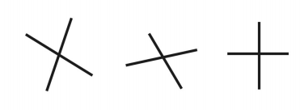
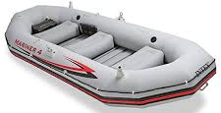
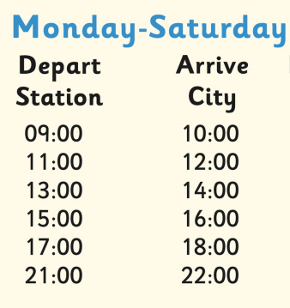


Morning Maths 03.06.20
7. Which of these lines are not perpendicular?
8. 6 children can
fit in a dinghy.
How many dinghies
would be needed to carry our
class?
9. What’s the
latest bus I can catch
from the station
to get me into the city
before 10:30?
10. The answer is 57. What’s the question?
365 + 50
2. Complete the pattern
4 x 10 = 40
4 x 100 = 400
4 x 1000 =
3. 49 + 50
4. Write the calculation statement
5. 50 ➗ 8 =
6.
b
c
a
-

Slide 3

Answers.
7.
8. 5 because 5 x 6 = 30
9. 9.00
10. Various answers
50 + 7 = 57
100 - 43 = 57
25 x 2 + 7 = 57
300 ÷ 2 - 100 + 7 = 57
415
4000
99
49 + 33 = 82
6 x 8 = 48 with 2 left over so 6 r2
3/6 - 2/6 = 1/6

Slide 4

St Catherine’s Classroom Beliefs
Mistakes are valuable.
Everyone can learn maths to the highest level.
Questions are really important.
Depth is more important than speed.
Maths is about making connections.
We may not be learning together in the classroom, but it is important to still remember our classroom beliefs.

Slide 5
WALT: identify parallel lines.
If you have a tablet, laptop or computer, you can follow the link below and do the following lesson interactively. We will be doing slide 10 only but feel free to start from the first slide for a recap on lines and angles.
https://app.mymaths.co.uk/1755-lesson/angles-1

Slide 6
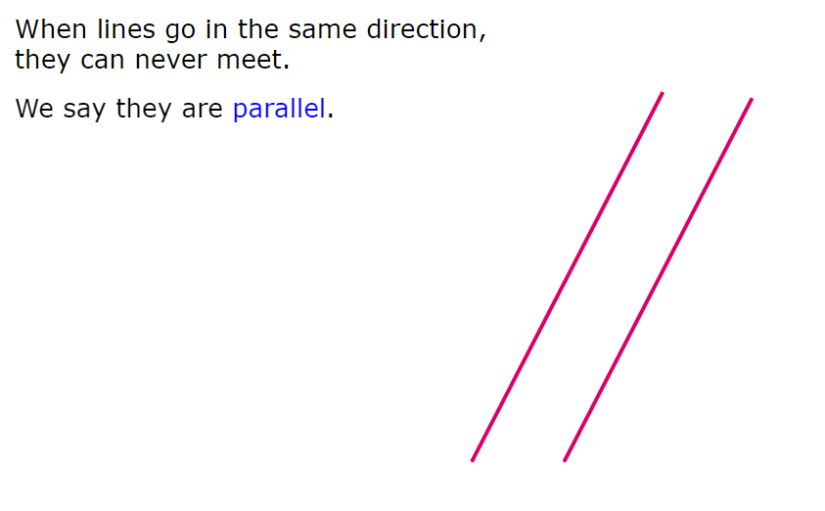
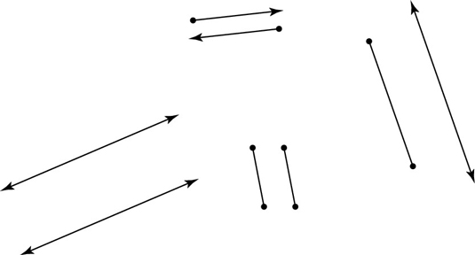

Slide 7
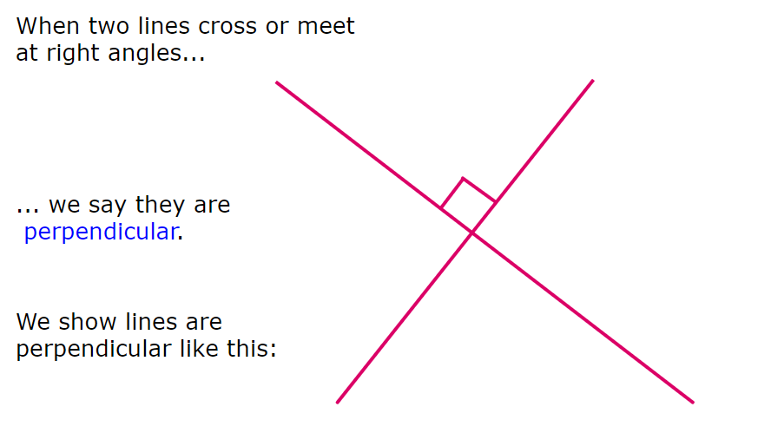

Slide 8
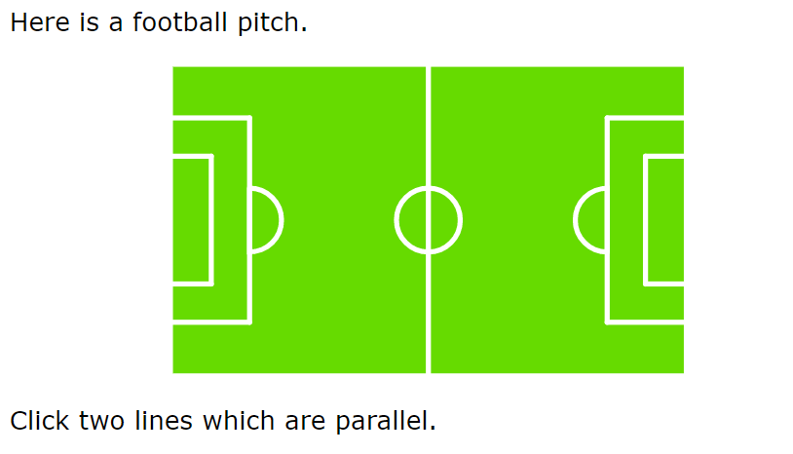

Slide 9
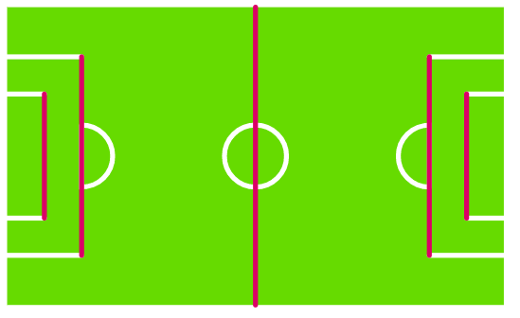
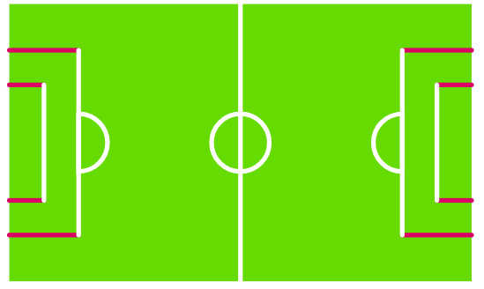
If you picked any two lines that are vertical (the ____ ones) you got it right.
You could also choose any of the horizontal lines (the ____ ones) too, as long as they aren’t on the same level.

Slide 10
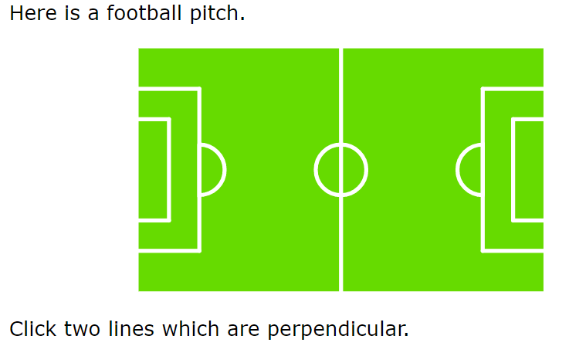

Slide 11
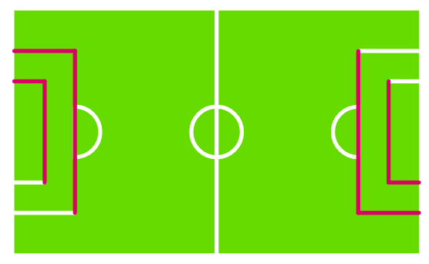
As long as you pick one horizontal line and one vertical line that are connected to each other, they will be perpendicular. Here are some examples.

Slide 12

Time for a break.
Have a drink and a snack.

Slide 13
WALT: use synonyms to extend our vocabulary when writing.
Some words are used too often. We overuse them and so need to find some different words to use. Our new words or synonyms will have a more powerful meaning in the sentence we are using them in. BUT we have to choose appropriate words.
Today we will focus on the word pull and synonyms we can use instead to improve our sentences.

Slide 14
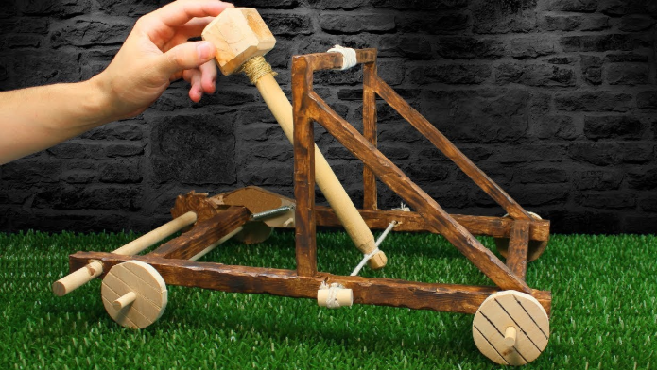
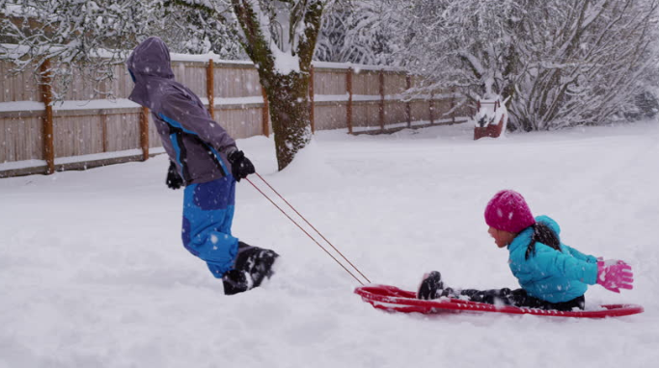
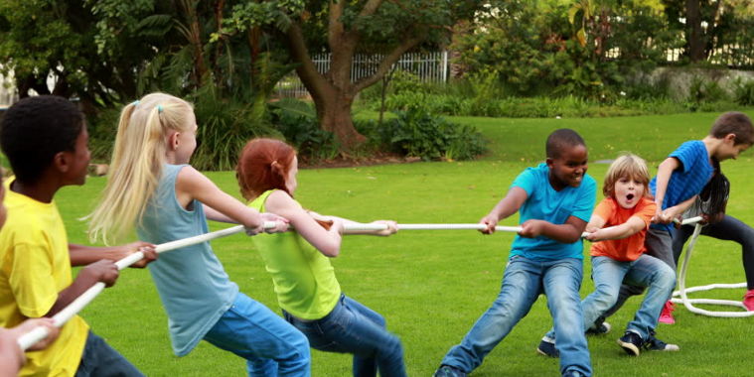
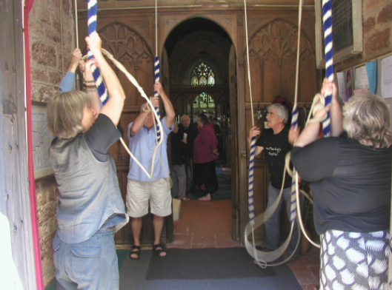
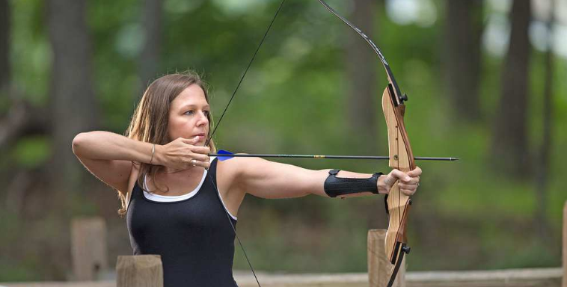
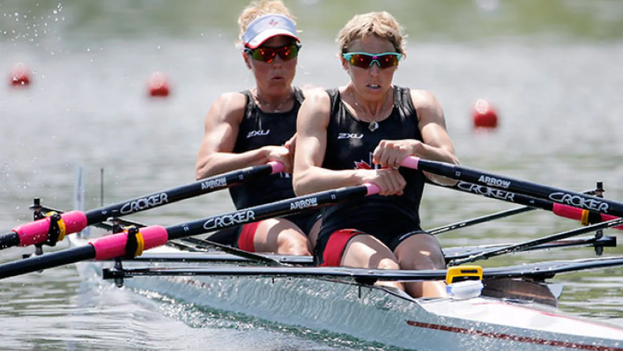
Do you remember these pulling forces from your science on Monday afternoon?

Slide 15
draw
tow
tug
trail
jerk
Synonyms for PULL
yank
haul
drag

Slide 16
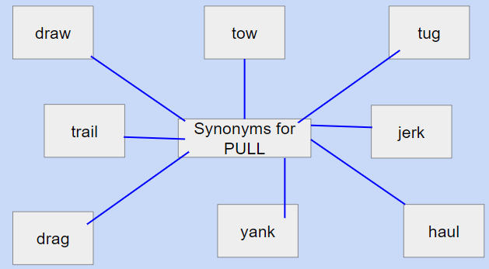
Which of these words suggest a small pull and which words suggest a pull with a larger amount of force?
If you are not sure what the words mean you can look them up in a dictionary or use your search engine.
Try acting the words out.
Look back at the pictures showing pulls - which of these words could you use about the
pull in the photo?

Slide 17
Now rewrite the sentences and replace the word pulled with an appropriate synonym. Remember past tense!
The archer pulled the bow in order to fire the arrow.
The team pulled with all their might to win the Tug of war.
She pulled the oars back as she rowed the boat.
The sledder pulled his sledge behind him.
The boy pulled back the catapult to fire a missile.
They pulled the ropes to make the church bells peal.

Slide 18
Did you choose an appropriate synonym?
The archer drew back the bow in order to fire the arrow.
The team hauled/tugged with all their might to win the Tug of war.
She drew the oars back as she rowed the boat.
The sledder trailed/dragged/towed his sledge behind him.
The boy drew/yanked back the catapult to fire a missile.
They tugged the ropes to make the church bells peal.

Slide 19

Look at these written spelling patterns
sh, ch, s, ss and c,
Sometimes they make the sound ‘sh’
15 minute Spelling Activity

Slide 20
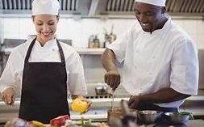


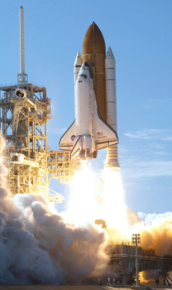

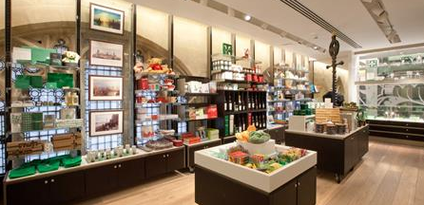
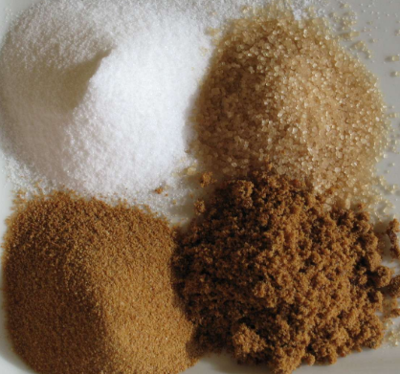
Remember these words from yesterday? Say them out loud, remember the letters in red make a ‘sh’ sound. |  |  | chef
brochure |  |  | sure
mission |  |  | special
shop |  |  | sugar

Slide 21
Complete the sentences below with an accurate spelling from the words you have been practising. You may need to make a plural.
We were lucky to get our cereals on _______ offer this week.
Mr Mottershead takes three _______ in his coffee.
NASA has launched a _________ to Mars.
The meal prepared by the _______ was divine.
I purchased a souvenir from the gift ______ .
I was not ________ which gift I should buy.
Dad was excited to show us the holiday __________ .

Slide 22
Did you choose the correct word and spell it accurately?
We were lucky to get our cereals on special offer this week.
Mr Mottershead takes three sugars in his coffee.
NASA has launched a mission to Mars.
The meal prepared by the chef was divine.
I purchased a souvenir from the gift shop.
I was not sure which gift I should buy.
Dad was excited to show us the holiday brochure.

Slide 23


Your morning lessons are completed.
Time for lunch.
Then come back this afternoon for your curriculum activity.

Slide 24
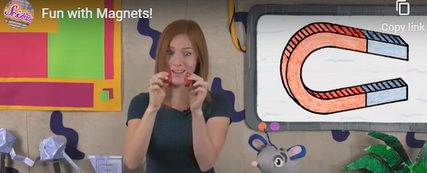
WALT identify magnetic materials.
We know that magnets can attract and repel each other. Can you remember when this happens? Use the video clip to see if you are right.
https://youtu.be/yXCeuSiTOug
Did you see that some materials are magnetic and some are non-magnetic.
Today we will think about which materials a magnet can attract to it by pulling it towards it.
Watch the video link to get you thinking.
https://youtu.be/s236Q1nuWXg

Slide 25
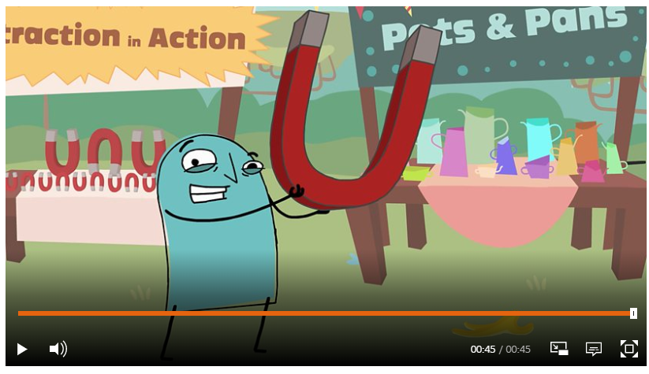
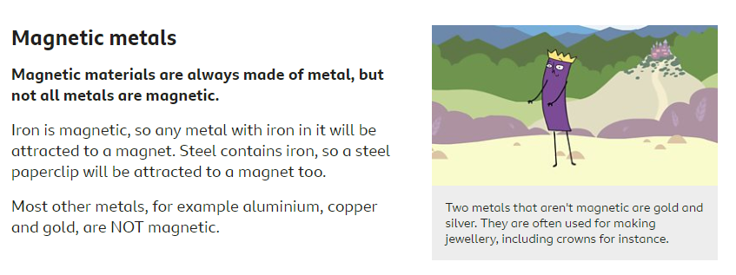
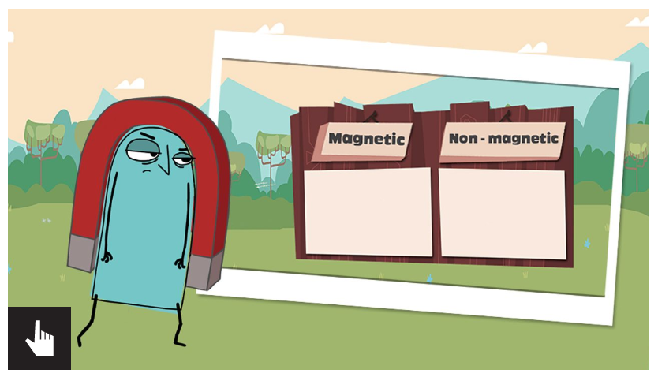
Use the link below to learn more about magnetic materials. The link will take you to the 3 activities shown below.
Watch the video clip. Read the information about Magnetic materials below the video clip and then try the quiz.
https://www.bbc.co.uk/bitesize/topics/zyttyrd/articles/zw889qt

Slide 26
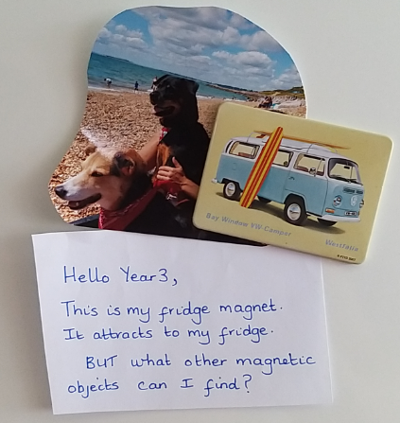
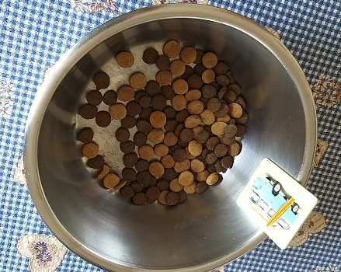
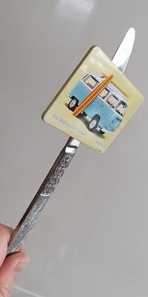
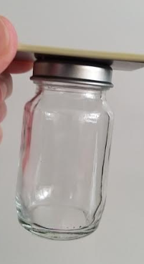
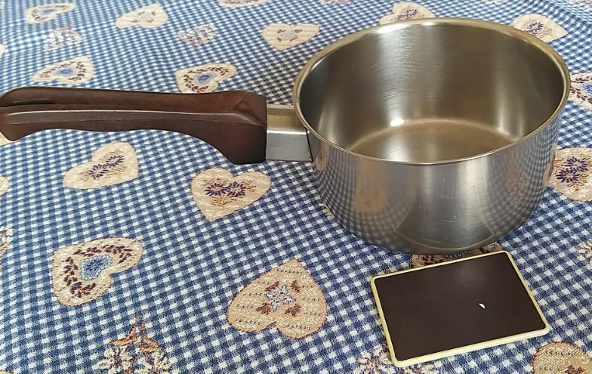
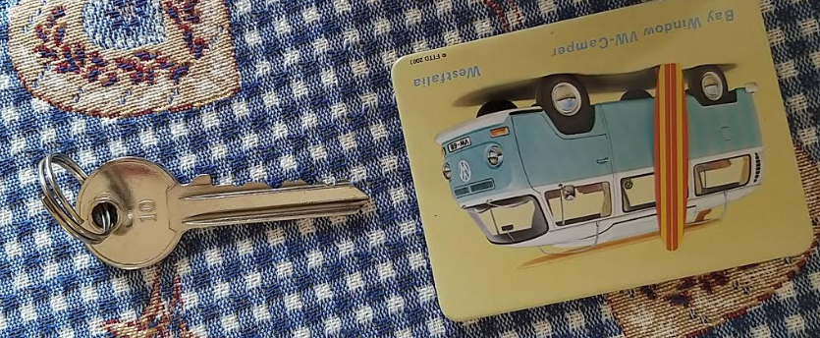
Magnetic✔️
Mrs Shipley’s Magnet Hunt!
Magnetic✔️
Magnetic✔️
Magnetic✔️
Non-magnetic
❌
Non-magnetic
❌

Slide 27
This is how Mrs Shipley recorded her results.
Object | Material | Magnetic Attracts to magnet. | Non-Magnetic Does not attract to magnet.
fridge | metal | ✔️ | ❌
saucepan | metal | ❌ | ✔️
key | metal | ❌ | ✔️
knife | metal | ✔️ | ❌
jar | metal lid and glass jar | ✔️metal lid | ✔️glass jar
dog food bowl | metal | ✔️ | ❌

Slide 28
Can you go on a magnet hunt and complete a table like Mrs Shipley did?
Object | Material | Magnetic Attracts to magnet. | Non-Magnetic Does not attract to magnet.
fridge | metal | ✔️ | ❌

Slide 29
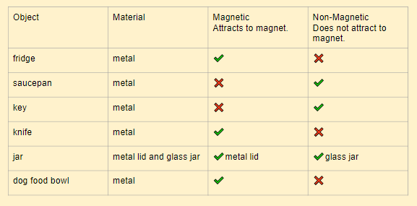
What did Mrs Shipley’s results tell her?
I noticed that all of my objects except the glass part of the jar were metal. Some of the objects were magnetic and some were not. Glass is not magnetic. I have found that metals can be different because some are magnetic and some metals are non-magnetic.
I could find out what the different types of metals are, in order to see which ones are magnetic.

Slide 30

Which materials were non-magnetic?
Were all the metal objects magnetic?
Which objects were magnetic? Why?
What did you discover?
When can objects have magnetic and non-magnetic properties?
Which metals are magnetic?
What could you investigate now?

