Slide 1

Thursday 4th June
Is your head ready to calculate?
Remember you can do these independently then share them with an adult.
Question 10 may have more than one answer.
Don’t worry about always finding the answer it is how you try to work out and reason that is important.

Slide 2
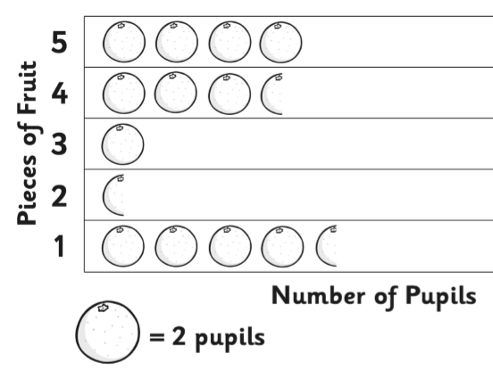
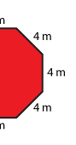
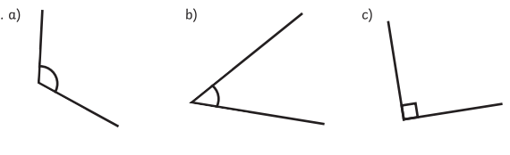

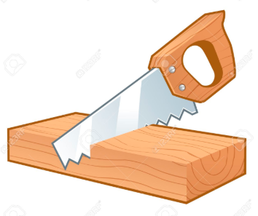
Morning Maths 04.06.20
7. What is the fewest pieces of fruit eaten by pupils?
8. 58 x 3
9. This shows
half of a regular
octagon. What is the
perimeter of the
complete octagon?
10. Use just 8s to
make 56. Use the same pattern
to make 42 just using 7s.
Once you have found the
pattern, what would the 3s
make?
27 + 4 +20
2. 217 + __ = 300
3. Which of these is NOT a multiple of 3: 13, 24, 27,
4. Insert the correct symbol (<,>,=)
⅗ ½
5. Order these angles from smallest to largest .
6. If I cut 87 cm from a 2m plank of
wood, how much have I got left?

Slide 3
Answers.
7. 2 pieces of fruit (1 child)
8. 8 x 3 = 24 and 50 x 3 = 150
150 +24 = 174
9. 8 x 4 = 32 m
10. 7 x 8 = 56
6 x 7 = 42
5 x 6 = 30
4 x 5 = 20
3 x 4 = 12
51
83
13
> greater than
b, c, a
200 - 87 = 13 cm

Slide 4

St Catherine’s Classroom Beliefs
Mistakes are valuable.
Everyone can learn maths to the highest level.
Questions are really important.
Depth is more important than speed.
Maths is about making connections.
We may not be learning together in the classroom, but it is important to still remember our classroom beliefs.

Slide 5
WALT: identify and describe 2D shapes

Slide 6

A 2D shape has only got one face to it. It has no thickness and can only be seen (not picked up). Here are some examples of common 2D shapes. Can you match the name of the shape to the correct name?
Square
Trapezium
Parallelogram
Oval
Circle
Rectangle
Right angled triangle

Slide 7
A 2D shape has only got one face to it. It has no thickness and can only be seen (not picked up). Here are some examples of common 2D shapes. Can you match the name of the shape to the correct name?
Square
Trapezium
Parallelogram
Oval
Circle
Rectangle
Right angled triangle

Slide 8
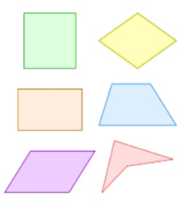
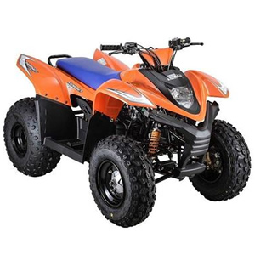
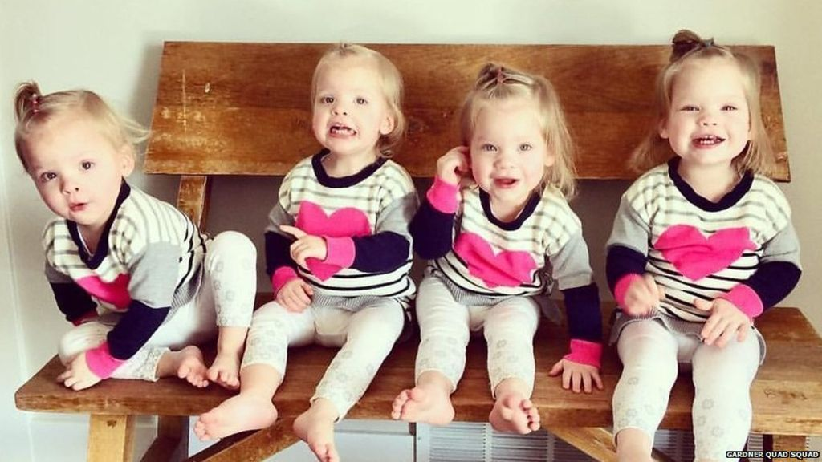
We sort our 2D shapes into groups. In one of those groups we have quadrilaterals. Think about the word ‘quad’ and where you have heard it before. What do you think a quadrilateral is? Here are some hints for you.
Quad bike
Quadruplets
Quadrilaterals

Slide 9
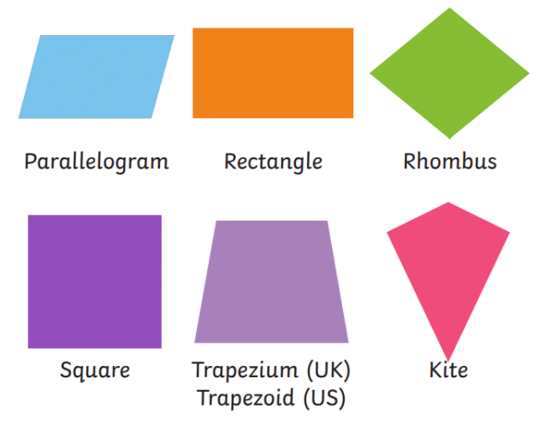
A quadrilateral is a 4 sided shape. Some you will already know. However, some you might not have heard of before.
That’s right it means 4.

Slide 10
Now we are going to move onto triangles. Believe it or not there are four different types of triangle. If you look at the names clearly you might be able to work out a few of them.
Image | Name | Features
 | Equilateral Triangle | All sides are the same length
 | Right Angled Triangle | Has 1 right angle
 | Isosceles Triangle | Two sides are the same length and one is different
 | Scalene Triangle | No sides are the same length

Slide 11

Time for a break.
Have a drink and a snack.

Slide 12
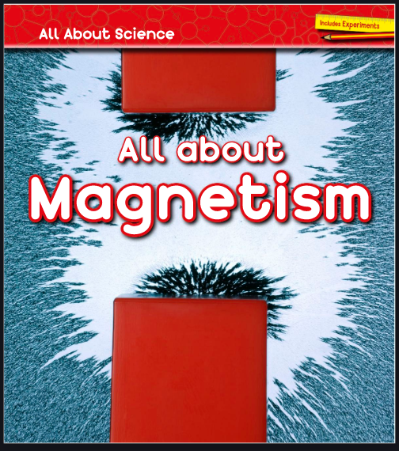
WALT retrieve and infer information from a text.
Use the link below to read the e- book -
All about Magnetism
https://readon.myon.co.uk/reader/index.html?a=aas_aamag_s16

Slide 13
WALT retrieve and infer information from a text.
Answer the following comprehension questions about the book. Use sentences.
Read pages 4 - 7 and answer these questions.
How does a fridge door work?
How does the magnet pick up a nail without touching it?
List 3 different types of magnet.
Explain what a keeper is used for.
Read pages 10 -13 and answer these questions.
List 4 ways that magnets can be used.
Name 2 metals that are magnetic and 1 non-magnetic metal.
How can you turn a paperclip into a magnet?
Read pages 16 -17 and answer this question.
Explain how a magnet can hold a sheet of paper to the fridge door.

Slide 14
Answers.
Read pages 4 - 7 and answer these questions.
How does a fridge door work?
There is a magnet in the rubber strip which pulls the door shut.
How does the magnet pick up a nail without touching it?
The magnetic force pulls the nail towards the magnet.
List 3 different types of magnet.
Bar, horseshoe and ring.
Explain what a keeper is used for.
It is put on the ends/poles of a magnet to stop the magnetic force leaking away. It helps the magnet maintain its magnetism.

Slide 15
Read pages 10 -13 and answer these questions.
5. List 4 ways that magnets can be used.
On toy trains to connect the cars, to fasten smart phones cases, to lift crushed scrap metal and to recycle metals at a recycling centre.
6. Name 2 metals that are magnetic and 1 non-magnetic metal.
Iron and steel are magnetic. Aluminium is non-magnetic.
7.How can you turn a paperclip into a magnet?
You can attach it to a magnet or rub it with a permanent magnet.
Read pages 16 -17 and answer this question.
8. Explain how a magnet can hold a sheet of paper to the fridge door.
It can do this because the magnetic force from the magnet passes through the paper and allows it to attract to the fridge door.
Answers.

Slide 16

15 minute Spelling Activity
This is revision of previous work
What is a suffix? (ful, less and ly)
ful means full of - truthful = full of truth
less means without - useless = without any use
ly tells us how - friendly (adverb) = she acts in a friendly way
Remember; When the root word has a consonant and y at the end you drop the y replace it with an i then add the suffix.
(e.g) happy happi happier

Slide 17
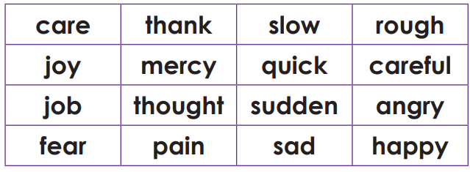
Read these root words or core words.

Slide 18
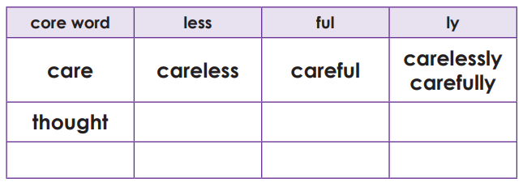
We can add a suffix (ful, ness, ly ) to some of the words to make new words. Draw a table like the one below and try making new words with each core word.

Slide 19
Core | less | ful | ly
care | careless | careful | carefully carelessly
joy | joyless | joyful | joylessly joyfully
job | jobless
fear | fearless | fearful | fearlessly fearfully
thank | thankless | thankful | thanklessly thankfully
mercy | merciless | merciful | mercilessly mercifully
thought | thoughtless | thoughtful | thoughtlessly thoughtfully
pain | painless | painful | painlessly painfully
Which ones did you find?
Did you spell them correctly?
Core | less | ful | ly
slow |  |  | slowly
quick |  |  | quickly
sudden |  |  | suddenly
sad |  |  | sadly
rough |  |  | roughly
careful |  |  | carefully
angry |  |  | angrily
happy |  |  | happily

Slide 20
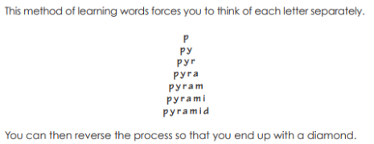
thoughtless
merciful
happily
roughly
fearfully
thankfully
Now practise these spellings using pyramid writing.

Slide 21

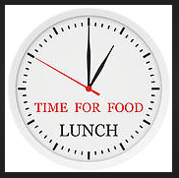
Your morning lessons are completed.
Time for lunch.
Then come back this afternoon for your curriculum activity.

Slide 22
History of Kidderminster

Slide 23
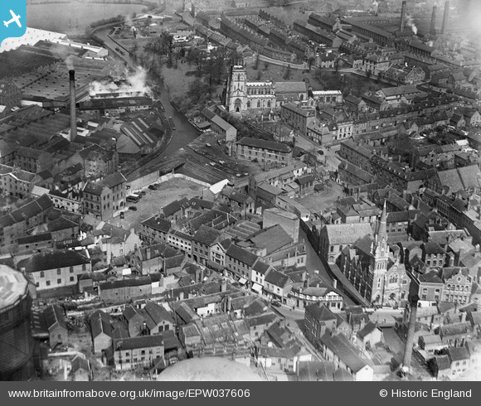
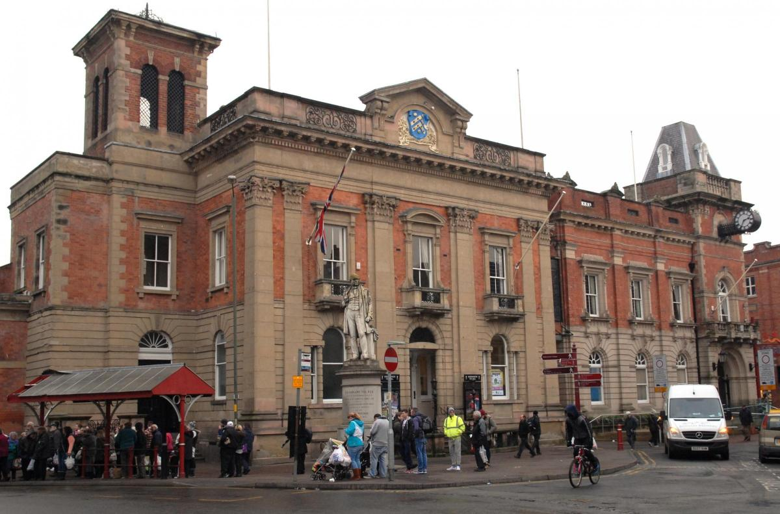
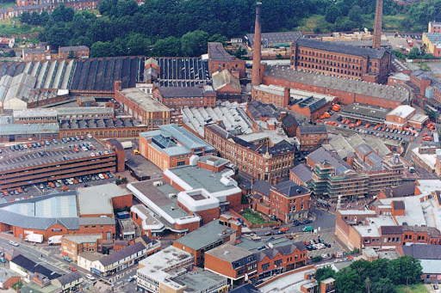
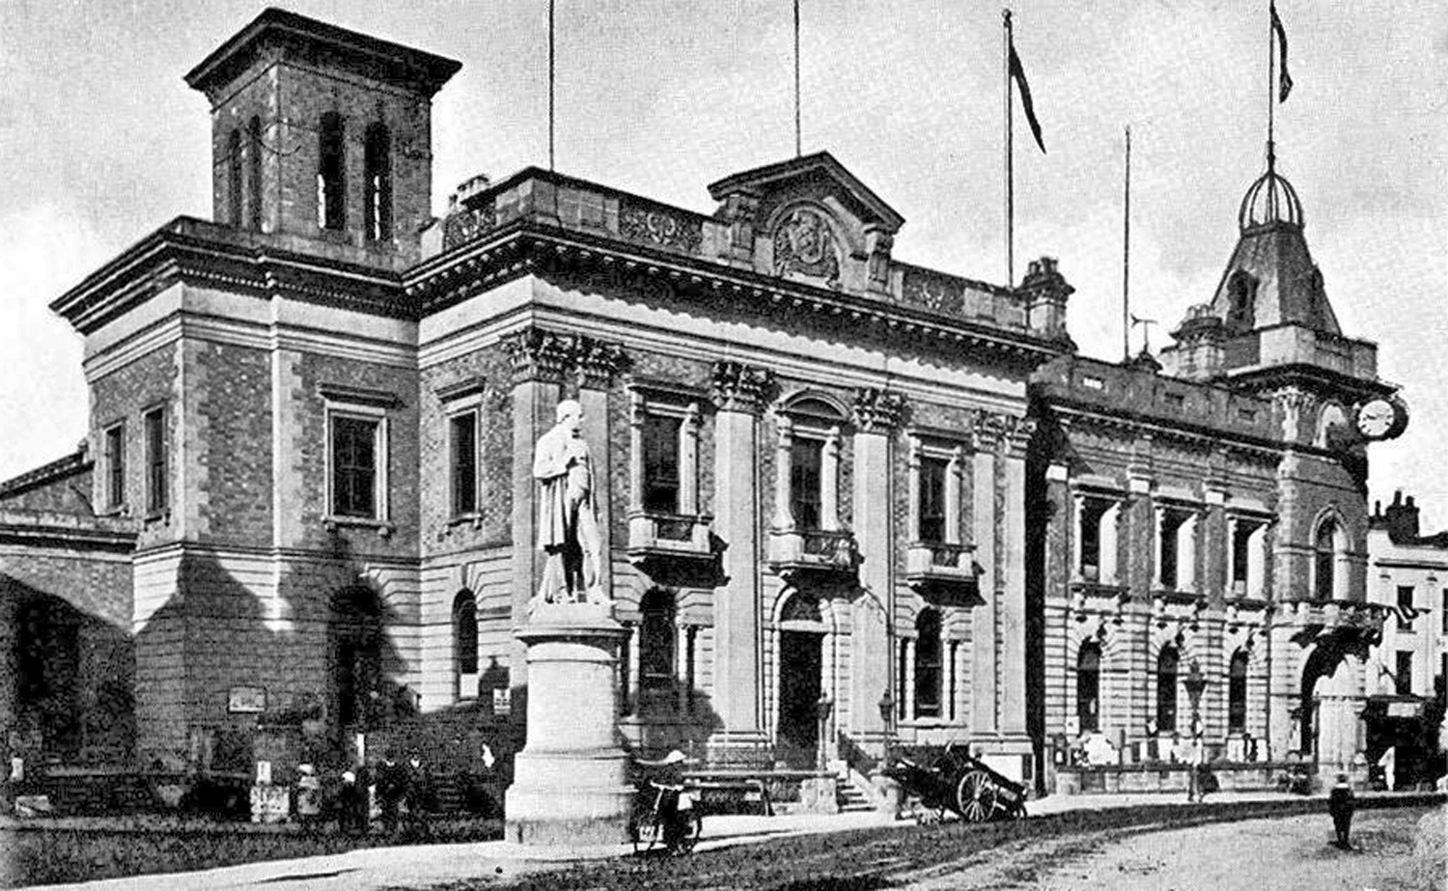
If we went back in time 300 years, Kidderminster would look very different. Most of the buildings you see today wouldn’t be there, the roads wouldn’t have cars and lorries on them and life itself would look completely different.

Slide 24
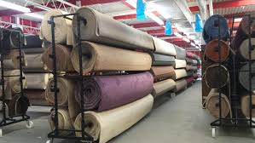
Something that Kidderminster is well known for is it’s production of carpets. Carpets have been made in Kidderminster for hundreds of years and this industry brought a lot of wealth to the town. Kidderminster was producing carpets very successfully but the way they made their success is very different to how businesses today reach success.

Slide 25
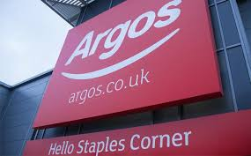
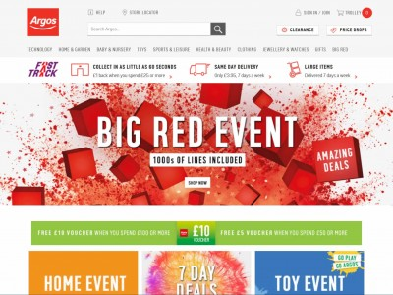

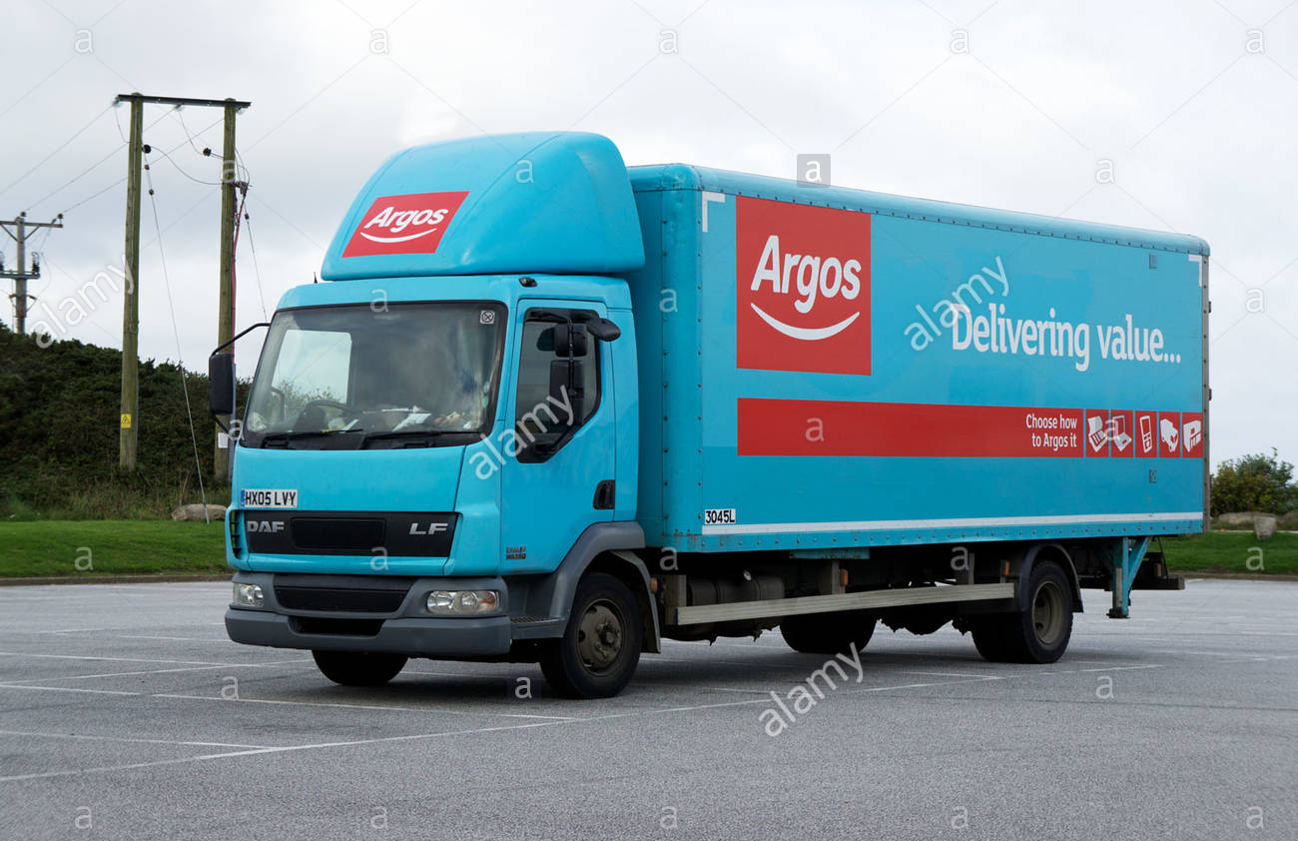
Companies like Argos get their products around through websites, deliveries and stores. But hundreds of years ago you couldn’t order something online or just have it delivered in a Lorry. So how did Kidderminster carpets get carpets to people?

Slide 26
Follow the link below and play a game to find out how people around the country moved goods around the country, including Kidderminster and it’s carpets.
https://canalrivertrust.org.uk/explorers/games/build-a-canal

