Slide 1
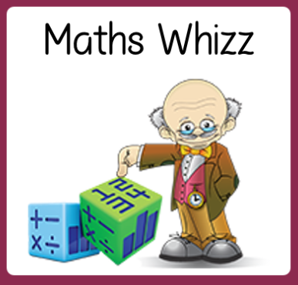
Friday 5th June
Are you a maths whizz today?
Remember you can do these independently then share them with an adult.
Question 10 may have more than one answer.
Don’t worry about always finding the answer it is how you try to work out and reason that is important.

Slide 2
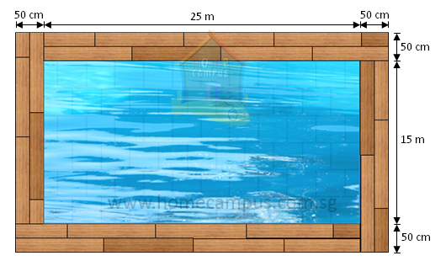

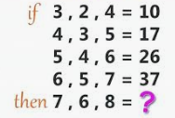
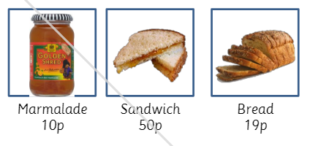
Morning Maths 05.06.20
9. What is the perimeter of the tiles around this pool ?
10.
40 fewer than 227?
2. Complete the pattern:
460 ➗ 10 = 46
4,600 ➗ 10 = __
3. 235 + 399
4. What is the subtraction statement
5. 456 + 132
6. 50 ➗ 4
7. Which is NOT a multiple of 8?
88, 808, 38, 48
8. How much change from £5 to buy
two loaves, 3 jars of marmalade and
a sandwich?
Challenge:
Can you complete the pattern?

Slide 3
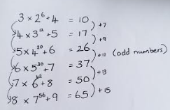
7. 38
8. 2 x 19 = 38
3 x 10 = 30
1 x 50 = 50
38 + 30 + 50 =118
500 - 118 = 382p or £3.82
9. 50 + 2500 + 50 = 2600 2600 x 2 = 5200 cm
50 + 1500 + 50 = 1600 1600 x 2 = 3200 cm
5200 + 3200 = 8400
8400 ÷ 100 = 84 so 8400 cm or 84 m
10.
Answers.
227 - 40 = 187
460
634
693 -103 = 590
588
10 x 4 = 40
2 x 4 = 8
12 x 4 = 48 with 2 left over out of 50
So 12 r 2

Slide 4

St Catherine’s Classroom Beliefs
Mistakes are valuable.
Everyone can learn maths to the highest level.
Questions are really important.
Depth is more important than speed.
Maths is about making connections.
We may not be learning together in the classroom, but it is important to still remember our classroom beliefs.

Slide 5
WALT: manipulate 2D shapes
To end the week, we are going to let you play a game. Follow the link below and enjoy.
https://pbskids.org/oddsquad/games/pienado/
If you don’t have a laptop, go to the next slide.

Slide 6
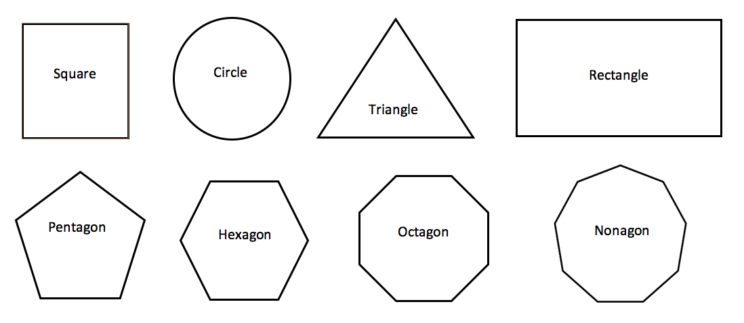
Going around your house, can you find an object that is the same shape as the following? You’ll find 3D shapes around your house but see if you can match the 2D shape on the page to the 3D shape in your house.
Coins might be helpful here.

Slide 7

Time for a break.
Have a drink and a snack.

Slide 8
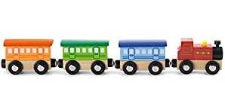
WALT: write an explanation.
How does this engine pull its carriages?
How does the engine move?
Talk about your ideas.
What do you notice at the end of each carriage?
Could you think of another way to make the engine move?
How are the carriages joined to each other?
How are the wheels useful?

Slide 9
WALT: write an explanation.
How does this engine pull its carriages?
I would need to pull the engine to make it move forwards.
Talk about your ideas.
The carriages have a magnet on each end.
I could also push the engine to make it move forwards.
The magnets attract and pull together to join the carriages.
The engine and carriages have wheels to help it move. They roll.

Slide 10
Here is an explanation using scientific knowledge of forces and magnets to help us understand how the train can pull its carriages.
On the back of the engine, and also on the end of each carriage is a magnet. When two magnets are placed at opposite poles it causes them to pull together or attract. This means they become joined together by magnetism.
The engine must either be pulled or pushed in order for it to roll along on its wheels.
The carriages follow the engine because they are held by the force of magnetism.
Read the text twice. Now can you pick out all the scientific words or vocabulary.

Slide 11
This is the scientific vocabulary.
Did you find them all?
On the back of the engine, and also on the end of each carriage is a magnet. When two magnets are placed at opposite poles it causes them to pull together or attract. This means they become joined together by magnetism.
The engine must either be pulled or pushed in order for it to roll along on its wheels.
The carriages follow the engine because they are held by the force of magnetism.

Slide 12
Now read the text again. This time look for all the causal conjunctions and causal phrases that help us explain why something happens.
On the back of the engine, and also on the end of each carriage is a magnet. When two magnets are placed at opposite poles it causes them to pull together or attract. This means they become joined together by magnetism.
The engine must either be pulled or pushed in order for it to roll along on its wheels.
The carriages follow the engine because they are held by the force of magnetism.

Slide 13
These are the causal conjunctions and causal phrases that help us explain why something happens.
On the back of the engine, and also on the end of each carriage is a magnet. When two magnets are placed at opposite poles it causes them to pull together or attract. This means they become joined together by magnetism.
The engine must either be pulled or pushed in order for it to roll along on its wheels.
The carriages follow the engine because they are held by the force of magnetism.

Slide 14
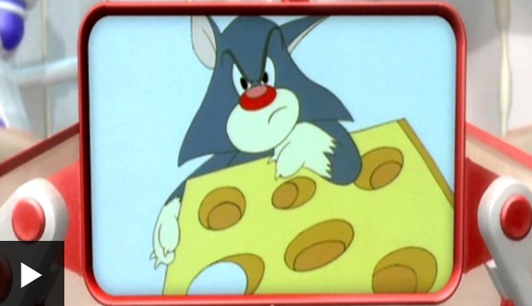
Use the link to watch this short clip.
https://www.bbc.co.uk/bitesize/clips/z3gvr82
How did the mice use magnets to get to the cheese?
How did they use magnets to escape from the cat?

Slide 15
Write an explanation using your knowledge of forces and magnets to explain how the mice climbed the fridge and how they escaped from the cat. Use these vocabulary lists to help you.
Causal Conjunctions/Phrases
because as the in order to
due to which makes by
consequently as a result of
this means this causes
Science Vocabulary.
force pull push magnet
magnetism attract repel
magnetic field north pole south pole
When you have finished share your work with an adult.

Slide 16
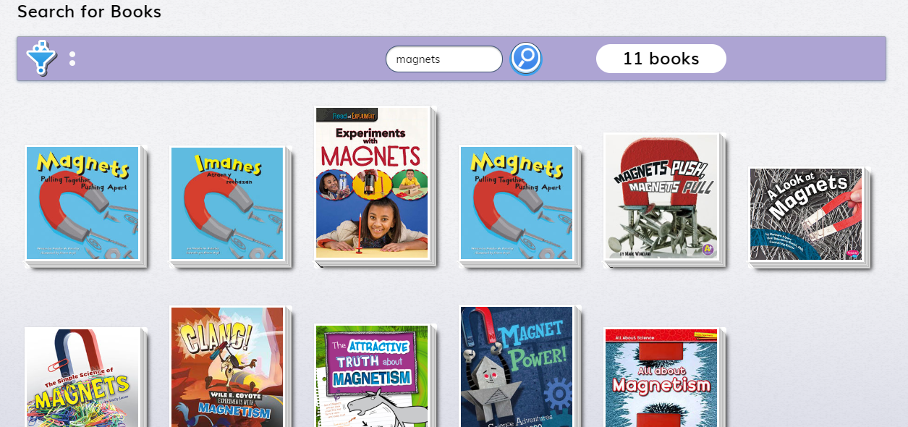
If you are interested you can do more reading on Magnets by clicking on the link.
This can be done if and when you want to look.
Type magnets in the search bar and click the blue symbol.
https://readon.myon.co.uk/library/search.html
You can even read a spanish book!

Slide 17

15 minute Spelling Activity
This is revision of previous work
What is a suffix? (ful, less, ness and ly)
ful means full of - truthful = full of truth
less means without - useless = without any use
ly tells us how - friendly (adverb) = she acts in a friendly way
ness means the act of being = happiness means you are being happy
Remember; When the root word has a consonant and y at the end you drop the y replace it with an i then add the suffix.
(e.g) happy happi happier

Slide 18

First click on the link to revise the suffix ness. It also revises the suffix er.
https://uk.video.search.yahoo.com/yhs/search?fr=yhs-itm-001&hsimp=yhs-001&hspart=itm&p=ness+suffix+for+kids#id=1&vid=f727079293e45cf46e5ba12ea05f5ffe&action=view
Write down the words you are searching for as you watch the video clip. - it explains on the video to look for er words and ness words.

Slide 19
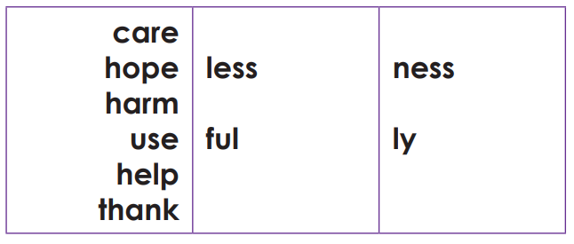
How many words can you make using these core words and the suffixes. Write them all down. Can you make 36 words?
Check the next slide for the answers. Make sure your spellings are correct.

Slide 20
Core word | less | ful | ness | ly
care | careless | careful | carelessness carefulness | carelessly carefully
hope | hopeless | hopeful | hopelessness hopefulness | hopelessly hopefully
harm | harmless | harmful | harmlessness harmfulness | harmlessly harmfully
use | useless | useful | uselessness usefulness | uselessly usefully
help | helpless | helpful | helplessness helpfulness | helplessly helpfully
thank | thankless | thankful | thanklessness thankfulness | thanklessly thankfully

Slide 21


Your morning lessons are completed.
Time for lunch.
Then come back this afternoon for your curriculum activity.

Slide 22

PE
Type in the website address show at the in the box above into your search engine.
Fill in the log in details and log in.

Slide 23
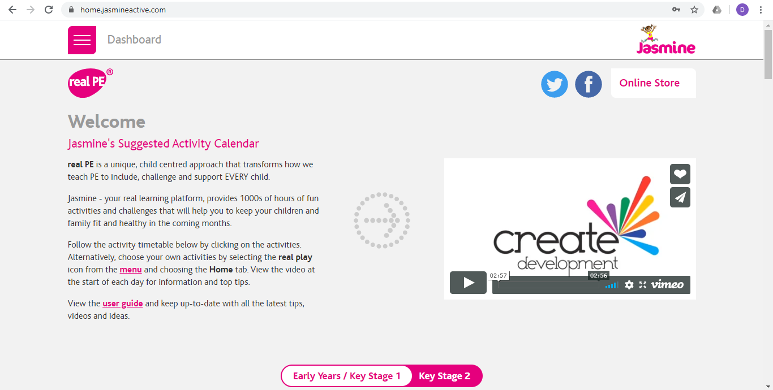
Once you have logged onto real PE click on ‘Key Stage 2’ and scroll down the page.

Slide 24
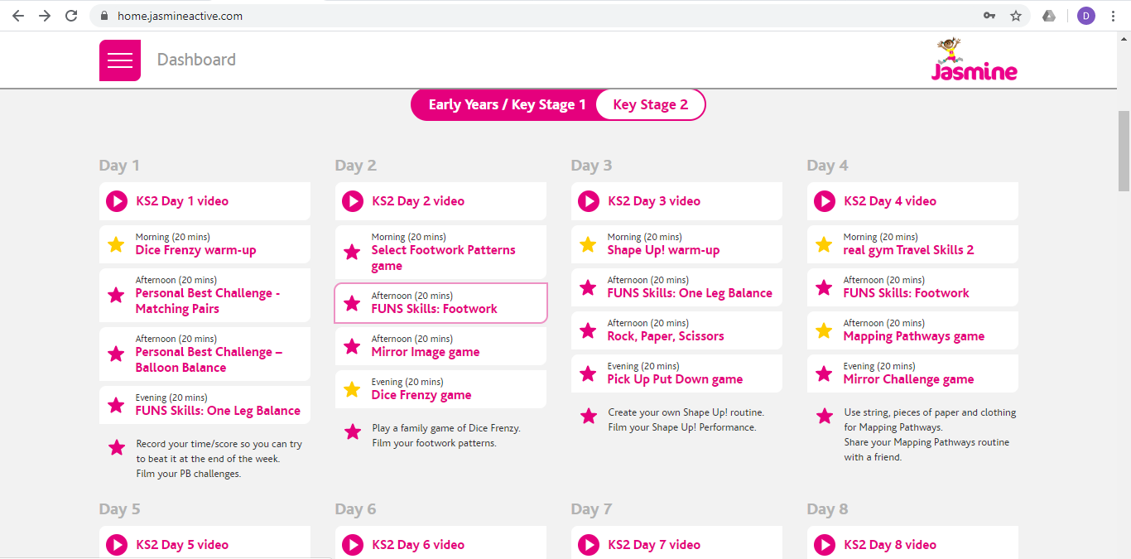
Then follow the sections for Day 3, starting with ‘KS2 Day 3 Video’.

Slide 25

Both Mrs Shipley and Mr Mottershead hope you have had a good week and enjoyed learning all about magnets and a little bit about the town we live in.
We hope you have a relaxing weekend and keep yourselves safe. We’ll see you again for more home learning next week.

