Slide 1

Monday 8th June
We will begin our day with Morning Maths - just like in school! This should be 10 -15 minutes.
You can do these independently then share them with an adult.
Remember question 10 may have more than one answer.
Don’t worry about always finding the answer it is how you try to work out and reason that is important.

Slide 2
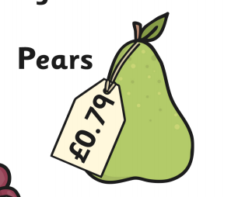
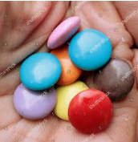
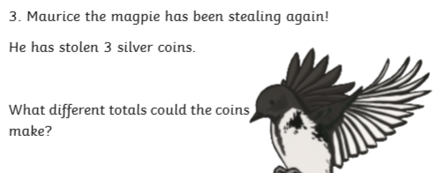
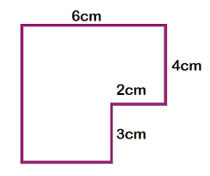
Morning Maths 08.06.20
8. 456 + 14 + __ = 500
9. How much would three pears cost?
10.
30 fewer than 115
2. 290 10
3. Complete this
bar model.
4. 48 12
5. What fraction of these
Smarties are blue?
6. 415cm = __m___cm
7. What is the perimeter of
this shape?
164
90

Slide 3
85
29
74
4
2/8 or ¼
4m 15 cm
6 + 4 + 2 + 3 =15
(3 + 4 = 7) and (6 -2 =4) 7 +4 = 11
15 + 11 = 26
30
79 x 3 = 237
9 x 3 = 27 and 70 x 3 = 210 210 + 27 = 237
Various answers.
3 x 50p = £1.50
3 x 20p = 60p
3 x 10p = 30p
3 x 5p = 15p
50 + 20 + 20 = 90p
50 + 20 + 10 = 80p

Slide 4

St Catherine’s Classroom Beliefs
Mistakes are valuable.
Everyone can learn maths to the highest level.
Questions are really important.
Depth is more important than speed.
Maths is about making connections.
We may not be learning together in the classroom, but it is important to still remember our classroom beliefs.

Slide 5
WALT: identify the properties of a 3D shape.

Slide 6
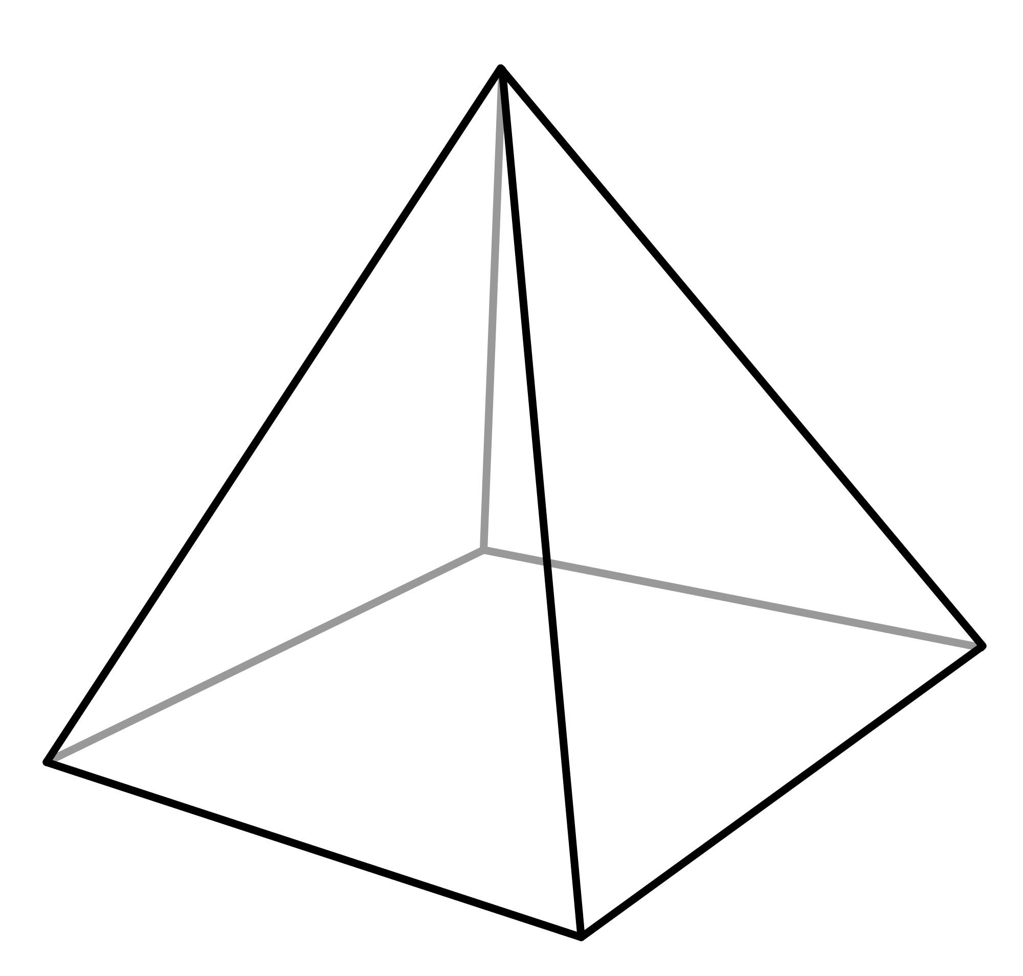
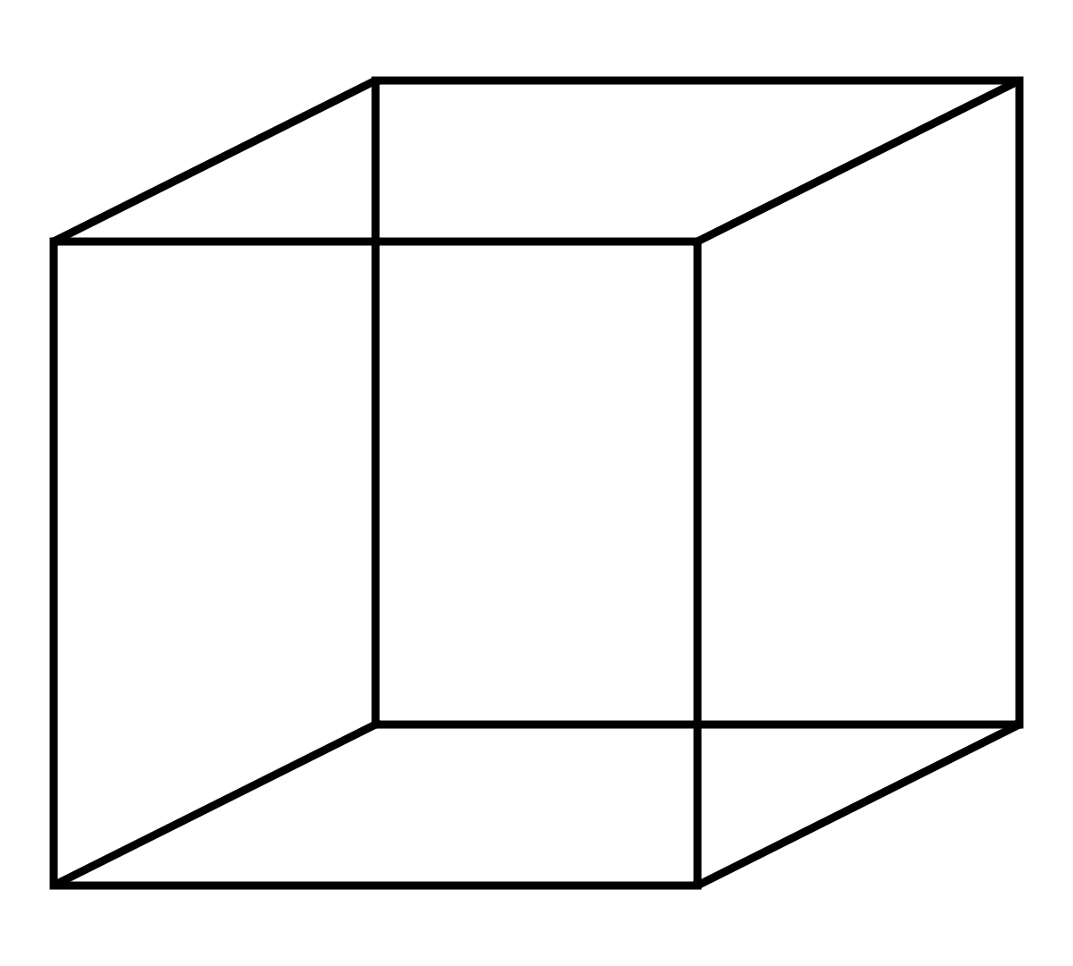
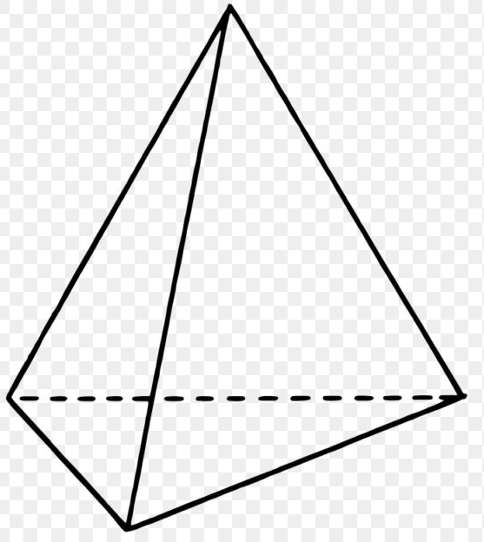
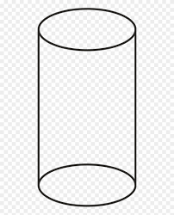
A three dimensional shape or 3D shape is made up of three parts.
Faces
Vertices (corners)
Edges (sides)
The faces of a 3D shape are 2D shapes on their own. The vertices are where two or more sides meet. The edges are the connections between the vertices. Can you spot which of the following shapes are 3D and which are 2D?

Slide 7
2D 3D

Slide 8
You might have spotted that on each of the 3D shapes, you can spot some 2D shapes. Let’s look at one example.
Here you can see a cube. However, all of the faces on the cube look like squares.

Slide 9
2
A cube has 6 faces which are all squares. Look at the red numbers on the diagram to see where the faces are.
3
6
1
4
1
3
5
The vertices are where the edges meet. The blue numbers show where the vertices are on a cube.
2
4
1
2
4
3
5
7
5
6
6
The edges are shown with the black numbers on the diagram. An edge is a continuous line that starts at ends at vertices.
8
8
7
9
10
12
11

Slide 10
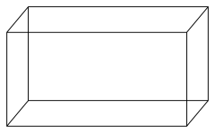
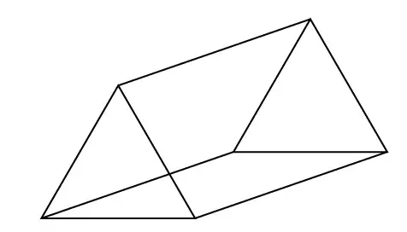
For the following shapes, can you identify how many faces, vertices and edges each one has?
Diagram and name | Number of faces | Number of vertices | Number of edges
Square based pyramid
Cuboid
Triangular prism

Slide 11
For the following shapes, can you identify how many faces, vertices and edges each one has?
Diagram and name | Number of faces | Number of vertices | Number of edges
Square based pyramid | 5 | 5 | 8
Cuboid | 6 | 6 | 12
Triangular prism | 5 | 6 | 9

Slide 12

Time for a break.
Have a drink and a snack.

Slide 13
Read the story of The Selfish Giant by Oscar Wilde
Then answer the comprehension questions in full sentences.
WALT: retrieve and infer information from a text.

Slide 14
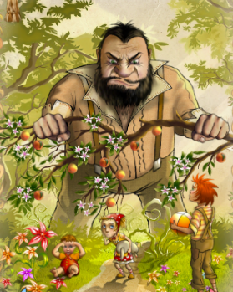
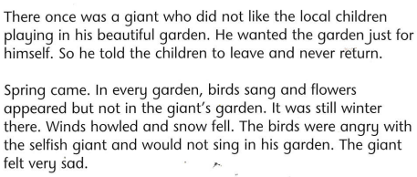
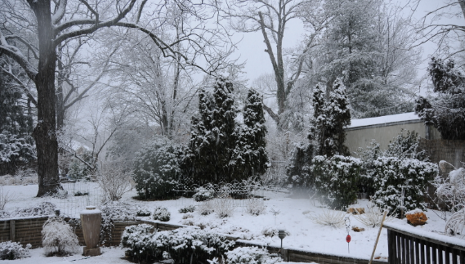
The Selfish Giant by Oscar Wilde

Slide 15
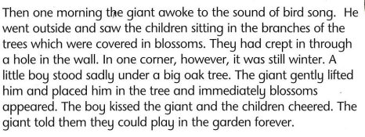
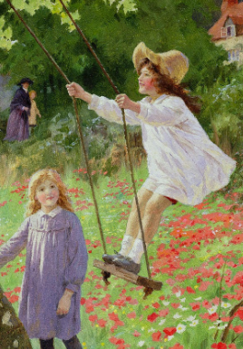
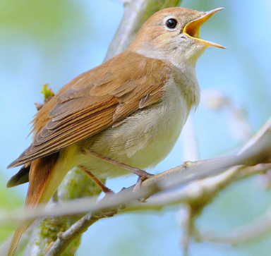

Slide 16
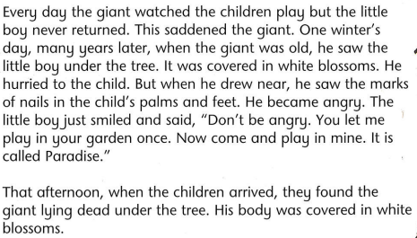
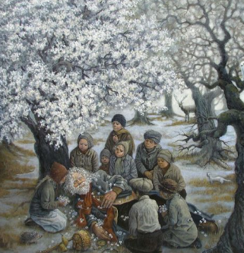

Slide 17
Why did the giant tell the children to leave his garden?
When Spring arrived why didn’t the birds sing in the giant’s garden?
Why do you think the little boy was not able to climb the tree?
When the children arrived in the afternoon what did they find?
Find and copy one word which the author uses to tell us that the winds were strong.
Using evidence from the second paragraph, explain why the giant was sad.
List the effects of the children on the garden when they began playing there again.
Who do you think the little boy in the story was? What is the evidence to support your answer?
Explain why it was surprising that the giants body was covered in white blossom.
Where do you think the garden of paradise might be?

Slide 18
Why did the giant tell the children to leave his garden?
It was his garden and he was angry that they were there he didn’t want to share it.
When Spring arrived why didn’t the birds sing in the giant’s garden?
The birds were angnry with the giant because he had asked the children to leave and hadn’t treated them kindly.
Why do you think the little boy was not able to climb the tree?
He couldn’t climb the tree because he was too small and he was injured.
When the children arrived in the afternoon what did they find?
They found the body of the giant covered in blossom.
Find and copy one word which the author uses to tell us that the winds were strong.
howled
Using evidence from the second paragraph, explain why the giant was sad.
He was sad because his garden was not beautiful with spring flowers and there was no bird song to listen to in his garden.
List the effects of the children on the garden when they began playing there again.
The birds sang, blossom covered the trees, Spring came back to the garden, the children played and were happy.
Who do you think the little boy in the story was? What is the evidence to support your answer?
The little boy could represent Jesus because he has the marks of nails in his palms and feet like Jesus did when he was crucified.
Explain why it was surprising that the giants body was covered in white blossom.
Because it was winter and blossom doesn’t flower in the winter.
Where do you think the garden of paradise might be?
The garden of paradise could represent heaven or a beautiful garden where people go when they die.

Slide 19

What is a prefix?
A prefix is a group of letters which we add to the beginning of a word to make a new word with a different meaning.
Today we will look at new prefixes
super, anti, auto, trans and over.
(The following 6 slides are taken from Twinkl.)
15 minute Spelling Activity

Slide 20
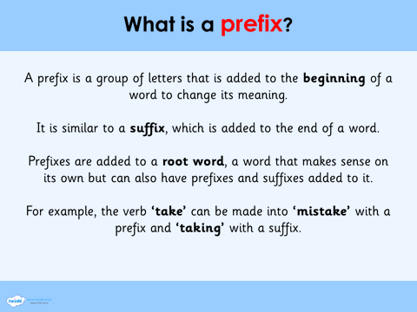

Slide 21
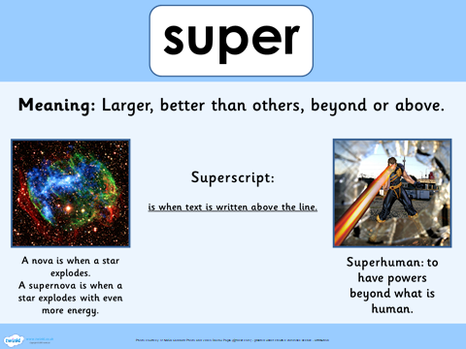

Slide 22
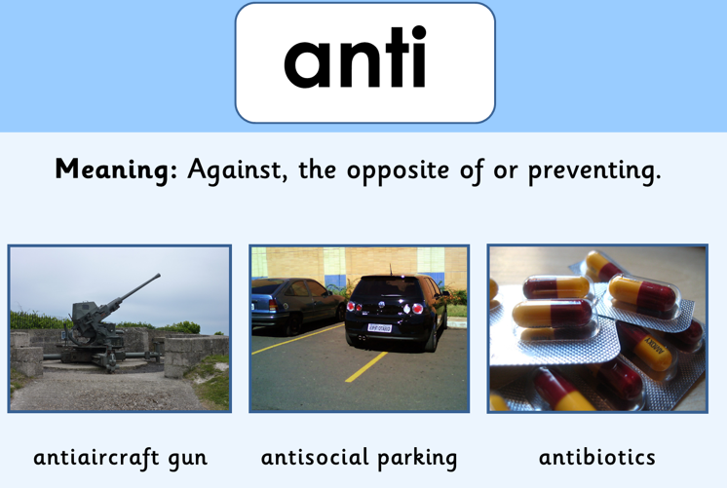

Slide 23
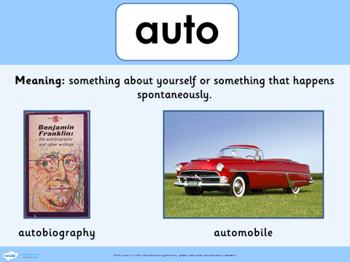

Slide 24
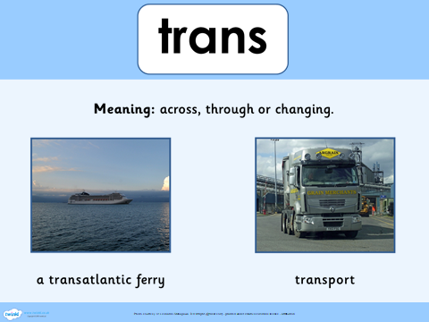

Slide 25
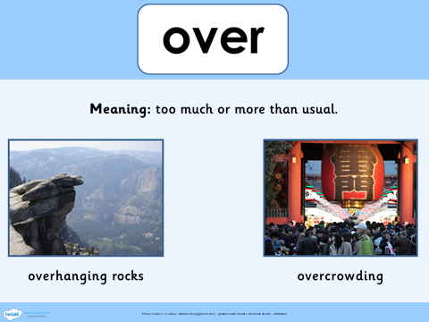

Slide 26
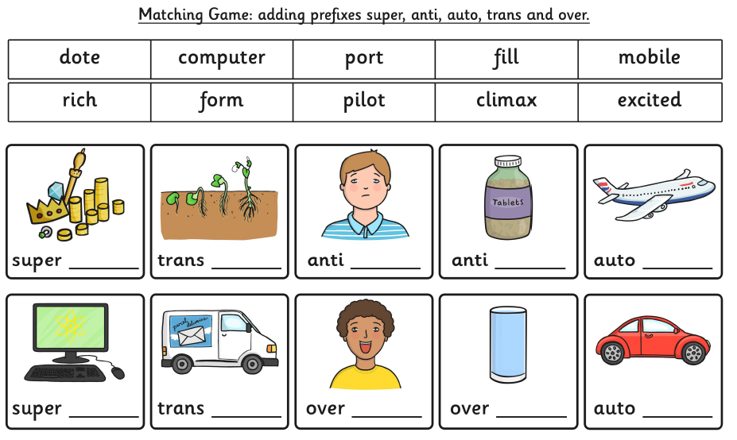

Slide 27
superrich
transform
anticlimax
antidote
autopilot
supercomputer
transport
overexcited
overfill
automobile

Slide 28
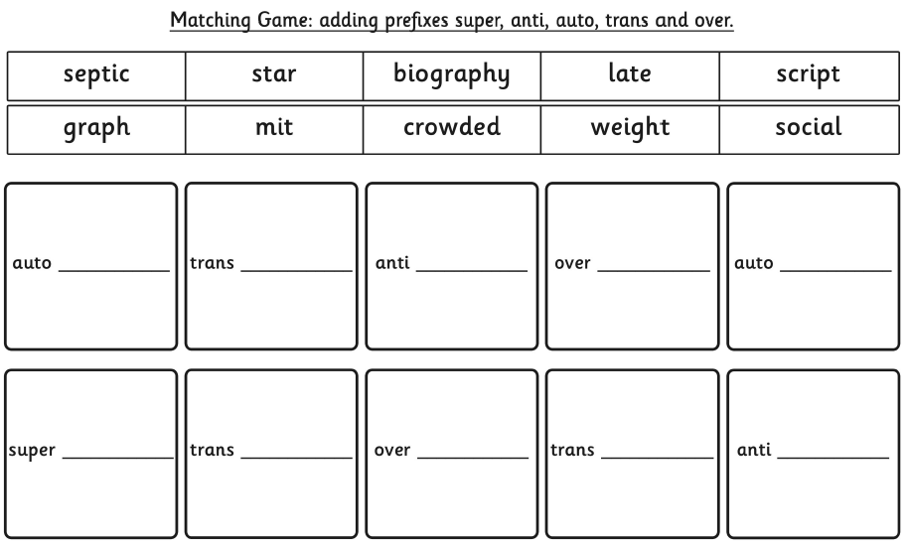

Slide 29
graph
script
social
weight
biography
crowded
late
septic
star
mit

Slide 30


Your morning lessons are completed.
Time for lunch.
Then come back this afternoon for your curriculum activity.

Slide 31
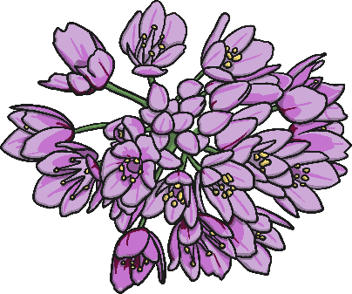
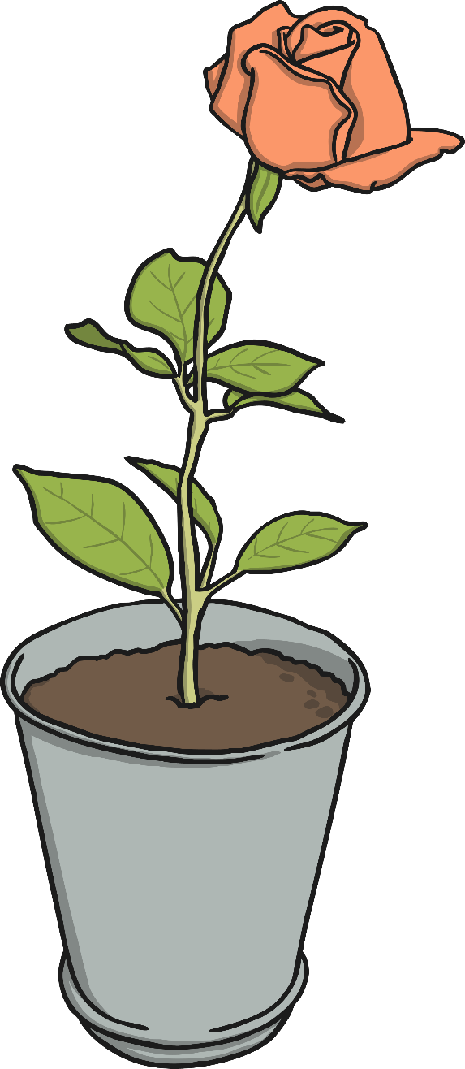
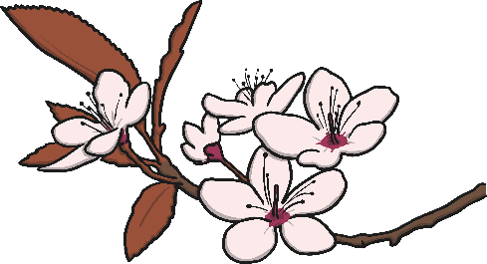
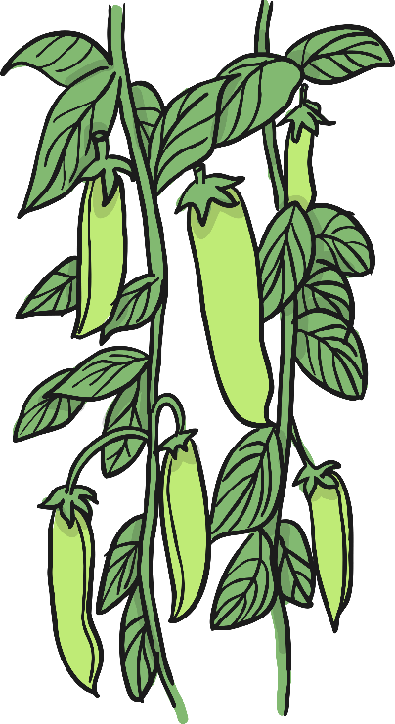
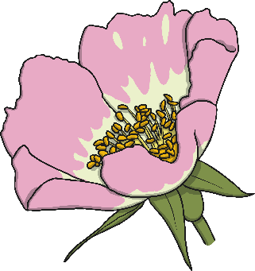
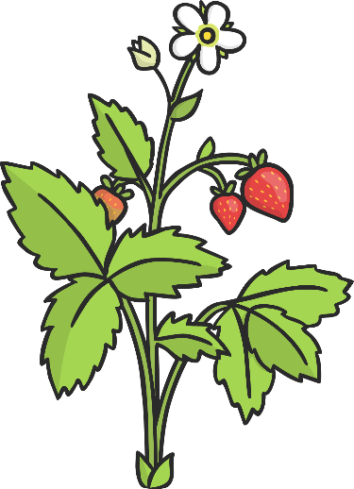
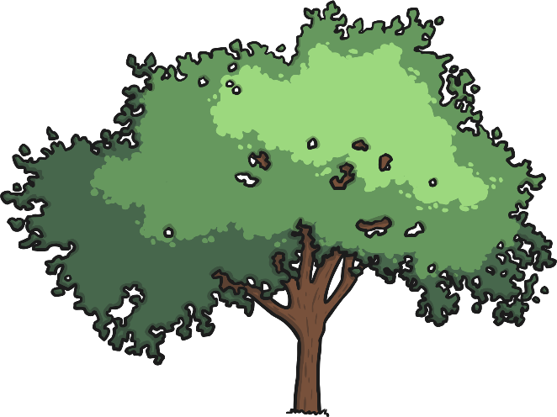
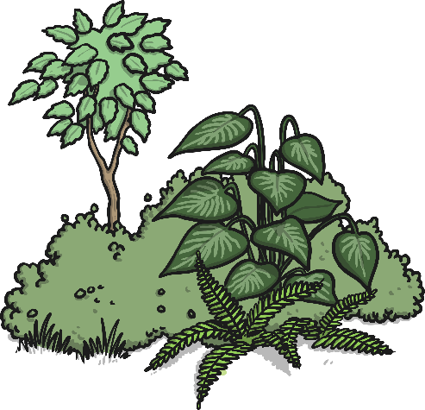
Plants!
We are going to be learning about plants.
Do you recognise any of these plants?
Do you know what the different parts of the plants are called?

Slide 32

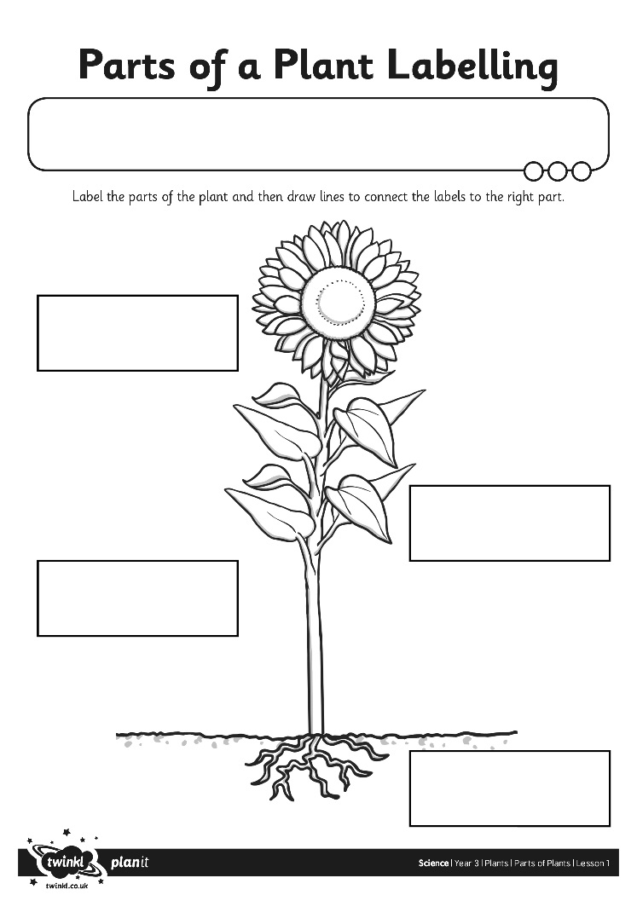
Parts of a Plant
Plants have different parts that do different jobs.
Do you know the names of the different parts of a plant?
Work with a partner to fill in the blank labels on the plant on your activity sheet.

Slide 33
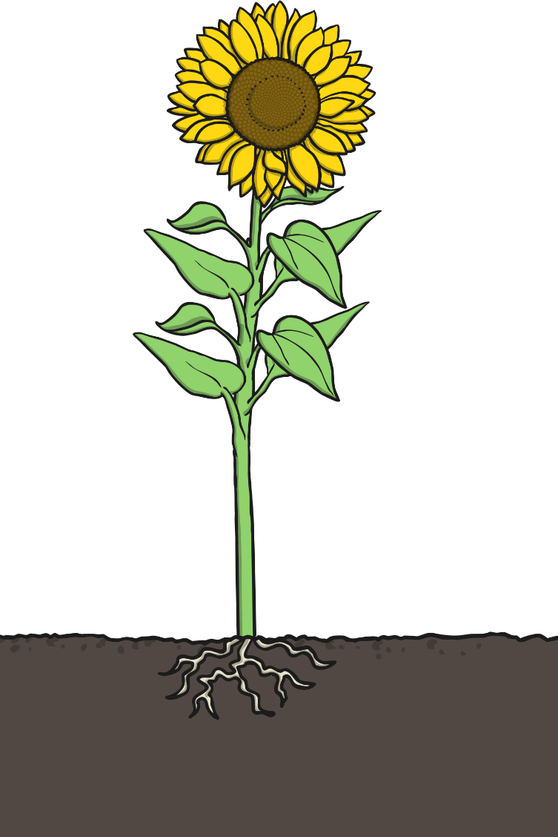
Parts of a Plant:
How Did You Do?
Flower
Leaves
Stem
Roots

Slide 34
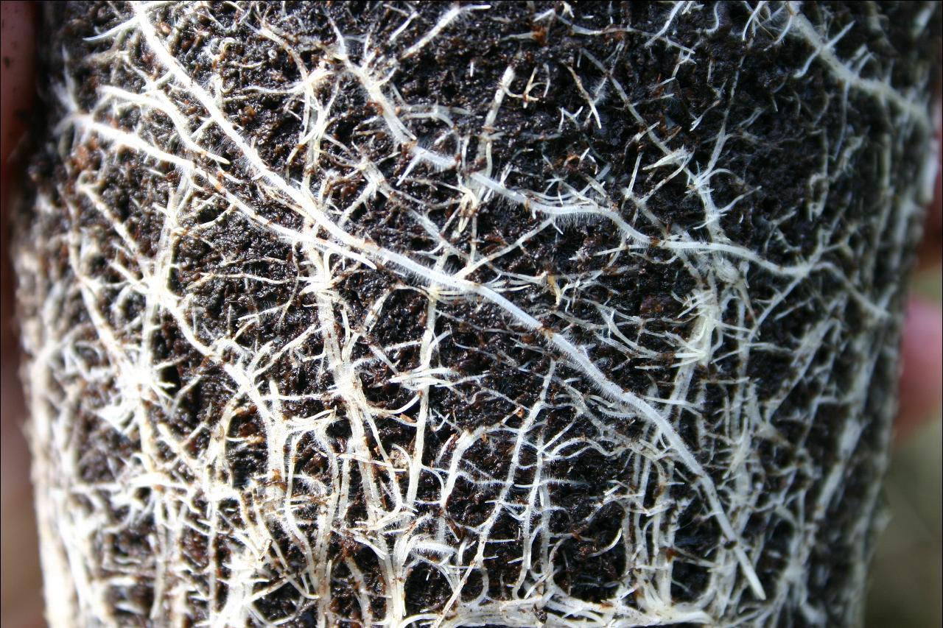
What Jobs Do They Do?
Roots
Where do we find the roots of a plant?
They grow underneath a plant, below the surface of the soil.
Roots are usually long and are covered in small hairs.
What do you think their jobs are?
The roots anchor the plant in the ground.
They absorb water and nutrients from the soil.
Photo courtesy of barnoid @flickr.com) - granted under creative commons licence – attribution

Slide 35
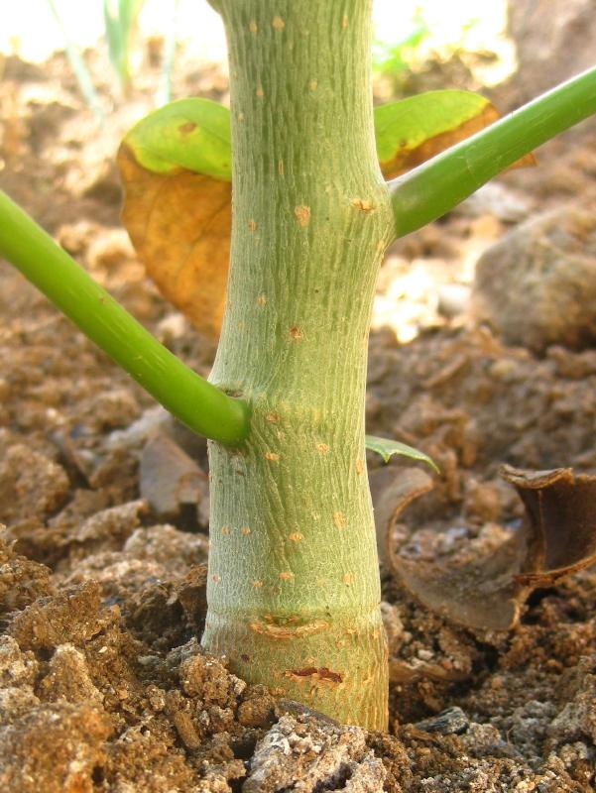
What Jobs Do They Do?
Stem or Trunk
What is a stem or trunk?
Branches, leaves and flowers grow from the stem or trunk.
A trunk is woody, and often has a layer of bark around it.
What job does it do?
The stem or trunk holds the plant up.
It also carries water and nutrients from the roots to the leaves.
Photo courtesy of tonrulkens @flickr.com) - granted under creative commons licence – attribution

Slide 36
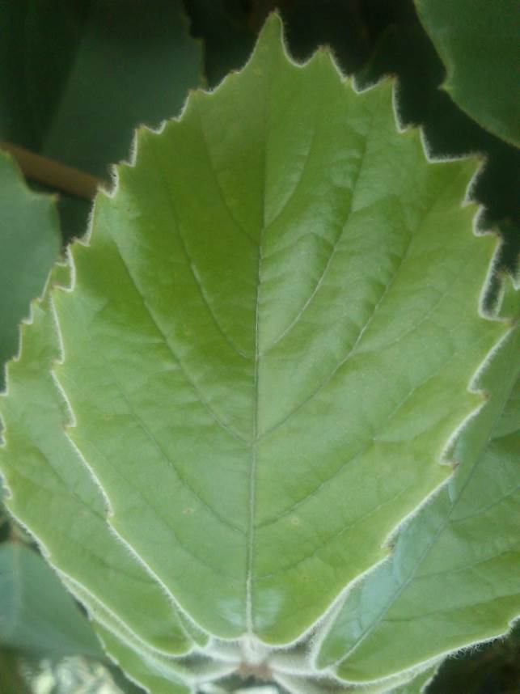
What Jobs Do They Do?
Leaves
What job do leaves do?
The leaves make food for the plant using sunlight and carbon dioxide from the air.
Photo courtesy of leaf watoru @flickr.com) - granted under creative commons licence – attribution

Slide 37
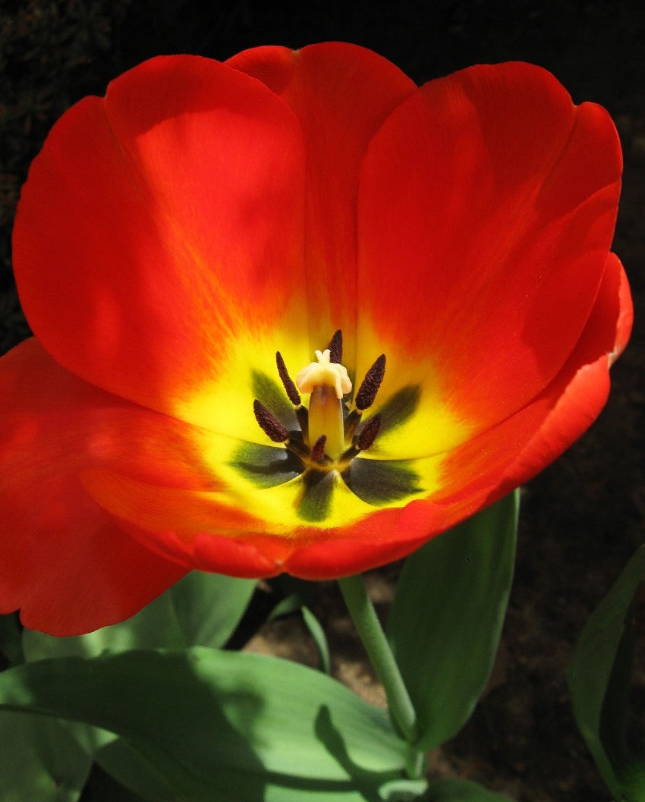
What Jobs Do They Do?
Flowers
Do you know what the flower’s job is?
Flowers are brightly coloured to attract insects and birds.
The insects carry pollen to other flowers.
Flowers use the pollen to make seeds to grow new plants.
Photo courtesy of Puzzler4879 @flickr.com) - granted under creative commons licence – attribution

Slide 38



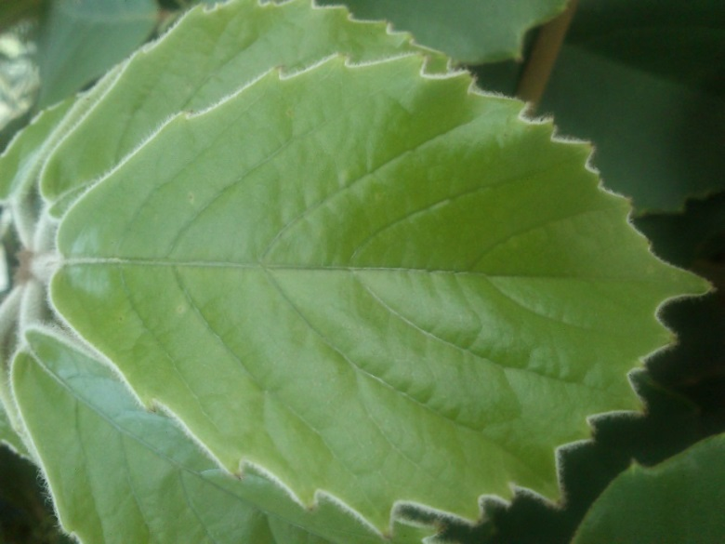
What Can You Remember?
Look at these pictures of the different parts of a plant.
Take turns to tell your partner what you can remember about the job or jobs each part does. Help each other to remember as much as you can!

Slide 39

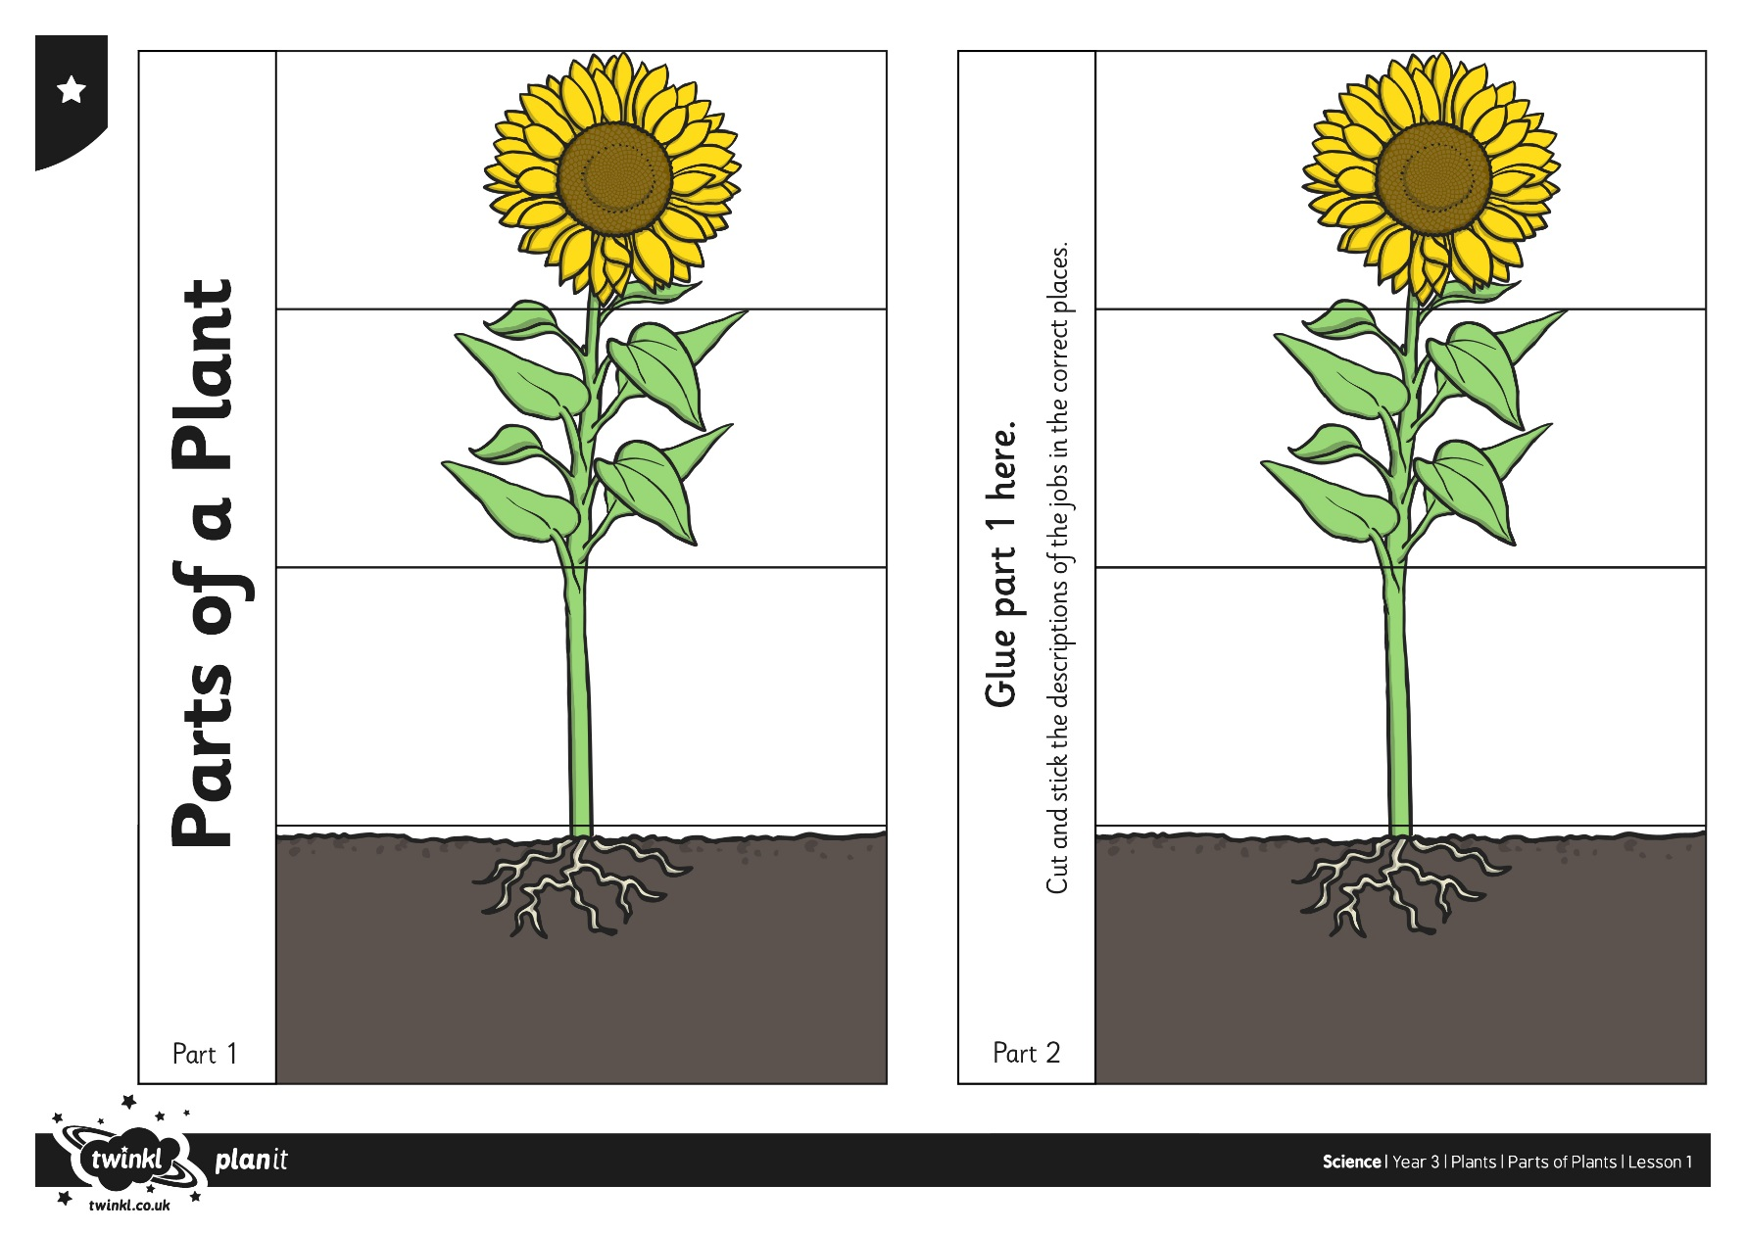
Fun Facts
Now is your chance to show what you have learnt!
Your job is to create a folding leaflet to explain the function of the different parts of a plant.

Slide 40
Your Task
Find a plant in your garden/house or a picture of one online for you to copy.
On a piece of paper copy draw the picture of the plant.
Label the parts of the plants accurately.

Slide 41

We hope your day went well.
See you tomorrow.

Slide 42

Tuesday 9th June
Ready to wake up your maths brains?
Remember you can do these independently then share them with an adult.
Question 10 may have more than one answer.
Don’t worry about always finding the answer it is how you try to work out and reason that is important.

Slide 43
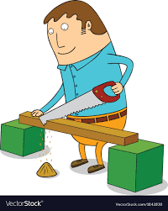


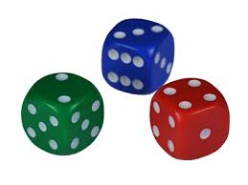
Morning Maths 09.06.20
7. Jim cuts off 35cm
from a 3m plank.
How long is the plank
afterwards?
8. Fill in the gaps:
653, __, __, 641, 637, __
9. What was the time half an hour before this?
10. How many ways
can you score 10
using 3 dice?
How many tens in 404 ?
2. Write a calculation statement for this part-whole model:
3. 341 - 283
4. 34 x 7
5. How many ml in ½ litre?
6. Which is the biggest angle?
18
56
a
c
b

Slide 44
40
56 - 18 = 38
341 - 283 = 58
7 x 4 = 28, 30 x 4 = 120 so 120 + 28 = 148
500ml
C
2m 65 cm
653, 649, 645, 641, 637, 633
20 mins to 11, 10:40
6 3 1, 6 2 2, 5 4 1, 5 3 2, 4 4 2, 4 3 3,

Slide 45
St Catherine’s Classroom Beliefs
Mistakes are valuable.
Everyone can learn maths to the highest level.
Questions are really important.
Depth is more important than speed.
Maths is about making connections.
We may not be learning together in the classroom, but it is important to still remember our classroom beliefs.

Slide 46
WALT: identify and name 3D shapes.

Slide 47
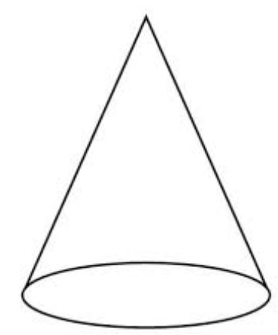
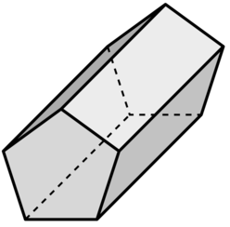
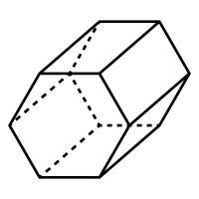
You have already heard of a few of the names of 3D shapes. But we are going to try and work out some of the names of 3D shapes ourselves. Here are the common 3D shapes. If you look carefully at the names you might be able to work out the shapes.

Slide 48
Cube
Cuboid

Slide 49
Cube
Cuboid

Slide 50
Triangular prism
Hexagonal prism
Pentagonal prism

Slide 51
Triangular prism
Hexagonal prism
Pentagonal prism

Slide 52
Triangular based pyramid
Cone
Square based pyramid
Cylinder

Slide 53
Triangular based pyramid
Cone
Square based pyramid
Cylinder

Slide 54
Time for a break.
Have a drink and a snack.

Slide 55

We know that we start a sentence with a capital letter.
We know that we use capital letters for proper nouns - (e.g)names of people, places, days and months
We should also use a capital letter for the pronoun I because this replaces the name of the person.
WALT: use capital letters for the personal pronoun I.
I am very important.
I always have a capital letter.

Slide 56
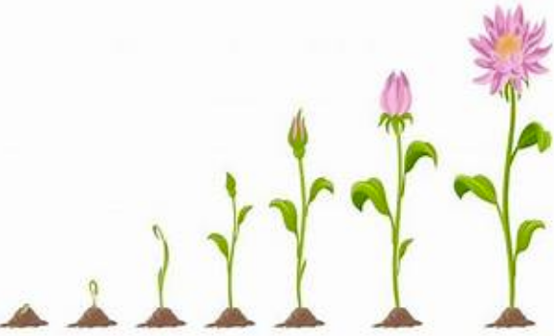
Imagine you are this flower. What is happening to you? Talk about this or write down your ideas.

Slide 57
Mrs shipley wrote these sentences as a little story about the pictures. She forgot all about capital letters for sentence starts, proper nouns and pronoun I. Her sentences are all in a muddle too! She didn’t put them in the correct order. Can you rewrite the text in order and add in the missing capitals and punctuation.
i was becoming big and strong then one day little green shoots appeared i started life as a tiny seed in june i became a fully grown flower the gardener planted me in the garden last april every wednesday he checked to see if i was growing he dug a hole and placed me in it his wife reminded him to water me soon i had leaves and a little buds

Slide 58
I started life as a tiny seed. The gardener planted me in the garden last April. He dug a hole and placed me in it. His wife reminded him to water me. Every Wednesday he checked to see if I was growing. Then one day little green shoots appeared. I was becoming big and strong. Soon I had leaves and little buds. In June I became a fully grown flower.

Slide 59
What is a prefix?
A prefix is a group of letters which we add to the beginning of a word to make a new word with a different meaning.
Today we will focus on the prefixes super, anti and auto
(The following 3 slides are taken from Twinkl.)
15 minute Spelling Activity

Slide 60
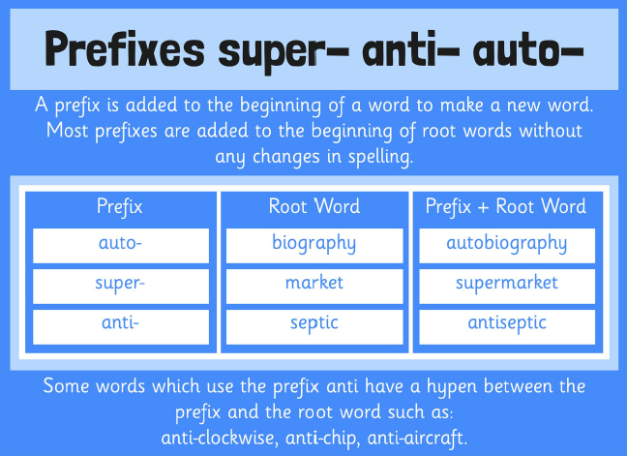

Slide 61
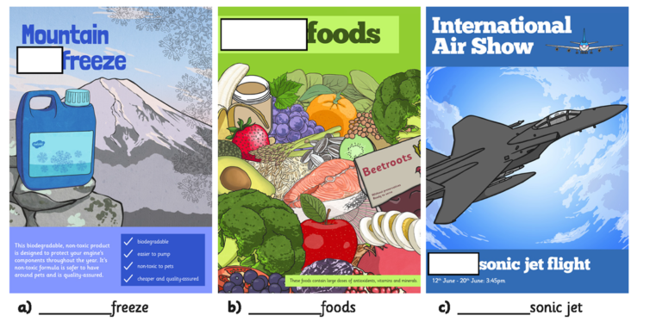
Look at the posters on this slide and the next slide. The prefix of some words are missing. Can you write the words in full by adding the correct prefix - super, auto or anti?

Slide 62


Slide 63
antifreeze
superfoods
supersonic
antibacterial
automatic
antiseptic
Super, Anti, Auto - Answers.

Slide 64


antifreeze
superfoods
supersonic
antibacterial
automatic
antiseptic
Rainbow write each
word 3 times.

Slide 65
Your morning lessons are completed.
Time for lunch.
Then come back this afternoon for your curriculum activity.

Slide 66


Science
WALT: explain the adaptations of a cactus.

Slide 67




Fill in the missing words using the bank below.

Slide 68
Fill in the missing words using the bank below.

Slide 69

We hope you had fun today.
See you tomorrow.

