Slide 1
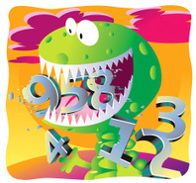
Wednesday 10th June
Ready to crunch some numbers?
Remember you can do these independently then share them with an adult.
Question 10 may have more than one answer.
Don’t worry about always finding the answer it is how you try to work out and reason that is important.

Slide 2
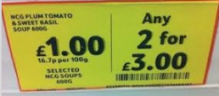
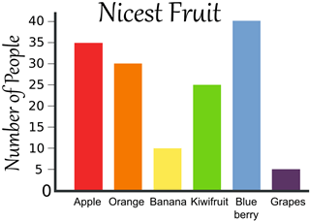
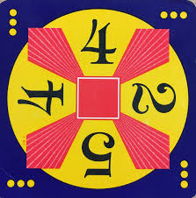
Morning Maths 10.06.20
8. What is wrong with this sale price?
9. How many more
people preferred
apples to
bananas?
10. Make 24 using
each number only
once and any of
the operators (+, -, x, ➗)
Put these in descending order:
101, 150, 501, 51, 115
2. £1 - 32p
3. Insert the correct symbol (< > = )
6 x 8 4 x 12
4. ➗ 3 = 5
5. Half of 110
6. I’m thinking of a number if I double it and add 5, I get 27. What is the number I am thinking of ?
7. The perimeter of a rectangle is 36cm. If one of the sides is 8cm. What is the length of the others?

Slide 3
501, 150, 115, 101, 51
68
=
15
55
11
8 + 8 = 16, 36 -16 = 20, 20 ÷ 2 = 10
At £1 per item it would only cost £2 for two which is cheaper than any 2 for £3 so the offer is not a saving.
35 liked apples - 10 liked bananas = a difference of 25
5 + 2 = 7, 7 x 4 = 28, 28 - 4 = 24

Slide 4

St Catherine’s Classroom Beliefs
Mistakes are valuable.
Everyone can learn maths to the highest level.
Questions are really important.
Depth is more important than speed.
Maths is about making connections.
We may not be learning together in the classroom, but it is important to still remember our classroom beliefs.

Slide 5
WALT: identify 3D shapes.

Slide 6
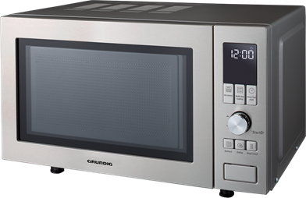
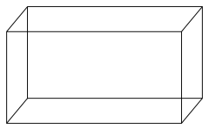
Today we are going to send you on a treasure hunt. We want to see if you can spot these objects in the things around the house. For example if you look at your microwave, you’ll see it is the shape of a cuboid.
The objects do not need to be exactly the shape. As you can see on the microwave it has legs and buttons that stick out, but the main shape is a cuboid.

Slide 7
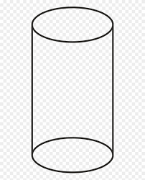
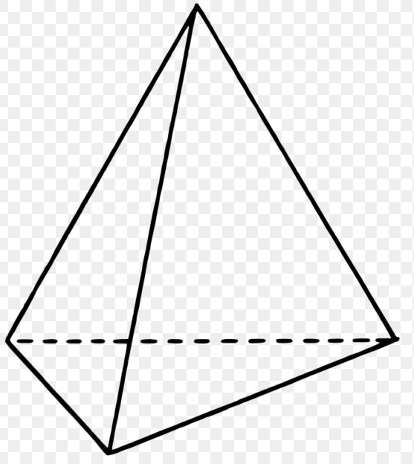
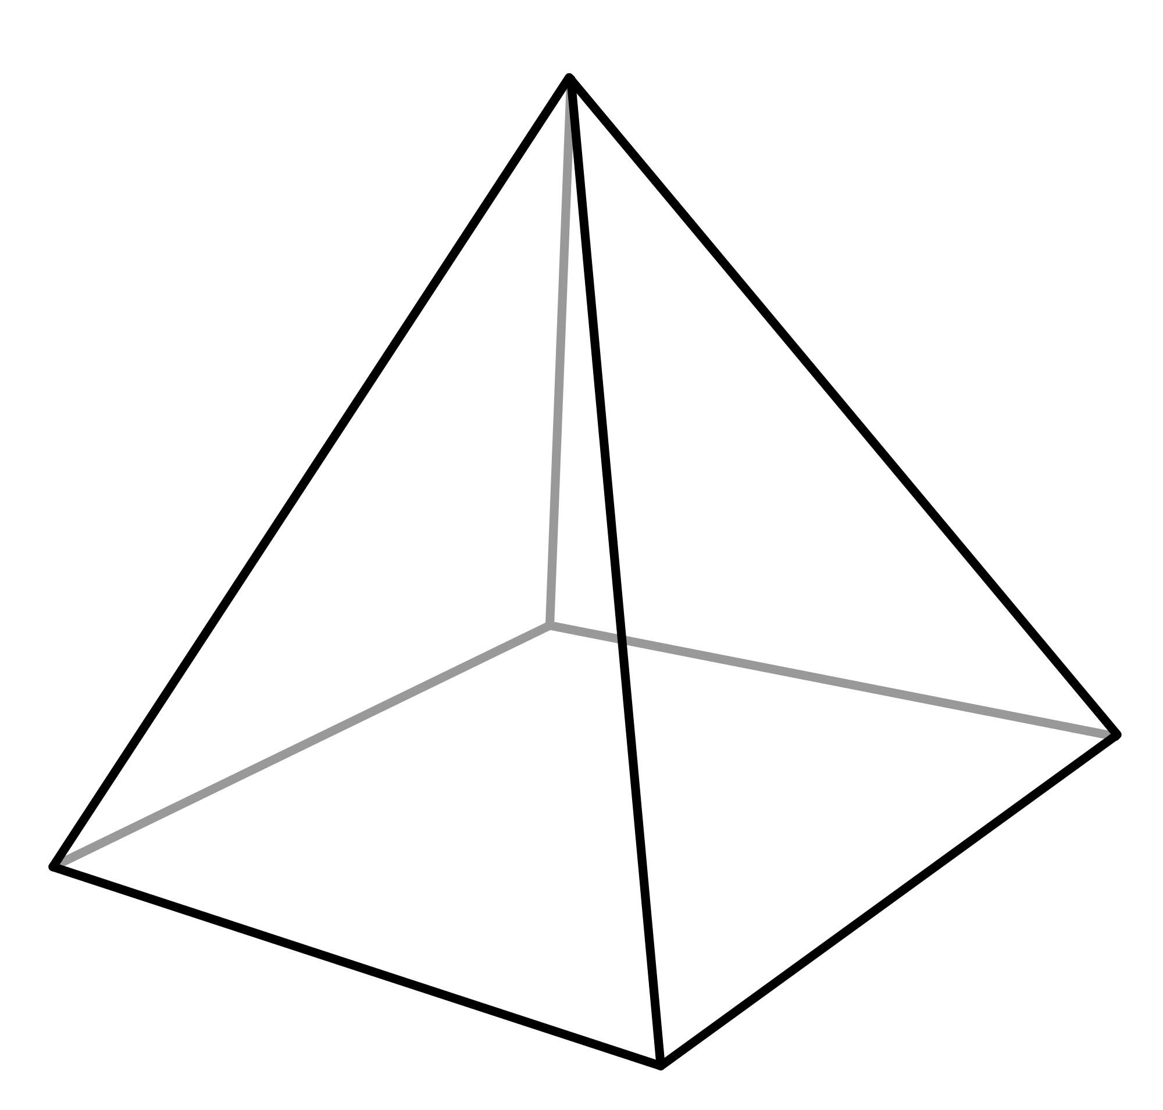
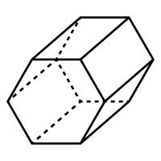
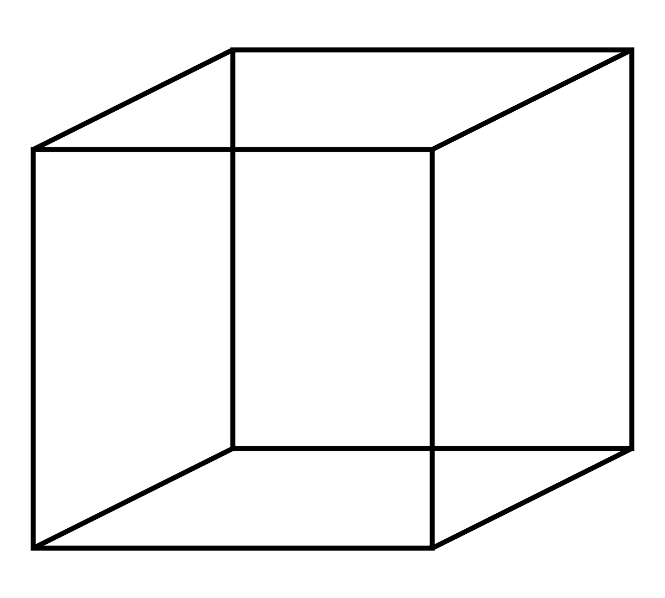
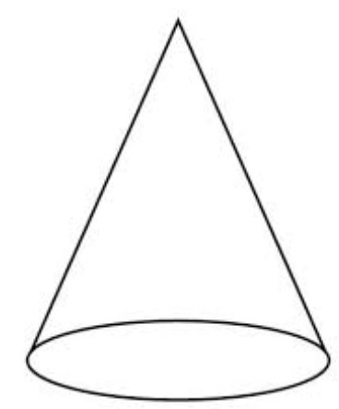
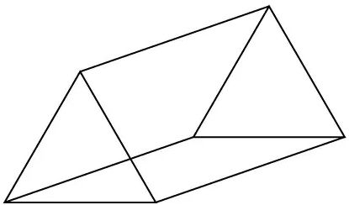
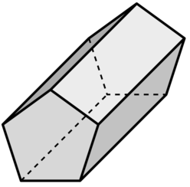

Slide 8

Time for a break.
Have a drink and a snack.

Slide 9
Our English task for today is a Close Reading Task
It is an extract from Blue John by Berlie Dougherty.
WALT: retrieve and infer information from a text.
Ask an adult to read the information (on the next page) to you.
Here are some meanings of words that might help you – stalactites - a rock formation that hangs from the ceiling of a cave
chipped - to hit and break away small pieces
lead - a type of heavy metal
miner - a person who digs for coal, stone or minerals underground
3. Now read it with your adult twice, they can help you with expression.
4. Now read it twice by yourself.
5. Read the questions and look for evidence in the text to help you answer them.
6. Write your answers in full sentences.

Slide 10
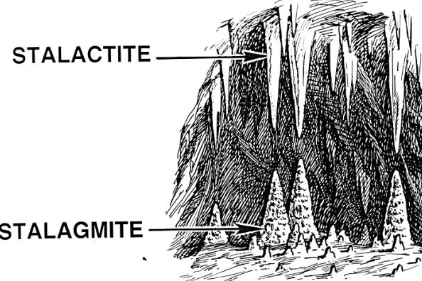
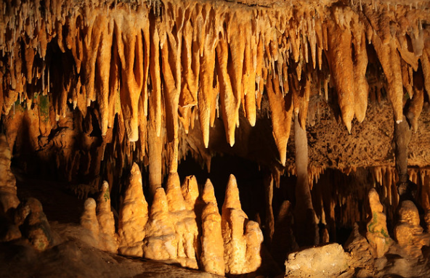
What is a stalactite?
stalactites - a rock formation that hangs from the ceiling of a cave
Here are some pictures to help you understand.

Slide 11
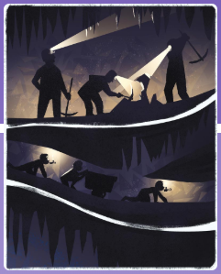
Stalactites grew like coral, like twisted icicles, like the horns of unicorns, like the crooked teeth of goblins. Miners crept along the tunnels and chipped and hammered with their picks and tools. Their children crawled on hands and knees down the narrow passageways, holding candles in their mouths, pushing cartloads of lead and stone in front of them.

Slide 12
Task:
How does the author help us to know what a stalactite looks like?
Find two words that suggest they moved slowly and at a low level in the tunnel.
Why do you think the children held candles in their mouths?

Slide 13
Task:
How does the author help us to know what a stalactite looks like?
He describes as like another object we might know such as a horn, icicle or tooth. These are similes.
Find and copy two words that suggest they moved slowly and at a low level in the tunnel.
crept and crawled
Why do you think the children held candles in their mouths?
They held them in their mouths because they were using their hands to crawl and push the carts. They needed them to see below ground.

Slide 14

What is a prefix?
A prefix is a group of letters which we add to the beginning of a word to make a new word with a different meaning.
Today we will focus on the prefix auto which means something about yourself or something that happens on its own
15 minute Spelling Activity

Slide 15
Put the prefix auto in front of these words and write down your new words.
Read the new words aloud.
Practise writing each word 3 times.
Which words would you use in the sentences on the next slide?
graph
pilot
biography
focus
matic
mobile

Slide 16
Now use the words you have practised to complete the sentences. Make sure you spell them correctly.
The camera had an _______________ for taking photographs.
The red _______________ sped swiftly along the motorway.
The fans asked the famous footballer to sign his ______________.
An __________ is the story someone writes about their own life.
Modern washing machines are ___________, therefore we don’t need to wash all our clothes by hand,.
The ______________ navigation system kept the airplane on a steady course.

Slide 17
Now use the words you have practised to complete the sentences. Make sure you spell them correctly.
The camera had an autofocus for taking photographs.
The red automobile sped swiftly along the motorway.
The fans asked the famous footballer to sign his autograph.
An autobiography is the story someone writes about their own life.
Modern washing machines are automatic, therefore we don’t need to wash all our clothes by hand,.
The autopilot navigation system kept the airplane on a steady course.

Slide 18

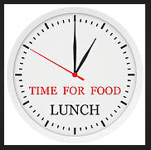
Your morning lessons are completed.
Time for lunch.
Then come back this afternoon for your curriculum activity.

Slide 19
Science

Slide 20
We are going to learn about what a plant needs to stay alive. But first, let’s think about what humans need to stay alive. What do you think a human needs to stay alive?

Slide 21
Humans need:
Water
Oxygen
A balanced diet (food)
Sun light
Exercise
Livable temperature
Sleep
Unfortunately, you do not need an xbox or McDonalds in order to survive.

Slide 22
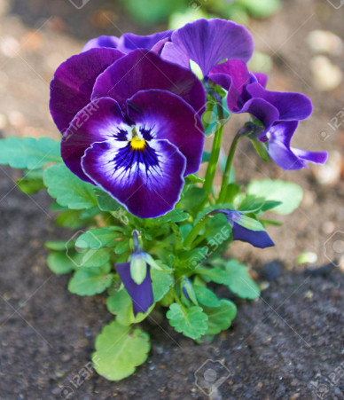
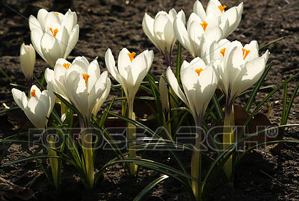
Have a look at the following plants. What do you think they need in order to survive? There are seven basic things they need. How many can you work out?
1.
2.
3.
4.
5.
6.
7.

Slide 23
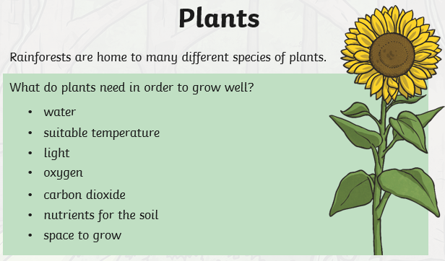

Slide 24
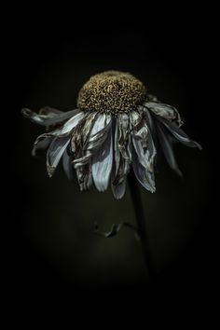
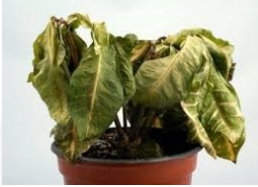
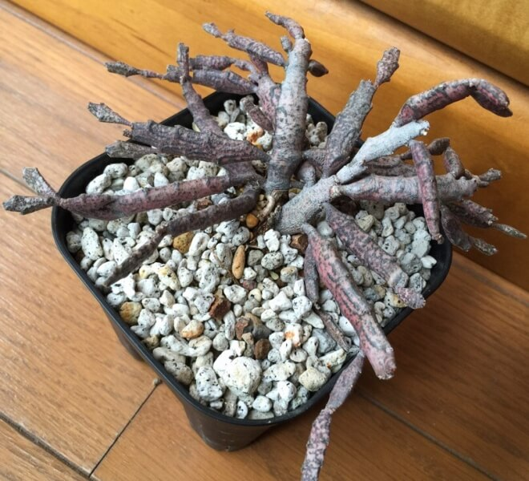
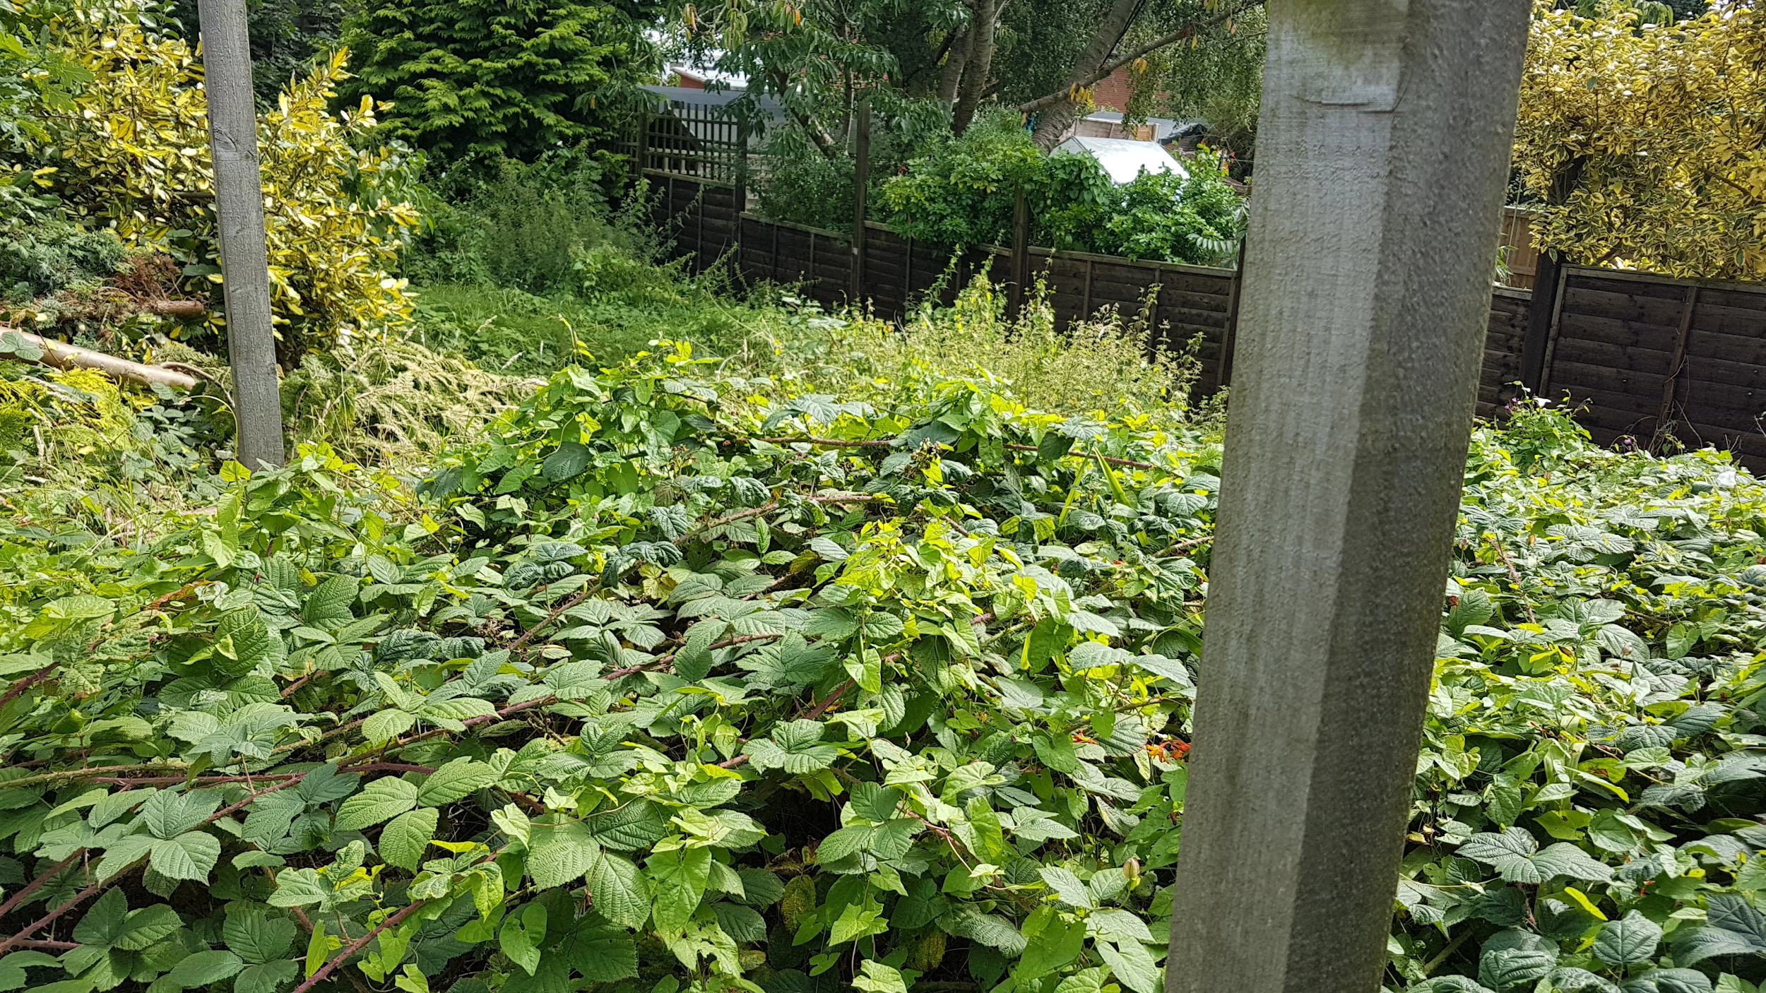
Time to test your knowledge. Can you work out what the plant is missing that is stopping it from surviving.

Slide 25
Time to test your knowledge. Can you work out what the plant is missing that is stopping it from surviving.
No water has meant this flower has dried out.
This plant is in the dark. It has no sunlight and therefore has no energy to grow.
This plant was planted in rocks and therefore can’t get any nutrients from soil.
It is too crowded for new plants to grow here. There isn’t enough space for them to grow. Only large bushes and trees can grow here.

Slide 26
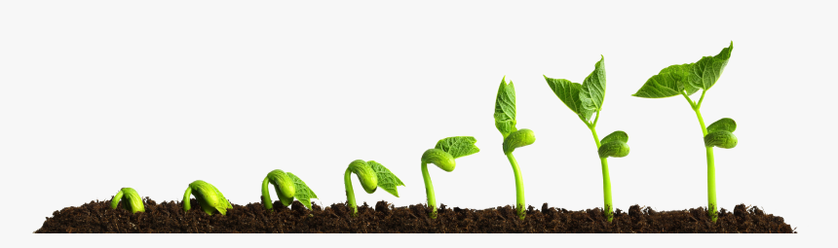
As a challenge, if you have a garden or any plants at home, find some plants that are struggling to grow and think about which thing is missing. Remember as a long as plants have all seven things it needs, it will grow.

Slide 27
Did you have a good day learning today?
See you in the morning.

