Slide 1

Thursday 11th June
Is your head ready to calculate?
Remember you can do these independently then share them with an adult.
Question 10 may have more than one answer.
Don’t worry about always finding the answer it is how you try to work out and reason that is important.

Slide 2
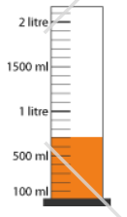

Morning Maths 11.06.20
8. Find ⅝ of 24
9. This container had 2 litres of orange juice. How much has been poured out?
10. Make 24 using
each number only
once and any of
the operators (+, -, x, ➗)
What day of the week will 25. 06 20 fall on?
2. How many sides on a heptagon?
3. Double 13
4. 400 - 347
5. 234 - 61 + 30
6. 36 x 8
7. Fill in the gaps:
__, __, __, 34, 39

Slide 3
Thursday
7
26
53
203
6 x 8 = 48, 30 x 8 = 240, 240 + 48 = 288
19, 24, 29, 34, 39
24 ÷8 = 3 so ⅛ = 3, 5 x 3 =15
1.3l or 1 litre 300ml
3 + 2 = 5, 5 x 4 = 20, 20 + 4 = 24

Slide 4

St Catherine’s Classroom Beliefs
Mistakes are valuable.
Everyone can learn maths to the highest level.
Questions are really important.
Depth is more important than speed.
Maths is about making connections.
We may not be learning together in the classroom, but it is important to still remember our classroom beliefs.

Slide 5
WALT: describe and work out the properties of a sphere.

Slide 6
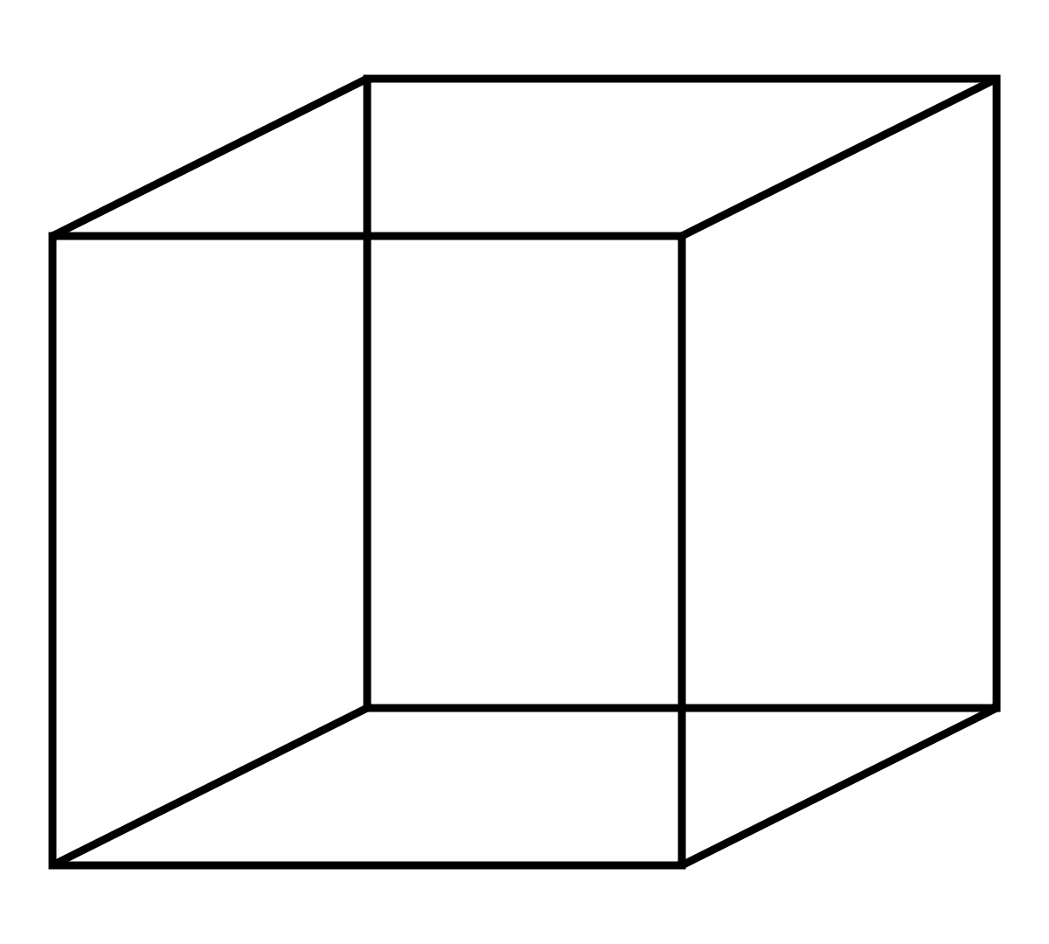
A sphere is a 3D version of a circle. You may see this shape in many places like sports equipment, lots of foods and the planets. However, there is something very special about a sphere.
Underneath is a picture of a cube and a description of its properties.
A cube has 6 faces that are all in the shape of a square. It has 8 vertices (corners) and 12 edges that are all the same length.

Slide 7
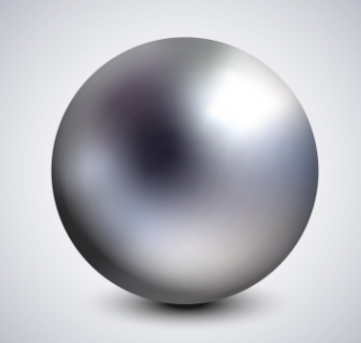
Your task today is to write a description of a sphere. We have included a bank of words that you will need to include in your description. Remember, a sphere is not a circle. It is a 3D shape that is shaped like a perfect ball.
Word Bank
Vertices
Edges
Faces
Equal
Curve
Number of

Slide 8
Our definition.
A sphere has 1 curved and continuous face. This means that it has no vertices or edges that break up the face. Therefore it has 0 vertices and 0 edges.

Slide 9

Time for a break.
Have a drink and a snack.

Slide 10
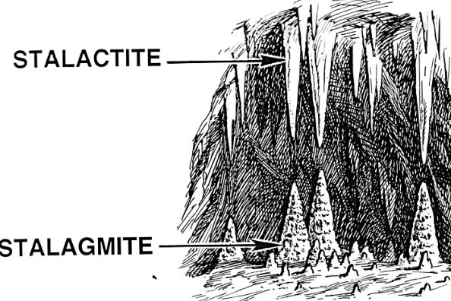
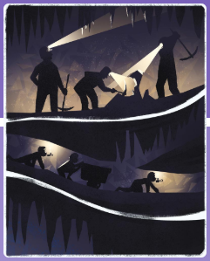
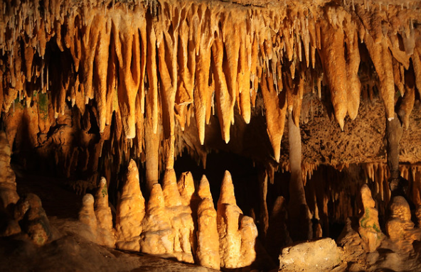
WALT: use a simile for description
Remember our close read from yesterday? Think about how the author described the stalactites.
Stalactites grew like coral, like twisted icicles, like the horns of unicorns, like the crooked teeth of goblins. Miners crept along the tunnels and chipped and hammered with their picks and tools. Their children crawled on hands and knees down the narrow passageways, holding candles in their mouths, pushing cartloads of lead and stone in front of them.

Slide 11
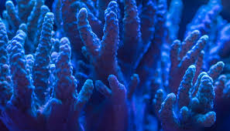
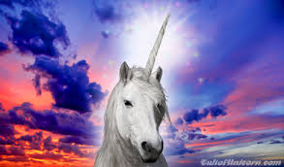
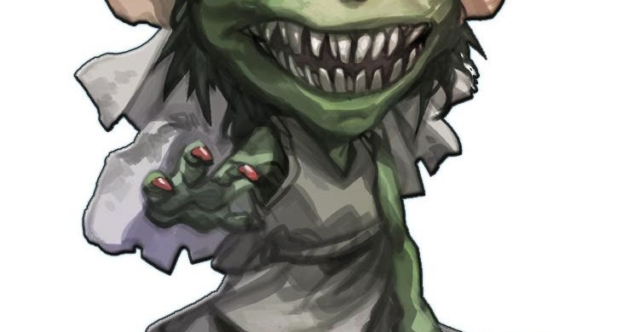
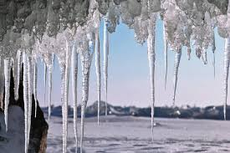
Why do you think the author chose these similes?
Stalactites grew
like coral,
like twisted icicles,
like the horns of unicorns,
like the crooked teeth of goblins.

Slide 12
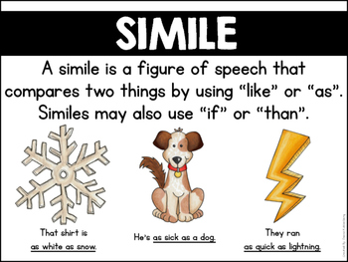
Here are some more examples of similes.
Now read the poem on the next slide. Can you find any similes?

Slide 13
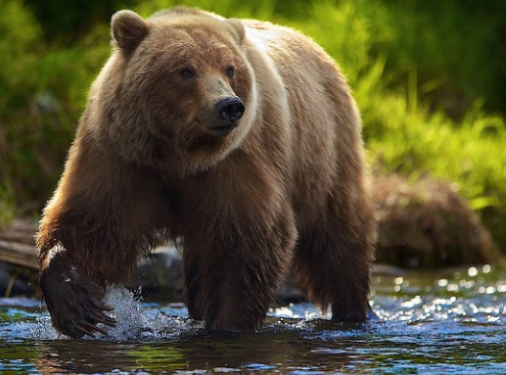
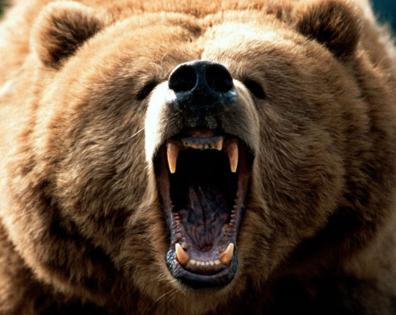
The Bear!
He needs:
A coat like thick brown moss,
A head like a sculptured rock,
Claws like metal combs,
Paws like boxing gloves,
And a growl like rumbling thunder.
Anonymous

Slide 14
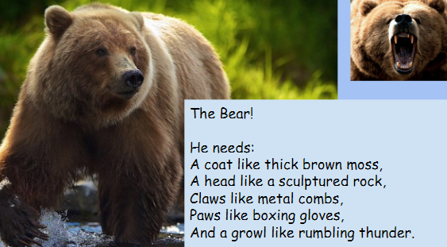
Copy the poem.
Underline the 5 things a bear needs.
Highlight or Circle the five things they are compared to.
Which word is left in each line?

Slide 15
The Bear!
He needs:
A coat like thick brown moss,
A head like a sculptured rock,
Claws like metal combs,
Paws like boxing gloves,
And a growl like rumbling thunder.
Anonymous

Slide 16
Now complete the table. Think about why th author chose the simile. What did it make you think of?
What a bear needs. | It is compared to... | The simile made me think of...
a coat | thick brown moss | Something soft because moss is soft

Slide 17
Now complete the table. Think about why the author chose the simile. What did it make you think of?
What a bear needs. | It is compared to... | The simile made me think of...
a coat | thick brown moss | Something soft because moss is soft
a head | a sculptured rock | A large round rock with a face on it
claws | metal combs | Something sharp that would pull at you
paws | boxing gloves | Something leathery and large because boxing gloves are made of leather
growl | rumbling thunder | because it comes from deep inside and gets louder just like thunder in the distance

Slide 18

What is a prefix?
A prefix is a group of letters which we add to the beginning of a word to make a new word with a different meaning.
Today we will focus on the prefix super which means something about yourself or something that happens on its own
15 minute Spelling Activity

Slide 19
Put the prefix super in front of these words and write down your new words.
Read the new words aloud.
Practise writing each word 3 times.
Which words would you use in the sentences on the next slide?
market
star
sonic
man
natural
human
impose
nova

Slide 20
Now use the words you have practised to complete the sentences. Make sure you spell them correctly.
Tesco and Aldi are both ________________.
Concord was the first _______________ passenger aeroplane.
Film makers ____________ one picture onto another picture.
People who audition on the X Factor want to become ___________.
A _____________ is when a star explodes with a huge amount of energy.
The strange ______________ phenomenon could not be explained.
S_________ had _________________ strength.

Slide 21
Now use the words you have practised to complete the sentences. Make sure you spell them correctly.
Tesco and Aldi are both supermarkets.
Concord was the first supersonic passenger aeroplane.
Film makers superimpose one picture onto another picture.
People who audition on the X Factor want to become superstars.
A supernova is when a star explodes with a huge amount of energy.
The strange supernatural phenomenon could not be explained.
Superman had superhuman strength.

Slide 22


Your morning lessons are completed.
Time for lunch.
Then come back this afternoon for your curriculum activity.

Slide 23
Science
Seeds formation and dispersal

Slide 24
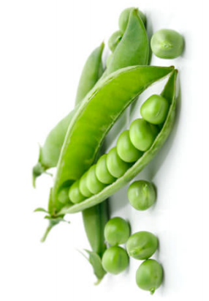
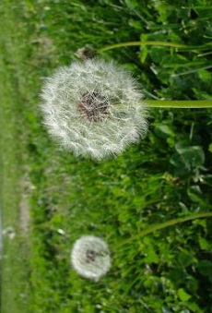
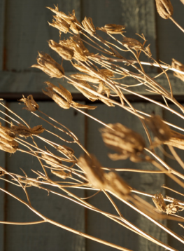
A very important part of any plant’s life is how it grows the next generation of plants. How can it spread its seeds to make sure the next generation of plants grows.
How do you think plants manage to spread their seeds out?

Slide 25
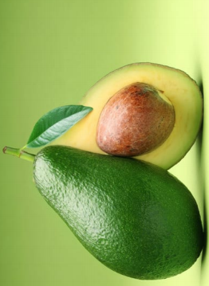
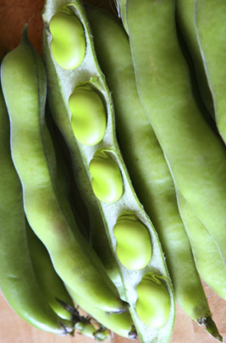
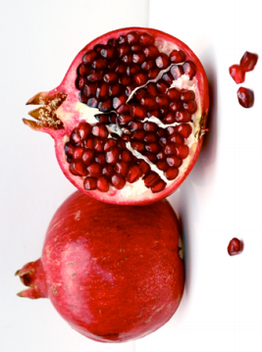
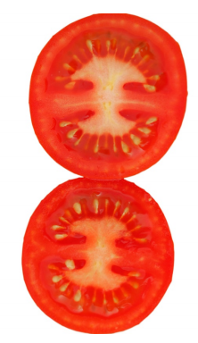
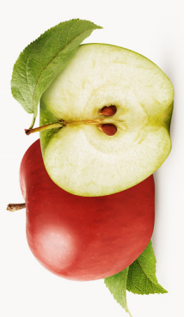
Seeds are mainly transported in two different ways. Here are some pictures of seeds that are dispersed in the same way. How do you think this is done?

Slide 26
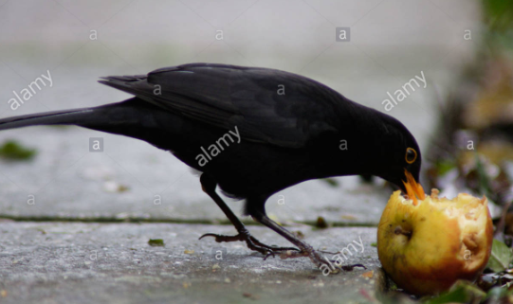
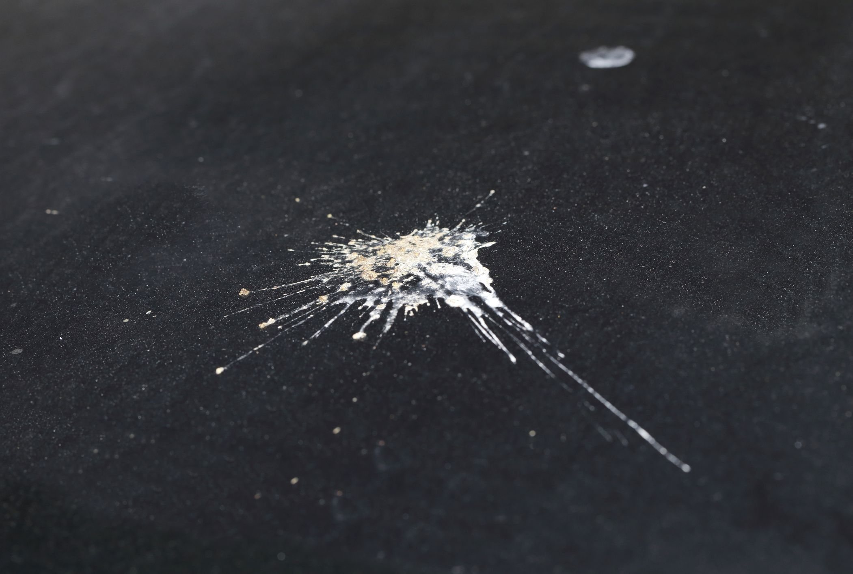
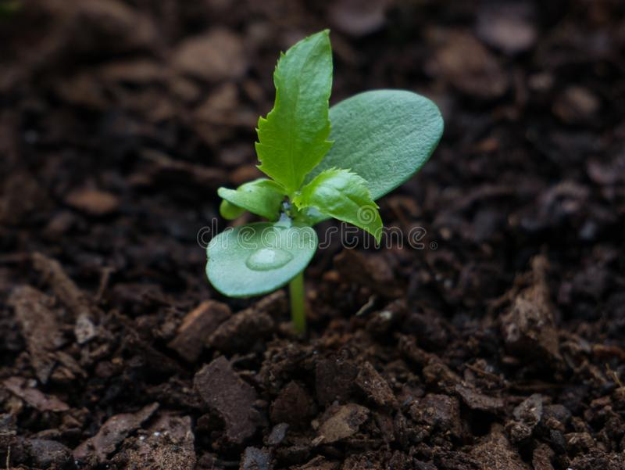
Plants give off fruit with their seeds inside. Animals like birds, insects and mammals then eat the fruit, including the seeds and excrete them out in their poo, somewhere far away from the plant. This means the seed is then able to grow on it’s own, as long as the conditions are right.

Slide 27
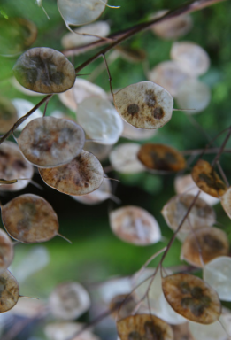
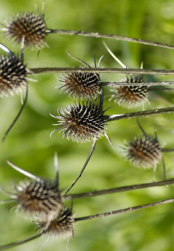
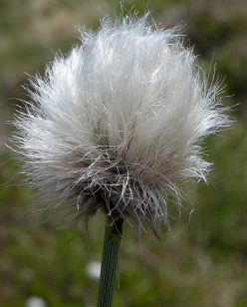
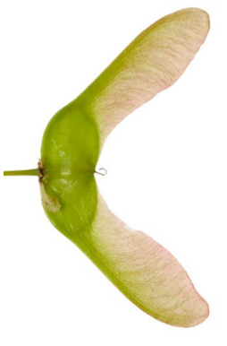
What about seeds that aren’t in fruit or cannot be eaten? How do they managed to spread their seeds?

Slide 28
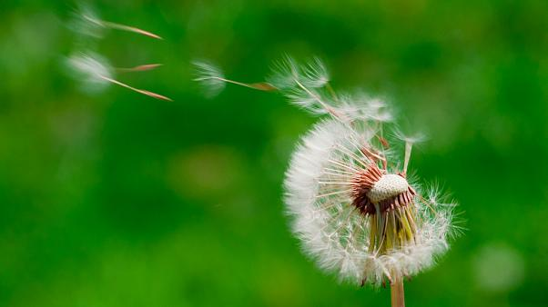
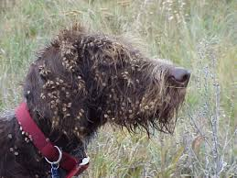
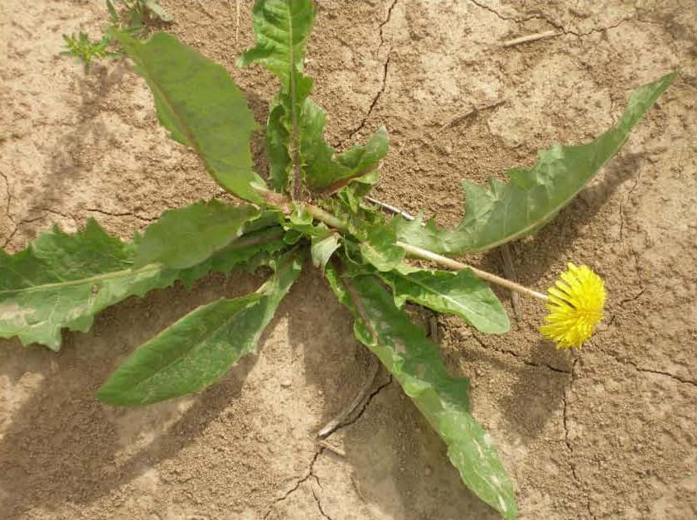
Some plants can’t grow fruit or their seeds aren’t edible. Therefore, some plants have seeds that are carried by the wind, rain or attached to animals. The wind, rain or animals carrying them off to other places where hopefully they will manage to grow.

Slide 29
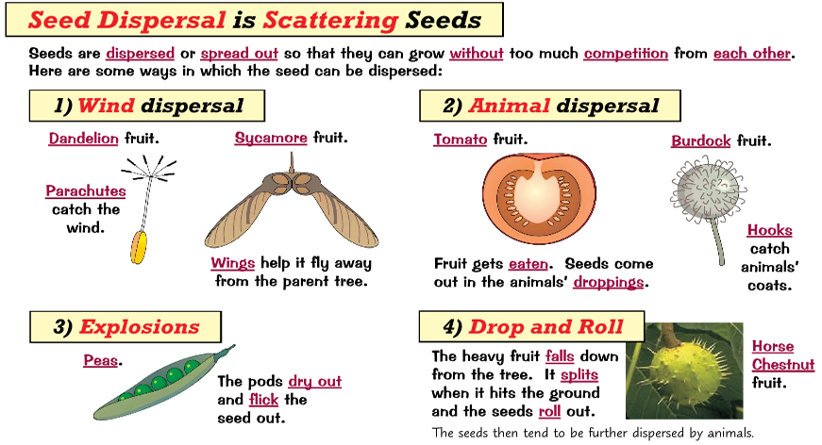
For your task, we want you to create a poster showing us what you have learnt about seed dispersal. You can include diagrams, images, descriptions and titles. Here is one example to give you some ideas.

Slide 30
Did you work hard with your learning today?
See you in the morning.

