Slide 1

Friday 12th June
Are you a maths whizz today?
Remember you can do these independently then share them with an adult.
Question 10 may have more than one answer.
Don’t worry about always finding the answer it is how you try to work out and reason that is important.

Slide 2

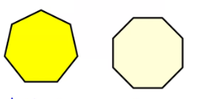


Morning Maths 12.06.20
7. How many of these
shapes can you name?
8. How much change
would I have from
a £10 note?
9. ⅗ of 40
10. Use the numbers 1-9 only
once in this grid so that the
sum of the squares in each
row, column or diagonal is 15.
48 + 30
2. 8 x 8
3. Insert the correct symbol ( <,> , =)
15 x 0 15 + 0
4. 500 - 452 =
5. What is the subtraction statement
6. Complete the missing numbers:
536
Was £12.70
Now half-price!
399
240
320
560

Slide 3
78
64
＜
48
137
240, 320, 400, 480, 560, 640
Triangle, square, pentagon, hexagon, heptagon, octagon
£12.70 ÷ 2 = £6.35, £10.00 - £6.35 = £3.65
40 ÷ 5 = 8 so ⅕ = 8 , 3 x 8 = 24
A possible solution is:
6 | 7 | 2
1 | 5 | 9
8 | 3 | 4

Slide 4

St Catherine’s Classroom Beliefs
Mistakes are valuable.
Everyone can learn maths to the highest level.
Questions are really important.
Depth is more important than speed.
Maths is about making connections.
We may not be learning together in the classroom, but it is important to still remember our classroom beliefs.

Slide 5
WALT: create 3D shapes.

Slide 6
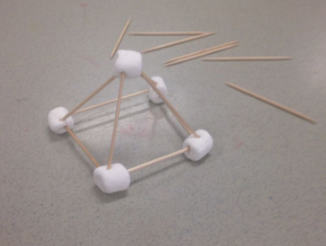
Using any materials you have at home, can you create 3D shapes accurately. We had a go using marshmallows and cocktail sticks to create a triangular prism.

Slide 7

Time for a break.
Have a drink and a snack.

Slide 8
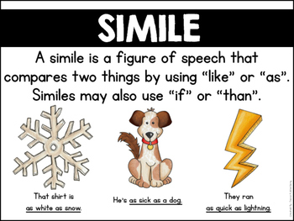
WALT: use similes for description
Remember a simile uses like or as to compare something to something else.
Look at the similes on the next slide and match them to the pictures.

Slide 9
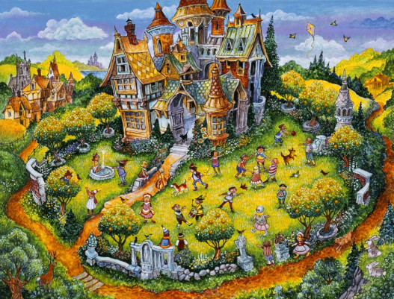
Remember on Monday we read the story of The Selfish Giant for our comprehension?
This picture shows the Selfish Giant’s garden.
Remember on Tuesday we had a close read describing the stalactites using simile?.
Today your task is to write a description of the giant’s garden using similes.
Work through the next slides to give you some ideas for your writing.

Slide 10
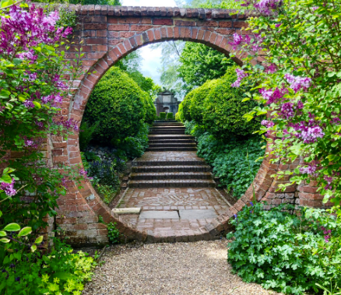
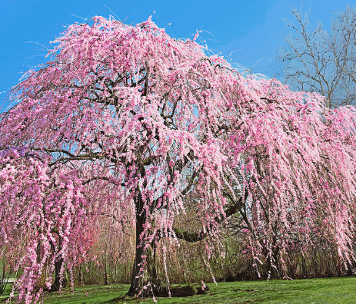
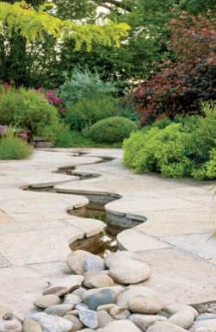
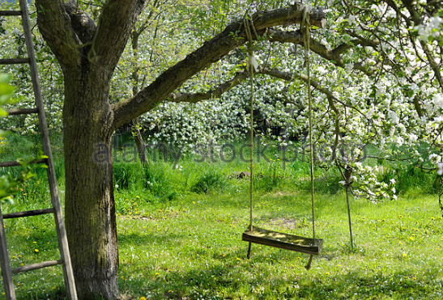
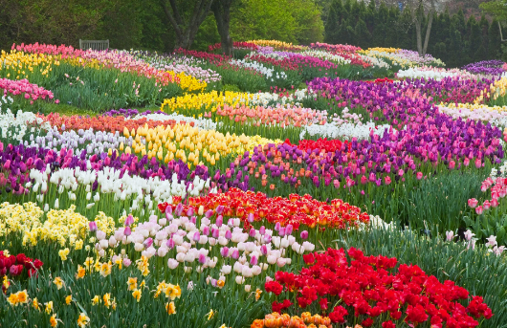
Match these similes to the pictures.
D
B
A
E
C
Flowers carpeted the ground like a colourful patchwork blanket stretching across the garden.
The stream wound like a slithering snake, along the centre of the garden path.
Stretching out like an arm, the branch held the children’s swing above the ground.
Looking through, the archway appeared like an eye showing the view of the garden’s entrance.
Blossom clung to the tree like soft tufts of pink candy floss.

Slide 11
Match these similes to the pictures.
D - 3
B - 5
A - 4
E - 1
C - 2
Flowers carpeted the ground like a colourful patchwork blanket stretching across the garden.
The stream wound like a slithering snake, along the centre of the garden path.
Stretching out like an arm, the branch held the children’s swing above the ground.
Looking through, the archway appeared like an eye showing the view of the garden’s entrance.
Blossom clung to the tree like soft tufts of pink candy floss.

Slide 12
Today your task is to write a description of the giant’s garden using similes.
You can describe the garden in the picture or draw a garden of your own and describe it using similes.
Share your work with an adult.

Slide 13

Today you have a revision quiz about the prefixes super, auto and anti.
You should read the ten sentences from the Twinkl quiz and make the correct word by choosing the right prefix.
Write a list 1 to 10 and record your answers.
You can check them at the end.
15 minute Spelling Activity

Slide 14

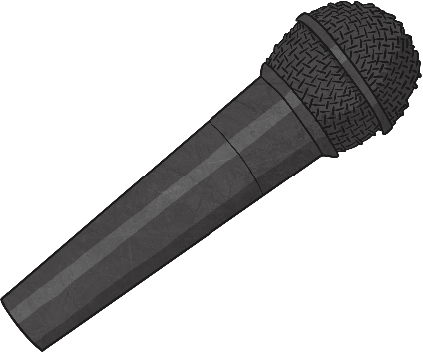
Prefixes super, anti, auto Quiz
Which is the correct prefix for the bold word?
She is a global star and loved by many.
super-
anti-
auto-

Slide 15
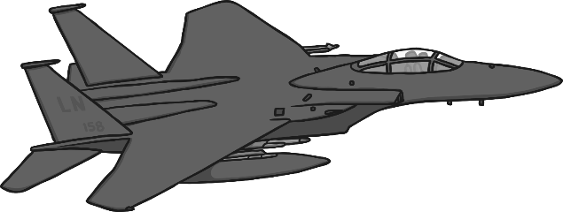
Prefixes super, anti, auto Quiz
Which is the correct prefix for the bold word?
The sonic jet named the Concorde was designed and built in Bristol.
super-
anti-
auto-

Slide 16
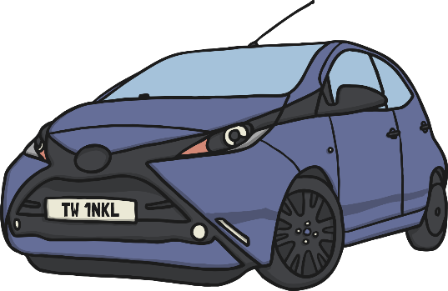
Prefixes super, anti, auto Quiz
Which is the correct prefix for the bold word?
A car is also known as an mobile.
super-
anti-
auto-

Slide 17
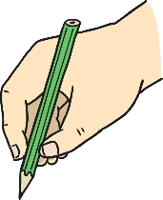


Prefixes super, anti, auto Quiz
Which is the correct prefix for the bold word?
The actor signed graphs outside the premier for his fans.
super-
anti-
auto-

Slide 18

Prefixes super, anti, auto Quiz
Which is the correct prefix for the bold word?
The opposite of clockwise is clockwise.
super-
anti-
auto-

Slide 19
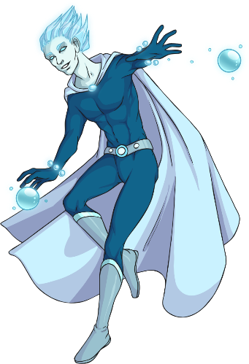
Prefixes super, anti, auto Quiz
Which is the correct prefix for the bold word?
Comic book characters often have human powers.
super-
anti-
auto-

Slide 20
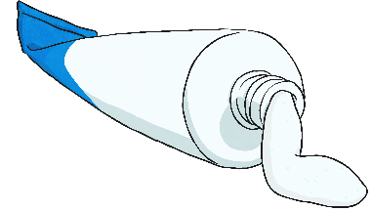
Prefixes super, anti, auto Quiz
Which is the correct prefix for the bold word?
To stop my cut from getting infected, the doctor gave me some septic cream.
super-
anti-
auto-

Slide 21
Prefixes super, anti, auto Quiz
Which is the correct prefix for the bold word?
My mum’s car has an matic gearbox.
super-
anti-
auto-

Slide 22
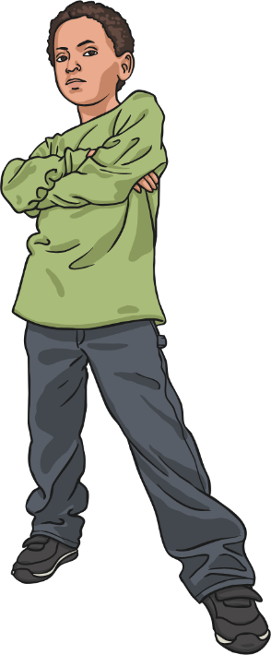
Prefixes super, anti, auto Quiz
Which is the correct prefix for the bold word?
My brother was told off for being social.
super-
anti-
auto-

Slide 23

Prefixes super, anti, auto Quiz
Which is the correct prefix for the bold word?
I was told to push the trolley around the market.
super-
anti-
auto-

Slide 24
superstar
supersonic
automobile
autographs
anticlockwise
superhuman
antiseptic
automobile
antisocial
supermarket
Answers to quiz.

Slide 25


Your morning lessons are completed.
Time for lunch.
Then come back this afternoon for your curriculum activity.

Slide 26
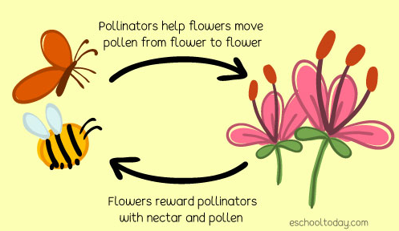
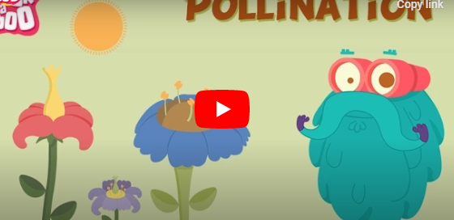
Science
What is pollination?
Find out more by watching the video clip below.
https://youtu.be/djPVgip_bdU

Slide 27
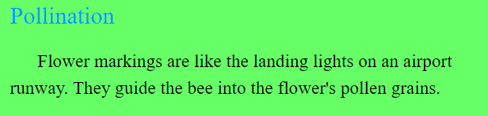
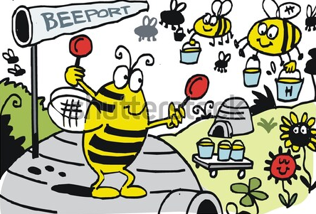

Slide 28
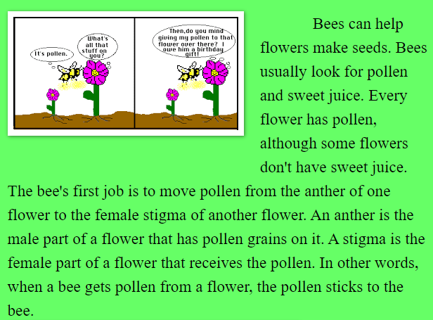

Slide 29
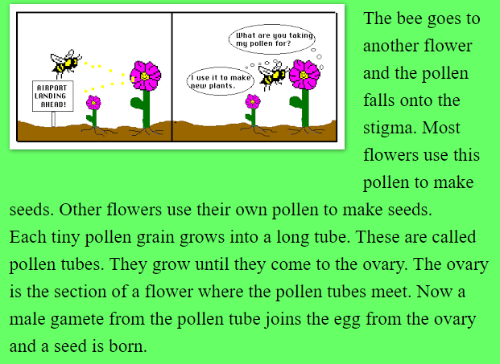

Slide 30
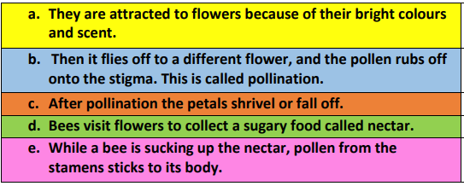
Read these sentences. They are in the wrong order can you write them out in the correct order to show the process of pollination by a bee.

Slide 31
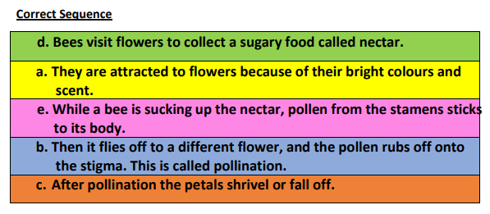

Slide 32
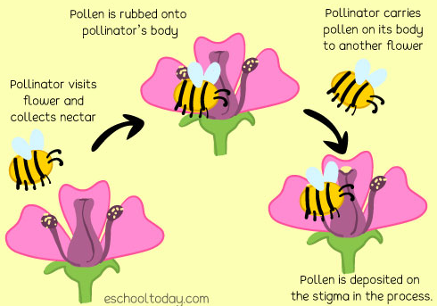
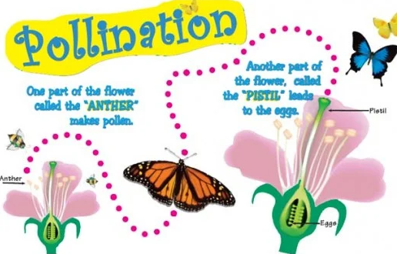
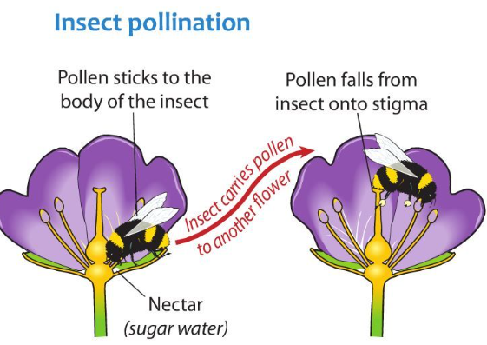
Here are some examples of a diagram/ poster about how pollination works. Can you design and make your poster that explains the process?

Slide 33
Well Done 3S and 3M!
Time for a well deserved weekend so enjoy yourselves and we will meet up with you again on Monday.

