Slide 1

Monday 15th June
We will begin our day with Morning Maths - just like in school! This should be 10 -15 minutes.
You can do these independently then share them with an adult.
Remember question 10 may have more than one answer.
Don’t worry about always finding the answer it is how you try to work out and reason that is important.

Slide 2
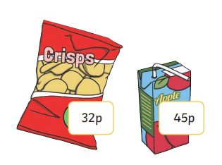
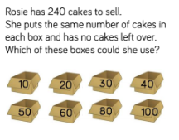
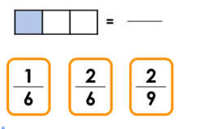
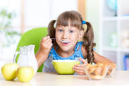
Morning Maths 15.06.20
8. Annie buys two
packets of crisps and
a drink. How much
change will she have
from a £2 coin?
9. 899 - 642
10.
200 = + 35
2. Which of these are NOT factors of 20:
4, 5, 6, 10, 12
3. Complete this
bar model.
4. 36 ➗ 12
5. Which of the fractions
shown are
equivalent to ⅓
6. 1.7 cm = __mm
7. am or pm?
210
15

Slide 3
165
6 and 12
210 - 15 = 195
3
2/6
17mm
am
2 x 32 = 64
64 + 45 = 109p or £1.09
200 - 109 = 91p
257
24 boxes of 10
12 boxes of 20
8 boxes of 30
6 boxes of 40
4 boxes of 60
3 boxes of 80

Slide 4

St Catherine’s Classroom Beliefs
Mistakes are valuable.
Everyone can learn maths to the highest level.
Questions are really important.
Depth is more important than speed.
Maths is about making connections.
We may not be learning together in the classroom, but it is important to still remember our classroom beliefs.

Slide 5
WALT: calculate measures and measure accurately.
Follow the link below to find the lesson on my maths. If you haven’t got the use of a laptop or tablet, follow the slides and work through the lesson.
https://app.mymaths.co.uk/285-lesson/measures

Slide 6
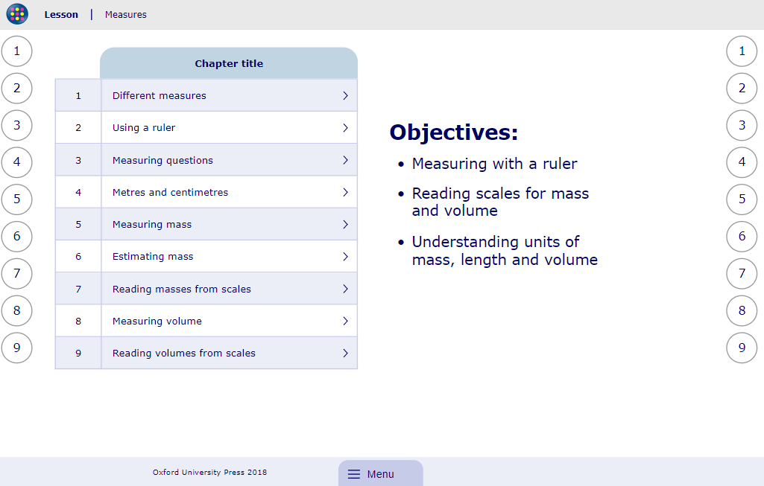

Slide 7
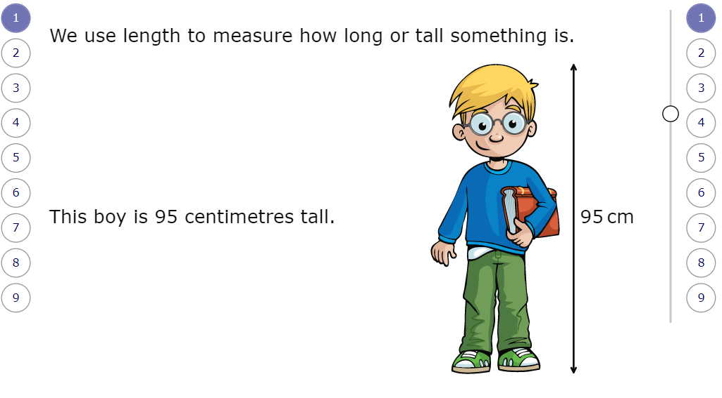

Slide 8
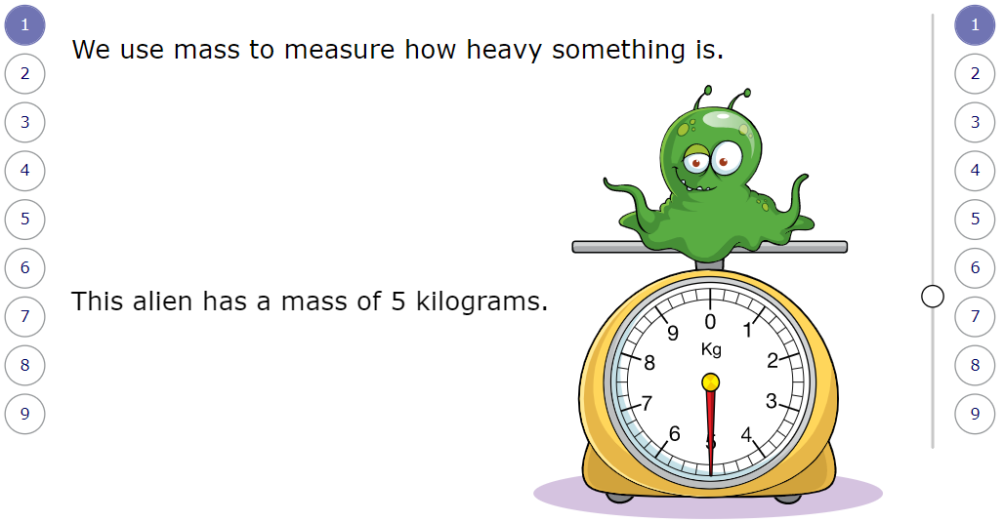

Slide 9
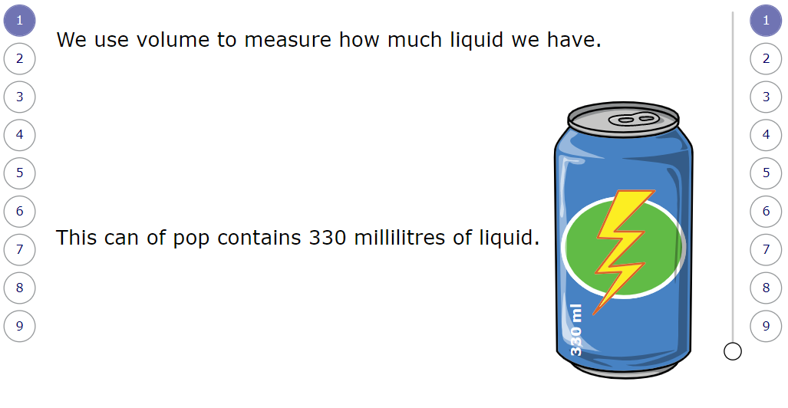

Slide 10
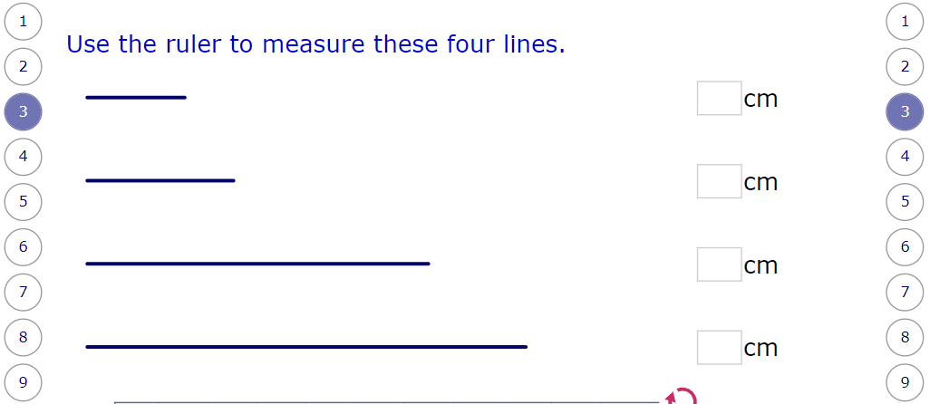

Slide 11
3
5
11
15

Slide 12
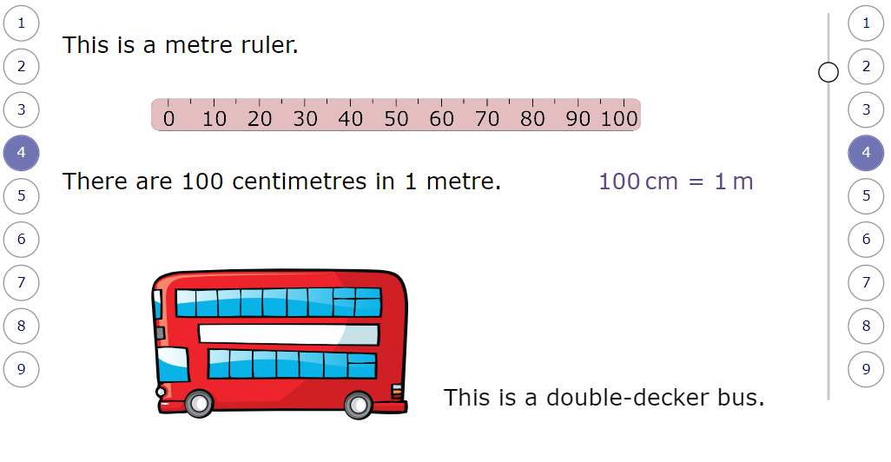

Slide 13
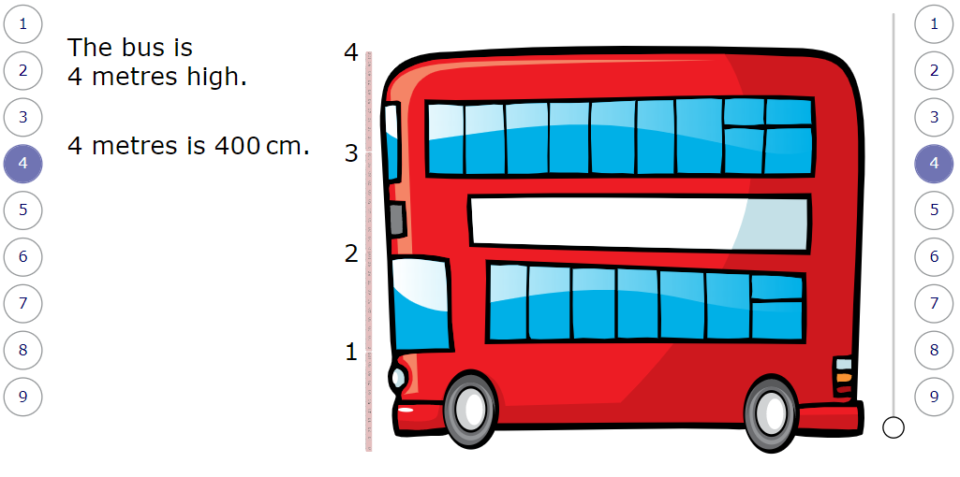

Slide 14
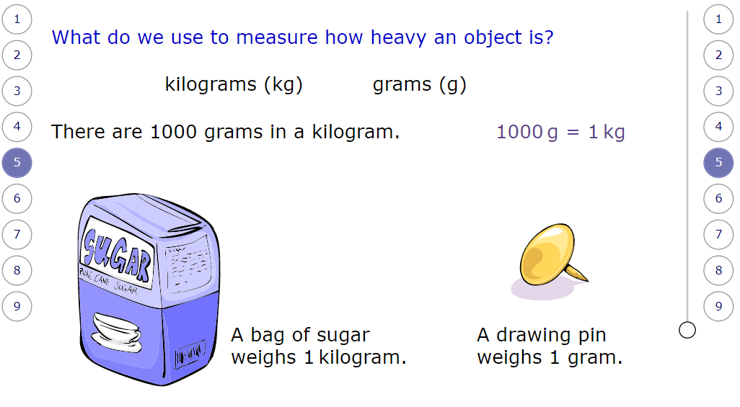

Slide 15
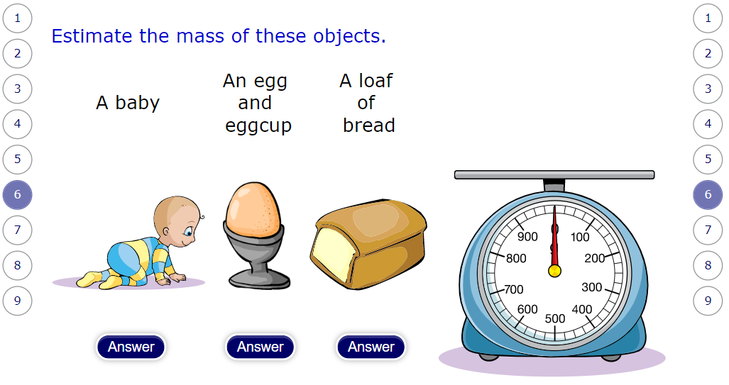

Slide 16
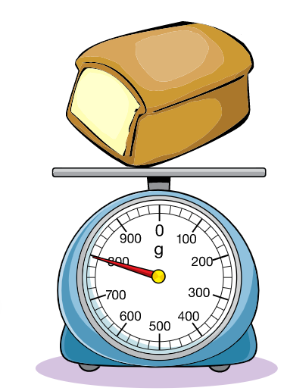
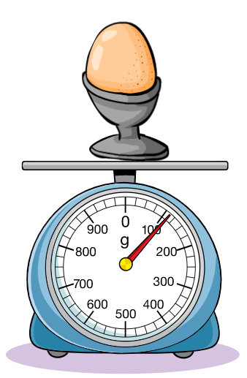
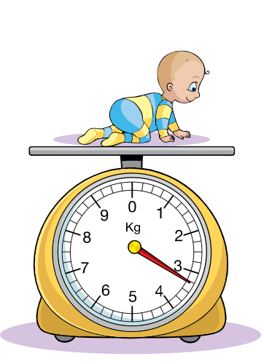
800 grams (g)
100 grams (g)
2.5 kilograms (kg)

Slide 17
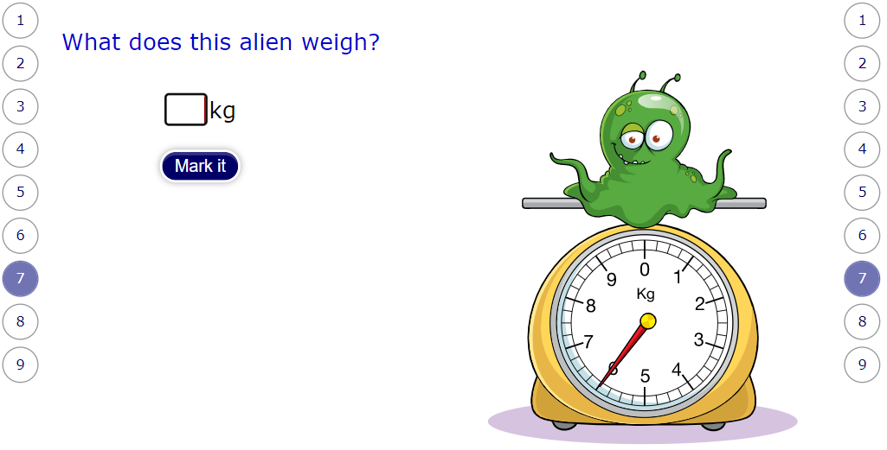

Slide 18
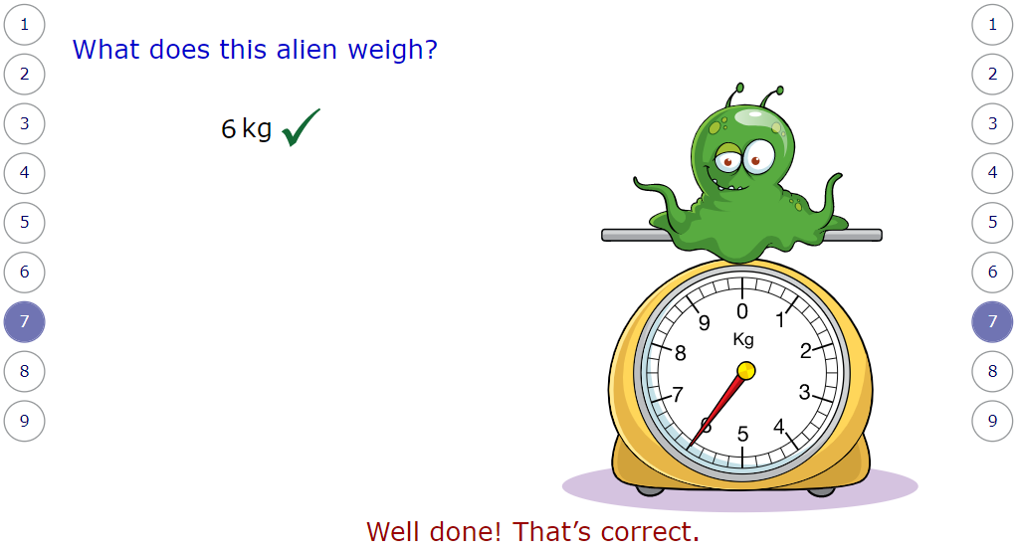

Slide 19
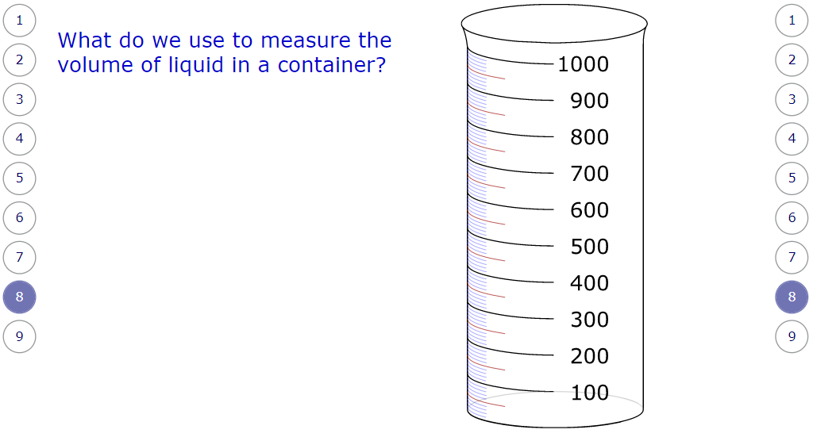

Slide 20
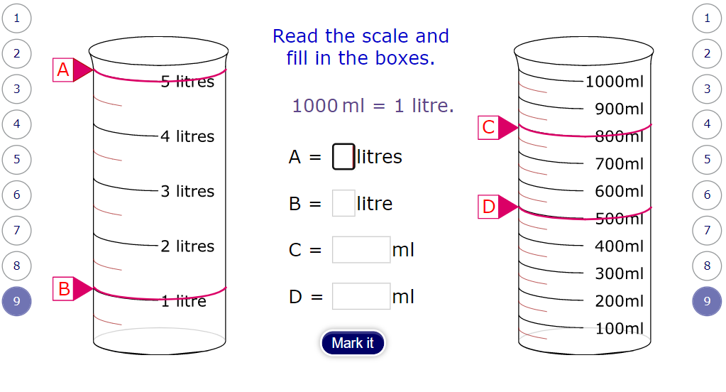

Slide 21
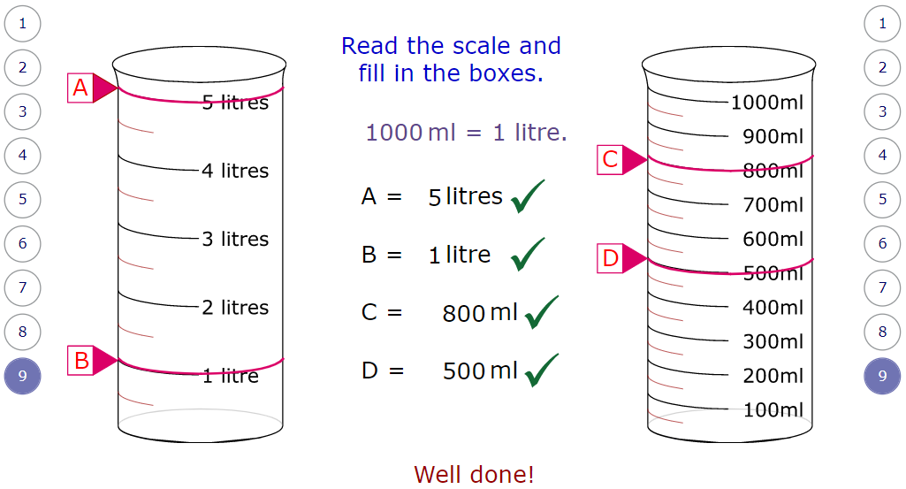

Slide 22
Time to practice what you have learnt. If you have an iPad or laptop, follow the link below and complete the homework. If not, move onto the next slide.
https://app.mymaths.co.uk/285-homework/measures

Slide 23
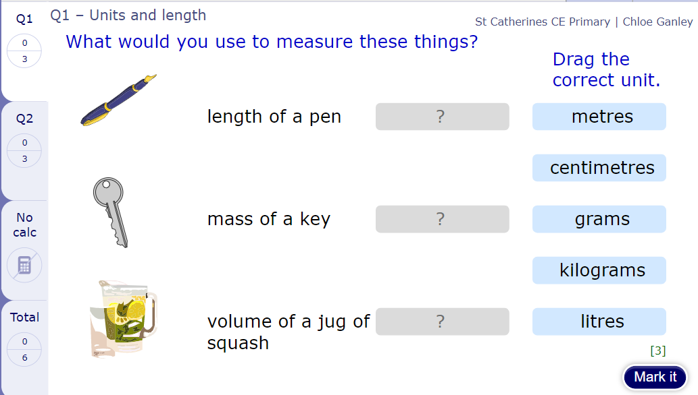

Slide 24
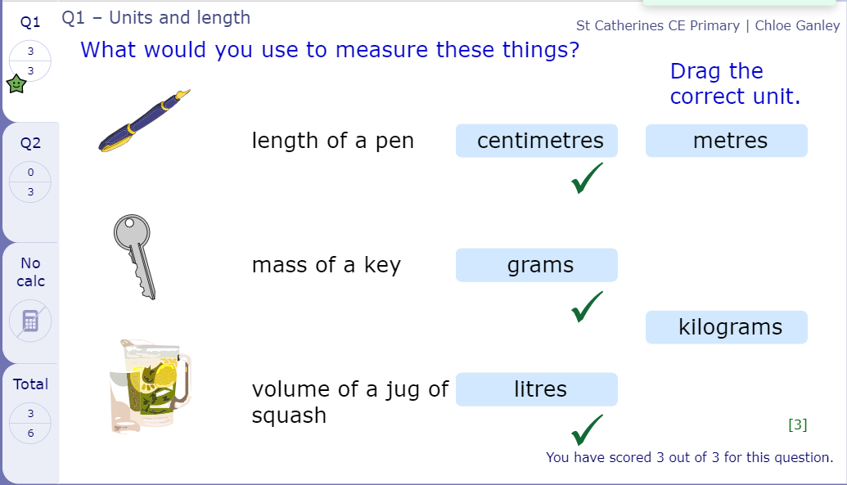

Slide 25
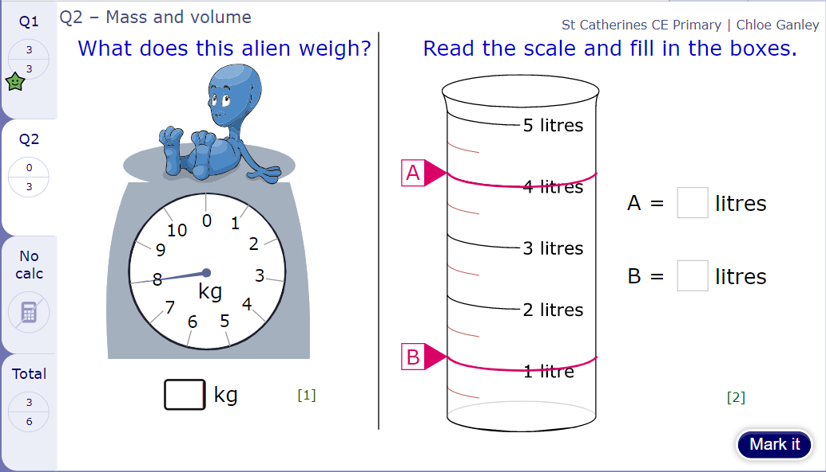

Slide 26
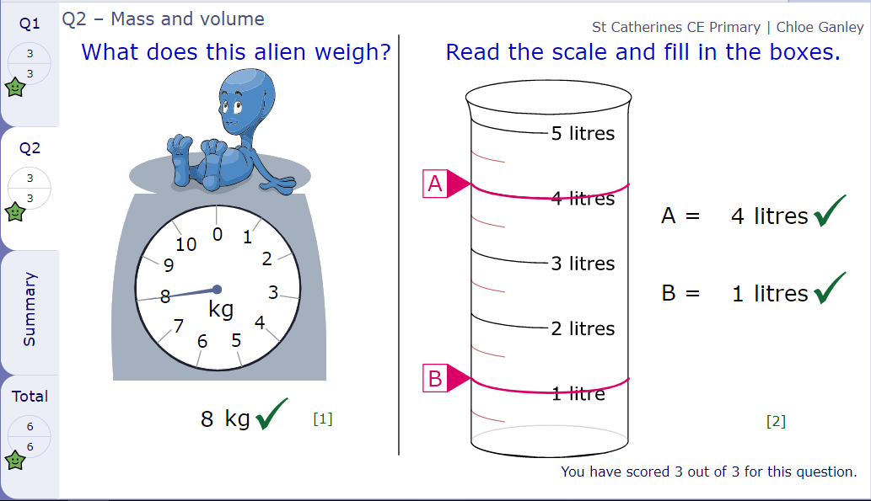

Slide 27

Time for a break.
Have a drink and a snack.

Slide 28
WALT: retrieve and infer information from a text.
Today you are going to read a text called the Goat, the Wolf and the Cabbages. You will have a short comprehension and a short written explanation to complete.
It is a bit of a brain teaser for you to puzzle out. Have fun!

Slide 29
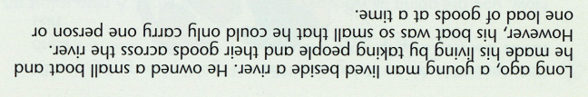
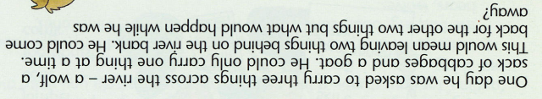
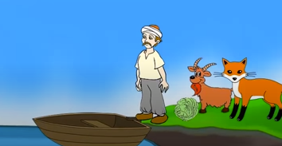
The Goat, the Wolf and the Cabbages.

Slide 30

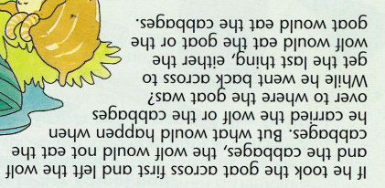

Slide 31
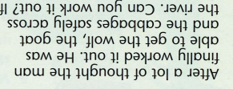

Slide 32
Comprehension questions.
Where did the farmer live?
How did he earn his living?
What was the problem with his boat?
Which three things was the man asked to take across the river?
Complete these sentences:
If he took the wolf, he would leave the _____ and the ________ together, therefore the ______ would eat the __________________.
If he took the cabbages, he would leave the _________ and the ________ together, therefore the _____ would eat the _________.
Which two things could the man never leave alone together? Find two possible answers.
How do we know the man found it difficult to work out the answer to his problem?
Can you work out the answer to the man’s problem? Write an explanation of what he does.

Slide 33
Comprehension questions.
Where did the farmer live?
He lived beside the river.
How did he earn his living?
He earned his living by transporting goods across the river.
What was the problem with his boat?
His boat was too small to carry all the items together
Which three things was the man asked to take across the river?
He was asked to take a cabbage, a goat and a wolf.
Complete these sentences:
If he took the wolf, he would leave the cabbage/goat and the goat/cabbage together, therefore the goat would eat the cabbage .
If he took the cabbages, he would leave the wolf/goat and the goat/wolf together, therefore the wolf would eat the goat.

Slide 34
Comprehension questions.
6. Which two things could the man never leave alone together? Find two possible answers.
He could never leave the cabbage and the goat together.
He could never leave the goat and the wolf together.
7. How do we know the man found it difficult to work out the answer to his problem?
We know he found it difficult because the author says after a lot of thought the man finally worked it out which tells us he had to think about it for a long time.
8. Can you work out the answer to the man’s problem? Write an explanation of what he does.
You can see the answer to this on the next slide and watch a video to link to see the solution.

Slide 35
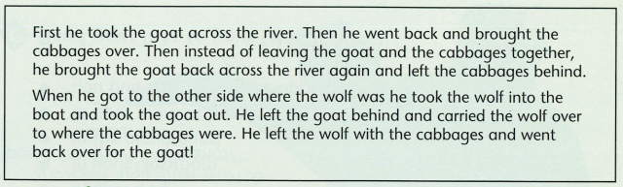
https://www.youtube.com/watch?v=0RdKdnVY-Kc

Slide 36

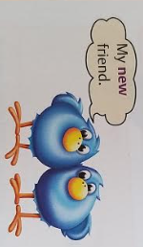
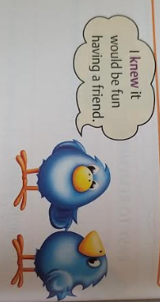
What are homophones?
Homophones are words that sound the same but have different meanings.
15 minute Spelling Activity

Slide 37
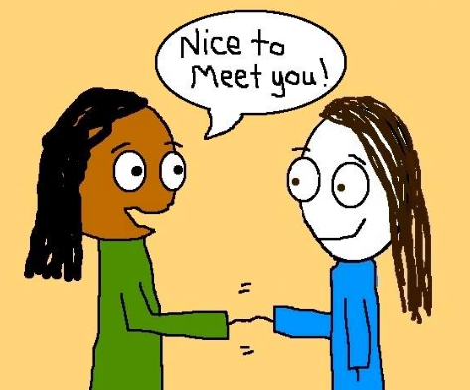
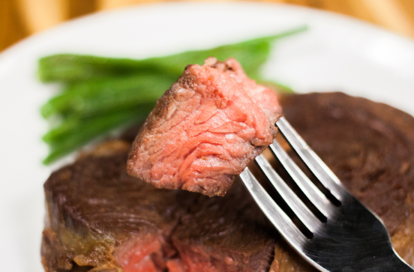
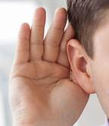

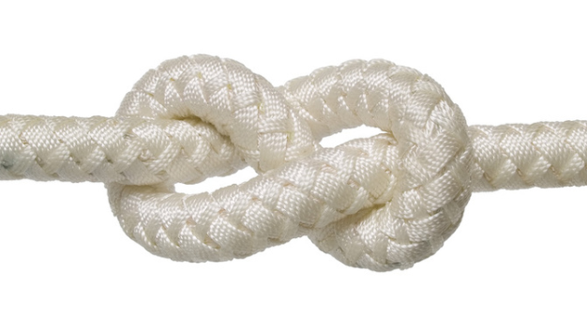

Take a look at these homophones.
meet | meat
hear | here
knot | not

Slide 38
Write the sentences out choosing the correct homophone.
I am knot/not allowed to visit my friends.
You can meat/meet your friends in the park..
Some of the books fit hear/here on the shelf.
The sailor tied a knot/not in the rope.
I would like meat/meet on my sandwich please.
I could not here/hear what the teacher was saying.

Slide 39
Answers. Check your spellings!
I am not allowed to visit my friends.
You can meet your friends in the park.
Some of the books fit here on the shelf.
The sailor tied a knot in the rope.
I would like meat on my sandwich please.
I could not hear what the teacher was saying.

