Slide 1
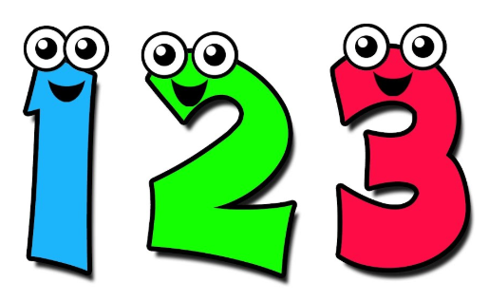
Tuesday 16th June
Ready to wake up your maths brains?
Remember you can do these independently then share them with an adult.
Question 10 may have more than one answer.
Don’t worry about always finding the answer it is how you try to work out and reason that is important.

Slide 2

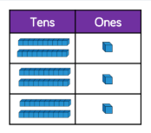
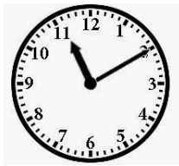

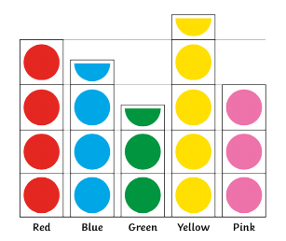


Morning Maths 16.06.20
7.
8. What will the time be in half an hour?
9. How many sides on
two hexagons and one heptagon?
10. What questions
can you write about
this pictogram?
How many tens in 425 ?
2. Write a calculation statement for this part-whole model:
3. 426 - 234
4. 35 x 4
5. 3cm 4 mm = . cm
6. Which is the smallest angle?
18
32

Slide 3
42
32 - 18 = 14
192
140
3.4cm
2
63
20 to 12 or 11.40
2 x6 = 12, 1 x 7 = 7, 12 + 7 = 19
Various
(e.g) How many children liked red?
How many more children preferred blue to green?
Which was the most popular colour?

Slide 4

St Catherine’s Classroom Beliefs
Mistakes are valuable.
Everyone can learn maths to the highest level.
Questions are really important.
Depth is more important than speed.
Maths is about making connections.
We may not be learning together in the classroom, but it is important to still remember our classroom beliefs.

Slide 5
WALT: measure scales accurately

Slide 6
20
Look at the number line and work out what the arrow could be point to.
What could the number be?

Slide 7
10
20
What about now? Has your number changed?

Slide 8
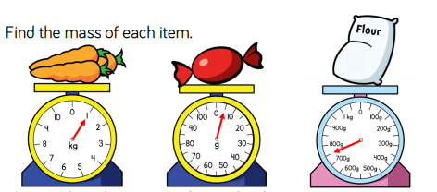
When you read a scale it is very important to look at all of your information.
Check the numbers on the scale
Check the number of lines and distances between the numbers
Look at the following scales and see if you can work out what the scale is pointing to.

Slide 9
1kg 5g 750g

Slide 10
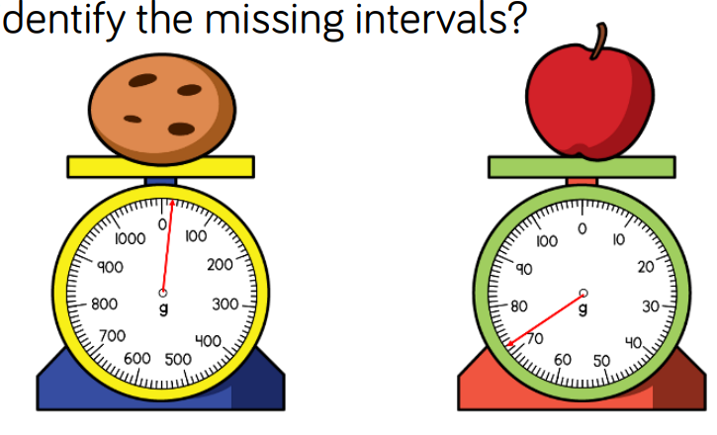
Can you work out the weight of each of these fruits? Look at the scales carefully.

Slide 11
20g 72g

Slide 12
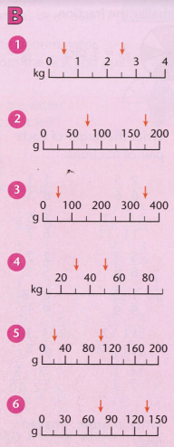
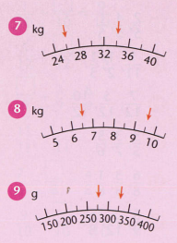

Slide 13
0.5kg & 2.5kg
75g & 175g
50g & 350g
30kg & 50kg
20g & 100g
74g & 135g
26kg & 34kg
6.5kg & 9.5kg
275g & 325g

Slide 14

Time for a break.
Have a drink and a snack.

Slide 15
WALT: use a known story as a scaffold for writing a similar story.
Yesterday you read the story The Goat, the Wolf and the Cabbages.
Today you are going to write the same story but change some of the ideas.
You can change the setting and the job that the main character does.
You can change the three things but two of them must be enemies like the wolf and the goat, and one of them must eat the other like the goat who ate the cabbage.
There are some ideas on the next slide if you cannot think of an idea of your own.
Then share your story with an adult.

Slide 16
There could be a cable car operator who has to deliver milk, a cat and a bird to the station at the top of a mountain.
How does he do it?
There could be a zoo keeper who has to deliver a lion, an antelope and a sack of grass to the safari park.
How does he do it?
There could be a veterinary nurse who has to deliver a bag of seed, and return a pet mouse and a pet cat to their owners.
How does he do it?

Slide 17

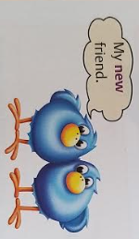
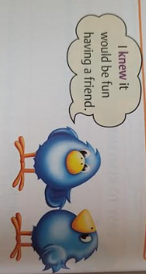
What are homophones?
Homophones are words that sound the same but have different meanings.
15 minute Spelling Activity

Slide 18
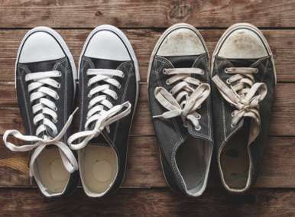
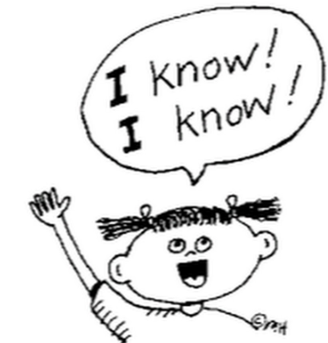
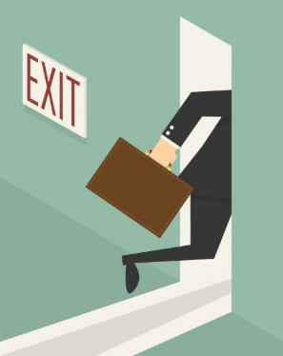
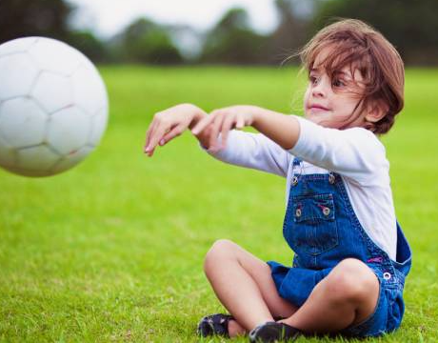
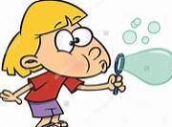

Take a look at these homophones.
new | knew
through | threw
blew | blue

Slide 19
Write the sentences out choosing the correct homophone.
The boy had a knew/new game for his playstation.
The strong wind blue/blew the sail boat across the pond.
The train went threw/through the tunnel.
She knew/new that she had missed the bus.
I dived from the cliff into the blue/blew ocean waves.
It is time she through/threw the old socks out.

Slide 20
Answers. Check your spellings!
The boy had a new game for his playstation.
The strong wind blew the sail boat across the pond.
The train went through the tunnel.
She knew that she had missed the bus.
I dived from the cliff into the blue ocean waves.
It is time she threw the old socks out.

Slide 21

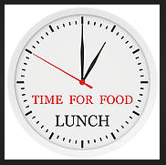
Your morning lessons are completed.
Time for lunch.
Then come back this afternoon for your curriculum activity.

Slide 22
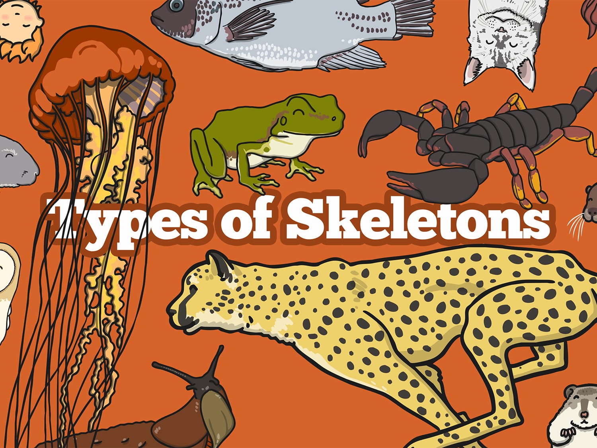


Slide 23
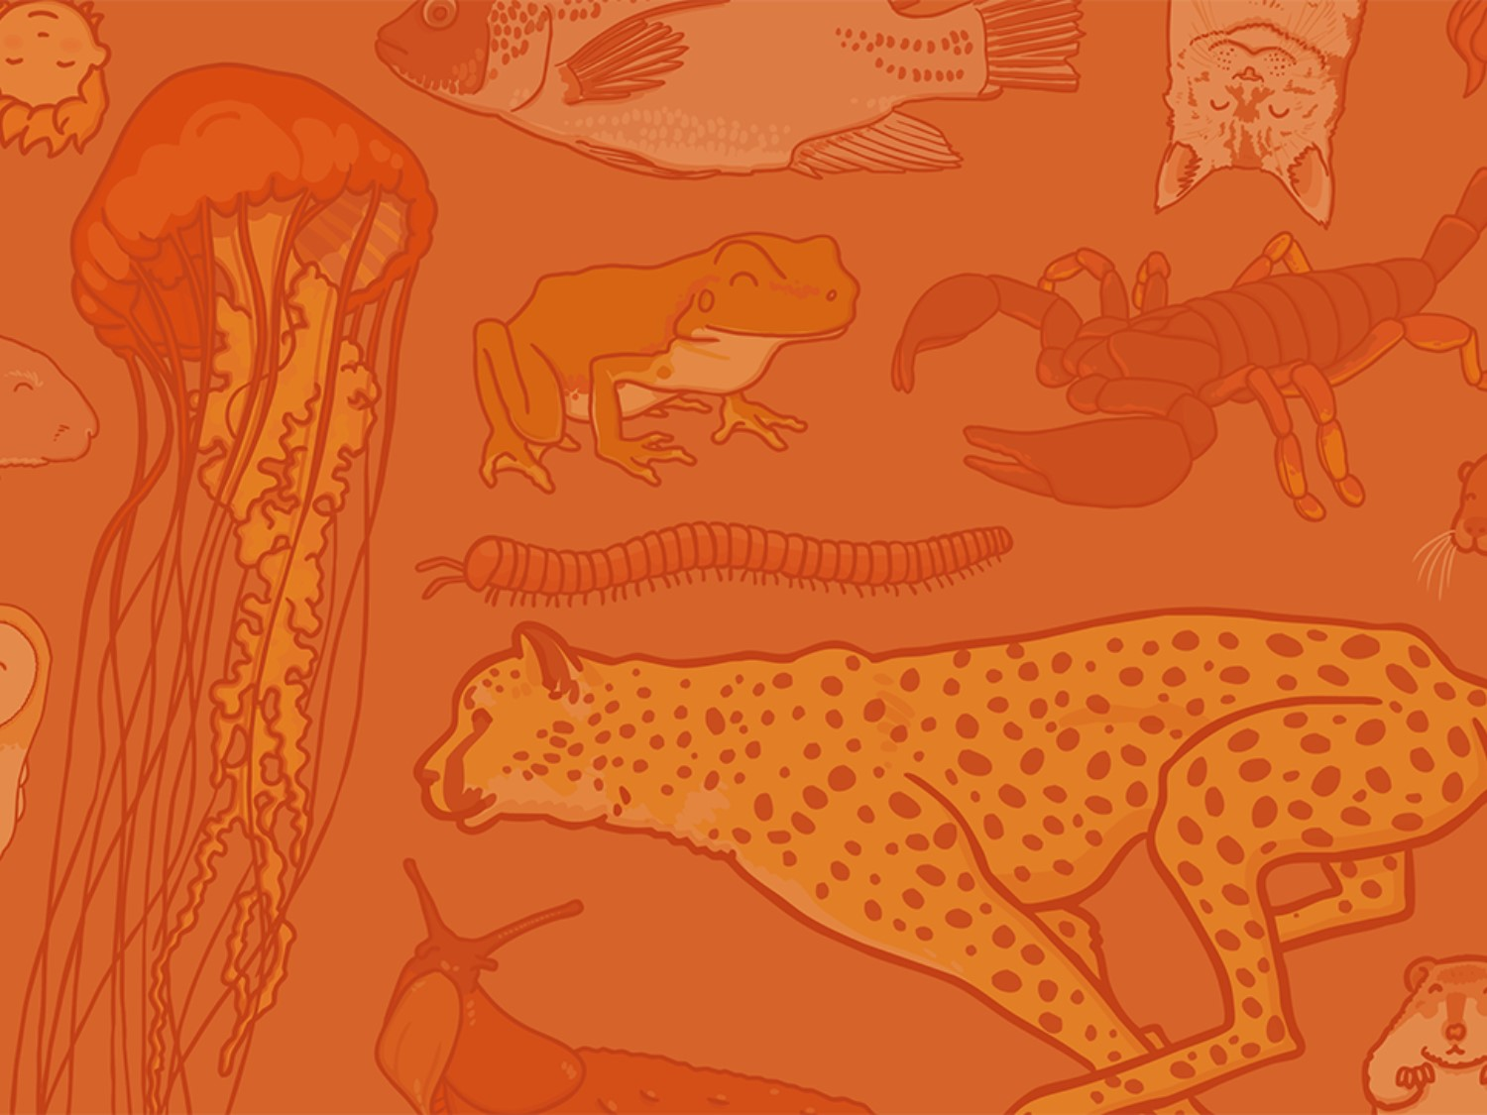
Aim
I can sort animals based on their skeletons.
Success Criteria
I can name the three different types of skeletons.
I can explain the pros and cons of different types of skeletons.

Slide 24

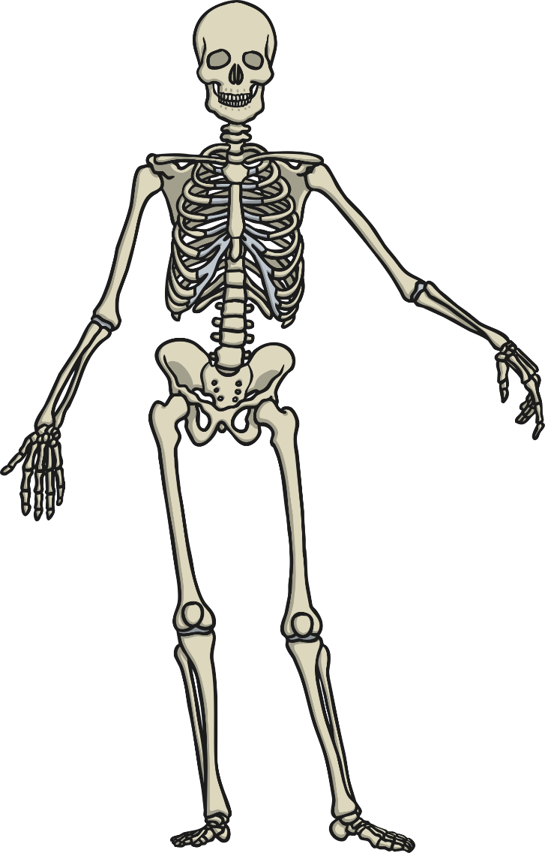
Skeleton
What do you associate with the word skeleton?

Slide 25

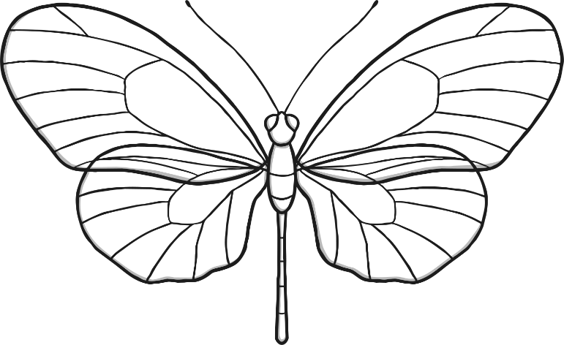
Vertebrates and Invertebrates
The difference between vertebrates and invertebrates is simple!
Vertebrates have a backbone (spine)…
…and invertebrates don’t
Backbone
(spine)
vertebrate
invertebrate
Now let’s see if you can categorise animals as vertebrates or invertebrates.

Slide 26

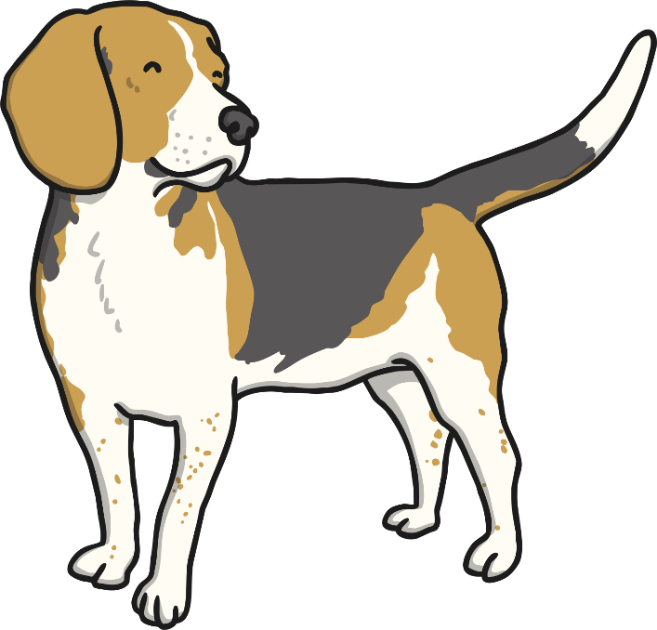
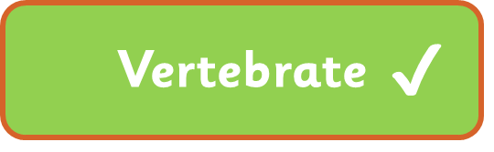

Dog
Vertebrate
Invertebrate
or

Slide 27
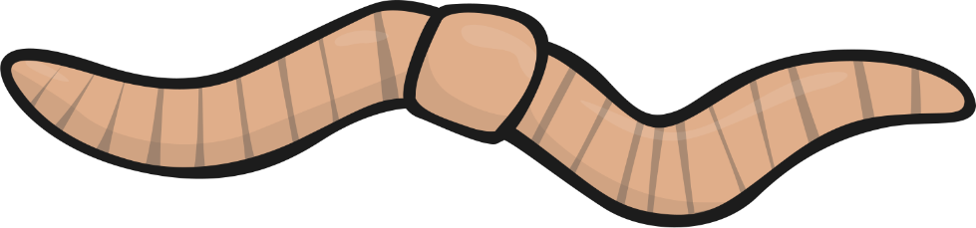

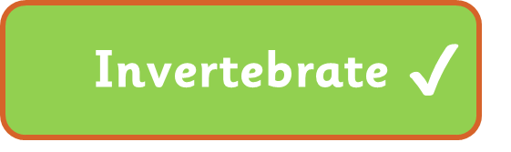
Worm
Vertebrate
Invertebrate
or

Slide 28
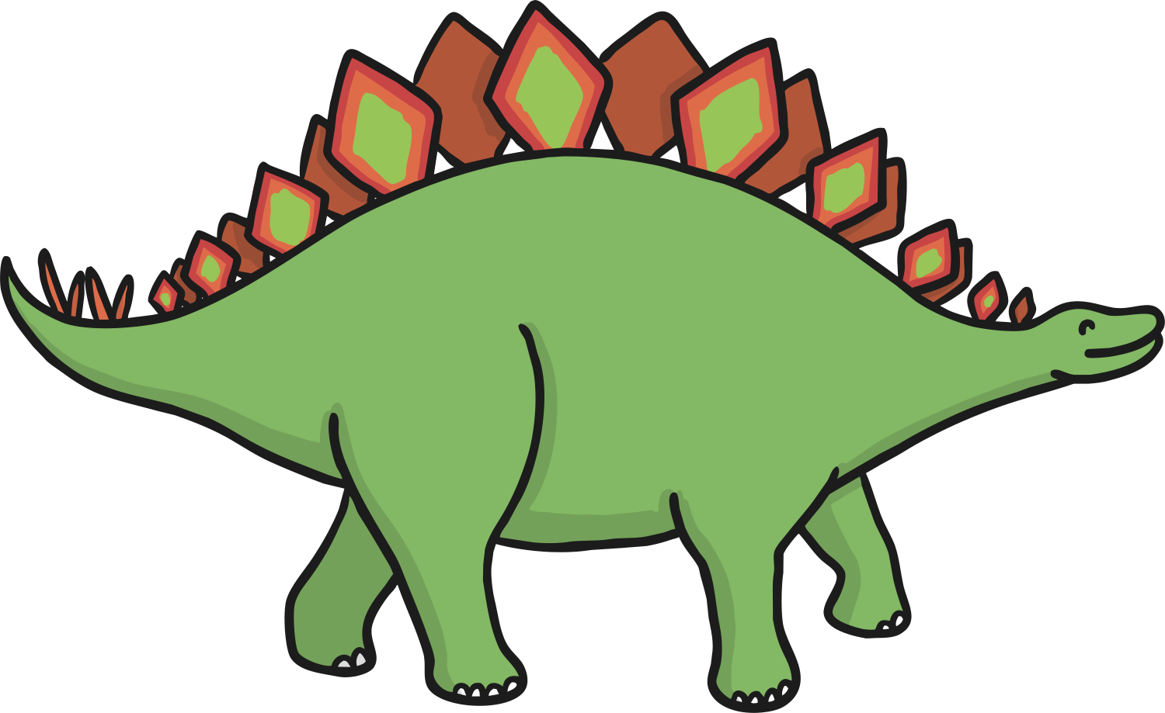
Dinosaur
Vertebrate
Invertebrate
or

Slide 29
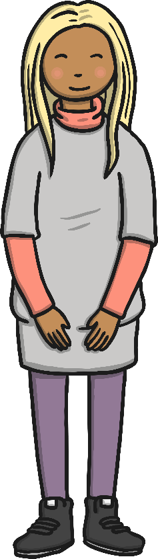
Human
Vertebrate
Invertebrate
or

Slide 30
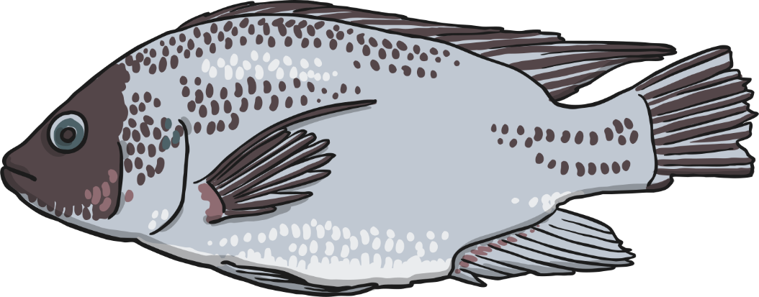
Fish
Vertebrate
Invertebrate
or

Slide 31
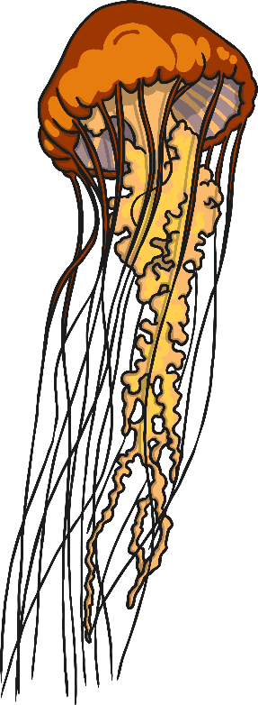
Jellyfish
Vertebrate
Invertebrate
or

Slide 32

Butterfly
Vertebrate
Invertebrate
or

Slide 33

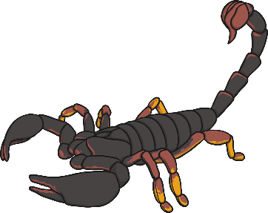

Types of Skeletons
A further classification of skeletons comes from if an animal has a skeleton and where it is.
All vertebrates have an endoskeleton. However invertebrates can be divided again between those with an exoskeleton and those with a hydrostatic skeleton.
vertebrate
invertebrate
endoskeleton
exoskeleton
hydrostatic skeleton
What do you think the words endoskeleton, exoskeleton and hydrostatic skeleton mean?

Slide 34
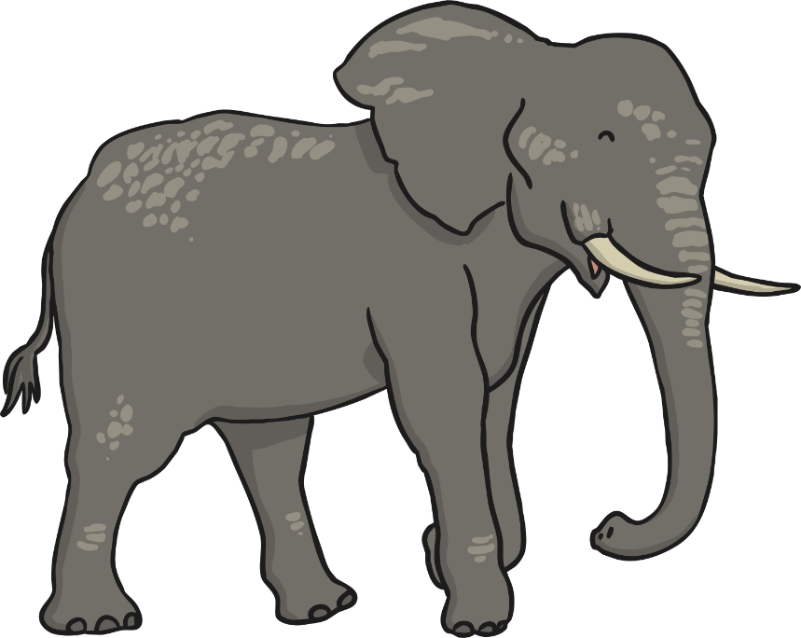
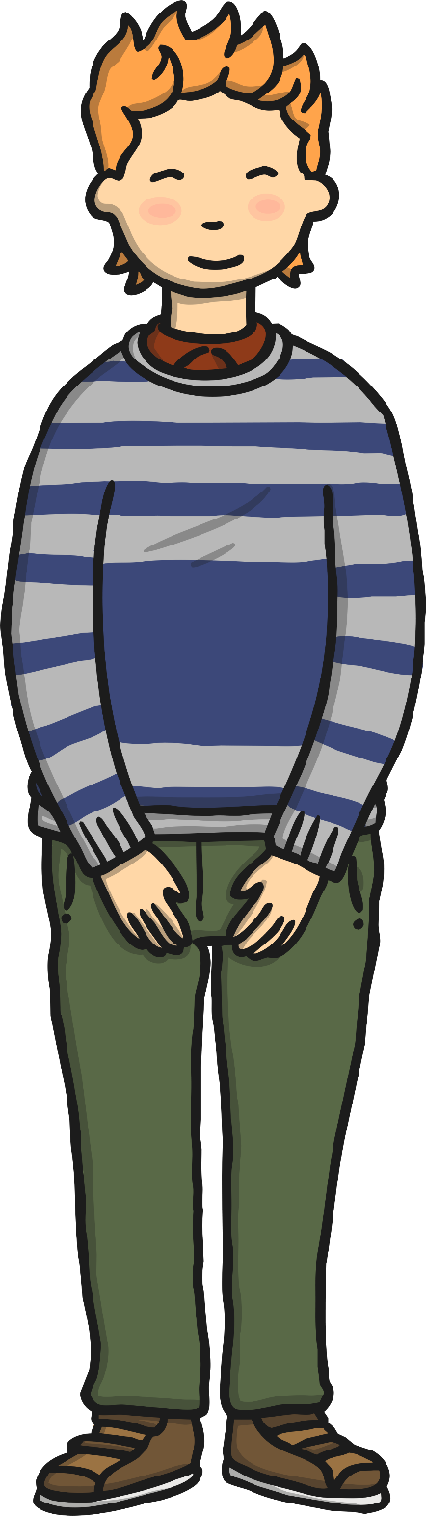
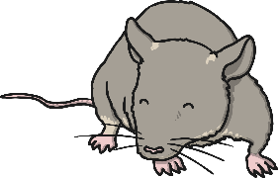
Endoskeletons
Animals with endoskeletons have skeletons on the inside of their bodies.
Endoskeletons are lighter than exoskeletons.
As the animal grows so does their skeleton.

Slide 35
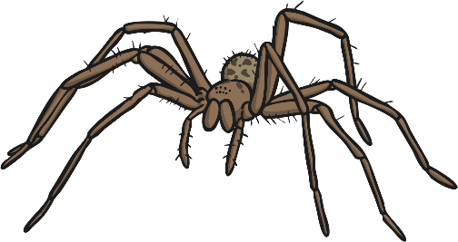
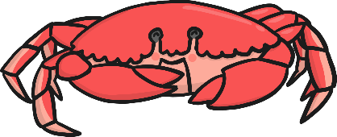

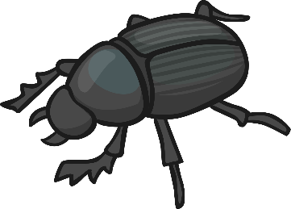
Exoskeletons
Animals with exoskeletons have their skeletons on the outside!
Watch the following
clip to see how they shed their skeletons
(clip the crab below).
Exoskeletons do not grow with the animal. Therefore the animal has to shed its skeleton and produce a new one!
https://vimeo.com/37438364

Slide 36
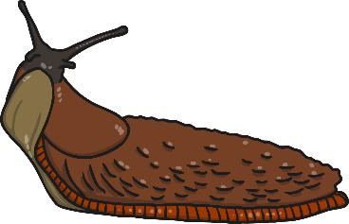

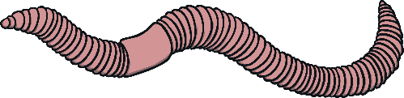
Hydrostatic Skeletons
Animals with hydrostatic skeletons don’t actually have any bones!
All animals with hydro-static skeletons are invertebrates.
Instead these animals have a fluid-filled compartment in their body called a coelom.

Slide 37

We hope you had fun today.
See you tomorrow.

