Slide 1

Thursday 18th June
Is your head ready to calculate?
Remember you can do these independently then share them with an adult.
Question 10 may have more than one answer.
Don’t worry about always finding the answer it is how you try to work out and reason that is important.

Slide 2
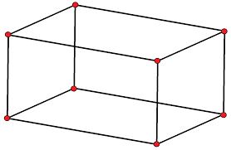
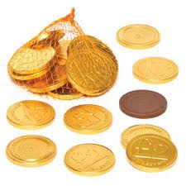

Morning Maths 18.06.20
8. Fill in the gaps:
9. Mr Mottershead has 300 chocolate coins. He eats half of them and then gives 50 to Mrs Shipley. How many does he have left?
10. Make 24 using
each number only
once and any of
the operators (+, -, x, ➗)
How many days in March?
2. How many edges on this shape?
3. Double 17
4. 400 - 364
5. Insert the correct symbol (<,>,=)
⅔ ½
6. If I pour 450ml from a 1 litre jug. How much is left in the jug?
7. 17 x 8
400
320
160

Slide 3
31
12
34
36
Greater than ＞
550l
7 x 8 = 56, 10 x 8 = 80, 80 + 56 = 136
480 and 240
300 ÷ 2 = 150, 150 - 50 = 100
3 x 4 = 12
12 x 2 = 24
24 x 1 = 24

Slide 4

St Catherine’s Classroom Beliefs
Mistakes are valuable.
Everyone can learn maths to the highest level.
Questions are really important.
Depth is more important than speed.
Maths is about making connections.
We may not be learning together in the classroom, but it is important to still remember our classroom beliefs.

Slide 5
WALT: add and subtract mass

Slide 6

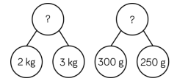
Add the parts together to reach the total. Copy the part whole models and complete the missing numbers.

Slide 7
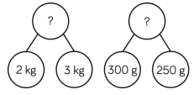
5kg
550g
5kg and 550g / 5.55kg

Slide 8
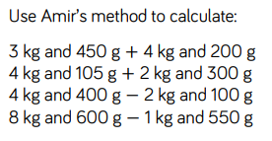
Have a go at the following calculations.

Slide 9
Answers
= 7kg and 650g
= 6kg and 405g
= 2kg and 300g
= 7kg and 50g

Slide 10
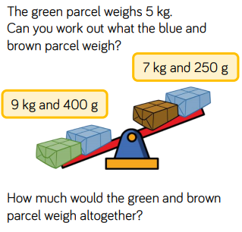

Slide 11
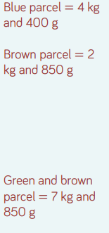

Slide 12

Time for a break.
Have a drink and a snack.

Slide 13
WALT: To use metaphors for description
Yesterday we looked at similes, which are used for comparing an object to something else in order to help us create a picture of it in our mind.
Today we will focus on metaphors, which authors also use for description.
First, we will consider how similes and metaphors are different.
Look at the next slide.

Slide 14
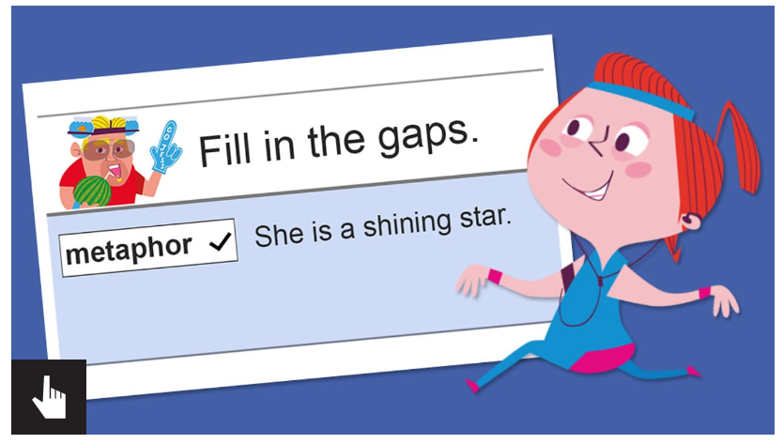
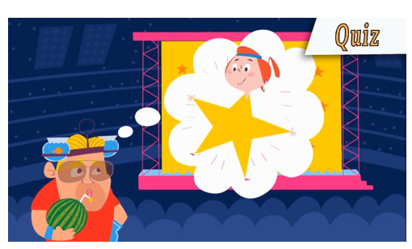
Use the link to watch the video clip
https://www.bbc.co.uk/bitesize/topics/zfkk7ty/articles/z9tkxfr
Scroll down from the video clip to read the information.
Try ‘the fill’ in the gaps activity
Take the quiz.

Slide 15
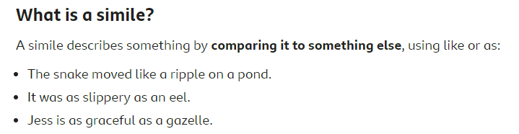
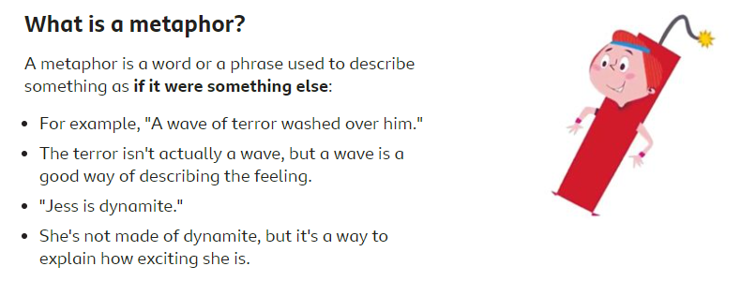
Let’s just recap that once more.

Slide 16
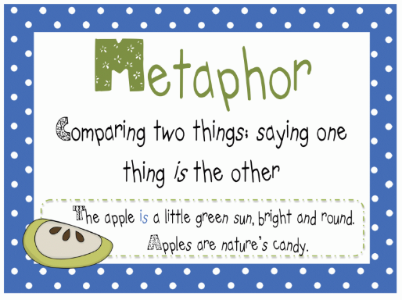
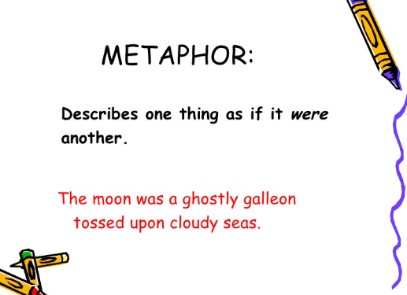
A metaphor can say something was something else.
Metaphors can say something is something else or are if there is two or more of them.

Slide 17
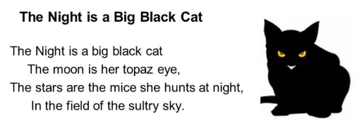
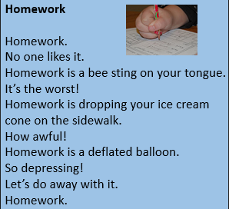
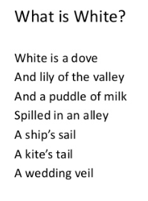
Here are some metaphor poems.

Slide 18
Match the metaphors. Choose an object and match it with a metaphor. Write them in your book. Draw a picture to go with them. You could make them into a poster.
Her hair | is a roaring lion.
The wind | is a golden river.
You | was a white blanket.
The moon | was a howling wolf.
She | were glistening jewels.
Thunder | is the sunshine.
The snow | are a star.
Her eyes | is a silver ball.

Slide 19
Match the metaphors. Answers.
Thunder | is a roaring lion.
Her hair | is a golden river.
The snow | was a white blanket.
The wind | was a howling wolf.
Her eyes | were glistening jewels.
She | is the sunshine.
You | are a star.
The moon | is a silver ball.

Slide 20
Copy the table below. Then look at the next slide and decide which bubble has a simile in it and which one has a metaphor. Write them in the correct place in your table.
Similes | Metaphors

Slide 21
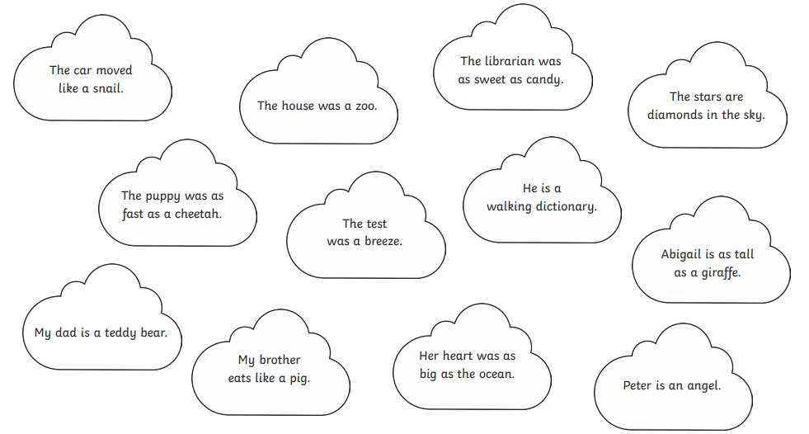

Slide 22
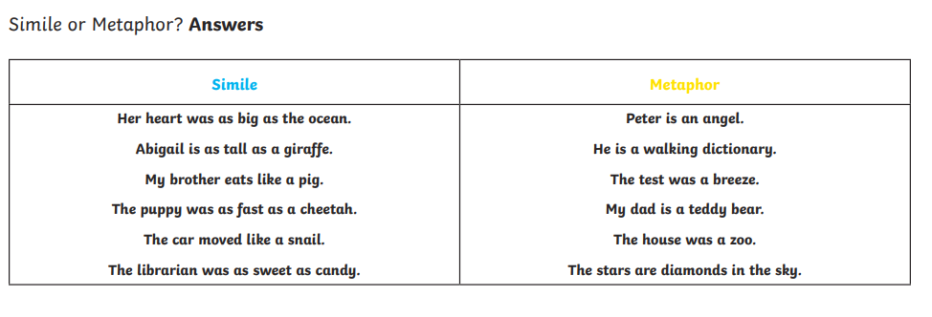

Slide 23

15 minute Spelling Activity
Today’s spelling activity is a set of 6 sentences where there are spelling mistakes.
They are all spellings that you have been practising over the last few weeks.
Copy out the sentences correcting the spellings so there are no mistakes.

Slide 24
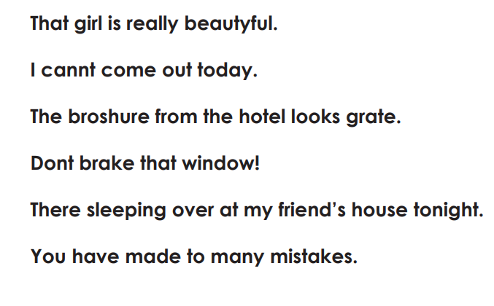

Slide 25
Answers
That girl is really beautiful.
I can’t come out today.
The brochure from the hotel looks great.
Don’t break that window!
They’re sleeping over at my friend’s house tonight.
You have made too many mistakes.

Slide 26


Your morning lessons are completed.
Time for lunch.
Then come back this afternoon for your curriculum activity.

Slide 27
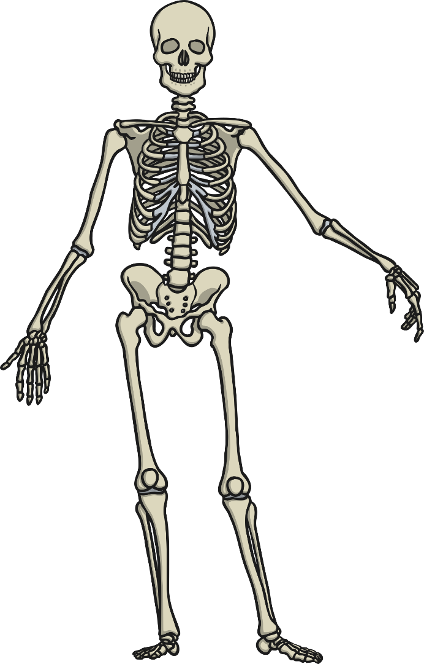
What is the purpose of a skeleton?
You will need to print out one of the slides for this afternoon’s activity, ( It tells you on the slide which one to print.) or you could add it to your drawing from yesterday or just talk about it with an adult.

Slide 28


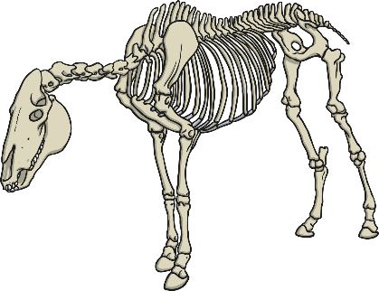
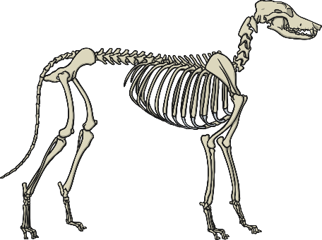
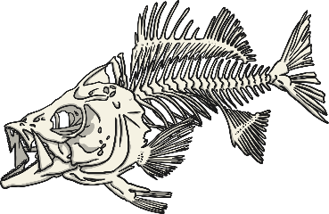
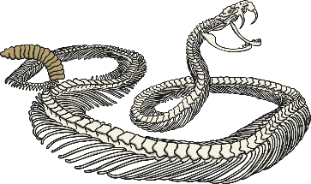
Whose Skeleton?
human
dog
horse
snake
fish

Slide 29

Purpose of a Skeleton
Think about the answers to the following questions.
Why do we
have skeletons?
What would happen if we
did not have
a skeleton?
1
2

Slide 30

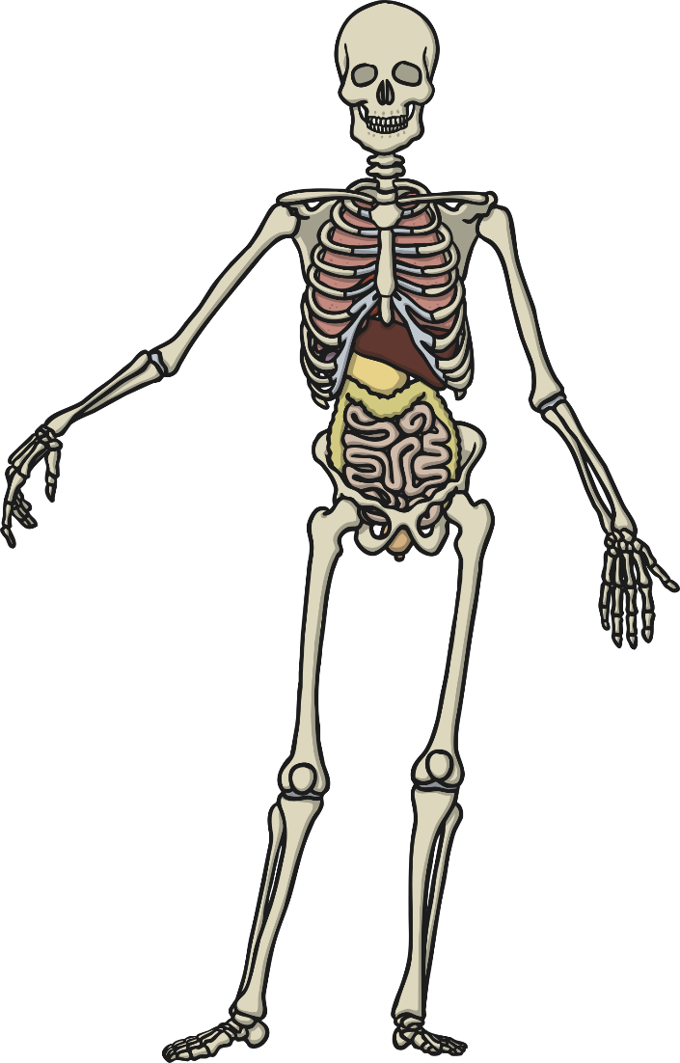
All Fall Down!
One of the functions of a skeleton is to support your body.
What would happen if you had no bones in your body?
Which part of the skeleton keeps your body upright?

Slide 31
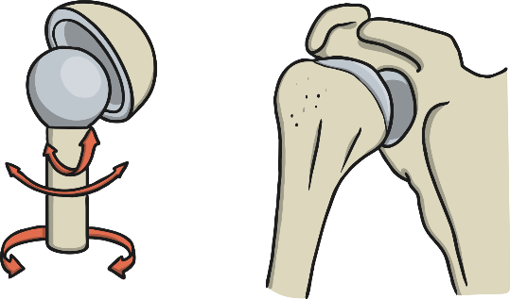
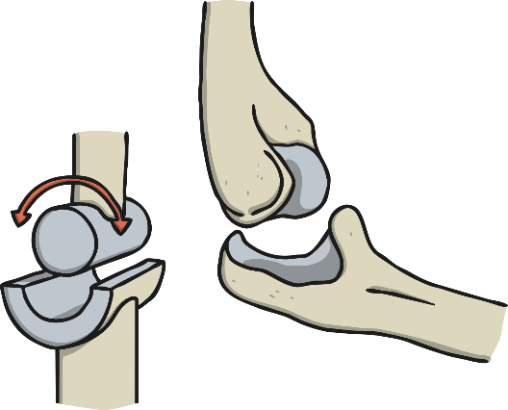
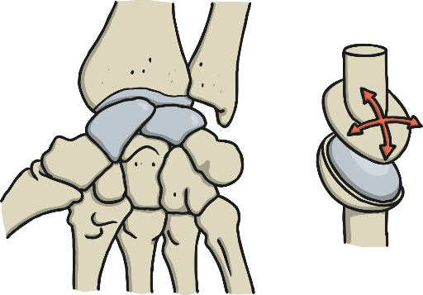
Joints
Without joints connecting our bones we would not be able to move the way we do. We would not be able to bend, jump, skip to name a few movements. There are 3 different types of joints in the body.
ball and socket
hinge
gliding
Ball and socket joints allow the most freedom of movement. One example in the human skeleton is the between the pelvis (hip) and femur (upper leg bone).
Hinge joints allow flex and extend movements. One example in the human skeleton is between the humerus (upper arm bone) and radius/ulna (lower
arm bones).
Gliding joints are also known as ‘plane’ joints. The bones are shaped to glide over one another and allow for small limited movements in different directions. One example in the human skeleton is the wrist bones.

Slide 32
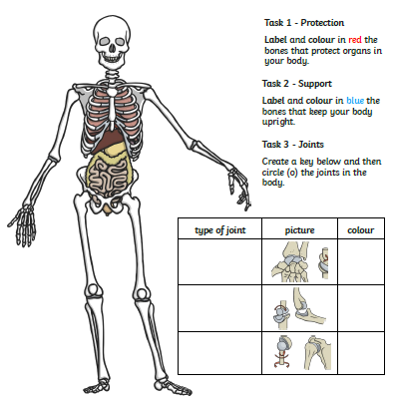
Print out this slide.

Slide 33
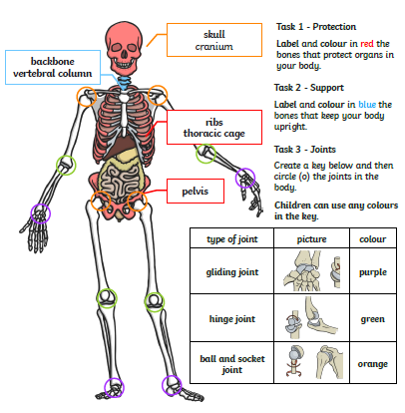
Answers

Slide 34
Did you work hard with your learning today?
See you in the morning.

