Slide 1
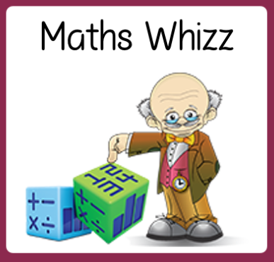
Friday 19th June
Are you a maths whizz today?
Remember you can do these independently then share them with an adult.
Question 10 may have more than one answer.
Don’t worry about always finding the answer, it is how you try to work out and reason that is important.

Slide 2
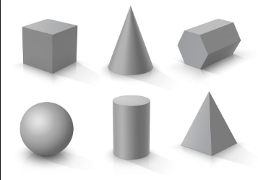
Morning Maths 19.06.20
7. How many of
these shapes can
you name?
8. 535 + 367
9. 4 of 12
6
10. Solve these anagrams of maths vocab:
dad
mus
at dig il
item
entalequiv
elm tulip
coin fart
65 + 7
2. 8 x 9
3. Insert the correct symbol ( <,> , =)
2 x 3 x 5 5 x 6
4. Which two fractions are equivalent?
5. What is the subtraction statement
6. Complete the missing numbers above
1
2
2
6
3
4
1
3
4
4
543
202
£1.60
£1.80
£2.20
£2.60

Slide 3
72
72
=
2/6 and ⅓
543 - 202 = 341
£2.00 and £2.80
Cube cone hexagonal prism
Sphere cylinder square based pyramid
12 ÷ 6 = 2, so ⅙ = 2, 4 x 2 = 8, so 4/6 = 8
902
add equivalent
sum multiple
digital fraction
time

Slide 4

St Catherine’s Classroom Beliefs
Mistakes are valuable.
Everyone can learn maths to the highest level.
Questions are really important.
Depth is more important than speed.
Maths is about making connections.
We may not be learning together in the classroom, but it is important to still remember our classroom beliefs.

Slide 5
WALT: convert and compare mass

Slide 6
Today we are going to be comparing masses to find out which weight is heavier. We need to know a couple of things.
How to convert between grams and kilograms
How to use < , > and =
There are 1000 grams in 1 kilogram.
1 kilogram = 1000g
2 kilograms = 2000g
Sometimes we see measures like 6.5 kilograms. This means 6500g.
3.7 kilograms = 3700g
2.1 kilograms = 2100g
There are three symbols we use when comparing.
^{< less than}
^{4.5 kilograms < 5 kilograms}
^{> more than}
^{4.7 kilograms > 4.5 kilograms}
^{= equal to}
^{5.5 kilograms = 5500 grams}

Slide 7
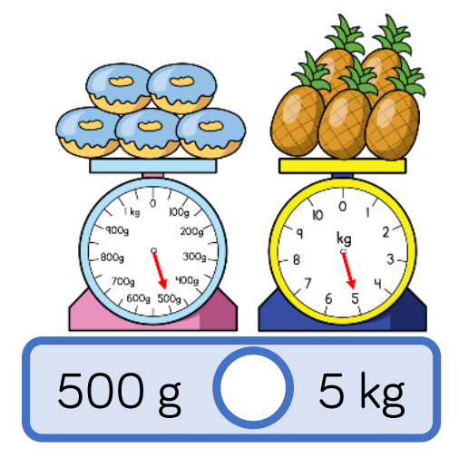
Let’s look at these two amounts and see which we think is the heavier amount.
What is the same about the two masses?
Both have 5 objects
Both masses start with a 5 digit
The scales point to the same position on their scale.
What is different about the two masses?
One is measured in grams
One is measure in kilograms
One weighs 5kg the other is 500g

Slide 8
When we compare the two amounts we need to convert one of them so we can see which is bigger.
The doughnuts weigh 500g. In grams, the pineapples weigh 5000g.
5kg = 5000g
We know that 500 is less than 5000 so we use the less than symbol.
<

Slide 9
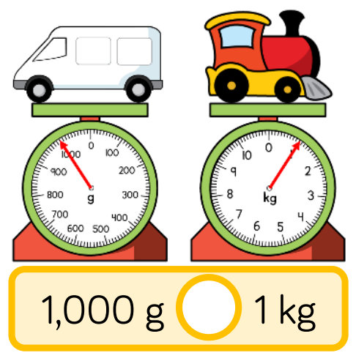
Try and work out which symbol should go in between the two masses. Work out which is larger.
Remember
< less than
> more than
= equal to

Slide 10
They are equal in weight because 1 kg is 1000g. The train and the van both weigh 1000g so we use the equals symbol to show they are the same weight.
=

Slide 11
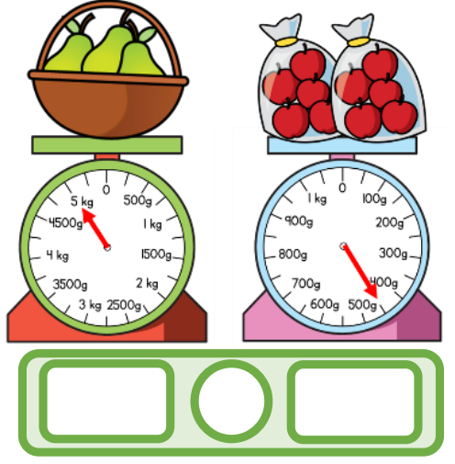
This time you need to read the scales to work out the weight of each side. Then you can work out which symbol should go in between the two masses. Work out which is larger.
Remember
< less than
> more than
= equal to

Slide 12
The pears weigh 5kg which is equivalent to 5000g.
The bags of apples weigh 450g.
5kg is therefore more than 450g.
5kg
>
450g

Slide 13
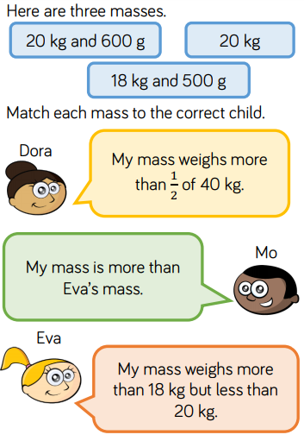

Slide 15

Time for a break.
Have a drink and a snack.

Slide 16
Our English task for today is a Close Reading Task
It is a poem by Pie Corbett.
WALT: retrieve and infer information from a text.
Ask an adult to read the information (on the next page) to you.
Here are some meanings of words that might help you – bundles - moves awkwardly across the road
joint - place
tucks - eats something enthusiastically
garbage - rubbish
titbits - snack
3. Now read it with your adult twice, they can help you with expression.
4. Now read it twice by yourself.
5. Read the questions and look for evidence in the text to help you answer them.
6. Write your answers in full sentences.

Slide 17
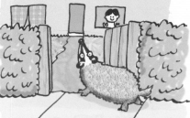
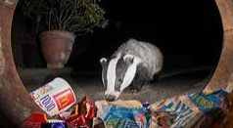
Animal Riddle by Pie Corbett
Like a small Bear it
bundles over the dArk road,
brushes past the front gate,
as if she owns the joint,
rolls the Dustbin
like an expert barrel rider,
Tucks into yesterday’s Garbage,
crunches worms for titbits.
Wakes up from deep slEep,
blinks back at torch light.
Our midnight feasteR,
ghost-friend,
moon-lit,
zebra bear.

Slide 18
Task:
Find and copy three similes in the poem that are used to describe the badger. Explain why the author uses these similes. (Remember to look for like, as if and as something as)
Explain why the author uses the metaphors, midnight feaster and zebra bear.
List all the things we learn about badgers from the poem.

Slide 19
Task:
Find and copy three similes in the poem that are used to describe the badger. Explain why the author uses these similes.
The three similes are; like a small bear it bundles (because it is shaped and moves like a bear), like an expert barrel rider (because she rolls the bin over easily to get to the food) and as if she owns the joint (she is like the owner of the night time bins and gardens because it is her home and she knows her way around).
Explain why the author uses the metaphors, midnight feaster and zebra bear.
The author uses the metaphor midnight feaster to explain that the badger feeds at night time and the metaphor zebra bear because it makes you imagine a small bear with black and white stripes which is what the badger looks like.
List all the things we learn about badgers from the poem.
It is a small bear shape which is black and white striped, it scavenges on rubbish we leave in bins, it eats worms and it is nocturnal - it is awake and out and about at night,

Slide 20

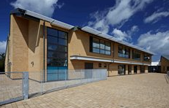
15 minute Spelling Activity
In today’s spelling, words we will be looking at
the written spelling pattern - ch
which makes the ‘k’ sound
like in the word school.

Slide 21
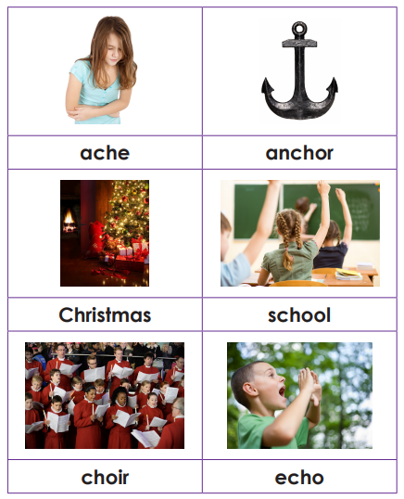
Read the words and say them out loud.
Can you hear the ‘k’ sound in the words.
Remember the letters ch are how the sound ‘k’ is spelled in these words.

Slide 22
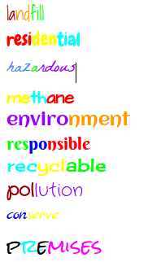
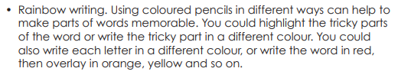
Rainbow write each word 3 times.
school | anchor | ache
choir | echo | Christmas

Slide 23
Choose one of the words you have been practising to go in the sentence.
The children broke up for the __________ holidays.
Their voices made an __________ in the hollow of the cave.
Before the ship set sail they had to haul up the ________ .
It was a beautiful concert and the _________ sang in perfect harmony.
Mrs shipley had many _________ cards from the children.
The boy had an ______ in his shoulder after he fell awkwardly.
Make sure you spell them correctly!

Slide 24
Choose one of the words you have been practising to go in the sentence.
The children broke up for the school holidays.
Their voices made an echo in the hollow of the cave.
Before the ship set sail they had to haul up the anchor.
It was a beautiful concert and the choir sang in perfect harmony.
Mrs shipley had many Christmas cards from the children.
The boy had an ache in his shoulder after he fell awkwardly.
Make sure you spell them correctly!

Slide 25


Your morning lessons are completed.
Time for lunch.
Then come back this afternoon for your curriculum activity.

Slide 26
Science - space

Slide 27
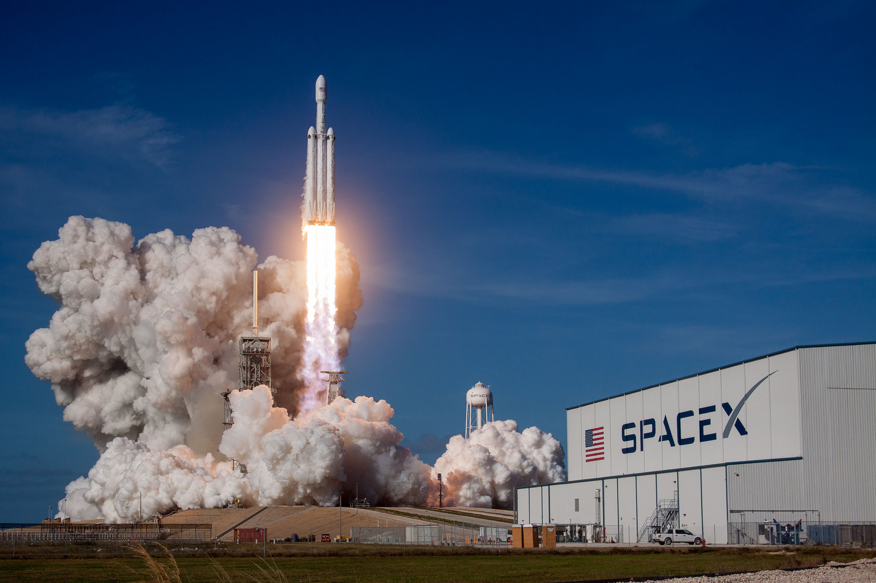
You may know that this year there have been a number of space rocket launches. They are blasting off for a number of reasons including supplies to the international space station and putting satellites into orbit.
But why are we exploring space? What’s out there?

Slide 28
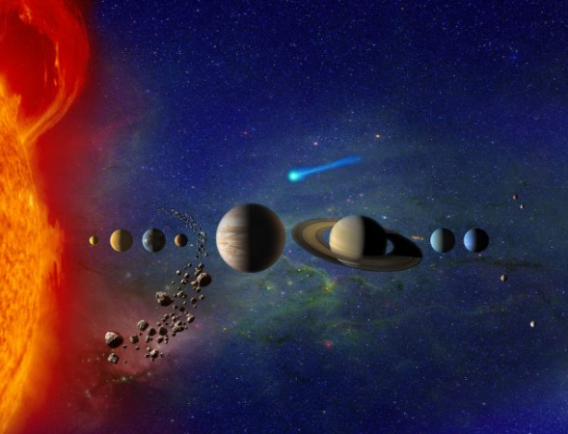
There are 8 planets in our solar system. They all orbit (move around) the sun, which is in the middle. Life is very different on each of these planets. Some are extremely hot, others are freezing cold. Some can support life while others cannot.

Slide 29
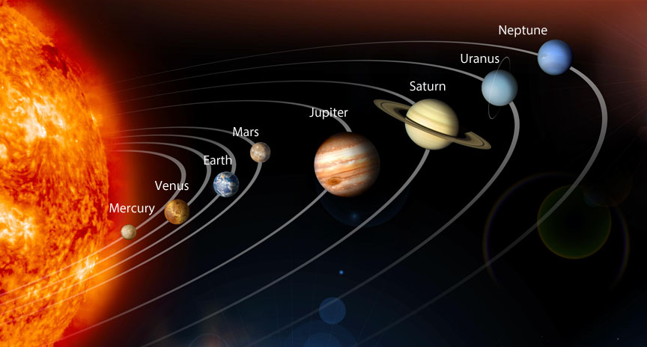
Today we want you to choose a planet and make a poster containing interesting facts, images, diagrams and relevant information all about one planet.
Look on the next slide to see some examples.

Slide 30
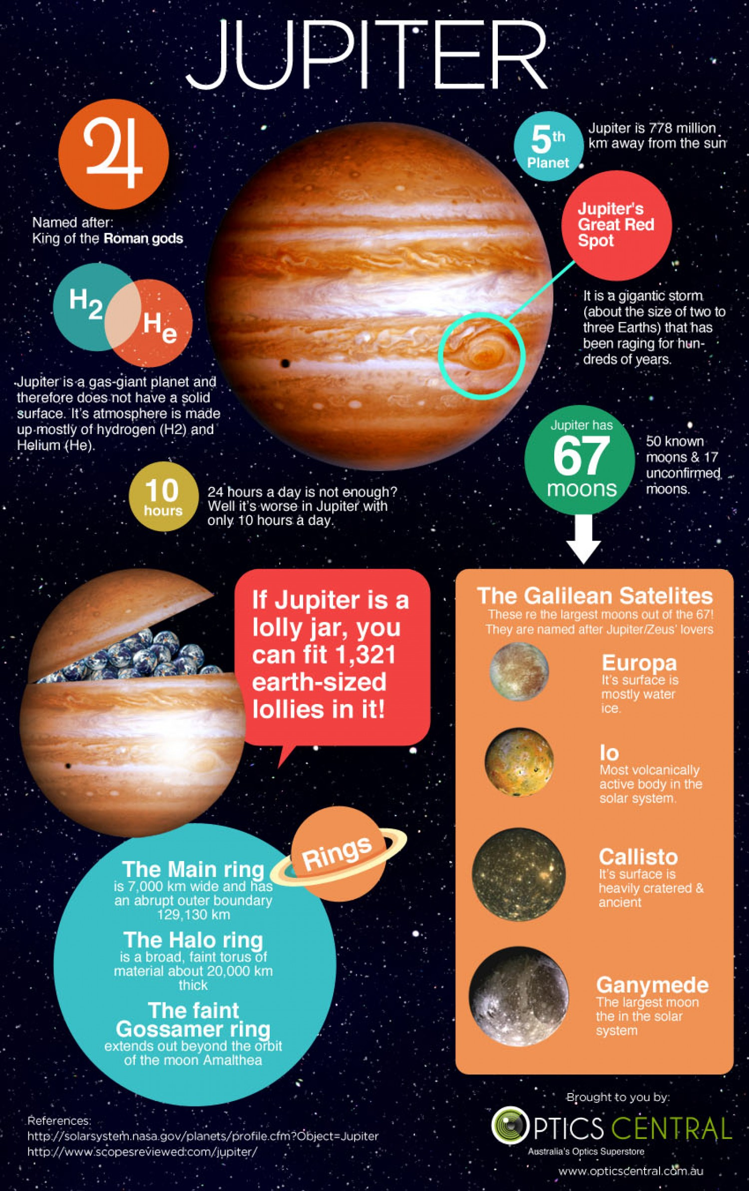
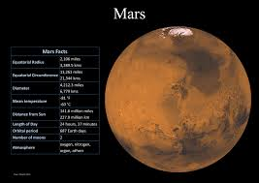
You can do your poster on a laptop or tablet or if you prefer you can do it on a piece of paper.

Slide 31
Well Done 3S and 3M!
Time for a well deserved weekend so enjoy yourselves and we will meet up with you again on Monday.

