Slide 1

Monday 22nd June
We will begin our day with Morning Maths - just like in school! This should be 10 -15 minutes.
You can do these independently then share them with an adult.
Remember question 10 may have more than one answer.
Don’t worry about always finding the answer it is how you try to work out and reason that is important.

Slide 2
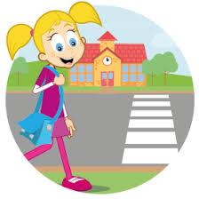


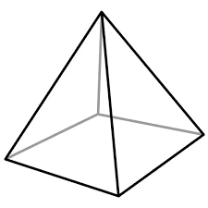
Morning Maths 22.06.20
8. Jess leaves home at 8:30 and arrives at school at 9:05. How long did her walk to school take?
9. 299 x 3
10. Always, sometimes,
never:
The sum of two numbers
is the same as their product.
100 = + 52
2. Which of these are NOT factors of 32:
3, 4, 5, 8, 12
3. Complete this
bar model.
4. 64 ➗ 8
5. Write 0.7 as a fraction
6. Write this time in another way:
7. How many vertices in this square-
based pyramid?
Ooh, look - a pronoun!
250
43

Slide 3
48
3,5,12
207
8
7/10
2.35pm
5
35 minutes
697
Sometimes
(because 2+2=4 and 2x2=4 but, not always as 3+4=7 3x7=12

Slide 4

St Catherine’s Classroom Beliefs
Mistakes are valuable.
Everyone can learn maths to the highest level.
Questions are really important.
Depth is more important than speed.
Maths is about making connections.
We may not be learning together in the classroom, but it is important to still remember our classroom beliefs.

Slide 5
WALT: measure capacity

Slide 6
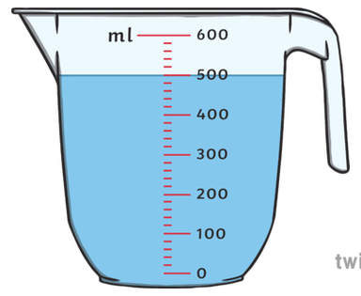
The amount of liquid within a container is called the volume.
The maximum amount the container can fill is called the capacity.
We measure the capacity using Litres (L) and Millilitres (ml).
There are 1000ml in 1L.
What is the volume of water in the jug?
____________
What is the capacity of water in the jug?
____________

Slide 7
The amount of liquid within a container is called the volume.
The maximum amount the container can fill is called the capacity.
We measure the capacity using Litres (L) and Millilitres (ml).
There are 1000ml in 1L.
What is the volume of water in the jug?
500ml
What is the capacity of water in the jug?
600ml

Slide 8
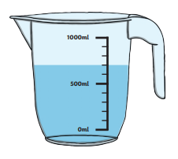
However, just like measuring mass, the volume won’t always be exactly on a number on the scale.
Use what you know about measuring the work out the volume of water in the jug.
What is the volume of water in the jug?
______________
What is the capacity of water in the jug?
______________

Slide 9
However, just like measuring mass, the volume won’t always be exactly on a number on the scale.
Use what you know about measuring the work out the volume of water in the jug.
What is the volume of water in the jug?
700ml
What is the capacity of the jug?
1000ml or 1L

Slide 10
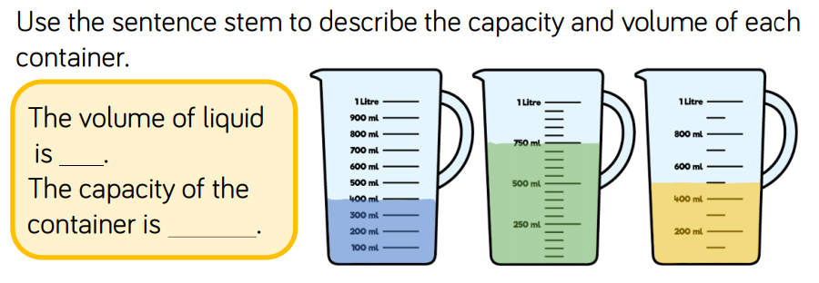

Slide 12
400ml
1L
500ml
1L
750ml
1L

Slide 13
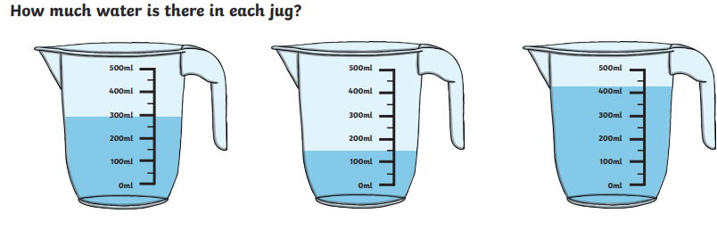
Volume: _________
Capacity: ________
Volume: _________
Capacity: ________
Volume: _________
Capacity: ________

Slide 14
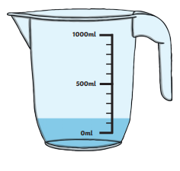
Volume: 300ml
Capacity: 500ml
Volume: 150ml
Capacity: 500ml
Volume: 150ml
Capacity: 1L or 1000ml

Slide 15
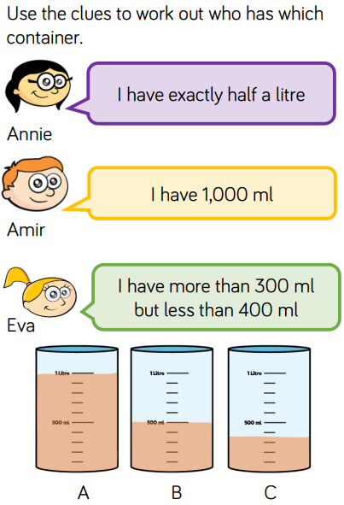
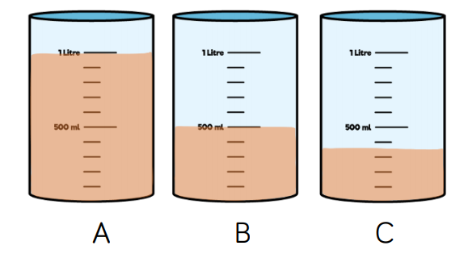

Slide 17

Time for a break.
Have a drink and a snack.

Slide 18
Today’s comprehension is from a poem called The Magic Box by Kit Wright.
The Magic Box - Comprehension:
WALT: retrieve information from fiction texts and make inferences.
Read the poem on the next slides, there are some pictures to help you to understand the poem too.
Then answer the questions about the poem.

Slide 19
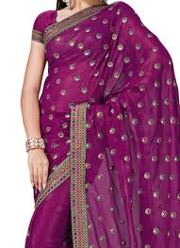
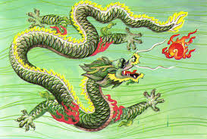
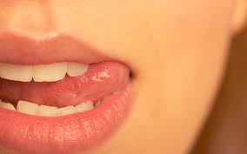
The Magic Box
I will put in the box
The swish of a silk sari on a summer night,
Fire from the nostrils of a Chinese dragon,
The tip of a tongue touching a tooth.

Slide 20
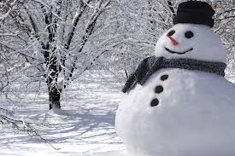
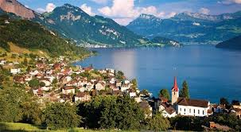
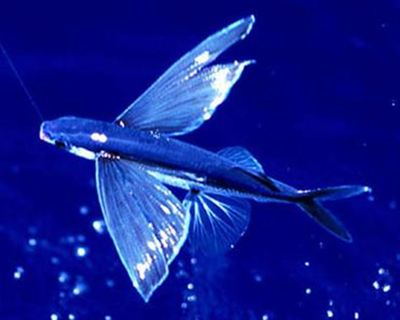
I will put into the box
A snowman with a rumbling belly,
A sip of the bluest water from Lake Lucerne,
A leaping spark from an electric fish.

Slide 21
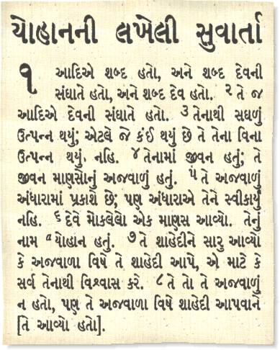
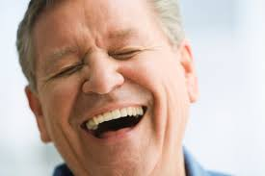
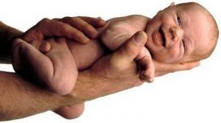
I will put into the box
Three violet wishes spoken in Gujarati,
The last joke of an ancient uncle,
And the first smile of a baby.

Slide 22
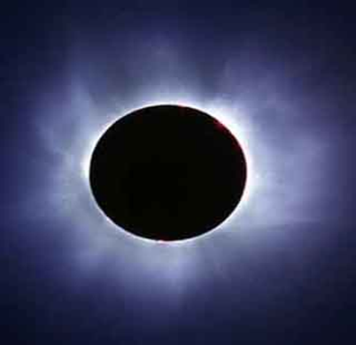
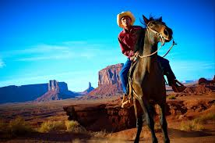
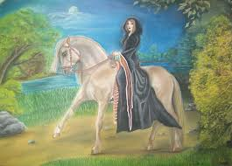
I will put into the box
A fifth season and a black sun,
A cowboy on a broomstick,
And a witch on a white horse.

Slide 23
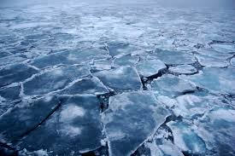
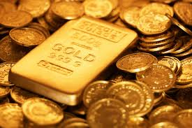
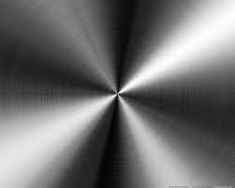
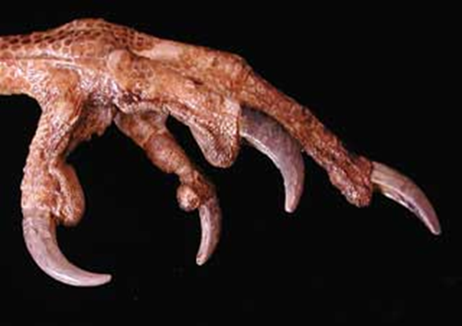
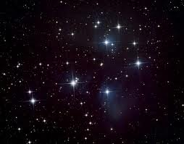
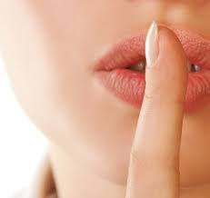
My box is fashioned from ice and gold and steel,
With stars on the lid and secrets in the corners.
Its hinges are the toe joints of dinosaurs.

Slide 24
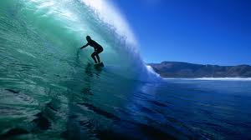
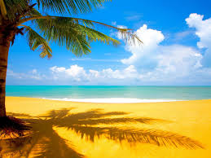
I shall surf in my box
On the great high-rolling breakers of the wild Atlantic,
Then wash ashore on a yellow beach
The colour of the sun.

Slide 25
The Magic Box - Comprehension: retrieve information from fiction texts and make inferences.
Understanding the text.
What does the author put in the box from a summer’s night?
Where does the bluest water come from?
How many wishes are spoken in Gujarati?
In the fourth verse what two things has the author muddled up which makes them sound strange?
What is the box made from?
Looking at the Language
Give an example of an onomatopoeia word in verse 1.
Find and copy one word which means nose.
Find and copy one which means old.
Which adjective describes the wishes?

Slide 26
Exploring the text.
10. What does ‘rumbling belly’ suggest about the snowman and why is this unusual?
11. Why do you think the joke is described as the last joke? Explain using evidence from the text.
12. What do you think the high rolling breakers are? Explain how you know.

Slide 27
The Magic Box - Comprehension: retrieve information from fiction texts and make inferences.
Understanding the text.
What does the author put in the box from a summer’s night?
The author puts in a swish from a silk sari.
Where does the bluest water come from?
The bluest water comes from Lake Lucerne.
How many wishes are spoken in Gujarati?
Three wishes are spoken in Gujarati.
In the fourth verse what two things has the author muddled up which makes them sound strange?
He muddles up the cowboy and the witch because the cowboy should be on a horse and the witch should be on a broomstick.
What is the box made from?
It is made from ice, gold, steel, stars, secrets and the toe joints of dinposaurs.
Looking at the Language
Give an example of an onomatopoeia word in verse 1. Swish because swish describes the sound of the sari moving.
Find and copy one word which means nose. nostrils
Find and copy one which means old. ancient
Which adjective describes the wishes? violet

Slide 28
Exploring the text.
10. What does ‘rumbling belly’ suggest about the snowman and why is this unusual?
It suggests that the snowman is hungry which is unusual because snowman do not eat/have a digestive system as they are not alive.
11. Why do you think the joke is described as the last joke? Explain using evidence from the text.
The uncle is described as ancient so he may have passed away and his last joke was saved to remember him.
12. What do you think the high rolling breakers are? Explain how you know.
The breakers are waves because the poet says he can surf in the box and you surf on the sea. It also says he washes ashore on the beach which is what waves do.

Slide 29

15 minute Spelling Activity
Revision of the suffixes ed, ing, s, es, ness, ful, less and ly
Remember that a short vowel sound a, e, i, o, u before the consonant means you must double the consonant before adding the suffix.
If the root word ends in e, you must drop the e before adding the suffix.
If the word ends in y you may need to drop the y and change it to an i before adding the suffix.

Slide 30
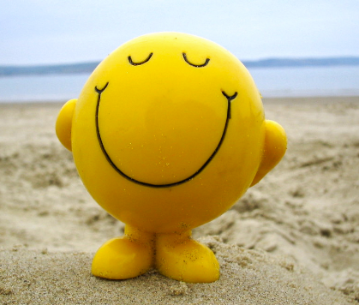
I took the root word smile and tried adding the suffixes
ed, ing, s, es, ness, ful, less and ly
Then I used some of the words in a sentence about the picture.
These are the new words I made:
smiled
smiling
smiles
smileless
Mr Happy smiled because he enjoyed being at the beach.
Mr Happy was smiling at the excellent sandcastle he had made.

Slide 31
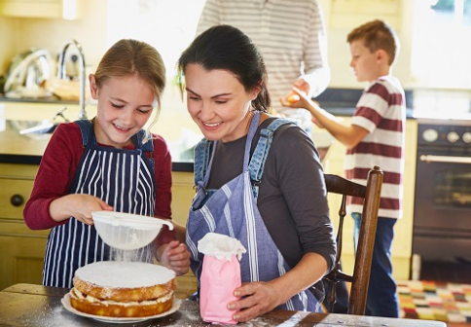
Take the root word bake and try adding the suffixes
ed, ing, s, es, ness, ful, less and ly
Then use some of the words in a sentence about the picture.
Which suffixes can you add to bake?
Write your words down.
The little girl _____ a cake with her mum.
They were ______ a cake for her brother’s birthday.
My mum _____ cakes every Friday.

Slide 32
Let us take the root word bake and try adding the suffixes
ed, ing, s, es, ness, ful, less and ly
Then use some of the words in a sentence about the picture.
Which suffixes can you add to bake?
Write your words down.
baked
bakes
baking
The little girl baked a cake with her mum.
They were baking a cake for her brother’s birthday.
My mum bakes cakes every Friday.

Slide 33
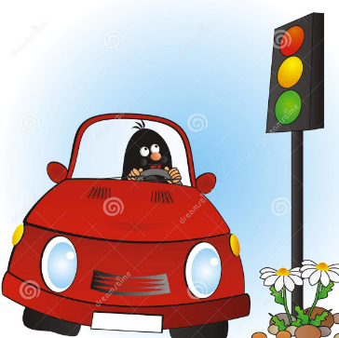
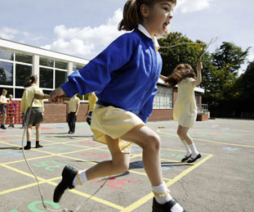
Take the root word stop and try adding the suffixes
ed, ing, s, es, ness, ful, less and ly
Then use some of the words in a sentence about the pictures.
Which suffixes can you add to stop?
Write your words down.
The red light _____ the cars at the traffic lights.
She _______ working when the bell rang for playtime.
“I am ________ now,” replied Jack.

Slide 34
Take the root word stop and try adding the suffixes
ed, ing, s, es, ness, ful, less and ly
Then use some of the words in a sentence about the pictures.
Which suffixes can you add to stop?
Write your words down.
stopped
stopping
stops
The red light stops the cars at the traffic lights.
She stopped working when the bell rang for playtime.
“I am stopping now,” replied Jack.

Slide 35
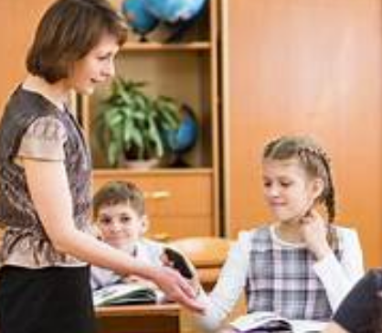
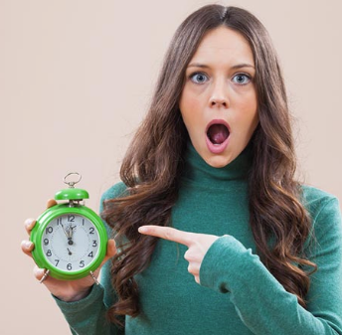
Take the root word phone and try adding the suffixes
ed, ing, s, es, ness, ful, less and ly
Then use some of the words in a sentence about the picture.
The teachers have been ______ your parents to see how you are getting on.
Year 6 children hand their ______ in to the teachers before school.
Jess was ______ and miserable because she couldn’t speak to her friends.
I ______ dad to let him know I would be late home.
Which suffixes can you add to phone?
Write your words down.

Slide 36
Take the root word phone and try adding the suffixes
ed, ing, s, es, ness, ful, less and ly
Then use some of the words in a sentence about the picture.
The teachers have been phoning your parents to see how you are getting on.
Year 6 children hand their phones in to the teachers before school.
Jess was phoneless and miserable because she couldn’t speak to her friends.
I phoned dad to let him know I would be late home.
Which suffixes can you add to phone?
Write your words down.
phoned
phoning
phones
phoneless

Slide 37
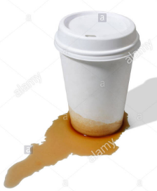
Take the root word use and try adding the suffixes
ed, ing, s, es, ness, ful, less and ly
Which suffixes can you add to use?
Write your words down.
It was ______, no matter how I tried, it just didn’t work.
I _____ to go to nursery but now I am at Primary school.
The children tidied up ________ at the end of the day.
The cup was no longer ________ as it was cracked.

Slide 38
Take the root word use and try adding the suffixes
ed, ing, s, es, ness, ful, less and ly
Which suffixes can you add to use?
Write your words down.
use
uses
used
useful
useless
usefully
uselessly
usefulness
uselessness
It was useless, no matter how I tried, it just didn’t work.
I used to go to nursery but now I am at Primary school.
The children tidied up usefully at the end of the day.
The cup was no longer useful as it was cracked.

Slide 39


Your morning lessons are completed.
Time for lunch.
Then come back this afternoon for your curriculum activity.

Slide 41
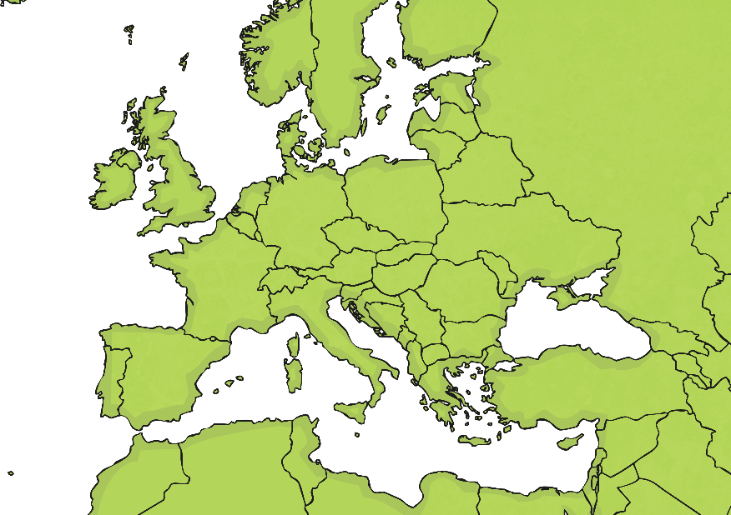
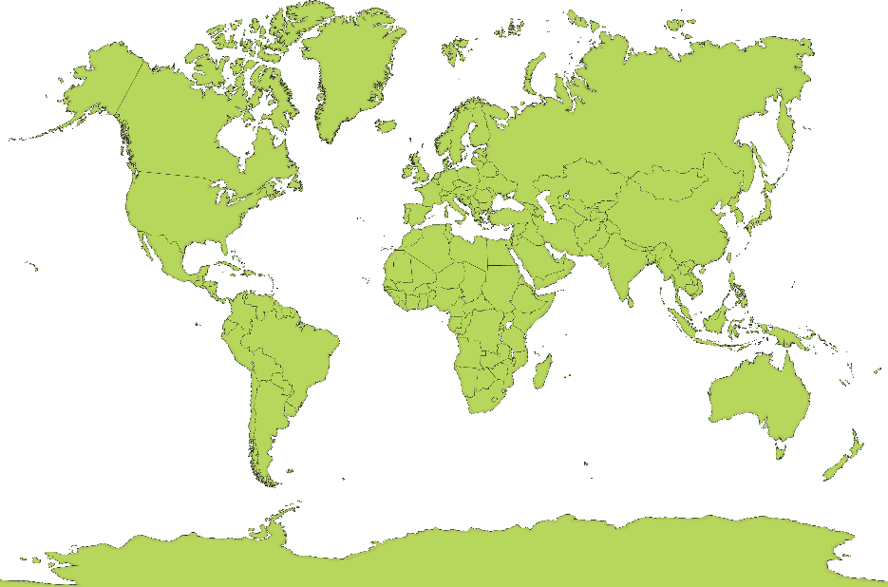
Where is the UK?
Can you spot the UK on each of these maps?

Slide 42

Where is the UK?
Can you spot the UK on each of these maps?

Slide 43

Where is the UK?
Can you spot the UK on each of these maps?

Slide 44
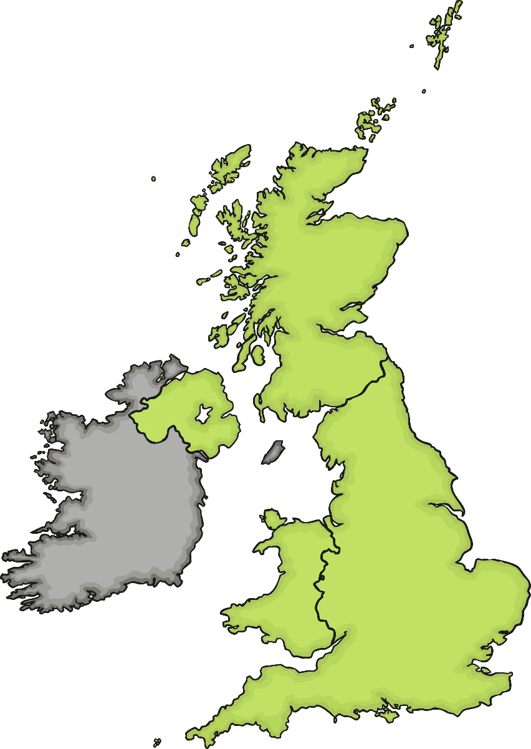
Which Countries Make
Up the UK?
Scotland
Northern Ireland
1
2
England
3
4
Wales

Slide 45

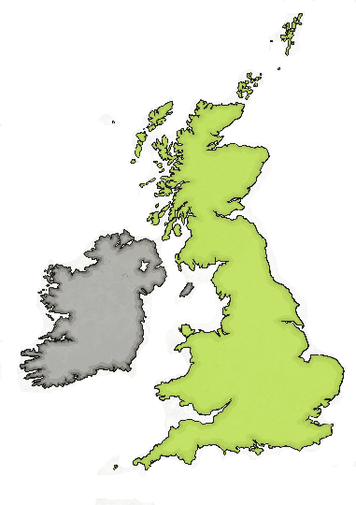
Which Countries Make
Up the UK?
The UK is short for:
The United Kingdom of Great Britain and Northern Ireland
Which countries do you think make up Great Britain?
The United Kingdom:
England
Scotland
Wales
Northern Ireland
Great Britain:
England
Scotland
Wales

Slide 46
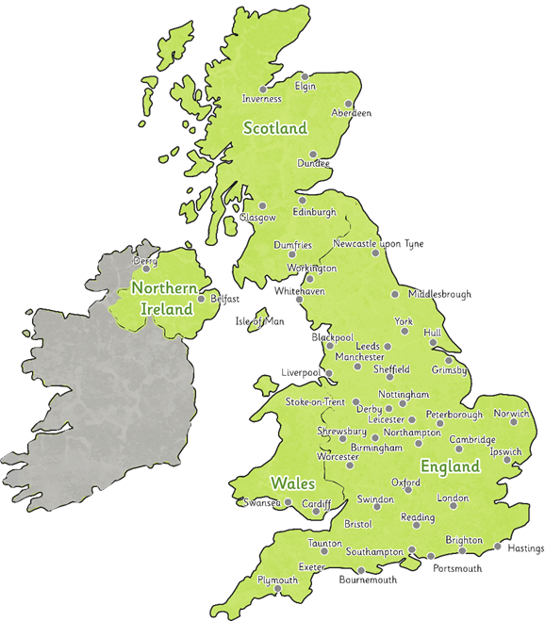
This map shows the countries and their cities.

Slide 47
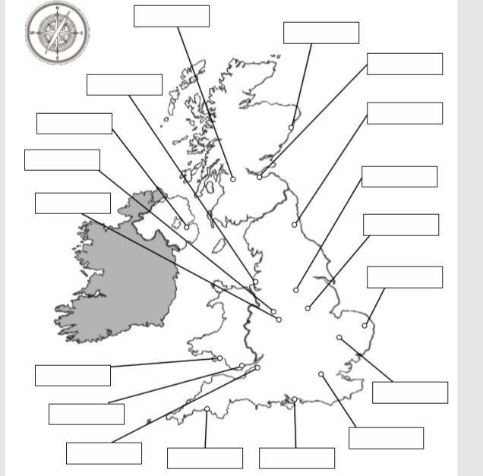
Print out this map and use the map on the previous slide to name the cities in the UK.

Slide 48
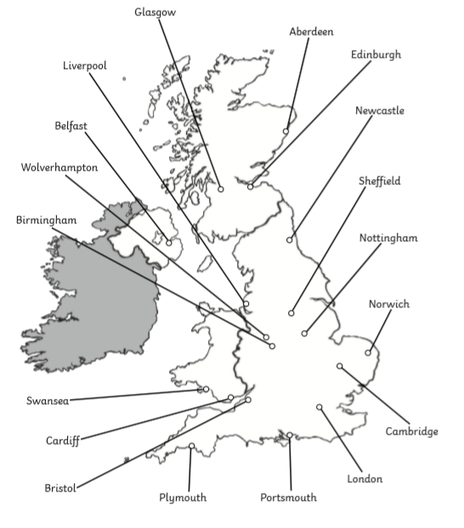
Answers

Slide 49
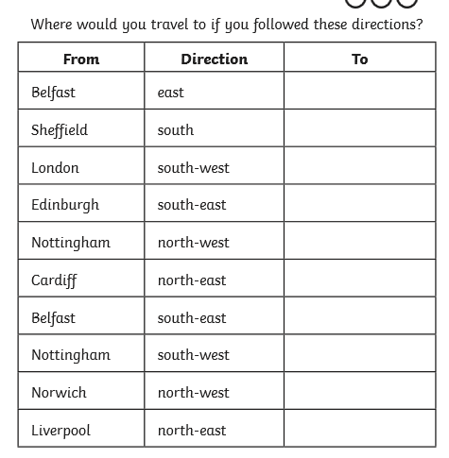
Use your maps to help you work out where you would travel to.

Slide 50
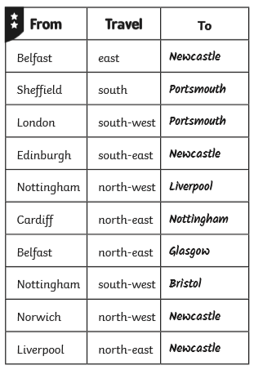
Answers.

Slide 51

We hope your day went well.
See you tomorrow.

