Slide 1

Tuesday 23rd June
Ready to wake up your maths brains?
Remember you can do these independently then share them with an adult.
Question 10 may have more than one answer.
Don’t worry about always finding the answer it is how you try to work out and reason that is important.

Slide 2
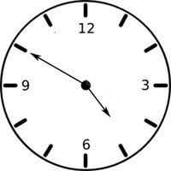
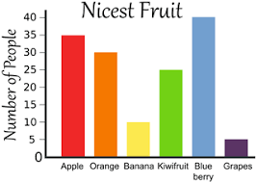
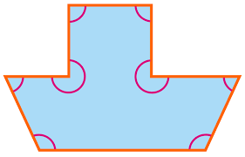
Morning Maths 23.06.20
7. I face North then make a ¾ clockwise turn. What direction am I now facing?
8. What will the time be in
half an hour?
9. Dad gives me £1.50
pocket money each week.
How much money will I
have after a year?
10. What
questions
can you
write
about
this
bar chart?
How many eights in 56 ?
2. Write a calculation statement for this part-whole model:
3. 426 + 259
4. 34 x 3
5. 17cm 5 mm = . cm
6. How many right angles in this shape?
57
75

Slide 3
7
57+18=75 75-57=18
685
102
17.5
4
West
20 past 5/ 5.20
18
Various answers. For example: Which is fruit is most popular?
How many people prefer Kiwifruit yo Bananas?

Slide 4

St Catherine’s Classroom Beliefs
Mistakes are valuable.
Everyone can learn maths to the highest level.
Questions are really important.
Depth is more important than speed.
Maths is about making connections.
We may not be learning together in the classroom, but it is important to still remember our classroom beliefs.

Slide 5
WALT: measure capacity accurately

Slide 6
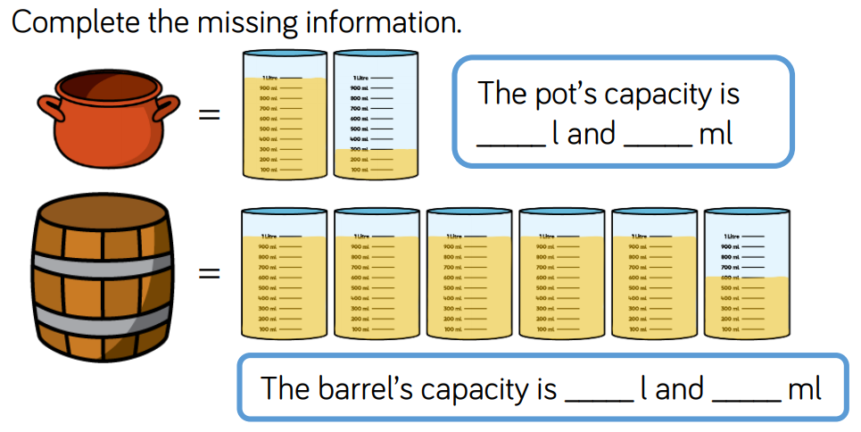

Slide 7
1L
300
1L
600

Slide 8
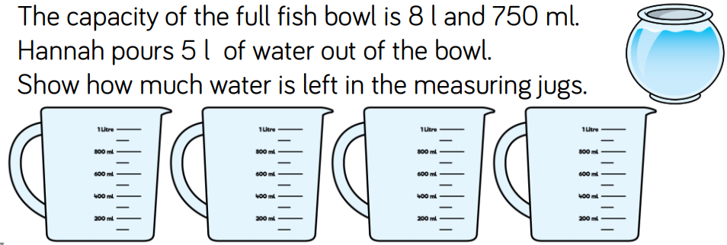

Slide 9
3L and 750ml
3.75L

Slide 10
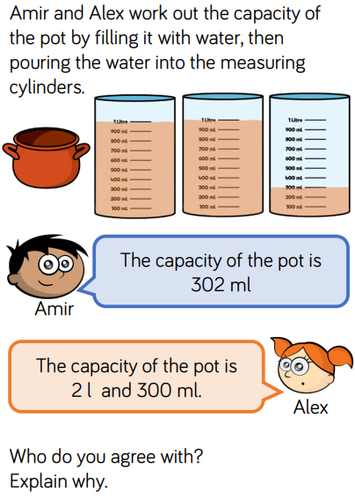

Slide 11
Alex is right because there are two jugs that each have 1L in and the third jug has 300ml in.
Together, the total volume of liquid is 2300ml or 2L and 300ml.

Slide 12

Time for a break.
Have a drink and a snack.

Slide 13
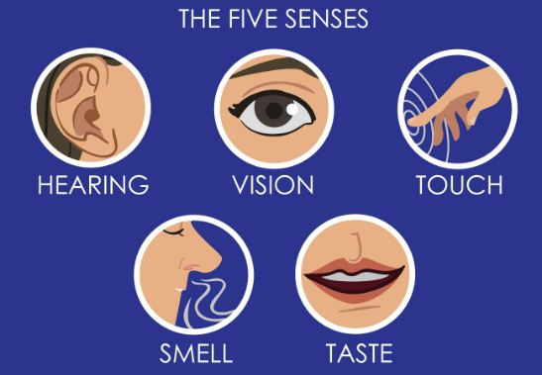
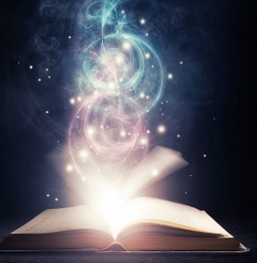
WALT: retrieve information from a text and consider word choices for description.
Reread the poem from yesterday. (On the next slide or go back and read yesterday’s slides with the pictures if you need to.)
When you are reading, think about how the author describes what is in the box and how he uses his five senses to talk about them.
He also describes unusual, strange and magical things.

Slide 14
I will put in the box
The swish of a silk sari on a summer night,
Fire from the nostrils of a Chinese dragon,
The tip of a tongue touching a tooth.
I will put into the box
A snowman with a rumbling belly,
A sip of the bluest water from Lake Lucerne,
A leaping spark from an electric fish.
I will put into the box
Three violet wishes spoken in Gujarati,
The last joke of an ancient uncle,
And the first smile of a baby.
I will put into the box
A fifth season and a black sun,
A cowboy on a broomstick,
And a witch on a white horse.
My box is fashioned from ice and gold and steel,
With stars on the lid and secrets in the corners.
Its hinges are the toe joints of dinosaurs
I shall surf in my box
On the great high-rolling breakers of the wild Atlantic,
Then wash ashore on a yellow beach
The colour of the sun.
‘The Magic Box’ – Kit Wright

Slide 15
What does the author see, hear, smell, taste or touch? What unusual things does he describe?
Draw a table like this one and fill it in using the poem to help you.
Sight | Sound | Smell | Taste | Touch | Unusual/magical

Slide 16
Sight | Sound | Smell | Taste | Touch | Unusual/magical
swish of a sari leaping spark smile of baby yellow beach | rumbling belly Gujarati language uncles Joke |  | sip of water | tip of tongue touching tooth | Chinese dragon electric fish violet wishes fifth season black sun cowboy on broomstick witch on a whitehorse

Slide 17
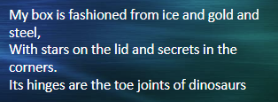
This is what the poet Kit Wright imagined his box to look like.
Imagine that you have your own magic box. What would it look like?
What would it be made from? Which materials?
What would be on the lid and in the corners?
What would the hinges be made from?
Draw a picture of your special magic box.

Slide 18
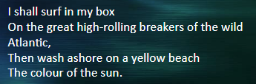
This is what the poet Kit Wright imagined he would do in his box..
Imagine that you are in your own magic box. What would you do in it? Write down your ideas.
What would you need instead of a surfboard?
What would the place be like?
What would happen to you?
Would you use a colour word for description?

Slide 19
Now it’s your turn
Close your eyes and imagine opening your own magic box.
What thoughts/feelings/emotions/objects will you put in it?
Think carefully about things that are important to you…
Sounds, feelings, places, tastes, thoughts, beautiful things, smells

Slide 20
Now draw a table and put your own ideas into it. You will be using your ideas tomorrow.
Sight | Sound | Smell | Taste | Touch | Unusual/magical

Slide 21

15 minute Spelling Activity
Revision of the suffixes ed, ing, s, es, ness, ful, less and ly
Remember that a short vowel sound a, e, i, o, u before the consonant means you must double the consonant before adding the suffix.
If the root word ends in e, you must drop the e before adding the suffix.
If the word ends in y you may need to drop the y and change it to an i before adding the suffix.

Slide 22
Take the root word and try adding the suffixes. How many words can you make?
ed, ing, s, es, ness, ful, less and ly
hope | care | like | chat | rub | hug | plan

Slide 23
Take the root word and try adding the suffixes. How many words can you make?
ed, ing, s, es, ness, ful, less and ly
hope | care | like | chat | rub | hug | plan
hoped hoping hopes hopeful hopeless hopefulness hopelessness hopefully | cared caring cares careful careless carefulness carelessness carefully | liked liking likes likeness likely | chatted chatting chats chattily chatless | rubbed rubbing rubs | hugged hugging hugs | planned planning plans planless

Slide 24


Your morning lessons are completed.
Time for lunch.
Then come back this afternoon for your curriculum activity.

Slide 26
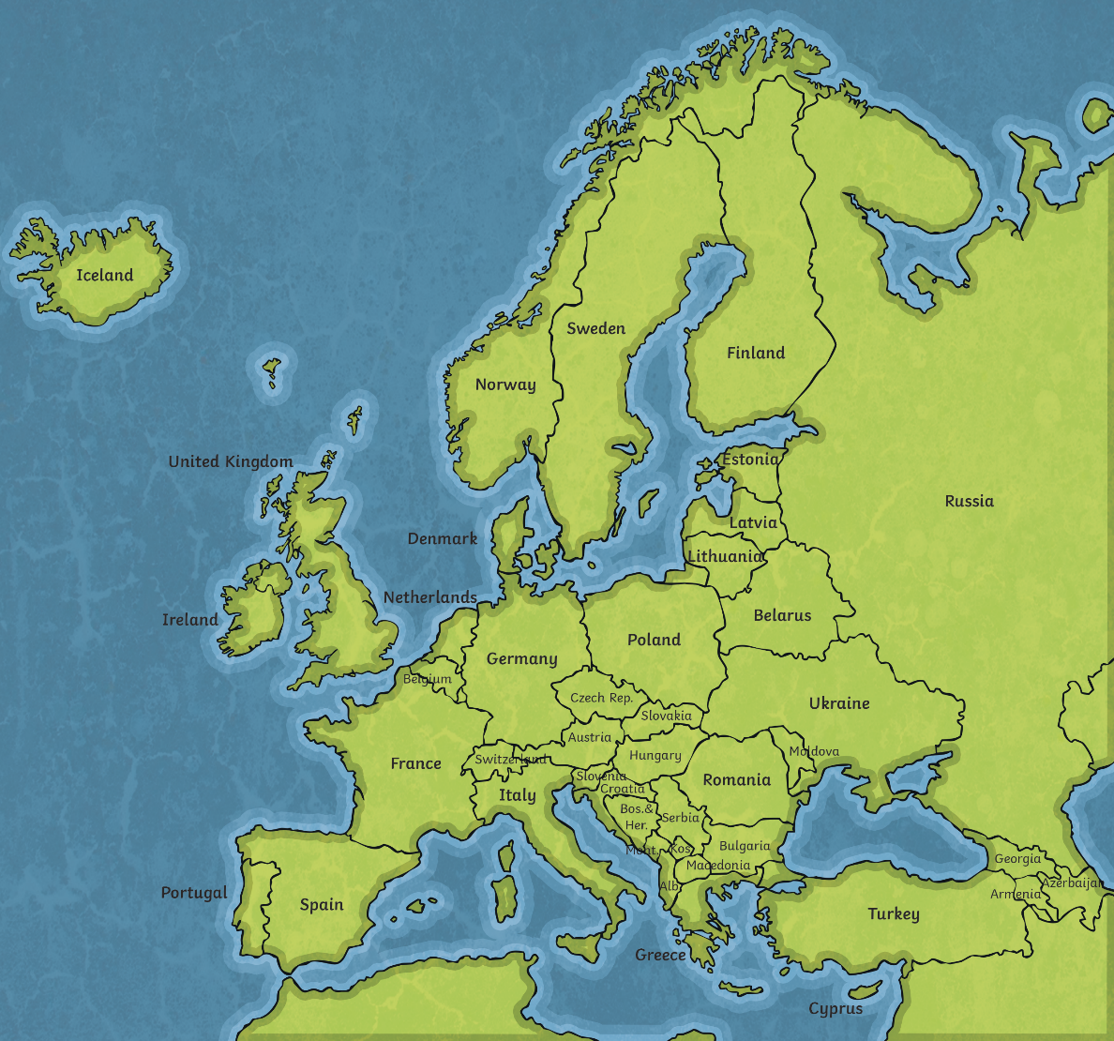
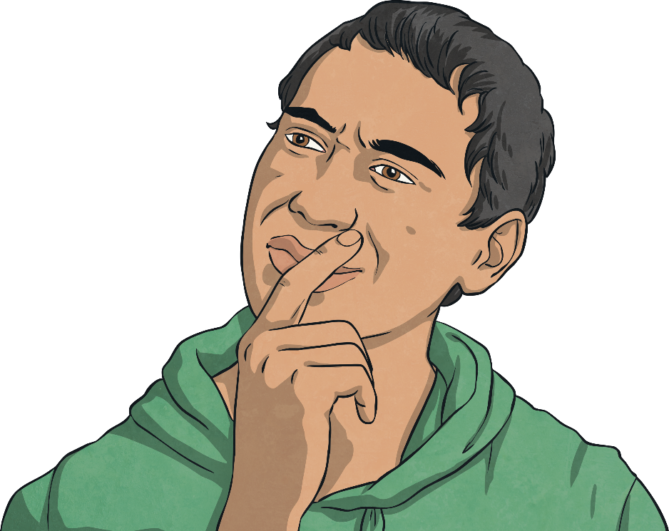
What Surrounds Us?
?
Where is the UK?
?
Can you find Austria?
On the map, how is the UK different to Austria?
?

Slide 27
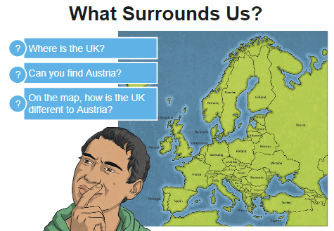
It is different because it is an island whereas Austria is landlocked and has no sea coast.

Slide 28
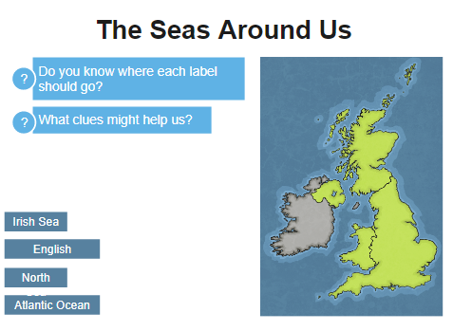

Slide 29
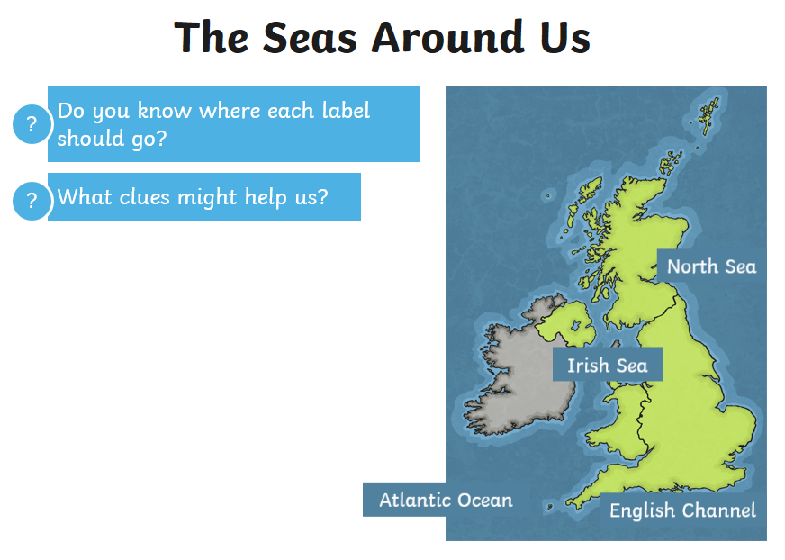

Slide 30
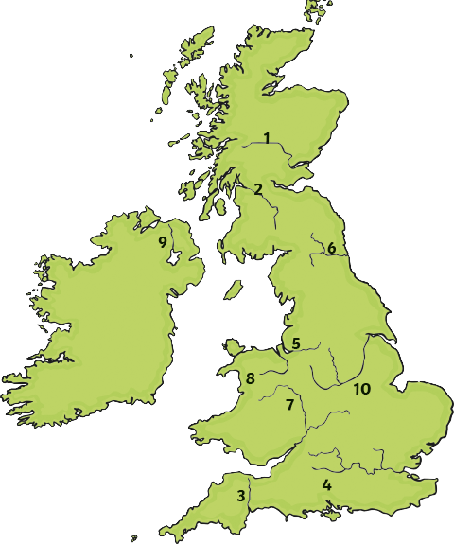
Rivers of the UK
Find out the names of the rivers labelled on your map of the UK.
?
Which seas do they flow into?
Print out the map on the next slide to fill in your answers and then use the three slides after that to help you locate the river and sea names.

Slide 31
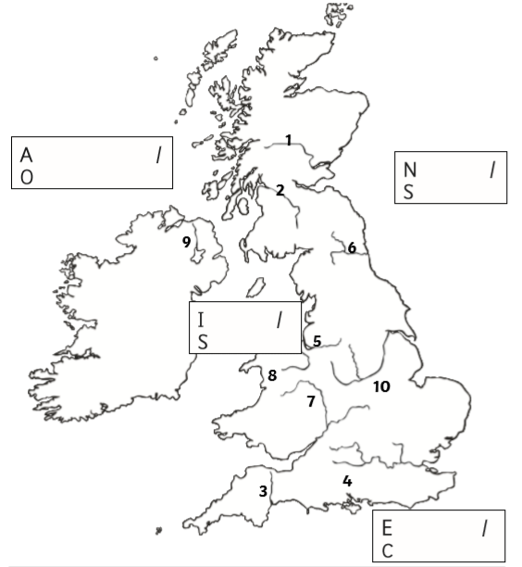

Slide 32
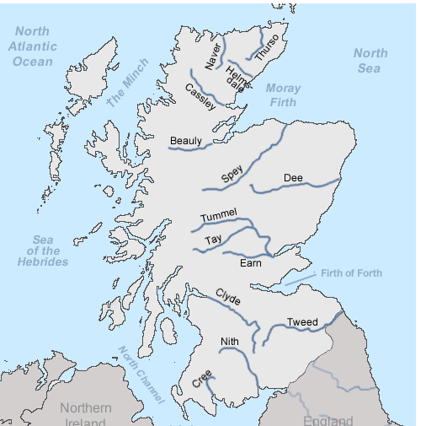

Slide 33
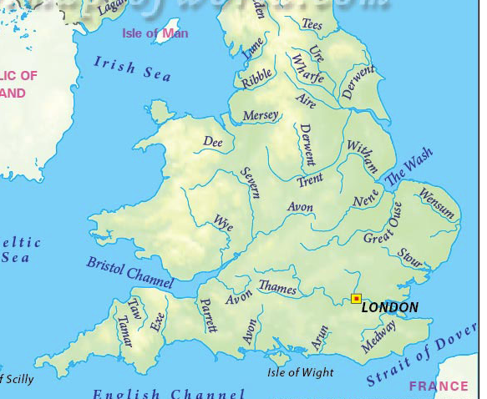

Slide 34
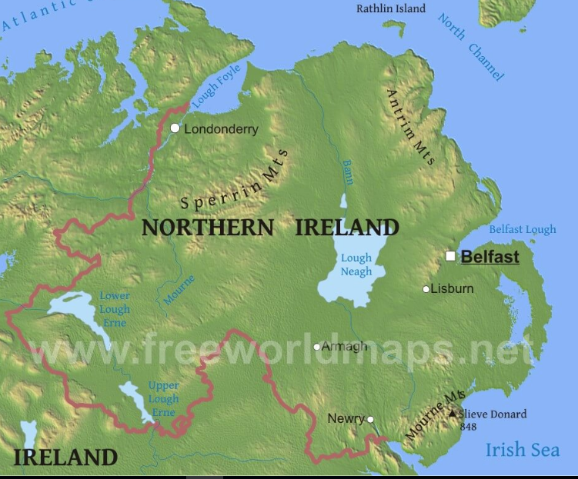

Slide 35
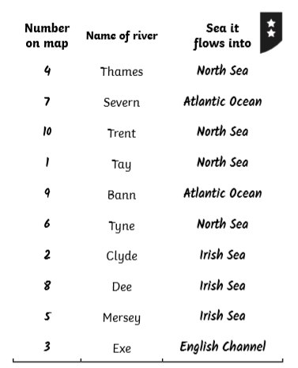

Slide 36

We hope you had fun today.
See you tomorrow.

