Slide 1

Wednesday 24th June
Ready to crunch some numbers?
Remember you can do these independently then share them with an adult.
Question 10 may have more than one answer.
Don’t worry about always finding the answer it is how you try to work out and reason that is important.

Slide 2
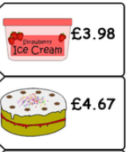
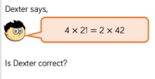

Morning Maths 24.06.20
8. How much change
from £10?
9.
10. The answer is 2 hours. What’s the question?
Put these in ascending order:
102, 112, 211, 201, 121
2. 1m - 34cm
3. I’m thinking of a number. If I halve it, I get 37. What is my number?
4. ➗ 8 = 7
5. Half of 130
6. How many right angles in the inside of this shape?
7. 435 + 675

Slide 3
102,112,121,201,211
66
74
56
65
4
1,110
£1.35
Yes, as he is halving the 4 to 2 however, he is also doubling 21 to 42.
Various answers. For example: If Poppy goes to the shop, and it takes 30 mins to get to the shop, how long will it take Poppy to get to the shop and home again?
If a train has 4 stations to get to, and each station take 15 mins to get to, how long does it take the train to get to all stations?

Slide 4

St Catherine’s Classroom Beliefs
Mistakes are valuable.
Everyone can learn maths to the highest level.
Questions are really important.
Depth is more important than speed.
Maths is about making connections.
We may not be learning together in the classroom, but it is important to still remember our classroom beliefs.

Slide 5
WALT: compare volumes of liquid

Slide 6
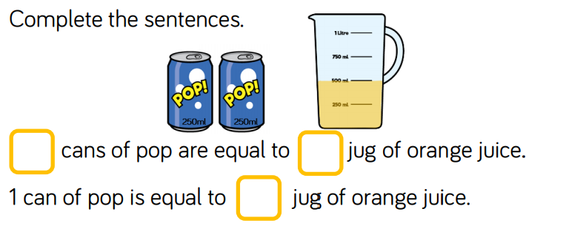

Slide 7
2
1
½

Slide 8
Using the following symbols, calculate which is larger or if the values are equal.
< less than
> more than
= equal to

Slide 9
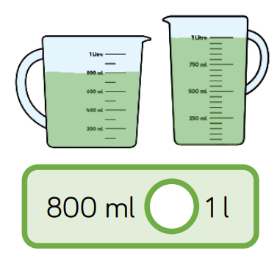

Slide 10
1L is the same as 1000ml.
800 is less than 1000 so we use the less than symbol.
<

Slide 11
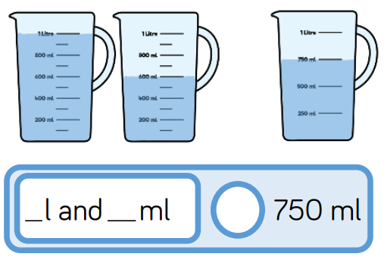

Slide 12
1
600
<

Slide 13
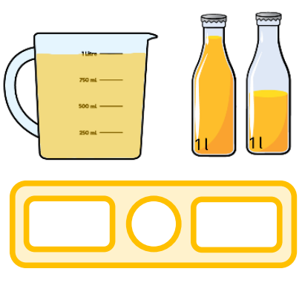

Slide 14
1L
<
1.5L

Slide 15
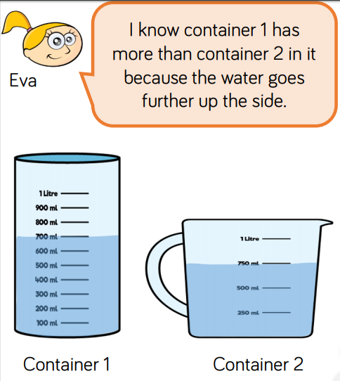
Is Eva correct? Explain your answer.

Slide 16
Eva is wrong because…
container two has 750ml
- container one has 700ml
- just because a container is taller, doesn’t mean it has a larger capacity
She hasn’t read the measurements. She’s only looked at the water level.

Slide 17

Time for a break.
Have a drink and a snack.

Slide 18
WALT: use a known poem as a scaffold for my own poem.
What have we done so far?
So far this week you have read The Magic box by kit Wright and considered how he uses the senses to describe what he put in his box. You have also thought about the unusual things that he included to make it special and exciting.
You have also decided what your own special box might look like and drawn a picture of it. You came up with ideas for things that you could put in your box.
Today’s task:
Today you are going to use Kit Wright’s poem as a scaffold to write your own poem.
Use your ideas from yesterday to include in your poem.
The next slide will show you how to set out your poem.
When you have finished you could illustrate your poem and display it somewhere at home.

Slide 19
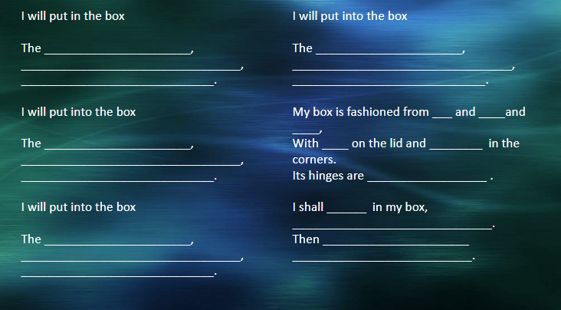

Slide 20

15 minute Spelling Activity
Revision of the suffixes ed, ing, s, es, ness, ful, less and ly
Remember that a short vowel sound a, e, i, o, u before the consonant means you must double the consonant before adding the suffix.
If the root word ends in e, you must drop the e before adding the suffix.
If the word ends in y you may need to drop the y and change it to an i before adding the suffix.

Slide 21
Take the root word and try adding the suffixes. Make the sentences make sense!
ed, ing, s, es, ness, ful, less and ly
He hop and skip and smile on his way to school.
I am hope that when Joe hop he didn’t hurt his knee.
We are phone the school and stop the share of lollies.
Mum hug her son when he slip over on the playground.
“Be care with those scissors!” warn the teacher.
I plan to bake cake for your birthday but it was hope because I had no flour.
The pencil was use because it was not sharp.
The like between the two boys was amazing, they were almost identical.
Your care has stop everyone enjoy the day!
His happy show on his face by the huge smile he give.

Slide 22
Take the root word and try adding the suffixes. Make the sentences make sense!
ed, ing, s, es, ness, ful, less and ly
He hopped and skipped and smiled on his way to school.
I am hopeful that when Joe hopped he didn’t hurt his knee.
We are phoning the school and stopping the sharing of lollies.
Mum hugged her son when he slipped over on the playground.
“Be careful with those scissors!” warned the teacher.
I had planned to bake a cake for your birthday but it was hopeless because I had no flour.
The pencil was useless because it was not sharp.
The likeness between the two boys was amazing, they were almost identical.
Your carelessness has stopped everyone enjoying the day!
His happiness showed on his face by the huge smile he gave.

Slide 23


Your morning lessons are completed.
Time for lunch.
Then come back this afternoon for your curriculum activity.

Slide 25
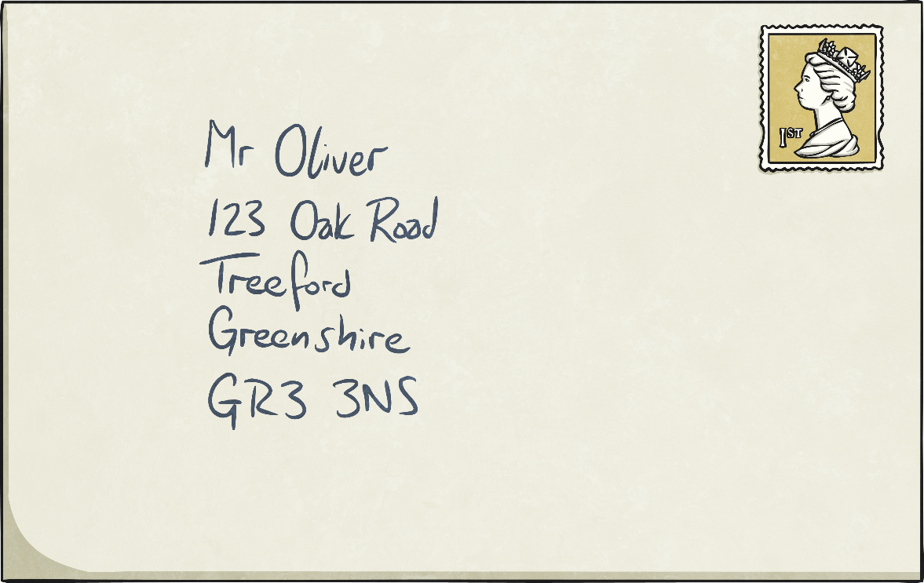
UK Addresses
?
What does each part of the address tell the Post Office?
Person the letter is for
House number and road
Town
County
Postcode
?
What is a county and why do we have counties?

Slide 26
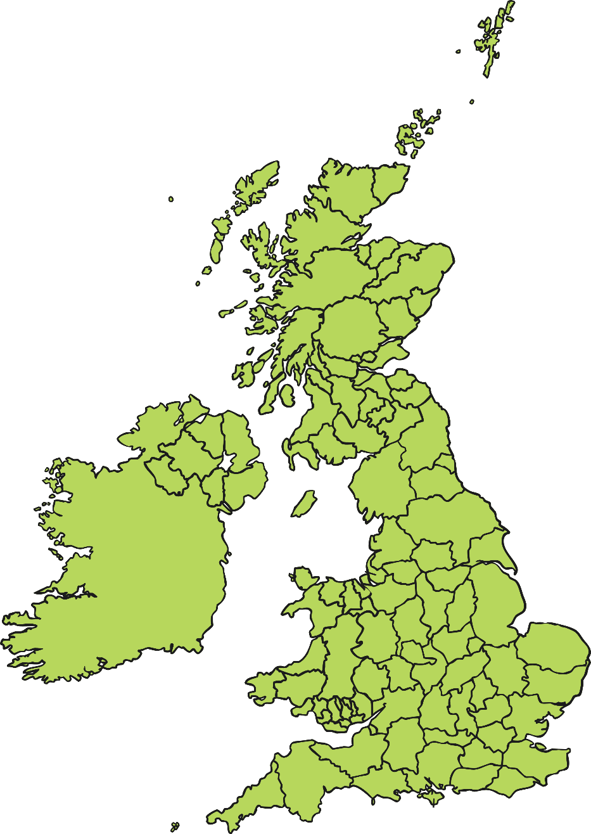
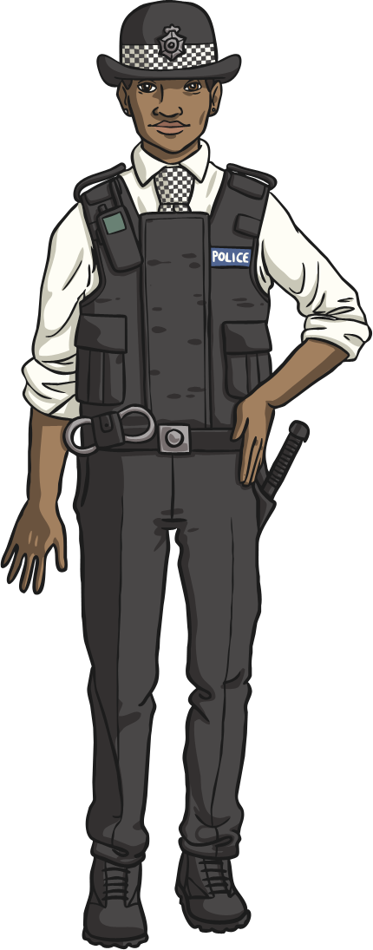
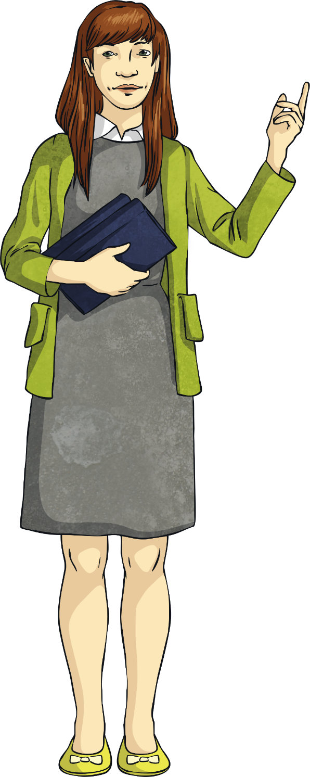
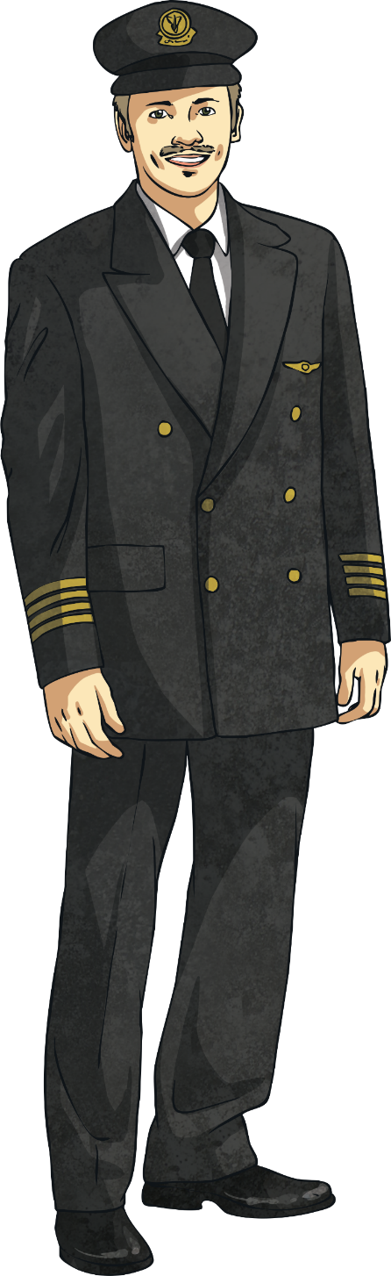
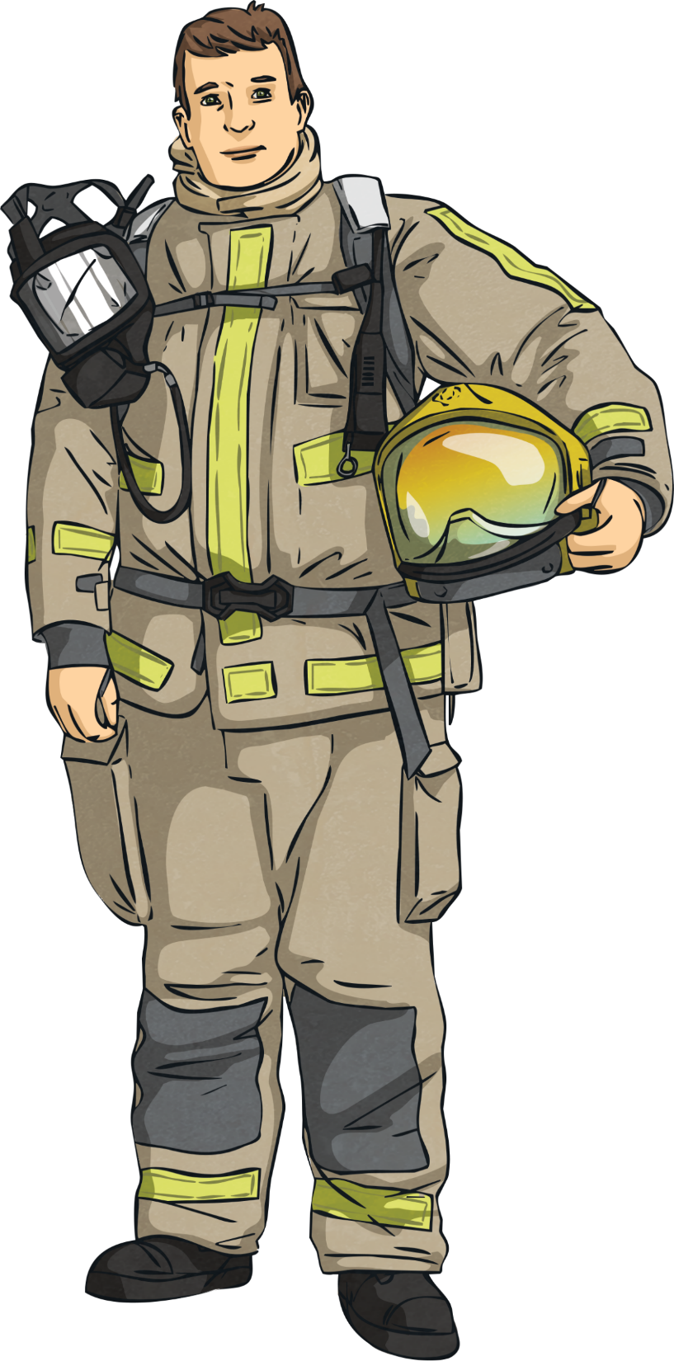
What is a County?
A county is a smaller area of the UK containing lots of towns and villages.
They are the top level of local government. They control the local area and the services within, such as education, transport, policing, fire & public safety, social care, libraries, and waste management.

Slide 27
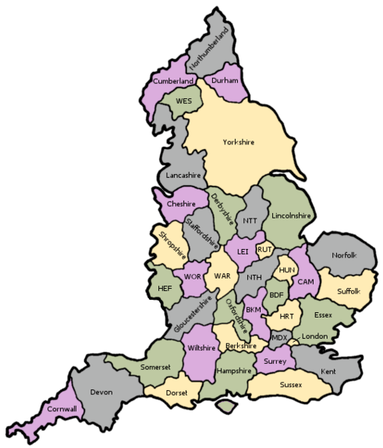
Our County.
This map shows how the country of England is divide up into counties.
Our school is in the county of Worcestershire. (Wor)
Mrs Shipley lives in the county of Shropshire which is one of it’s neighbours.

Slide 28
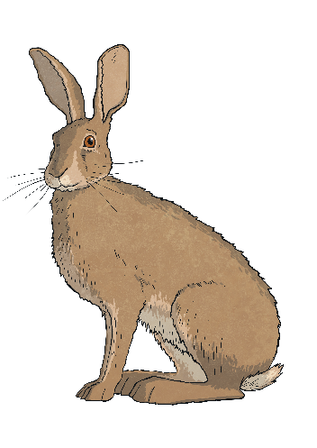
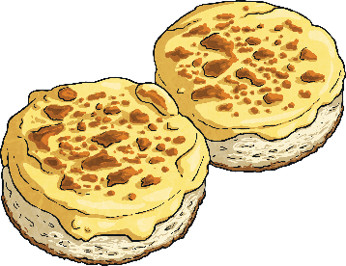
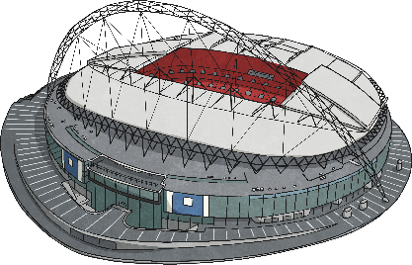
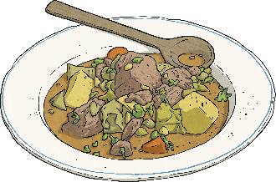

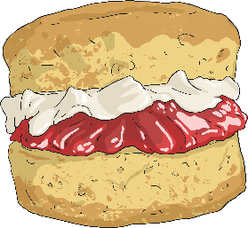

What Are We Famous For?
Let’s find out more about what our school county is famous for.
What foods are associated with this area?
?
Which famous people grew up here?
?
Is there a special county day?
?
Research your county and fill in the information in a table like one on the next slide.

Slide 29
Neighbouring counties | Rivers in the county | Towns and villages nearby | Important landmarks | Famous people who have lived here
Use your research to make a poster about your county.

Slide 30
Did you have a good day learning today?
See you in the morning.

