Slide 1
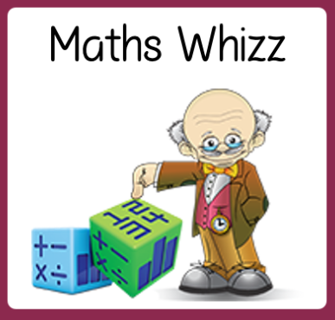
Friday 26th June
Are you a maths whizz today?
Remember you can do these independently then share them with an adult.
Question 10 may have more than one answer.
Don’t worry about always finding the answer it is how you try to work out and reason that is important.

Slide 2
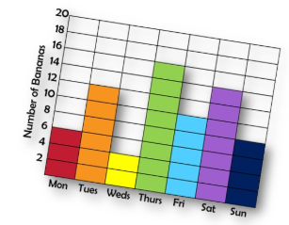
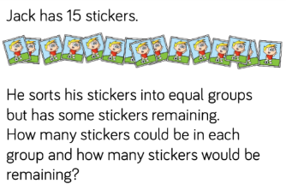
Morning Maths 26.06.20
7. 234 + 269
8. Which of these numbers is the odd one out?
Explain how you know.
9. How many bananas
were eaten during the
weekdays?
10.
65 + 8
2. 6 x 2 x 4
3. Insert the correct symbol ( <,> , =)
64 ➗ 8 36 ➗ 4
4. Which two fractions are equivalent?
5. What is the subtraction statement
6. Complete the missing numbers above
1
3
1
6
2
4
1
2
4
4
643
205
6mm
8mm
1cm 2mm
1cm 6mm

Slide 3
73
48
<
2/4 and 1/2
643-205=438
1cm, 1cm 4mm
503
215, this is because all of the other numbers are part of the 10 times table.
48
You could only have the following answers: 2 in each group & 1 remaining, 3 in each group and no cards remaining, 4 in each group and 3 remaining, 5 in each group and no cards remaining, 6 in each group and 3 remaining, 7 in each group and 1 remaining.

Slide 4

St Catherine’s Classroom Beliefs
Mistakes are valuable.
Everyone can learn maths to the highest level.
Questions are really important.
Depth is more important than speed.
Maths is about making connections.
We may not be learning together in the classroom, but it is important to still remember our classroom beliefs.

Slide 5
WALT: use measurements to create a fruit cocktail.

Slide 6
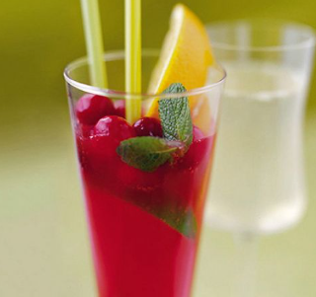
Recipe
100ml cranberry juice
500ml orange juice
600ml lemonade or sparkling water
As the weather is getting warmer, we thought we could use your new measuring skills to make a fruit cocktail drink.
You will need a jug or container than can measure in ml and the ingredients on the list below.
If you want to, feel free to add any fruit and ice to your drink. Enjoy!

Slide 7

Time for a break.
Have a drink and a snack.

Slide 8
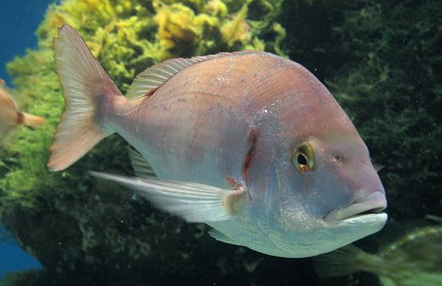
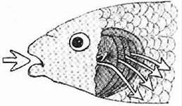
WALT: use a known poem as a scaffold for my own poem.
Today’s task:
Reread the poem from yesterday - it is on the next slide.
Today you are going to use Pie Corbett’s poem as a scaffold to write your own poem.
Instead of If I had Wings we are going to call our poems If I had Gills.
Gills are what a fish has to help it breathe underwater which suggests your poem will be about an underwater world.

Slide 9
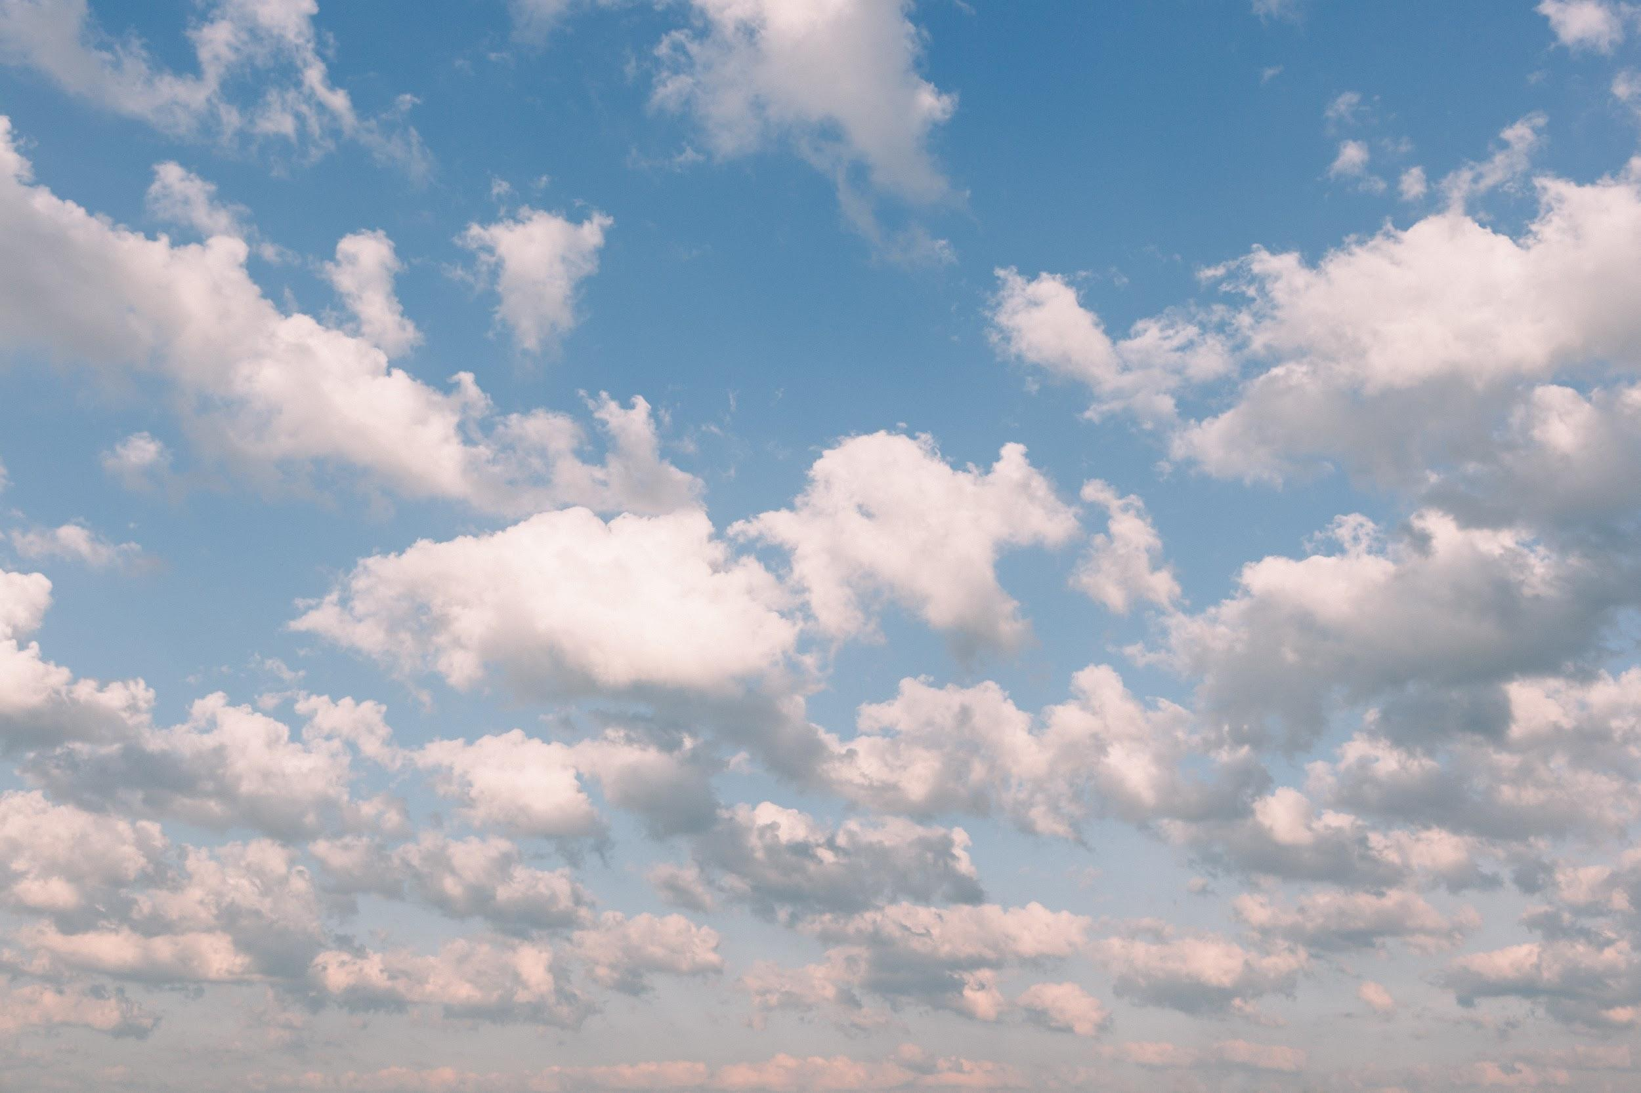
If I Had Wings
If I had wings
I would touch the fingertips of clouds
and glide on the wind.
If I had wings
I would taste a chunk of the sun
as hot as peppered curry.
If I had wings
I would listen to the clouds of a sheep bleat
that graze on the blue.
If I had wings
I would breathe deep and sniff
the scent of raindrops.
If I had wings
I would gaze at the people
who cling to the earth.
If I had wings
I would dream of walking the deserts
and swimming the seas.
By Pie Corbett

Slide 10
What would you hear under the ocean?
What would you see under the ocean?
What would you touch under the ocean?
What would you taste under the ocean?
What would you smell under the ocean?
What would you dream of under the ocean?

Slide 11
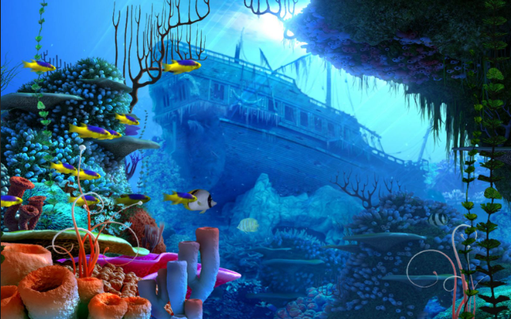
Here are some ideas to magpie. Or come up with your own.
saltiness of the vivid blue sea
neon flash of a flicking fish tail
world of the dazzling sun which lies above the ocean
creaking and groaning of an ancient wooden wreck
colourful tubular pipes of the sea creatures
jagged dark rocks of the sea bed

Slide 12
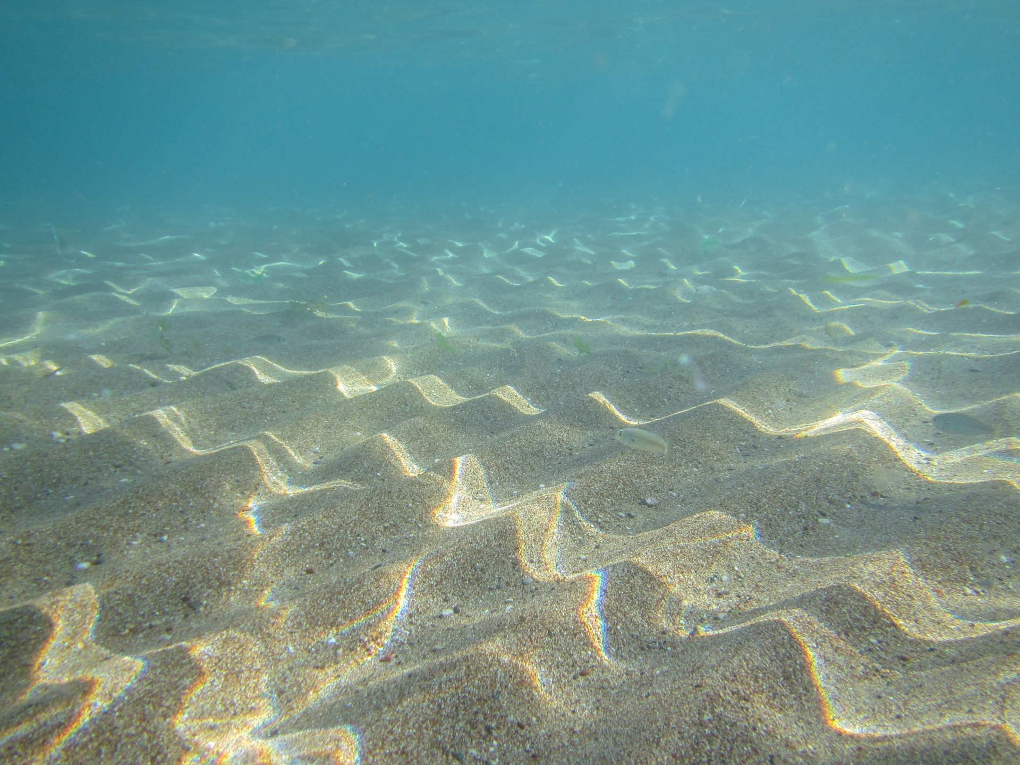
If I Had Gills
If I had gills
I would touch the ________
and___________.
If I had gills
I would taste a ___________
as _____ as _________.
If I had gills
I would listen to ____________
that ____________.
If I had gills
I would breathe deep and sniff
the _________.
If I had gills
I would gaze at ______
who _________.
If I had gills
I would dream of ________
and ___________.
By Pie Corbett

Slide 13

15 minute Spelling Activity
The suffix ly with root words ending in ‘le’ and ‘ic’
Use these rules to complete the table on the next slide.
Remember the suffix ly starts with a consonant letter so it is added straight on to most root words. (e.g) friend + ly = friendly
If the root word has more than one syllable and ends in the consonant y the y is changed to an i before adding the ly. (e.g) happy becomes happi + ly = happily
If the root words ends in le the le is changed to ly. (e.g) gentle becomes gently
If the root word ends with ic then ally is added not just ly. (e.g) basic becomes basically

Slide 14
quick
basic
late
happy
simple
frantic
nice
funny
humble
lucky
close
gentle
dramatic
Sort these words into groups and explain the spelling rule for when we add the suffix ly to the root word
Group 1 | Group 2 | Group 3 | Group 4
Words are: | Words are: | Words are: | Words are:
Rule is | Rule is | Rule is | Rule is

Slide 15
Group 1 | Group 2 | Group 3 | Group 4
Words are: quick late nice close | Words are: basic frantic dramatic | Words are: happy funny lucky | Words are: simple humble gentle
Rule is The suffix is added straight on to the root word. | Rule is When the root word ends with ic then ally is added. | Rule is When the root word has more than one syllable and ends in the consonant y the y is changed to an i before adding the ly. | Rule is When the root words ends in le the le is changed to ly.
quick
basic
late
happy
simple
frantic
nice
funny
humble
lucky
close
gentle
dramatic

Slide 16
Choose the correct word for the sentence then add the suffix to the root word to make the spelling correct.
The mother ________ laid the baby in the cot so that he would sleep.
In his panic he _________ scrambled to grab hold of a tree root.
“Follow me _________ and you won’t lose your way,” stated the guide.
____________, the weather has been beautiful but next week rain is forecast.
“You are _______ the best at football and you deserve the award,” said the commentator.
__________ walking to the beach, the family looked forward to their day.
The thief ______ stuffed the jewels into the bag, before he was seen.
nice close simple late frantic lucky happily quick gentle

Slide 17
Choose the correct word for the sentence then add the suffix to the root word to make the spelling correct.
The mother gently laid the baby in the cot so that he would sleep.
In his panic he frantically scrambled to grab hold of a tree root.
“Follow me closely and you won’t lose your way,” stated the guide.
Lately/luckily, the weather has been beautiful but next week rain is forecast.
“You are simply the best at football and you deserve the award,” said the commentator.
Happily walking to the beach, the family looked forward to their day.
The thief quickly stuffed the jewels into the bag, before he was seen.
nice close simple late frantic lucky happily quick gentle

Slide 18


Your morning lessons are completed.
Time for lunch.
Then come back this afternoon for your curriculum activity.

Slide 19
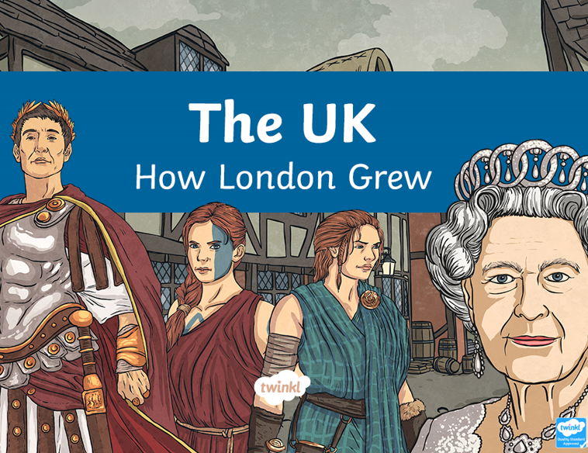

Slide 20
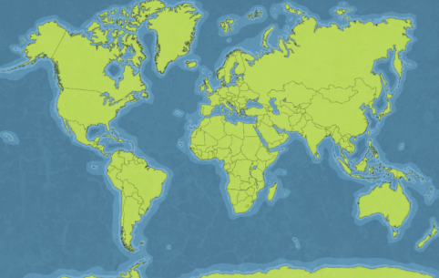
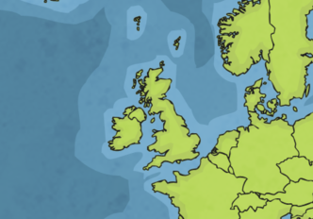
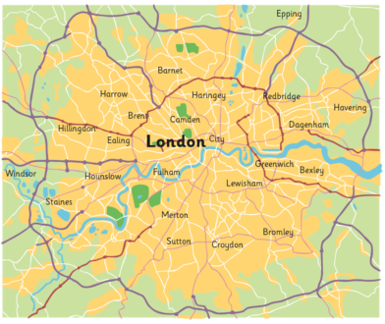
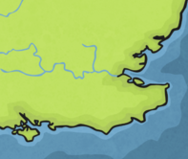
Where is London?

Slide 21
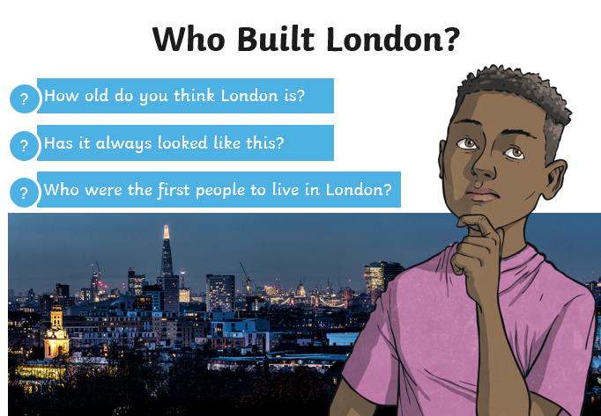

Slide 22
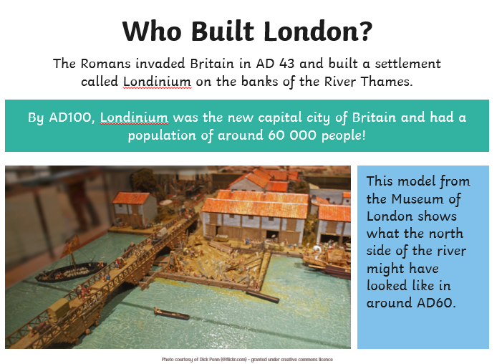

Slide 23
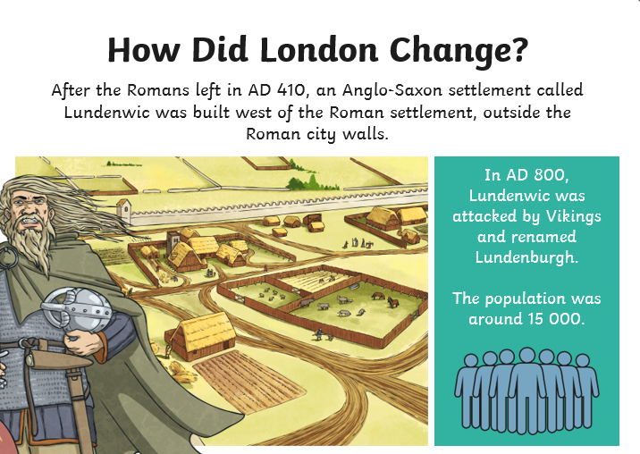

Slide 24
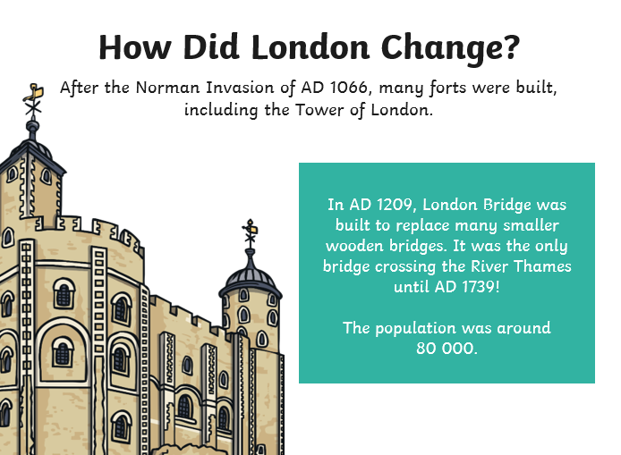

Slide 25
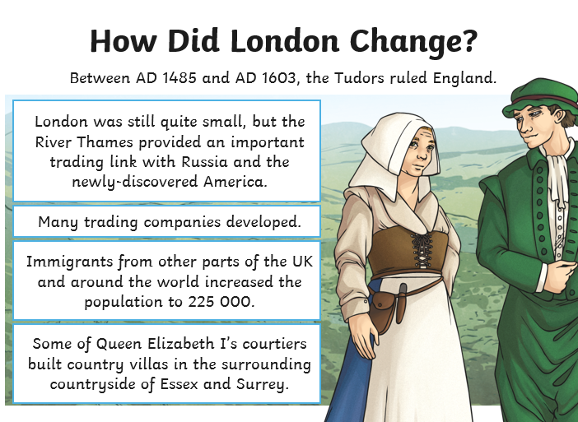

Slide 26
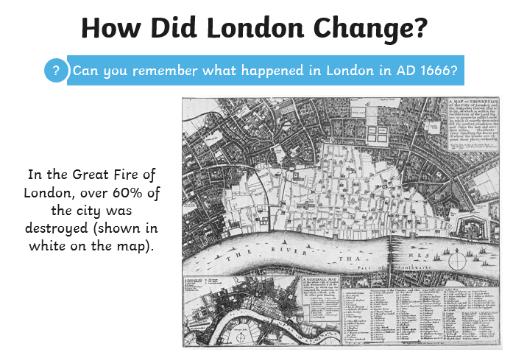

Slide 27
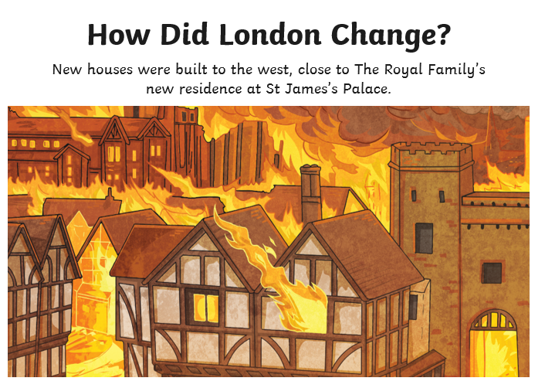

Slide 28
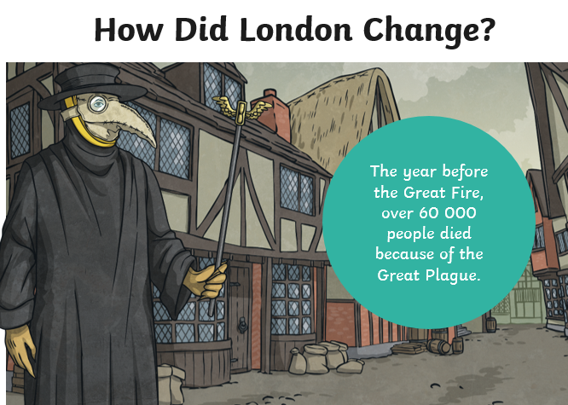

Slide 29
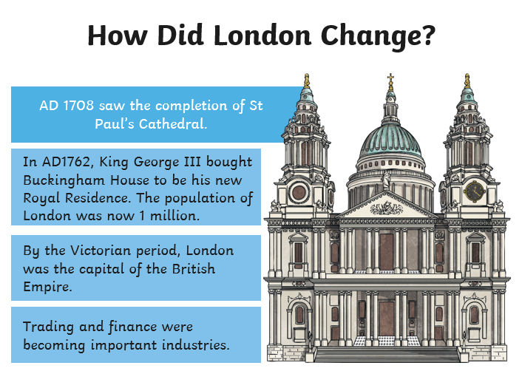

Slide 30
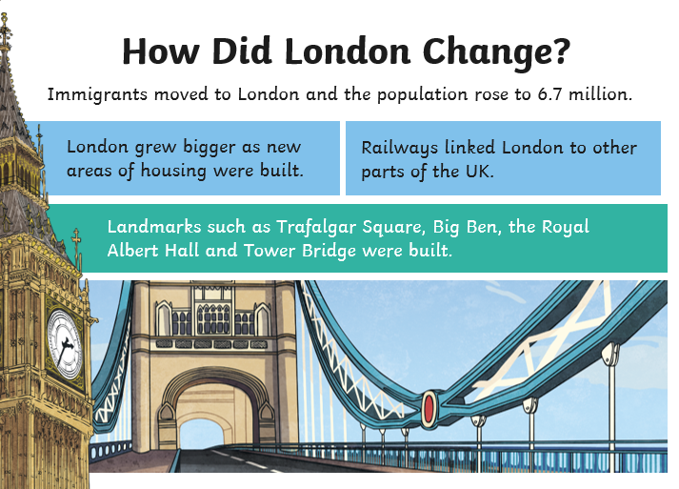

Slide 31
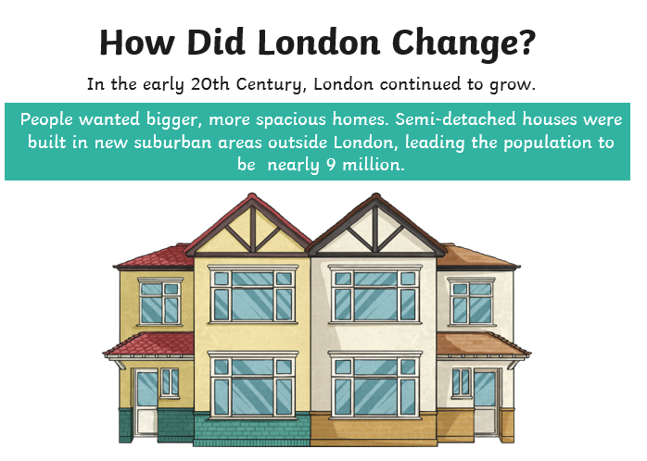

Slide 32
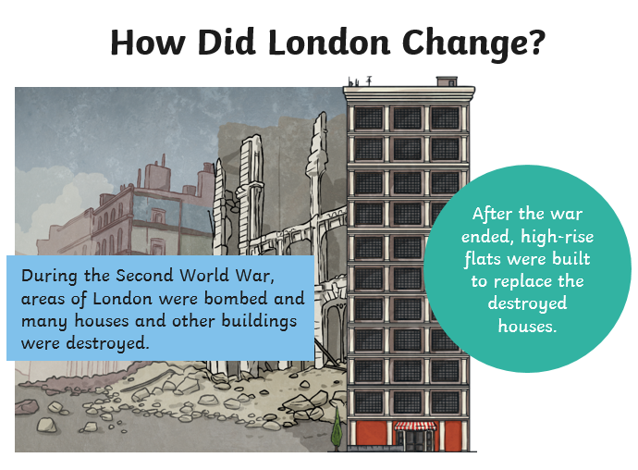

Slide 33
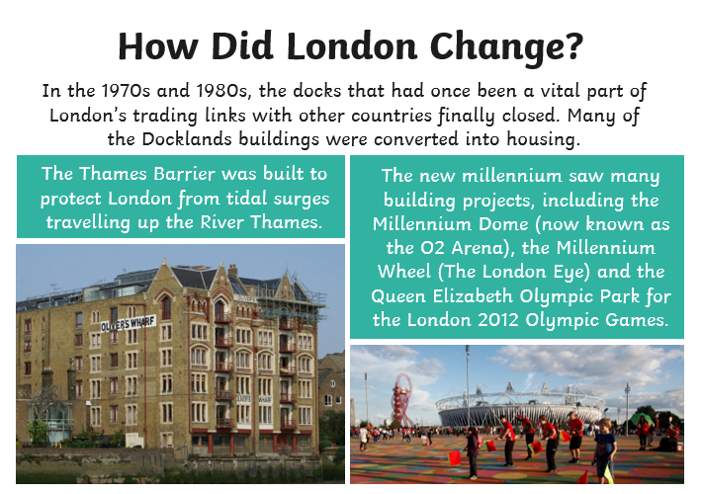

Slide 34
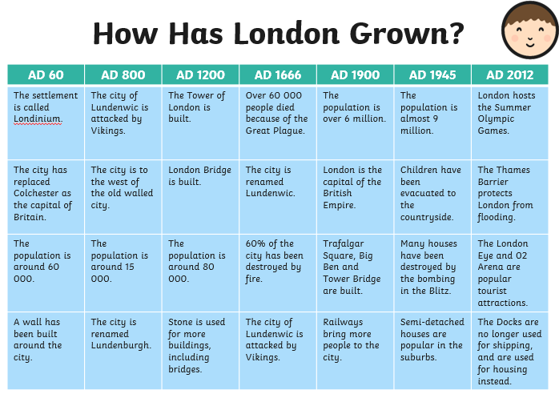

Slide 35
You could make your own timeline of how London has changed.
You could research more about London today and make your own poster.

Slide 36
Well Done 3S and 3M!
Time for a well deserved weekend so enjoy yourselves and we will meet up with you again on Monday.

