Slide 1

Monday 29th June
We will begin our day with Morning Maths - just like in school! This should be 10-15 minutes.
You can do these independently then share them with an adult.
Remember question 10 may have more than one answer.
Don’t worry about always finding the answer it is how you try to work out and reason that is important.

Slide 2



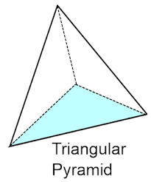
Morning Maths 29.06.20
8. Toy Story 4 started at 4:30 and ended at 5:45. How long is the film?
9. 399 x 4
10. Always, sometimes,
never:
You need a zero place holder if there are no tens.
56 = 100 -
2. Which of these are NOT factors of 20:
3, 4, 5, 8, 12
3. Complete this
bar model.
4. 36 ➗ 3
5. Write 0.5 as a fraction
6. Write this time in another way:
7. How many vertices in this triangle
based pyramid?
234
43

Slide 3
44
3,8,12
191
12
½ or 5/10
1.35pm
6
1 hour 15 minutes or 75 minutes
1,596
Sometimes, because 205 is 20 tens and 5 ones. If there was no placeholder it would change the value of the number to 25.

Slide 4

St Catherine’s Classroom Beliefs
Mistakes are valuable.
Everyone can learn maths to the highest level.
Questions are really important.
Depth is more important than speed.
Maths is about making connections.
We may not be learning together in the classroom, but it is important to still remember our classroom beliefs.

Slide 5
WALT: divide 2 digit numbers by 1 digit numbers.

Slide 6
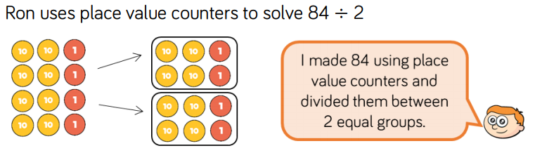

You can draw the counters out or use something to represent the counters. Solve each one and get your answers. The answers will be on the next three slides.

Slide 7

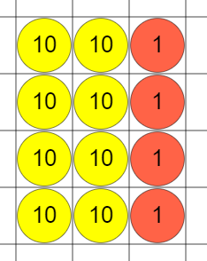
= 21
21
21
21
21

Slide 8
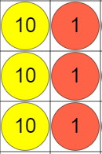
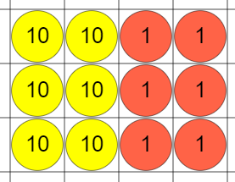
33
= 33
33

Slide 9
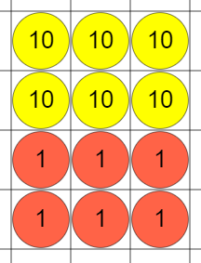

= 22

Slide 10
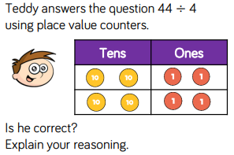

Slide 11
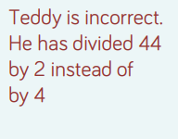

Slide 12
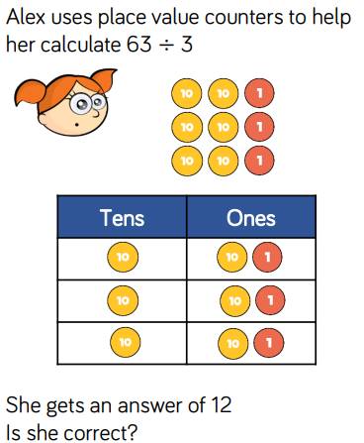

Slide 13
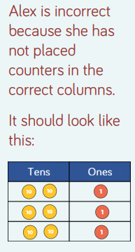

Answer

Slide 14

Time for a break.
Have a drink and a snack.

Slide 15
This week we will be reading and writing instructions.
There are ideas for making truffles, chocolate fudge sauce to serve with ice cream, toasties, a jar to attract bees to your garden, planting seeds even making a sock puppet - perhaps you might even be able to try making some of the ideas at home.

Slide 16
Our English tasks for today begin with a Close Reading Task
WALT: retrieve and infer information from a text.
Ask an adult to read the text (on the next page) to you.
Here are some meanings of words that might help you
light - means they won’t fill you up
coated - means the outside is covered
beat - to stir quickly with force
refrigerator - fridge
truffle - the kind of sweet being made
Now read it with your adult twice, they can help you with expression.
Now read it twice by yourself.
Read the questions and look for evidence in the text to help you answer them.
Write your answers in full sentences.

Slide 17
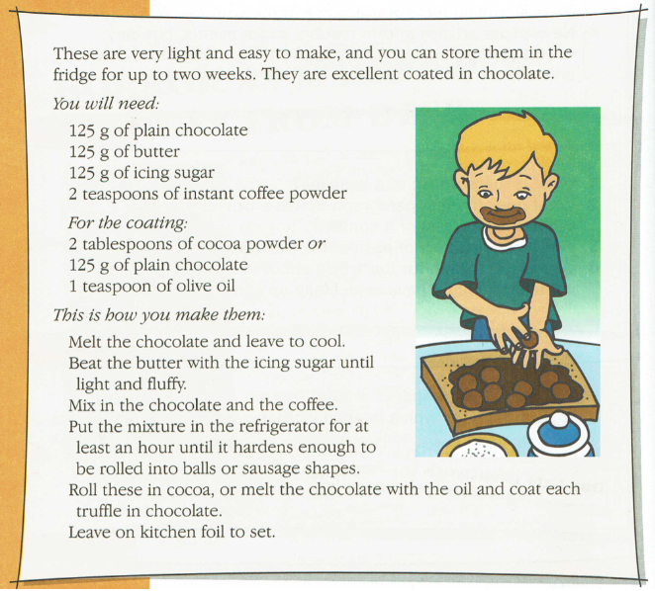

Slide 18
TASK:
Where should you store the chocolates when they are made?
Which ingredient is used in both the truffles and the coating?
How many steps are there to making the truffles if you coat them?
Find two reasons that the author uses to persuade you to make the truffles.
Challenge!
Explain how the layout of the instructions is helpful to the reader.

Slide 19
TASK:
Where should you store the chocolates when they are made?
When they are made the chocolates should be stored in the fridge.
Which ingredient is used in both the truffles and the coating?
Plain chocolate is used in both the truffles and the sauce.
How many steps are there to making the truffles if you coat them?
There a 6 steps to making the truffles if you coat them.
Find two reasons that the author uses to persuade you to make the truffles.
The author describes them as light and easy to make and describes them as excellent. These are positive points that would persuade you to try making them.
Challenge!
Explain how the layout of the instructions is helpful to the reader.
The instructions are set out in clear sections, an introduction, the things you need and clear steps of how to make them. The sections are spaced out and the titles are in a different type of text.

Slide 20

What is a contraction?
A contraction is a shortened word. An apostrophe is used where a letter or group of letters are taken out to make the word shorter.
For example:
She will = she will = she’ll
This is revision you can rewatch the link below and join it where it asks you to.
https://uk.video.search.yahoo.com/yhs/search?fr=yhs-itm-001&hsimp=yhs-001&hspart=itm&p=contractions+for+kids#action=view&id=1&vid=f812debddba542a96d82f093b683139a
Now match the contractions on the next slide.
15 minute Spelling Activity

Slide 21
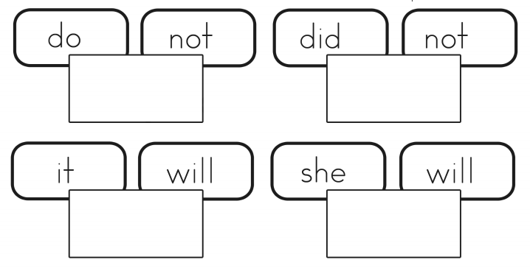
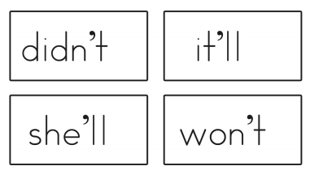
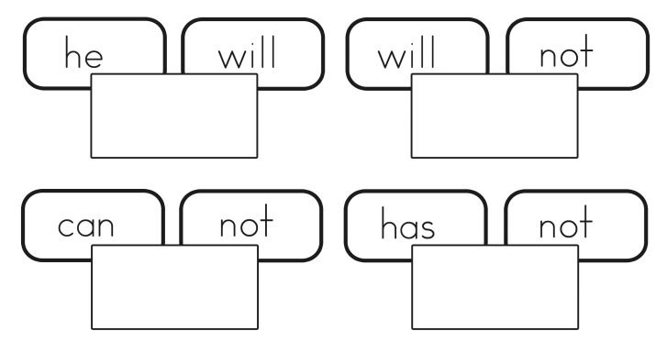
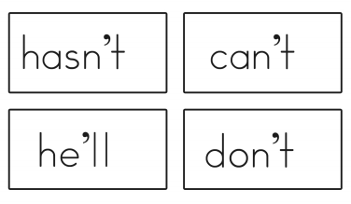

Slide 22









Slide 23
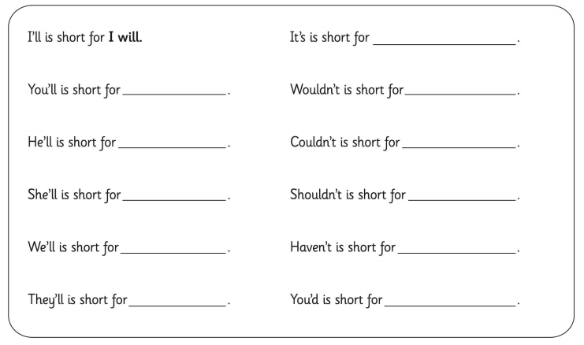
What are these contractions short for?

Slide 24
It is
Would not
Could not
Should not
Have not
You would
You will
He will
She will
We will
They will

Slide 25
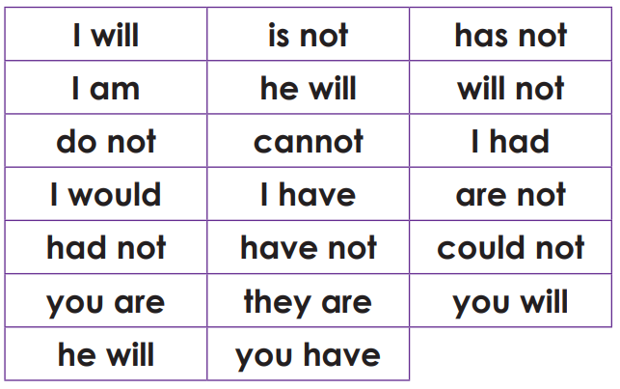
Now turn these into contractions.

Slide 26
Answers.
I’ll | isn’t | hasn’t
I’m | he’ll | won’t
don’t | can’t | I’d
I’d | I’ve | aren’t
hadn’t | haven’t | couldn’t
you’re | they’re | you’ll
he’ll | you’ve

Slide 27


Your morning lessons are completed.
Time for lunch.
Then come back this afternoon for your curriculum activity.

Slide 28


Slide 29


Colour Mixing

Slide 30


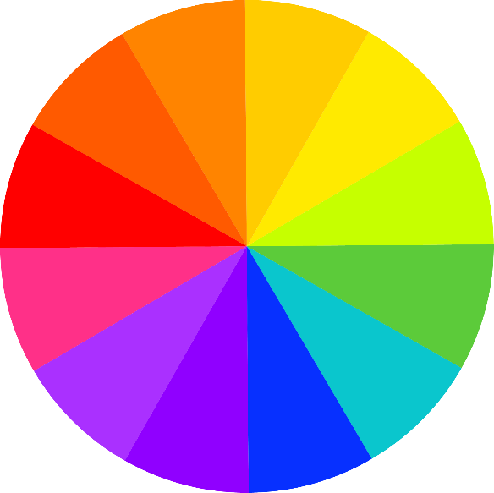
Colour Mixing
We have been learning about colour mixing at school.

Slide 31
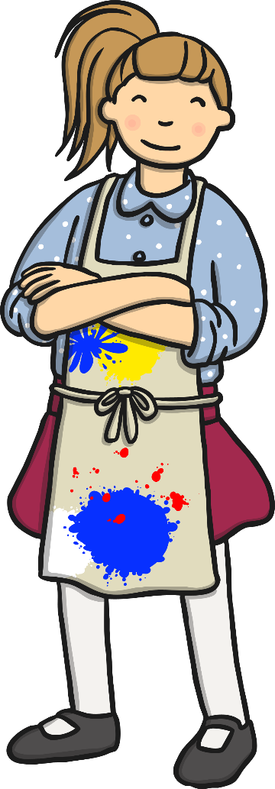

Primary Colours
We have learnt about the primary colours.

Slide 32
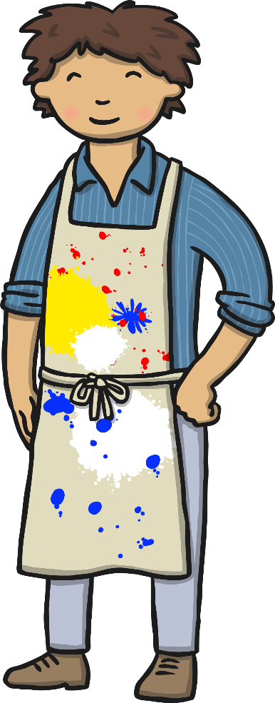

Secondary Colours
We have learnt about secondary colours.
You use the
primary colours
to mix these.

Slide 33
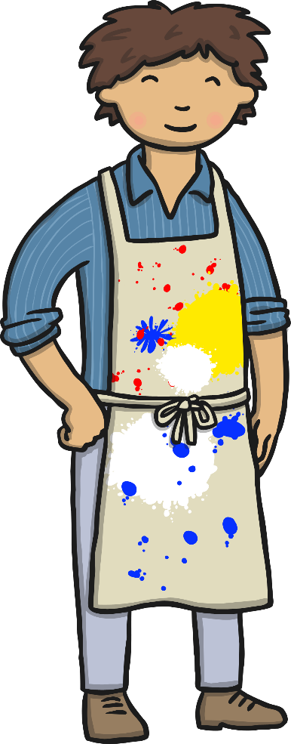



Mixing Secondary Colours

Slide 34

Mixing Secondary Colours
We have practiced mixing lots more colours!

Slide 35
Neutral Colours
We have learnt about neutral colours.

Slide 36

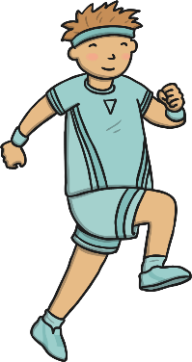
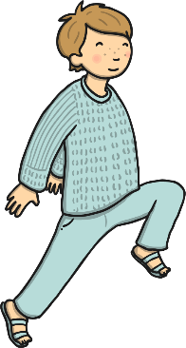
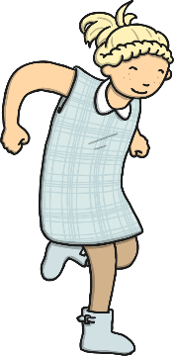
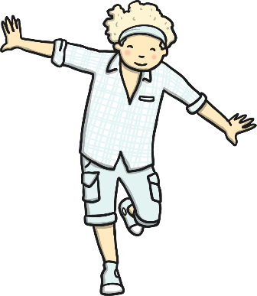

Mixing Tints
We added white to a colour, to make tints.
This makes a colour lighter.

Slide 37
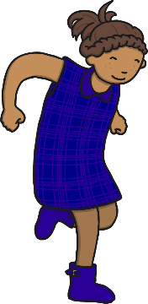
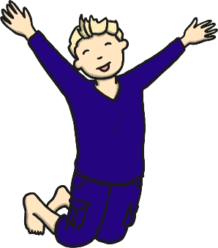
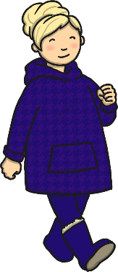
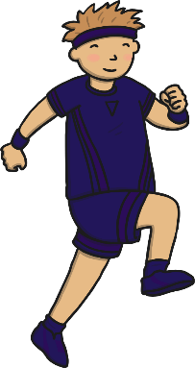
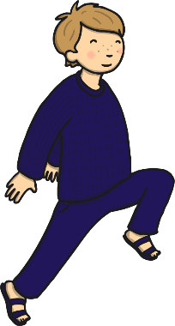
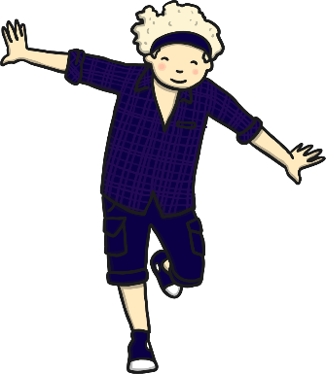
Mixing Shades
We added black to a colour, to make shades.
This makes the colour darker.

Slide 38
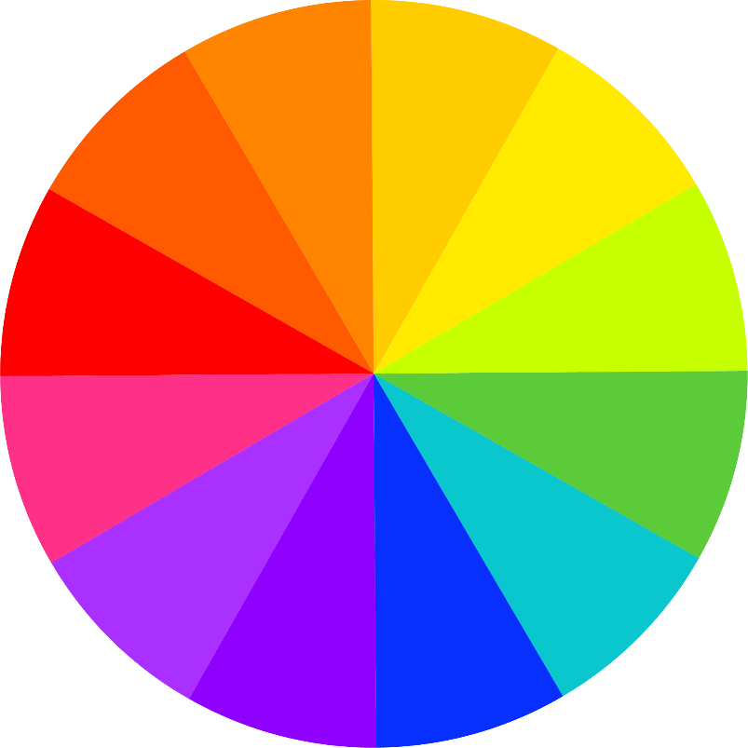
Warm and Cool Colours
We made warm and cool colours.
warm colours
cool colours
-----------------------------

Slide 39
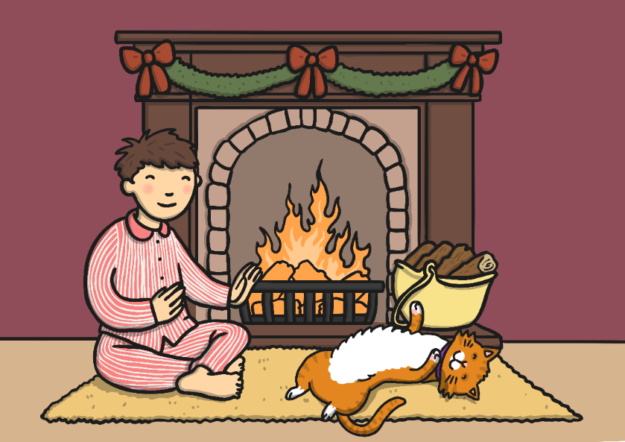
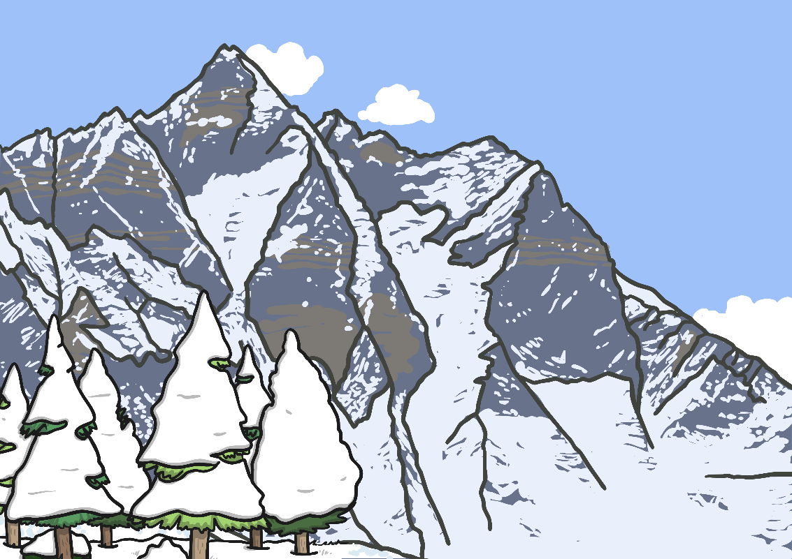
Warm Colours
Cool Colours
Red, orange, and yellow are warm colours. They make us think of sunny, warm and cosy things.
Green, blue and purple are cool colours. They make us think of fresh, calm and chilly things.

Slide 40
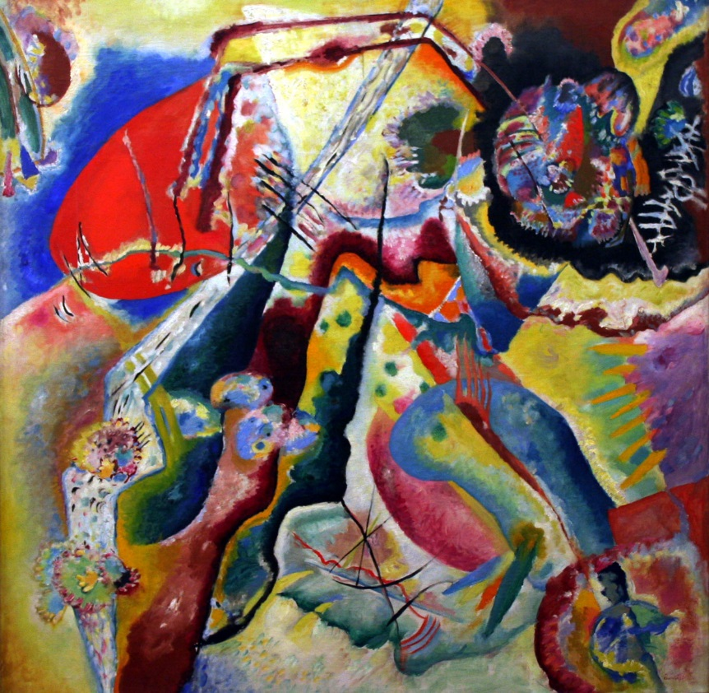
Wassily Kandinsky
Wassily Kandinsky was
a Russian painter.
Many people think he was
the first abstract artist.
Abstract Painting
by Wassily Kandinsky
Photo courtesy of Playing Futures: Applied Nomadology (@flickr.com) - granted under creative commons licence – attribution

Slide 41
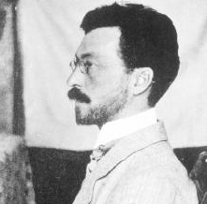
All about Wassily Kandinsky
(1866 - 1944)
Russian
Wassily Kandinsky was born in Russia, in 1866. When he grew up, he worked as a teacher at a university but it didn’t make him happy.
When he was 30, he left his job and went to art school. He found art school easy and was very good at his studies.
Kandinsky thought a lot about what colours mean and how they make people feel. He believed that colours had a soul.
Wassily Kandinsky

Slide 42





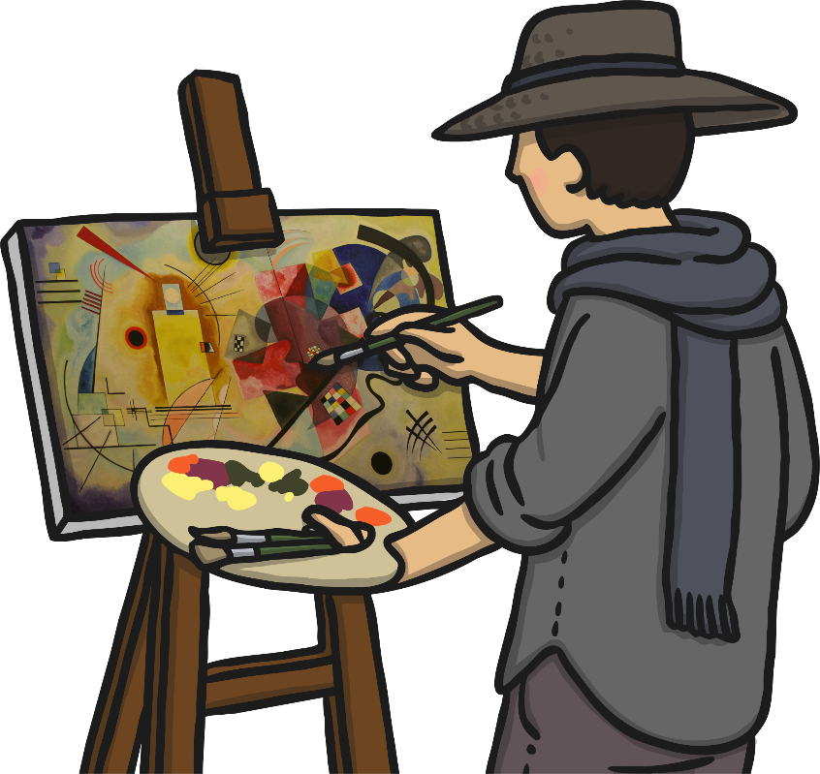
All about Wassily Kandinsky
(1866 - 1944)
Russian
He was the first painter to stop painting pictures of things and instead paint just using colours and shapes. He believed that this let him paint honestly about his feelings.
Often Kandinsky would listen to music while he painted and try to paint what he heard.
All the other painters we have found out about learned a lot from Kandinsky’s ideas.

Slide 43
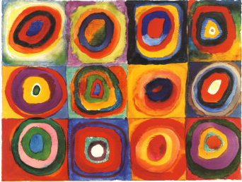
Colour Studies: Squares with Concentric Circles
by Wassily Kandinsky
Photo courtesy of NailsandNoms (@flickr.com) - granted under creative commons licence – attribution

Slide 44
Looking at Abstract Art:
Colour Studies: Squares with
Concentric Circles (1913)
What do you see when you look
at this painting?
How has the painting been made?
What kind of colours does Kandinsky use?
How would you describe these colours?
What shapes can you see?
What kind of lines can you see?
How do you think Kandinsky was feeling when he painted this?
How does the painting make you feel?
Do you like it? Why?
Photo courtesy of NailsandNoms (@flickr.com) - granted under creative commons licence – attribution

Slide 45
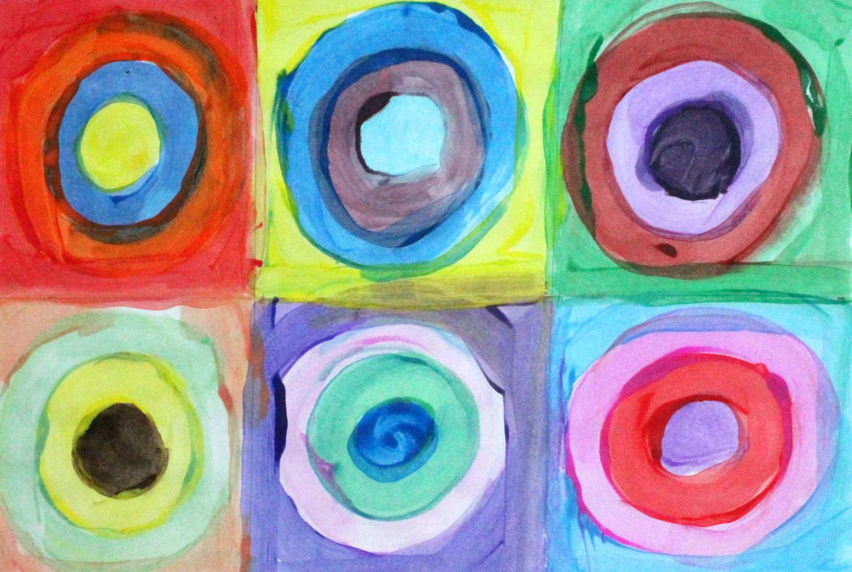
What a good circle painting looks like…
If you have paints or painting pencils at home you could make your own circle painting.
If you don’t have paints you could use crayons or felts.

Slide 46

We hope your day went well.
See you tomorrow.

