Slide 1

Tuesday 30th June
Ready to wake up your maths brains?
Remember you can do these independently then share them with an adult.
Question 10 may have more than one answer.
Don’t worry about always finding the answer it is how you try to work out and reason that is important.

Slide 2





Morning Maths 30.06.20
7. I face North-East then make a 1/2 clockwise turn. What direction am I now facing?
8. What will the time be in
15 minutes?
9.Mr Greedy wants to lose weight. He weighs 110kg now. If he loses 2kg every week, how many weeks until he is 80kg?
10. Without drawing them, can you write down the lengths of the sides of as many rectangles as you can which have a perimeter of 24cm?
How many fours in 24 ?
2. Write a calculation statement for this part-whole model:
3. 453 - 147
4. 35 x 4
5. 24cm 5 mm = . cm
6. Which of these triangles has a right angle?
23
24
a
c
b

Slide 3
12
23+24=47
306
140
24.5cm
A
SW
10.25
40
Various answers. For example: 10cm,10,2cm,2cm or 9cm,9cm,3cm,3cm or 11cm,11cm,1cm,1cm

Slide 4

St Catherine’s Classroom Beliefs
Mistakes are valuable.
Everyone can learn maths to the highest level.
Questions are really important.
Depth is more important than speed.
Maths is about making connections.
We may not be learning together in the classroom, but it is important to still remember our classroom beliefs.

Slide 5
WALT: divide 2 digit numbers by 1 digit numbers.

Slide 6
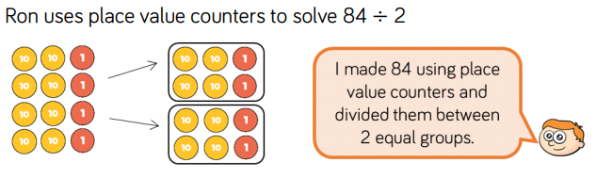
We are going to practice using place value counters to solve division calculations.
Let’s remind ourselves of how we do that.
= 42

Slide 7
Use the method shown to solve the following questions.
64 ÷ 2 =
90 ÷ 5 =
99 ÷ 3 =
69 ÷ 3 =
48 ÷ 4 =
60 ÷ 6 =

Slide 8
Use the method shown to solve the following questions.
64 ÷ 2 = 32
90 ÷ 5 = 18
99 ÷ 3 = 33
69 ÷ 3 = 23
48 ÷ 4 = 22
60 ÷ 6 = 10

Slide 9
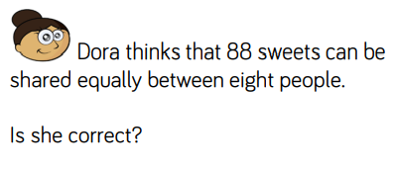

Slide 10
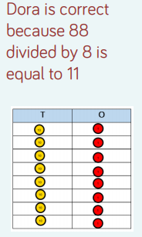
Answer

Slide 11

Time for a break.
Have a drink and a snack.

Slide 12
WALT: identify the sequence of a set of instructions.
When you read or write a set of instructions they have to be read or written in a series of steps.
The steps show the order that a task must be done so that the task can be carried out successfully.
On the next two slides you will be given a set of photographs and set of instructions that are in a muddle. Your task is to sort them into the correct sequence.

Slide 13
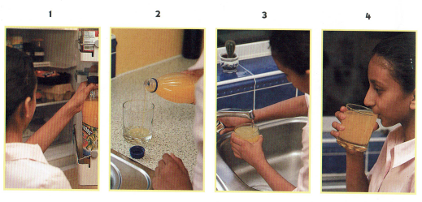
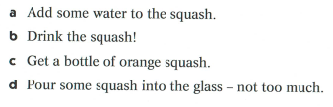
Complete the table to show the correct order of the instructions.
Photo number | Instruction letter
1
2
3
4

Slide 14
Complete the table to show the correct order of the instructions.
Photo number | Instruction letter
1 | c
2 | d
3 | a
4 | b

Slide 15
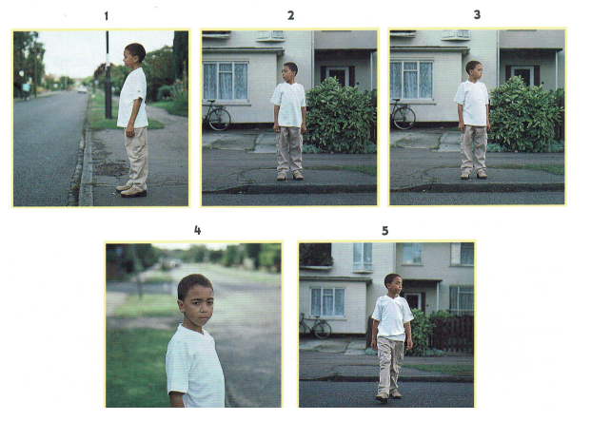
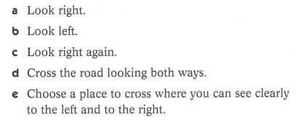
Complete the table to show the correct order of the instructions.
Photo number | Instruction letter
1
2
3
4
5

Slide 16
Complete the table to show the correct order of the instructions.
Photo number | Instruction letter
1 | e
2 | a
3 | b
4 | c
5 | d

Slide 17
On the next slide is a set of instructions for making a sock puppet.
They are in the wrong order.
Copy them out in the correct order.
Don’t forget to add a title where you need one.

Slide 18
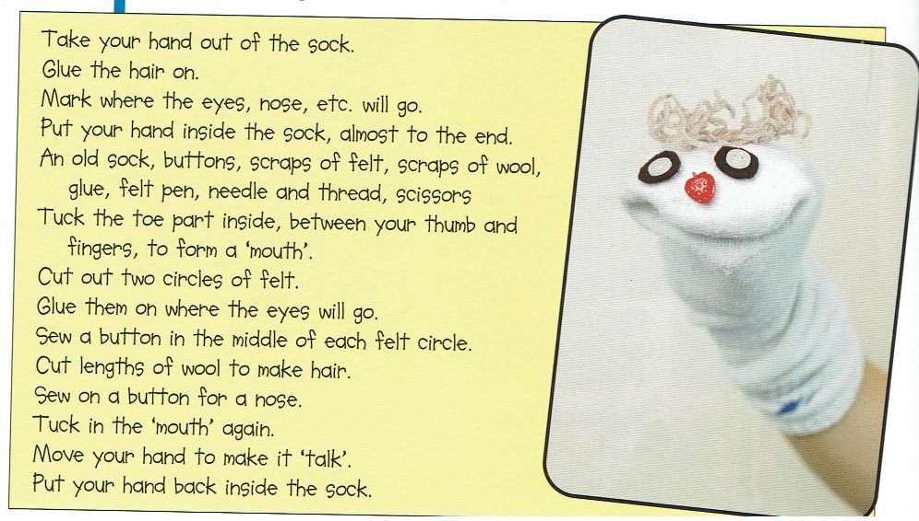

Slide 19
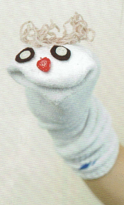
Making a sock puppet.
What you need:
An old sock, buttons, scraps of felt, scraps of wool, glue, felt pen, needle and thread, scissors
What to do:
Put your hand inside the sock almost to the end.
Tuck the toe part inside, between your thumb and fingers, to form a mouth.
Mark where the eyes, nose, etc, will go.
Take your hand out of the sock.
Cut out two circles of felt
Glue them on where the eyes will go.
Sew a button in the middle of each felt circle.
Sew on a button for a nose.
Cut lengths of wool to make the hair
Glue the hair on.
Put your hand back inside the sock.
Tuck in the mouth again.
Move your hand to make it ‘talk’.

Slide 20

Spell the short vowel sound ‘i’.
This is revision so you can rewatch the link below
https://uk.video.search.yahoo.com/yhs/search;_ylt=AwrEzeG88oleREEAhD.c3olQ;_ylu=X3oDMTBncGdyMzQ0BHNlYwNzZWFyY2gEdnRpZAM-;_ylc=X1MDMTM1MTIxMjcwMA
Match the correct spelling words to the pictures on the next page.
Write the words down. I have introduced some new words too.
15 minute Spelling Activity

Slide 21
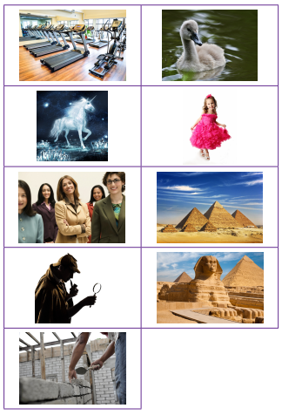
Can you match the word to the picture?
Which letter or letters produce the ‘i’ sound in these words?
pretty
cygnet
pyramid
women
gym
myth
mystery
build
Egypt

Slide 22
Can you match the word to the picture?
Which letter or letters produce the ‘i’ sound in these words?
pretty
cygnet
pyramid
women
gym
myth
mystery
build
Egypt

Slide 23

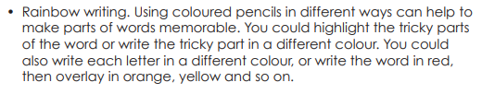
Rainbow write each
word 3 times.
women
cygnet
pyramid
build
Egypt
gym
myth
mystery
pretty

Slide 24


Your morning lessons are completed.
Time for lunch.
Then come back this afternoon for your curriculum activity.

Slide 25





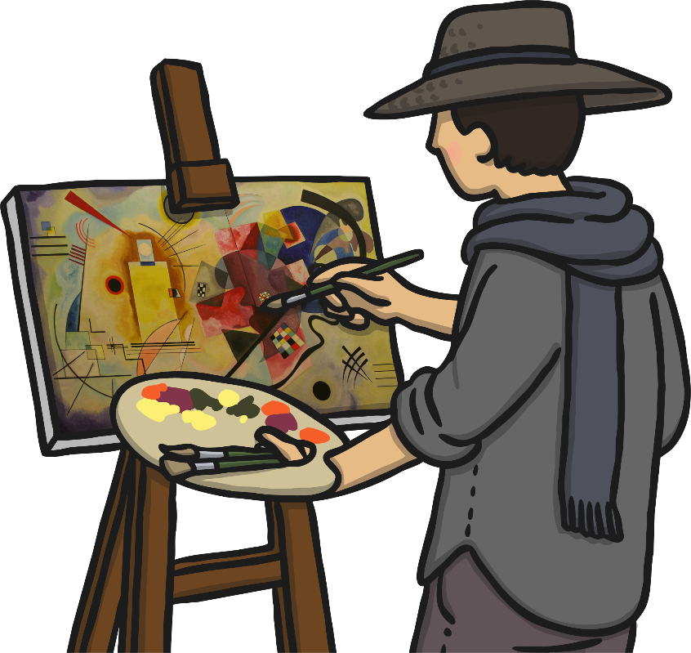
Wassily Kandinsky
(1866 - 1944)
Russian
Yesterday we read about Kandinsky and saw some of his artwork.
How did you get on making your own circle painting or drawing?
On the next slides you can see two more examples of Kandinsky’s work.

Slide 26
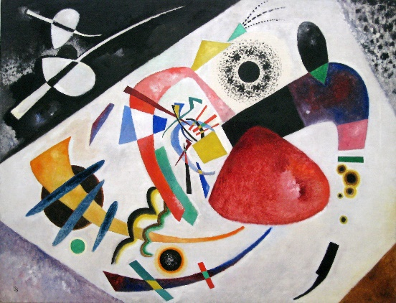
Red Spot II (1921)
by Wassily Kandinsky
Photo courtesy of Sharon Mollerus (@flickr.com) - granted under creative commons licence – attribution

Slide 27
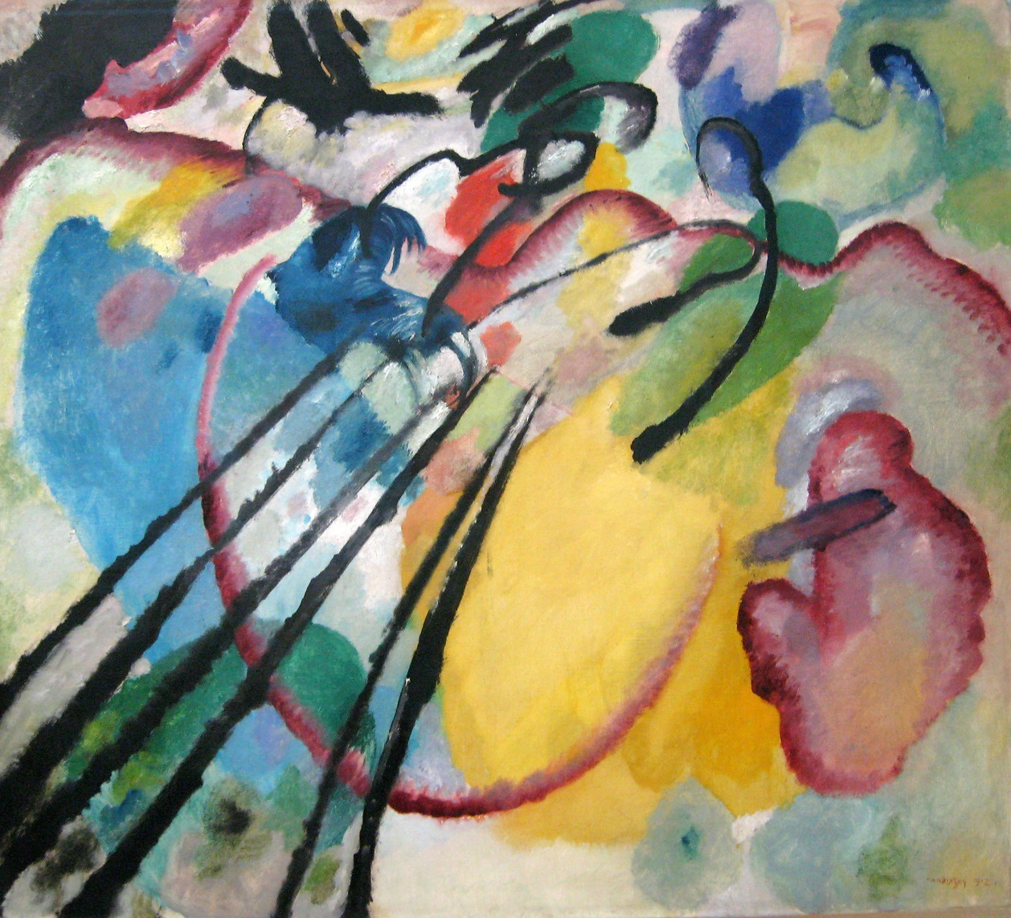
Improvisation 26 (Rowing) (1912)
by Wassily Kandinsky
Photo courtesy of Sharon Mollerus (@flickr.com) - granted under creative commons licence – attribution

Slide 28

Kandinsky
1. You can print off this slide and paint or colour the Kandinsky style art.
2. Or you could copy it and then paint or colour it.
3. Or you could try drawing your own artwork in his style and completing it.

Slide 29

We hope you had fun today.
See you tomorrow.

