Slide 1
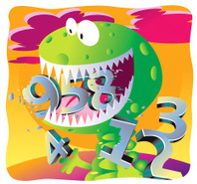
Wednesday 1st July
Ready to crunch some numbers?
Remember you can do these independently then share them with an adult.
Question 10 may have more than one answer.
Don’t worry about always finding the answer it is how you try to work out and reason that is important.

Slide 2
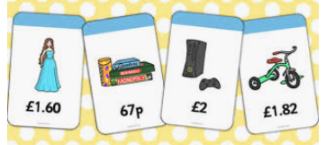
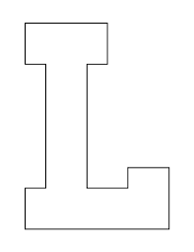
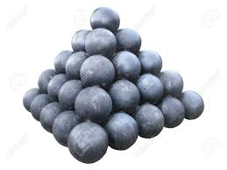
Morning Maths 01.07.20
8. How much change
from £10?
9. Draw two parallel lines. Both should be 4.5 cm long.
10. How many cannon balls there are
here?
Explain how you know.
Put these in ascending order:
320 230 23 302 203 320
2. 1m - 33cm
3. I’m thinking of a number. If I halve it, I get 29. What is my number?
4. ➗ 8 =6
5. Half of 150
6. How many right angles in the
inside of this shape?
7. 155 + 255

Slide 3
123,203,230,302,320
320
67
58
48
75
13
410
£3.91
55. Because there is 1 balls, then 2 rows of 2 balls = 4, 3 rows of 3 balls = 9, 4 rows of 4 balls = 16, 5 rows of 5 balls = 25. Added altogether = 55

Slide 4

St Catherine’s Classroom Beliefs
Mistakes are valuable.
Everyone can learn maths to the highest level.
Questions are really important.
Depth is more important than speed.
Maths is about making connections.
We may not be learning together in the classroom, but it is important to still remember our classroom beliefs.

Slide 5
WALT: divide two digit numbers by one digit numbers.

Slide 6
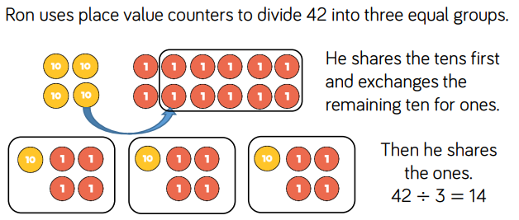

Slide 7
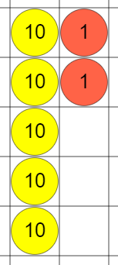
Here is another example. We are going to work out 52 ÷ 4 =
What do you notice?

Slide 8
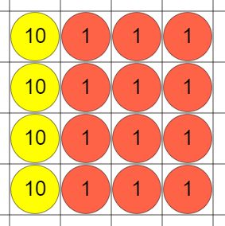
If we split the place value counters into 4 groups, the groups won’t be equal.
We need to exchange the ten that doesn’t fit and exchange it for 10 ones. Then we can sort them into 4 groups.

Slide 9
Now we can see that each part has 13. The answer to our question 52 ÷ 4 = 13
If you have found this confusing, go back to the start of the lesson and read through the slides again. It might make sense to draw the counters out to help you.

Slide 10
If you can’t draw them or are finding it difficult, it might be easier if you use the website bellow. It allows you to use place value counters and exchange them a lot easier.
https://mathsbot.com/manipulatives/placeValueCounters

Slide 11
= 16
= 13
= 10 r 4

Slide 12
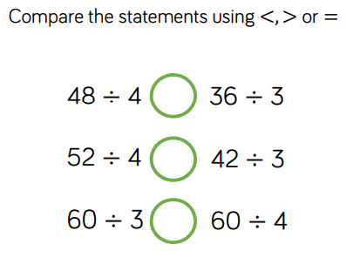

Slide 13
=
<
>

Slide 14

Time for a break.
Have a drink and a snack.

Slide 15
WALT: identify the language used in instructions.
When you read or write a set of instructions they have to tell someone what to do. When you do something we call this an action.
Action words are doing words or verbs.
Each time we read or an write an instruction it includes an imperative verb that tells the person who is following the instruction exactly what to do.
We sometimes call these imperative verbs ‘bossy’ verbs because it is an instruction or command that we must follow.

Slide 16
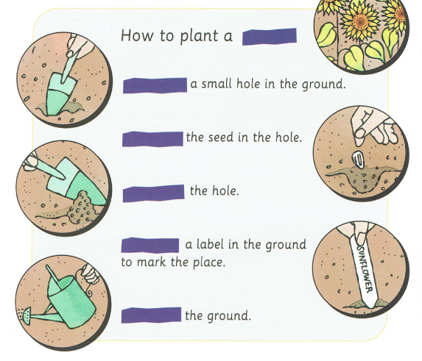
Where do these imperative verbs go?
Dig
Cover
Water
Drop
Place

Slide 17
Where do these imperative verbs go?
Dig
Cover
Water
Push
Place
Did you notice there was a missing word? It is not an imperative verb. Did you work out you would need the noun -sunflower?

Slide 18
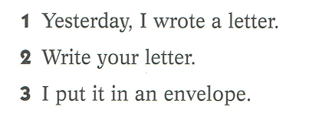
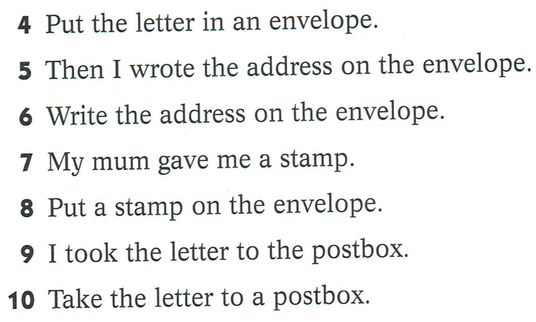
Some of these sentences are recount and some of them are instructions.
Copy JUST the instructions.
Remember to look for imperative verbs.
What are the instructions for?

Slide 19
Answers.
These are JUST the instructions.
What are the instructions for?
Instructions for sending a letter.
2 - Write your letter.
3 - Put the letter in an envelope.
6 - Write the address on the envelope.
8 - Put a stamp on the envelope.
10 - Take the letter to a postbox.

Slide 20
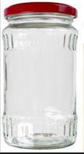
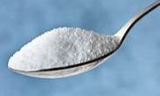
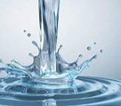
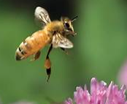
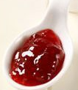
This is a recount.
Change the sentences into instructions.
Think about imperative verbs!
We got an empty jam jar. We put a spoonful of jam and sugar into it. We filled it with water. We put a lid on it. We made some big holes in the lid. We left it in the garden for a few days.

Slide 21
Attracting Bees to your Garden.
Get/Take/Use an empty jam jar.
Put/Place a spoonful of jam and sugar into it.
Fill it with water.
Put/Screw/Place a lid on it.
Make/Pierce/Drill some big holes in the lid.
Leave/Place/House it in the garden for a few days.

Slide 22

Spell the short vowel sound ‘i’.
Today we will use the words we practised yesterday in our spellings.
15 minute Spelling Activity

Slide 23
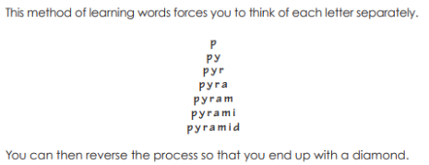
Now practise the spellings using pyramid writing.
women
cygnet
pyramid
build
Egypt
gym
myth
mystery
pretty

Slide 24
Use the spellings you have been practising to complete the sentences. Remember to spell the words accurately.
The _________ had grey feathers whereas it’s mother was white.
Jack wanted to ________ a new house for his family.
The princess wore a ________ dress to the ball.
The _______ would be difficult to solve for the detective.
_______ is a country in Africa..
_______ were built as tombs for the pharaohs.
Mr Mottershead likes to visit the ____ after work to do his exercises.
A ____ is a type of story, it may have a creature such as a dragon in it..
The toilet were signposted for men and for ________.

Slide 25
Use the spellings you have been practising to complete the sentences. Remember to spell the words accurately.
The cygnet had grey feathers whereas it’s mother was white.
Jack wanted to build a new house for his family.
The princess wore a pretty dress to the ball.
The mystery would be difficult to solve for the detective.
Egypt is a country in Africa..
Pyramids were built as tombs for the pharaohs.
Mr Mottershead likes to visit the gym after work to do his exercises.
A myth is a type of story, it may have a creature such as a dragon in it.
The toilet were signposted for men and for women.

Slide 26


Your morning lessons are completed.
Time for lunch.
Then come back this afternoon for your curriculum activity.

Slide 27
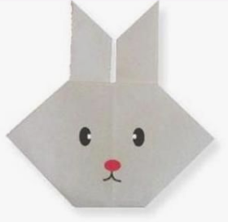

Design Technology Instructions Tasks.
You have been reading and writing instructions in English this week so for DT this afternoon we would like you to follow the visual instructions to make origami animals.

Slide 28
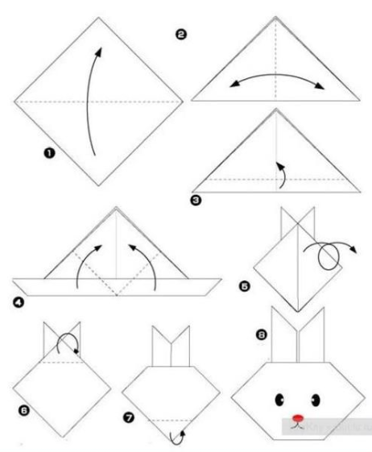
Make the origami rabbit in 8 steps.
You need a square of paper for this task. It can be any colour and you can decorate it with a face and whiskers

Slide 29
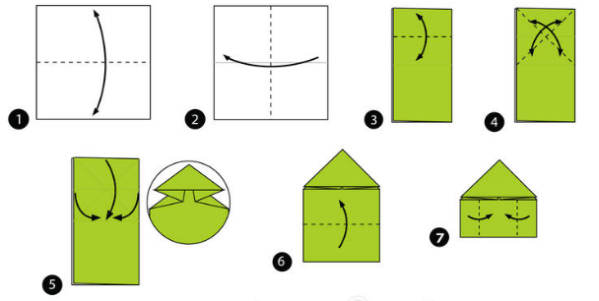
Now try the jumping frog.

Slide 30
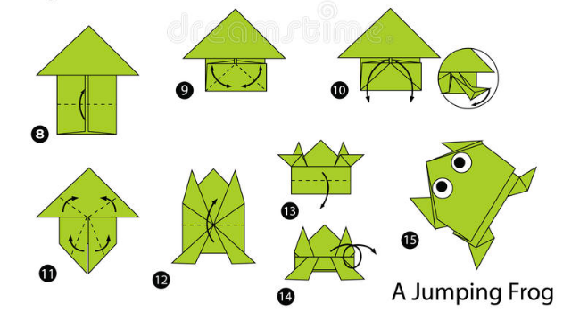

Slide 31
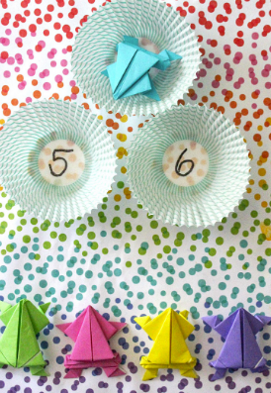
Design a game to play with your jumping frog.
It could be like Tiddlywinks with a scoring system.
Make your game and play it.
You could write the instructions for how to play it.

Slide 32
Did you have a good day learning today?
See you in the morning.

