Slide 1

Thursday 2nd July
Is your head ready to calculate?
Remember you can do these independently then share them with an adult.
Question 10 may have more than one answer.
Don’t worry about always finding the answer it is how you try to work out and reason that is important.

Slide 2


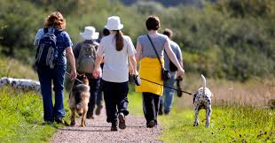
Morning Maths 02.07.20
7. 35 ➗ 8
8. Fill in the gaps:
9. How many legs on 6 dogs and their owners? Two of the owners have two dogs.
10. Make 24 using
each number only
once and any of
the operators (+, -, x, ➗)
How many days in December?
2. How many faces on this shape?
3. Double 117
4. 731 - 236
5. Insert the correct symbol (<,>,=)
0.5 ¾
6. 3x4x2
90
120
180

Slide 3
31
1
234
494
<
3x4=12, 12x2 = 24
32r3
60,150
4x6 = 24, 2x6=12, 24+12=36
5x4=20, 2+2=4, 20+4 = 24

Slide 4

St Catherine’s Classroom Beliefs
Mistakes are valuable.
Everyone can learn maths to the highest level.
Questions are really important.
Depth is more important than speed.
Maths is about making connections.
We may not be learning together in the classroom, but it is important to still remember our classroom beliefs.

Slide 5
WALT: divide two digit numbers by one digit numbers.

Slide 6
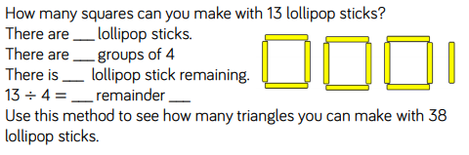

Slide 7
13
3
1
3
1
You can make 12 triangles with 2 left over.

Slide 8
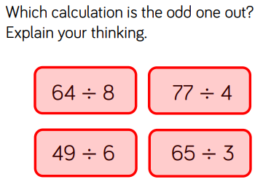

Slide 9
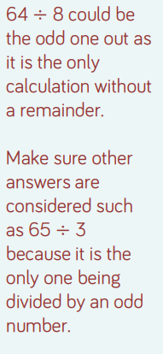

Slide 10

Time for a break.
Have a drink and a snack.

Slide 11
How to Make Chocolate Fudge Sauce - Comprehension
WALT: retrieve and infer information from a non-fiction text.
Read the text on the next two slides then answer the questions.

Slide 12
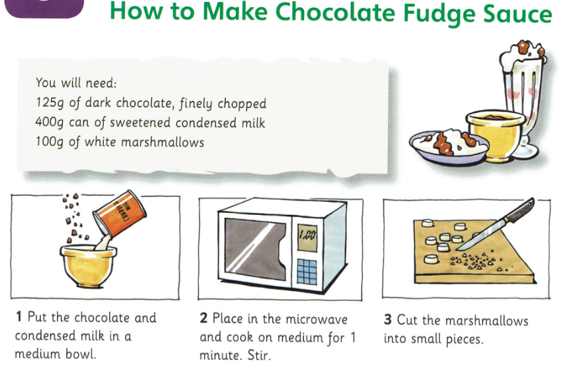

Slide 13
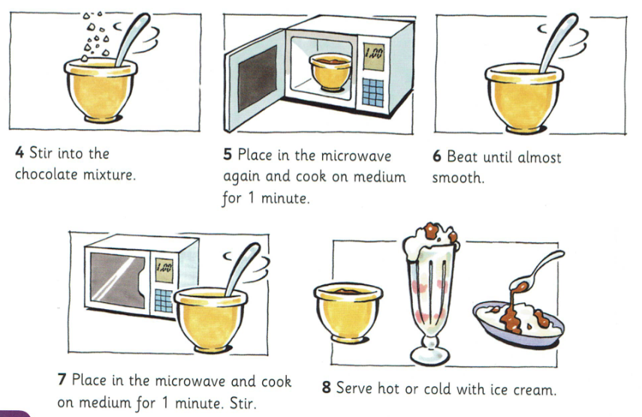

Slide 14
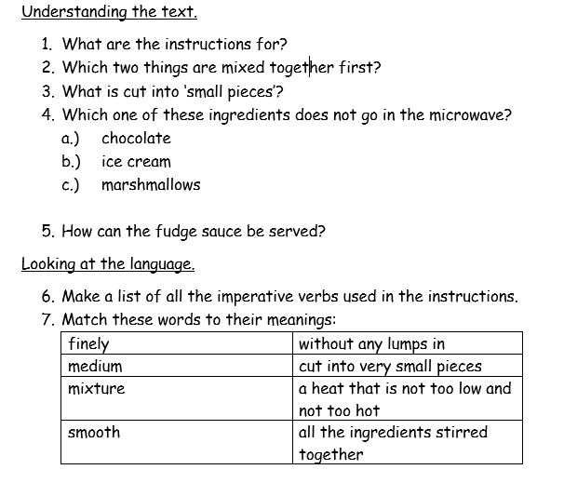

Slide 15
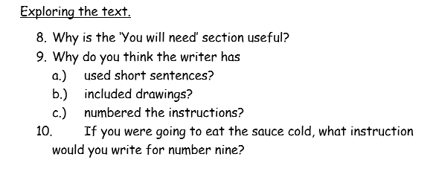

Slide 16
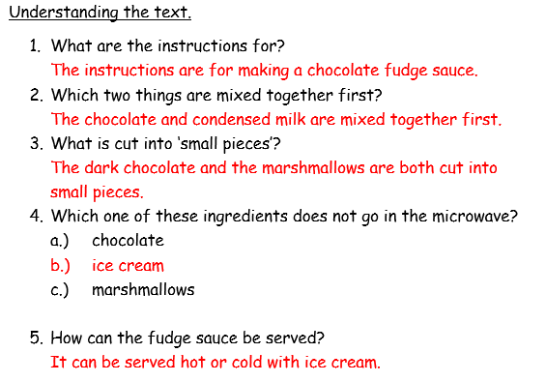

Slide 17
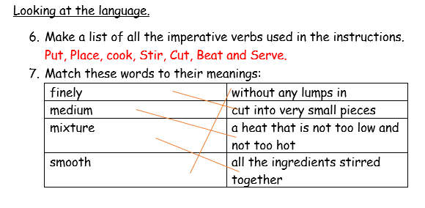

Slide 18
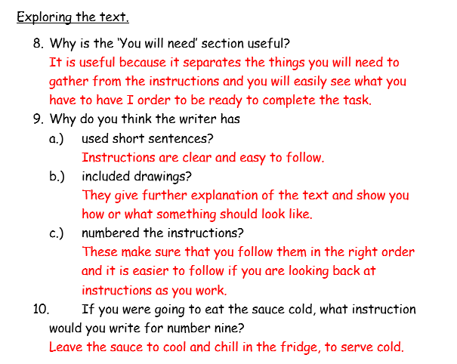

Slide 19

Spell words from the ‘ee’ sound family.
Read the story called The Spooky Halloween Party on the next two slides.
Write down all the words you find with an ‘ee’ sound in them.
Remember the ‘ee’ sound could be spelt in different ways.
Try listing the ‘ee’ sounding words into spelling patterns.
(e.g) ee and y
Halloween spooky
party
15 minute Spelling Activity

Slide 20
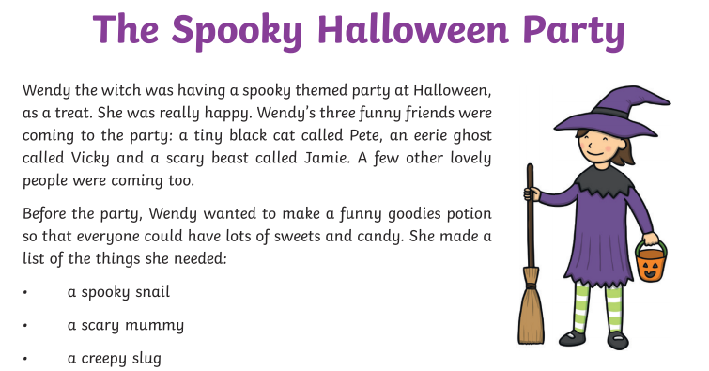

Slide 21
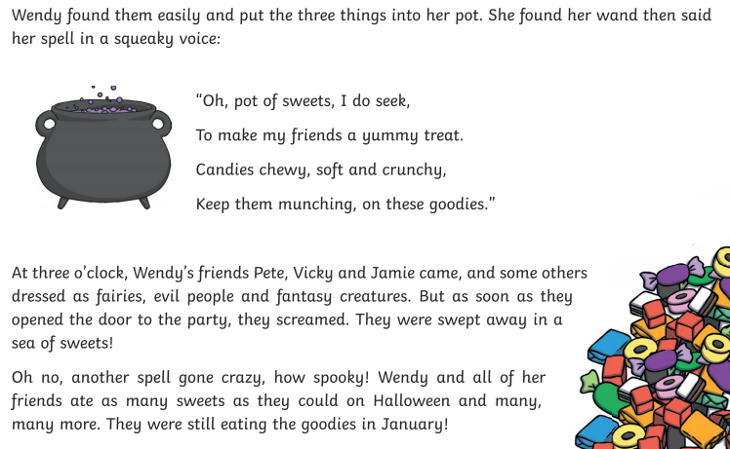

Slide 22
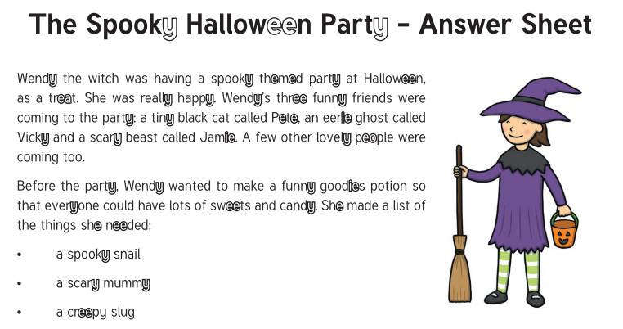

Slide 23
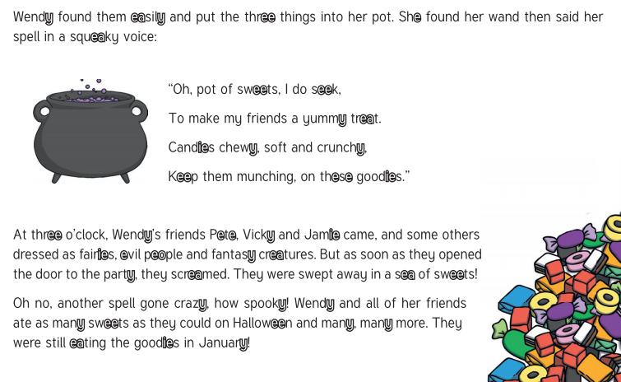

Slide 24


Your morning lessons are completed.
Time for lunch.
Then come back this afternoon for your curriculum activity.

Slide 25

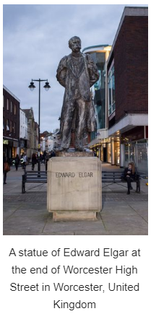
Time for Music.
Our school is in the county of Worcestershire.
Worcester is the city of our county.
If you have ever been to Worcester you may have seen this statue in the high street.
It is a statue of a famous composer who came from Worcester.

Slide 26
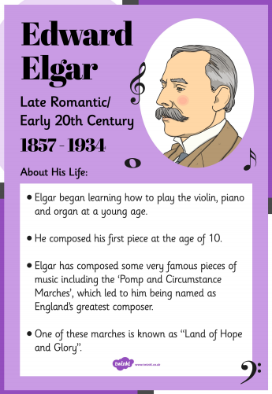
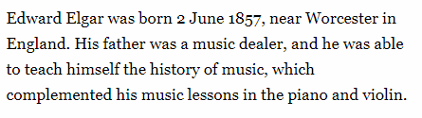
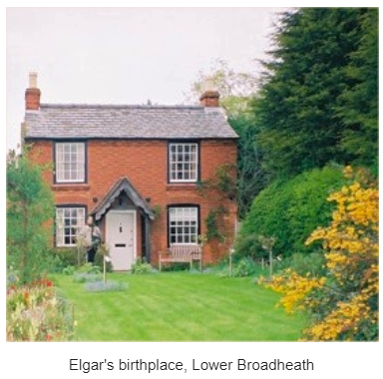
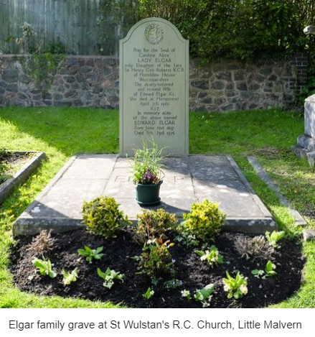
Facts about Elgar.
Click on the link to find out more.
https://kids.kiddle.co/Edward_Elgar

Slide 27
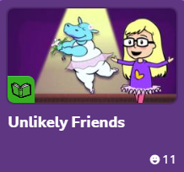
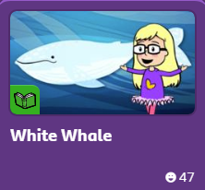
https://www.bbc.co.uk/cbeebies/stories/melody-unlikely-friends
Here are some questions for you to think about and answer.
Listen to the two pieces of music and use the questions for both pieces.
How does the music make you feel?
Do you like the piece of music? Explain your answer.
What instruments can you hear?
When or where do you think this piece of music might be played?
https://www.bbc.co.uk/cbeebies/stories/melody-white-whale

Slide 28

Elgar is well known for the five ‘Pomp and Circumstance Marches’ which were composed between 1901 and 1930. This work is very popular among millions of viewers of television worldwide.
Watch the video from the link below and listen to the music.
https://www.youtube.com/watch?v=1r94sjdHQ0c
Can you narrate your own story to this piece of music like the clips you saw earlier.

Slide 29
Did you work hard with your learning today?
See you in the morning.

