Slide 1

Friday 3rd July
Are you a maths whizz today?
Remember you can do these independently then share them with an adult.
Question 10 may have more than one answer.
Don’t worry about always finding the answer it is how you try to work out and reason that is important.

Slide 2
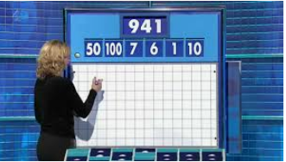
Morning Maths 03.07.20
7. 234 + 309
8. Which of these numbers is the odd one out?
42 56 35
9. I am thinking of a number between 30 and 60. If I divide it by 8, I have a remainder of 5. If I divide it by 5 I have 3 left over. What is my number?
10.
74 + 9
2. 6 x 20
3. Insert the correct symbol ( <,> , =)
56 ➗ 8 24 ➗ 4
4. Which two fractions are equivalent?
5. What is the subtraction statement
6. Complete the missing numbers above
1
3
1
2
4
1
2
4
4
743
205
80cm
90cm
1m 10cm
1m 30cm

Slide 3
83
120
>
2/4 or 1/2
538
1m, 1m20cm
543
35 as it is not a multiple of 2
multiples of 8 = 32, 40, 48, 56 - add remainder of 5 = 37, 45, 53, 61
multiples of 5 = 35, 40, 45, 50, 55, - add remainder of 3 = 38, 43, 48, 53, 58
6x100=600, 7x50=350, 600+350=950, 950+1=951, 951-10 = 941

Slide 4

St Catherine’s Classroom Beliefs
Mistakes are valuable.
Everyone can learn maths to the highest level.
Questions are really important.
Depth is more important than speed.
Maths is about making connections.
We may not be learning together in the classroom, but it is important to still remember our classroom beliefs.

Slide 5
WALT: divide using a bar model
Today, if you have a tablet, laptop or computer, you can access this lesson online using my maths. The link is copied below. If you not, just follow the slides and they will talk you through the lesson.
https://app.mymaths.co.uk/6017-lesson/bar-division

Slide 6
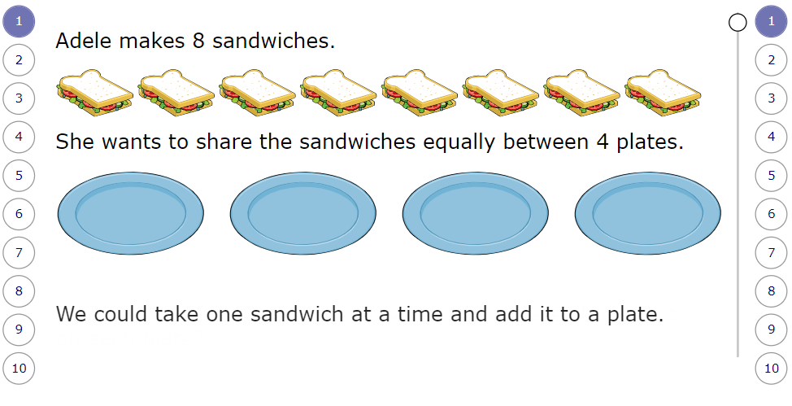
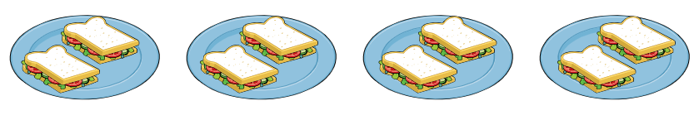

Slide 7
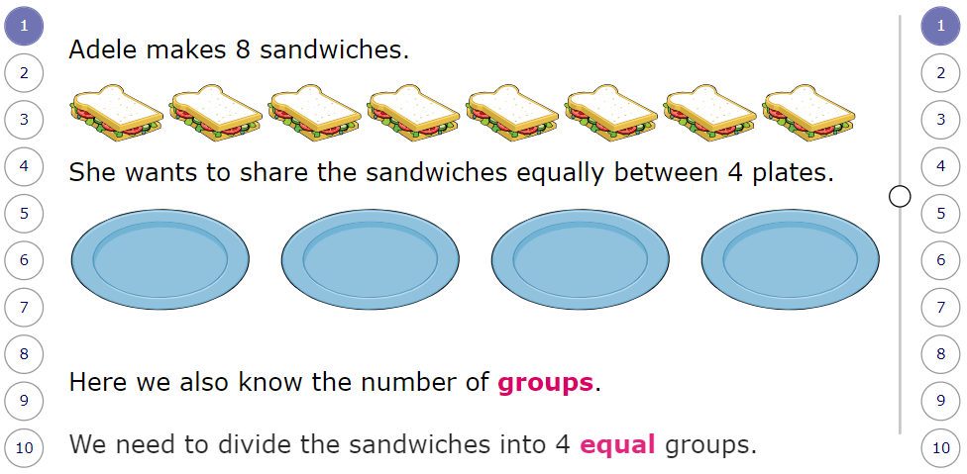

Slide 8
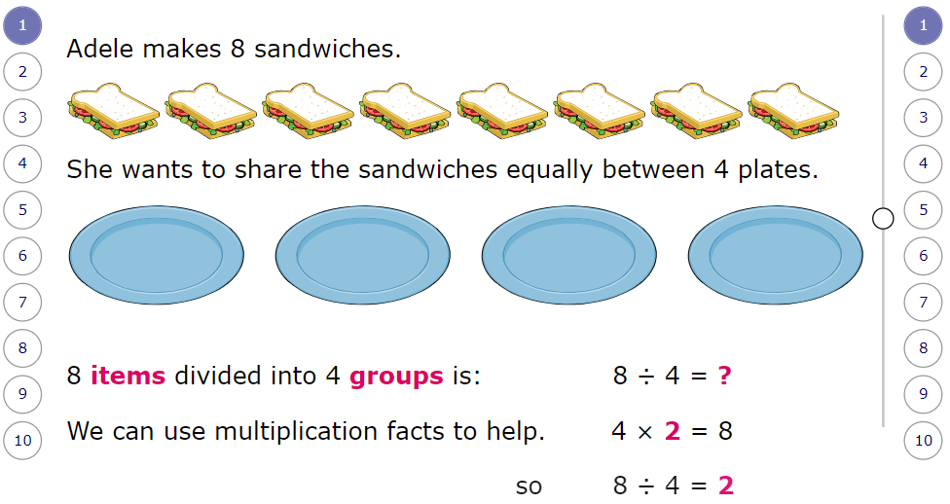

Slide 9
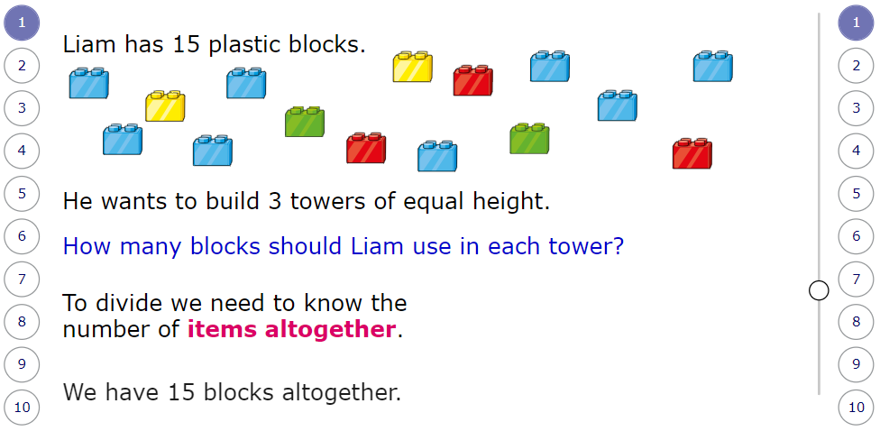
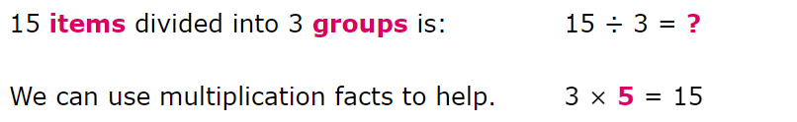

Slide 10
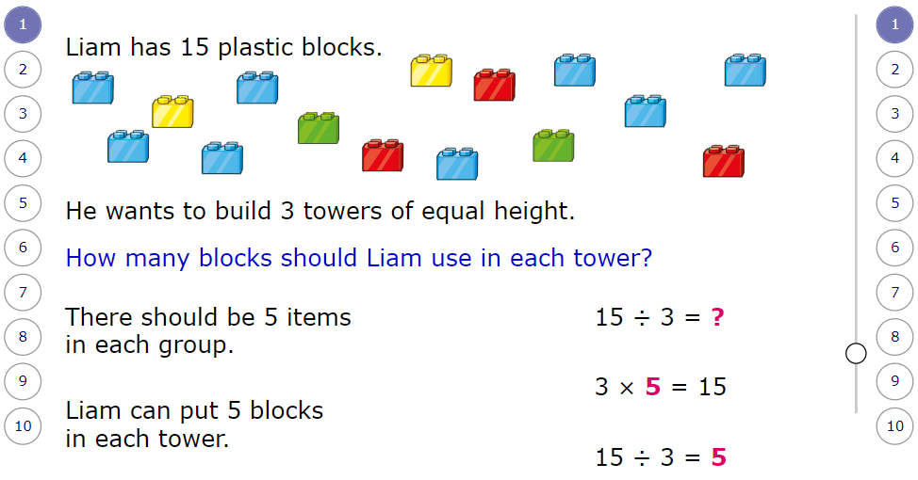

Slide 11
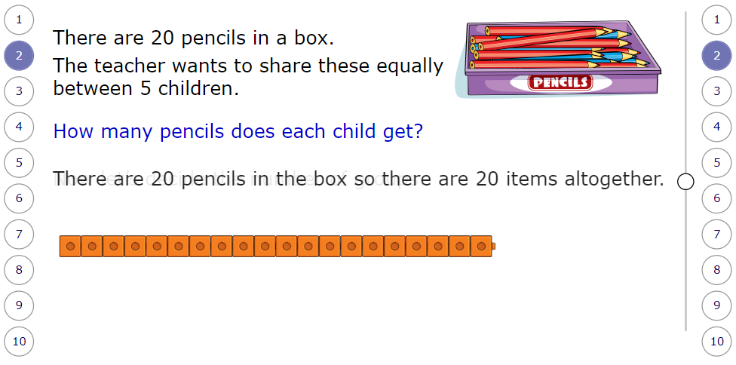

Slide 12
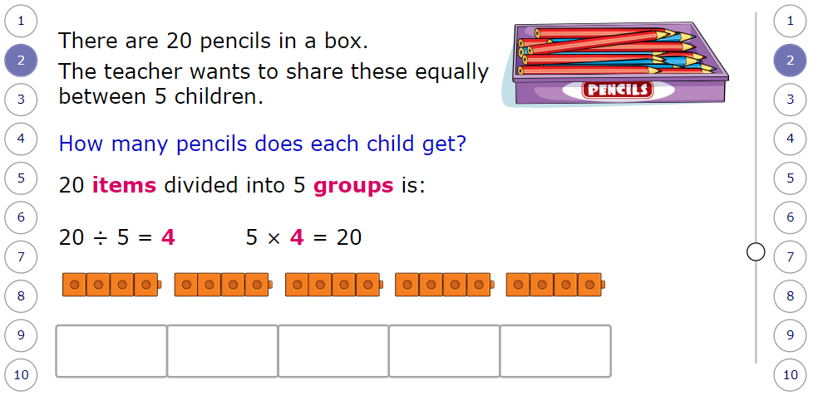

Slide 13
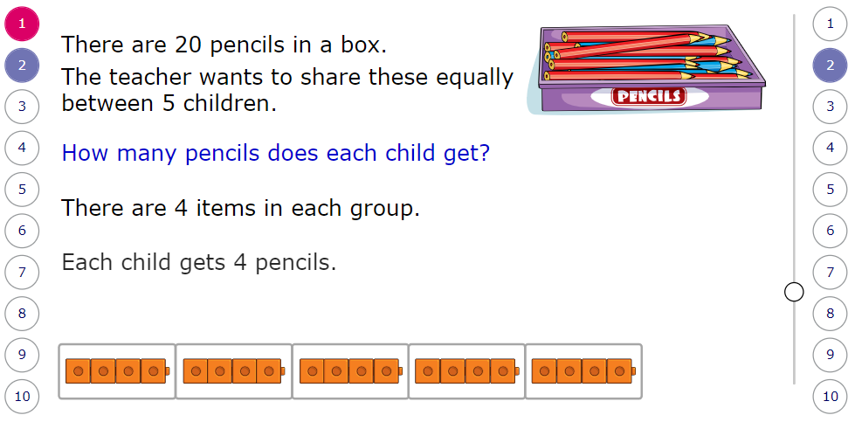

Slide 14
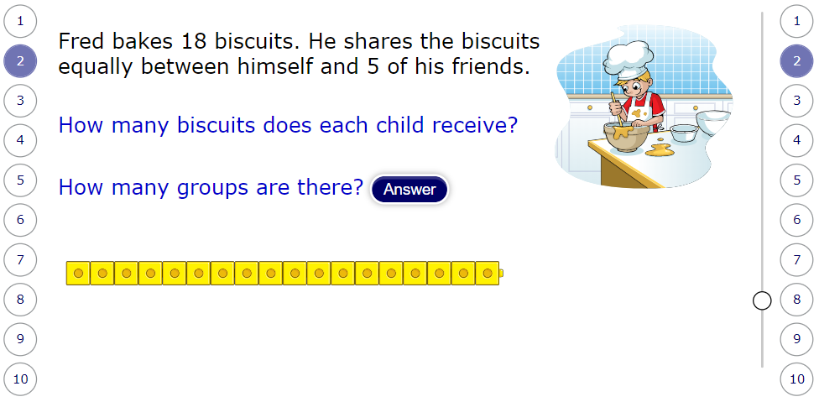

Slide 15
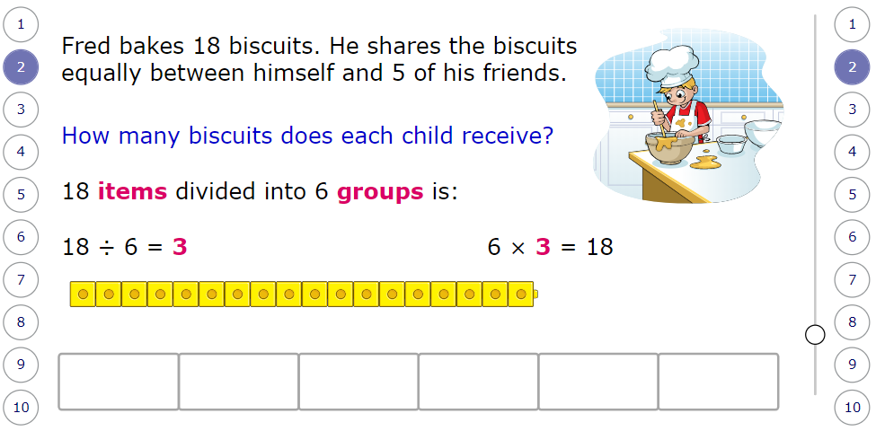

Slide 16
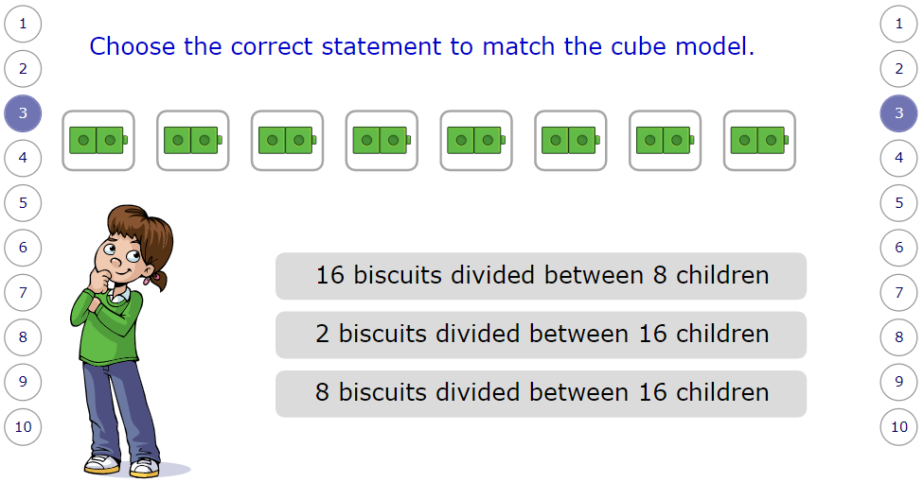

Slide 17
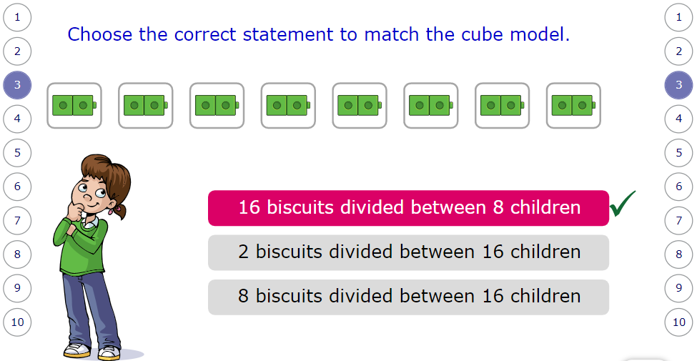

Slide 18
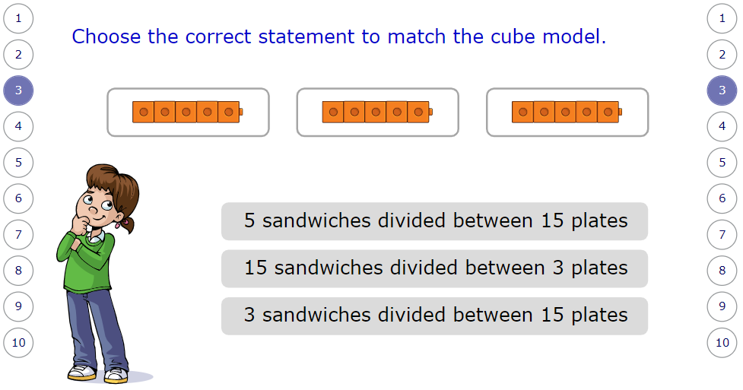

Slide 19
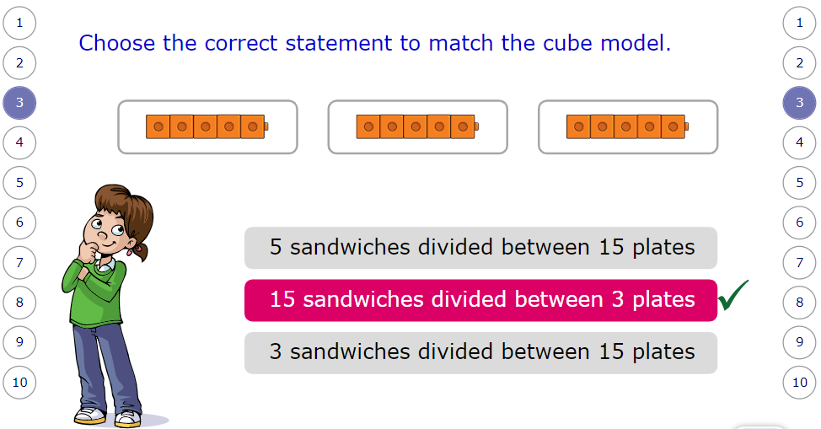

Slide 20
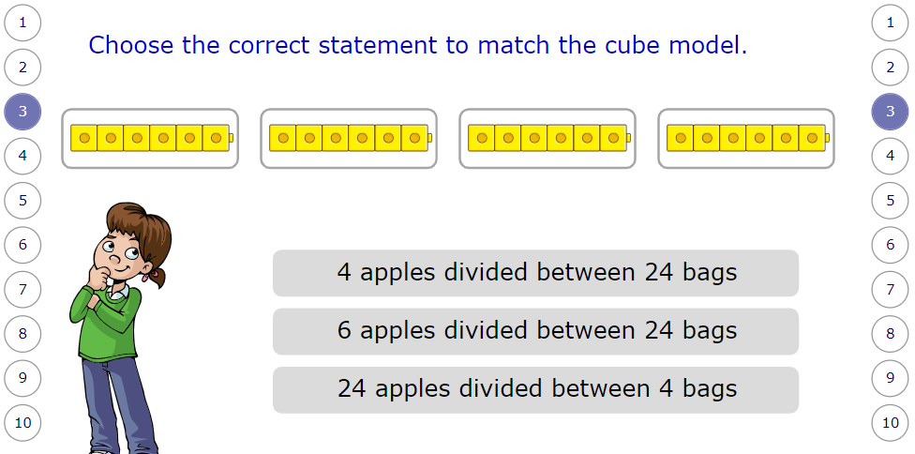

Slide 21
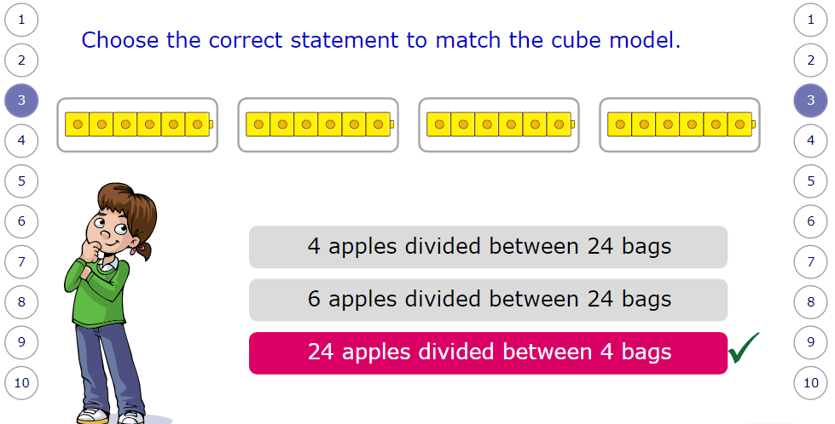

Slide 22
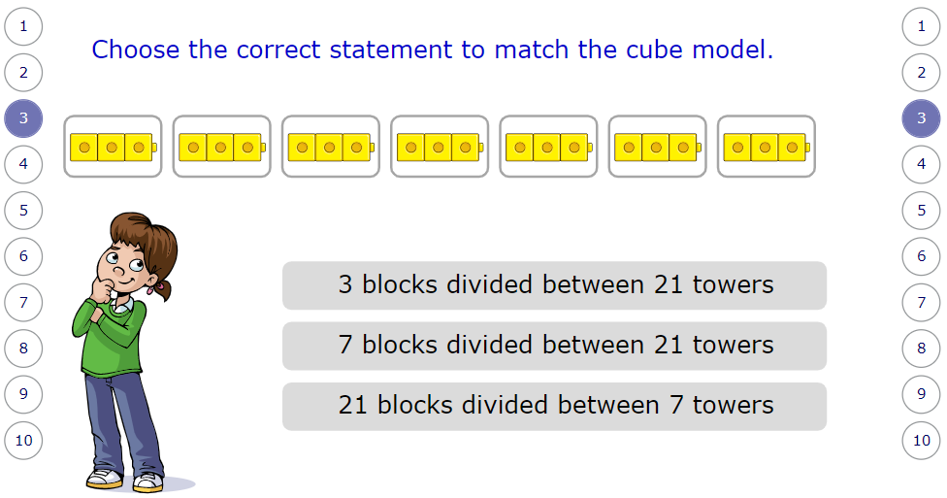

Slide 23
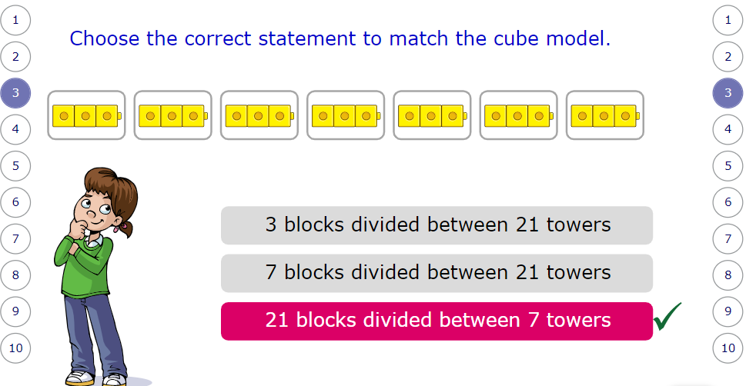

Slide 24
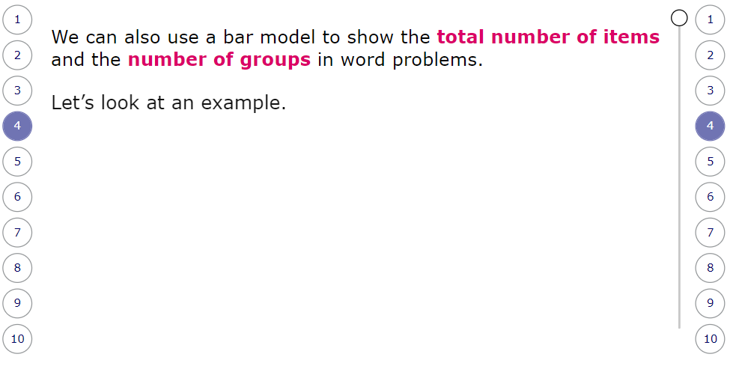

Slide 25
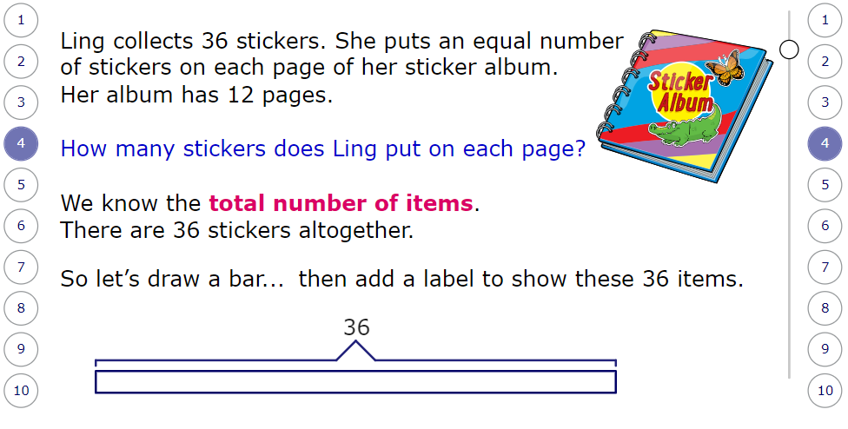

Slide 26
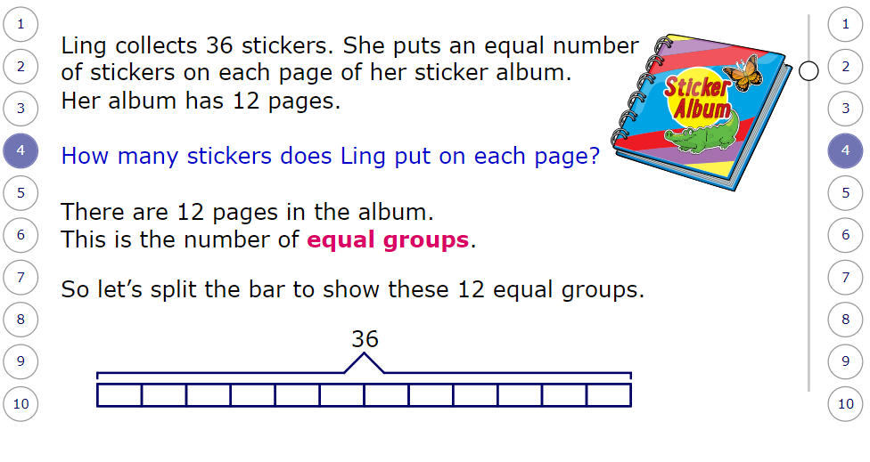

Slide 27
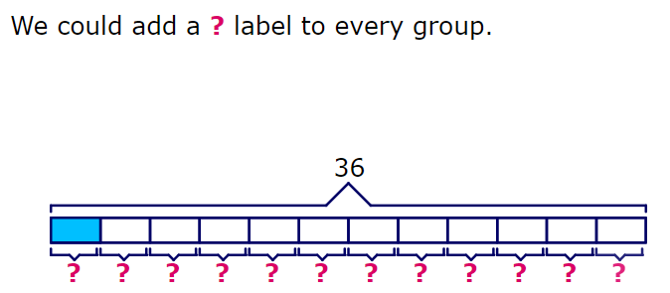

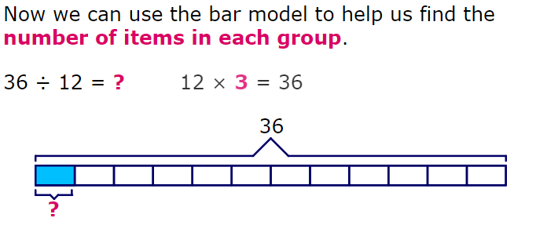

Slide 28
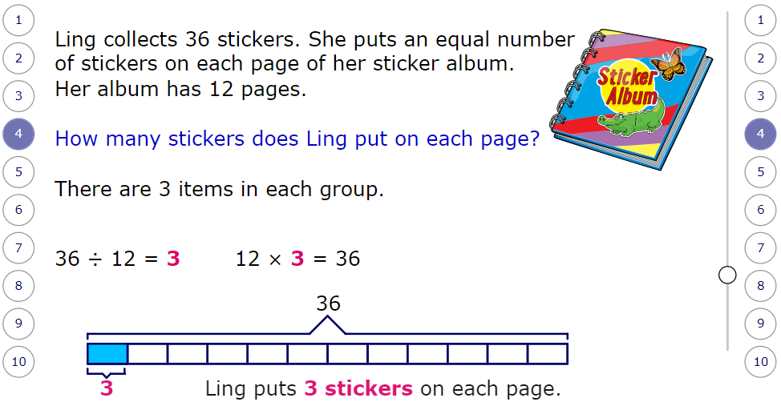

Slide 29
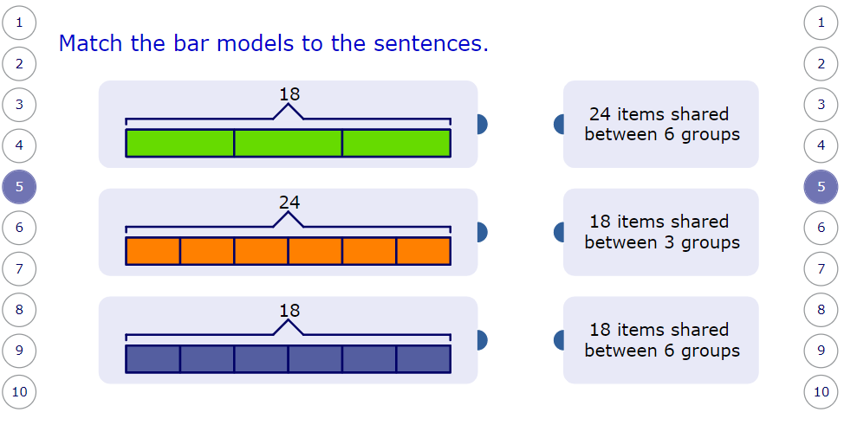

Slide 30
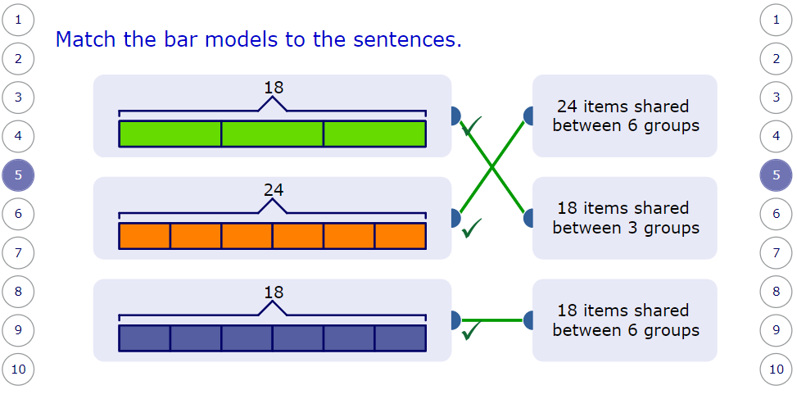

Slide 31
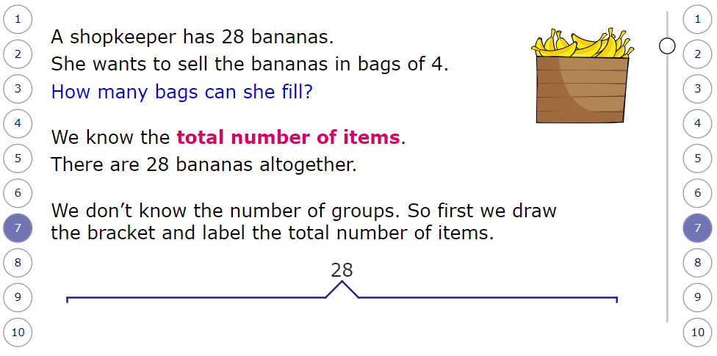

Slide 32
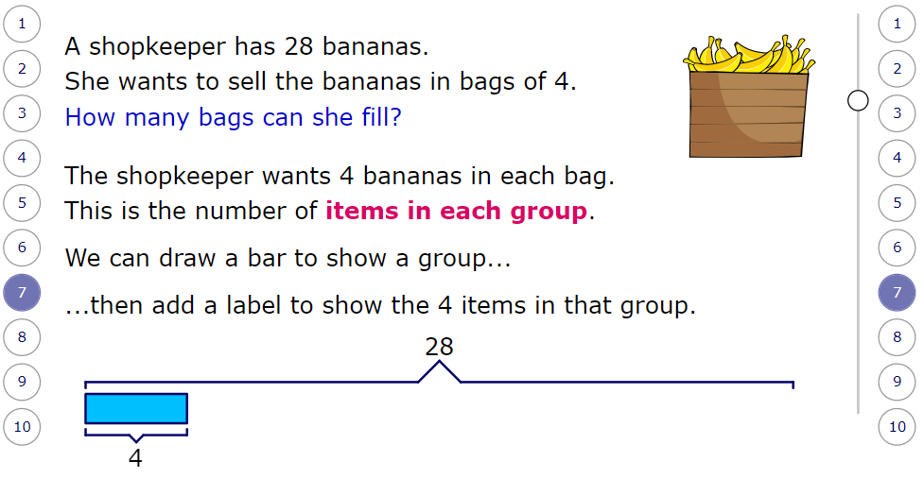

Slide 33
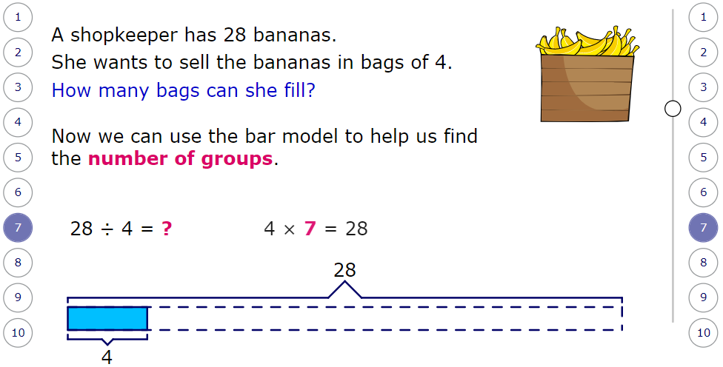

Slide 34
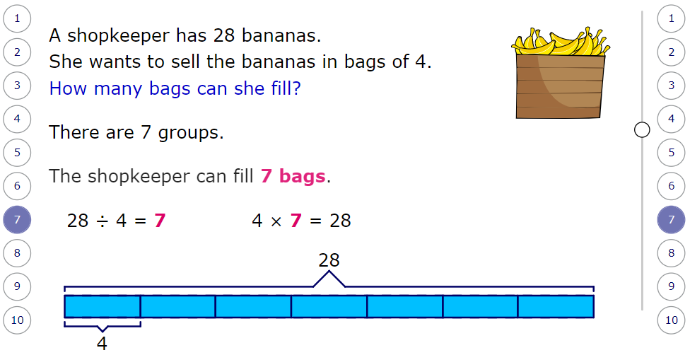

Slide 35

Time for a break.
Have a drink and a snack.

Slide 36
WALT to write a set of instructions.
I will include titles.
I will give a list of any equipment needed.
I will write them in the correct order.
I will number the instructions.
I will use short sentences.
I will use imperative verbs.
On the next slide there is a set of pictures that shows how to make a cheese toastie.
Talk about the pictures with an adult to make sure you understand what is happening.

Slide 37
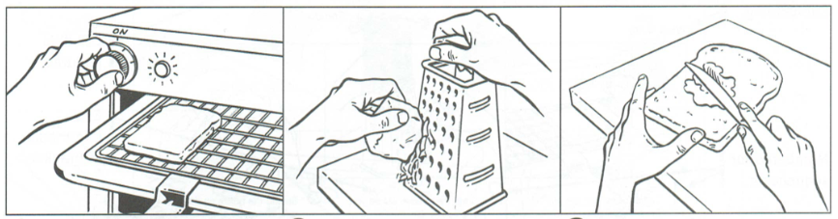
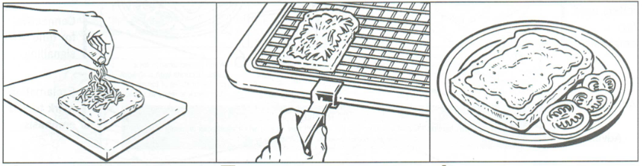

Slide 38
Useful vocabulary
Ingredients
switch
light
grill
toast
bread
grater
cheese
butter
knife
golden
tomato
sauce
warning
Imperative verbs you may use
switch
toast
grate
mind
spread
add
pile
make
cover
press
replace
arrange
decorate
serve

Slide 39

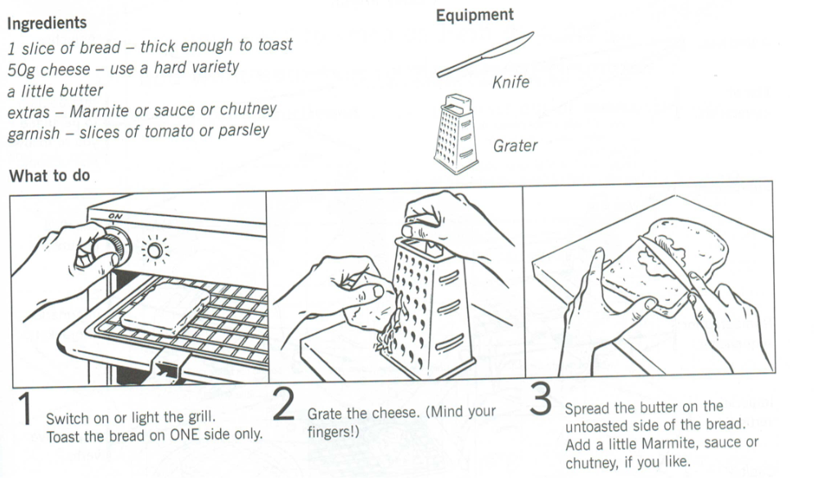
Here is an example:

Slide 40
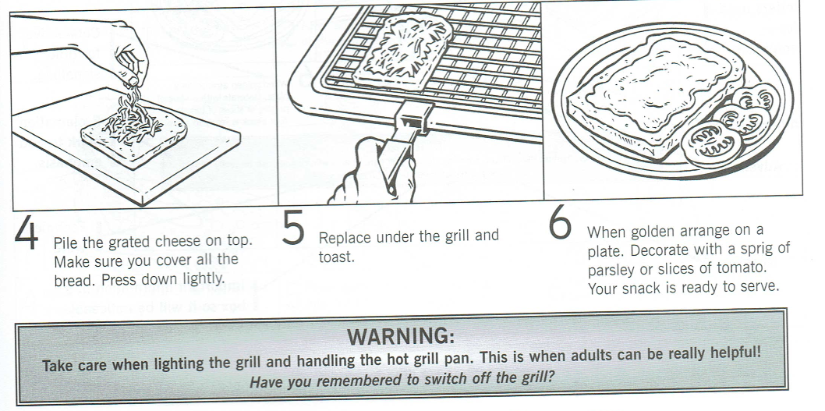

Slide 41

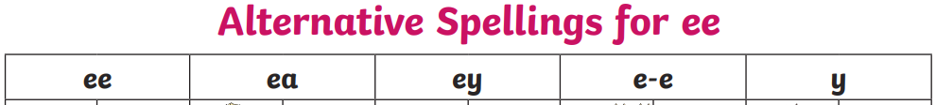
Spell words from the ‘ee’ sound family.
On the next slide you will see pictures to represent the words with an ‘ee’ sound in them. You should write the words trying to spell them accurately.
15 minute Spelling Activity

Slide 42
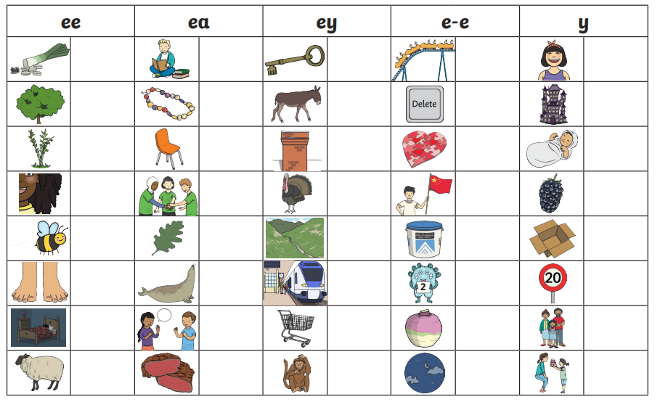

Slide 43
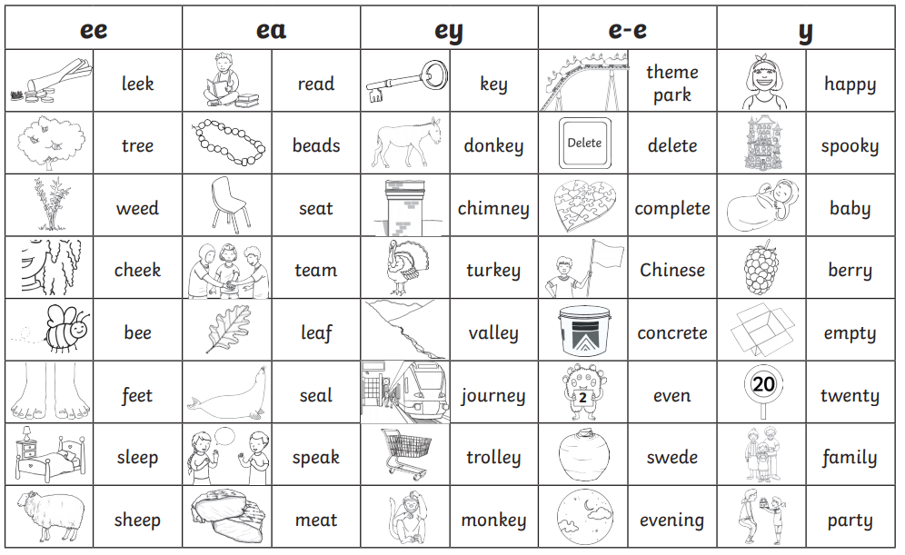

Slide 44


Your morning lessons are completed.
Time for lunch.
Then come back this afternoon for your curriculum activity.

Slide 45
PE

Slide 46
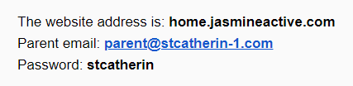
For today’s lesson you will need to Log onto Real PE with the details above. Follow the next slide to find the lesson.

Slide 47
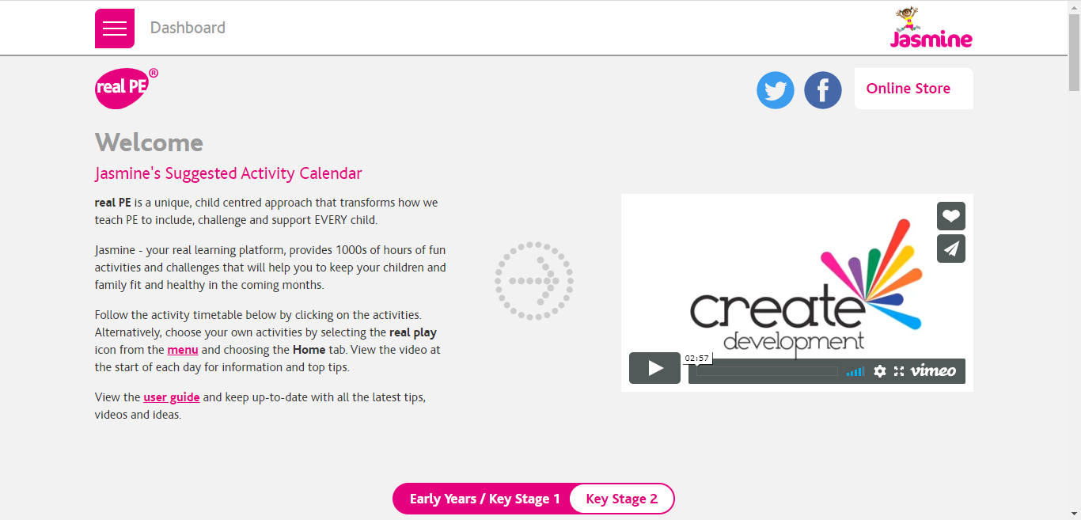
Once you have logged on, select ‘Key Stage 2’ and scroll down the page.

Slide 48
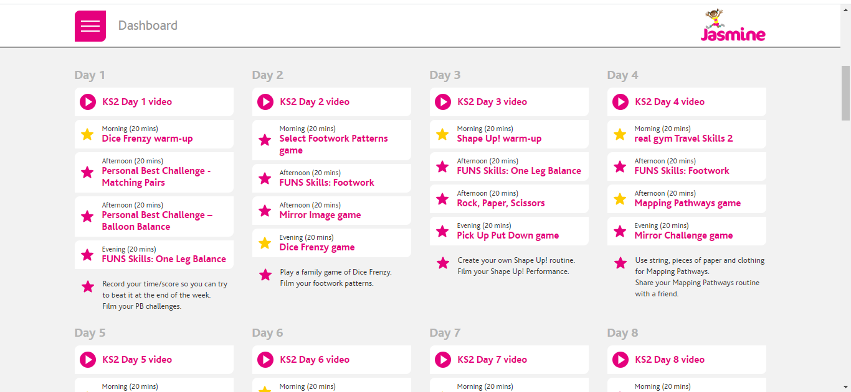
Click on the video for Day 4, and then follow the exercises below.

Slide 49
Well Done 3S and 3M!
Time for a well deserved weekend so enjoy yourselves and we will meet up with you again on Monday.

