Slide 1

Monday 6th July
We will begin our day with Morning Maths - just like in school! This should be 10 -15 minutes.
You can do these independently then share them with an adult.
Remember question 10 may have more than one answer.
Don’t worry about always finding the answer it is how you try to work out and reason that is important.

Slide 2


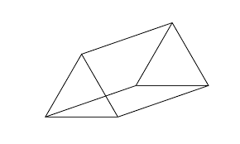
Morning Maths 06.07.20
8. A film started at 6:30 and ended at 8:10. How long is the film?
9. 401 ➗ 4
10. Always, sometimes,
never:
If a number is a multiple of 6 is must also be a multiple of 2 and 3.
Explain how you know this.
32 = 100 -
2. Which of these are NOT multiples of 8:
4, 32, 48, 50, 80,
3. Complete this
bar model.
4. 160 ➗ 8
5. Write 0.9 as a fraction
6. Write this time in another way:
7. How many vertices in this triangular
prism?
93
27

Slide 3
68
4,50
66
20
9/10 or 90/100
14.45
6
1 hour 45 minutes or 105 minutes
100.25
Always
As all the numbers in the 6 times tables feature in the 2 and 3 times table.

Slide 4

St Catherine’s Classroom Beliefs
Mistakes are valuable.
Everyone can learn maths to the highest level.
Questions are really important.
Depth is more important than speed.
Maths is about making connections.
We may not be learning together in the classroom, but it is important to still remember our classroom beliefs.

Slide 5
WALT: divide by 4.

Slide 6
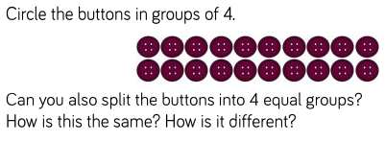

Slide 7

In a calculation, we would say we started with 20 buttons and divided them into 4 groups. We can see that there are 5 in each group.
20 ÷ 4 = 5

Slide 8
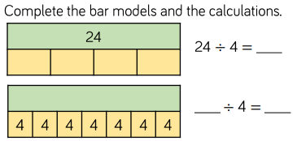

Slide 9
6
28
7

Slide 10
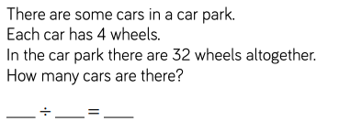

Slide 11
32
4
8

Slide 12
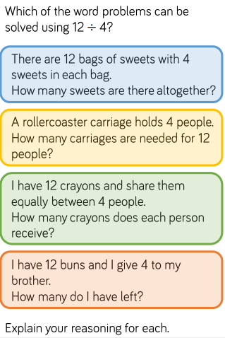

Slide 13
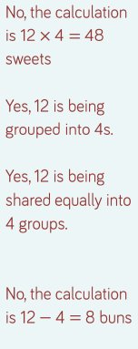

Slide 14
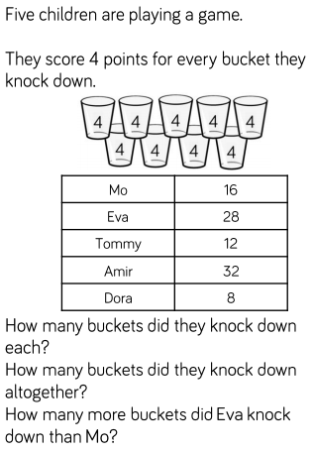

Slide 15
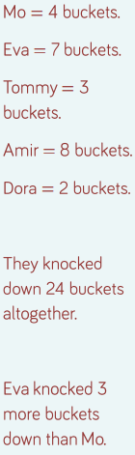

Slide 16

Time for a break.
Have a drink and a snack.

Slide 17
Our English task for today is a Close Reading Task
WALT: retrieve and infer information from a text.
Ask an adult to read the information (on the next page) to you.
Here are some meanings of words that might help you – kitchen hand - someone who works doing jobs for the cook/chef in the kitchen of a restaurant.
advantage - they asked him to do everything because he was willing even
though they should have done it themselves.
credit - they took the praise or the compliments for the good work
fluffy - light and doesn’t fill you up
3. Now read it with your adult twice, they can help you with expression.
4. Now read it twice by yourself.
5. Read the questions and look for evidence in the text to help you answer them.
6. Write your answers in full sentences.

Slide 18
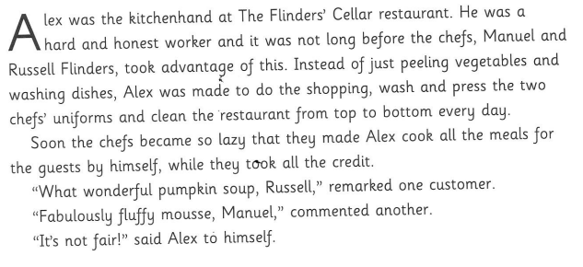

Slide 19
Task:
What qualities did Alex have that made the two chefs take advantage of him?
What were the extra tasks that they gave Alex to do?
Explain in as much detail as possible why Alex said “It’s not fair!”

Slide 20
Task:
What qualities did Alex have that made the two chefs take advantage of him?
The two qualities were that he was hard working and he was an honest person.
What were the extra tasks that they gave Alex to do?
The extra tasks they gave him were doing the shopping, washing and pressing the uniforms, cleaning the restaurant every day and cooking the meals.
Explain in as much detail as possible why Alex said “It’s not fair!”
He said this because he was asked to do too much extra and they didn’t thank him but instead took the credit for what he did. He probably thought he should have the praise for the delicious meals and the two chefs should have been honest and told the guests who had really cooked it.

Slide 21

Spell words from the ‘ee’ sound family.
On the next slide you will see pictures to represent the words with an ‘ee’ sound in them. You should write the words trying to spell them accurately.
Watch out for ie spellings with an ‘ee’ sound.
15 minute Spelling Activity

Slide 22
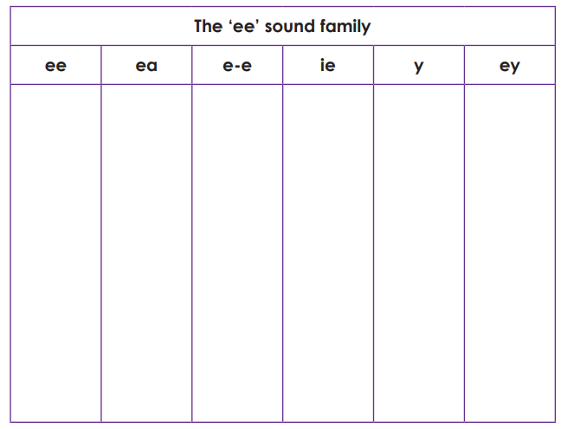
Copy the table into your book.
The ie spelling for the phoneme ‘ee’ is included here too.
Look at the pictures on the next slide and write the word for them in the correct column of the table.

Slide 23
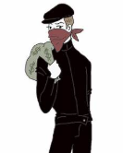

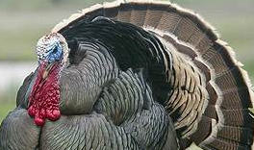

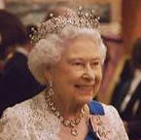
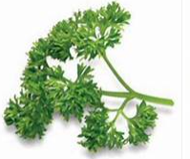
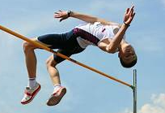

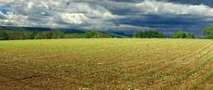
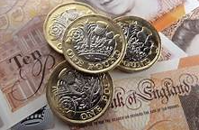
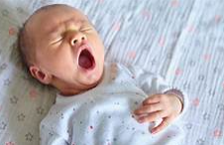
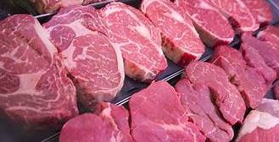

Slide 24
Answers.
The ‘ee’ sound family
ee | ea | e-e | ie | y | ey
feet queen sleeve | meat bleach | athlete | thief field | baby | turkey parsley money

Slide 25
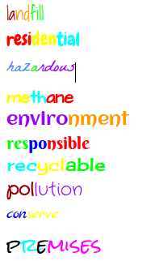
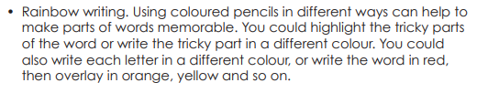
feet
queen
sleeve
meat
bleach
athlete
thief
field
baby
money
turkey
parsley
Rainbow write each
word 3 times.
We will be using these spellings in tomorrow’s lessons.

Slide 26


Your morning lessons are completed.
Time for lunch.
Then come back this afternoon for your curriculum activity.

Slide 27
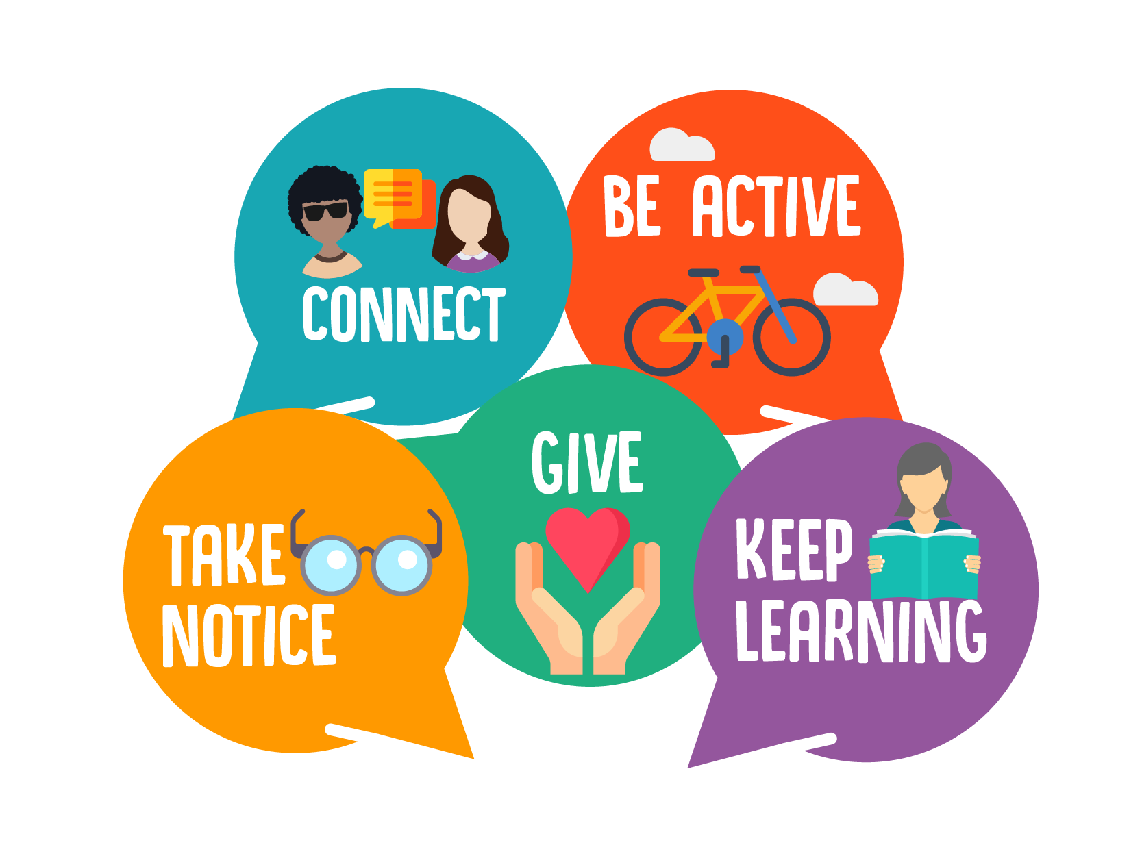
The five ways to wellbeing
Click on the link below to watch the clip.
https://www.youtube.com/watch?v=yF7Ou43Vj6c

Slide 28


How can connecting with others help your wellbeing?
One of the hardest things about being in Lockdown was not being able to see all of our family and our friends.
We have been able to spend more time with our immediate family who live in our home but we have missed others.
This tells us how important it is to connect with other people. When we see our family and friends we feel better inside.
Is there someone in your family or friendships that you still haven’t been able to see - a grandparent or an aunty or a school friend or your teacher.
Take a look at the next slides and think about some of the new things you might have been able to learn during lockdown - turn it into a poster about you, next time you see them or talk to them you can show them and tell them all about it.

Slide 29
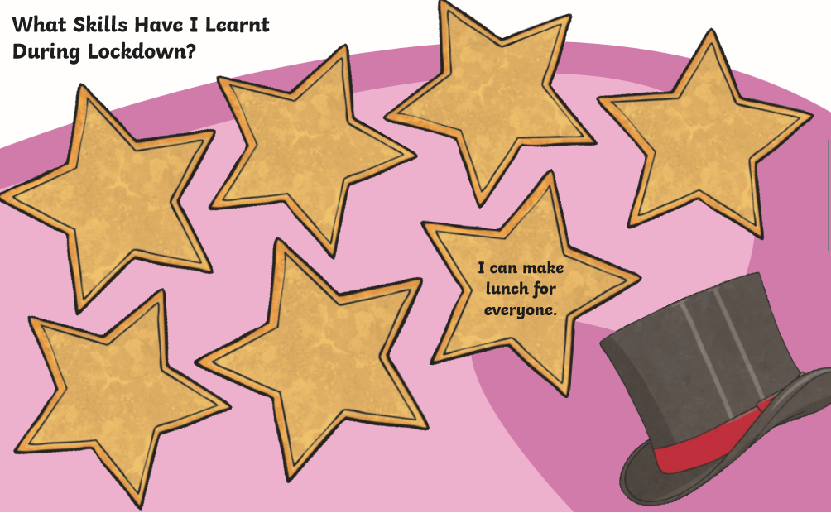

Slide 30
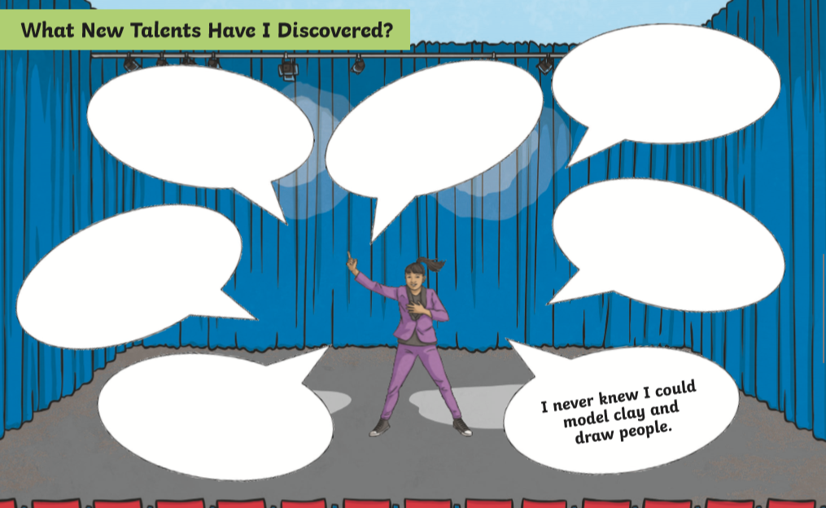

Slide 31
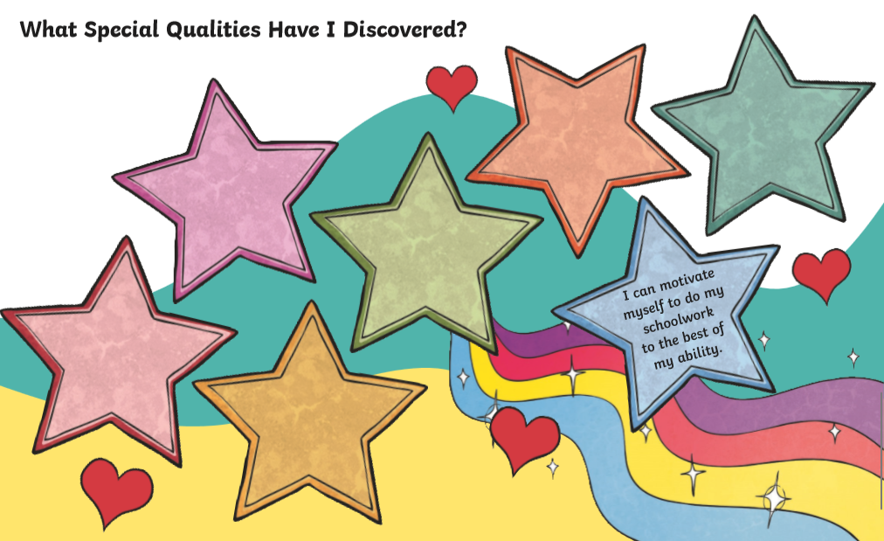

Slide 32

We hope your day went well.
See you tomorrow.

