Slide 1
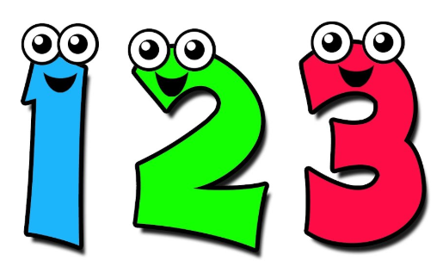
Tuesday 7th July
Ready to wake up your maths brains?
Remember you can do these independently then share them with an adult.
Question 10 may have more than one answer.
Don’t worry about always finding the answer it is how you try to work out and reason that is important.

Slide 2
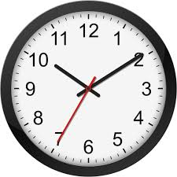
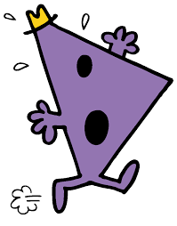

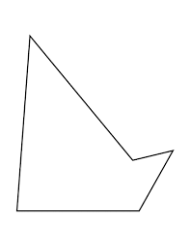

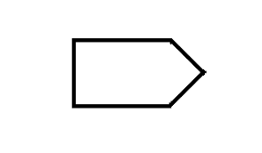

Morning Maths 07.07.20
7. I face South-West
then make a 1/2 anticlockwise turn.
What direction am I now facing?
8. What was the time
15 minutes before this?
9.Mr Rush travels 80km every
hour. Mr Happy lives 100km
away. How long will it take
Mr Rush to get to him?
10. I am a 3D shape. I have six faces, 12 edges and 8 vertices.
What am I?
How many threes in 24 ?
2. Write a calculation statement for this part-whole model:
3. 753 - 435
4. 32 x 8
5. 23cm 9 mm = . cm
6. Which of these pentagons has two right angles?
32
52
c
b
a

Slide 3
8
84
318
256
23.9cm
b
NE
9.55
1 hour 25 minutes
Cube or Cuboid

Slide 4

St Catherine’s Classroom Beliefs
Mistakes are valuable.
Everyone can learn maths to the highest level.
Questions are really important.
Depth is more important than speed.
Maths is about making connections.
We may not be learning together in the classroom, but it is important to still remember our classroom beliefs.

Slide 5
WALT: divide by 1 digit numbers.

Slide 6
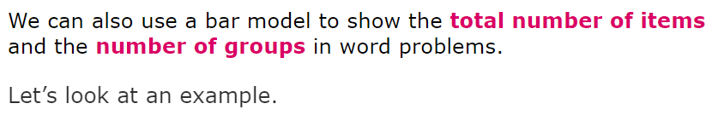
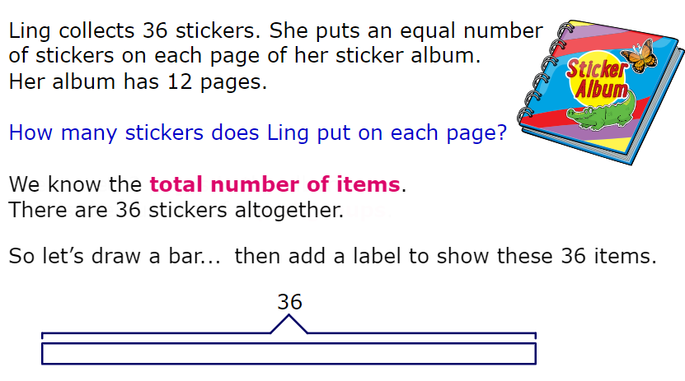

Slide 7
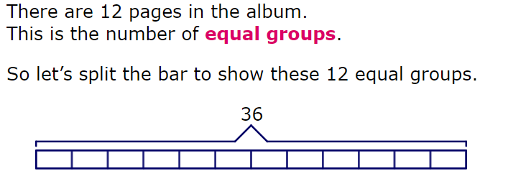


Slide 8
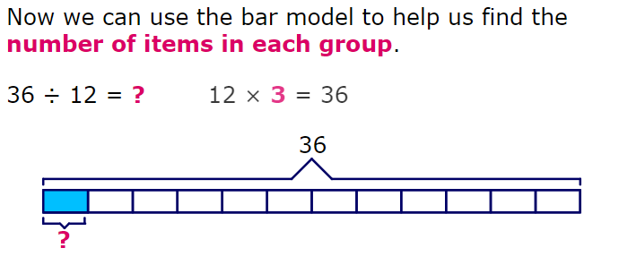
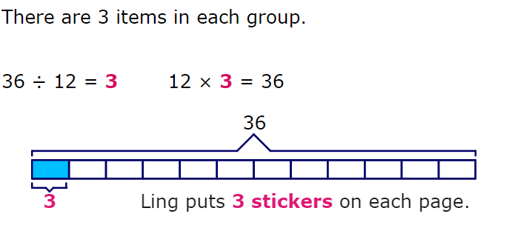

Slide 9
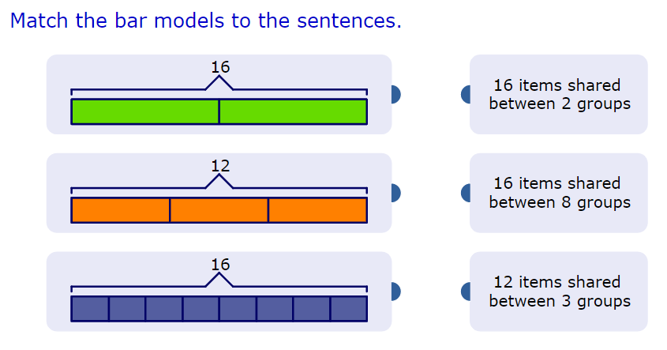

Slide 11
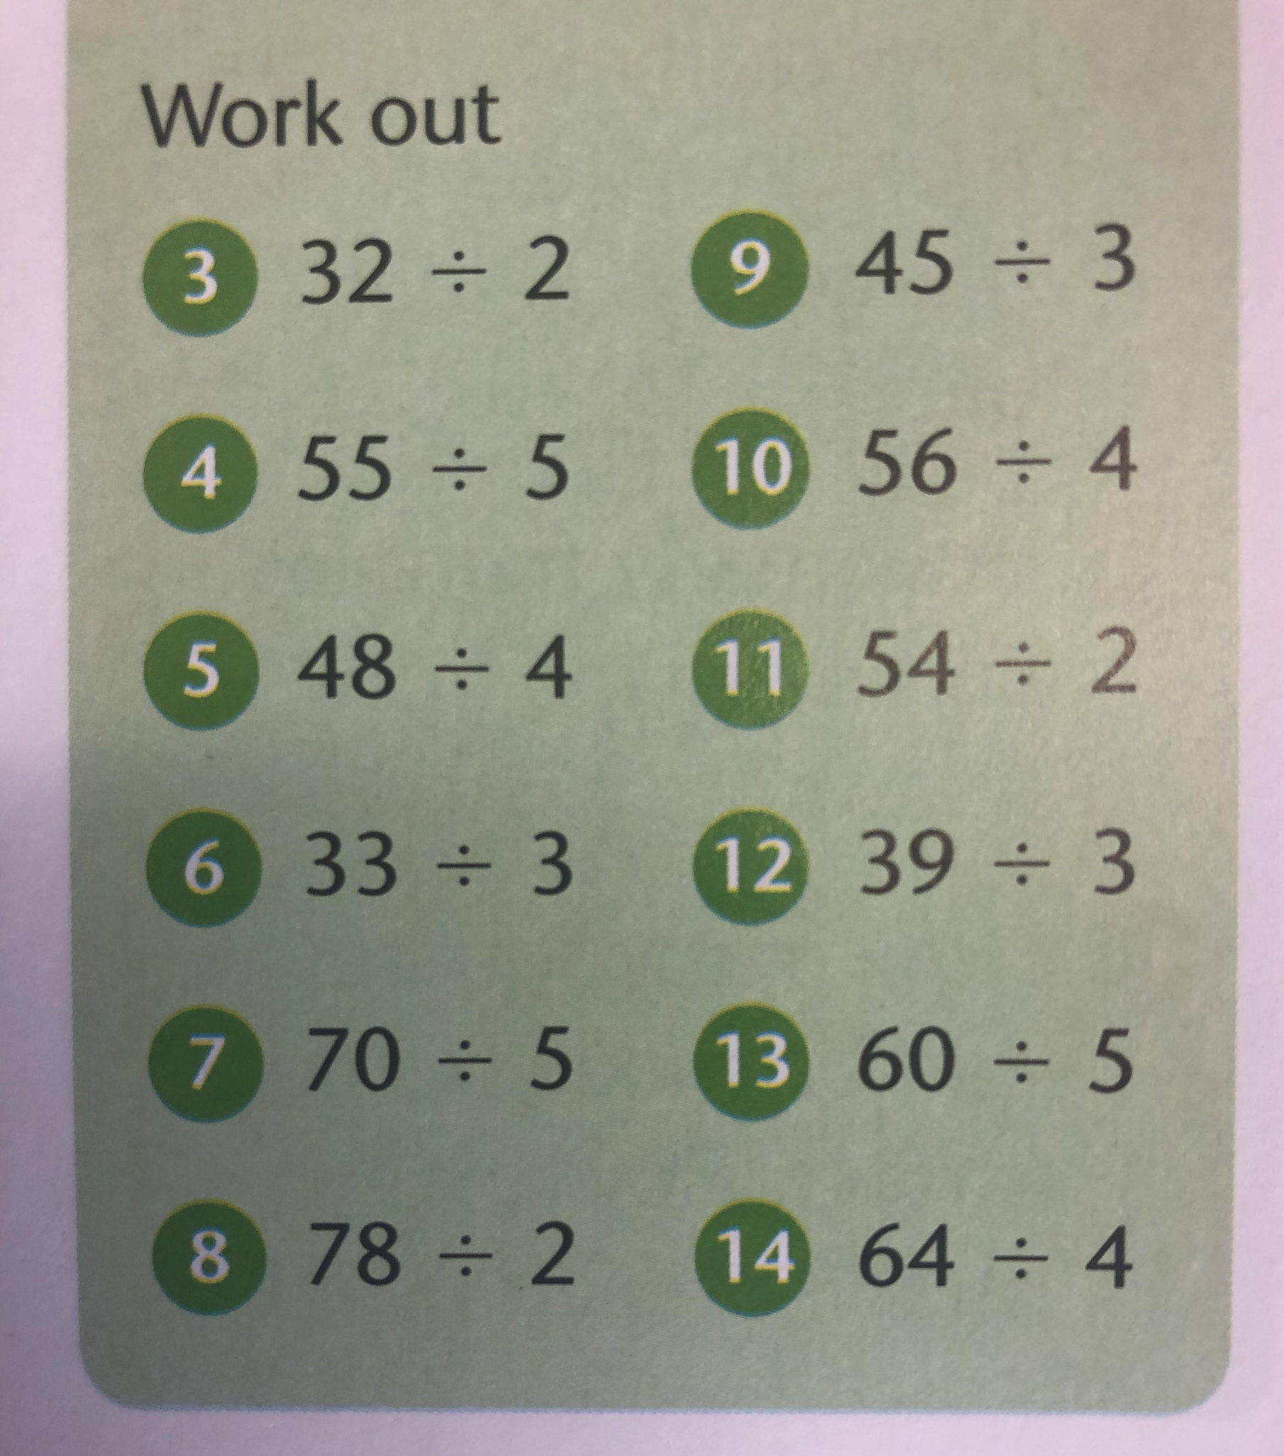

Slide 12
3) 16
4) 11
5) 12
6) 11
7) 14
8) 39
9) 15
10) 14
11) 27
12) 13
13) 12
14) 16

Slide 13

Time for a break.
Have a drink and a snack.

Slide 14
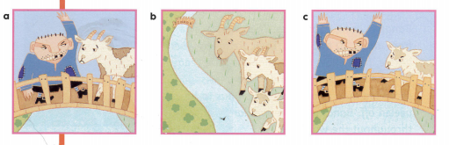
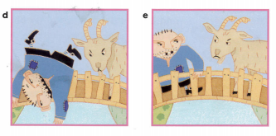
WALT: explore the structure of a traditional story.
These pictures tell the traditional story of the Three Billy Goats Gruff.
What is wrong with the story? Can you order it correctly?
The middle sized billy goat went across the bridge. “Don’t eat me, the next goat will make a bigger meal,” she said.
The three billy goats saw the beautiful green grass on the other side of the river.
The littlest billy goat went across the bridge. “Who is that trip trapping over my bridge?” roared the troll.
The largest billy goat went across the bridge. “I’m not going to be anyone’s dinner,” he said.
The largest billy goat quickly used his horns to butt the troll and he fell over the bridge.

Slide 15
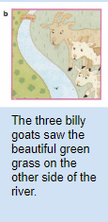
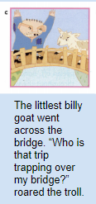
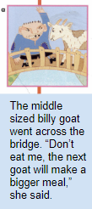
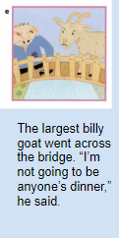
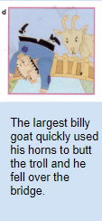
When you tell a traditional story, the narrative is always in the correct order. It has a clear beginning, middle and end.

Slide 16
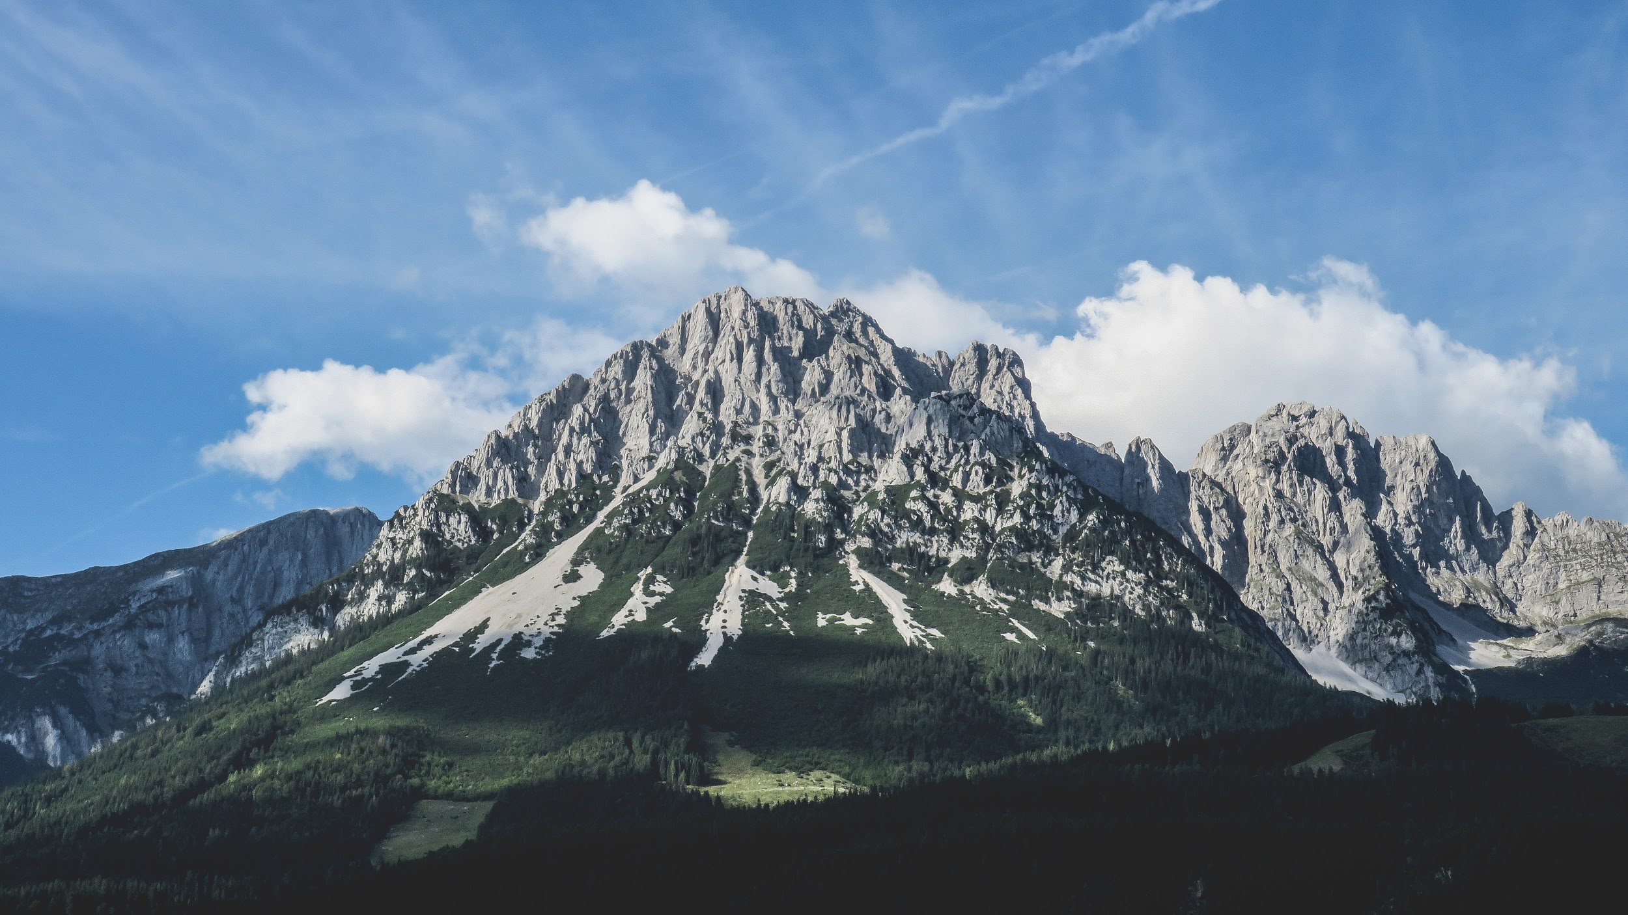
This is a story mountain.
We had been using these at school to plan a story.
Climax.
This is the most exciting part of the story.
Resolution.
The problem is solved.
Build Up.
The main character has a problem.
Opening.
Where is the story set?
Who is/are the main characters?
Conclusion.
In a traditional tale character from opening usually lives happily.

Slide 17
This is a story mountain for
The Three Billy Goats Gruff.
Climax.
The largest billy goat is about to be eaten by the hungry troll,who roars at him.
Resolution.
The largest billy goat uses his strong horns to push the troll over the bridge.
Build Up.
The goats have to cross the bridge to get to the other side but there is a troll living under the bridge.
Opening.
The family of three goats live in the fields by a river. There is a bridge across the river and the grass on the other side looks tasty.
Conclusion.
All three goats have safely crossed to the other side of the river and get a tasty meal of grass.

Slide 18
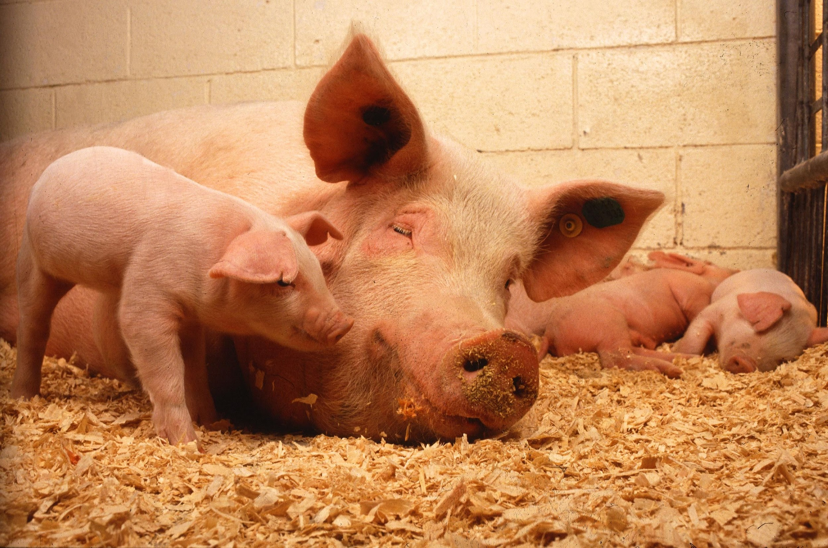
Click on the link and listen to the story of The three Little Pigs.
https://youtu.be/HtHjB6rRmQc
When you have heard the story complete a story mountain using the one on the next slide to help you.

Slide 19
This is a story mountain for
The Three Little Pigs.
Climax.
This is the most exciting part of the story.
Resolution.
The problem is solved.
Build Up.
The main character has a problem.
Opening.
Where is the story set?
Who is/are the main characters?
Conclusion.
In a traditional tale character from opening usually lives happily.

Slide 20
This is a story mountain for
The Three Little Pigs.
Climax.
The wolf has all three pigs trapped in the house of bricks. He can’t blow it down so he climbs the chimney.
Resolution.
They build a fire and put a big cooking pot on it. The wolf falls in the pot.
Build Up.
The mother warns them to be careful of the wolf who will eat them and they set off on a journey. They meet men selling straw, sticks and bricks.
Opening.
The mother pig is at home and she tells her three little pigs they need to go and build their own houses.
Conclusion.
The pigs have a safe home to live in.

Slide 21

Spell words from the ‘ee’ sound family.
Today we will practise the spellings from yesterday and use them in sentences.
15 minute Spelling Activity

Slide 22
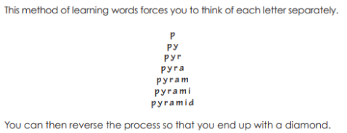
feet
queen
sleeve
meat
bleach
athlete
thief
field
baby
money
turkey
parsley
Now practise the spellings from yesterday using pyramid writing.

Slide 23
Use the spellings you have been practising to complete the sentences. Remember to spell the words accurately.
My mother stitched the _________ of my shirt.
She was frightened the _______ would return to steal more of her belongings.
________ is used to clean and kill germs.
I paid with my pocket ________ to see the _______ compete at the stadium.
The chef used __________ to garnish the potatoes that were served with my roast __________.
The ________ lives in Buckingham Palace which is in London.
The newborn _________ has incredibly small _______.
Carnivores are ________ eaters.
The sheep shelter around the edges of the ______ below the hedgerows.

Slide 24
Use the spellings you have been practising to complete the sentences. Remember to spell the words accurately.
My mother stitched the sleeve of my shirt.
She was frightened the thief would return to steal more of her belongings.
Bleach is used to clean and kill germs.
I paid with my pocket money to see the athlete compete at the stadium.
The chef used parsley to garnish the potatoes that were served with my roast turkey.
The queen lives in Buckingham Palace which is in London.
The newborn baby has incredibly small feet.
Carnivores are meat eaters.
The sheep shelter around the edges of the field below the hedgerows.

Slide 25

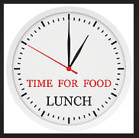
Your morning lessons are completed.
Time for lunch.
Then come back this afternoon for your curriculum activity.

Slide 26

The five ways to wellbeing

Slide 27


How can being active help your well being?
Try the go noodle activities on the next slide to get you active.

Slide 28
Be Active
Go Noodle
https://app.gonoodle.com/activities/the-pirate-life?s=Channel&t=Moose%20Tube&sid=18&cs=moose-tube
https://app.gonoodle.com/activities/peanut-butter-in-a-cup?s=Channel&t=Moose%20Tube&sid=18&cs=moose-tube

Slide 29
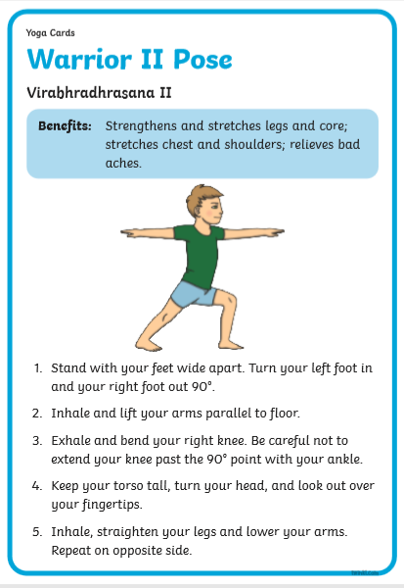
Now try some yoga moves that as well as being active help you to strengthen and calm your mind.

Slide 30
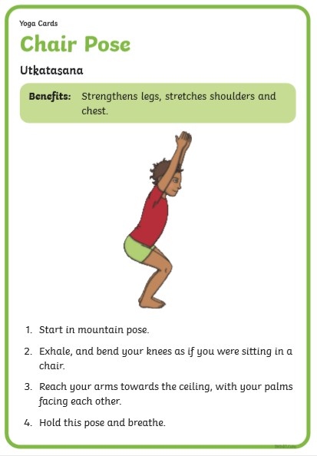
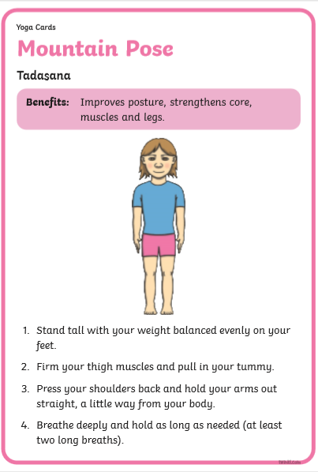

Slide 31
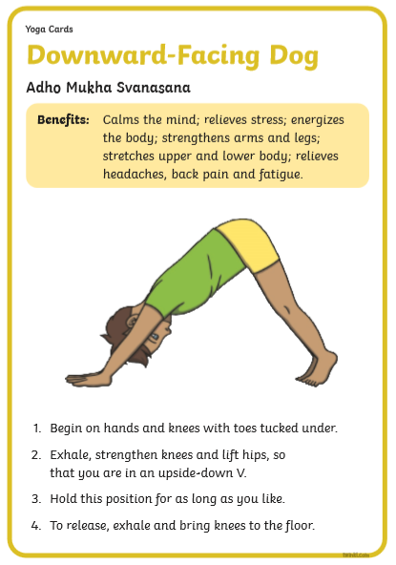
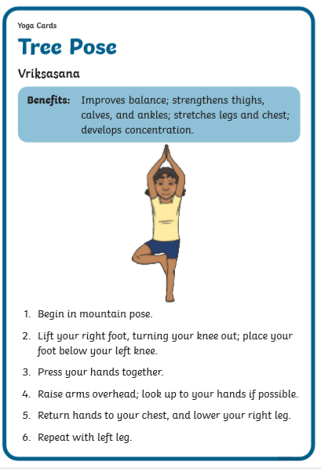

Slide 32

We hope you had fun today.
See you tomorrow.

