Slide 1

Wednesday 08.07.20
Ready to crunch some numbers?
Remember you can do these independently then share them with an adult.
Question 10 may have more than one answer.
Don’t worry about always finding the answer it is how you try to work out and reason that is important.

Slide 2
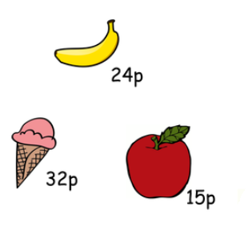

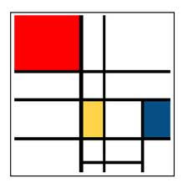
Morning Maths 08.07.20
8. How much change
from £1?
9. Draw two perpendicular lines. Both should be 4.5 cm long.
10. Are there more pairs of perpendicular lines or pairs of parallel lines in this picture?
Put these in ascending order:
180, 118, 108, 810, 801, 811, 881
2. 1m - 46cm
3. I’m thinking of a number. If I halve it, I get 27. What is my number?
4. ➗ 8 = 7
5. Half of 130
6. How many right angles in the
inside of this shape?
7. 155 + 645

Slide 3
108,118,180,801,810,811,881
54
54
56
65
2
800
29p
You should be able to count at least 11 sets of perpendicular lines and at least 6 sets of parallel lines. Remember, perpendicular lines meet at a right angle and parallel lines never meet and are the same distance apart.

Slide 4

St Catherine’s Classroom Beliefs
Mistakes are valuable.
Everyone can learn maths to the highest level.
Questions are really important.
Depth is more important than speed.
Maths is about making connections.
We may not be learning together in the classroom, but it is important to still remember our classroom beliefs.

Slide 5
WALT: divide by one digit numbers

Slide 6
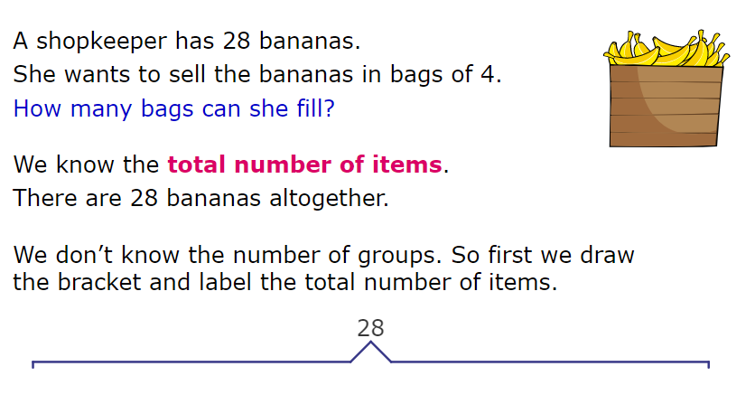

Slide 7
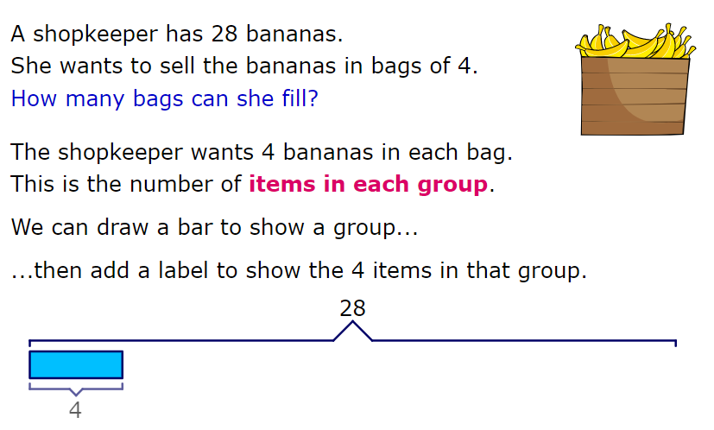

Slide 8
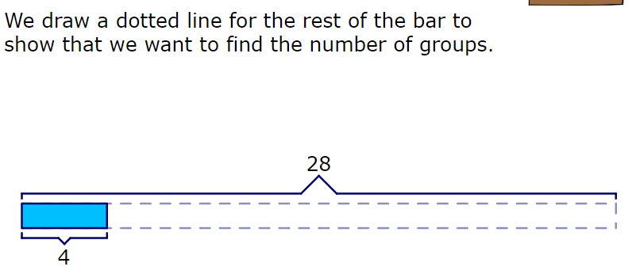
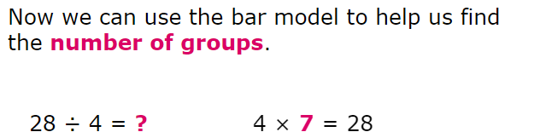

Slide 9
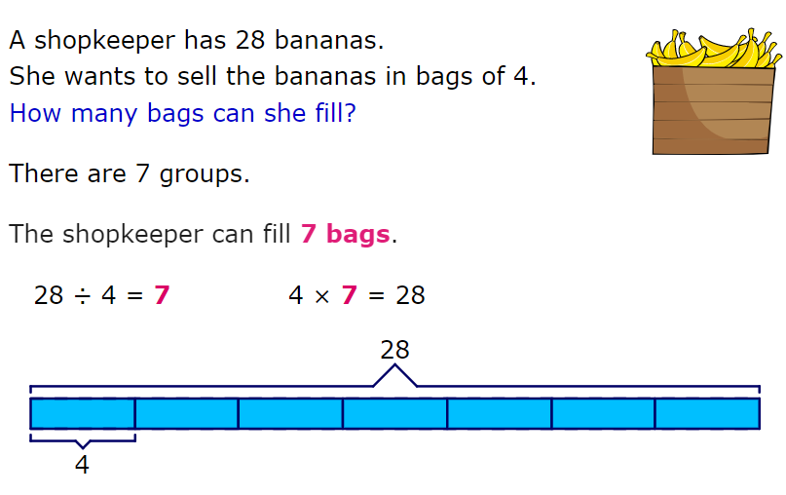

Slide 10
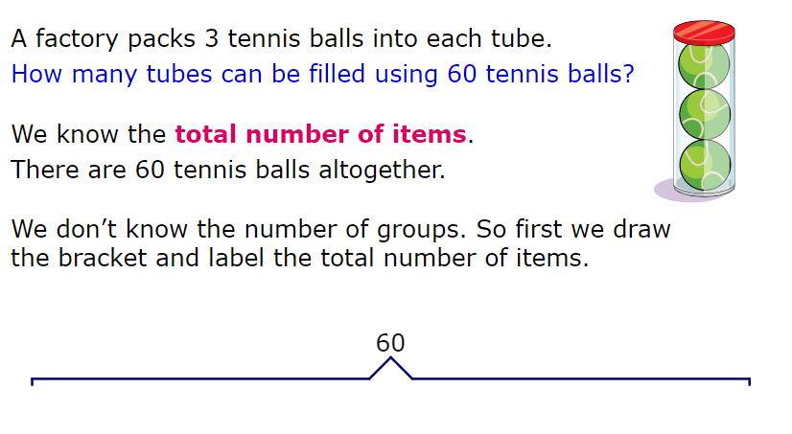

Slide 11
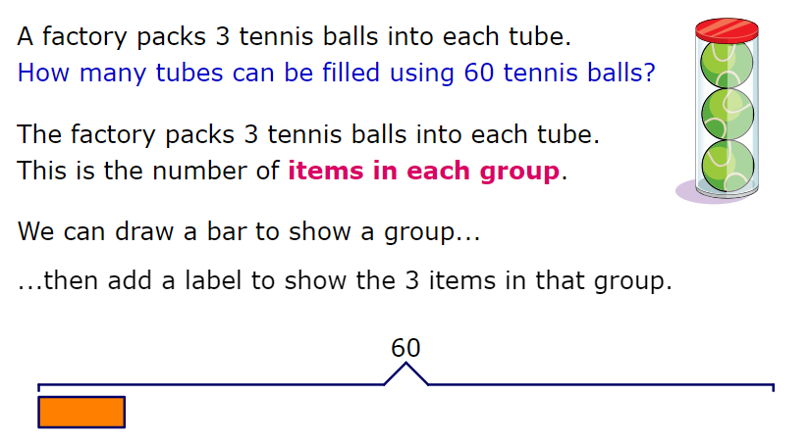
3

Slide 12
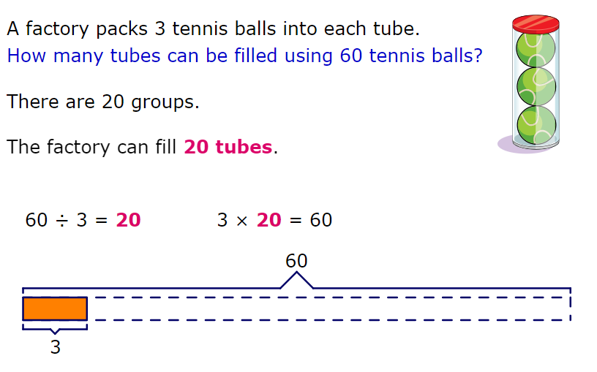

Slide 13
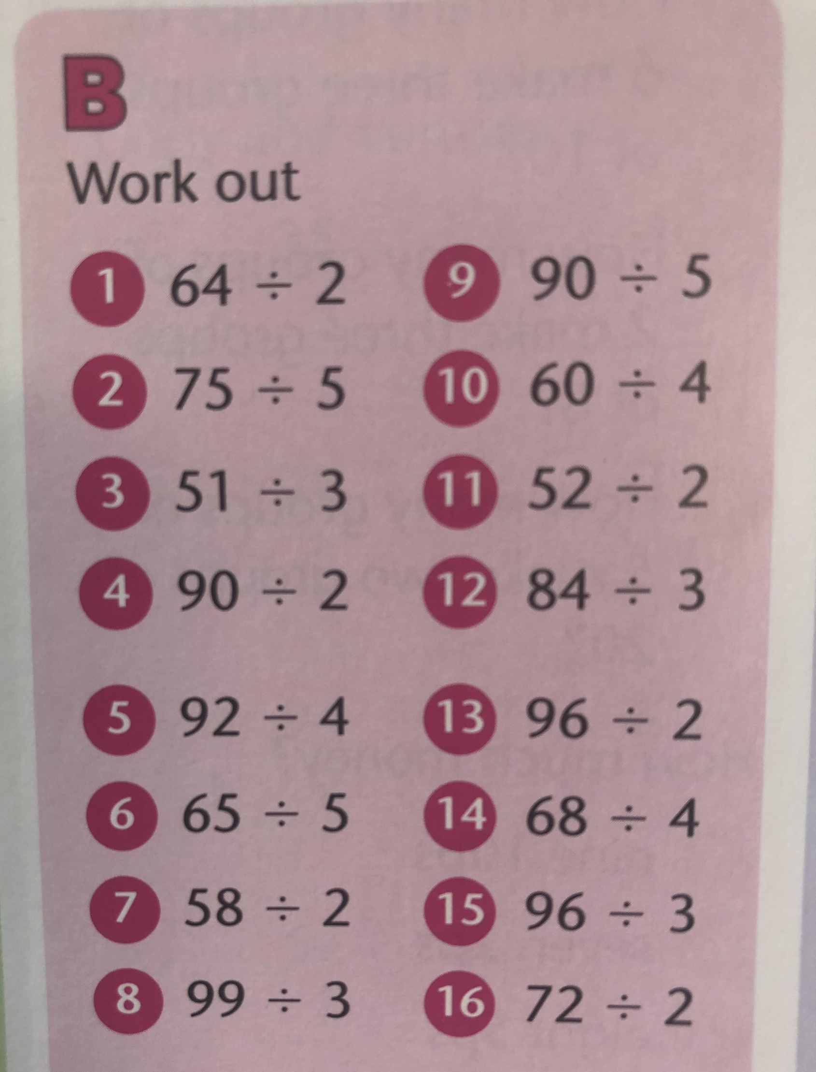

Slide 14
32
15
17
45
23
13
29
33
18
15
26
28
48
17
32
36

Slide 15

Time for a break.
Have a drink and a snack.

Slide 16
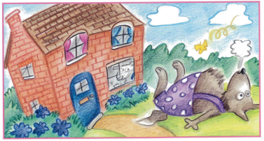
WALT: explore the structure of a traditional story and think about what belongs in the opening and the middle of the story.
Which story do you think this picture comes from?
Look carefully at the picture.
I have tried to trick you!

Slide 17
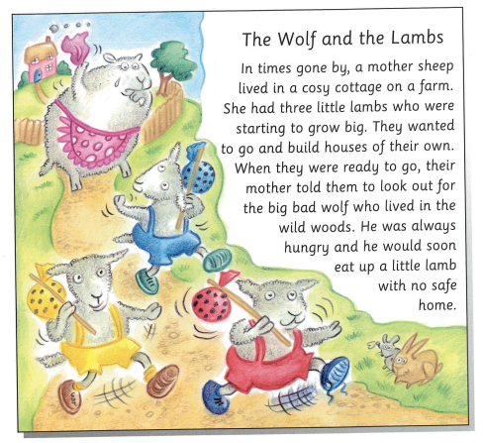
This is the beginning of the story.
It contains the opening and the build up.
Read the text and answer these questions.
What is the opening phrase?
Who are the characters in this part of the story?
Where does this part of the story take place?
What is the problem in the story?

Slide 18
This is the beginning of the story.
It contains the opening and the build up.
Read the text and answer these questions.
The opening phrase is ‘In times gone by’
The characters are the mother and the three lambs. The wolf is not yet in the story, he is just talked about.
The setting for the story is a cosy cottage on a farm.
The problem is the big Bad Wolf because their mother warns them that he would eat them.

Slide 19
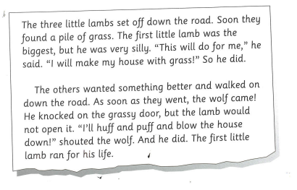
We will now look at the middle of the story. This is the first part of the middle. This piece of text is about the first lamb and the wolf.
Read the text and answer the questions.
What two things did the first lamb say?
What did the wolf say?
How many little lambs are left to set off down the road?

Slide 20
What two things did the first lamb say?
“This will do for me,” and “I will make my house with grass!”
What did the wolf say? “I’ll huff and I’ll puff and blow the house down!”
How many little lambs are left to set off down the road?
There were two little lambs left.

Slide 21
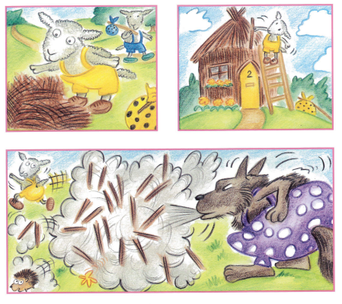
These are the pictures that tell the second part of middle of the story.
Use them to complete the text. You might also want to look back at the last slide to help you with the pattern of the story.
Here are some words to help you but you will need to do some of the spaces yourself!
sticks thoughtful two wooden second middle-sized third sprinted better
The ______ little lambs set off down the road. Soon they found a heap of ________. The ________ little lamb was the _____________ one, and he was more_________. ______________________ he said. ______________________ So he did.
The _____ little lamb wanted something ________ and skipped on down the road. As soon as he went, the wolf came! He knocked on the _______ door, but the lamb would not open it. ___________________
growled the wolf. And he did. The second little lamb_____ for his life.

Slide 22
Here are some words to help you but you will need to do some of the spaces yourself!
sticks thoughtful two wooden second middle-sized third sprinted better
The two little lambs set off down the road. Soon they found a heap of sticks. The second little lamb was the middle-sized one, and he was more thoughtful. “This will do for me,” he said. “I will make my house with grass!” So he did.
The second little lamb wanted something better and skipped on down the road. As soon as he went, the wolf came! He knocked on the wooden door, but the lamb would not open it. “I’ll huff and I’ll puff and blow the house down!” growled the wolf. And he did. The second little lamb sprinted for his life.

Slide 23
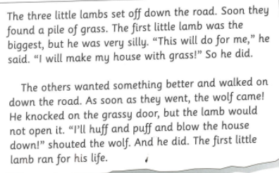
Read these two parts of the middle of the story again.
Can you spot what is the same and what is different?
The two little lambs set off down the road. Soon they found a heap of sticks. The second little lamb was the middle-sized one, and he was more thoughtful. “This will do for me,” he said. “I will make my house with grass!” So he did.
The second little lamb wanted something better and skipped on down the road. As soon as he went, the wolf came! He knocked on the wooden door, but the lamb would not open it. “I’ll huff and I’ll puff and blow the house down!” growled the wolf. And he did. The second little lamb sprinted for his life.

Slide 24
This is the picture that tells the last part of the middle of the story.
Use the repetitive patterns from the story to write it yourself.
Now share it with an adult.

Slide 25

The sound spelt ‘ou’
Look at the pictures on the next slide and match them to the spellings.
What sound is represented by the letters ‘ou’?
15 minute Spelling Activity

Slide 26

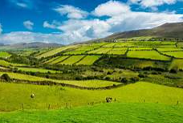
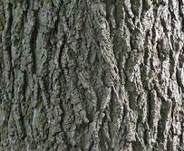
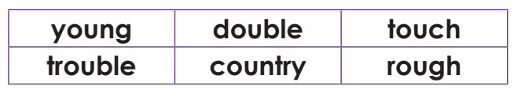
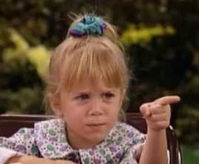
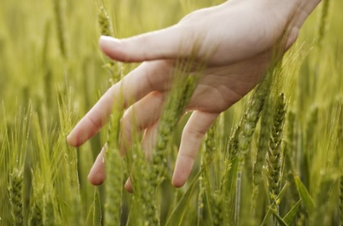
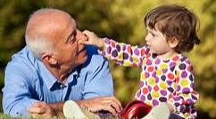

Slide 28
Say the words again. The ou letters represent the short vowel sound ‘u’.
Look at the word.
Say the word.
Cover the word.
Try spelling the word without looking at it.
Now check to see if you were correct.

Slide 29
Which one looks right?
Write out the sentences with the correct spelling in them.
The farmer lived in the cuntry / country / cuntree.
He walked carefully as the ground was ruff / rouf / rough.
Half of twenty is ten because double /doubull / dubble ten is twenty.
He was too yung /young / yuong to remember who the singer was that his Grandma listened to.
The boy rarely chose to do the right thing so he often got into trubble / troubul / trouble at school.
Jenny was moving house but she promised to keep in tuche / touch / touche with her friends.

Slide 30
Which one looks right?
Write out the sentences with the correct spelling in them.
The farmer lived in the country.
He walked carefully as the ground was rough.
Half of twenty is ten because double ten is twenty.
He was too young to remember who the singer was that his Grandma listened to.
The boy rarely chose to do the right thing so he often got into trouble at school.
Jenny was moving house but she promised to keep in touch with her friends.

Slide 31


Your morning lessons are completed.
Time for lunch.
Then come back this afternoon for your curriculum activity.

Slide 32

The five ways to wellbeing

Slide 33


How can learning new things help your wellbeing?
This afternoon we would like you to learn something new.
Choose an activity from the next slide.

Slide 34

Log into linguascope and learn to count to 10 in French or German. Or choose something new to learn in Spanish.
Find out about one of these famous people.
Mother Teresa
Ludwig Beethoven
Eddy Merckx
Elvis Presley
Research one of these countries - What is it like there?
Denmark
Netherlands
Canada
Or choose one of your own.
Learn to draw something new:
Lilo from Lilo and Stitch https://youtu.be/_g4vy7H8bdoething
A soccer player
https://youtu.be/TvxUlbslGVo
Or choose something of your own.

Slide 35
Did you have a good day learning today?
See you in the morning.

