Slide 1
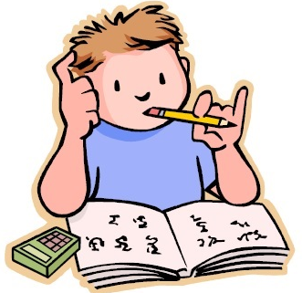
Thursday 9th July
Is your head ready to calculate?
Remember you can do these independently then share them with an adult.
Question 10 may have more than one answer.
Don’t worry about always finding the answer it is how you try to work out and reason that is important.

Slide 2
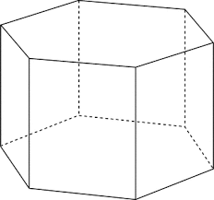
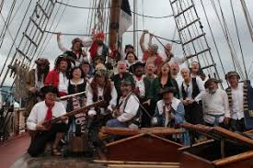
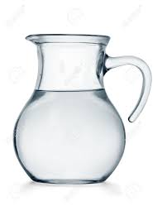
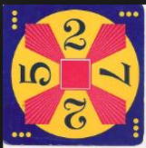
Morning Maths 09.07.20
8. Fill in the gaps:
9. Captain Jack needs 4 men to fire each of his cannons and 8 men to unfurl the sails on each mast. His ship has 3 masts and 12 cannons. He will also need a powder monkey, a chef, a boatswain, quartermaster, a cabin boy and a first mate. How many men will he need?
10. Make 24 using
each number only
once and any of
the operators (+, -, x, ➗)
How many days in three weeks?
2. How many faces on this shape?
3. Double 47
4. 73 x 3
5. Insert the correct symbol (<,>,=)
0.2 ¾
6. How many legs on 7
octopuses?
7. There is 1litre and 500ml in a
jug. If I pour half of it out,
how much is left?
160
200
280

Slide 3
21
8
94
219
<
56
750ml
120,240
4x12 = 48, 8x3 = 24
48+24=72
72+6=78
2x7=14, 2x5=10
14+10=24

Slide 4

St Catherine’s Classroom Beliefs
Mistakes are valuable.
Everyone can learn maths to the highest level.
Questions are really important.
Depth is more important than speed.
Maths is about making connections.
We may not be learning together in the classroom, but it is important to still remember our classroom beliefs.

Slide 5
WALT: practice division calculations
Today we are going to test our speed when solving division problems. We are going to play a game!

Slide 6
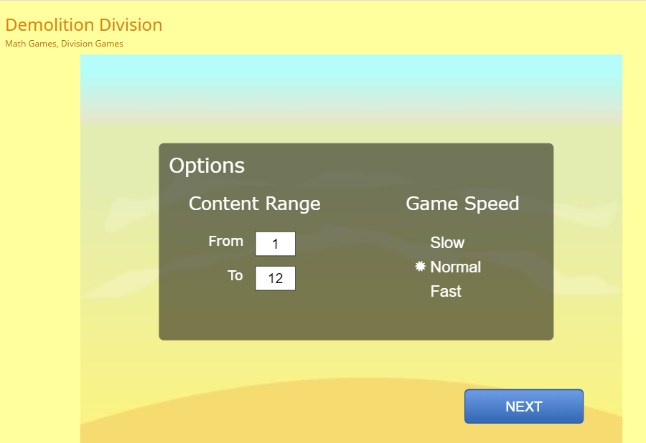
https://www.arcademics.com/games/demolition
If you are not confident with your times tables, you can change the range of times tables and slow the speed of the questions down.
If you are not confident with your times tables, you can change the range of times tables and slow the speed of the questions down.

Slide 7

Time for a break.
Have a drink and a snack.

Slide 8
WALT: explore the structure of a traditional story and think about what belongs at the end of the story.
As you know from the story mountain the ending of a story is split into two parts the resolution and the conclusion.

Slide 9
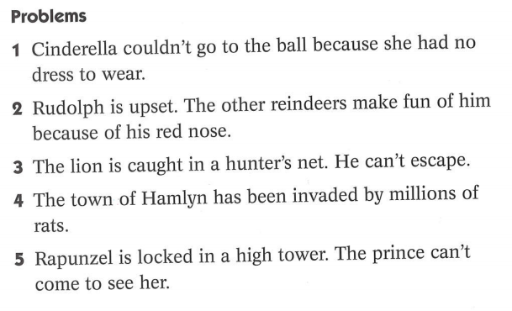
We already know that the problem in a story is usually introduced during the beginning of a story in the build up.
The problem usually gets solved in the ending of the story. This part of the story is called the resolution.
These are the problems in 5 well known stories.
Do you know how the problems are solved or resolved in the stories?

Slide 10
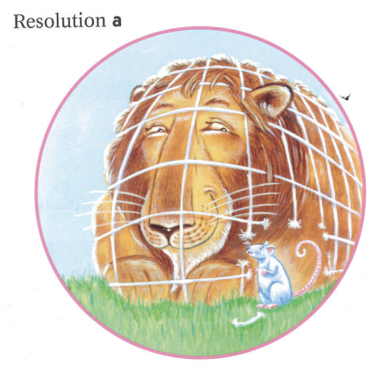
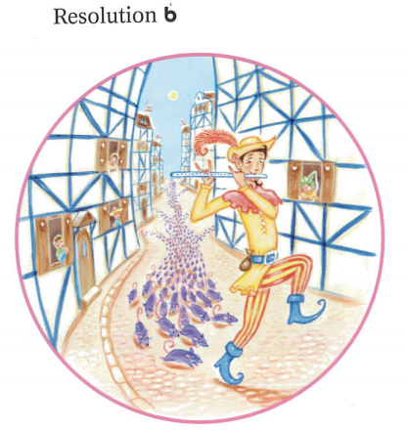
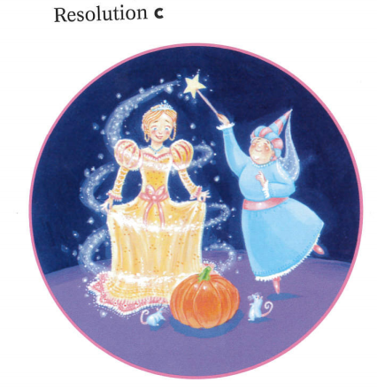
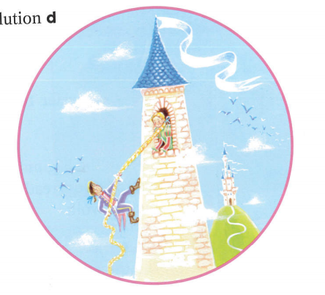
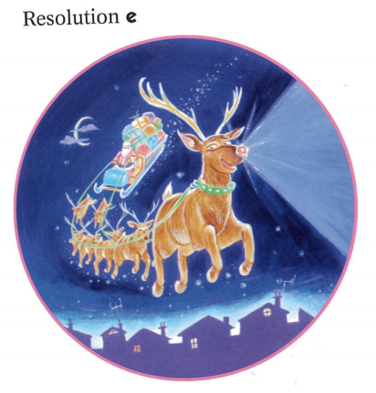
Problem | Resolution
1
2
3
4
5

Slide 11
Problem | Resolution
1 | c
2 | e
3 | a
4 | b
5 | d

Slide 12
The ending of a story has two parts, one is the resolution BUT THIS IS NOT THE END BECAUSE the final part of the story is the conclusion. This is usually a happy ending in a traditional tale or a fairy tale and it usually links back to the story opening.
Build up | Ending
Problem | Resolution | Conclusion
The billy goats want to get to the other side of the river but the dangerous troll lives under the bridge. | The largest billy goat uses his horns to butt the troll from the bridge. | The family of billy goats are all reunited. They have crossed the bridge safely. They can now eat the tasty grass on the other side of the meadow.All the family are contented.
Now try completing the table on the next slide.

Slide 13
Problem | Resolution | Conclusion
Rudolph is upset. The other reindeers make fun of him because of his red nose.
The lion is caught in the hunters net. He can’t escape.
The town of Hamlyn has been invaded by millions of rats.
Cinderella couldn’t go to the ball because she had dress to wear.

Slide 14
Problem | Resolution | Conclusion
Rudolph is upset. The other reindeers make fun of him because of his red nose. | Santa asks Rudolph to lead the sleigh. | The other reinders stop teasing Rudolph and he gets a special job. He does the job well because of his lit up nose.
The lion is caught in the hunters net. He can’t escape. | The little mouse gnaws the net to free the lion. | The mouse has repaid the lion for letting him go free and the lion realises that even though the mouse is small he can do great things.
The town of Hamlyn has been invaded by millions of rats. | The piper plays his pipe and takes the rats away. | The town is free of rats and the people are able to live happily in their town without them stealing the food.
Cinderella couldn’t go to the ball because she had no dress to wear. | The fairy godmother uses magic to give her a dress. | Cinderella goes to the ball and has a wonderful time. The prince falls in love with her.

Slide 15
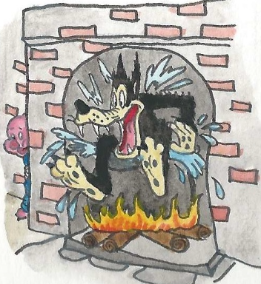
The Wolf and the Three Little Lambs.
Complete the table yourself and then use it to write the end of the story from yesterday.
The share your story ending with an adult.
Build up | Ending
Problem | Resolution | Conclusion
The wolf wants to eat the three little lambs so he climbs down the chimney of the house of bricks.

Slide 16

The sound spelt ‘ou’
Look at the 24 words on the next slide. The letters ou represent the ‘u’ sound.
Can you sort the words into word families?
15 minute Spelling Activity

Slide 17
couple
country
courage
cousin
cousins
double
tough
trouble
roughly
touching
touches
young
younger
youngest
couples
countries
nourishment
encourage
doubling
enough
nourish
rough
southern
touch

Slide 18
Family 1 | couple | couples
Family 2 | country | countries
Family 3 | cousin | cousins
Family 4 | touch | touches | touching
Family 5 | young | younger | youngest
Family 6 | courage | encourage
Family 7 | rough | roughly
Family 8 | nourish | nourishment
Family 9 | double | doubling
Family 10 | enough
Family 11 | southern
Family 12 | tough
Family 13 | trouble
Can you see how new words have been made by adding a suffix or prefix?

Slide 19
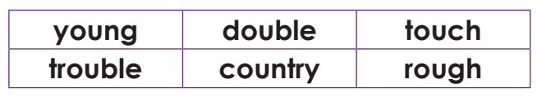
Choose a word from the box above to complete the sentence. You will need to add a suffix at the end of the word.
__________ ,the ogre pushed Jack down the beanstalk.
The competition was won by the ____________ and smallest competitor.
In maths we practised the skill of __________ and halving.
She was gently __________ the dog to calm him.
“What is _________ you?” she asked kindly.
There are many ____________ in Europe.

Slide 20
Choose a word from the box above to complete the sentence. You will need to add a suffix at the end of the word.
Roughly ,the ogre pushed Jack down the beanstalk.
The competition was won by the youngest and smallest competitor.
In maths we practised the skill of doubling and halving.
She was gently touching the dog to calm him.
“What is troubling you?” she asked kindly.
There are many countries in Europe.
Did you remember all the rules for adding the suffixes?

Slide 21


Your morning lessons are completed.
Time for lunch.
Then come back this afternoon for your curriculum activity.

Slide 22

The five ways to wellbeing

Slide 23


How can giving help your well being?
While you have been at home your adults have been helping you complete your workpacks, as well as all the other things they do for you, like cooking your meals, washing your clothes , taking you out on your bikes, changing your beds etc
Today you can do something to show you are grateful and appreciate them.
You can either make a Thank You card or poster for them, or print out a mindfulness colouring Thank You to colour for them. Remember to say Thank You too!

Slide 24
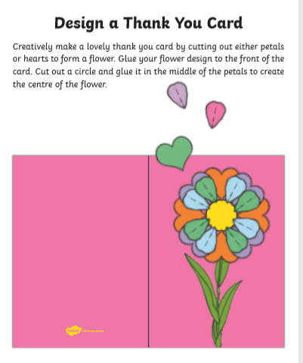
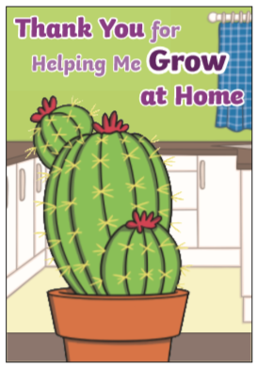

Copy one of these ideas or design one of your own.

Slide 25


Slide 26


Slide 27
Did you work hard with your learning today?
See you in the morning.

