Slide 1
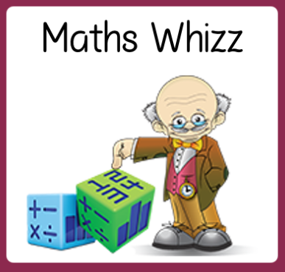
Friday 10th July
Are you a maths whizz today?
Remember you can do these independently then share them with an adult.
Question 10 may have more than one answer.
Don’t worry about always finding the answer it is how you try to work out and reason that is important.

Slide 2
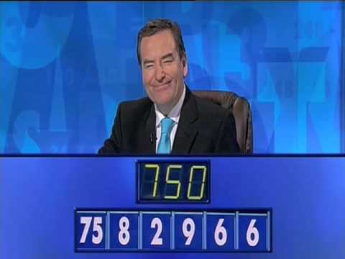
Morning Maths 10.07.20
7. 342+ 311
8. Which of these numbers is the odd one out?
50 57 55
9. I am thinking of a number between 30 and 60. If I divide it by 8, I have a remainder of 2. If I divide it by 5 I also have 2 left over. What is my number?
10.
74 + 11
2. 8 x 20
3. Insert the correct symbol ( <,> , =)
64 ➗ 8 20 ➗ 4
4. Which two fractions are equivalent?
5. What is the subtraction statement
6. Complete the missing months above
1
3
1
2
8
1
2
1
4
564
199
Jan
Feb
April
June

Slide 3
85
160
>
2/8 and 1/4
564-199=365
March and May.
653
57 as it is not a multiple of 5.
multiples of 8 = 32, 40, 48, 56 - add remainder of 2 = 34, 42, 50, 58
multiples of 5 = 35, 40, 45, 50, 55, - add remainder of 2 = 37, 42, 47, 52, 57
6÷6=1, 9-1=8, 8+2=10,10x75 = 750

Slide 4

St Catherine’s Classroom Beliefs
Mistakes are valuable.
Everyone can learn maths to the highest level.
Questions are really important.
Depth is more important than speed.
Maths is about making connections.
We may not be learning together in the classroom, but it is important to still remember our classroom beliefs.

Slide 5
WALT: solve problems involving times tables.

Slide 6
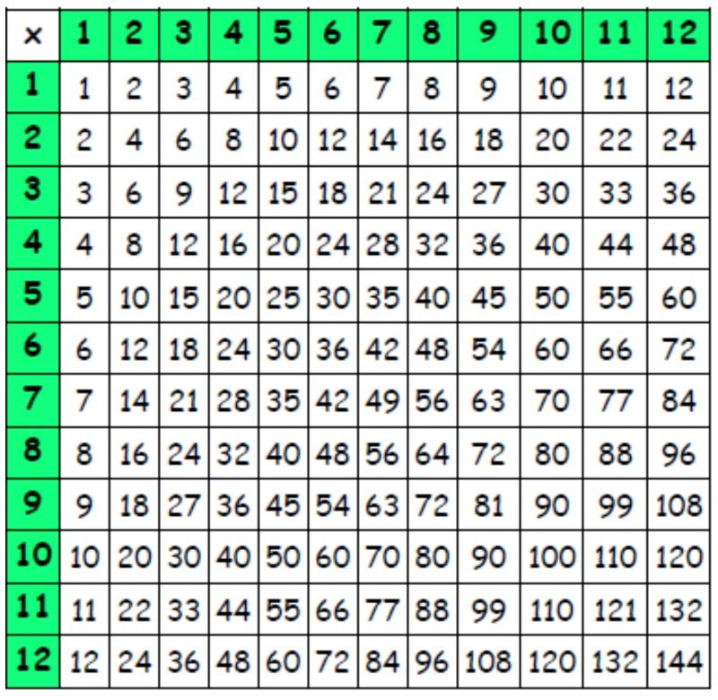
A multiplication grid works by multiplying a number from the top row with a number from the first column. The answer is written where the two numbers meet.
Look at the blue boxes to show the example of
4 x 3 = 12

Slide 7
x | 2 | 3 | 4 | 5 | 6
2
3
4
5
6
Using what you now know about multiplication grids, fill in the table.

Slide 8
x | 2 | 3 | 4 | 5 | 6
2 | 4 | 6 | 8 | 10 | 12
3 | 6 | 9 | 12 | 15 | 18
4 | 8 | 12 | 16 | 20 | 24
5 | 10 | 15 | 20 | 25 | 30
6 | 12 | 18 | 24 | 30 | 36

Slide 9
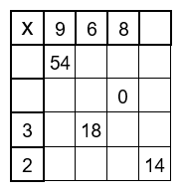

Slide 10
7
6
36
48
42
0
0
0
0
27
24
21
18
12
16

Slide 11

Time for a break.
Have a drink and a snack.

Slide 12
The Ugly Duckling - Comprehension:
WALT: retrieve information from fiction texts and make inferences.
Read the story on the next slides then answer the questions about the narrative.

Slide 13
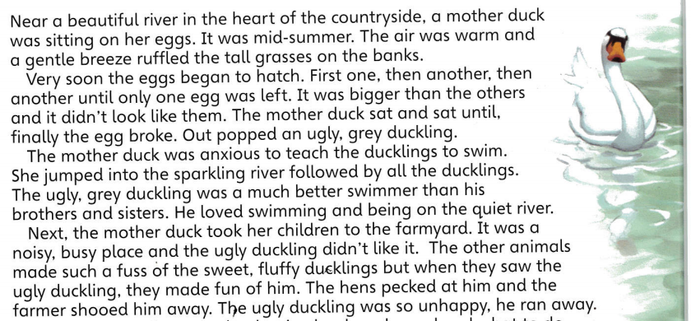
The Ugly Duckling

Slide 14
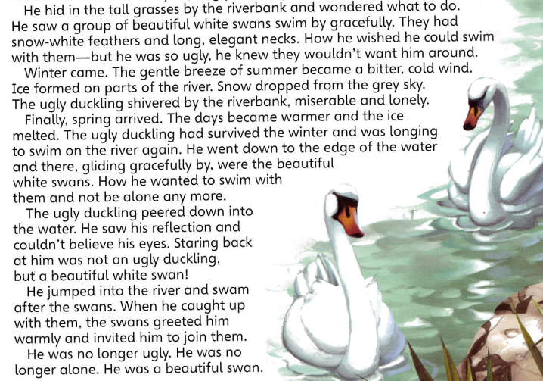

Slide 15
Understanding the text.
What season was it at the beginning of the story?
How was the last egg to hatch different to the others?
What did the mother duck want to teach her ducklings?
Who did the ugly duckling want to swim with?
What did his reflection tell him about himself?
Looking at the Language
Find and copy the words in the passage that mean the same as
a.) at last
b.) lots going on
c.) unhappy
Find a word in the passage that means the opposite of
a.) short
b.) beautiful
c.) worse
d.) clumsily
e.) colder
f.) froze
Explain what it means when it says the ugly duckling ‘couldn’t believe his eyes’.

Slide 16
Exploring the text.
9. This part of the story is set in three different places. What are the three settings?
10. Find the adjectives (describing words) in the passage which describe
a.) the river
b.) the ducklings
c.) the swans
11. How was the river different to the farmyard?
12. What was the wind like in the summer and how was it different in the winter?
13. Why do you think the ugly duckling hid in the tall grasses?
14. How do you think the ugly duckling felt when he was in the farmyard and then when he looked at his reflection?

Slide 17
Understanding the text.
What season was it at the beginning of the story?
The season at the beginning of the story was mid-summer.
How was the last egg to hatch different to the others?
The last egg was bigger than all the others.
What did the mother duck want to teach her ducklings?
The mother duck wanted to teach her ducklings to swim.
Who did the ugly duckling want to swim with?
The ugly duckling wanted to swim with the swans.
What did his reflection tell him about himself?
His reflection told him that he was no longer an ugly duckling but instead he was a beautiful white swan.

Slide 18
Looking at the Language
6. Find and copy the words in the passage that mean the same as
a.) at last - finally
b.) lots going on - busy
c.) unhappy - miserable
7. Find a word in the passage that means the opposite of
a.) short - tall
b.) beautiful - ugly
c.) worse - better
d.) clumsily - gliding gracefully
e.) colder - warmer
f.) froze - melted
8. Explain what it means when it says the ugly duckling ‘couldn’t believe his eyes’.
This means he had seen his reflection and it had taken him by surprise because he was not an ugly duckling he had changed to become a beautiful swan and he hadn’t realised this.

Slide 19
Exploring the text.
9. This part of the story is set in three different places. What are the three settings?
The river bank, the farmyard and the river - all are in the countryside.
10. Find the adjectives (describing words) in the passage which describe
a.) the river - beautiful, sparkling,
b.) the ducklings - sweet, fluffy
c.) the swans - beautiful, elegant,
11. How was the river different to the farmyard?
The river was quiet and not so busy.
12. What was the wind like in the summer and how was it different in the winter?
The wind was a gentle breeze in the summer but it became a bitter cold wind in the winter.
13. Why do you think the ugly duckling hid in the tall grasses?
I think he hid in the tall grasses because he was miserable, he wanted to escape from those that teased him and he didn’t know where else to go because he felt like he didn’t belong anywhere. He probably felt safer on his own hidden from view.
14. How do you think the ugly duckling felt when he was in the farmyard and then when he looked at his reflection?
I think the ugly duckling felt uncomfortable in the farmyard because he didn’t belong their he was not with anyone who looked liked him, he felt different. I think he would have been overjoyed to see his reflection particularly as he had seen the swans and admired them, he would have been glad he belonged with them and finally had somewhere he would fit.

Slide 20

The sound spelt ‘ou’
Today you have a domino game to make and play.
15 minute Spelling Activity

Slide 21
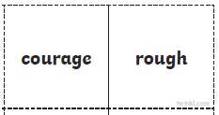
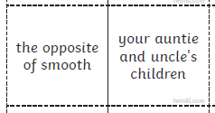
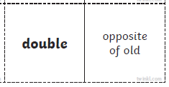
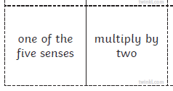
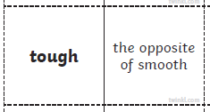
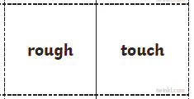
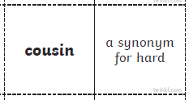
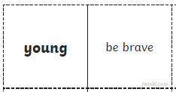
1. Print out this slide.
2. Cut out the dominoes or copy them to make your own.
3. Match up the clues to the correct spelling words.
4. Make a rectangular shape. like on the next slide, to end up back where you started.

Slide 22
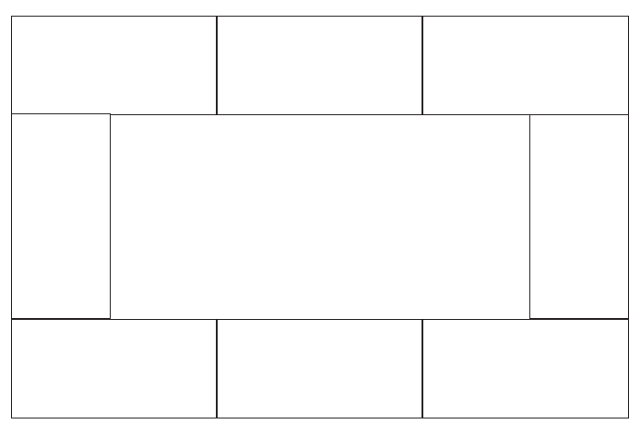

Slide 24


Your morning lessons are completed.
Time for lunch.
Then come back this afternoon for your curriculum activity.

Slide 25

The five ways to wellbeing

Slide 26

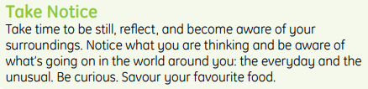
How can taking notice in your daily life help your wellbeing?
Try the activities from on the next three slides. You could ask an adult or a brother or sister to join in with you.
Then finish off with some meditation.

Slide 27
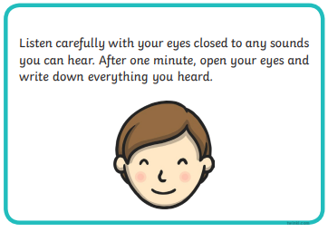
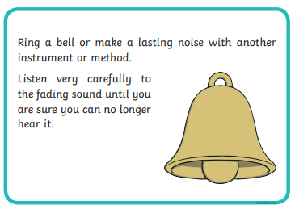
Hearing and listening.

Slide 28
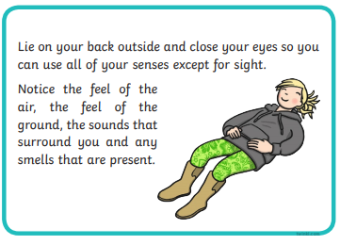
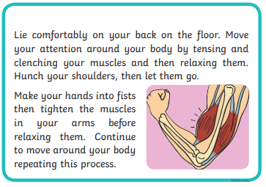
Using your senses.

Slide 29
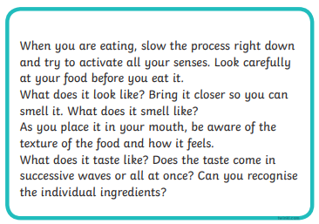
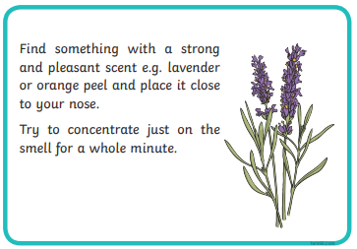
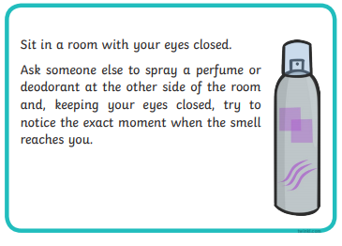
Smell and taste.

Slide 30
Take notice - meditation
https://app.gonoodle.com/activities/bring-it-down?s=Channel&t=Flow&sid=23&cs=flow
https://app.gonoodle.com/activities/melting?s=Channel&t=Flow&sid=23&cs=flow

Slide 31
Well Done 3S and 3M!
Time for a well deserved weekend so enjoy yourselves and we will meet up with you again on Monday.

