Slide 1

Monday 13th July
We will begin our day with Morning Maths - just like in school! This should be 10 -15 minutes.
You can do these independently then share them with an adult.
Remember question 10 may have more than one answer.
Don’t worry about always finding the answer it is how you try to work out and reason that is important.

Slide 2


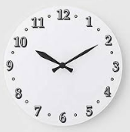




Morning Maths 13.07.20
7. What is another way of writing this
time?
8. How much longer until half past 10?
9. If I 5x8=40 what else do I know? (remember to think about division as well).
10.
56+199
2. 28x3=
3. What fraction is shaded?
4. 48÷8=
5. 6m 31cm = m cm
6. Dollie has a birthday party and buys gifts to go into the party bags. She buy 6 of each, how much change from £5?

Slide 3
255
84
6/8 or 3/4
6
631cm
£3.32
16.15
20 minutes
8x5=40, 40÷5=8, 40÷8=5
.
75x4=300, 6x5=30, 300-30=270, 10-3=7, 270+7=277

Slide 4

St Catherine’s Classroom Beliefs
Mistakes are valuable.
Everyone can learn maths to the highest level.
Questions are really important.
Depth is more important than speed.
Maths is about making connections.
We may not be learning together in the classroom, but it is important to still remember our classroom beliefs.

Slide 5
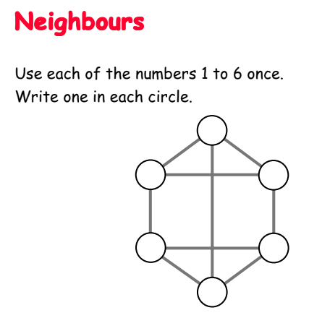
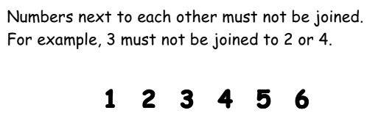

Slide 6
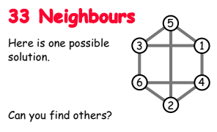

Slide 7

Time for a break.
Have a drink and a snack.

Slide 8
The Story of Alex.
WALT: retrieve information from fiction texts and make inferences.
Do you remember the close read you did last Monday?
Read it again on the next slide 1.
It is the opening to The Story of Alex.
Then today you are going to read the build up slide 2 of the story then answer the questions about if for your Close read.

Slide 9
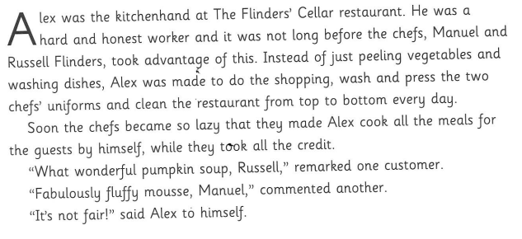
1

Slide 10
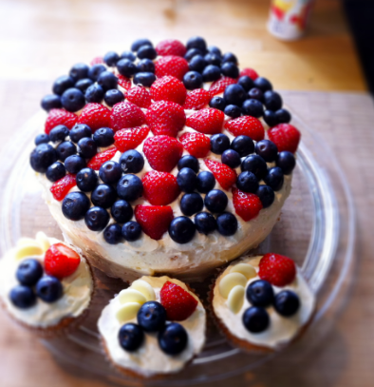
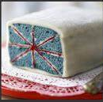
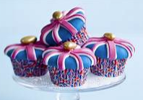
Our English task for today is a Close Reading Task
WALT: retrieve and infer information from a text.
Ask an adult to read the information (on the next page) to you.
Here are some meanings of words that might help you –
announcing - telling them about something in writing
overjoyed - extremely happy
jubilee cake - a cake designed for a special occasion such as the Queen’s Jubilee see pictures
3. Now read it with your adult twice, they can help you with expression.
4. Now read it twice by yourself.
5. Read the questions and look for evidence in the text to help you answer them.
6. Write your answers in full sentences.

Slide 11
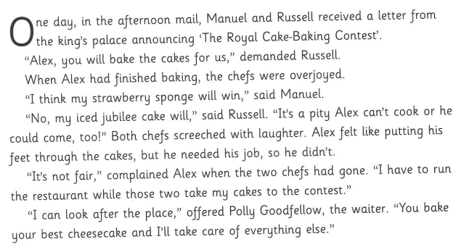
2

Slide 12
TASK:
Why did the two chefs ask Alex to bake cakes?
What does the word demanded suggest about the way they asked him?
Explain as fully as possible what made Alex want to put his feet through the cake?
What do you think Polly Goodfellow is ‘going to take care of’?

Slide 13
TASK:
Why did the two chefs ask Alex to bake cakes?
They wanted him to bake them so they could take them to the palace and enter the baking competition. They knew his cakes were so good that they would probably win with them rather than their own.
What does the word demanded suggest about the way they asked him?
Demanded suggests that rather than asking him, they were ordering him to do it. They said it in a way that he couldn’t refuse and they expected that he would have to do it and not really have a choice to say no.
Explain as fully as possible what made Alex want to put his feet through the cake?
He was probably annoyed because he was being forced to bake cakes which he knew they were going to say they had made themselves. He was probably frustrated because they had him trapped into doing it because he needed the job to earn his living. He was also envious that they could go to the palace for the competition and he couldn’t.
What do you think Polly Goodfellow is ‘going to take care of’?
She was going to take care of the restaurant. Maybe she would find him a chef uniform to wear to the palace.

Slide 14


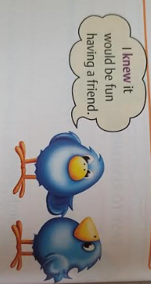
What are homophones?
Homophones are words that sound the same but have different meanings.
15 minute Spelling Activity

Slide 15
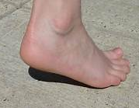

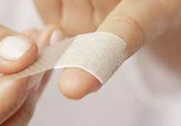
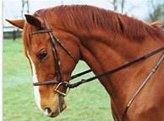
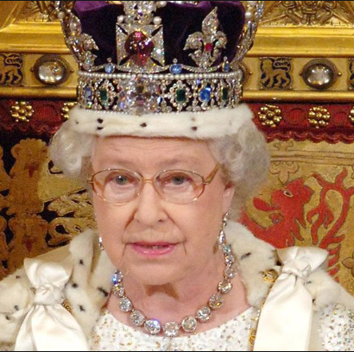

Take a look at these homophones.
heel | rain
heal | rein
he’ll | reign

Slide 16
Write the sentences out choosing the correct homophone.
My heel/heal/he’ll is too painful to put to the floor.
Queen Elizabeth is in rain/rein/reign over the country.
This time heel/heal/he’ll be eight on his birthday.
The downpour was so heavy the rain/rein/reign soaked through his clothing.
Injuries are treated to help them heel/heal/he’ll.
The rider tugged on the rain/rein/reign to slow the horse.

Slide 17
Write the sentences out choosing the correct homophone.
My heel is too painful to put to the floor.
Queen Elizabeth is in reign over the country.
This time he’ll be eight on his birthday.
The downpour was so heavy the rain soaked through his clothing.
Injuries are treated to help them heal.
The rider tugged on the rein to slow the horse.

Slide 18


Your morning lessons are completed.
Time for lunch.
Then come back this afternoon for your curriculum activity.

Slide 19
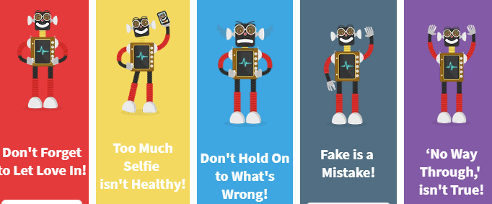
Heart Smart Afternoon
Here are the High Five Heart smart rules.

Slide 20

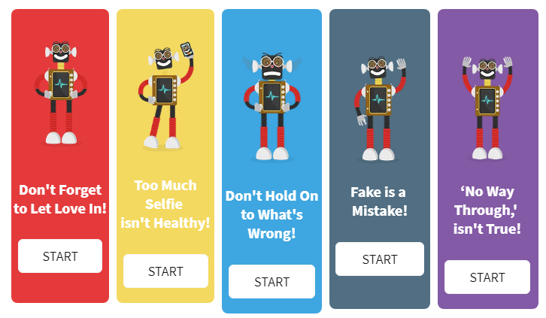
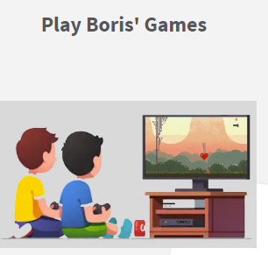
Click on the link for the Heart Smart site.
Then scroll down until you see Boris’s Story
Click on it to hear the book read to you.
Now scroll back up to see Boris’s High Five Heart Smart rules.You can click on each one to remind you of our high five by watching Boris’s videos.
Now scroll back down to play Boris’s Games.
https://www.heartsmart.family/

Slide 21

We hope your day went well.
See you tomorrow.

