Slide 1

Tuesday 14th July
Ready to wake up your maths brains?
Remember you can do these independently then share them with an adult.
Question 10 may have more than one answer.
Don’t worry about always finding the answer it is how you try to work out and reason that is important.

Slide 2




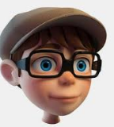
Morning Maths 14.07.20
7. 26 x 8
8. Fill in the gaps:
9. Mrs Shipley has baked 18 cookies, she shares them out equally between herself, Mr Mottershead and Miss Hyrons. How many cookies will they have each?
10. Make 24 using
each number only
once and any of
the operators (+, -, x, ➗)
How many days in December?
2. How many faces on this shape?
3. Double 315
4. 723 - 365
5. Insert the correct symbol (<,>,=)
6.
Spencer thinks that 36 chocolate bars can be shared out between 9 people.
Is Spencer correct?
100
125
175

Slide 3
31
2
630
358
=
Yes, as 36 is a multiple of 9
208
75,150
.
6
.
8-6=2, 2÷2=1, 1x24=24

Slide 4

St Catherine’s Classroom Beliefs
Mistakes are valuable.
Everyone can learn maths to the highest level.
Questions are really important.
Depth is more important than speed.
Maths is about making connections.
We may not be learning together in the classroom, but it is important to still remember our classroom beliefs.

Slide 5
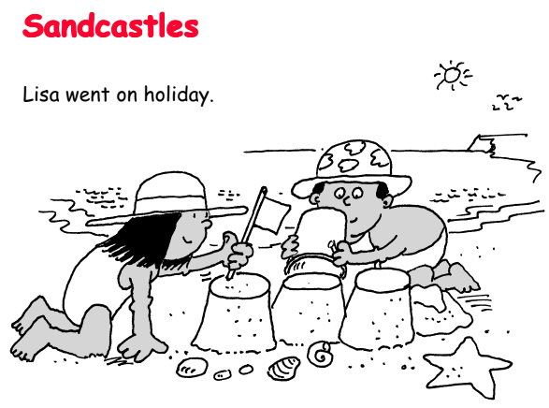
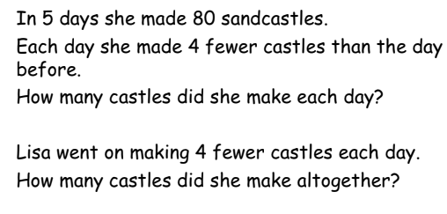

Slide 6
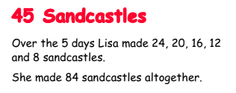

Slide 7

Time for a break.
Have a drink and a snack.

Slide 8
The Story of Alex- Comprehension:
WALT: retrieve information from fiction texts and make inferences.
Today you are going to read the middle of the story, leading up to the climax or the most exciting part of the story
Read the story on the next slides 3 and 4 then answer the questions about the narrative.

Slide 9
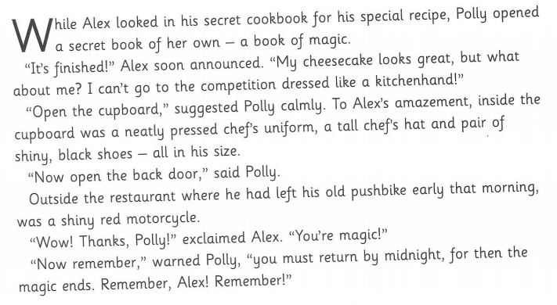
3

Slide 10
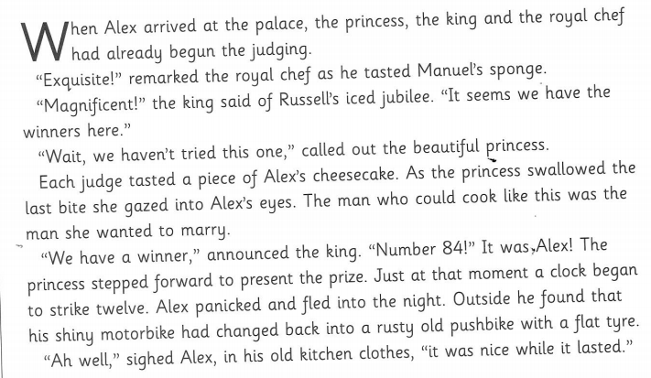
4

Slide 11
The Story of Alex - comprehension
Understanding the text. (These questions are from the middle of the story.)
Why do you think Alex looked in his secret cookbook?
Why did Alex still think he would be unable to to the palace?
Where did Alex get the chefs uniform, hat, shiny black shoes and the red motorbike from?
Why does Alex have to return by midnight?
Who was judging the cake baking contest when Alex arrived?
Which cake would have won the competition if Alex’s cheesecake had not have won? Explain how you know.

Slide 12
Looking at the Language
Find an adjective that is used to describe
a.) the strawberry sponge
b.) the iced jubilee cake
Find and copy one word in the text that means
a.) ironed
b.) chime
c.) get back
Find a group of words in the text that mean
a.) to give an award
b.) he was frightened and ran
c.) it was ok at the time

Slide 13
Exploring the text.
Explain what Polly Goodfellow means when she says ‘for then the magic ends’.
How was the winning cake finally decided?
What do you think the princess was going to present to Alex as the winner of the contest? Explain using the evidence from the text that supports your answer.
Challenge:
Which story does The Story of Alex remind you of?
Predict the end of story by completing the table.
Build up | Ending
Problem | Resolution | Conclusion
Alex fled from the palace as the magic wore off. The Princess wanted to marry him but she didn’t know where to find him.

Slide 14
The Story of Alex - comprehension
Understanding the text. (These questions are from the middle of the story.)
Why do you think Alex looked in his secret cookbook?
This was because it had a special recipe in it that he hoped would win the contest.
Why did Alex still think he would be unable to go the palace?
He knew he didn’t have a smart chef’s uniform and his kitchen hand clothes were too poor and old.
Where did Alex get the chefs uniform, hat, shiny black shoes and the red motorbike from?
He found the uniform, hat and shoes in the cupboard and the red motorcycle was where he had left his old pushbike. Polly had used magic to put them there.
Why does Alex have to return by midnight?
This is when the magic wears off and his clothes will return to his old ones and his motorbike will become a push bike again.
Who was judging the cake baking contest when Alex arrived?
The king and his royal chef were judging the cake contest when Alex arrived.
Which cake would have won the competition if Alex’s cheesecake had not have won? Explain how you know.
Manuel’s strawberry sponge and Russell’s iced jubilee cake were going to win because the king said
”It seems we have the winners here!”, although actually they were both Alex’s cakes!!!

Slide 15
Looking at the Language
Find an adjective that is used to describe
a.) the strawberry sponge - exquisite
b.) the iced jubilee cake - magnificent
Find and copy one word in the text that means
a.) ironed - pressed
b.) chime - strike
c.) get back - return
Find a group of words in the text that mean
a.) to give an award - to present the prize
b.) he was frightened and ran - panicked and fled
c.) it was ok at the time - it was nice while it lasted

Slide 16
Exploring the text.
Explain what Polly Goodfellow means when she says ‘for then the magic ends’.
It means that the effects of the magic would wear off and his smart uniform would change back to the poor clothes of a kitchen hand and the red motorbike would change back to the old bicycle.
How was the winning cake finally decided?
The winning cake was finally decided when the princess tasted Alex’s cheesecake.
What do you think the princess was going to present to Alex as the winner of the contest? Explain using the evidence from the text that supports your answer.
She said she wanted to marry the man who could cook like that, so she was probably going to give herself as the prize by allowing Alex to marry her.
Challenge:
Which story does The Story of Alex remind you of?
Predict the end of story by completing the table.
Wait and see if your version is the same as the real story - we will take a look tomorrow

Slide 17

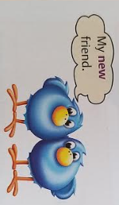
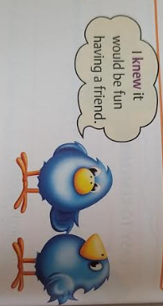
What are homophones?
Homophones are words that sound the same but have different meanings.
15 minute Spelling Activity

Slide 18
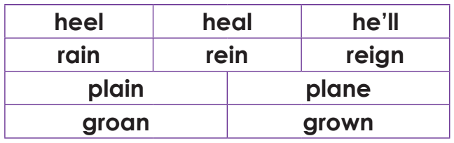
Can you remember the first six homophones from yesterday. Do you remember what they mean? You can go back and look again if you have forgotten.
The last four can be seen on the next slide.

Slide 19
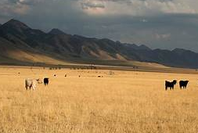
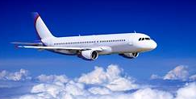
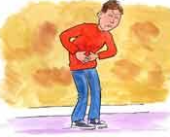
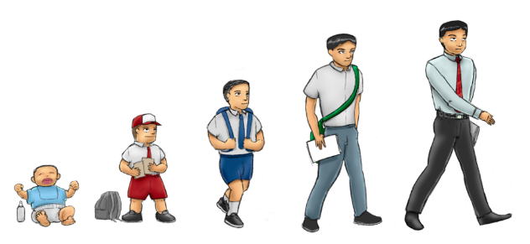
Take a look at these homophones.
plane | plain
grown | groan

Slide 20

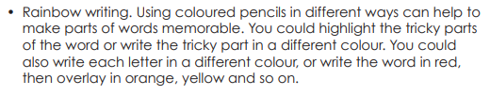
Rainbow write each word 3 times.
heal | plain | rein
he’ll | grown | reign
heel | groan
plane | rain

Slide 21
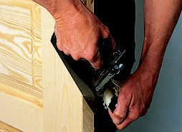
Which is the correct word for the sentence?
Plane/plain paper was given out for the art lesson.
The injured man let out a groan/grown of pain.
My first journey by plain/plane was to France.
I know that I have groan/grown because my trousers are too short.
With a grown/groan of discontentment he did what his boss asked.
Dad used a wood plain/plane to fix the door.

Slide 22
Which is the correct word for the sentence?
Plain paper was given out for the art lesson.
The injured man let out a groan of pain.
My first journey by plane was to France.
I know that I have grown because my trousers are too short.
With a groan of discontentment he did what his boss asked.
Dad used a wood plane to fix the door.

Slide 23


Your morning lessons are completed.
Time for lunch.
Then come back this afternoon for your curriculum activity.

Slide 24
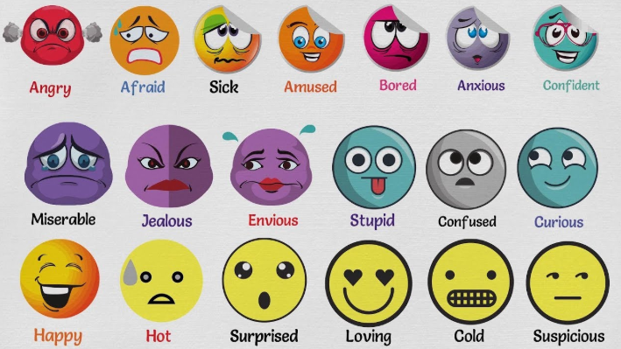
Let’s think about feelings this afternoon.

Slide 25

How does this picture make you feel?

Slide 26
sad depressed frightened
miserable anxious tired
down in the dumps
worried troubled scared

Slide 27
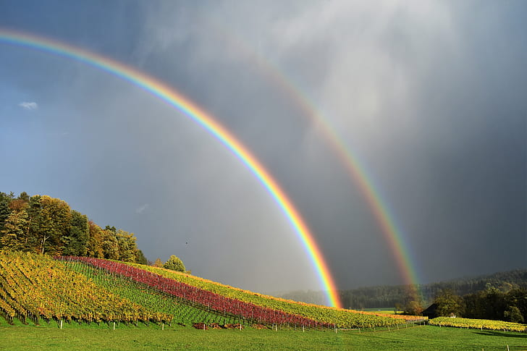
How does this picture make you feel?

Slide 28
happy hopeful cheerful
brighter warm inside
safe free excited
joyful playful

Slide 29


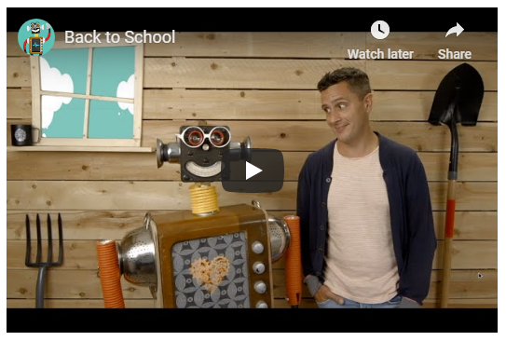
Click on the link for the Heart Smart site you looked at yesterday.
Then scroll down until you see the back to school resource.
Click on it.
Then click the tab that says for students.
You will see the clip shown below in the picture. Click play and watch it.
https://www.heartsmart.family/

Slide 30
Moving class can be exciting but also a worrying time. This year we might have extra worries as some of you have been away from school and away from your teachers for a long time.
When you do come back you will be in new classes with new teachers which is always very strange for us.
On the next slide you can see a rainbow with a cloud at either end. Copy the picture - draw a big rainbow. Write your worries about going back to school in the clouds and the things you are excited about on the rainbows.
Show it to your adults at home and talk about it with them. This might help with getting rid of some of your worries and help you to focus on the exciting things.

Slide 31


Slide 32

We hope you had fun today.
See you tomorrow.

