Slide 1

Wednesday 15th July
Ready to crunch some numbers?
Remember you can do these independently then share them with an adult.
Question 10 may have more than one answer.
Don’t worry about always finding the answer it is how you try to work out and reason that is important.

Slide 2

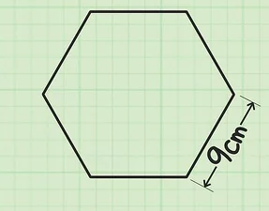

Morning Maths 15.07.20
8. 250 + 19 + __ = 500
9. How much would three robots cost?
10. Toby the thief has been stealing again!
He has stolen 3 notes (money) from the bank. Can you work
out all the possible
amounts he could
have stolen?
40 fewer than 110
2. 880÷10
3. Complete this
bar model.
4. 108÷12
5. Emily invited 20 friends to her party, one quarter of them were girls, how many were boys?
6. 218cm = __m___cm
7. What is the perimeter of
this shape?
123
76

Slide 3
70
88
47
9
15
2m 18cm
54
231
.
£1.44
.
Various, some examples:
£5, £5,£5 £5,£10,£20 £5,£10,£50

Slide 4

St Catherine’s Classroom Beliefs
Mistakes are valuable.
Everyone can learn maths to the highest level.
Questions are really important.
Depth is more important than speed.
Maths is about making connections.
We may not be learning together in the classroom, but it is important to still remember our classroom beliefs.

Slide 5
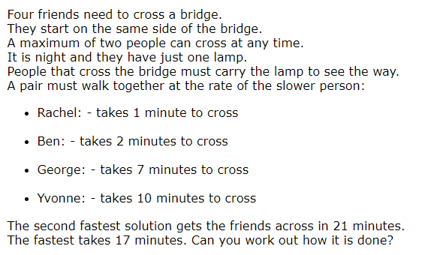
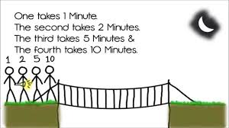
Rachel = 1 minute
Ben = 2 minutes
George = 7 minutes
Yvonne = 10 minutes

Slide 6
17 minutes solution
Rachel and Ben cross: 2 minutes
Rachel travels back and gives the torch to George: 1 minute
George and Yvonne cross: 10 minutes
Ben takes the torch back to rachel: 2 minutes
Rachel and Ben cross together: 2 minutes
21 minutes solution
Rachel and Yvonne cross: 10 minutes
Rachel comes back: 1 minute
Rachel and George cross: 7 minutes
Rachel goes back: 1 minute
Rachel and Ben cross: 2 minutes

Slide 7

Time for a break.
Have a drink and a snack.

Slide 8
WALT: explore the structure of a traditional story and think about the elements within it.
Yesterday you tried to predict the ending of The Story of Alex.
What did you think would happen in the resolution and the conclusion of the story?
On the next two slides 5 and 6, you can read the ending of the story.
Then there are some questions to answer.

Slide 9
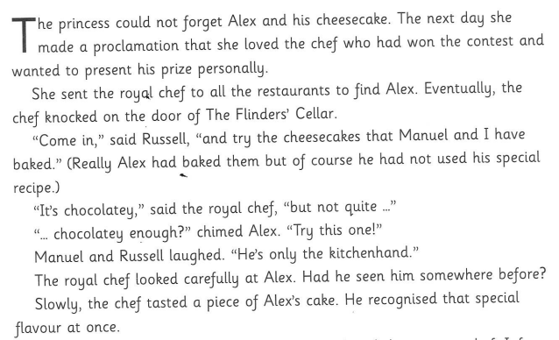
5

Slide 10
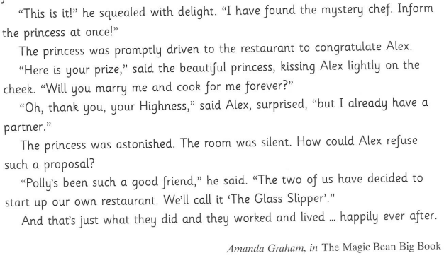
6

Slide 11
Even though Alex had made all the cheesecakes that he himself, Manuel and Russell presented to the royal chef, how could the chef recognise the one that was the winner?
What was the prize that the princess gave Alex.
Did the story end as you predicted? If not what was the big surprise?
Why do you think Alex turned down the princess and wouldn’t marry her?
Do you think the princess really loved Alex. Explain your answer.

Slide 12
Even though Alex had made all the cheesecakes that he himself, Manuel and Russell presented to the royal chef, how could the chef recognise the one that was the winner?
This was because Alex put a special ingredient/flavour into his own cheesecake and he didn’t put it in the ones he made for Manuel and Russell.
What was the prize that the princess gave Alex.
She gave him a kiss on the cheek and asked him to marry her and cook for her forever.
Did the story end as you predicted? If not what was the big surprise?
No, i thought he would marry the princess and it was a surprise that he turned her down and said no.
Why do you think Alex turned down the princess and wouldn’t marry her?
I think he wanted to open a new restaurant with Polly. He knew she cared about him because she had helped him before and he was grateful.
Do you think the princess really loved Alex. Explain your answer.
I think she loved the idea that he would cook nice things for her and she loved his cakes but she didn’t really know anything about Alex as a person.

Slide 13
Now we are going to compare two stories.
Cinderella and The Story of Alex.
What was the same? What was different?

Slide 14
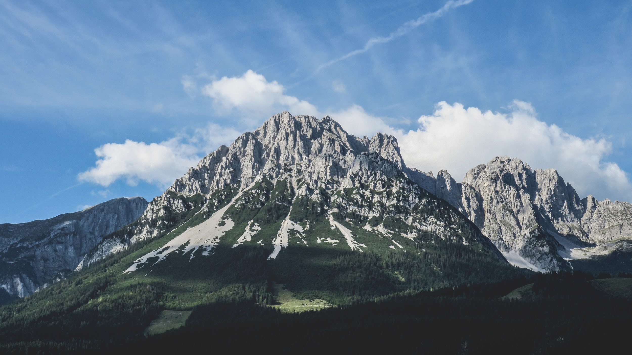
This shows a story mountain for the story of Cinderella.
Climax.
Cinderella dances with the prince. As the clock struck 12 Cinderella’s fairy godmother’s magic wears off and she runs from the palace just in time.
Resolution.
One of the magic glass slippers remains and the prince finds Cinderella when it fits to her foot.
Build Up.
There is a ball at the palace
And cinderella wants to go but she doesn’t have any pretty clothes.
Conclusion.
Cinderella marries the prince and goes to live in the palace where she doesn’t have to do chores and is no longer poor or badly treated.
Opening.
Cinderella lives in a house with her step mother and two step sisters. She is poor and treated badly.

Slide 15
Use your knowledge of the story of cinderella to fill in the table.
 | Cinderella
Good character
Bad character
Jobs for the good character
Invitation
Good characters wish
Who does the magic?
What is the warning?
What is left behind?
How does the wish come true?

Slide 16
Use your knowledge of the story of cinderella to fill in the table.
 | Cinderella
Good character | Cinderella
Bad character | Stepmother and stepsisters
Jobs for the good character | Cleaning and cooking
Invitation | To the palace for the ball
Good characters wish | To go to the ball
Who does the magic? | Fairy godmother
What is the warning? | To leave at 12
What is left behind? | Glass slipper
How does the wish come true? | The fairy godmother uses magic to cast the spells and help

Slide 17
Complete a story mountain for The Story of Alex.
Climax.
Resolution.
Build Up.
Conclusion.
.
Opening.

Slide 18
This shows a story mountain for The Story of Alex.
Climax.
Alex wins the contest but runs form the palace just in time before his chef’s smart clothes return to his poor ones as the magic wears off.
Resolution.
The princess finds Alex when his cheesecake is recognised and asks him to marry her and cook for her.
Build Up.
Alex wants to enter the cake baking contest at the palace but he has no chef’s uniform to wear.
Conclusion.
.Alex says no because he is escaping Manuel and Russell to set up his own restaurant with Polly. Just what he wants to make him happy.
Opening.
Alex is treated badly at the restaurant by Russell and Manuel. He is just a poor kitchen hand.

Slide 19
 | Cinderella | Complete this for The Story of Alex
Good character | Cinderella
Bad character | Stepmother and stepsisters
Jobs for the good character | Cleaning and cooking
Invitation | To the palace for the ball
Good characters wish | To go to the ball
Who does the magic? | The fairy godmother
What is the warning? | To leave at 12
What is left behind? | Glass slipper
How does the wish come true? | The fairy godmother uses magic to cast the spells and help

Slide 20
 | Cinderella | Complete this for The Story of Alex
Good character | Cinderella | Alex
Bad character | Stepmother and stepsisters | Manuel and Russell
Jobs for the good character | Cleaning and cooking | Peeling veg, washing dishes, shopping, wash and press uniforms and cleaning
Invitation | To the palace for the ball | To the palace for the cake baking contest.
Good characters wish | To go to the ball | To go the palace and enter the baking contest
Who does the magic? | The fairy godmother | Polly Goodfellow
What is the warning? | To leave at 12 | To leave at midnight
What is left behind? | Glass slipper | cheesecake
How does the wish come true? | The fairy godmother uses magic to cast the spells and help | Polly Goodfellow uses magic to cast the spells and help

Slide 21


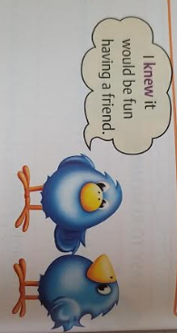
What are homophones?
Homophones are words that sound the same but have different meanings.
15 minute Spelling Activity

Slide 22
Today it is time to practise some of the homophones we have been using. Write out the following sentences making sure you correct spellings and use the correct homophones.
When he becomes king, heal rain over all the land.
The boy let out a grown as he landed on his painful heal.
The farmer ploughed the fields upon the planes where he lived. He planted the seeds in the Spring. The son shone and the rein fell upon the young plants. When they had groan the farmer harvested them.

Slide 23
Write out the following sentences making sure you correct spellings and use the correct homophones.
When he becomes king, he’ll reign over all the land.
The boy let out a groan as he landed on his painful heel.
The farmer ploughed the fields upon the plains where he lived. He planted the seeds in the Spring. The sun shone and the rain fell upon the young plants. When they had grown the farmer harvested them.

Slide 24
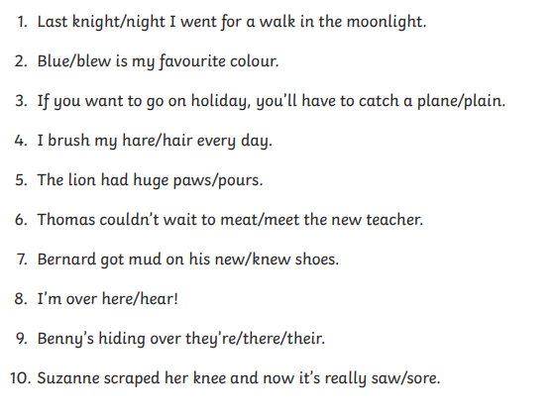
Now let’s try some from previous lessons at home and at school.

Slide 25
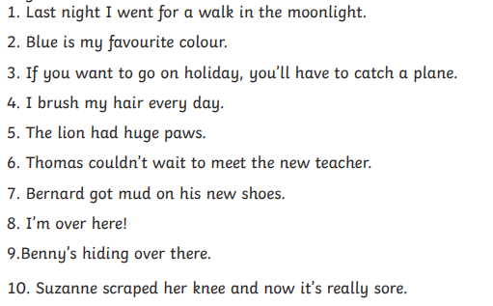
Answers

Slide 26
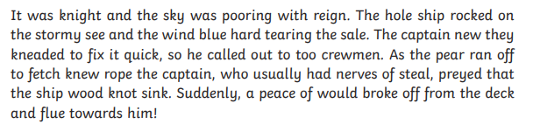
Rewrite the passage below correcting all the homophones.
It’s a tricky one so read carefully.

Slide 27
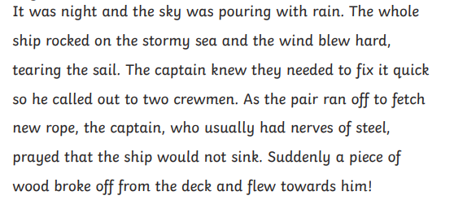
Answers

Slide 28


Your morning lessons are completed.
Time for lunch.
Then come back this afternoon for your curriculum activity.

Slide 29
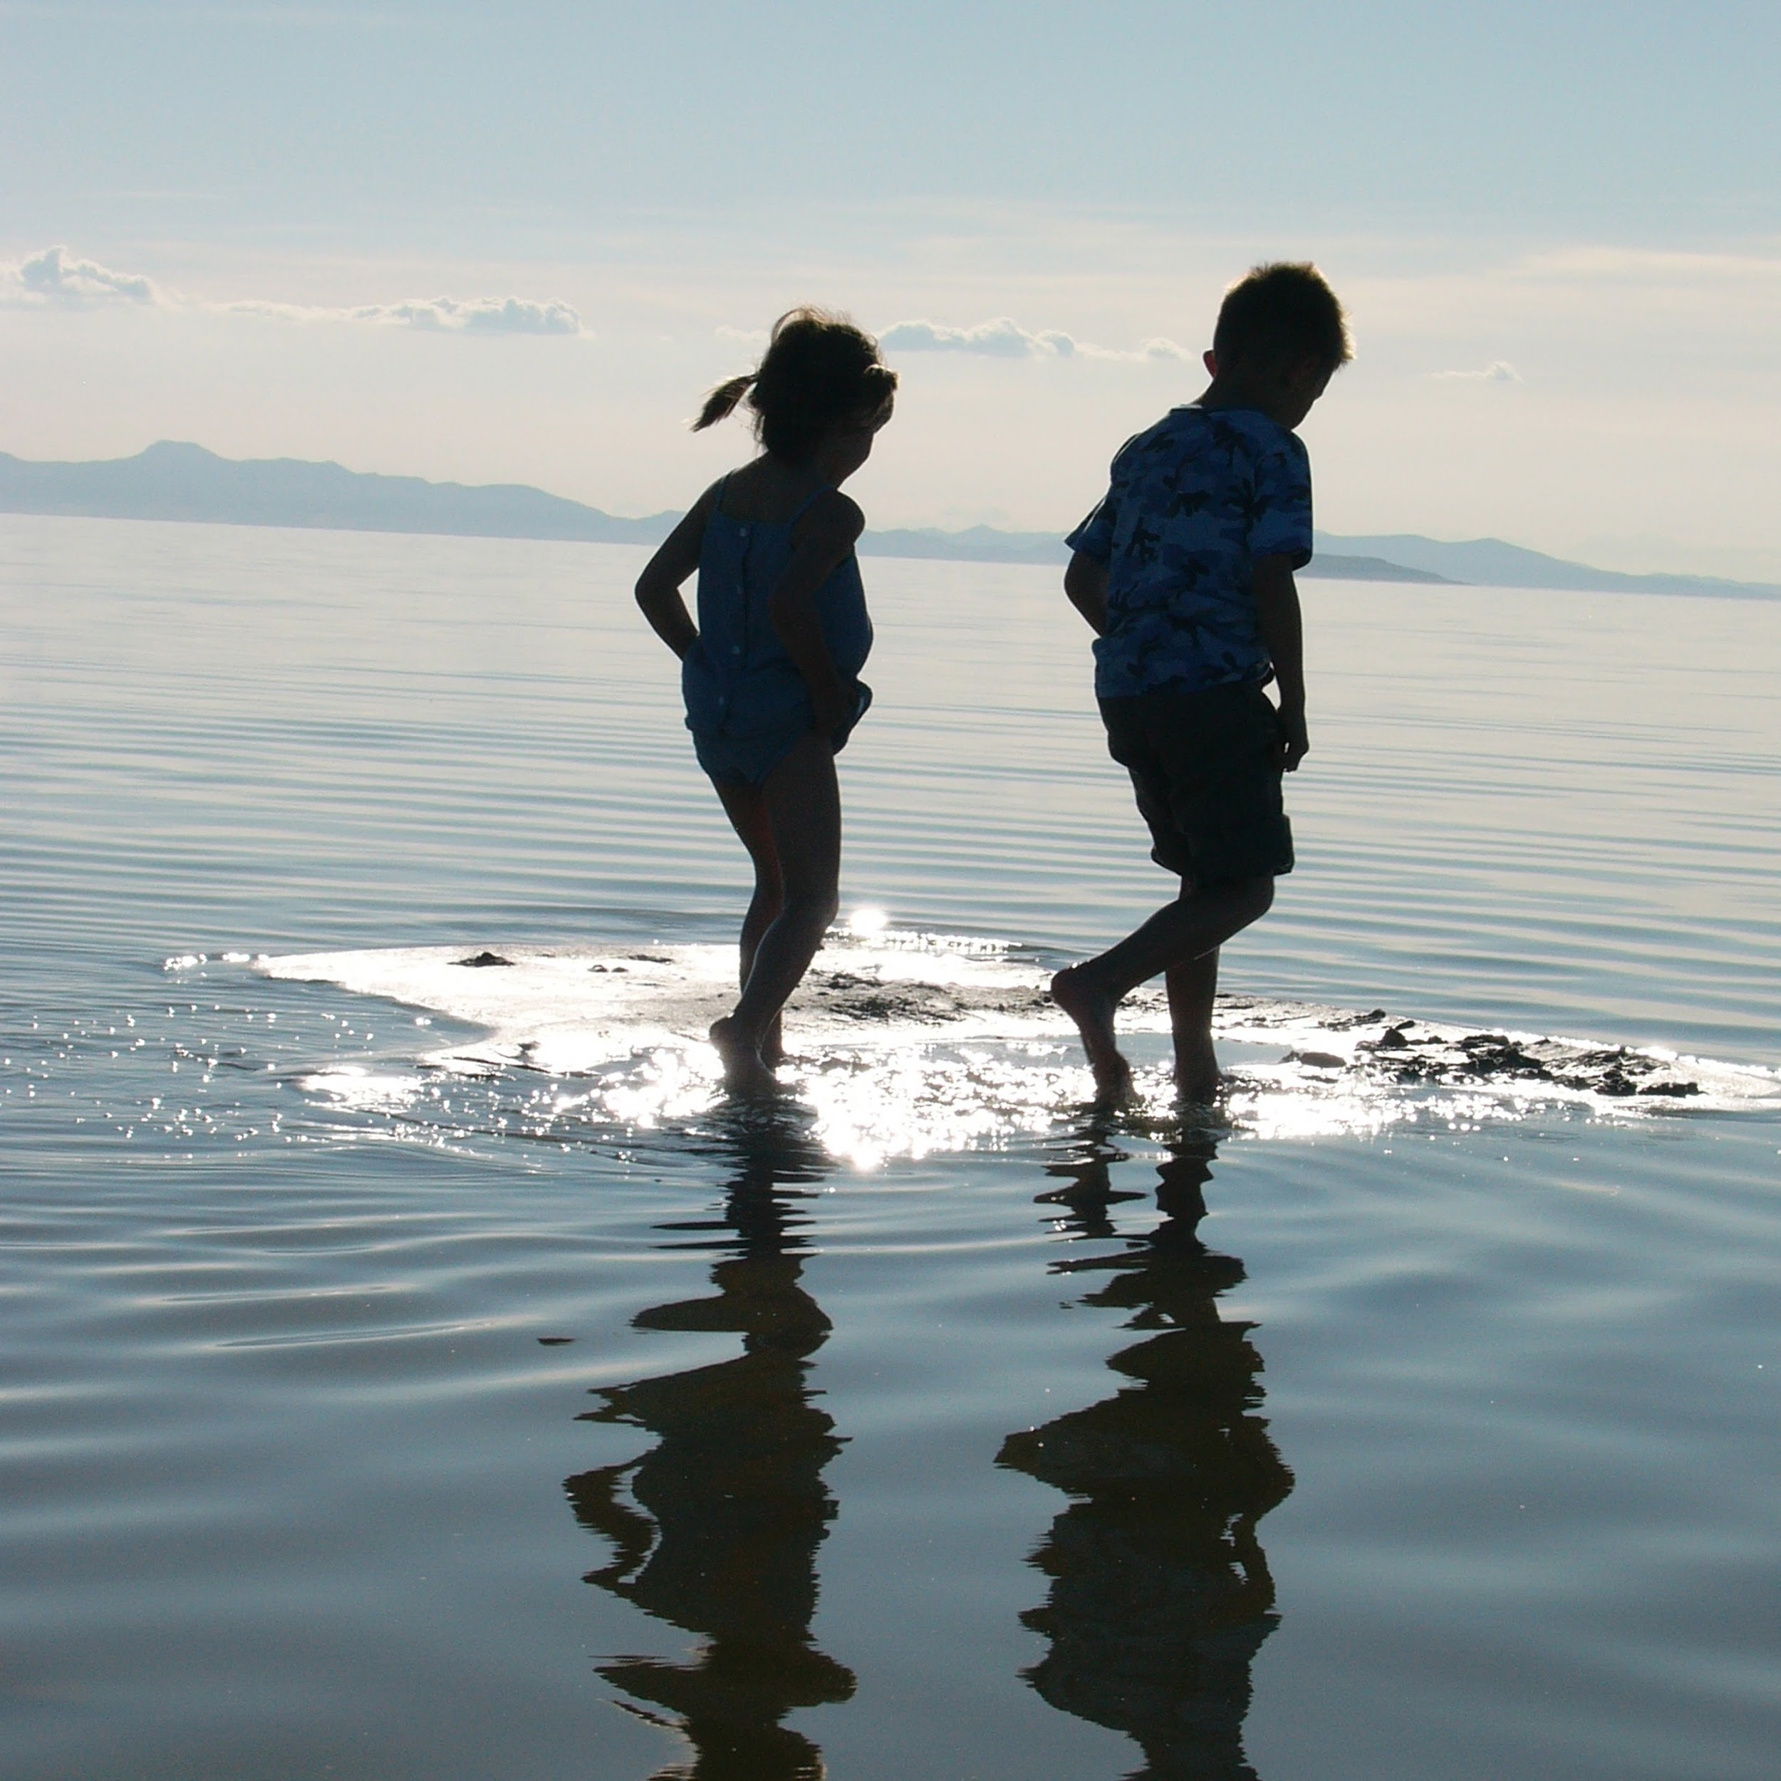
Time for reflection - looking back to Year 3!
Think about the time you spent in Year 3.
What did you enjoy?
Use the ideas from the next two slide to make a memories of Year 3 poster.

Slide 30


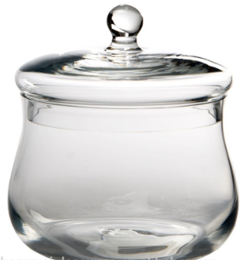

My favourite memories of Year 3
My favourite moments:
My friends:
My favourite activities:
Memories I will treasure:

Slide 31



My favourite memories of Year 3
A moment when I had to think really hard and i enjoyed the challenge:
My funniest moment:
What I loved most about Year 3 :

Slide 32
Did you have a good day learning today?
See you in the morning.

