Slide 1
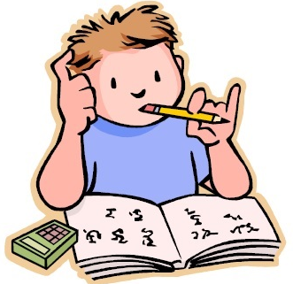
Thursday 16th July
Is your head ready to calculate?
Remember you can do these independently then share them with an adult.
Question 10 may have more than one answer.
Don’t worry about always finding the answer it is how you try to work out and reason that is important.

Slide 2

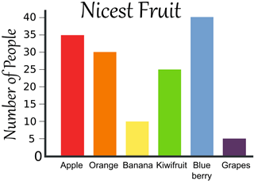
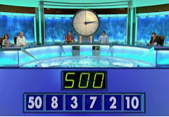
Morning Maths 16.07.20
8. If I buy 6 Roses at £3 per rose, how much will it cost?
9. How many more
People preferred
Blueberries to
Bananas?
10. Make 24 using
each number only
once and any of
the operators (+, -, x, ➗)
Put these in descending order:
100, 50, 32, 35, 101
2. £1 - 27p
3. Insert the correct symbol (< > = )
8 x 9 6 x 12
4. ➗ 4 = 38
5. Half of 220
6. I’m thinking of a number if I double it and add 12, I get 22. What is the number I am thinking of ?
7. The perimeter of a square is cm. If one of the sides is 8cm. What is the length of the others?

Slide 3
101,100,50,35,32
73p
=
4
110
5
32
£12
.
£30
.
50x10=500, 8+2=10, 500+10=510, 7+3=10, 510-10=500

Slide 4

St Catherine’s Classroom Beliefs
Mistakes are valuable.
Everyone can learn maths to the highest level.
Questions are really important.
Depth is more important than speed.
Maths is about making connections.
We may not be learning together in the classroom, but it is important to still remember our classroom beliefs.

Slide 5
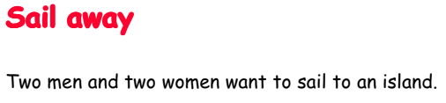
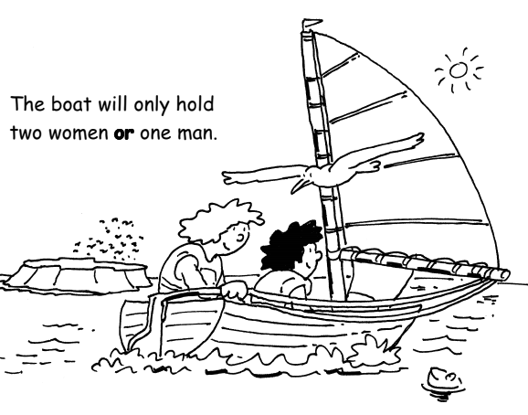

Slide 6
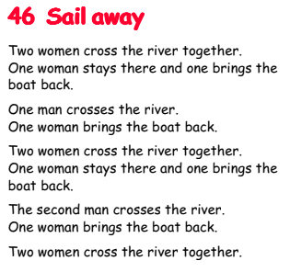

Slide 7

Time for a break.
Have a drink and a snack.

Slide 8
WALT plan our own story using a scaffold and a story mountain.
On the next slide you will see a reminder of the elements with the story of Cinderella and The Story of Alex.

Slide 9
 | Cinderella | Complete this for The Story of Alex
Good character | Cinderella | Alex
Bad character | Stepmother and stepsisters | Manuel and Russell
Jobs for the good character | Cleaning and cooking | Peeling veg, washing dishes, shopping, wash and press uniforms and cleaning
Invitation | To the palace for the ball | To the palace for the cake baking contest.
Good characters wish | To go to the ball | To go the palace and enter the baking contest
Who does the magic? | The fairy godmother | Polly Goodfellow
What is the warning? | To leave at 12 | To leave at midnight
What is left behind? | Glass slipper | cheesecake
How does the wish come true? | The fairy godmother uses magic to cast the spells and help | Polly Goodfellow uses magic to cast the spells and help

Slide 10
Now add in your own ideas for a story that is similar.
Remember to give it a title.
My Story
Good character
Bad character
Jobs for the good character
Invitation
Good characters wish
Who does the magic?
What is the warning?
What is left behind?
How does the wish come true?

Slide 11
Reread the story mountains on the next two slides to remind you of the story of Cinderella and the Story of Alex.
On the third slide you can print out or copy the blank story mountain into your book.
You need to plan a story mountain for the ideas you have just added into the table for your own new story.
When this is completed tell your story to someone. Don’t write it. Tell it by saying it jot down anything you missed out on your story mountain.

Slide 12
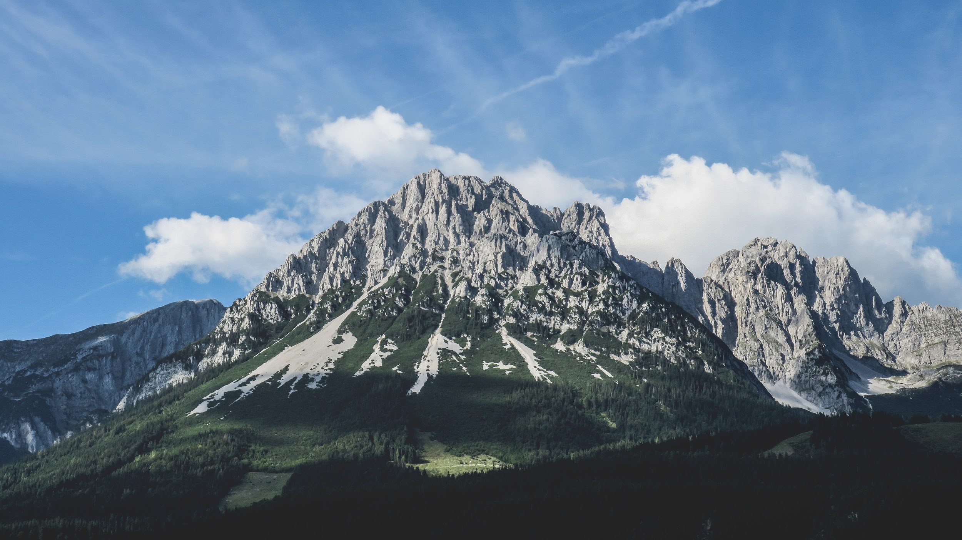
This shows a story mountain for the story of Cinderella.
Climax.
Cinderella dances with the prince. As the clock struck 12 Cinderella’s fairy godmother’s magic wears off and she runs from the palace just in time.
Resolution.
One of the magic glass slippers remains and the prince finds Cinderella when it fits to her foot.
Build Up.
There is a ball at the palace
And cinderella wants to go but she doesn’t have any pretty clothes.
Conclusion.
Cinderella marries the prince and goes to live in the palace where she doesn’t have to do chores and is no longer poor or badly treated.
Opening.
Cinderella lives in a house with her step mother and two step sisters. She is poor and treated badly.

Slide 13
This shows a story mountain for The Story of Alex.
Climax.
Alex wins the contest but runs form the palace just in time before his chef’s smart clothes return to his poor ones as the magic wears off.
Resolution.
The princess finds Alex when his cheesecake is recognised and asks him to marry her and cook for her.
Build Up.
Alex wants to enter the cake baking contest at the palace but he has no chef’s uniform to wear.
Conclusion.
.Alex says no because he is escaping Manuel and Russell to set up his own restaurant with Polly. Just what he wants to make him happy.
Opening.
Alex is treated badly at the restaurant by Russell and Manuel. He is just a poor kitchen hand.

Slide 14
My Story Mountain.
Climax.
Resolution.
Build Up.
Conclusion.
.
Opening.

Slide 15


WALT use and spell the words from the Year 3 and 4 word list.
At the start of Year 3 in your reading diaries we gave you a list of the Year 3 and 4 spelling words. We also gave you a printed copy of them in your first home learning pack.
These are the words that you should be able to spell by the end of Year 4. Some of you already know most of them and some of you knew almost half of them. We hope you have been practising them at home.
The activities over the next two days are for you to see how you are getting on.

Slide 16
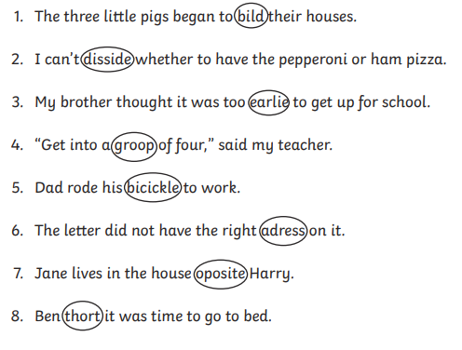
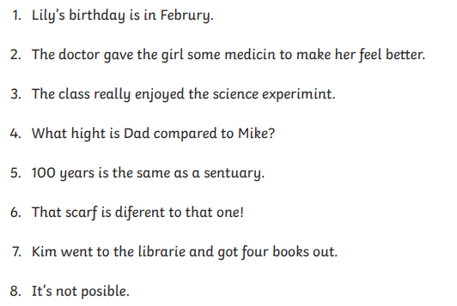
The incorrect spelling from your Year 3 and 4 list has been circled.
Write down the correct spellings.
Find the incorrect spelling from your Year 3 and 4 list.
Write down the correct spellings.

Slide 17
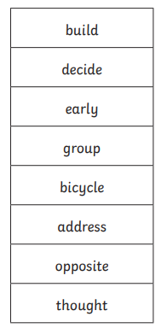
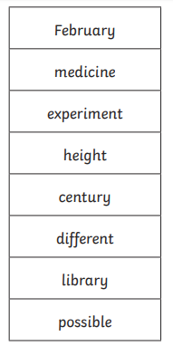
Here are your answers.

Slide 18
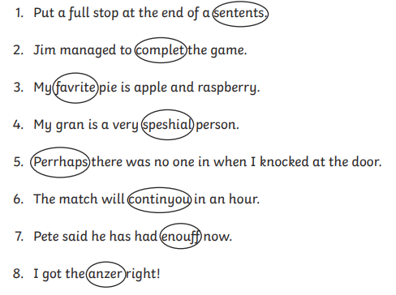
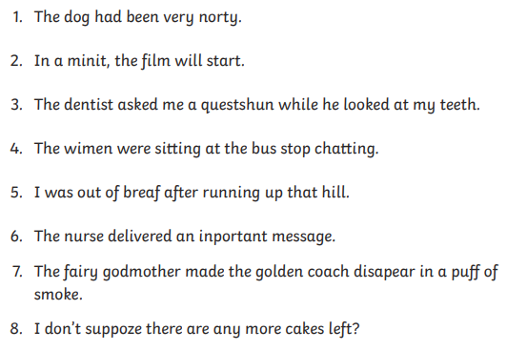
The incorrect spelling from your Year 3 and 4 list has been circled.
Write down the correct spellings.
Find the incorrect spelling from your Year 3 and 4 list.
Write down the correct spellings.

Slide 19
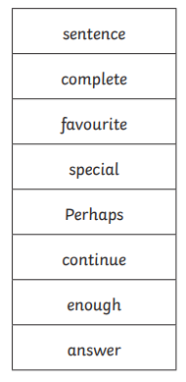
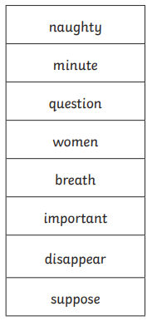
Here are your answers.

Slide 20
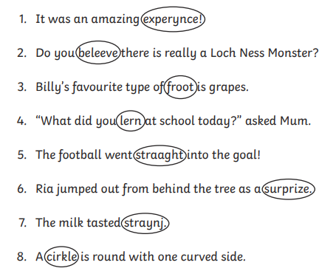
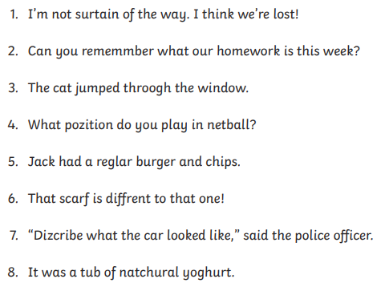
The incorrect spelling from your Year 3 and 4 list has been circled.
Write down the correct spellings.
Find the incorrect spelling from your Year 3 and 4 list.
Write down the correct spellings.

Slide 21
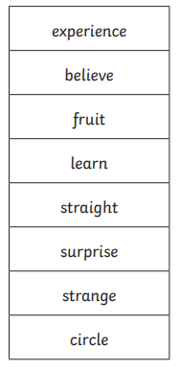
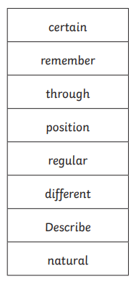
Here are your answers.

Slide 22


Your morning lessons are completed.
Time for lunch.
Then come back this afternoon for your curriculum activity.

Slide 23
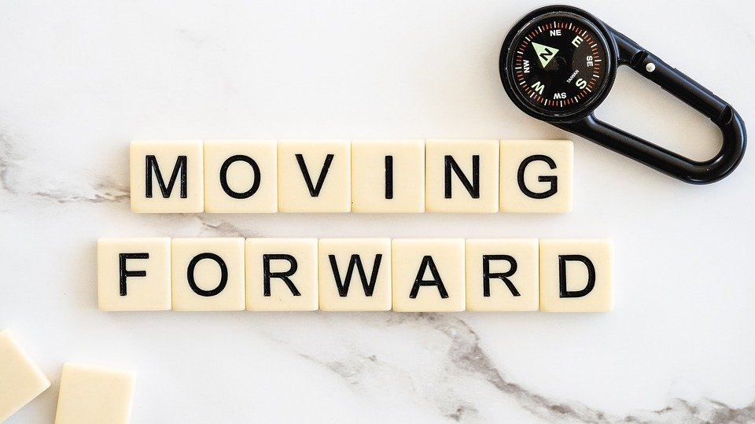
Yesterday you were reflecting on your memories of Year 3. Today we would like you to think about moving on to Year 4. What will you tell your new teacher?
Print out the next slide and add your ideas or you could draw a different bird with outstretched wings and put your ideas around it.
You might include any worries from your work on Monday afternoon if they are still worries because your new teacher could talk about them with you.

Slide 24
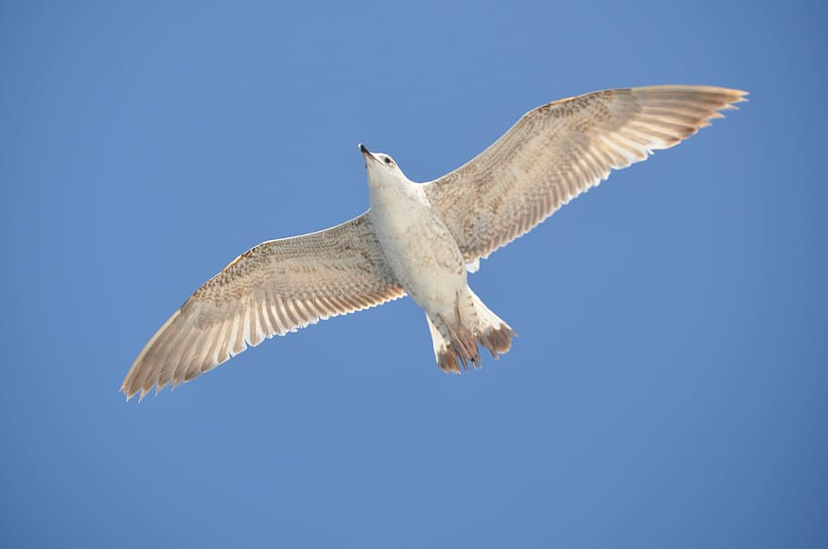
Spreading my wings from Year 3 to Year 4
I am worried about...
I enjoy…
I want to get better at...
I’m good at...
I am looking forward to...

Slide 25
Did you work hard with your learning today?
See you in the morning.

