Slide 1

Friday 17th July
Are you a maths whizz today?
Remember you can do these independently then share them with an adult.
Question 10 may have more than one answer.
Don’t worry about always finding the answer it is how you try to work out and reason that is important.

Slide 2
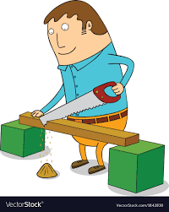



Morning Maths 17.07.20
7. Jim cuts off 75cm
from a 2m plank.
How long is the plank
afterwards?
8. Fill in the gaps:
652, __, __, 688, 700, __
9. What was the time 3 quarters of an hour?
10.
How many tens in 309 ?
2. Write a calculation statement for this part-whole model:
3. 34 - 272
4. 24 x 7
5. How many ml in 1 litre?
6. Which angle is the odd one out and why?
28
89
a
c
b

Slide 3
30
61
238
168
1,000
C, as it is an obtuse angle and the other 2 are acute angles.
.
1m 25cm or 1.25m
664,676,712
11.55
7-1=6, 6x3=18, 25+4=29, 29+8=37, 37x18=666

Slide 4

St Catherine’s Classroom Beliefs
Mistakes are valuable.
Everyone can learn maths to the highest level.
Questions are really important.
Depth is more important than speed.
Maths is about making connections.
We may not be learning together in the classroom, but it is important to still remember our classroom beliefs.

Slide 5
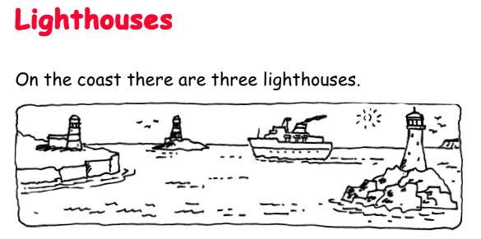
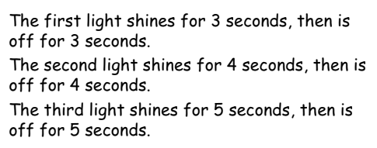
All three lights have just come on together.
When is the first time that all three lights will be off?
When is the next time that all three lights will come on at the same moment?

Slide 6
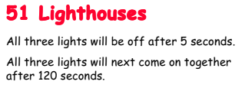

Slide 7

Time for a break.
Have a drink and a snack.

Slide 8
WALT write our own story using a scaffold and story mountain
Use the ideas that you created yesterday on the following two slide templates to write your story.
You should have told your story to someone yesterday. You may want to think your story through again before you write it.
You could make it into a book and illustrate it too.

Slide 9
Now add in your own ideas for a story that is similar.
Remember to give it a title.
My Story
Good character
Bad character
Jobs for the good character
Invitation
Good characters wish
Who does the magic?
What is the warning?
What is left behind?
How does the wish come true?

Slide 10
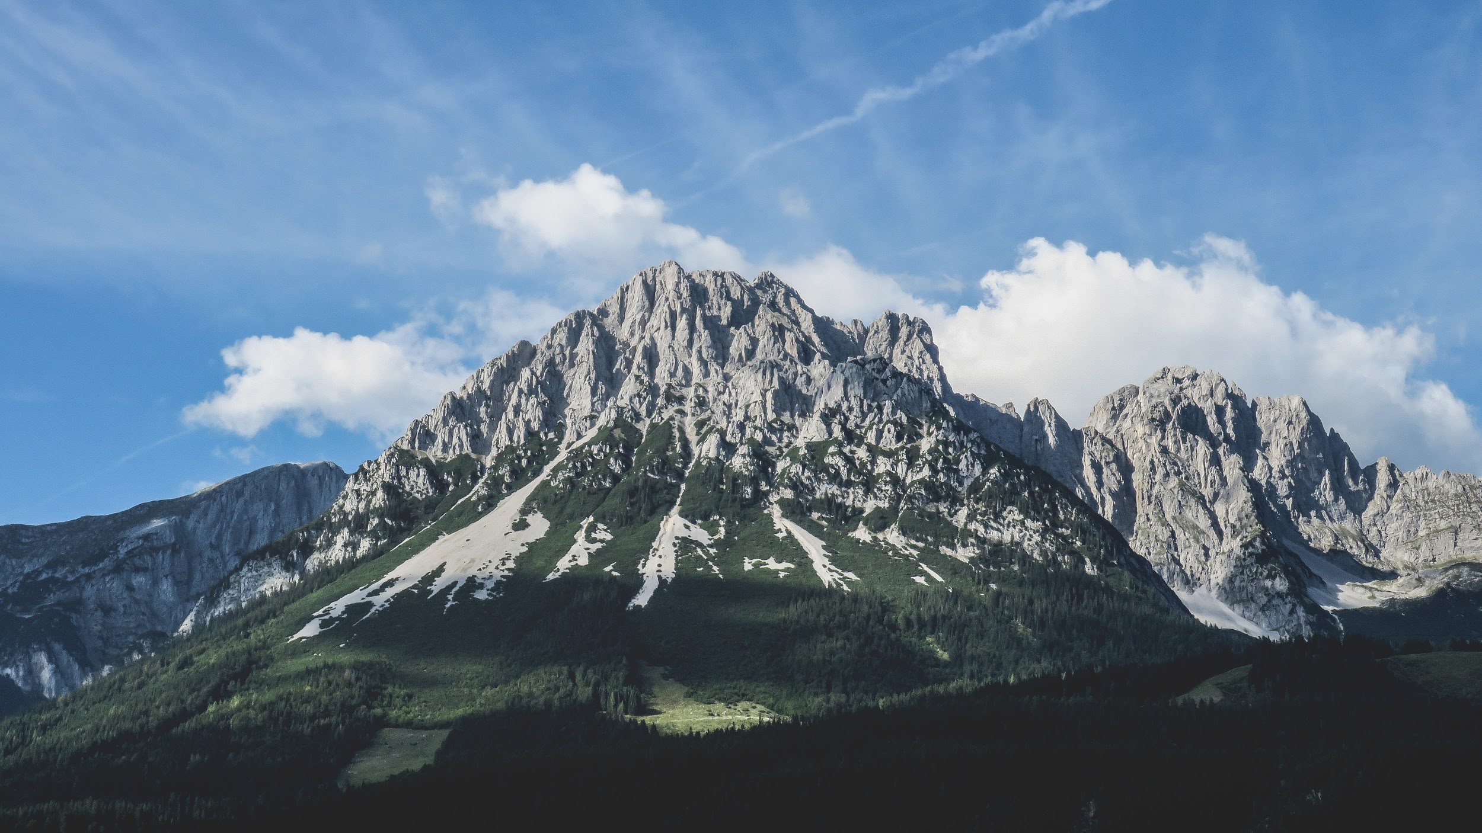
My Story Mountain.
Climax.
Resolution.
Build Up.
Conclusion.
.
Opening.

Slide 11


WALT use and spell the words from the Year 3 and 4 word list.
How did you get on yesterday? We have more practise for you today.
Remember that you need to keep up learning your spellings all the time at home. Choose a few from your list each day and practise them. You could use pyramid writing, rainbow writing or look, say, cover, spell and check.

Slide 12
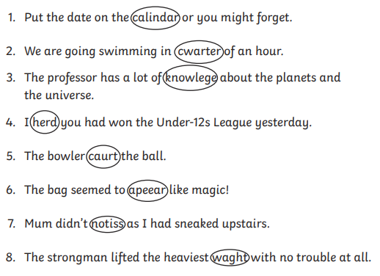
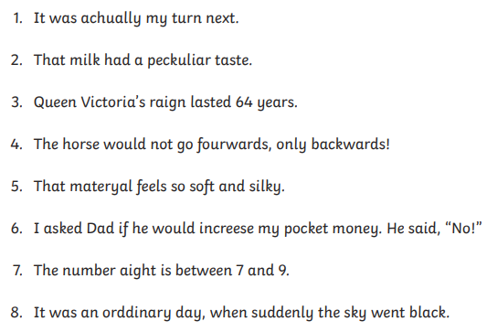
The incorrect spelling from your Year 3 and 4 list has been circled.
Write down the correct spellings.
Find the incorrect spelling from your Year 3 and 4 list.
Write down the correct spellings.

Slide 13
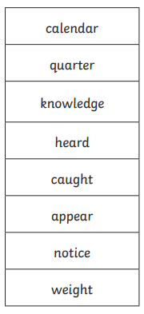
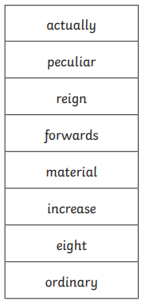
Here are your answers.

Slide 14
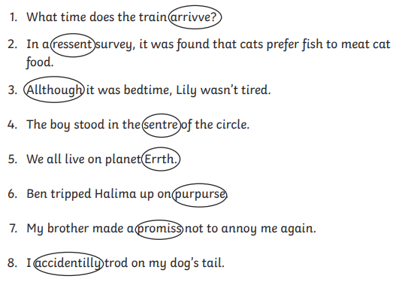
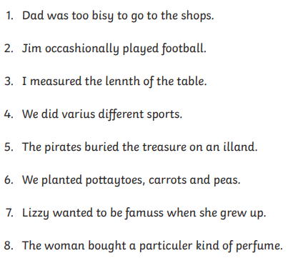
The incorrect spelling from your Year 3 and 4 list has been circled.
Write down the correct spellings.
Find the incorrect spelling from your Year 3 and 4 list.
Write down the correct spellings.

Slide 15
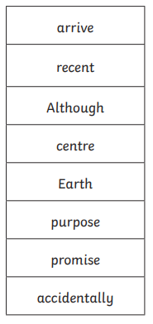
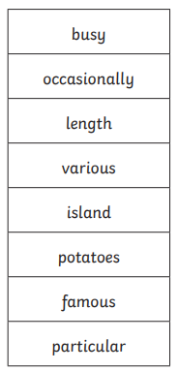
Here are your answers.

Slide 16
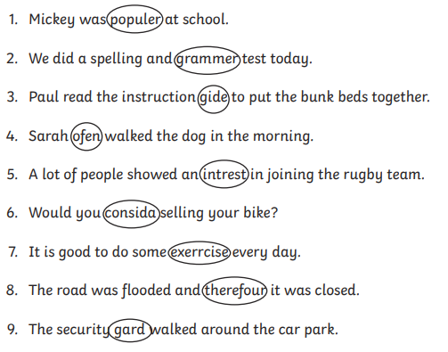
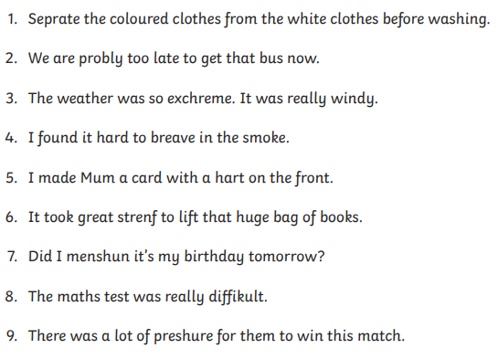
The incorrect spelling from your Year 3 and 4 list has been circled.
Write down the correct spellings.
Find the incorrect spelling from your Year 3 and 4 list.
Write down the correct spellings.

Slide 17
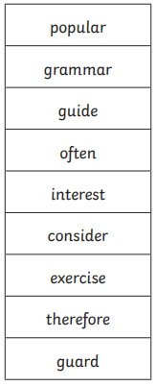
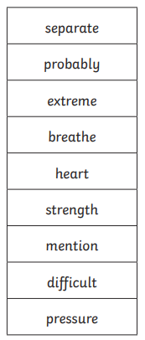
Here are your answers.

Slide 18


Your morning lessons are completed.
Time for lunch.
Then come back this afternoon for your curriculum activity.

Slide 19
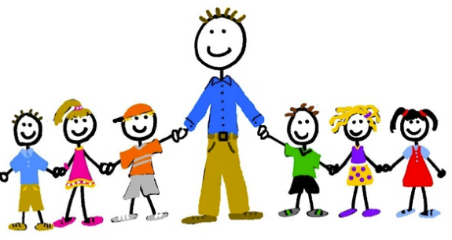

Time to think about next year....
What would you like your teacher to be like when we come back to school in September?
Look at what some of the children on the next slide are hoping for.

Slide 20


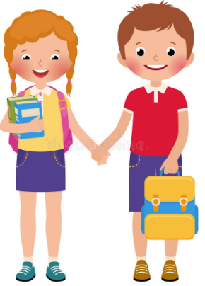


We hope our teacher sets us challenges where we can really think for ourselves.
I love building things so I want my teacher to be good at DT.
We hope our teacher is funny and has some great jokes for playtime.
I hope my teacher is patient when I’m reading because i find it really tricky.
I hope my teacher does Dance in PE because I’m really good at it.

Slide 21
Today’s Task
Write a letter to your new teacher. First tell them something about yourself. Next tell them what you hope they will be like. There are a few ideas to help you.
Dear Teacher,
My name is…
I like…
My favourite…
I love…
I find… tricky
I am looking forward to...
I hope you are…
patient, kind, funny, clever, great at PE, a football fan,
because…
from...

Slide 22

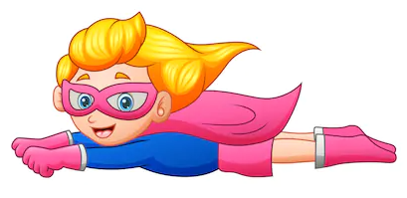
We are not superheroes
We are something even more powerful:
We are teachers!
We don’t need a cape because we are lifted up by YOU the amazing and inspiring children that we teach.
Mr M
Mrs S
We have loved teaching you all and are only sorry that we didn’t get to spend the whole of Year 3 with you in the classroom at school.
We hope you had a good time with us too and that you enjoyed your learning.
We wish you a wonderful Summer Holiday!

