Slide 1


Slide 2
Session 1 - Close Read
Teacher Notes
The purpose of a close read activity is to gain an understanding of the text by reading it multiple times and making sure we really study what the author is trying to tell us.
(All close read texts are age appropriate.)
Close Read Instructions:
Look at the vocabulary highlighted. Do you know what the words mean? The vocabulary box will help you.
Read the text to yourself and think:
What did I just read?
What did it say?
Now read the text again with a grown-up.
Read the questions and now reread the text again to find the clues for your answer.
Answer the questions in writing.

Slide 3

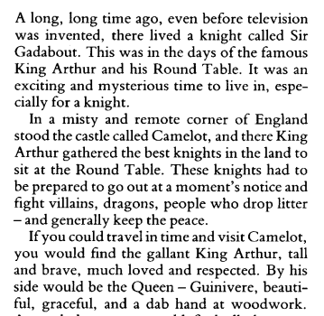
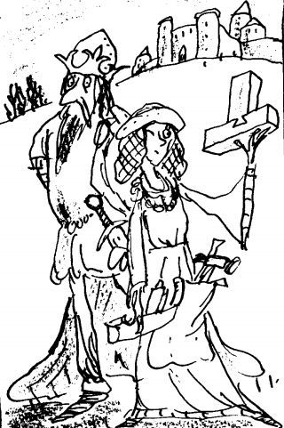
Today’s extract comes from this book.
Vocab Box
misty - light fog
remote - far away part of the land
dab hand - quite good at something
Questions
Why was it an exciting time to live?
What parts of this text do you think are just a bit silly?

Slide 4
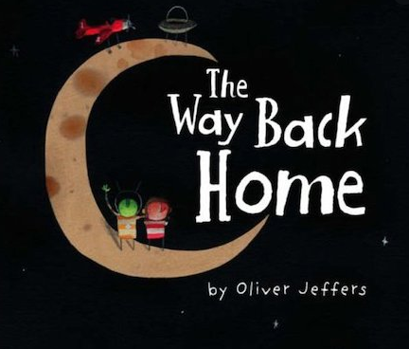
Sessions 2,3,4 and 5
This week, we are going to look at the book called The Way Back Home.
It is written by Oliver Jeffers and is about a really special friendship between a boy and … well I’ll let you find that out.
You can follow the book on the next pages as well as watching it on YouTube (by clicking on the link below).
Each day you have to read a few pages and then do a task.
Have fun!
Click here!
https://www.youtube.com/watch?v=RbyUrb0X5iU

Slide 5
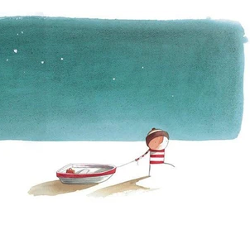
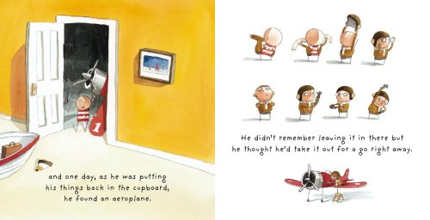
Session 2
1
Once there was a boy,
He didn’t remember leaving it in there but he thought he’d take it out for a go right away.
and one day, as he was putting his things back inthe cupboard, he found an aeroplane.

Slide 6
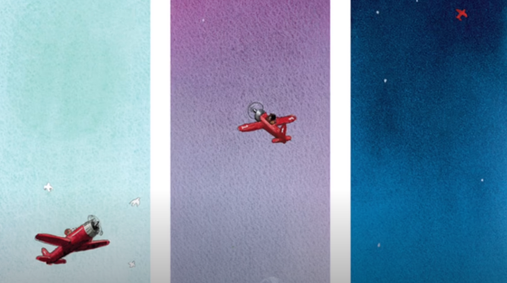
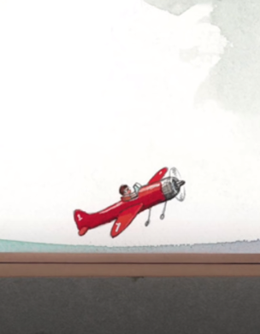
higher
and higher
and higher.
The plane lifted off the ground and up into the sky,,,.

Slide 7
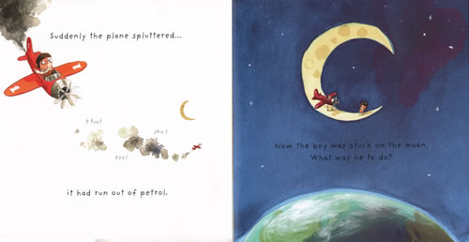
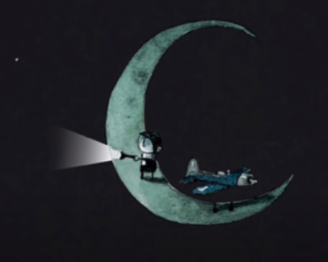
Suddenly the plan spluttered ...
Now the boy was stuck on the moon. What was he to do?
it had run out of petrol.
He was all alone and afraid and soon his torch began to go out.

Slide 8
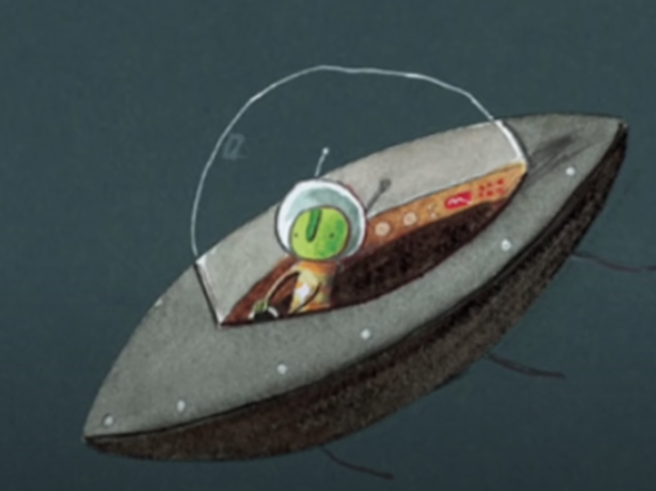
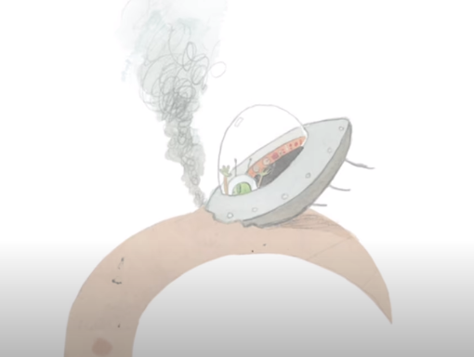
and steering his ship towards a flicker of light, he landed on the moon with a bump.
Up in space someone else was in trouble too.
His engine had broken down...

Slide 9
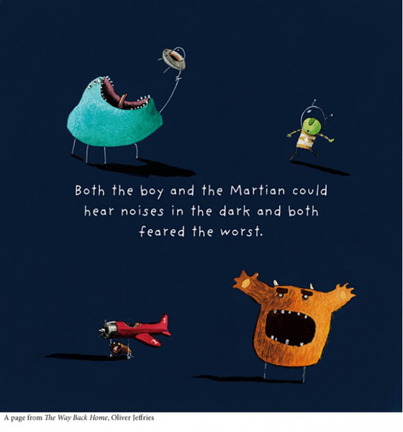

Slide 10
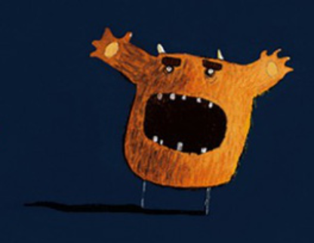
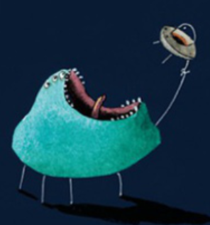
Task 2 - noun phrases.
Oliver and the martian both imagined monsters.
Draw a picture of your own monster.
Label your monster using noun phrases. Remember a noun is a thing (like table, pen, sky, idea) and a noun phrase is a noun with some adjectives to describe it (like huge, razor-sharp fangs covered with oozy slime).
enormous mouth ringed with stubby, white teeth

Slide 11
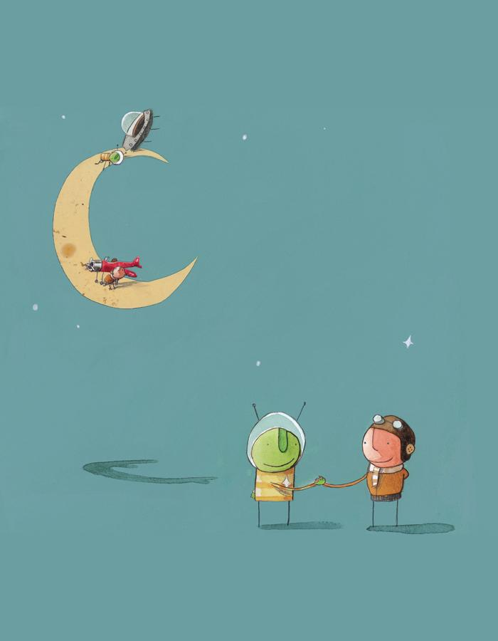
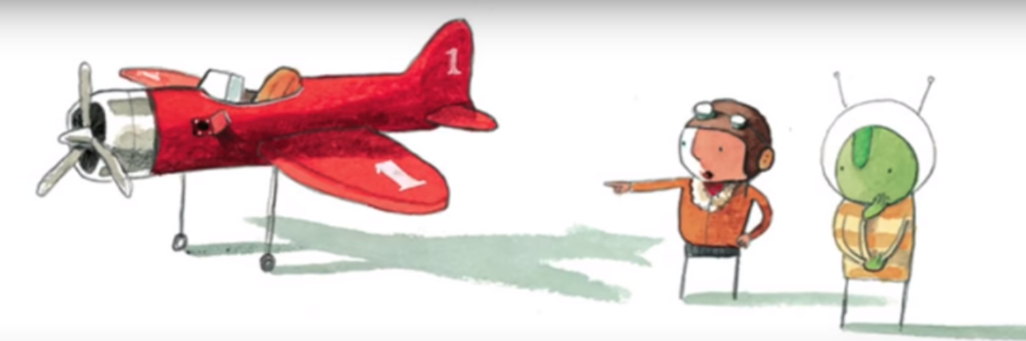
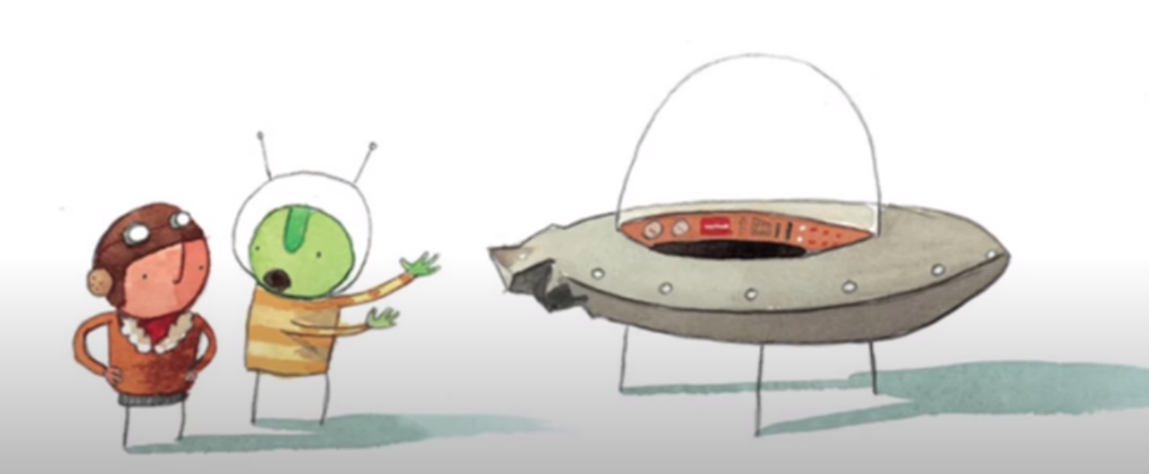
Session 3
But as their eyes got used to the dark, they both realised they’d met someone else in trouble
The boy showed the Martian his empty petrol tank and the Martian showed the boy his broken engine.
They weren’t alone any more.

Slide 12
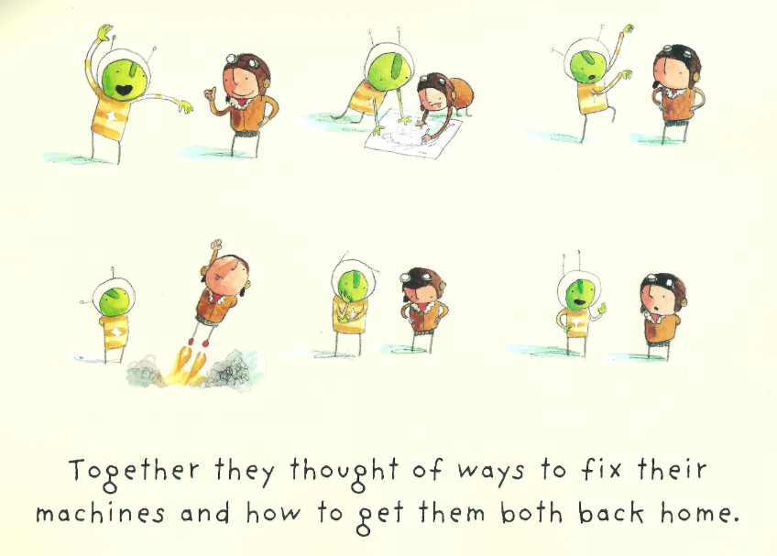

Slide 13
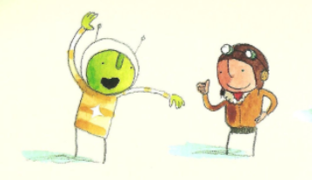
Task 3 - inverted commas (speech marks).
Inverted commas are the “ and “ we put around the words being spoken by a character in our story.
Like this:
“My petrol tank is empty,” said the boy.
My engine should go round and round like this.
Your turn
Copy one of the pictures from the previous screen and draw speech bubbles for the Martian and the boy.
Decide what you want them to say and put it into the bubbles.
Write it down in two sentences like I have done here. DON’T FORGET THE INVERTED COMMAS.
I think I could fix it if I had a spanner.
“My engine should go round and round like this,” explained the Martian.
“I think I could fix it if I had a spanner,” replied the boy.

Slide 14
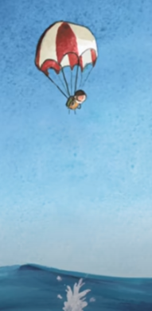
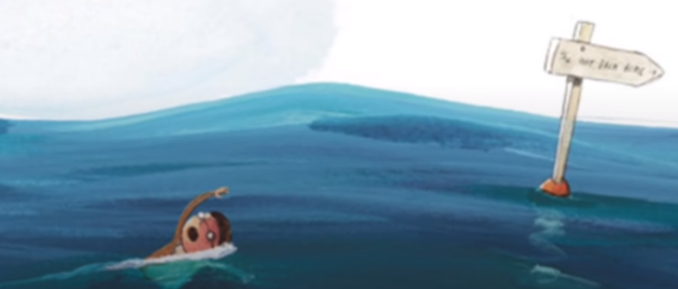
Session 4
The boy jumped down to earth to get the things they would need...
right down into the sea...
and swam towards home.

Slide 15
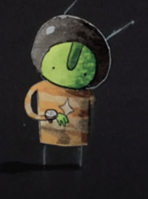
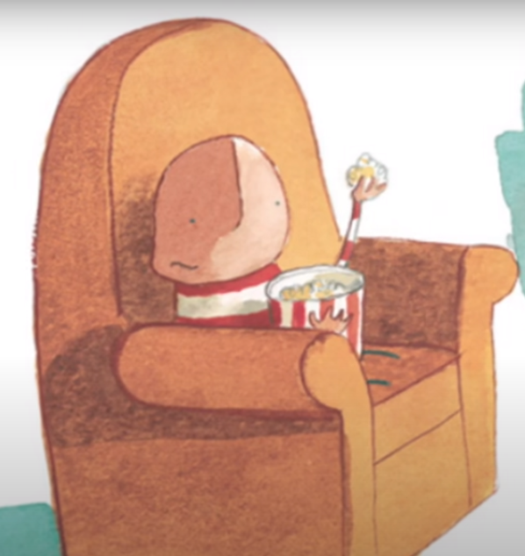
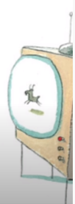
But by the time he got there, the boy was tired so he sat in his favourite chair just to catch his breath.

Slide 16
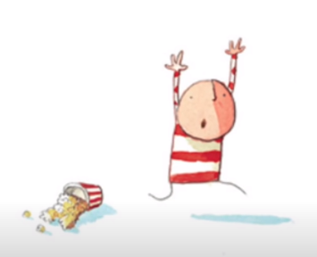
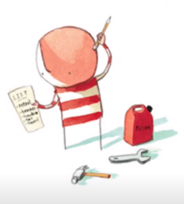
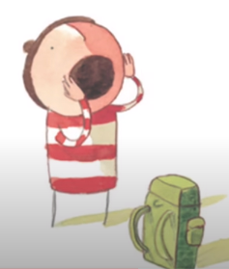
Suddenly he remembered what he should be doing and rushed off to the cupboard to get what he needed.
He ran outside and shouted.

Slide 17
Task 4 - inverted commas (speech marks).
Remember inverted commas we put around the words being spoken by a character? Today we are going to use them with exlamation marks ! and question marks ? .
Hello my friend! Can you hear me?
Your turn
Copy the picture of the boy.
Decide what you want him to shout up to the Martian on the Moon and put it into the bubble.
Write it down in the sentence like I have done here. DON’T FORGET THE INVERTED COMMAS.
Can you think of a better word than said ?
“ Hello my friend ! Can you hear me ? ” said the boy.

Slide 18
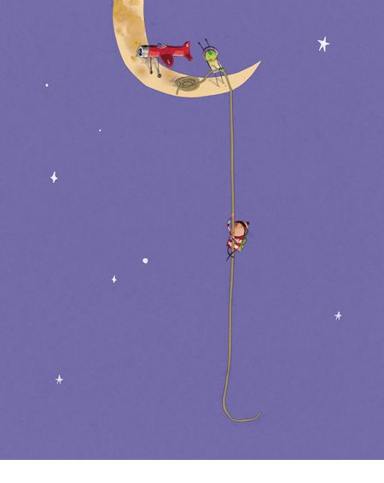
Session 4
The boy began to climb and the Martian began to pull.
Soon the boy was back on the moon.

Slide 19
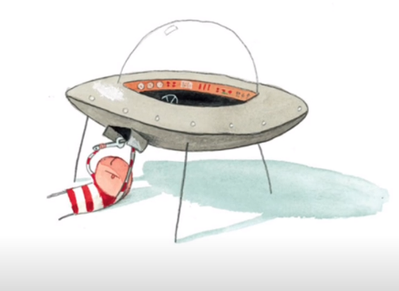
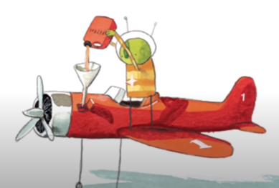
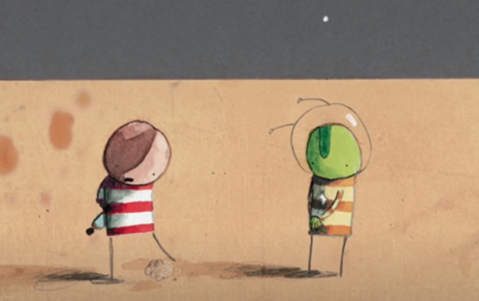
They sad goodbye and thanked each other for their help.
They wondered if they’d ever meet again.
The boy fixed up the Martian’s engine with the right spanner and the Martian filled the boy’s petrol tank.

Slide 20
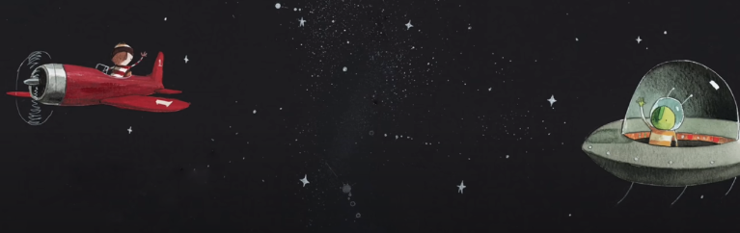
After a long night they were both finally off the moon.
The boy went one way and the Martian went another, both on their way back home.

Slide 21
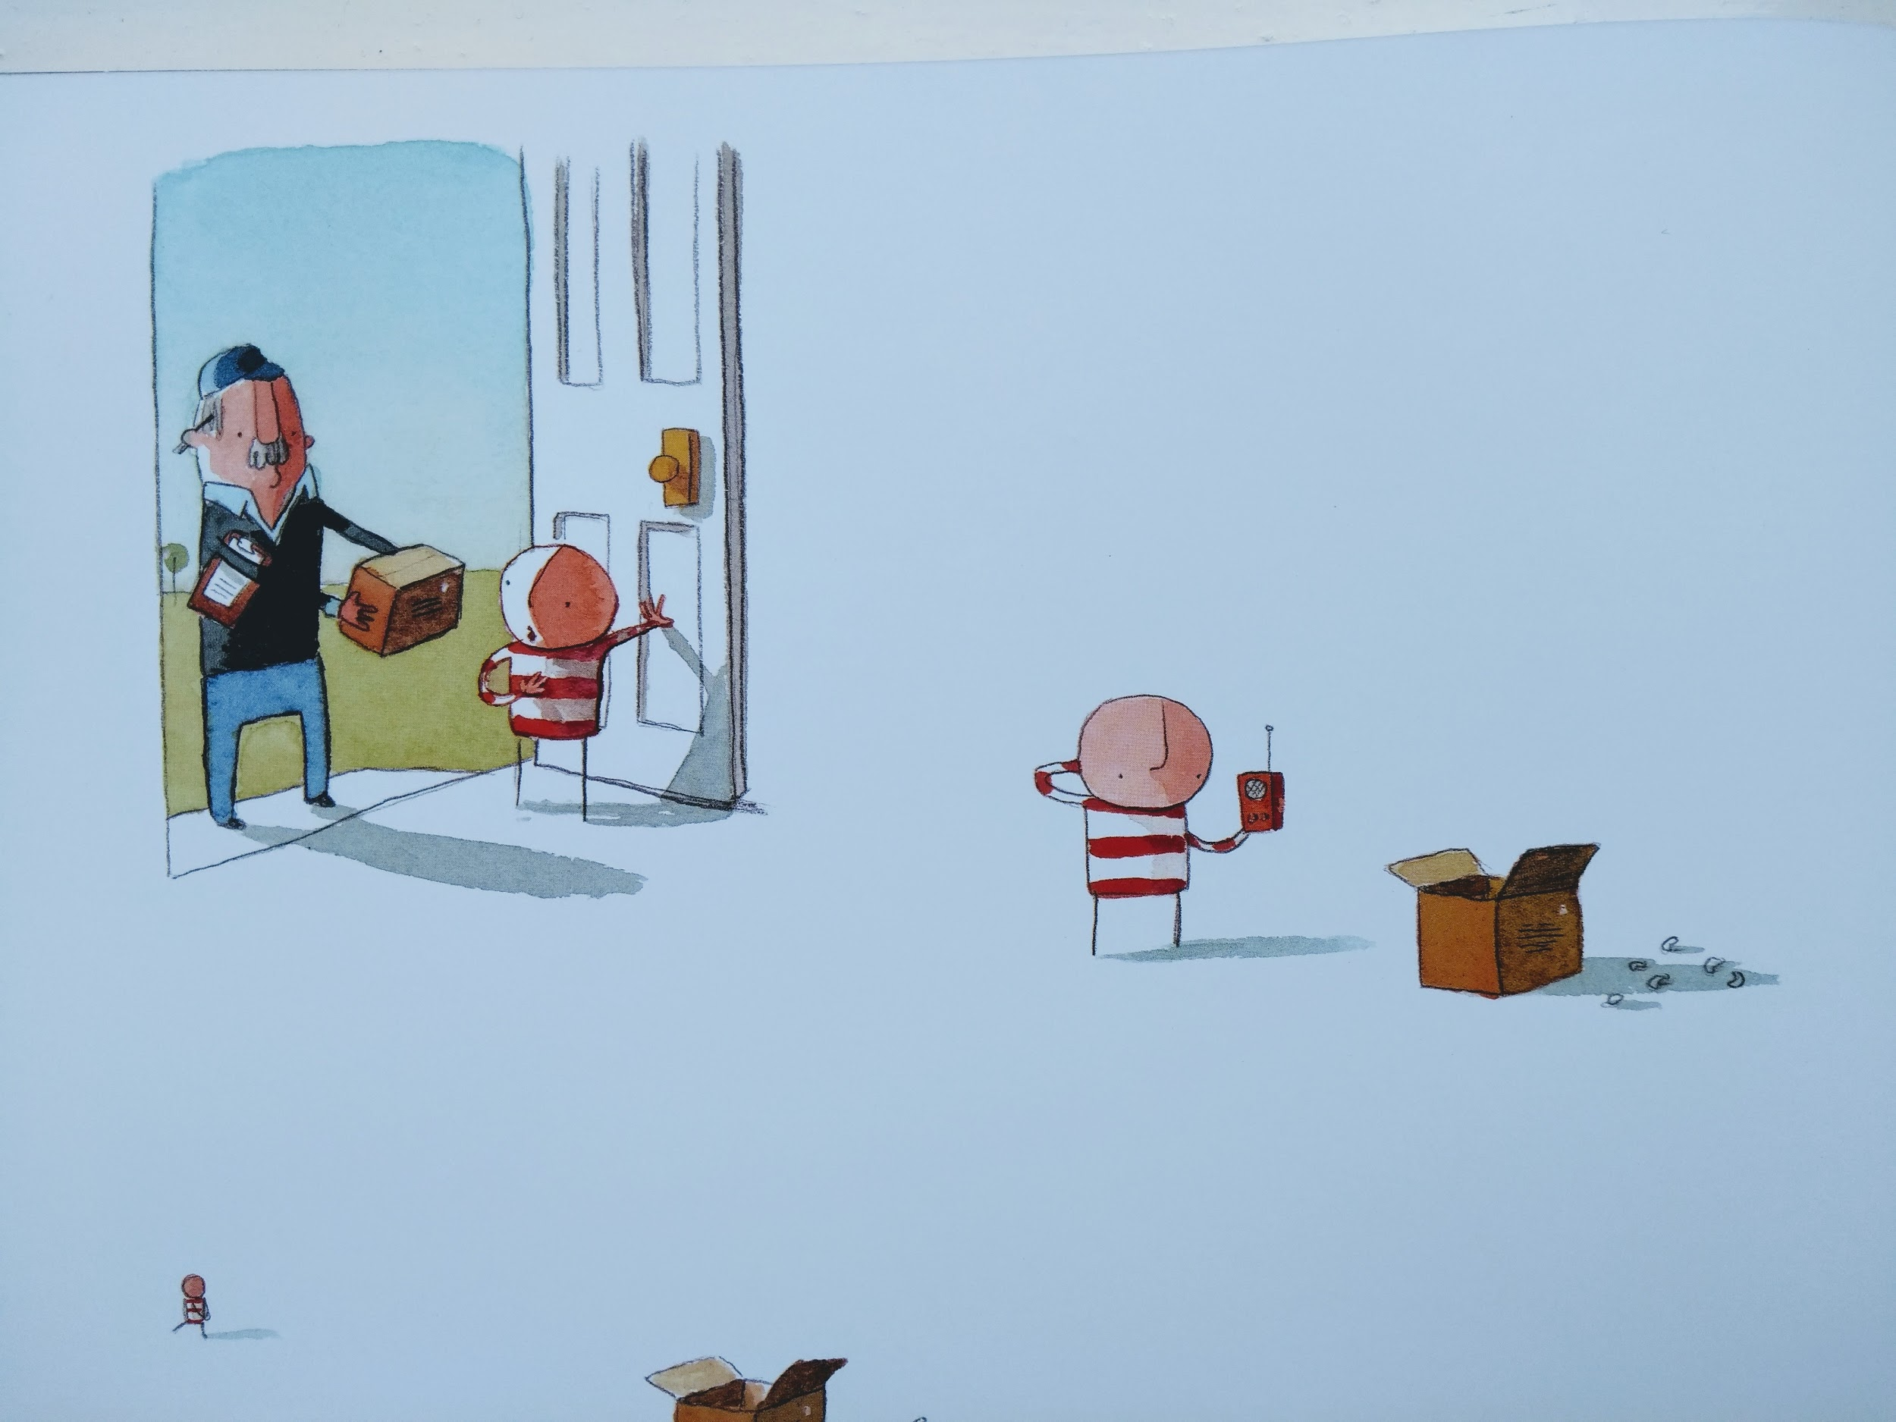
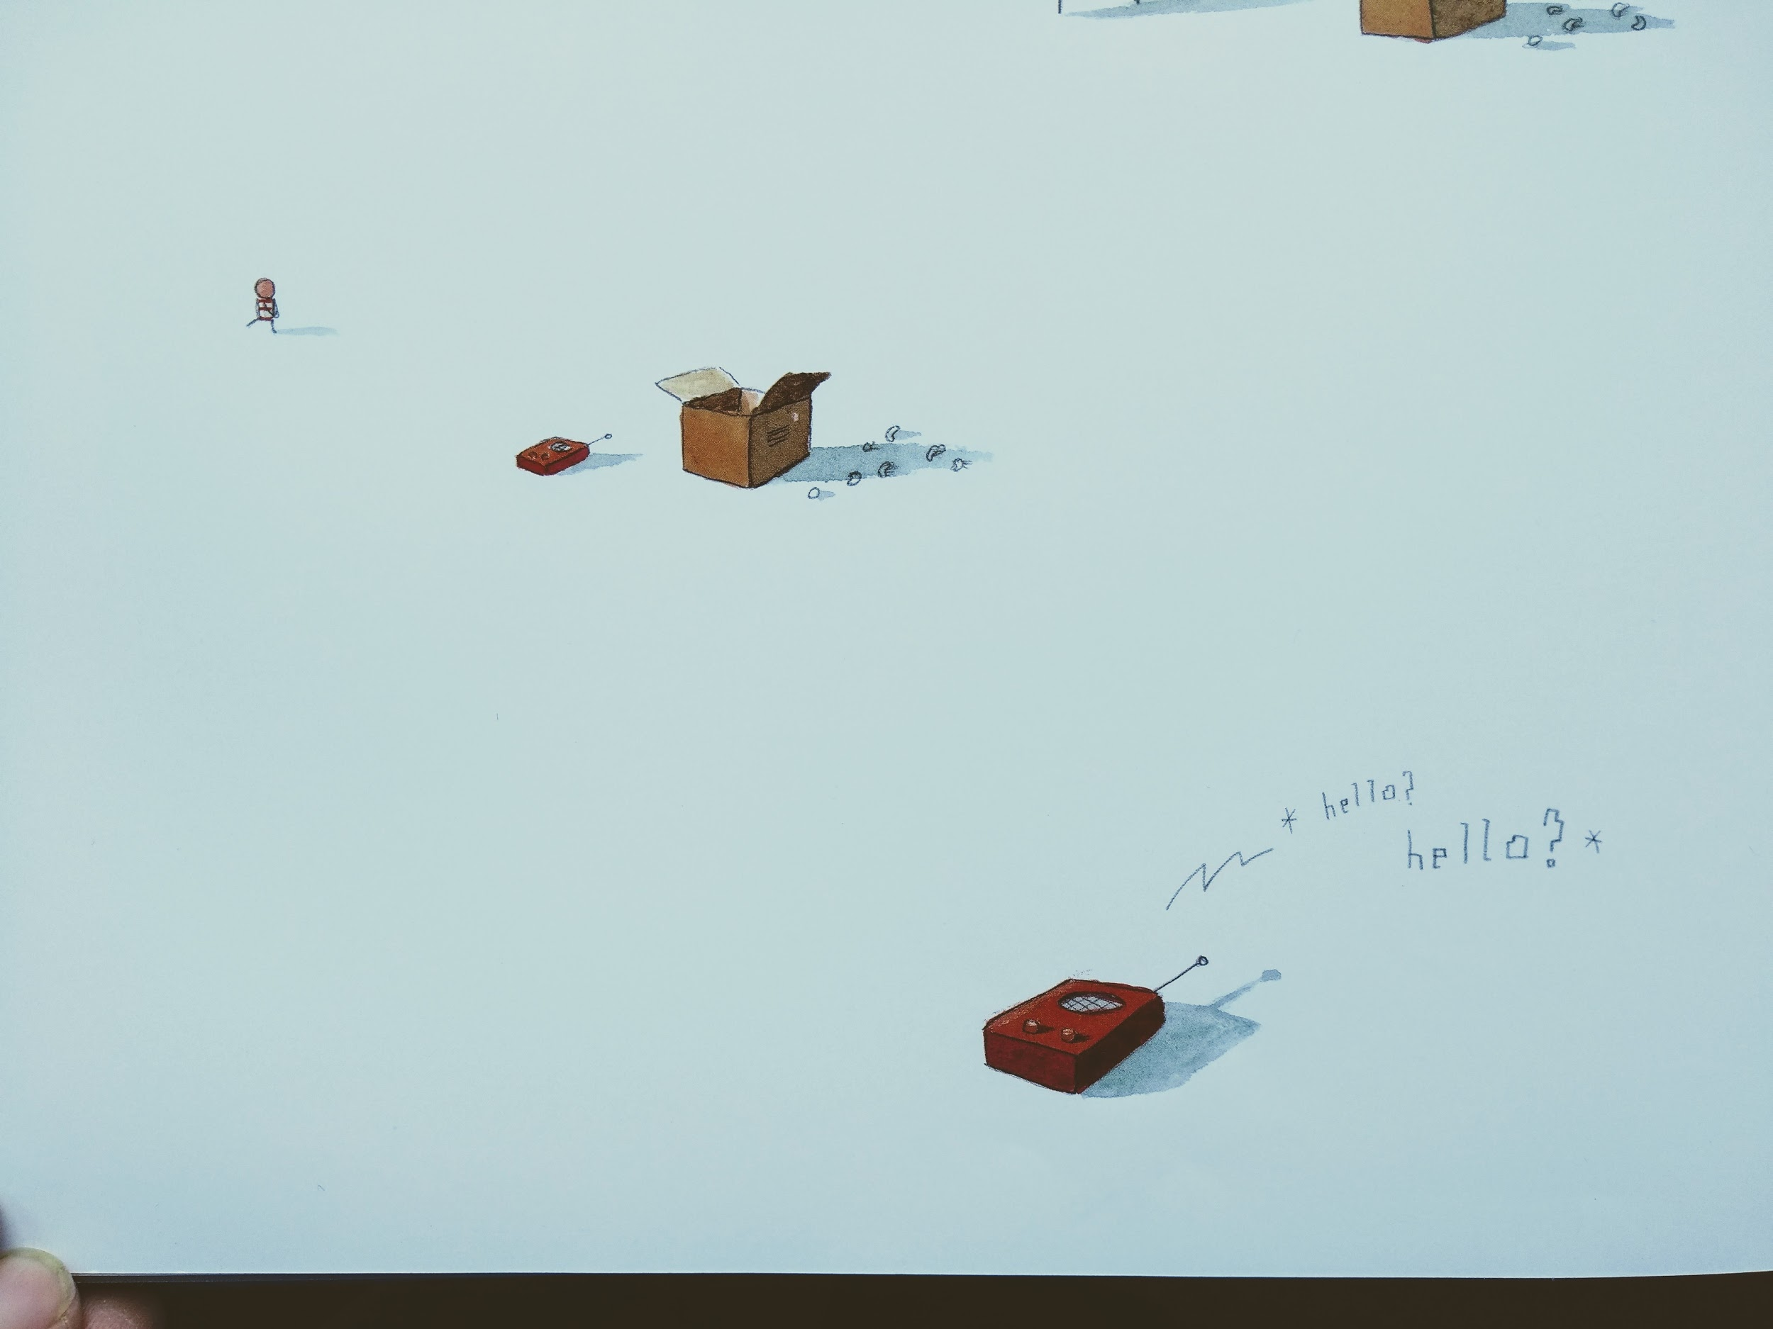
A few weeks later, a parcel arrived.
What was it?
Who could it have been from?

Slide 22

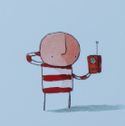
Task 5 - inverted commas (speech marks).
Hi! It’s me! Did you make it home okay?
Your turn
Imagine a conversation between the boy and the Martian over their walkie-talkies.
Write down in sentences what they might say to each other. DON’T FORGET THE INVERTED COMMAS.
Shall we meet again one day?
I never got to know your name!
Hi! I miss you so much!
Thanks for helping me back up to the moon.

Slide 23
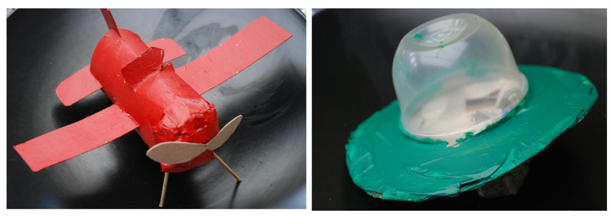
If you have time, why not try to make a model of the boy’s aeroplane or the Martian’s space ship?

