Slide 1


Slide 2
Session 1 - Close Read
Teacher Notes
The purpose of a close read activity is to gain an understanding of the text by reading it multiple times and making sure we really study what the author is trying to tell us.
(All close read texts are age appropriate.)
Close Read Instructions:
Read the blurb about the text to see where it it taken from.
Look at the vocabulary highlighted. Do you know what the words mean? The vocabulary box will help you.
Read the text to yourself and think:
What did I just read?
What did it say?
Now read the text again with a grown-up.
Read the questions and now reread the text again to find the clues for your answer.
Answer the questions in writing.

Slide 3
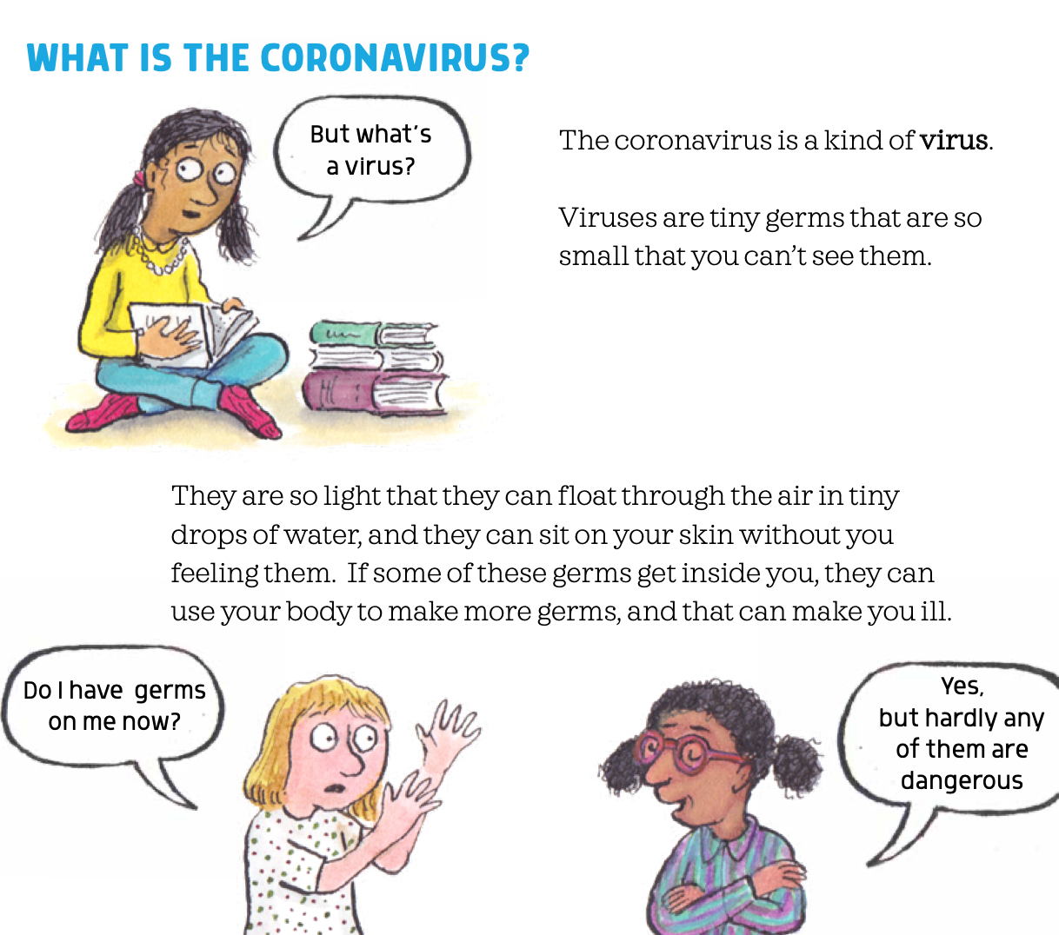

Today’s extract comes from a brand new book!
Questions
Write down 2 things that the coronavirus germs can do becuase they are so small.
Should the girl in the spotty top be worried about germs? Explain your answer.

Slide 4
Session 2 - Sentence Writing
Teacher Notes
The purpose of this session is to make sure that the verbs used in a sentence are in the correct tense.
To do this. We have to check that the verb.
Verbs can be in the present tense:
I watch the TV today.
OR
They can be in the past tense:
I watched the TV yesterday.
Often we add ed to the of a verb to change to the past tense (jump -> jumped). Sometimes, the whole verb changes (run-> ran).
Answers on the next page.

Slide 5
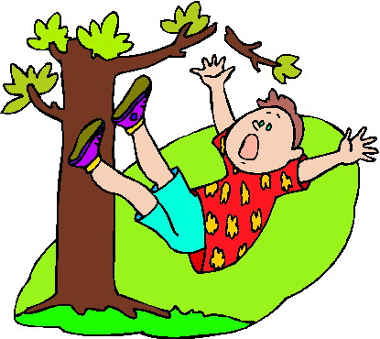
Change each sentence into the past tense by changing the verb. The first one has been done for you.
Last week I walk to the shops.
Last week I walked to the shops.
The day before, James climb up the tree.
The boy fall out out the tree.
Jane run as fast as she could.
Paula and Kenny hop on one leg.
The cat grab the mouse by its tail.

Slide 6
Answers
Last week I walked to the shops.
The day before, James climbed up the tree.
The boy fell out out the tree.
Jane ran as fast as she could.
Paula and Kenny hopped on one leg.
The cat grabbed the mouse by its tail.

Slide 7
Session 3 - Sentence Writing
Teacher Notes
The purpose of this session is to practise some precise grammar skills in sentence writing. The skill we are looking at today is to use conjunctions to join two parts (clauses) of a sentence together.
Here is a sentence:
I took my umbrella because it was raining.
The two blue parts (the clauses) are joined by the red conjunction because .
This is more interesting than just writing:
I took my umbrella. It was raining.
Other conjunctions we will use in this session are: and , but

Slide 8
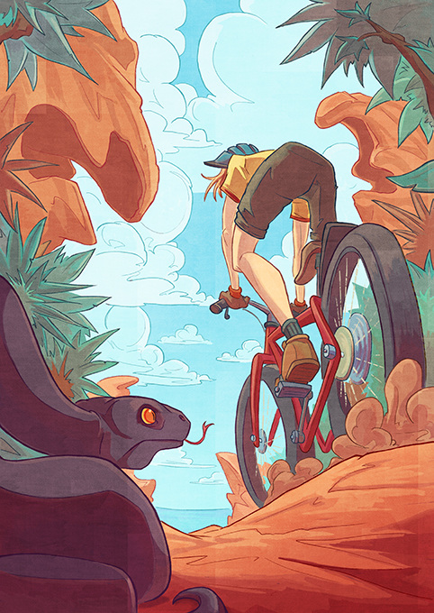
Here is part of a story. Read it and spot the conjunctions:
and but because .
Jo had been waiting to get on her bike all morning. She was upset because her mum had said she must tidy her bedroom before she went out. It took her a lot longer to clean her room than she had hoped and now it was nearly eleven o’clock.
Finally, she was ready and she wheeled her red mountain bike down the drive. Soon she was racing along the dirt track towards the sea and she felt her heart pound with excitement. Jo hoped it would be another fab day but someone had just slithered out of the bushes to change that!

Slide 9
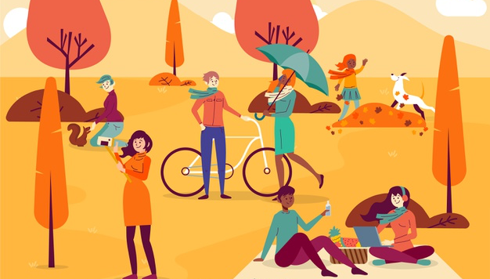
Copy these sentences down and choose the best conjunction (and but because) to fill in the gap. The first one has been done for you.
Now, finish off these sentences (use the picture to help you):
Jane smiled because she was taking a selfie.
Marie took her umbrella ______ she though it might rain.
Flo was eating her picnic ____ Jess was working on her laptop.
Rob had put a scarf on _____ he was still cold.
The dog wagged his tail because __________ .
The sun was shining and __________ .
Lil had got some nuts for the birds but __________ .

Slide 10
Session 4 - Reading Comprehension
Teacher Notes
Typically reading comprehension extracts are longer than those used for Close Read exercises. The purpose of the reading comprehension is, as the name suggests, to develop and demonstrate an understanding of the text. Your child should be encouraged to read the text twice before attempting to answer the questions. They should refer to the text as they are answering the question using the techniques of scanning (searching the text for a key-word) and skimming (‘hopping’ over the text not reading every word in order to locate the part where the answer may lie).
Reading Comprehension Instructions:
This text is taken from an extract of a book called Popcord Eating Squirrels go Nuts on Everest
Read the text.
Now read the text again with a grown-up.
Read the questions and now reread the text again to find the clues for your answer (look for key-words in the question and use scanning and skimming to help you find them in the text.
Answer the questions in writing.

Slide 11
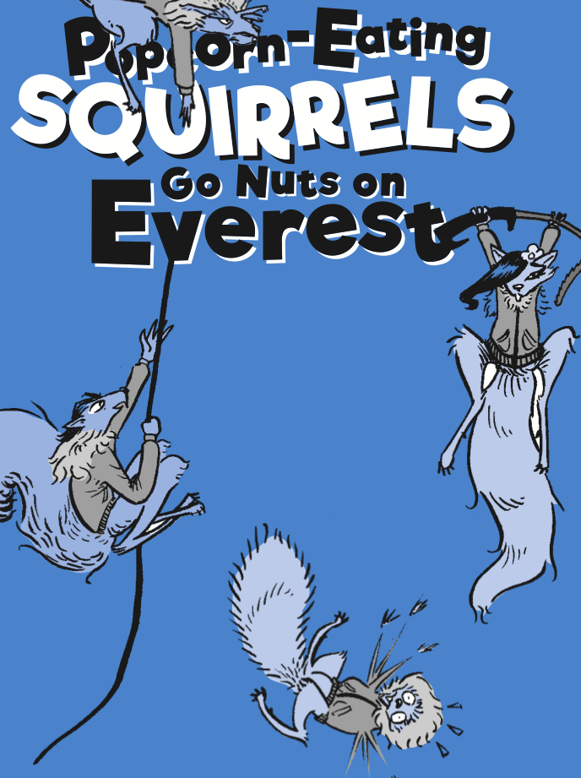
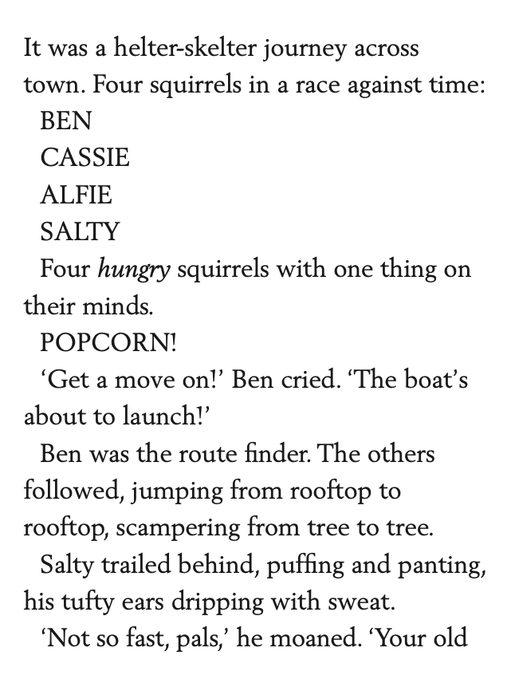
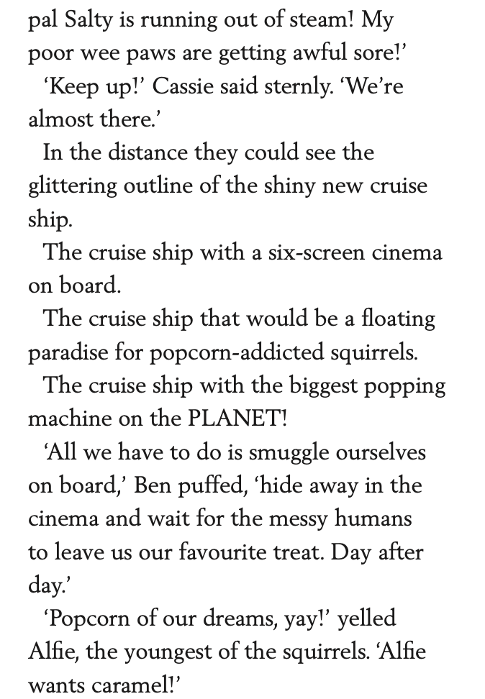
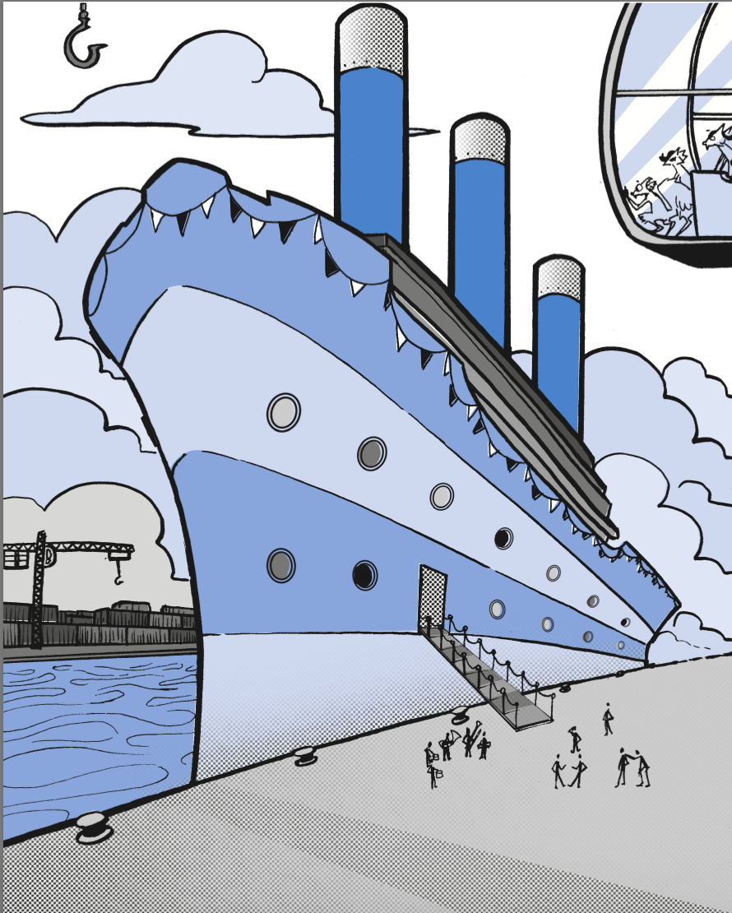

Slide 12
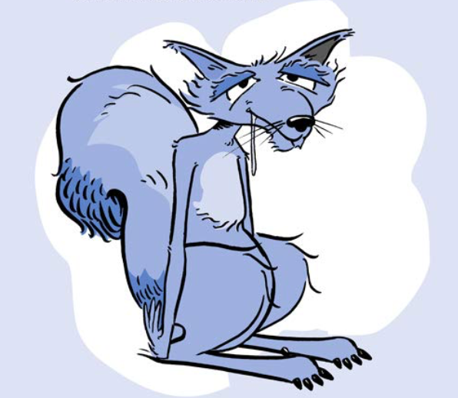
Questions
What are the names of the 4 squirrels?
What is the only thing on their minds?
What is Ben’s job (choose one)?
  treasure finder
  route finder
  food finder
  tree climber?
Why are the squirrels in a hurry?
What is the verb used to describe the way the squirrels moved from rooftop to rooftop?
Salty trailed behind, puffing and panting, his tufty ears dripping with sweat. What does this tell you about Salty squirrel.
How many screens does the ship’s cinema have?
Why do the squirrels want to hide in the cinema?
(Answers on the next page.)

Slide 13
Answers
What are the names of the 4 squirrels? Ben, Cassie, Alfie, Salty
What is the only thing on their minds? Popcorn
What is Ben’s job (choose one)?
  treasure finder
  route finder
  food finder
  tree climber?
Why are the squirrels in a hurry? The ship is about to sail away (launch).
What is the verb used to describe the way the squirrels moved from rooftop to rooftop? jumping
Salty trailed behind, puffing and panting, his tufty ears dripping with sweat. What does this tell you about Salty squirrel. He is very hot and tired.
How many screens does the ship’s cinema have? Six
Why do the squirrels want to hide in the cinema? So that they can eat the popcorn dropped by the messy humans.

Slide 14
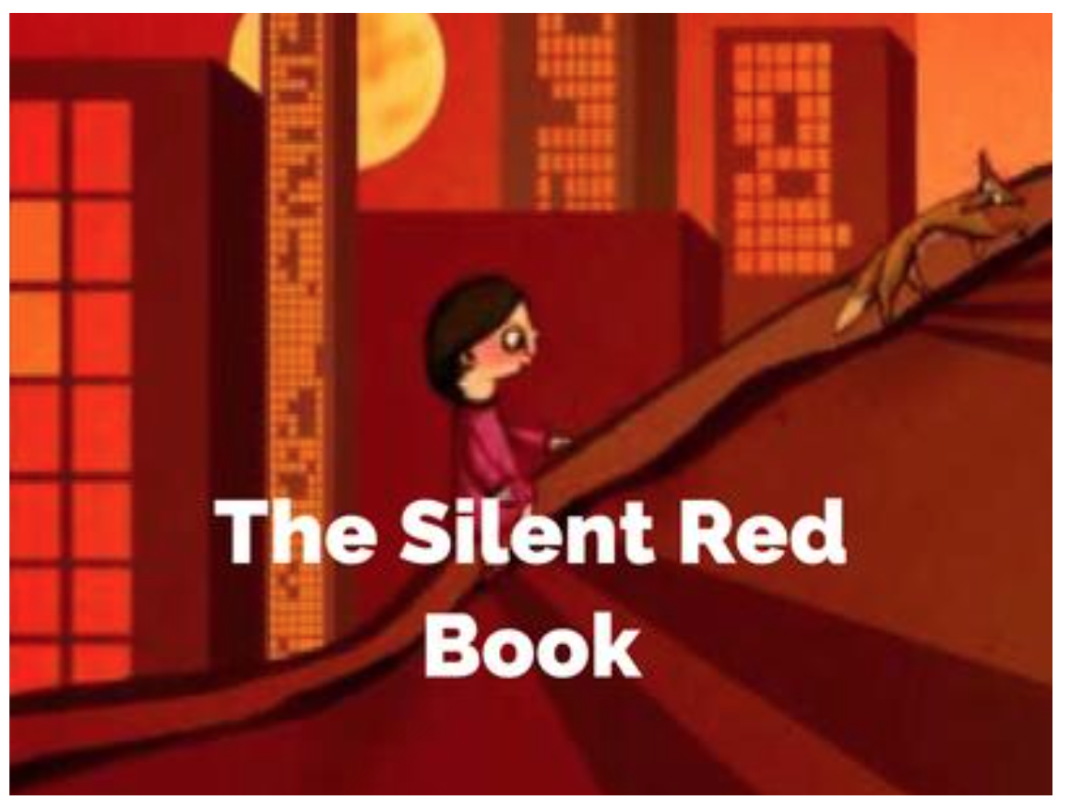
Session 5 - Writing Task
Teacher Notes
Instructions:
On the next page is a link to a video of a short story called The Silent Red book.
You need to watch the video (two times)
You need to write the story in your own words.
When you have finished, go back and check you writing for spellings, CL, FS and sense.

Slide 15
Click on the picture to watch the video.
When you have watched the video, tell the story in your own words.
When you have finished, check your work:
spelling
CL & FS
sense
Here are some words that you might need to spell:
city
station
hungry
lonely
rubbish bins
angry
climbed
gazed
shooting star
shadows
remembered
https://www.literacyshed.com/silentredbook.html

