Slide 1


Slide 2
Session 1 - Close Read
Teacher Notes
The purpose of a close read activity is to gain an understanding of the text by reading it multiple times and making sure we really study what the author is trying to tell us.
(All close read texts are age appropriate.)
Close Read Instructions:
Read the blurb about the text to see where it it taken from.
Look at the vocabulary highlighted. Do you know what the words mean? The vocabulary box will help you.
Read the text to yourself and think:
What did I just read?
What did it say?
Now read the text again with a grown-up.
Read the questions and now reread the text again to find the clues for your answer.
Answer the questions in writing.

Slide 3
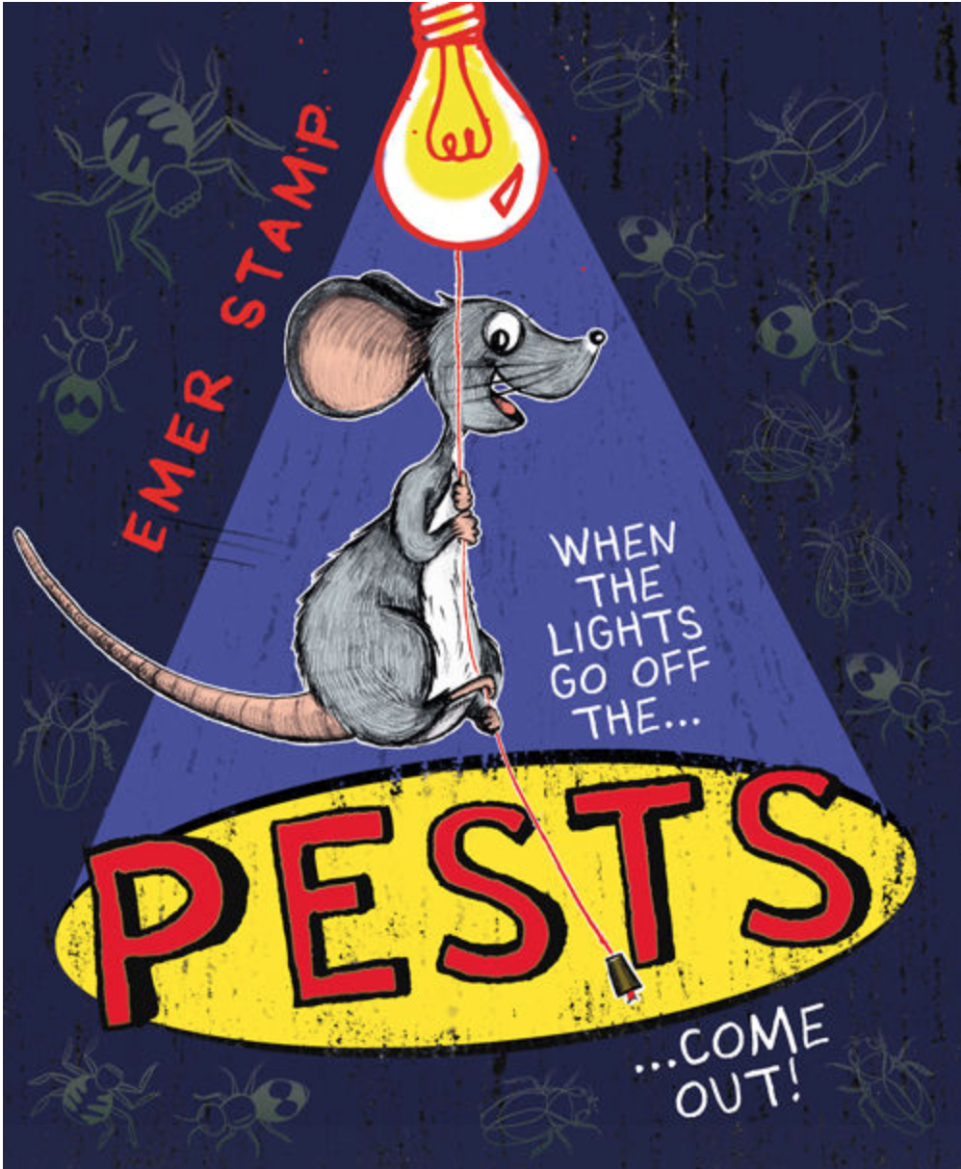
Blurb
Today’s extract is from the book Pests about a mouse called Stix. He probably lives behind your washing machine, but you wouldn't know it, because his grandma taught him to always stay out of trouble and NEVER let the humans know he's there.

Slide 4
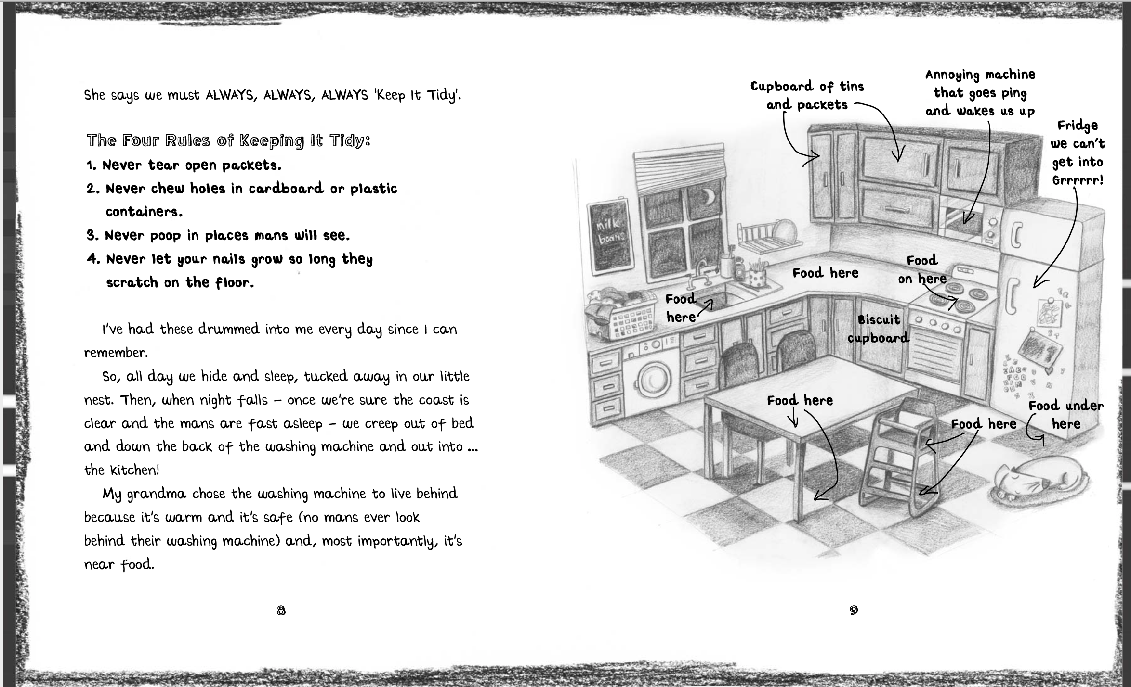
Vocabulary Box
drummed into me - told again and again until I can’t forget (like a drumbeat rhythm stuck in your head).
coast is clear - what someone who is keeping a look-out says to tell you that it’s safe to come out of your hiding place. It’s what smugglers used to say!

Slide 5
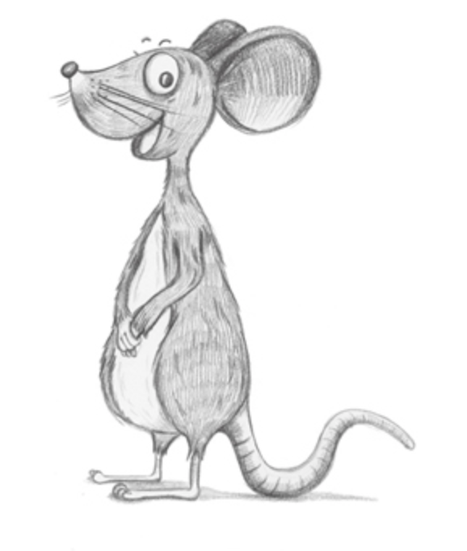
Questions
Read the 4 rules of keeping tidy. They are not just about keeping tidy, why else might Stix’s grandma have made these rules?
Why did his grandma choose their home to be behind the washing machine?
Draw a picture of your kitchen labelling all the places a mouse might:
  find food
  choose to live
  find things scary or annoying.

Slide 6
Session 2 - Sentence Writing
Teacher Notes
The purpose of this session is to practise some precise grammar skills in sentence writing. The skill we are looking at today is to use adjectives (describing words) effectively. The purpose of using adjectives is to make our descriptions clearer and to ‘paint’ a specific picture in the reader’s mind. We suggest that no more than two adjectives are used to describe something (where two are used, a comma may be used to separate them). To use adjectives effectively, they must add something - there is little use in using tall to describe a skyscraper or green to describe grass.

Slide 7
How many adjectives can you find in this extract?
They had to cross the river on the stone bridge. Will looked back down at the old mill as he and Mum climbed the cobbled street on the other side. The tall trees that grew along the riverbank blocked the view, but a warm breeze parted the branches for a second. Was that a face in the top-floor window? Ghost-white, it was looking down at the rushing water. Then the thick leaves hid the building again.
Answer:
stone old cobbled tall warm ghost-white rushing thick

Slide 8
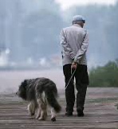
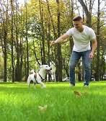
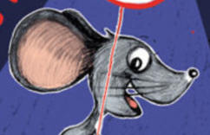
Copy out each sentence two times. Add different adjectives each time to change the meaning of the sentences. The first one has been done for you.
The old man walked down the deserted lane with his faithful dog.
The fit, young man walked down the grassy lane with his playful dog.
2. Inside the room, ____________ woman sat on her ____________ chair.
3. They watched as the ____________ ship sailed across the ____________ sea.
4. Suddenly, the ____________ puppy wagged his ____________ tail.
5. Together, the ____________ children crept down the ____________ passageway.
6. ____________ clouds drifted across the ____________ sky towards the ____________ forest.
Hints:
You can use either one or two adjectives in each place. If you use two, try to put a comma (,) in between them.
Colours are okay to use as long as you use another adjective with them ( e.g. oozy, green slime)

Slide 9
Session 3 - Reading Comprehension
Teacher Notes
Typically reading comprehension extracts are longer than those used for Close Read exercises. The purpose of the reading comprehension is, as the name suggests, to develop and demonstrate an understanding of the text. Your child should be encouraged to read the text twice before attempting to answer the questions. They should refer to the text as they are answering the question using the techniques of scanning (searching the text for a key-word) and skimming (‘hopping’ over the text not reading every word in order to locate the part where the answer may lie).
Close Read Instructions:
This text is about a famous explorer - Christopher Columbus - who we will be looking at in History sessions.
Read the text.
Now read the text again with a grown-up.
Read the questions and now reread the text again to find the clues for your answer (look for key-words in the question and use scanning and skimming to help you find them in the text.
Answer the questions in writing.

Slide 10
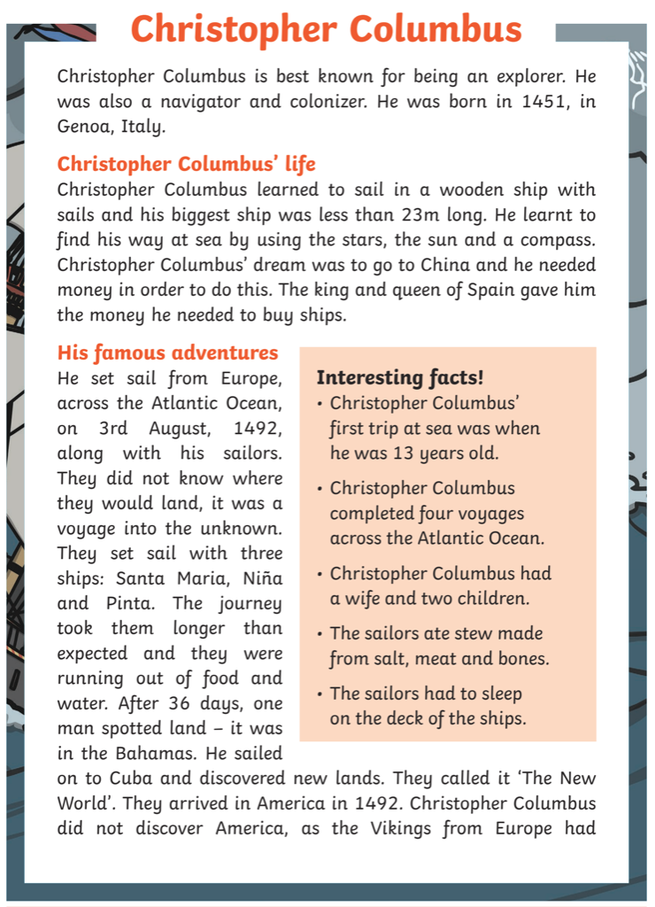
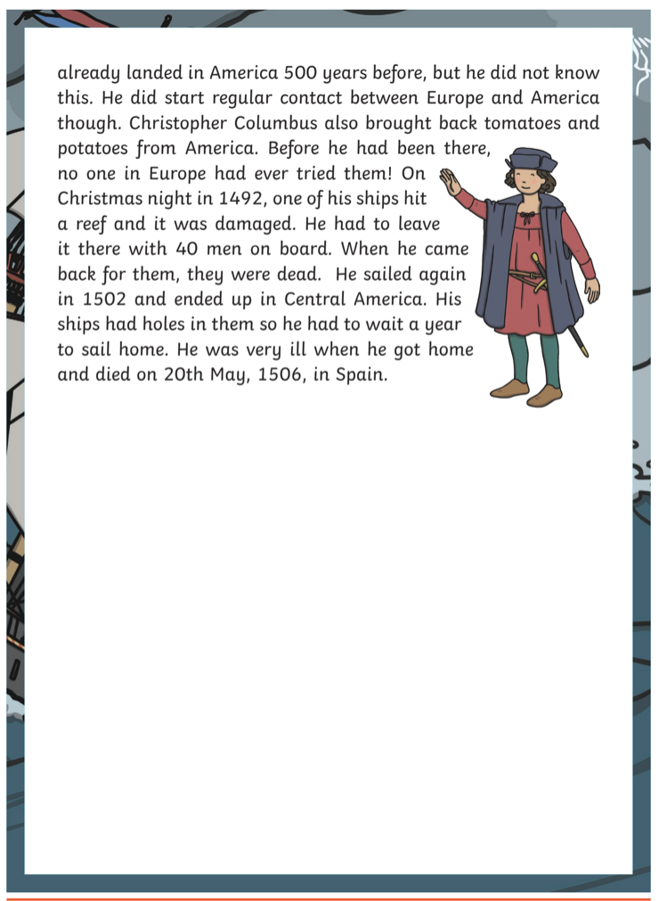
Now look on the next page for the questions...

Slide 11
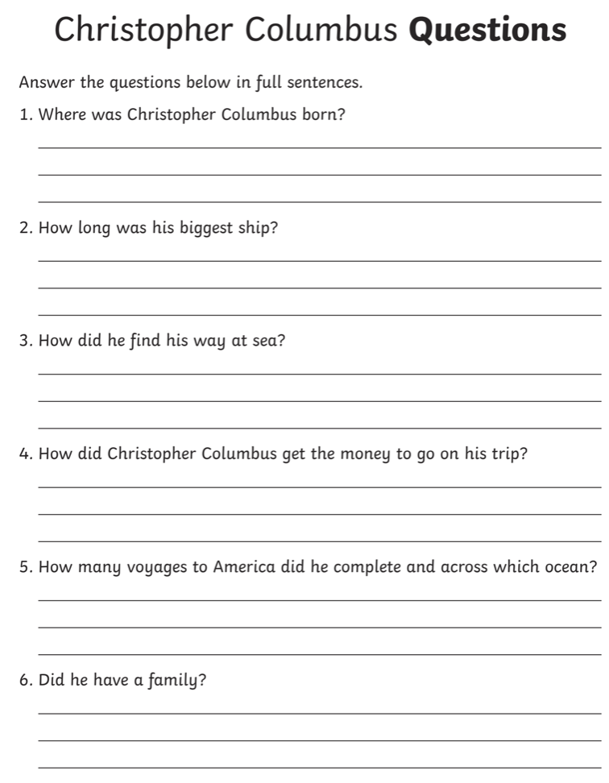
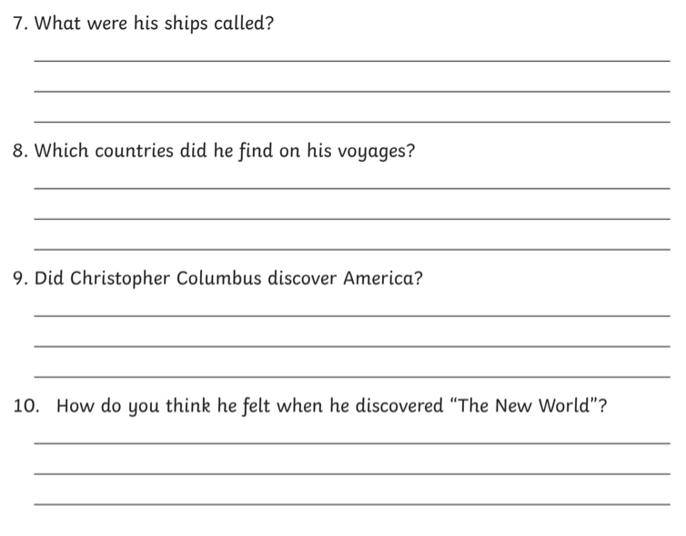
When you have finished, show your grown up and check your answers with them (on the next page).

Slide 12
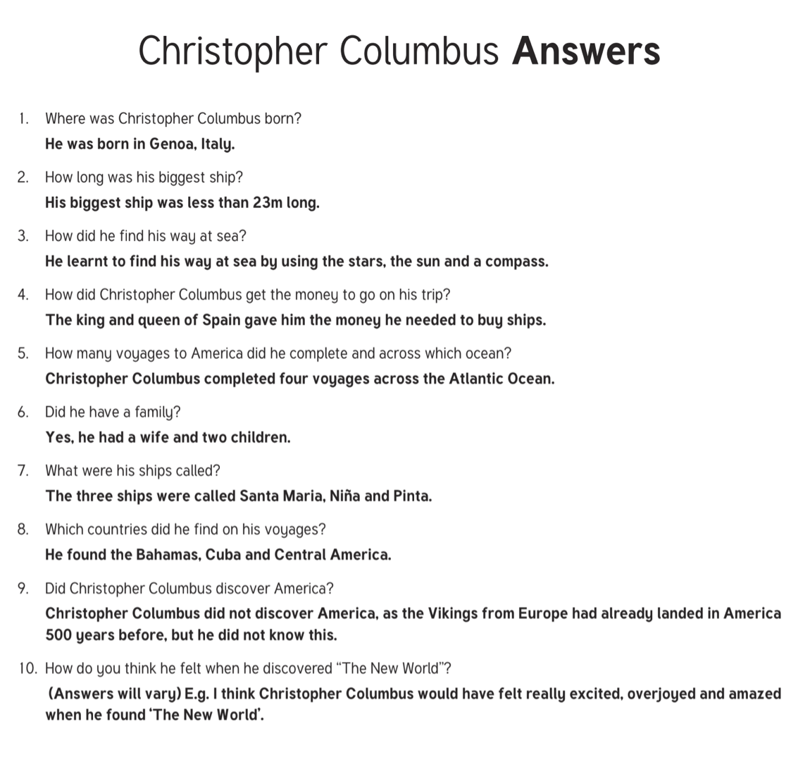

Slide 13
Session 4 - Writing Task
Teacher Notes
This is an open-ended writing task with a picture as the prompt. Hopefully, it provides scope to practise using some great adjectives. The writing need not be a whole story, it could be just part. The initial task just gets the children to discuss what they definitely know from looking at the picture, what they think they might now (i.e. infer) and what they wonder (this is where the story-making ideas start forming).
Once your child has had a go at writing the story, ask them to proof-read it, this is where they look at any spellings which they think may not look right, check for grammatical errors (capital letters and full stops) and whether the sentences actually make sense. Have fun!
Instructions:
On the next page is a picture that we would like you to use to write a story.
The first task is to look copy the table onto a piece of paper and write down what you know for sure by looking at the picture, what you think you know and what you wonder (who could the girl be, where could they be going, how did she train that tiger, what has she got in her hand). Don’t forget to look really closely at the picture.
Then have a go at writing part of a story based on the picture.
When you have finished, go back and check you writing for spellings, CL, FS and sense.

Slide 14
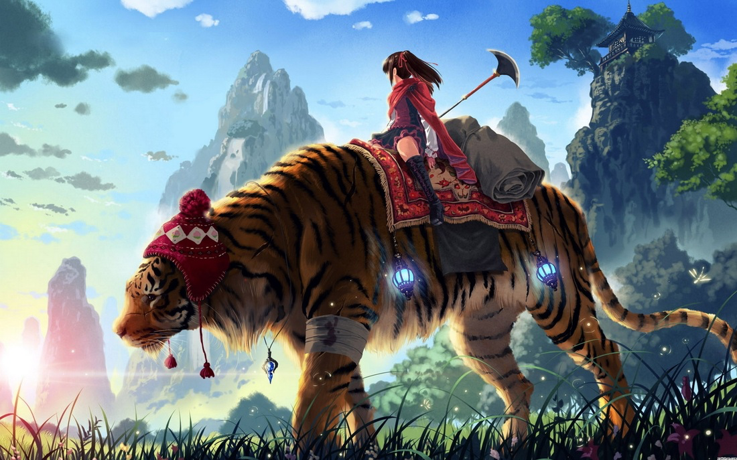

Slide 15
What I know from looking at the picture | What I think I know | What I wonder

Slide 16
Now here is your chance to write part of the story based on the picture.
Here are some key words that might help.
tiger
striped
warrior
wounded
bandage
mountains
lanterns
distance
Tibet
mysterious
forest
clearing
rode
travelled
quest
journey

Slide 17
Session 5 - Improving Writing
Teacher Notes
This activity gives your child an opportunity to read an existing piece of writing, to correct and to improve it. There are errors in spelling, punctuation (missing capital letters, question marks) and grammar (tense, singular/plural agreement) and general sense. In addition to this, your child could be encouraged to add improvements or replace weak adjectives (e.g. nice, big, happy).
Instructions:
Read my version of the story.
There are mistakes, can you copy the writing but correcting the mistakes (some of these have been done in a different colour to help you).
Can you improve my writing by using better adjectives
Challenge: Can start some of the sentences off in more intresting ways?

Slide 18
tibet was a larger country than Hina had imagined. it had taken almost three weeks for there journey across it. She had worry about toran’s leg the hole time. He had been limp badly and the blud from his wound was beginning to show threw his bandage. They left the big dark forest behind them and looked across at the big mountins to the north. had they really manage cross them. it seemed hard to imagine now. the sun was beginning to rise. And hina new that the lanterns that hung from the corners of her rug wood soon go owt. It was going to be another hot day. they was warm. Toran seemed lost in his thoughts.
Hina heard a sound to her left and twisted round to peer into the distants. Wot cud it have been
Key
__ - spelling
wrong tense
wrong singular/plural

