Slide 1


Slide 2
Session 1 - Close Read
Teacher Notes
The purpose of a close read activity is to gain an understanding of the text by reading it multiple times and making sure we really study what the author is trying to tell us.
(All close read texts are age appropriate.)
Close Read Instructions:
Look at the vocabulary highlighted. Do you know what the words mean? The vocabulary box will help you.
Read the text to yourself and think:
What did I just read?
What did it say?
Now read the text again with a grown-up.
Read the questions and now reread the text again to find the clues for your answer.
Answer the questions in writing.

Slide 3
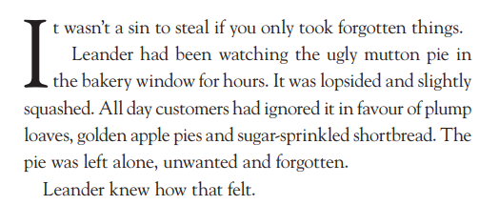
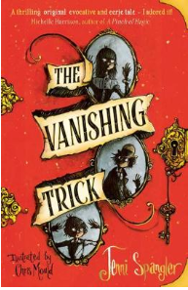
Vocab Box
mutton - cheap, meat (from sheep)
sin- something that’s wrong to do
lopsided - leaning to one side
in favour of - chosing something
better
Today’s extract comes from this book.
Questions
Why do you think no-one wanted the mutton pie?
How does the author make the loaves, apple pies and shortbread sound nice?
What do you think Leander is going to do?

Slide 4

Sessions 2,3,4 and 5
This week, we are looking at a video story called Little Boat. It’s about a little boat who suffers some terrible things but then the kindness of people and animals help him to recover.
We will be writing our own words to go with the video. Don’t worry if you haven’t got an iPad, tablet or laptop to watch the video, the pictures are shown on the next page.
To watch it, please click on the link on the left.
Click here!
https://vimeo.com/22894261

Slide 5
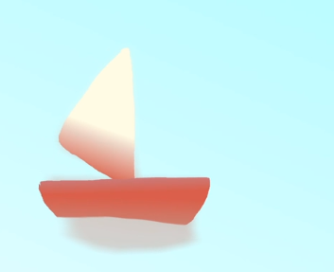
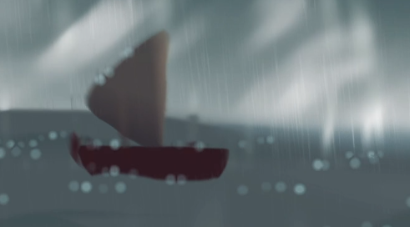
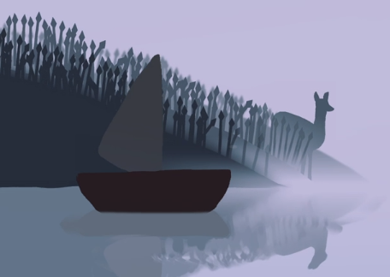
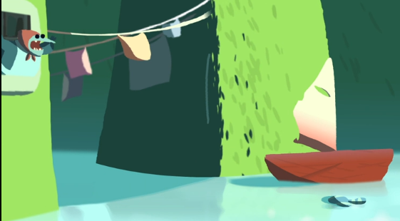
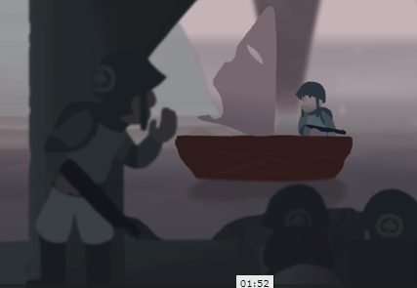
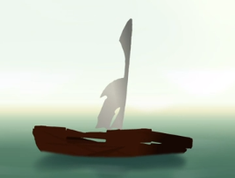
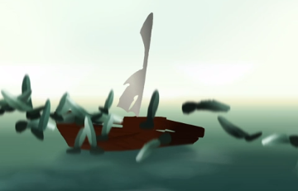
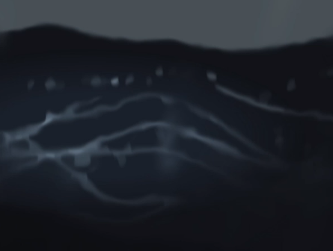
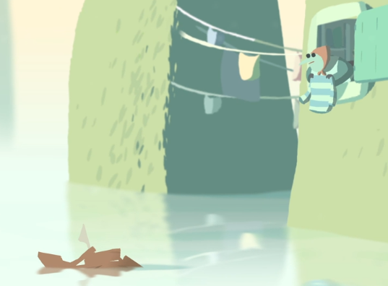
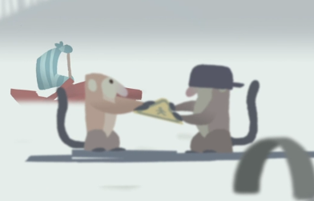
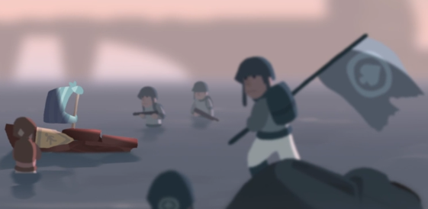
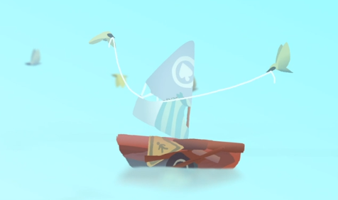
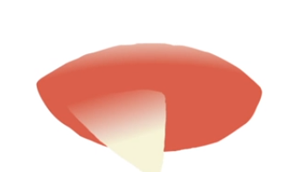

Slide 6
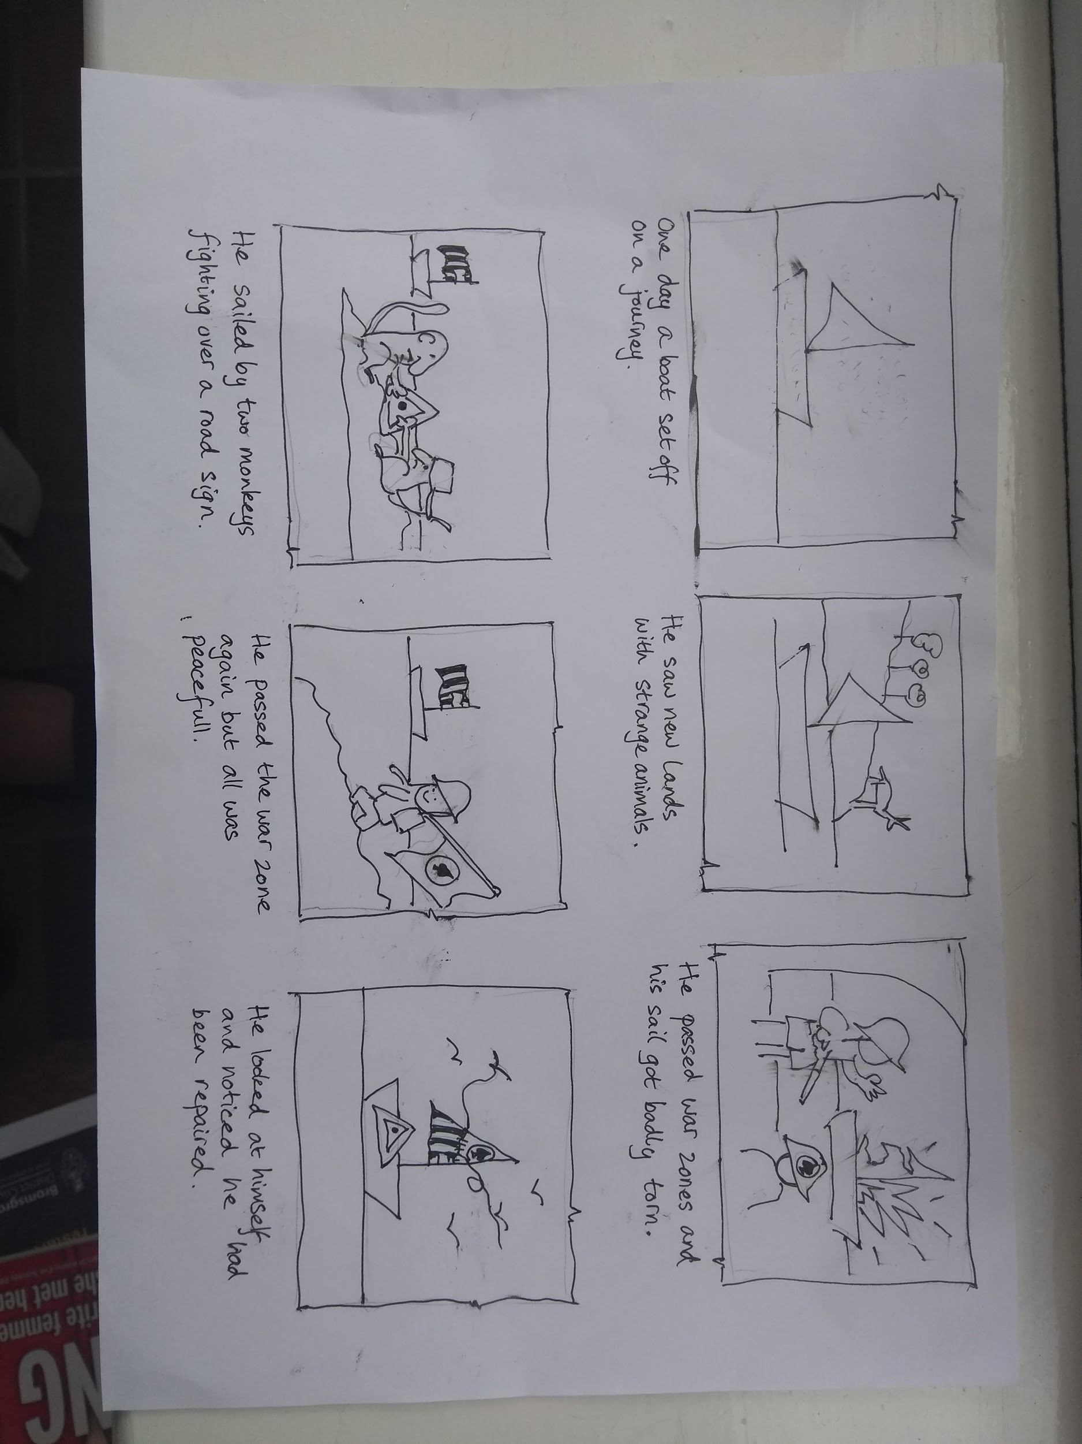
Task 2 - story plan.
The video had no words so you are going to write the story to go with it.
Today, we are just going to plan our story.
Make a story board like mine. Draw 6 pictures that you think would help you tell the story. Make sure they are in the right order. Write a short sentence underneath each one.
We are going to use our plan to help write our story later in the week.

Slide 7
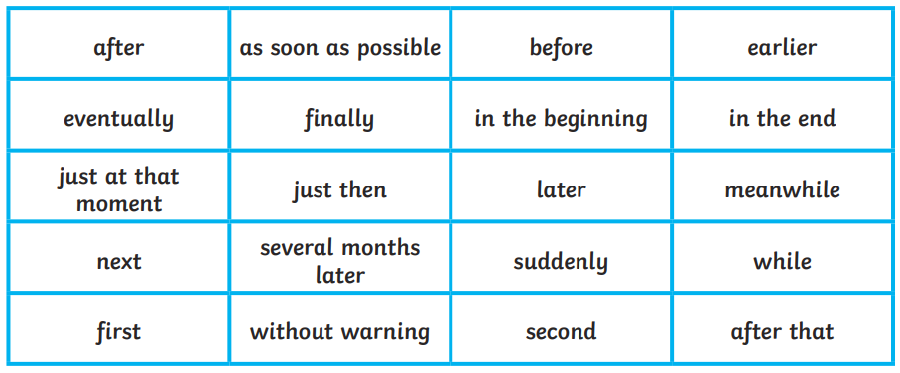
Session 3 - Time Connectives
Time connectives are used to move a story along in time. They are words like after, next, then, eventually. We will need to use them in out story tomorrow, so we are going to practise using them today.
Here are some time connectives.

Slide 8
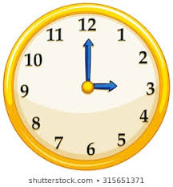
Task 3 - time connectives.
Copy these sentences and choose time connectives on the previous page to fill in the gaps.
It had been a long day but ________ it was time for a bath.
__________ I was watching TV my brother climbed up the tree.
__________ the monster jumped out from behind the bush
__________ I could have more steak, I had to eat all of my peas.
Mrs Ben took the dog for a walk _______ she gave him some water.
________ Tess picked some beautiful flowers.

Slide 9
Session 4
Today we are going to start writing the first half of our story! We are going to use the first 3 pictures of our plan. So far, we have only written a sentence for each picture. Today we are going to write more and add more detail. Have a look at my story so far.
One cold, blustery day, a little boat set off on a journey all by himself. Before long, the wind began to blow and the boat soon picked up speed. Eventually, it found itself on the huge, wide ocean. After many days, it passed a strange, dark island covered in trees. A curious deer crept down to the shore to take a look.
Adjectives
Time connectives
Go to the next page ready to start!

Slide 10
Task 4 - writing the first part of our story.
Ok, here are the time connectives you could use.
You can use my first sentence to get you started if you want (just fill in the gaps)!
One ____________ day, a _____boat set off on a journey all by himself.
Other useful words:
ocean island strange war
soldiers monkeys washing explosion
tore storm passed

Slide 11
Session 5
Today we are going to finish writing the last half of our story! We are going to use the last 3 pictures of our plan. Remember to try and add plenty of detail about what the little boar saw and use time connectives to move your story alongHave a look at my story so far.
Several months later, the little boat drifted passed a very strange sight. Two monkeys were fighting over an old, battered road sign. Suddenly, they look up and saw the little boat. They felt sorry for it when they saw it’s broken wood and immediately helped to fix it using the road.
Adjectives
Time connectives
Go to the next page ready to continue!

Slide 12
Task 5 - writing the last part of our story.
Ok, here are the time connectives you could use.
Don’t forget to include some adjectives to describe the little boat and the things it sees!
Other useful words:
ocean island strange peaceful
soldiers monkeys sewed birds
flew storm passed exhausted

