Slide 1
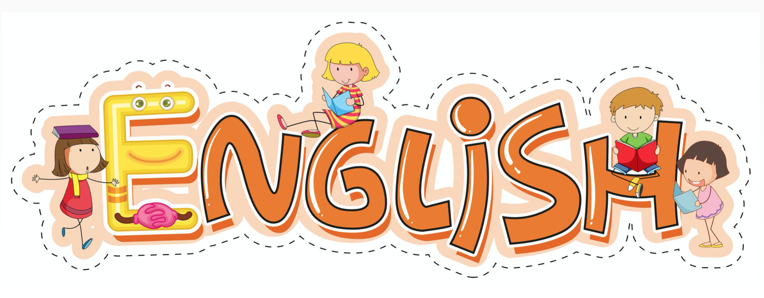

Slide 2
Session 1 - Close Read
Teacher Notes
The purpose of a close read activity is to gain an understanding of the text by reading it multiple times and making sure we really study what the author is trying to tell us.
(All close read texts are age appropriate.)
Close Read Instructions:
Look at the vocabulary highlighted. Do you know what the words mean? The vocabulary box will help you.
Read the text to yourself and think:
What did I just read?
What did it say?
Now read the text again with a grown-up.
Read the questions and now reread the text again to find the clues for your answer.
Answer the questions in writing.

Slide 3
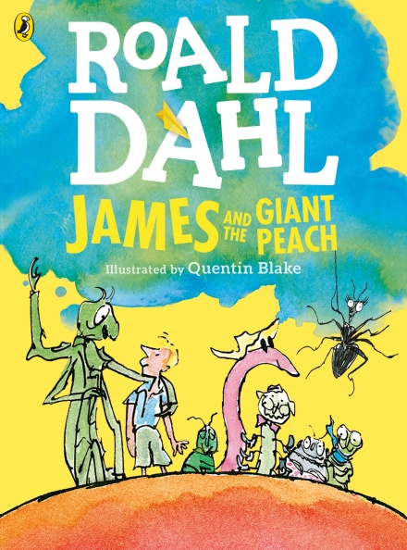
James’s large frightened eyes travelled slowly round the room. The creatures, some sitting on chairs, others reclining on a sofa, were all watching him intently. Creatures? Or were they insects? An insect is usually something rather small, is it not? A grasshopper, for example, is an insect. So what would you call it if you saw a grasshopper as large as a dog? As large as a large dog. You could hardly call that an insect, could you? There was an Old-Green-Grasshopper as large as a large dog sitting directly across the room from James now. And next to the Old-Green-Grasshopper, there was an enormous Spider.
Vocab Box
reclining - leaning back (almost
lying down)
intently- in a concentrating sort of
way
directly across - straight across
Questions
What do you think the author means when he says that James’s eyes travelled around the room?
Why do you think James was not sure whether the creatures were actually insects?
Today’s extract comes from this book.

Slide 4
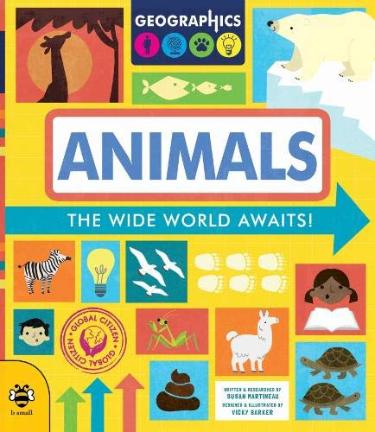
Sessions 2,3,4 and 5
This week, we are looking at a non-fiction text all about animals.

Slide 5
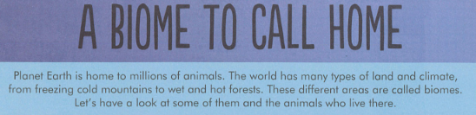
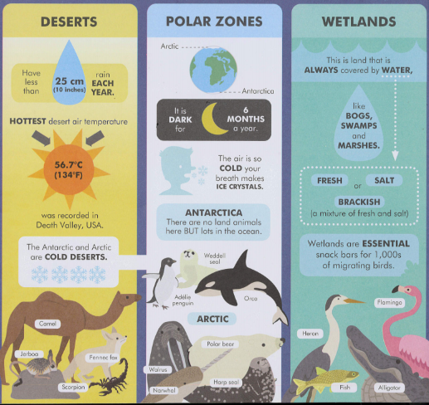
Task 2 - reading comprehension
Questions
Find and copy one word that means an area of land or climate.
What 2 places are cold deserts?
What happens to your breath in the Polar Zones?
Which biome would you find a flamingo?
  Desert
  Polar Zone
  Wetland
Name 3 animals that live in Antarctica.
What sort of land are wetlands?
What are the 3 types of water that are found in wetlands?
Wetlands are ESSENTIAL snack bars… What do you think this means?

Slide 6
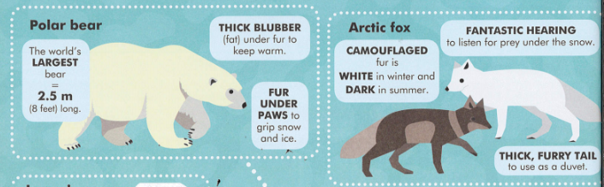
Task 3 - conjunctions
Remember conjunctions are words that join two phrases to make a longer sentence. They are words like because
and
but
Read the text about these two Arctic animals. Then copy each of these sentences and choose the best conjunction to fill in the gap (because, and, but).
Polar bears and 2.5m long ____ they are the world’s largest bear.
They have thick blubber under their fur _________ it is very cold in their habitat.
It is slippy on snow and ice ________ polar bears have fur under their paws to help them grip.
The Arctic fox has white fur in the winter _____ dark fur in the winter.
An Arctic fox does not need a duvet _______________ it has a thick furry tail instead.

Slide 7
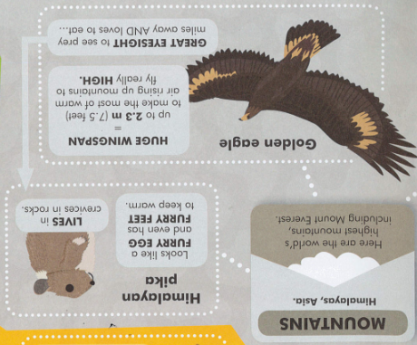
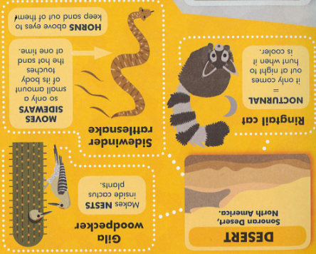
Session 4 and 5
Here are fact files about two biomes (Mountains and Deserts).
For the next two sessions, you are going to write a fact file about the creatues you could find in habitats near you (your garden or a park or countryside nearby).
You need to include a description of the habitat and then 3 sections - each for a different animal that lives there). The next slide has some facts you could use.

Slide 8
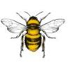
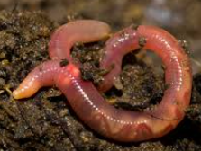
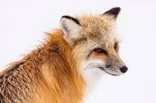
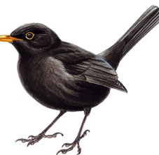
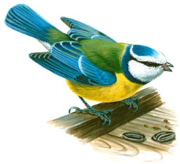
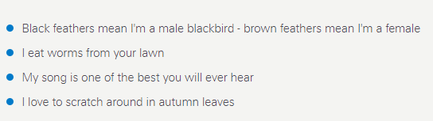

Animals found in a garden habitat
breath through their skin
cannot see or hear
eats its own weight of soil every day
if you cut on in half, the half with the head will live!
Fox
Bee
a member of the dog family
can live up to 15 years
female called vixen, male called a dog
can live in towns or countryside
Worm
have 5 eyes, 6 legs and 4 wings
collect nectar from flowers to make honey
live in hives with about 50 thousand others)
male bees do not have a stinger
Blackbird
Blue tit

