Slide 1

Week 11 – 6.7.20
5 sessions

Slide 2
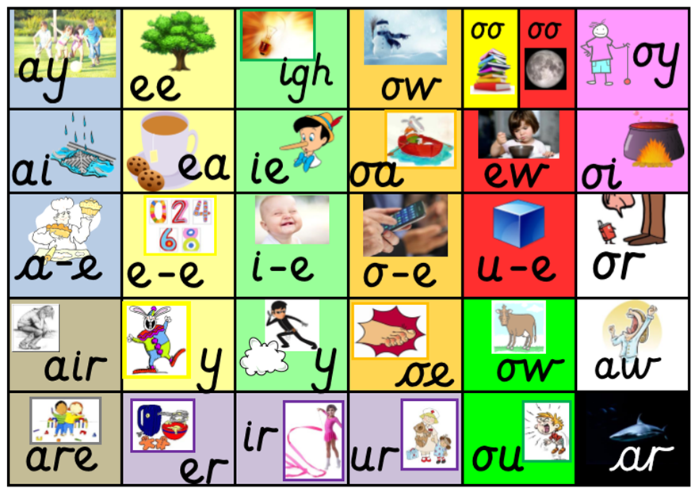
Remind yourself of all the sounds on our sound mat.
How quickly can you say them?

Slide 3
6.7.20
Session 1
Split digraph
e_e
These are even!

Slide 4
Digraph
ai
Rain down the drain

Slide 5
Sound out these words aloud.
2. Copy them down and add sound buttons. Can you spot a digraph or split digraph in each word?
For example, rain even
jail
waist
chain
afraid
eve
these
delete
Pete
concrete

Slide 6
1. Segment and blend each word aloud.
2. Copy each word using your neatest handwriting.
3. Add a picture to represent each word.
train | Steve
athlete | rainbow

Slide 7
7.7.20
Session 2
Our key sounds for this week
e_e
ai
These are even!
Rain down the drain

Slide 8

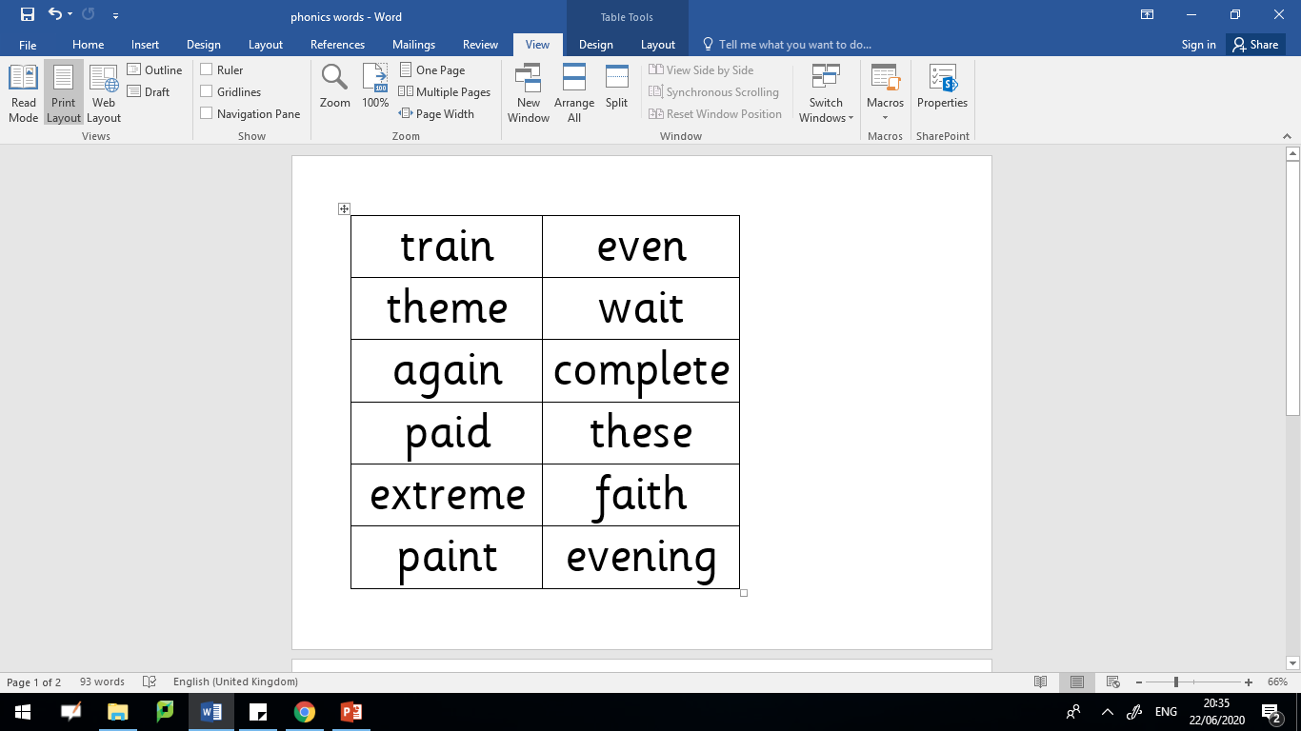
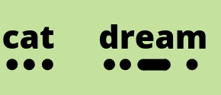

Read these words aloud. Don’t forget to use your phonics fingers to help segment the different sounds before you blend them together.

Slide 9

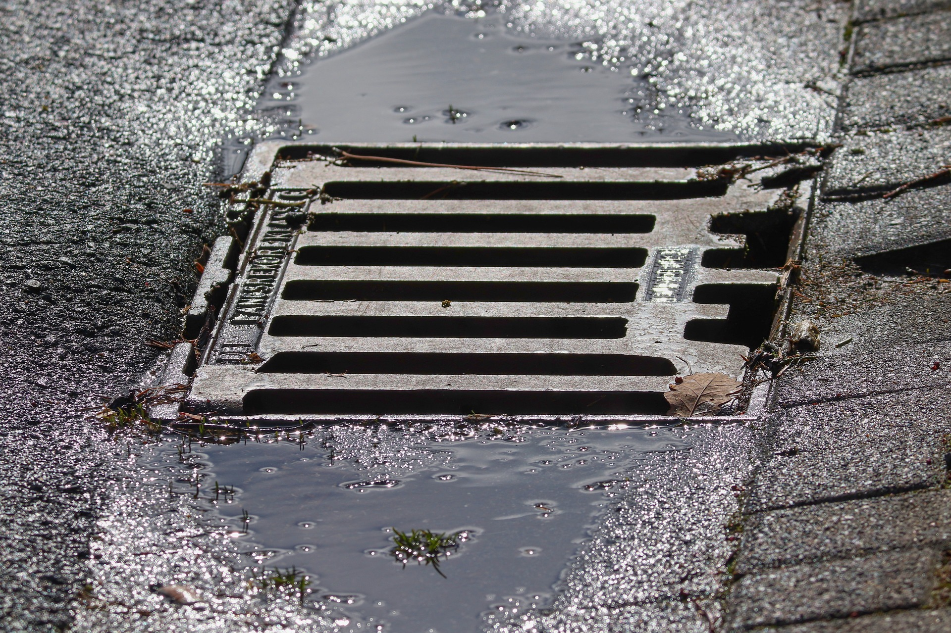
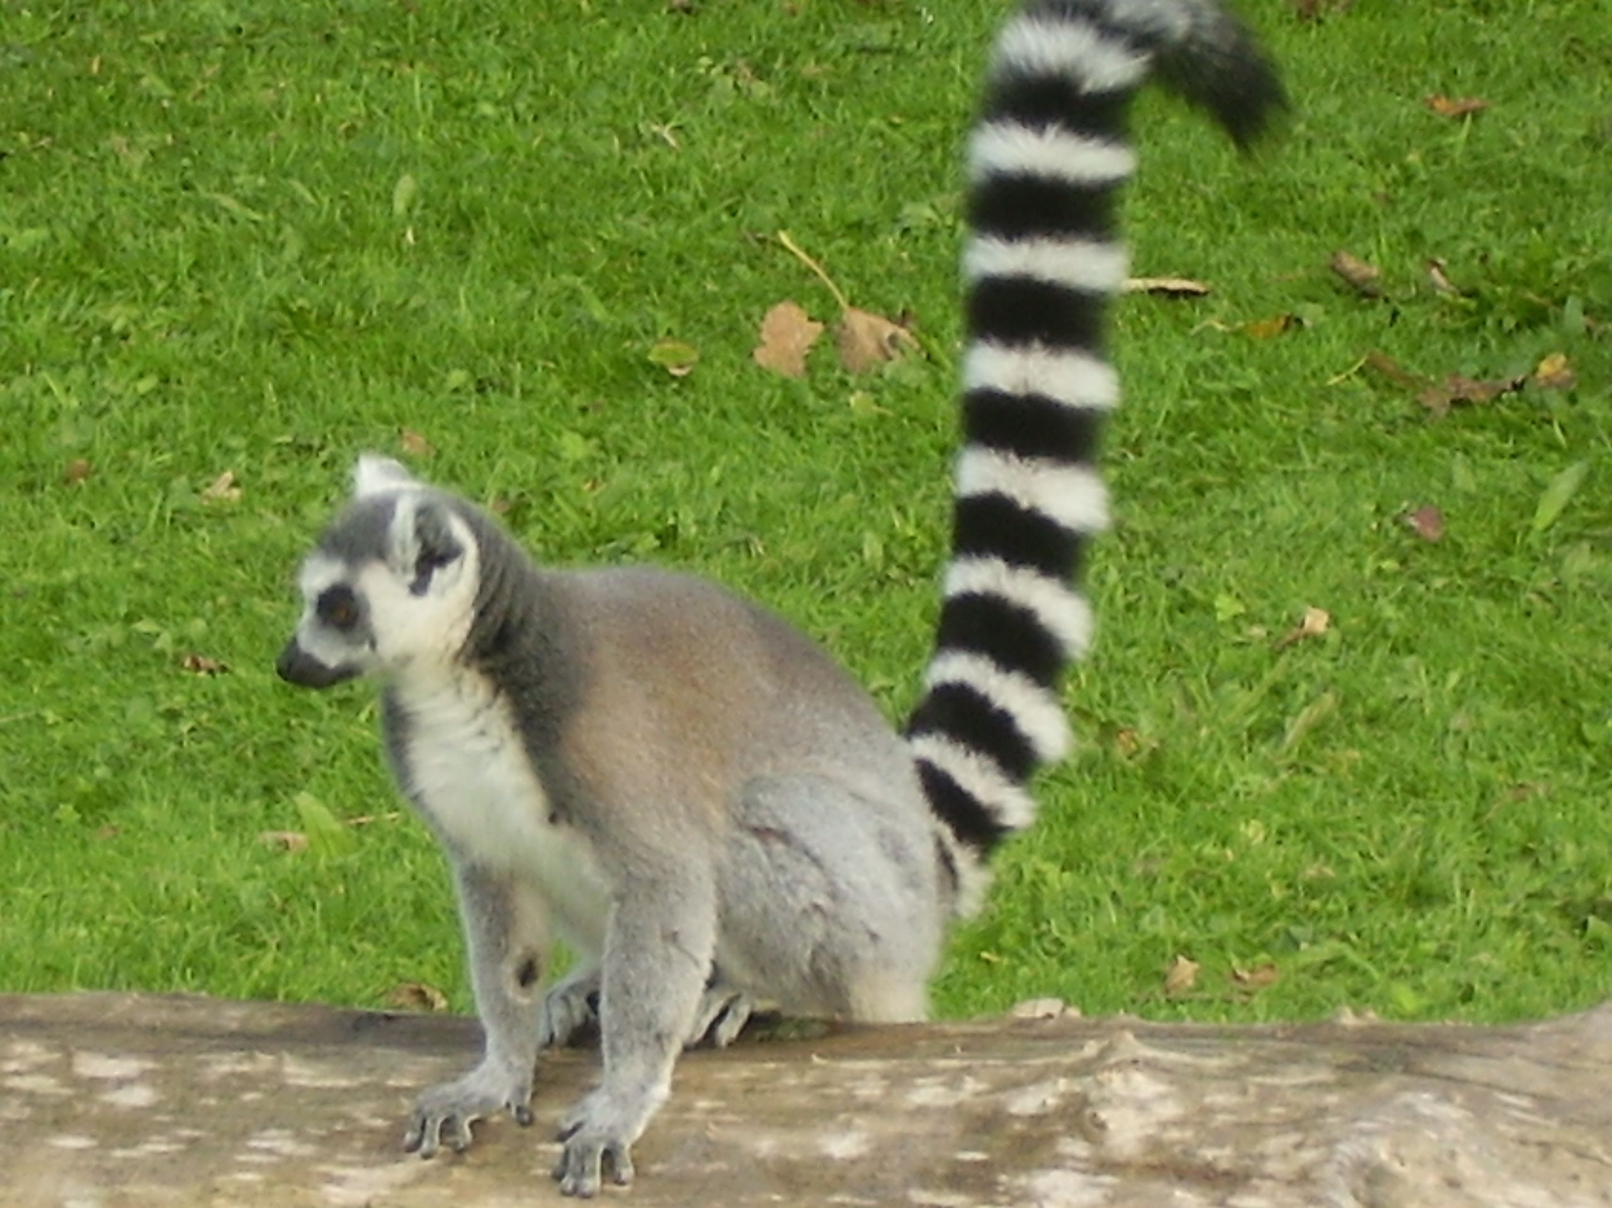
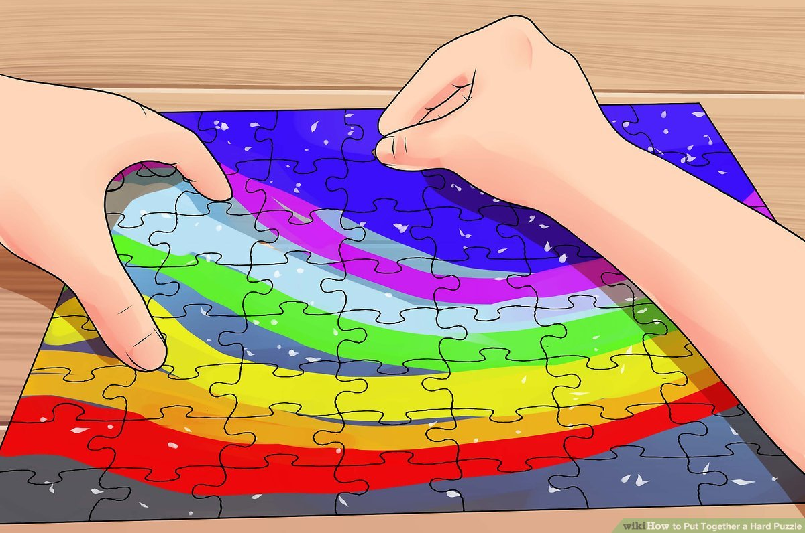
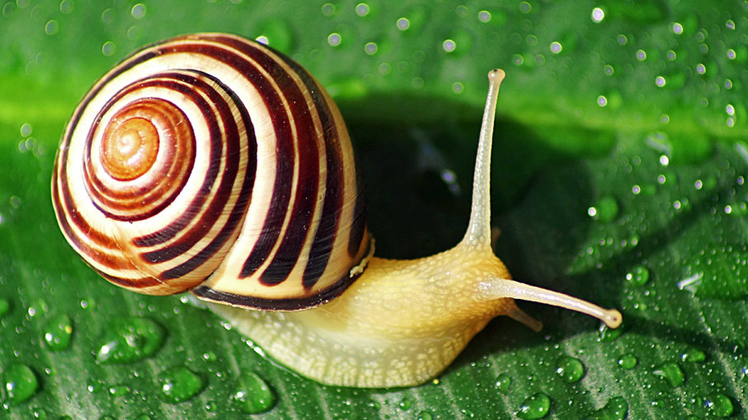
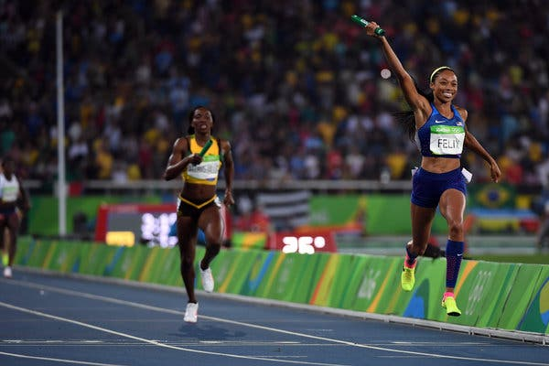
e_e or ai?
Which sound is missing? Write the word down using the correct digraph.
_v_n
t___l
dr__n
sn___l
athl__t__
compl_t__

Slide 10
e_e or ai?
Answers
Which sound is missing? Write the word down using the correct digraph.
even
tail
drain
snail
athlete
complete

Slide 11
8.7.20
Session 3
Our key sounds for this week
e_e
ai
These are even!
Rain down the drain

Slide 12
Read these words aloud. Don’t forget to use your phonics fingers to help segment the different sounds before you blend them together.

Slide 13
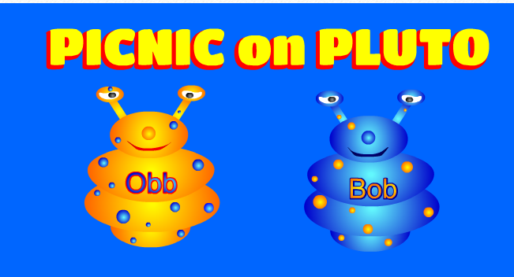
https://www.phonicsplay.co.uk/PicnicOnPluto.html
Picnic on Pluto - this is a game for children to sort real and alien words. Click on the link and follow the instructions below to make sure children are using this week’s target sound.
Once loaded, click the ‘next’ button.
Then click on Phase 5 for ‘e_e’ and Phase 3 for ‘ai’ words.
Have fun! :)

Slide 14
9.7.20
Session 4
Our key sounds for this week
e_e
ai
These are even!
Rain down the drain

Slide 15
ai or e_e?
Can you fill in the missing words for the following sentences?
My teacher asked me to _________ my turn.
I made a __________ chain at playtime.
Dad said he was saving the fireworks until the ________.
daisy evening wait

Slide 16

Ask an adult to say one word at a time.
Without looking, try to spell the word.
Then check your answers together.

Slide 17
10.7.20
Session 5
Our key sounds for this week
e_e
ai
These are even!
Rain down the drain

Slide 18
Could you put 3 of these words into your own sentences?
Remember to start each sentence with a capital letter and finish with a full stop.

Slide 19
https://www.phonicsplay.co.uk/PicnicOnPluto.html
Picnic on Pluto - this is a game for children to sort real and alien words. Click on the link and follow the instructions below to make sure children are using this week’s target sound.
Once loaded, click the ‘next’ button.
Then click on Phase 5 for ‘e_e’ and Phase 3 for ‘ai’ words.
Have fun! :)

