Slide 1
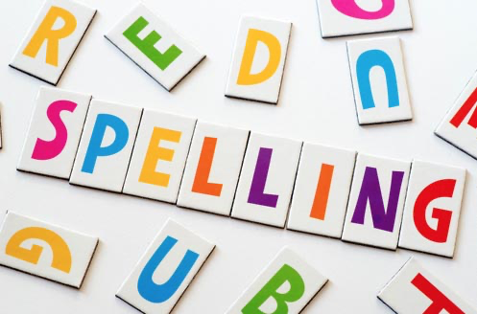
Session 1
their, there and they’re homophones

Slide 2
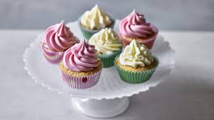
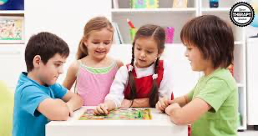
Remember that words that are homophones sound the same as each other but have different spellings and meanings.
E.g. to and two
there
- Look over there.
- There are some cakes.
their - It’s their game.
they’re - They’re having fun.

Slide 3
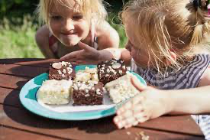
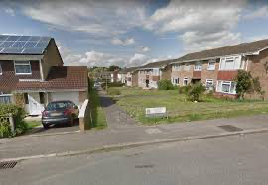
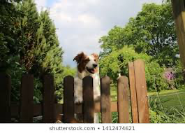
Choose the correct homophone there/their/they’re to fill in the gap and copy out each sentence.
_____ are three cakes in the tin.
_____ going to eat those cakes.
_____ cakes are delicious!
_____ house is down this road.
_____ is a big dog by that gate.
_____ going swimming tonight.

Slide 4
Session 2
adding es to nouns and verbs ending in y

Slide 5
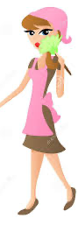


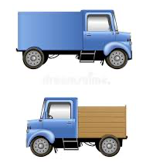
Remember:
nouns are things (like chair, cake, idea).
For some nouns ending in y, when we write the plural version, we change the y for an i and add es .
one lady
two ladies
one lorry
two lorries

Slide 6

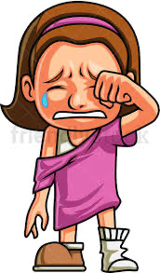
Remember:
verbs are doing or being words (like sleep, hopping, think, am)
For some verbs ending in y, when we change the subject, we change the y for an i and add es .
I cry
She cries

Slide 7
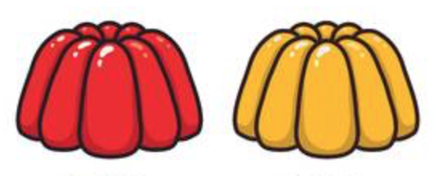

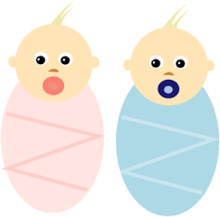
Copy the sentences filling in the gaps.
One lady. Two ____ .
2. One jelly. Two ____ .
3. I cry. She ____ .
4. I copy. She ____ .
5. One baby. Two ____ .

Slide 8
Session 3
using the possessive apostrophe

Slide 9

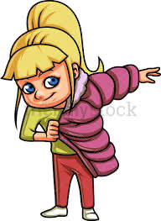
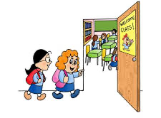

If the ball belongs to Petra we say it is Petra’s ball. We add an apostrophe (‘) before we add the s to show that it is Petra who owns the ball.
Ali’s book
Jill’s coat
the driver’s taxi
the children’s classroom

Slide 10
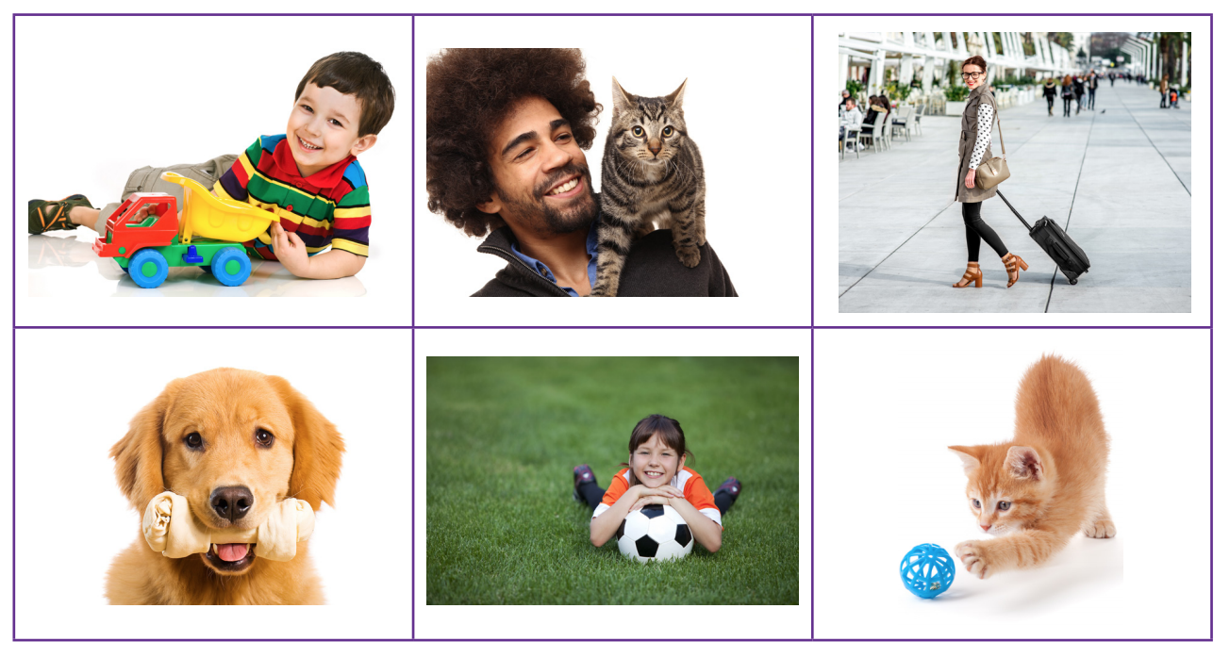
Choose any four of these pictues. Write a sentence for each one using the possessive apostrophe (‘).
e.g. This is Bruno’s favourite chewy bone.

Slide 11
Session 4
using the possessive apostrophe

Slide 12
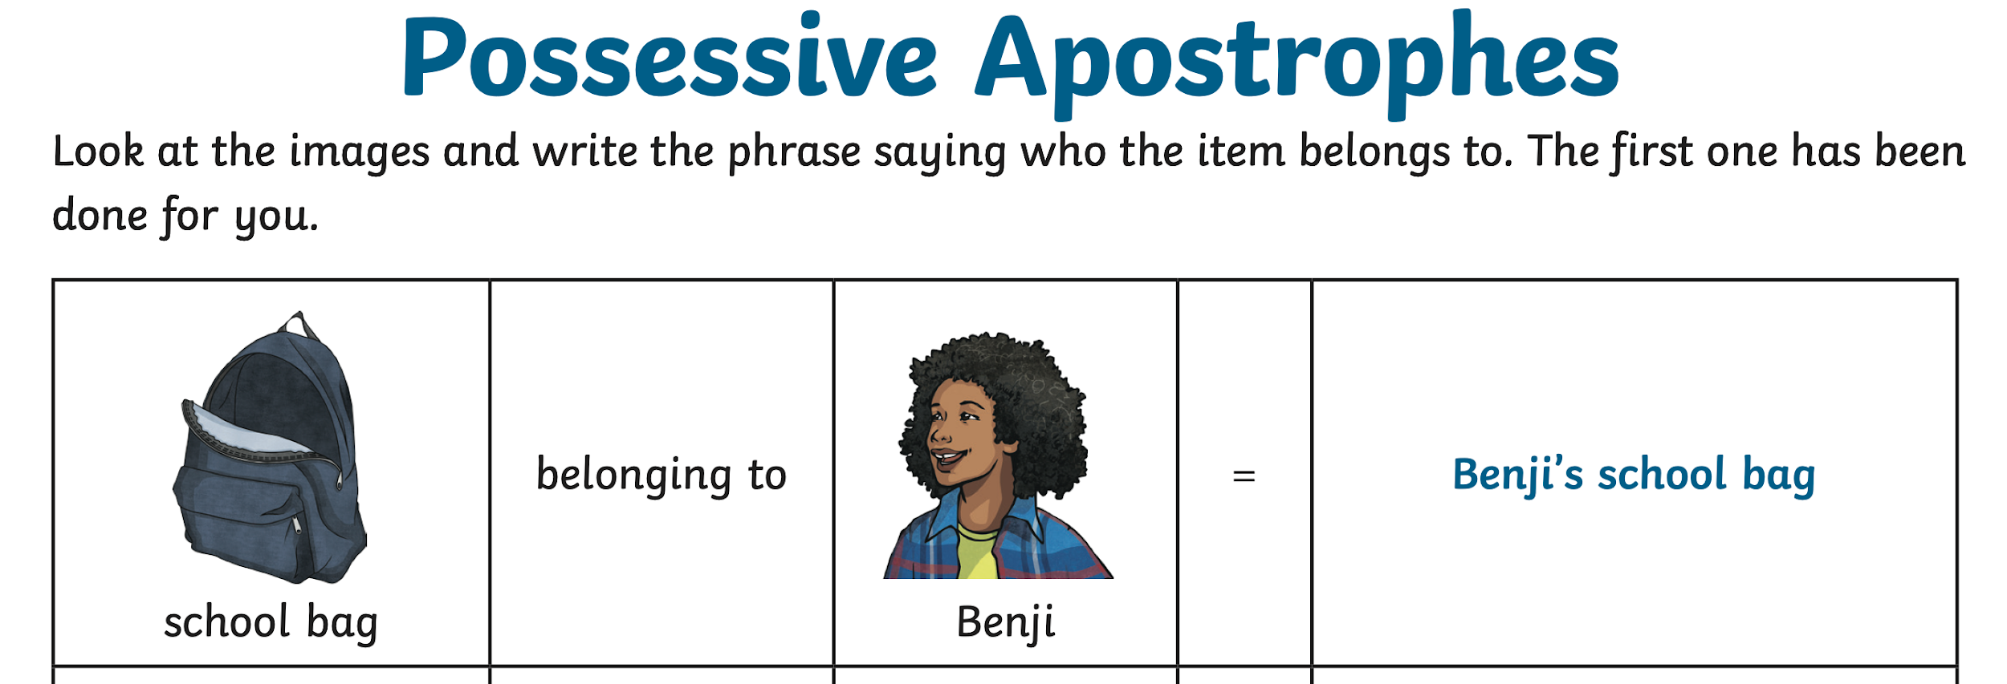
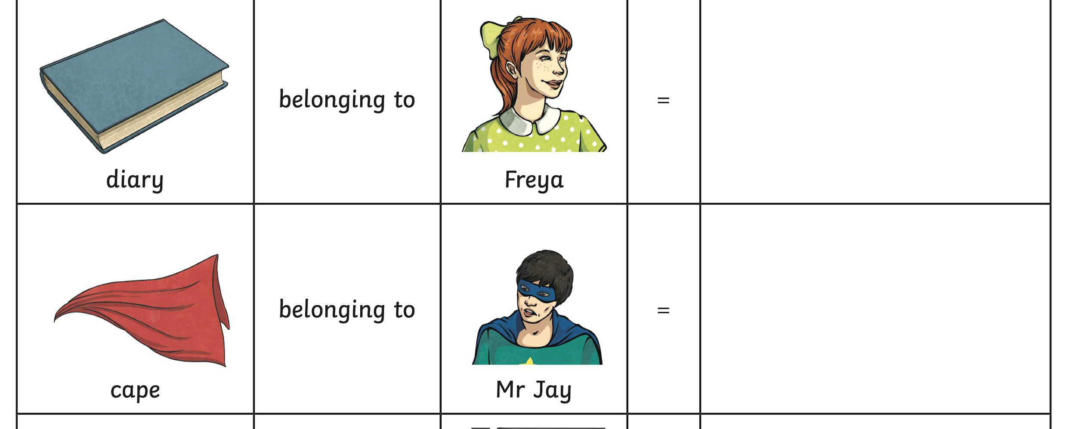
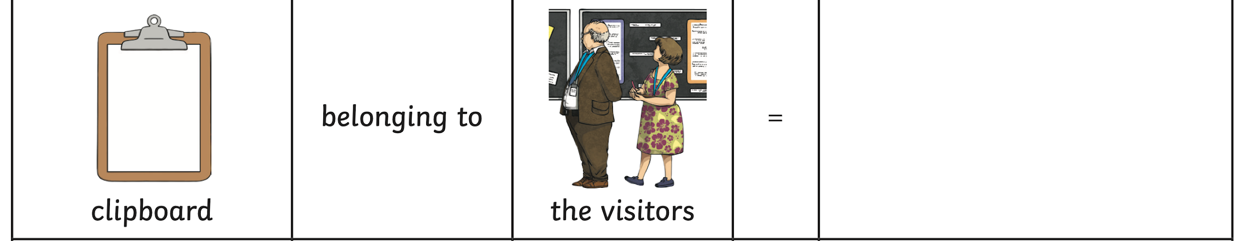

Slide 13
Session 5
using suffixes ful less ly

Slide 14
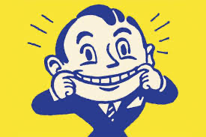
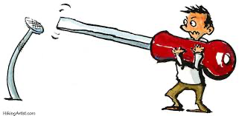
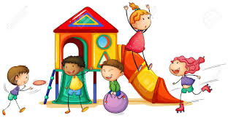
A suffix is something added to the end of a root word.
We are going to look at the suffixes ful, less and ly
a cheerful smile
a useless tool
play happily

Slide 15

Watch out! Only one l in the ful suffix.
a cheerful smile

Slide 16
Watch out! When adding ly suffix to a word ending in y, the y changes to i.
happy -> happily
play happily

Slide 17

Try adding the ful suffix to these words:
help skill care
2. Try adding the less suffix to these words:
fear joy help
3. Try adding the ly suffix to these words
neat brave happy

