Slide 1

Week 1
5 sessions

Slide 2
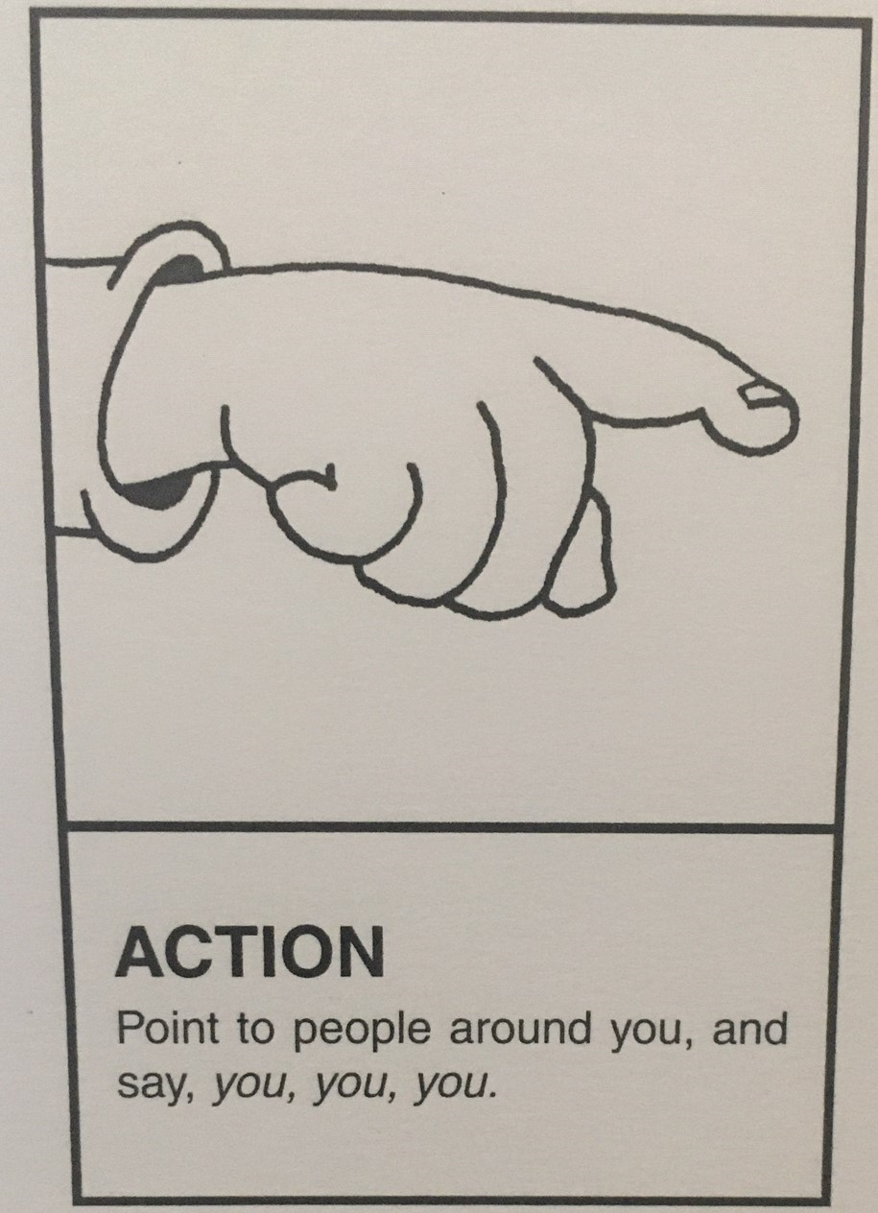
Session 1
Digraph
Action
ue

Slide 3
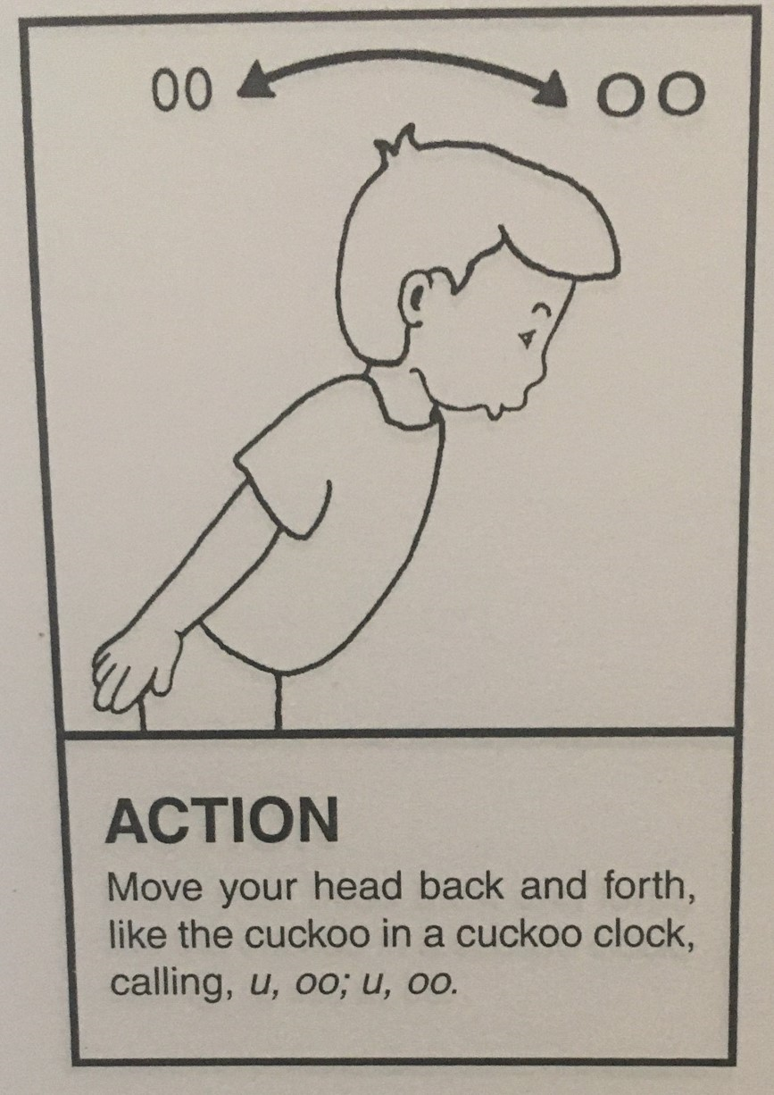
Digraph
Action
oo

Slide 4
Sound out these words aloud.
Copy them down and add sound buttons. Can you spot the digraph in each word?
For example, glue
true
rescue
statue
blue
book
foot
crook
look
hook

Slide 5

Listen to this video. Can you spot the songs for this week’s digraphs?
https://vimeo.com/35396335

Slide 6
Session 2
Digraphs
ue
oo

Slide 7

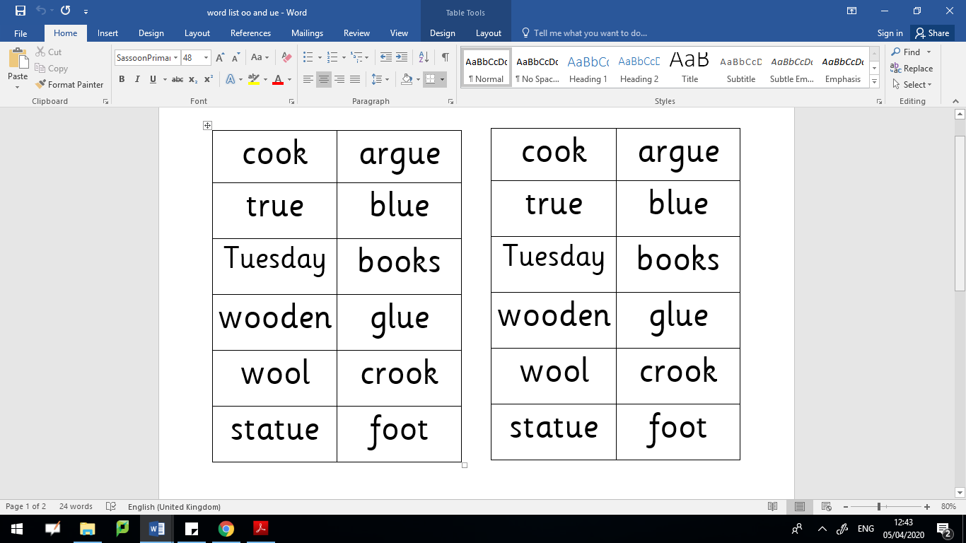
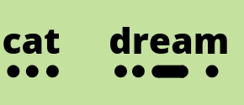

Read these words aloud. Don’t forget to use your phonics fingers to help segment the different sounds before you blend them together.

Slide 8






ue or oo?
Which digraph is missing? Write the word down using the correct digraph.
bl___
b___k
f___t
cl___
gl___
h___k

Slide 9
Session 3
Digraphs
ue
oo

Slide 10
Read these words aloud. Don’t forget to use your phonics fingers to help segment the different sounds before you blend them together.

Slide 11
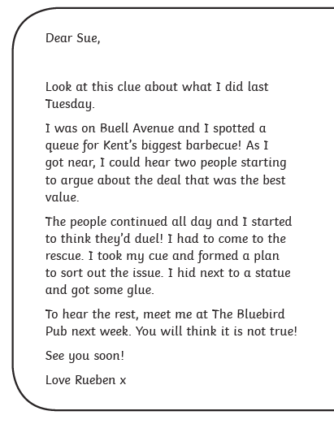

Can you be a detective and see how many ‘ue’ words are in this postcard?

Slide 12
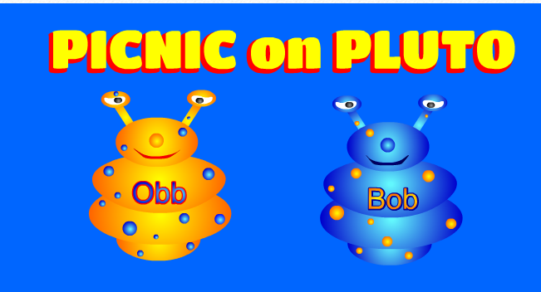
https://www.phonicsplay.co.uk/PicnicOnPluto.html
Picnic on Pluto - this is a game for children to sort real and alien words. Click on the link and follow the instructions below to make sure children are using this week’s target sounds.
Once loaded, click the ‘next’ button.
Then click on Phase 3 for ‘oo’ words or click on Phase 5 for ‘ue’ words.
Have fun! :)

Slide 13
Session 4
Digraphs
ue
oo

Slide 14

Ask an adult to say one word at a time.
Without looking, try to spell the word.
Then check your answers together.

Slide 15
https://www.phonicsplay.co.uk/PicnicOnPluto.html
Picnic on Pluto - this is a game for children to sort real and alien words. Click on the link and follow the instructions below to make sure children are using this week’s target sounds.
Once loaded, click the ‘next’ button.
Then click on Phase 3 for ‘oo’ words or click on Phase 5 for ‘ue’ words.
Have fun! :)

Slide 16
Session 5
Digraphs
ue
oo

Slide 17
ue or oo
Write some sentences of your own using words with either an ‘oo’ or ‘ue’ sound in.
Remember to start each sentence with a capital letter and end with a full stop.

