Slide 1

Week 4
5 sessions

Slide 2
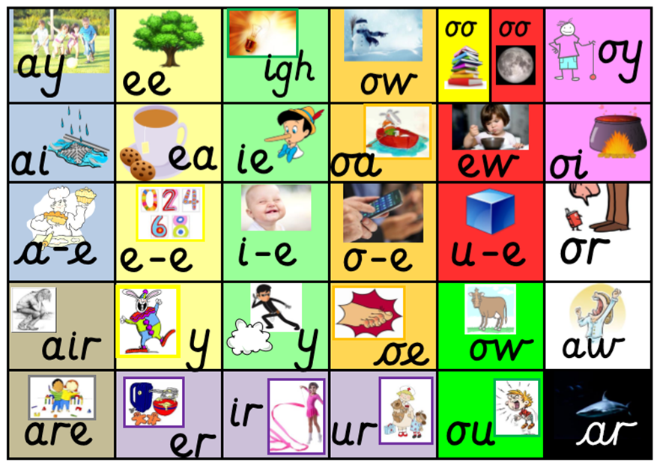
Remind yourself of all the sounds on our sound mat.
How many can you say?

Slide 3

Go to www.phonicsplay.co.uk
Enter the following details:
Username: march20
Password: home
Go to: parents/ interactive resources/ phase 3/ flashcards/
Select phases 3&5A. Make your choices and begin the game! If your child correctly identifies the sound, click the tick. If your child is incorrect, click the cross and this sound will reappear later.
How long did it take you to name all of the sounds?
Try to beat your score tomorrow!

Slide 4
Session 1
Trigraph
Action
air
That’s not fair!

Slide 5
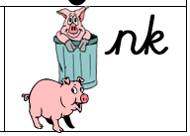
Digraph
Action
nk
I think I stink.

Slide 6
Sound out these words aloud.
Write each word and add sound buttons. Can you spot the digraph or trigraph in each word?
For example, wink
chair
fairy
haircut
stairs
pink
junk
sank
think
bank

Slide 7
Session 2
This week’s sounds
air
nk
That’s not fair!
I think I stink.

Slide 8
Go to www.phonicsplay.co.uk
Enter the following details:
Username: march20
Password: home
Go to: parents/ interactive resources/ phase 3/ flashcards/
Select phases 3&5A. Make your choices and begin the game! If your child correctly identifies the sound, click the tick. If your child is incorrect, click the cross and this sound will reappear later.
How long did it take you to name all of the sounds?
Try to beat your score tomorrow!

Slide 9

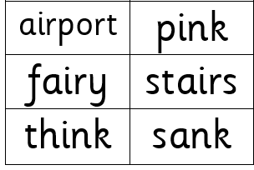
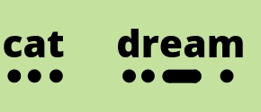

Read these words aloud. Don’t forget to use your phonics fingers to help segment the different sounds before you blend them together.

Slide 10

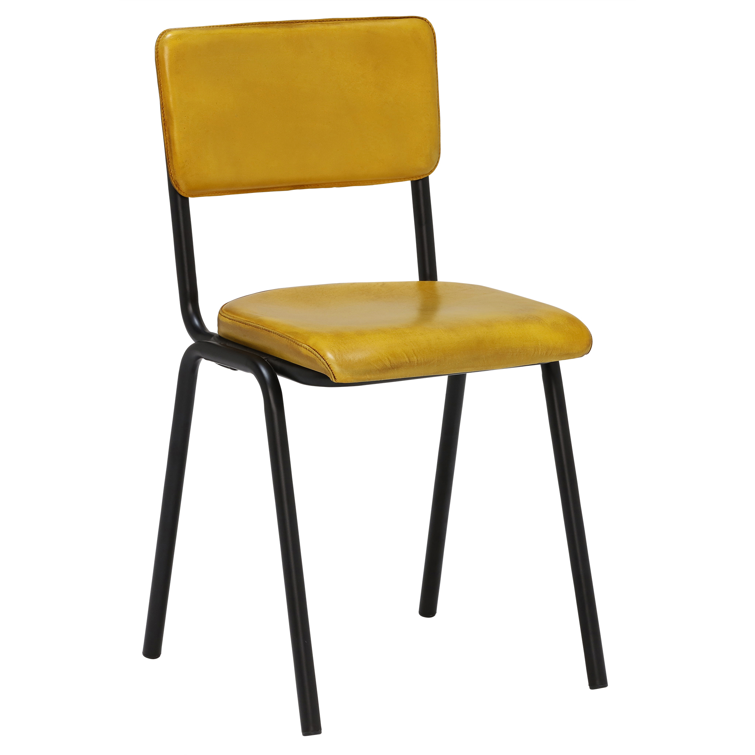

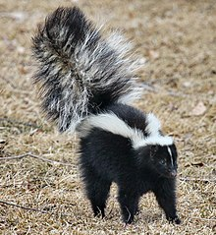
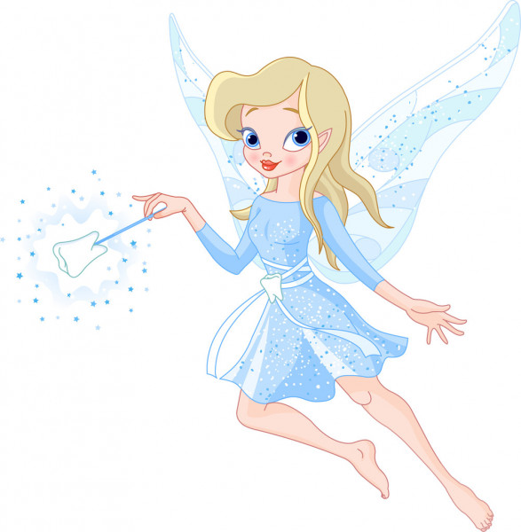
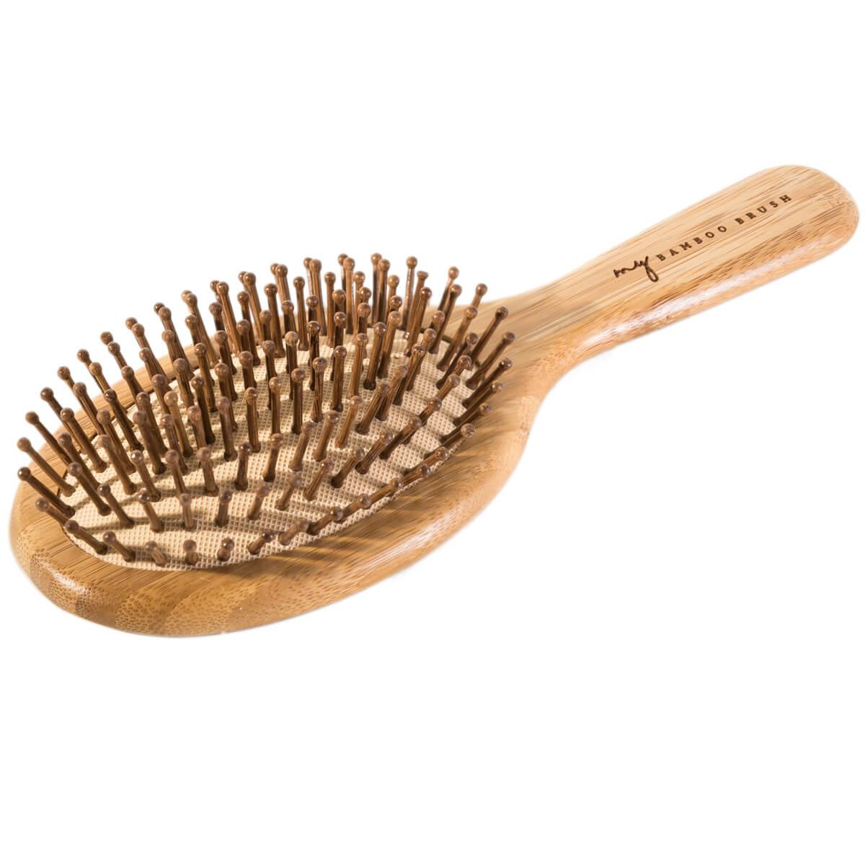
air or nk?
Which sound is missing? Write the word down using the correct digraph or trigraph.
ch____
dri___
pi___
f___y
h___brush
sku___

Slide 11
Session 3
This week’s sounds
air
nk
That’s not fair!
I think I stink.

Slide 12
Go to www.phonicsplay.co.uk
Enter the following details:
Username: march20
Password: home
Go to: parents/ interactive resources/ phase 3/ flashcards/
Select phases 3&5A. Make your choices and begin the game! If your child correctly identifies the sound, click the tick. If your child is incorrect, click the cross and this sound will reappear later.
How long did it take you to name all of the sounds?

Slide 13
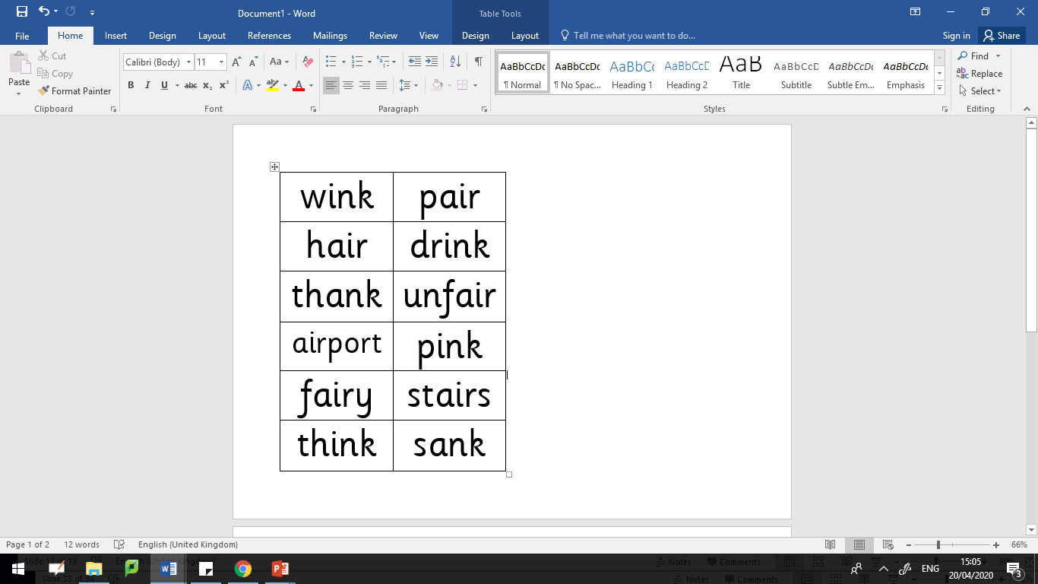
Read these words aloud. Don’t forget to use your phonics fingers to help segment the different sounds before you blend them together.

Slide 14

I put on my pink pair of socks and went downstairs. I said thank you to my mum as she gave me a drink in my favourite fairy cup. I was excited because we were going to a funfair. I said to my Dad ‘I think it will be the best day ever!’
He winked at me and went outside to start the car. Mum brushed my hair and we heard the ‘honk’ of the car horn. We were ready!
Can you be a detective and see how many ‘nk’ and ‘air’ words are in this story?

Slide 15
Session 4
This week’s sounds
air
nk
That’s not fair!
I think I stink.

Slide 16

Ask an adult to say one word at a time.
Without looking, try to spell the word.
Then check your answers together.

Slide 17
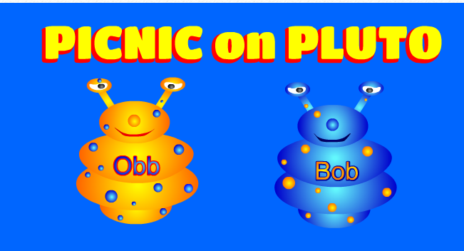
https://www.phonicsplay.co.uk/PicnicOnPluto.html
Picnic on Pluto - this is a game for children to sort real and alien words. Click on the link and follow the instructions below to make sure children are using this week’s target sound.
Once loaded, click the ‘next’ button.
Then click on Phase 3 for ‘air’ words.
Have fun! :)

Slide 18
Session 5
This week’s sounds
air
nk
That’s not fair!
I think I stink.

Slide 19

nk or air
Silly sentences!
Write some silly sentences of your own using words with either an ‘nk’ or ‘air’ sound in.
Here’s an example…
The stinky, pink fairy sank into a hairy chair and said ‘That’s not fair!’.
Remember to start each sentence with a capital letter and end with a full stop.

Slide 20
https://www.phonicsplay.co.uk/PicnicOnPluto.html
Picnic on Pluto - this is a game for children to sort real and alien words. Click on the link and follow the instructions below to make sure children are using this week’s target sound.
Once loaded, click the ‘next’ button.
Then click on Phase 3 for ‘air’ words.
Have fun! :)

