Slide 1
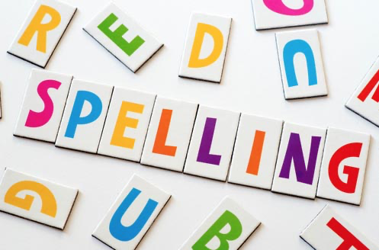
Session 1
spelling common exception words

Slide 2
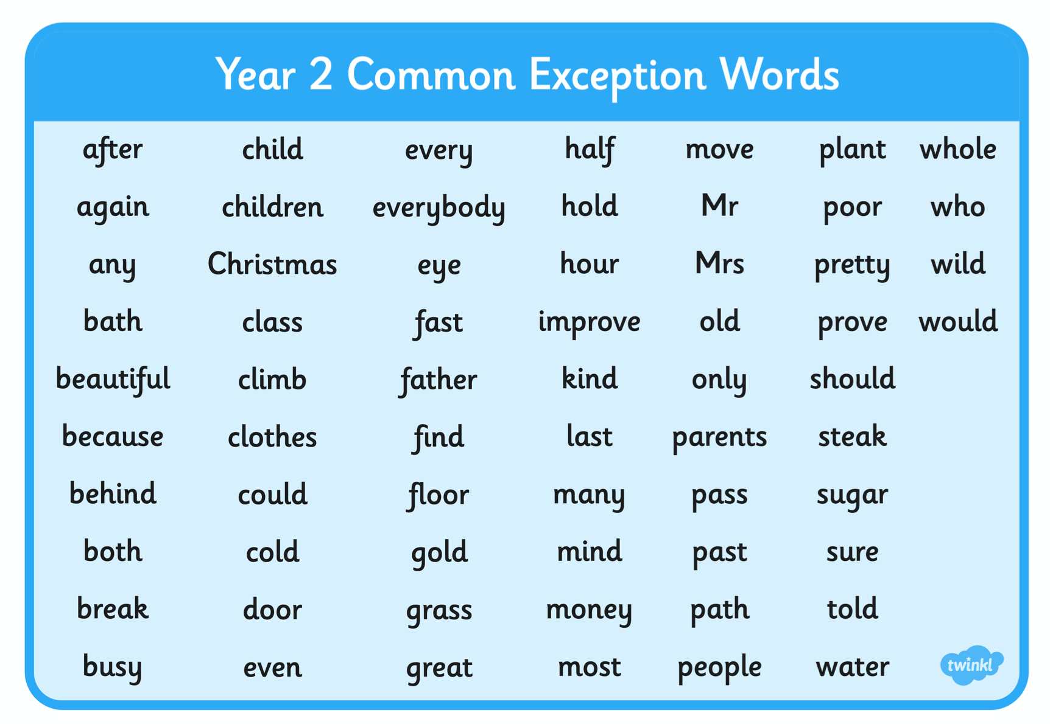
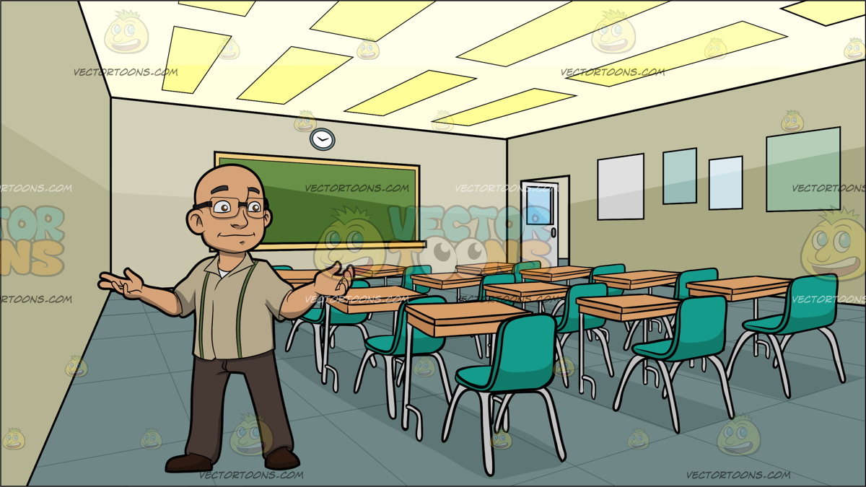

Recap: a common exception word is one that doesn’t follow the normal spelling words (you can’t sound out the letters to read it) . There are lots of these. The ones we meet most are called the common exception words.
Here is a list of common exception words.
On the next page, I am going to see if you can spell the ones highlighted in yellow. So, practise them first!

Slide 3

Click on each of these speaker icons to hear a different sentence.
For each one, listen carefully and then try to write the sentence down.
Each sentence has two of the exception words highlighted on the previous screen.
sentence 1
sentence 2
sentence 3
sentence 4
Answers on the next screen.

Slide 4
Answers
1. Look at the beautiful green grass.
2. Don’t climb, you will rip your clothes.
Here are the answers!
3. Ben mopped half of the floor.
4. Would the people like the show?

Slide 5
Session 2
Adding ed to
words ending in y

Slide 6
When we add
ed
to words ending in y, sometimes, the y changes to i
cry cried
copy copied
worry worried
hurry hurried
This doesn’t happen to words that have a vowel before the y.
(e.g. play)

Slide 7
Your turn !
tidy
multiply
try
carry
empty
fry
Now try adding
ed
to these words
Don’t forget to change the y to an i

Slide 8
Session 3
Adding er and est
words ending in y

Slide 9
When we add
er or est
to words ending in y, sometimes, we just drop the y .
happy happier
happy happiest
funny funnier
funny funniest

Slide 10
Your turn !
tidy
greedy
lucky
happy
empty
Now try adding
er or est
to these words
Don’t forget to change the y to an i

Slide 11
Session 4
Adding ed er and est
words ending in y

Slide 12
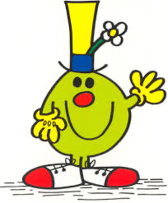


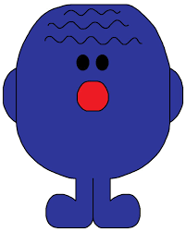
How many new words can you make by adding ed er or est to these words?

Slide 13
Session 5
Adding ed er and est
words ending in y

Slide 14
Click on each of these speaker icons to hear a different sentence.
For each one, listen carefully and then try to write the sentence down.
sentence 1
sentence 2
sentence 3
sentence 4
Answers on the next screen.

Slide 15
Answers
1. She the copied the word.
2. Dad was happier today.
Here are the answers!
3. The baby cried in her cot.
4. The last clown was the funniest .

