Slide 1

Week 7 – 8.6.20
5 sessions

Slide 2
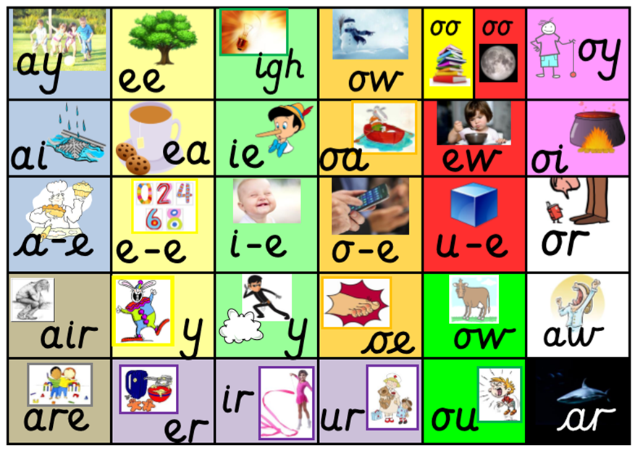
Remind yourself of all the sounds on our sound mat.
How quickly can you say them?

Slide 3
8.6.20
Session 1
Split digraph
a_e
Make a cake

Slide 4
Digraph
aw
Yawn at dawn

Slide 5
Sound out these words aloud.
2. Copy them down and add sound buttons. Can you spot a digraph or split digraph in each word?
For example, paw cake
hawk
straw
draw
yawn
gaze
flake
shape
came
cape

Slide 6
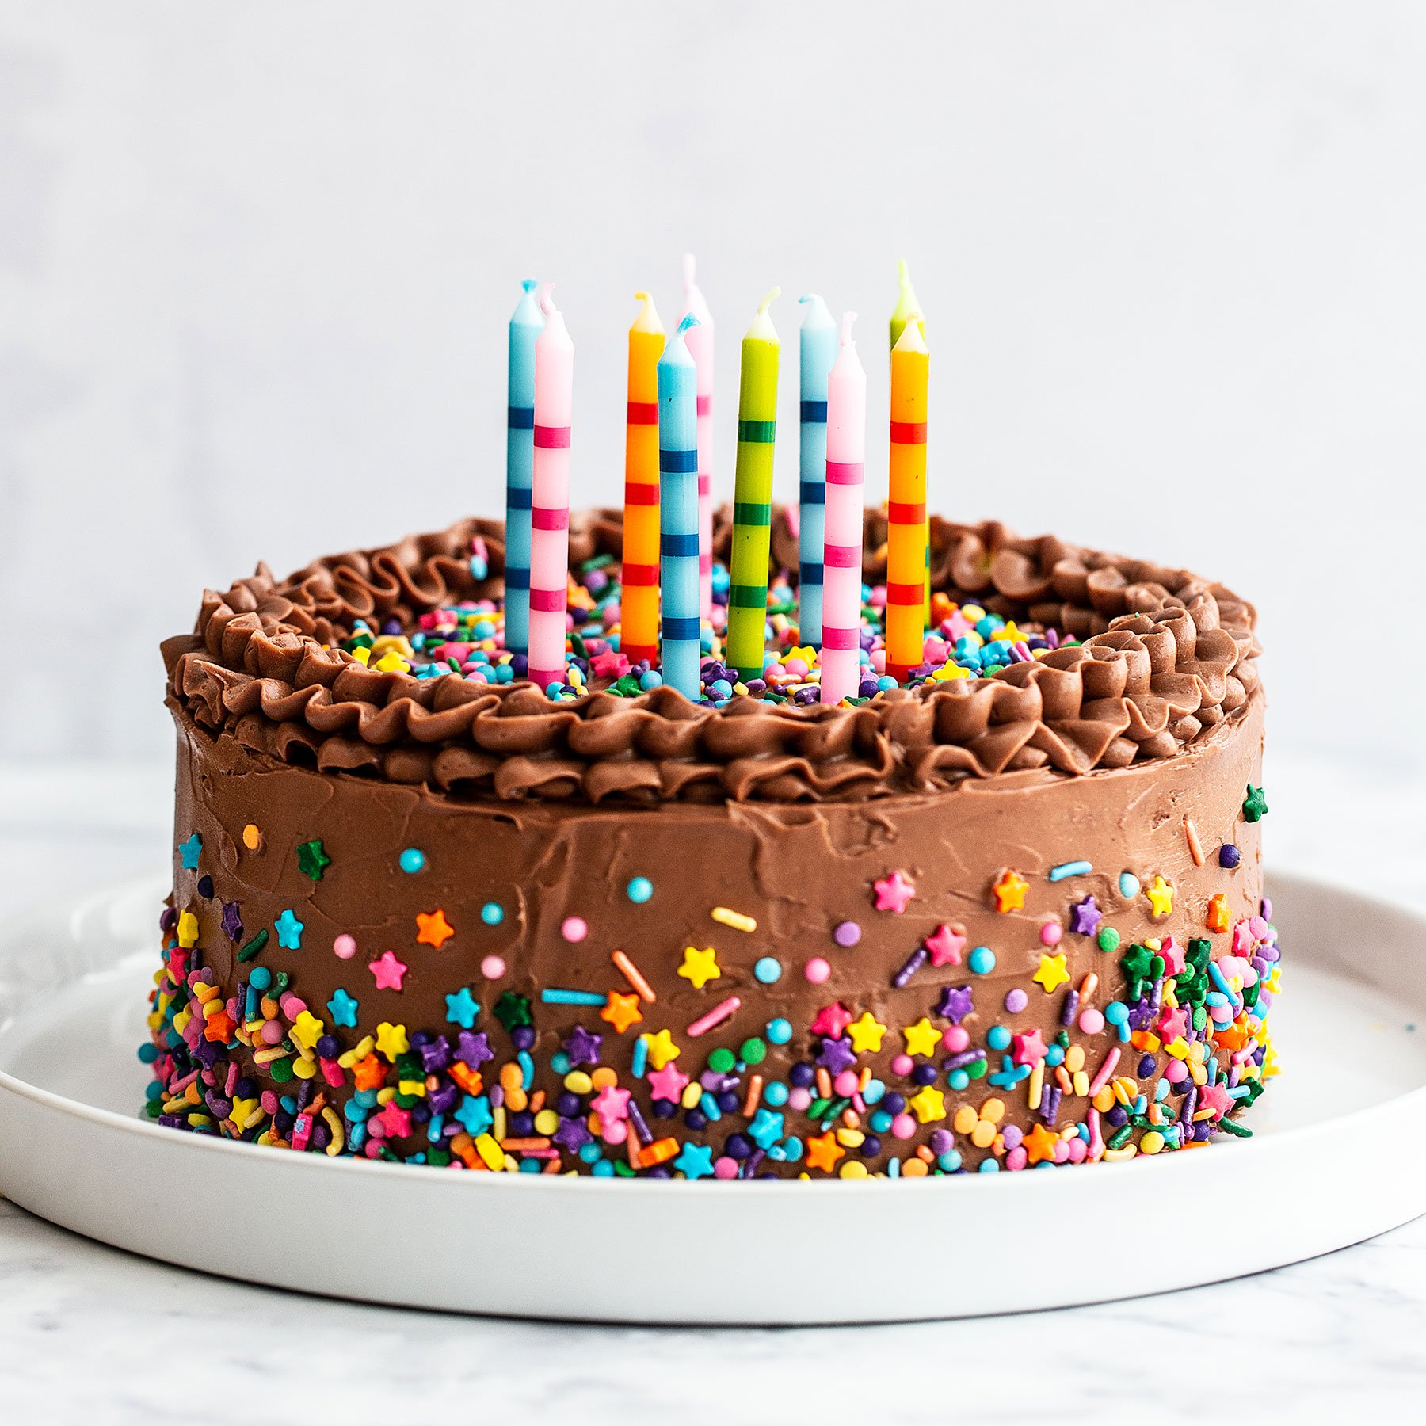
1. Segment and blend each word aloud.
2. Copy each word using your neatest handwriting.
3. Add a picture to represent each word.
cake | claw
seesaw | grapes

Slide 7
9.6.20
Session 2
Our key sounds for this week
a_e
aw
Make a cake
Yawn at dawn

Slide 8
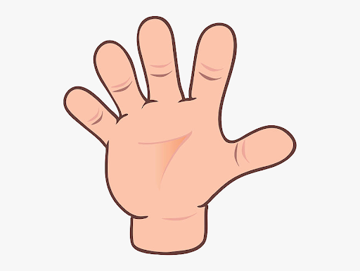
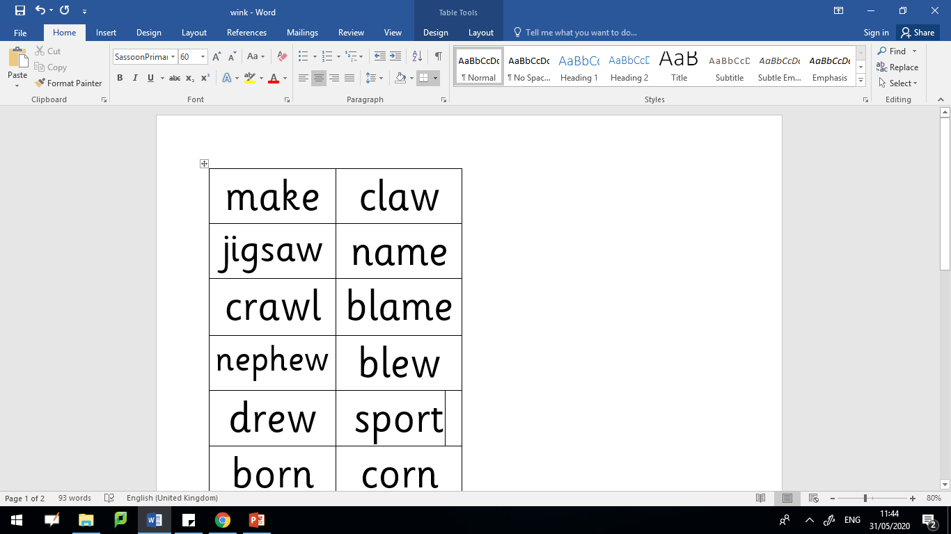
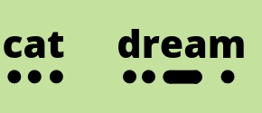
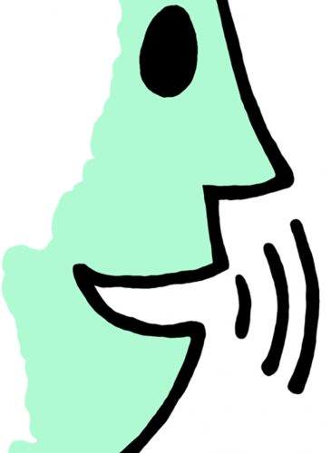
Read these words aloud. Don’t forget to use your phonics fingers to help segment the different sounds before you blend them together.

Slide 9
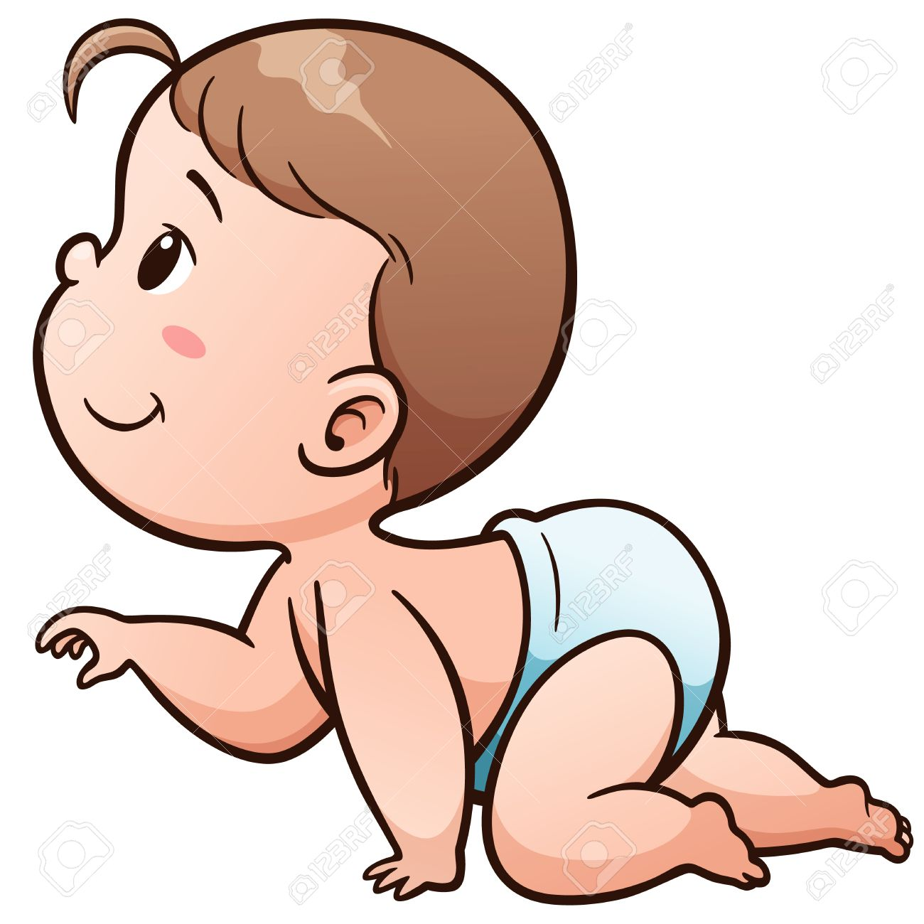
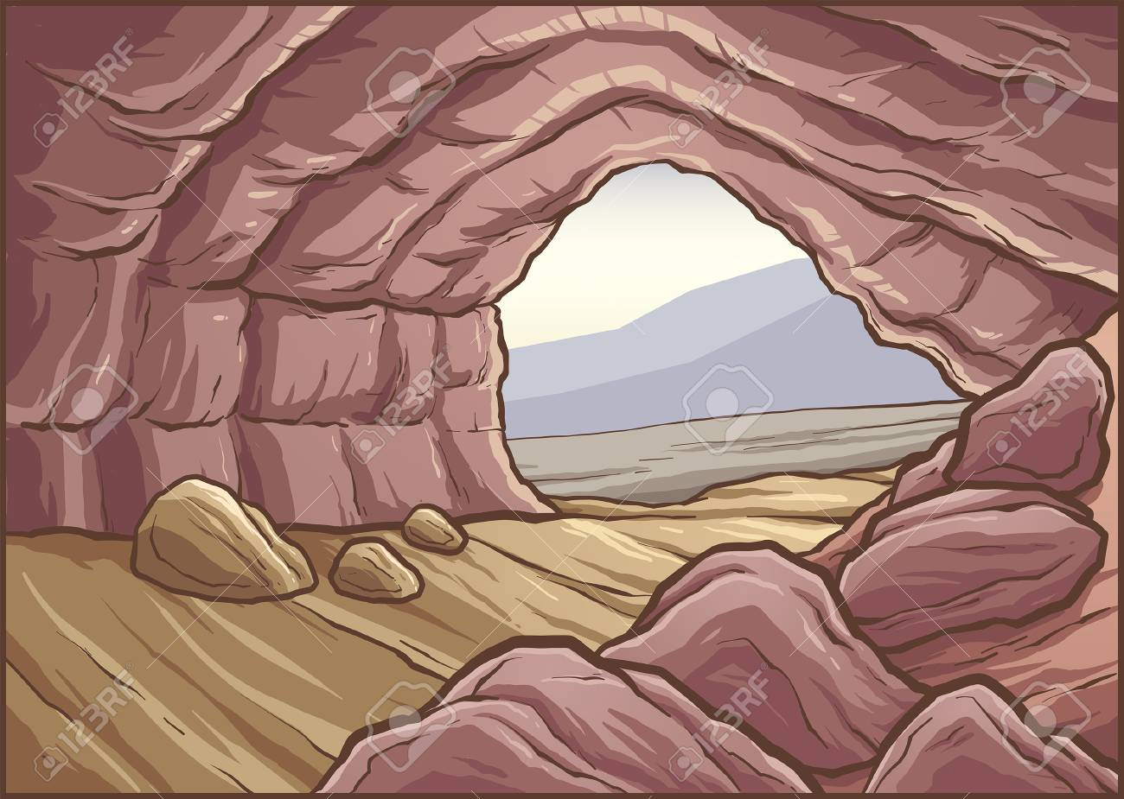


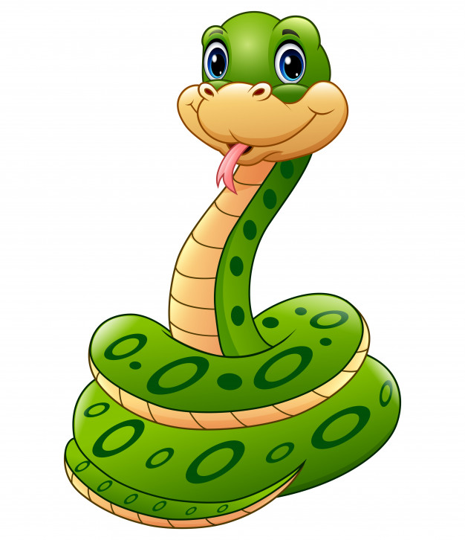

a_e or aw?
Which sound is missing? Write the word down using the correct digraph.
cr___l
c__v__
h___k
jigs___
sn__k__
pl__n__

Slide 10
a_e or aw?
Answers
Which sound is missing? Write the word down using the correct digraph.
crawl
cave
hawk
jigsaw
snake
plane

Slide 11
10.6.20
Session 3
Our key sounds for this week
a_e
aw
Make a cake
Yawn at dawn

Slide 12
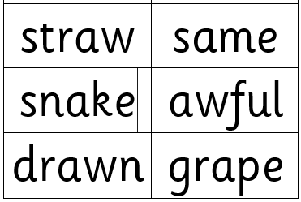
Read these words aloud. Don’t forget to use your phonics fingers to help segment the different sounds before you blend them together.

Slide 13
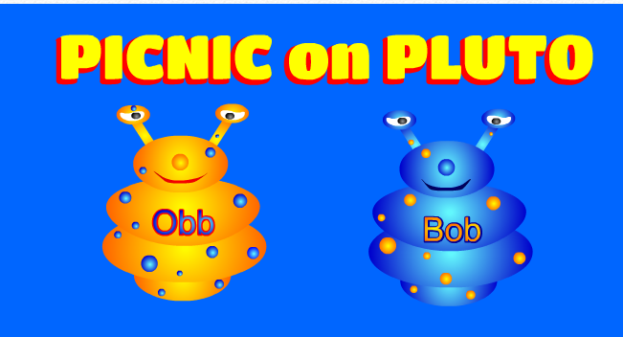
https://www.phonicsplay.co.uk/PicnicOnPluto.html
Picnic on Pluto - this is a game for children to sort real and alien words. Click on the link and follow the instructions below to make sure children are using this week’s target sound.
Once loaded, click the ‘next’ button.
Then click on Phase 5 for ‘aw’ and ‘a_e’ words.
Have fun! :)

Slide 14
11.6.20
Session 4
Our key sounds for this week
a_e
aw
Make a cake
Yawn at dawn

Slide 15
aw or a_e?
Can you fill in the missing words for the following sentences?
Can you pass me a _____________ please?
The __________ fireman came to the rescue.
The bird let out a gigantic __________.
squawk straw brave

Slide 16

Ask an adult to say one word at a time.
Without looking, try to spell the word.
Then check your answers together.

Slide 17
12.6.20
Session 5
Our key sounds for this week
a_e
aw
Make a cake
Yawn at dawn

Slide 18
Could you put 3 of these words into your own sentences?
Remember to start each sentence with a capital letter and finish with a full stop.

Slide 19
https://www.phonicsplay.co.uk/PicnicOnPluto.html
Picnic on Pluto - this is a game for children to sort real and alien words. Click on the link and follow the instructions below to make sure children are using this week’s target sounds.
Once loaded, click the ‘next’ button.
Then click on Phase 5 for ‘aw’ and ‘a_e’ words.
Have fun! :)

