Slide 1
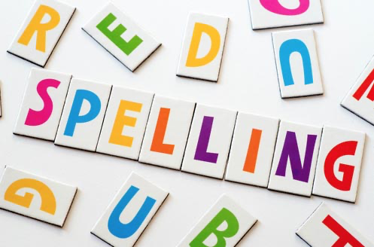
Session 1
Spelling common exception words

Slide 2
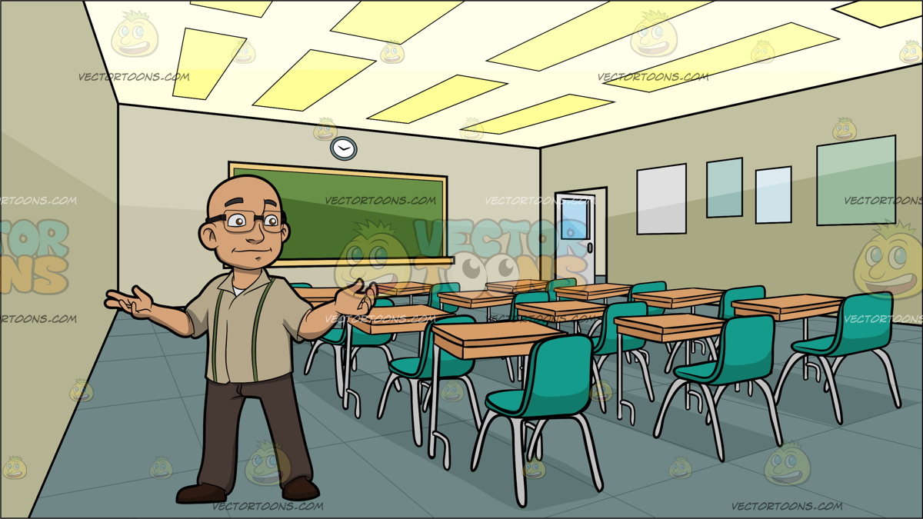
Remember, Common Exception Words are words that aren’t spelt like they sound. They are words that we meet a lot in our writing so we really need to remember how to spell them.
Practise spelling each of these words 3 times.
Look at the word,
say it,
cover it (so you can’t cheat),
write it and
check (have a peep - did you get it right?).
told
any
people
money
parents

Slide 3
Session 2
Spelling the er sound after w.

Slide 4



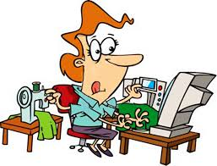
Often when we put the letter o after w, it makes an er sound.
Practise spelling each of these words by writing the letters wor in one colour, then add the end of the word in a different colour.
Like this:
word
work
word
worse
worm
work
worst

Slide 5
Session 3
Spelling the er sound after w.

Slide 6
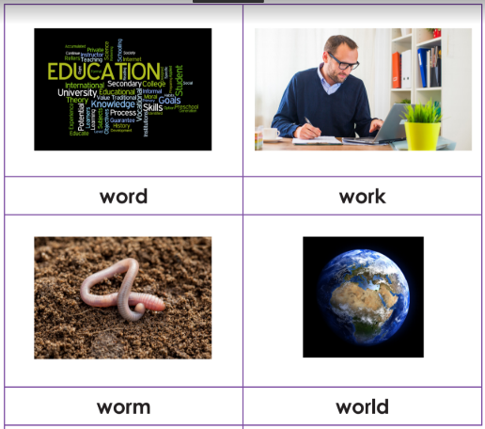
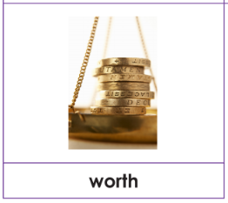
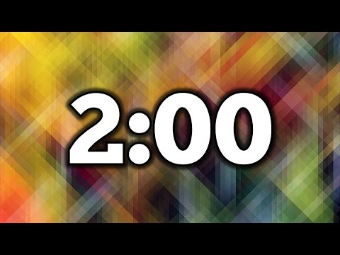
How many times can you spell all of these words in 2 minutes?

Slide 7
Session 4
Spelling the er sound after w.

Slide 8
Dictation
Ask a grown-up to read these sentences to you and see if you can copy them down spelling the words correctly.

Slide 9
Session 5
Spelling the er sound after w.

Slide 10
Boggle
n | t | a | h
a | w | o | t
o | l | r | s
u | d | m | e
How many words can you make from the letters in the grid?
Letters must be next to each other but they can be fowards, backwards, up, down or even diagonally.
Clue: you can make the words we have been spelling this week?
Red arrows show you an example of how you could do it!

