Slide 1

Week 6 – 1.6.20
5 sessions

Slide 2
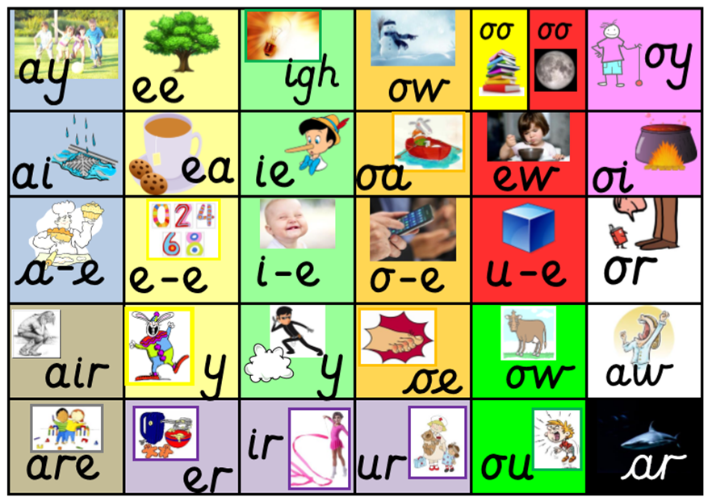
Remind yourself of all the sounds on our sound mat.
How many words can you think of with an ‘ar’ sound in?

Slide 3

Go to www.phonicsplay.co.uk
Enter the following details:
Username: march20
Password: home
Go to: parents/ interactive resources/ phase 3/ flashcards/
Select phases 3&5A. Make your choices and begin the game! If your child correctly identifies the sound, click the tick. If your child is incorrect, click the cross and this sound will reappear later.
How long did it take you to name all of the sounds?
Try to beat your score tomorrow!

Slide 4
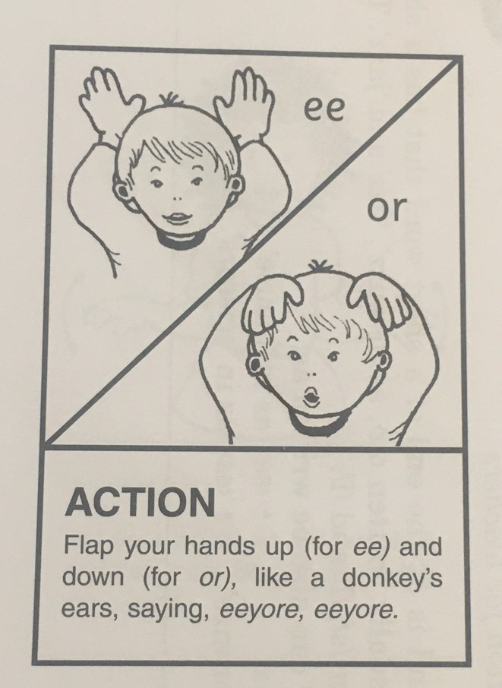
1.6.20
Session 1
Digraph
Action
or

Slide 5
Digraph
ew
Chew the stew.

Slide 6
Sound out these words aloud.
2. Write each word and add sound buttons. Can you spot the digraph in each word?
For example, grew
chew
blew
few
drew
fork
short
corn
sport
port

Slide 7
2.6.20
Session 2
This week’s sounds
or
ew
Chew the stew.

Slide 8
Go to www.phonicsplay.co.uk
Enter the following details:
Username: march20
Password: home
Go to: parents/ interactive resources/ phase 3/ flashcards/
Select phases 3&5A. Make your choices and begin the game! If your child correctly identifies the sound, click the tick. If your child is incorrect, click the cross and this sound will reappear later.
How long did it take you to name all of the sounds?
Try to beat your score tomorrow!

Slide 9

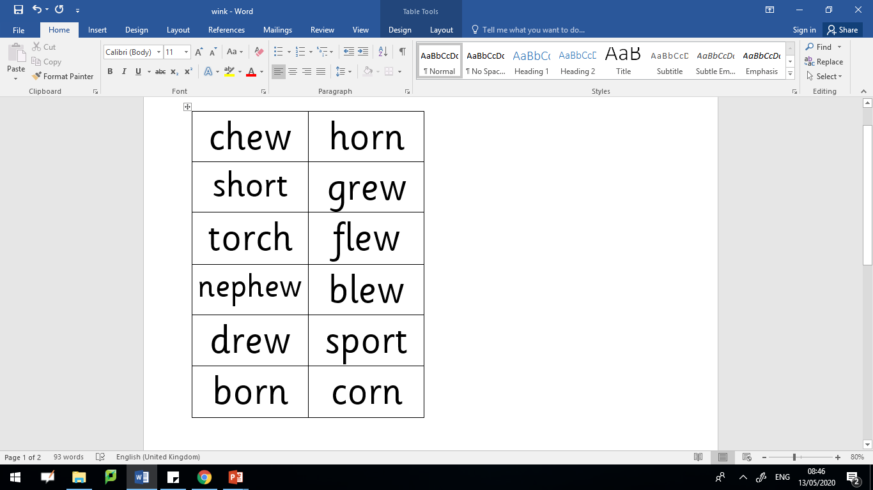
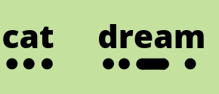

Read these words aloud. Don’t forget to use your phonics fingers to help segment the different sounds before you blend them together.

Slide 10
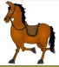

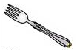



or or ew?
Which sound is missing? Write the word down using the correct digraph.
f___k
h___se
scr___
j___el
gr___
n___th

Slide 11
or or ew?
Answers
Which sound is missing? Write the word down using the correct digraph or trigraph.
fork
horse
screw
jewel
grew
north

Slide 12
3.6.20
Session 3
This week’s sounds
or
ew
Chew the stew.

Slide 13
Go to www.phonicsplay.co.uk
Enter the following details:
Username: march20
Password: home
Go to: parents/ interactive resources/ phase 3/ flashcards/
Select phases 3&5A. Make your choices and begin the game! If your child correctly identifies the sound, click the tick. If your child is incorrect, click the cross and this sound will reappear later.
How long did it take you to name all of the sounds?

Slide 14
Read these words aloud. Don’t forget to use your phonics fingers to help segment the different sounds before you blend them together.

Slide 15

The storm was getting worse and the boat was heading north towards the port. A few of the crew were eating their chicken stew when they heard the loud horn from the captain. This told the crew the port was in view. They put down their forks and flew out of their seats. They knew it would only be a short time until they arrived.
Can you be a detective and see how many ‘or’ and ‘ew’ words are in this story?

Slide 16
4.6.20
Session 4
This week’s sounds
or
ew
Chew the stew.

Slide 17

Ask an adult to say one word at a time.
Without looking, try to spell the word.
Then check your answers together.

Slide 18
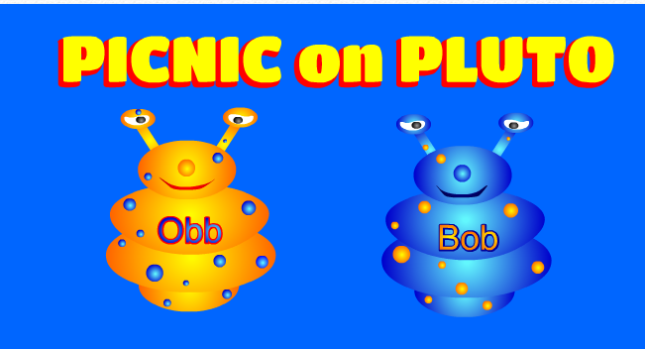
https://www.phonicsplay.co.uk/PicnicOnPluto.html
Picnic on Pluto - this is a game for children to sort real and alien words. Click on the link and follow the instructions below to make sure children are using this week’s target sound.
Once loaded, click the ‘next’ button.
Then click on Phase 5 for ‘ew’ words.
Have fun! :)

Slide 19
5.6.20
Session 5
This week’s sounds
or
ew
Chew the stew.

Slide 20

ew or or
Silly sentences!
Write some silly sentences of your own using words with either an ‘or’ or ‘ew’ sound in.
Here’s an example…
A bird flew across the sky in a storm. He was chewing a horn.
Remember to start each sentence with a capital letter and end with a full stop.

Slide 21
https://www.phonicsplay.co.uk/PicnicOnPluto.html
Picnic on Pluto - this is a game for children to sort real and alien words. Click on the link and follow the instructions below to make sure children are using this week’s target sound.
Once loaded, click the ‘next’ button.
Then click on Phase 5 for ‘ew’ words.
Have fun! :)

