Slide 1

Session 1
Different ways to spell the or sound.

Slide 2

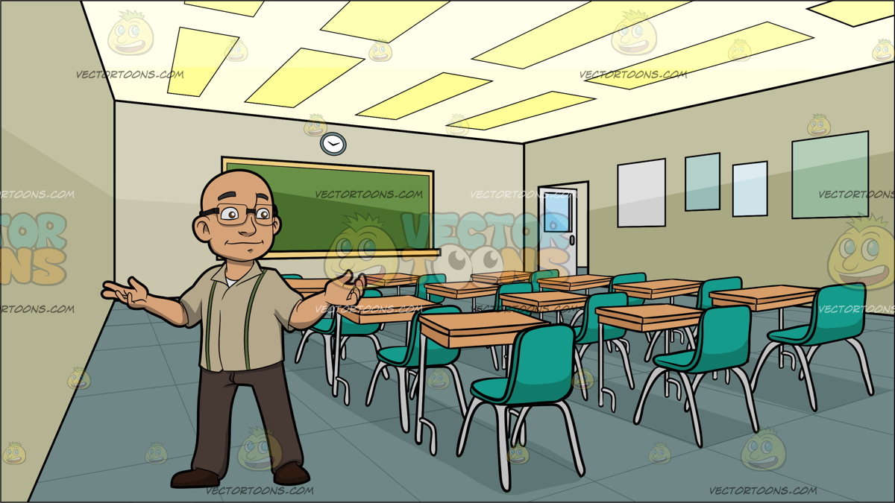
Remember the or sound can be made by the letter a before the letters l and ll (as in halt and hall).
The same sound can also be made by the letters ar after the a w (as in warm)
chalk hallway
warm towards
See how many times you can write these words in 2 minutes.
Repeat and see if you can beat your score!

Slide 3
Session 2
Adding the ness suffix to a word.

Slide 4
A suffix is a group of letters we add to the end of a word to make a new word.
The suffix we are going to look at today is the ness suffix.
sad + ness = sadness
sad
kind
fit
foolish
Copy out each word and add the ness suffix on the end.
Challenge
Try and use each word in a sentence.

Slide 5
Session 3
Adding the ness suffix to a word.

Slide 6
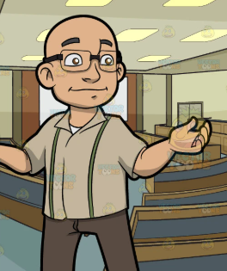
If a word ends in y we change it to an i before we add the ness suffix.
happy + ness = happiness
happy
lovely
tidy
silly
Copy out each word and add the ness suffix on the end.
REMEMBER - change the y to an i.
Challenge
Try and use each word in a sentence.

Slide 7
Session 4
Adding the mentsuffix to a word.

Slide 8
A suffix is a group of letters we add to the end of a word to make a new word.
The suffix we are going to look at today is the ment suffix.
move+ ment= movement
move
enjoy
entertain
pave
Copy out each word and add the ment suffix on the end.
Challenge
Try and use each word in a sentence.

Slide 9
Session 5
Adding the mentsuffix to a word.

Slide 10

Using 3 different colours, rainbow write each of these words.
pavement movement enjoyment
entertainment

